Slide 1
APRIL 2023
TFCG SLIDE DECK

Slide 2
Crown Castle/T-Mobile @
Pepco 799423-171010
(2023022111)

Slide 3
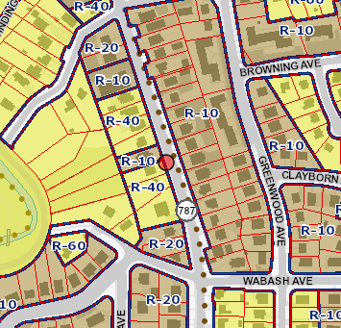
PEPCO 799423-171010

Slide 4
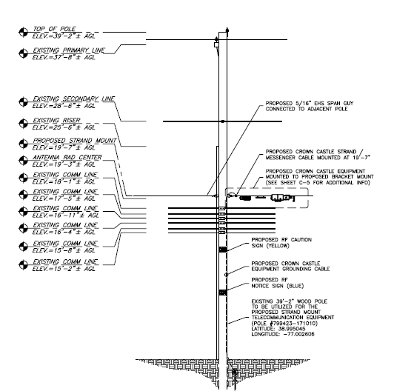
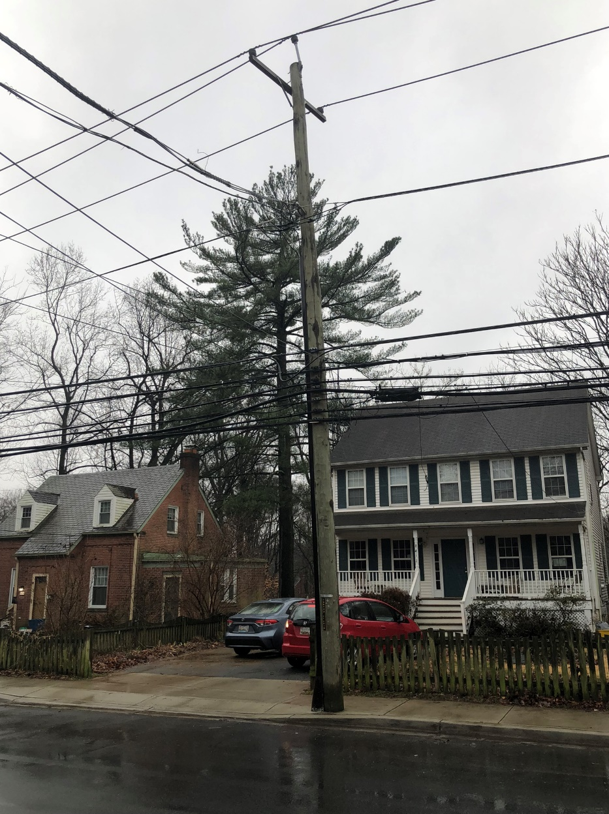
PEPCO 799423-171010

Slide 5
Crown Castle/T-Mobile @
Pepco 813444-088754
(2023022112)

Slide 6
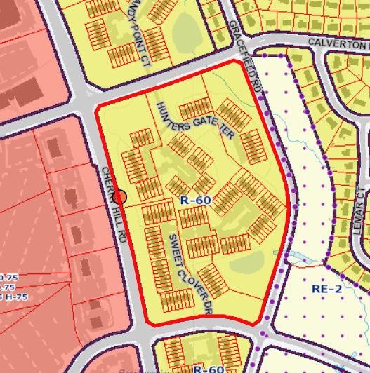
PEPCO 813444-088754

Slide 7
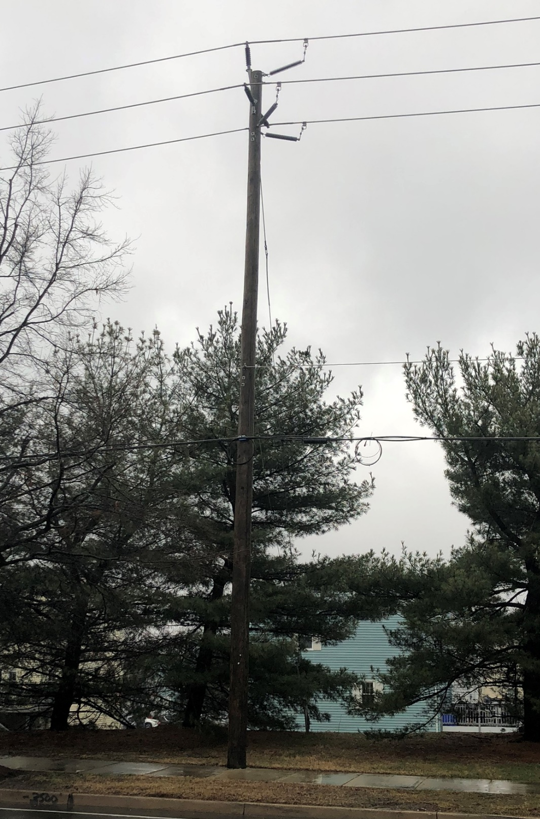
PEPCO 813444-088754

Slide 8
Applications 2023012076 and 2023022115
Verizon/T-Mobile
New Temporary Monopole and Colocation
Pepco Substation 118 Temporary Monopole

Slide 9
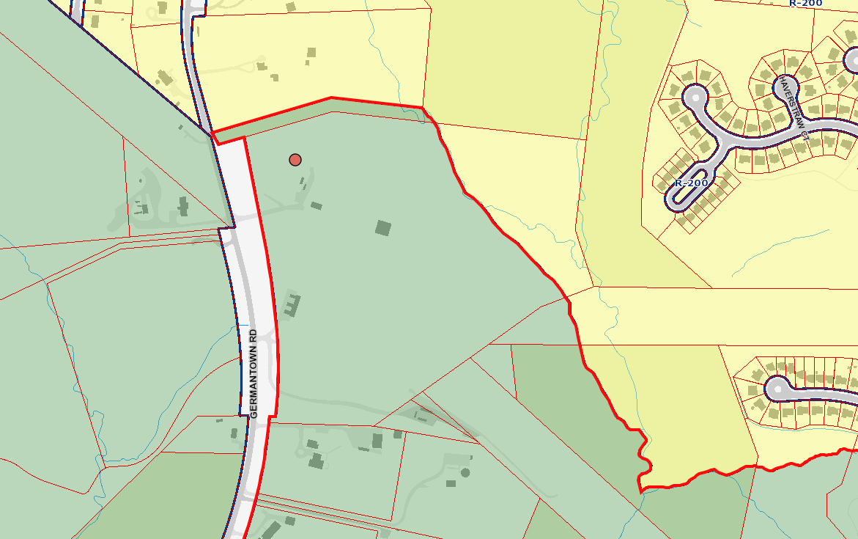
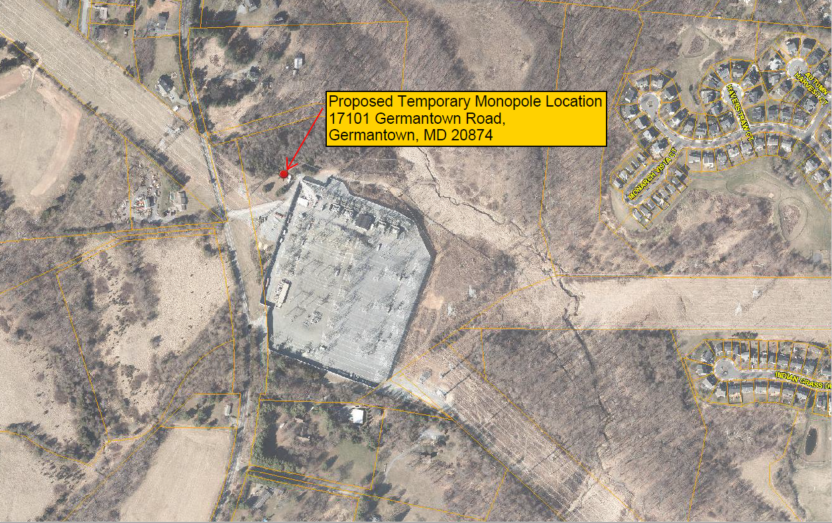
PEPCO Substation 118 Temporary Monopole

Slide 10
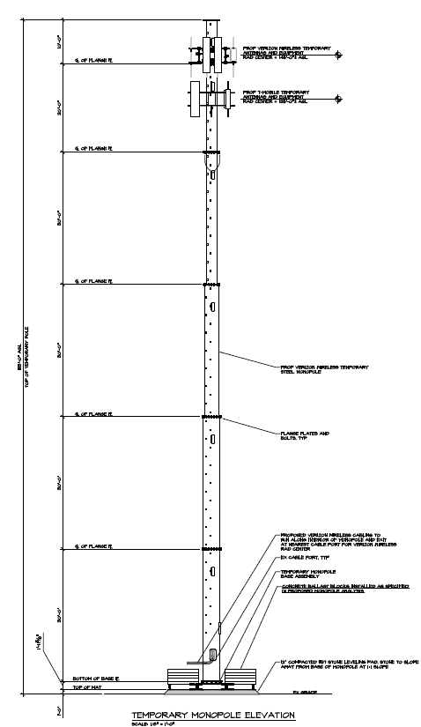
PEPCO Substation 118 Temporary Monopole
Proposed Temporary Monopole
Existing Lattice Tower
Notes:
Groundwork ss, general area map

Slide 11
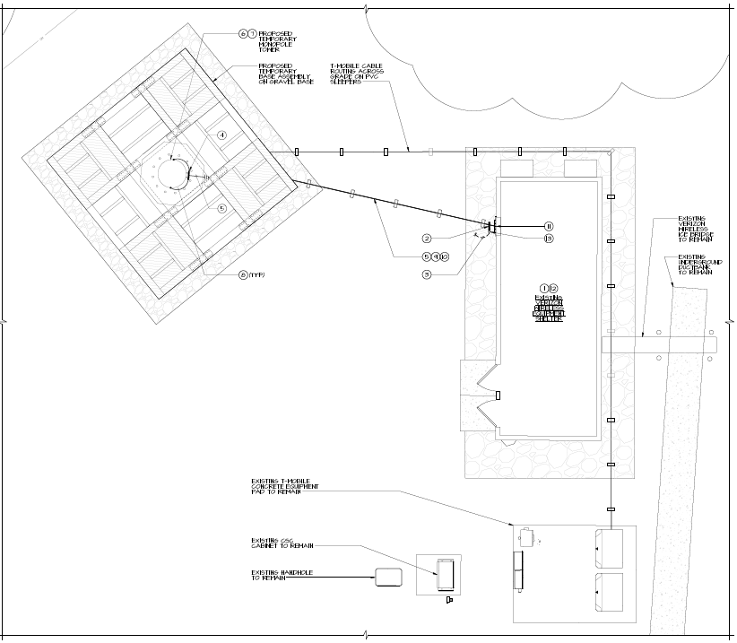
PEPCO Substation 118 Temporary Monopole

