Slide 1
Telecommunications Facilities Coordination Group (TFCG) Meeting
April 2025

Slide 2
Site Link Wireless LLC/T-Mobile @
PEPCO 795421-860630
(2025022410)

Slide 3
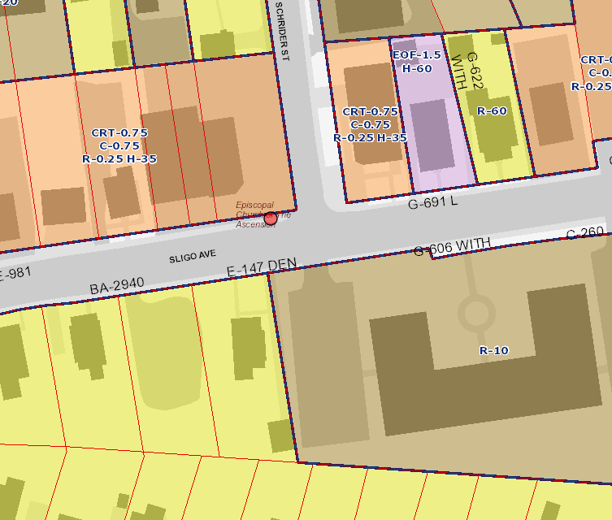
619 Sligo Avenue

Slide 4
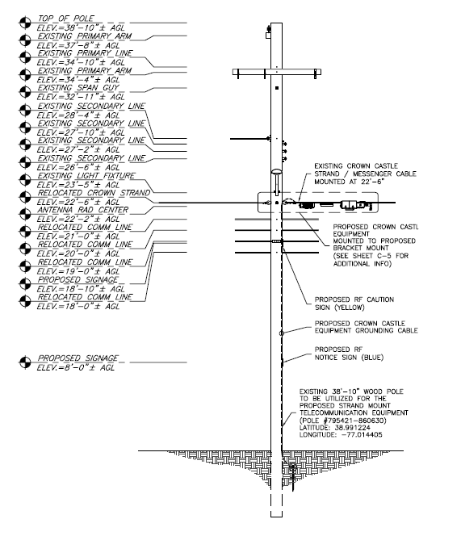
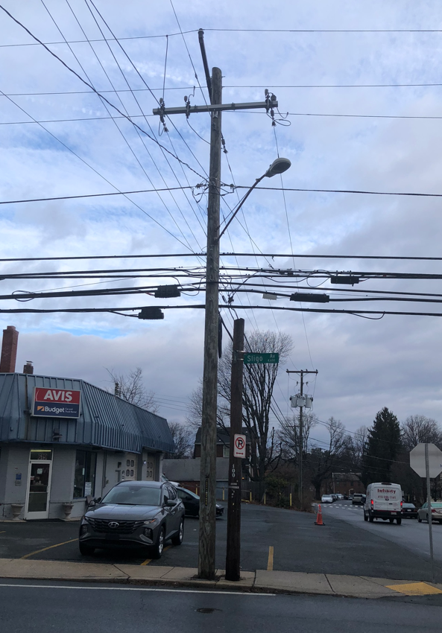
619 Sligo Avenue

