Slide 1
Telecommunications Facilities Coordinating Group (TFCG) Meeting
February 2025

Slide 2
Verizon Wireless at
Colesville Depot new monopole
(2024112367)

Slide 3
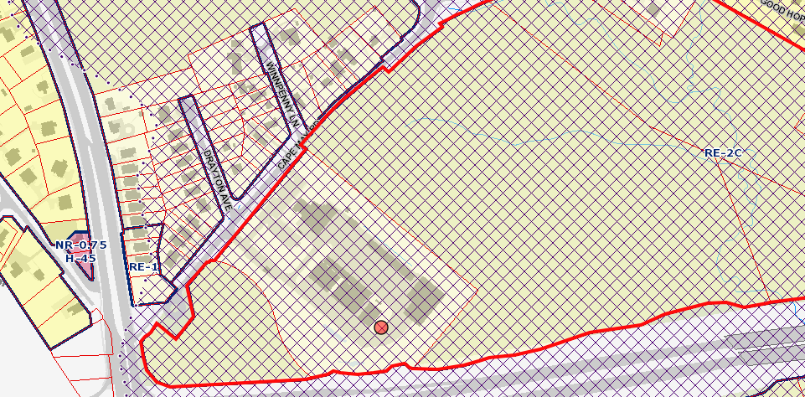

14335 Cape May Road

Slide 4
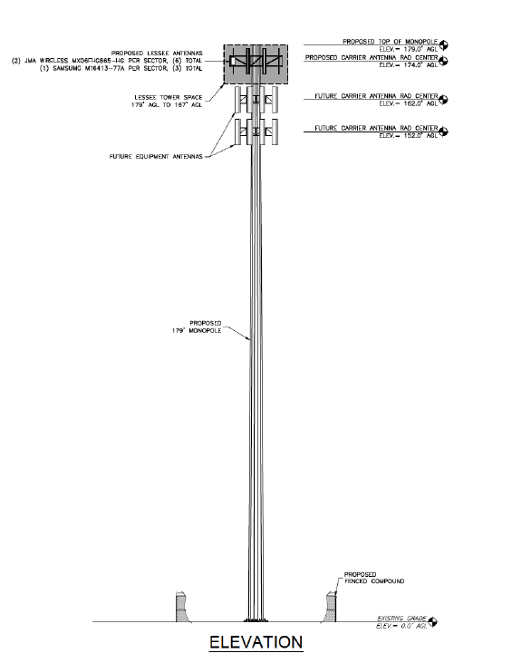

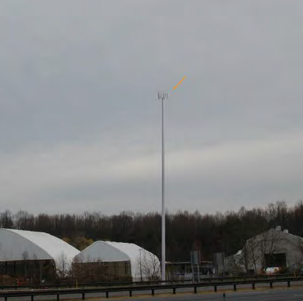
14335 Cape May Road
Proposed New Monopole

Slide 5
Verizon Wireless at
Darnestown temporary monopole
(2024122377)

Slide 6
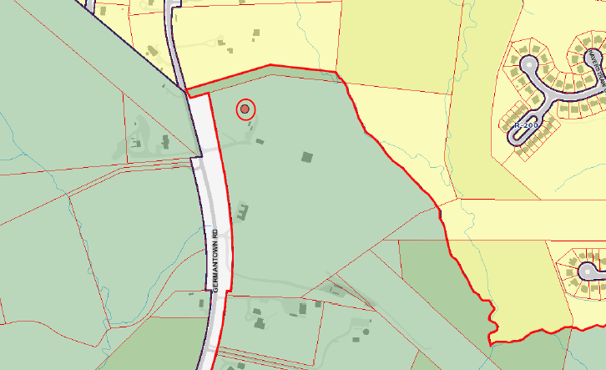
17101 Germantown Rd

Slide 7
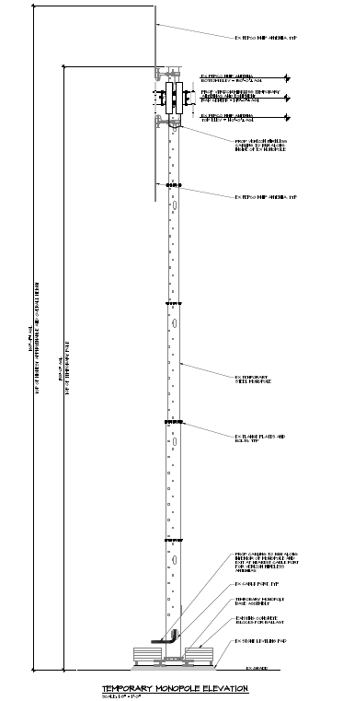
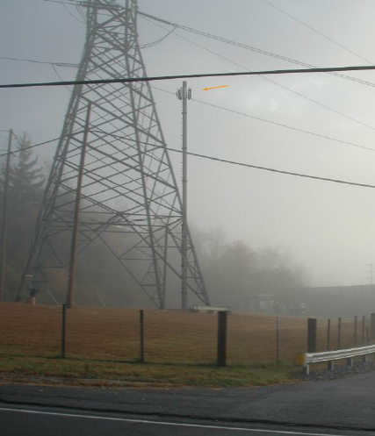
17101 Germantown Rd

