Slide 1
Transmission Facilities Coordination Group (TFCG) Meeting
May 2025

Slide 2
Siren Telecom Consulting/Dish Wireless @
Hughes Network Tower
(2025022427)

Slide 3
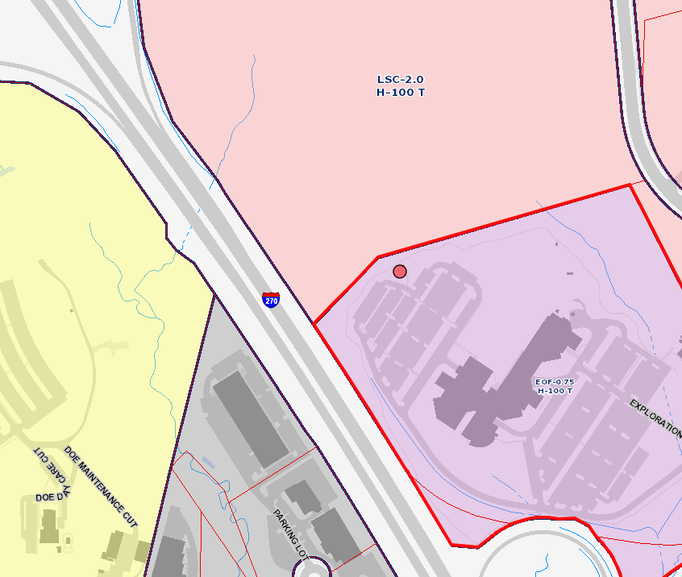
11717 Exploration Lane

Slide 4
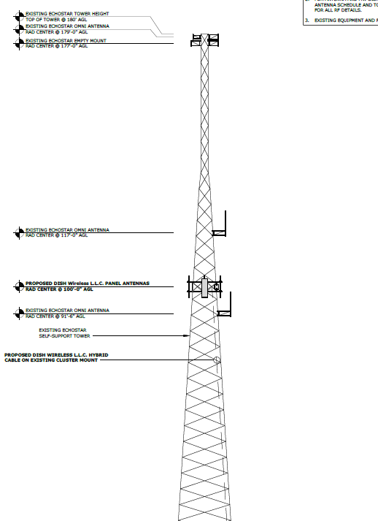
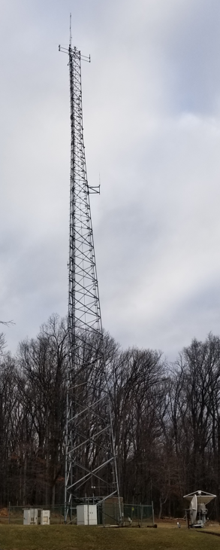
11717 Exploration Lane

Slide 5
NB+C/Verizon Wireless @
Pepco 54-S
(2025042479)

Slide 6
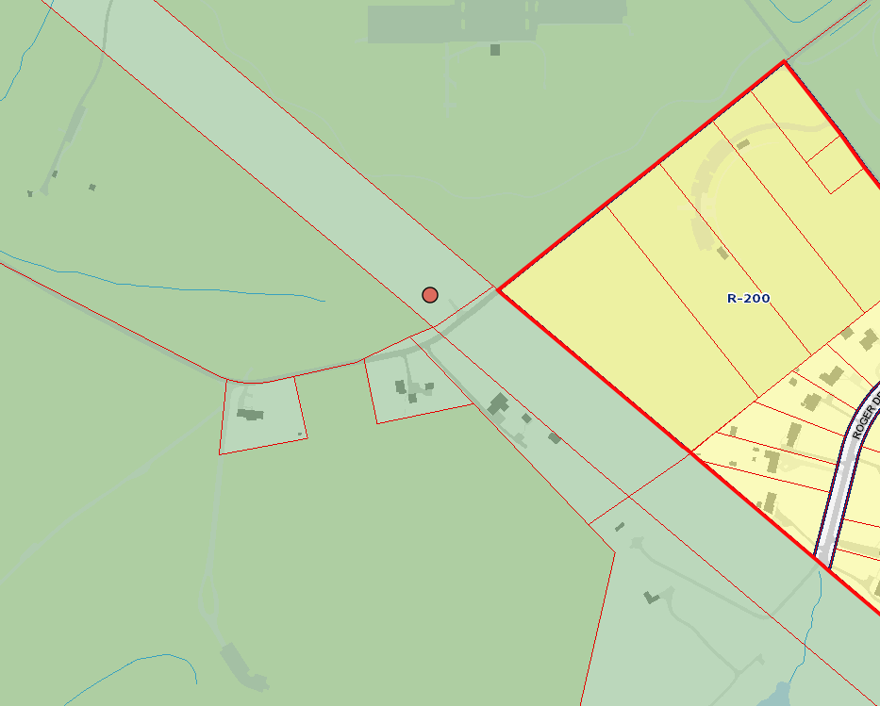
14800 Schaeffer Road

Slide 7
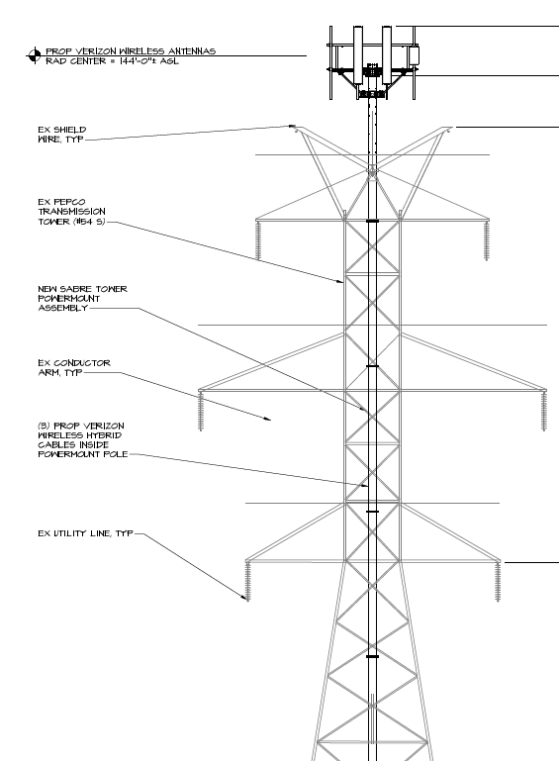
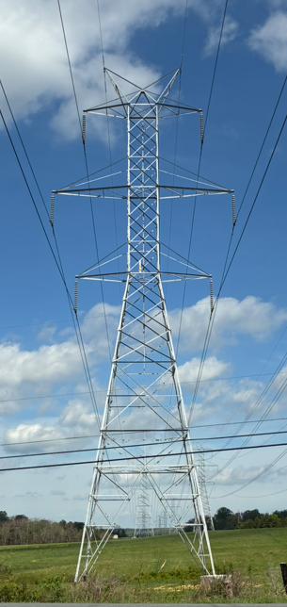
14800 Schaeffer Road

