Slide 1
T-Mobile @
PEPCO 794422-9988
(2021041420)

Slide 2
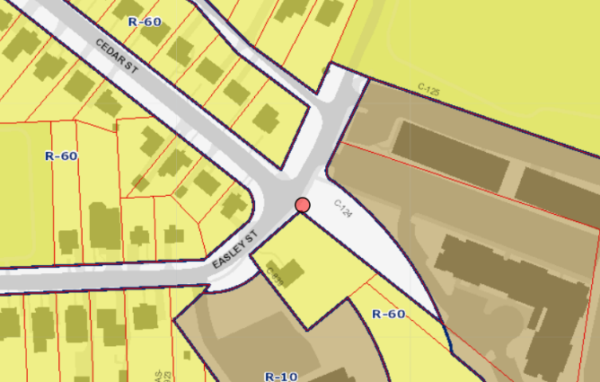
1420- PEPCO 794422-9988

Slide 3
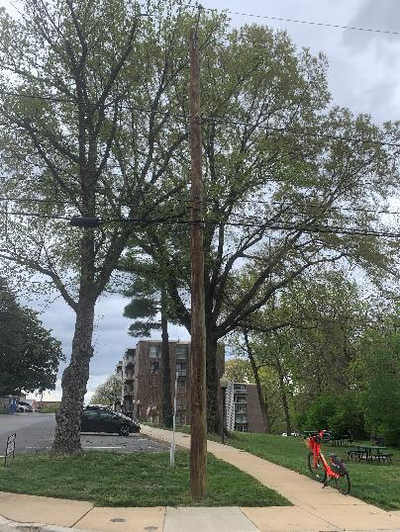
1420- PEPCO 794422-9988

Slide 4
T-Mobile @
PEPCO 788424-550660
(2021041433)

Slide 5
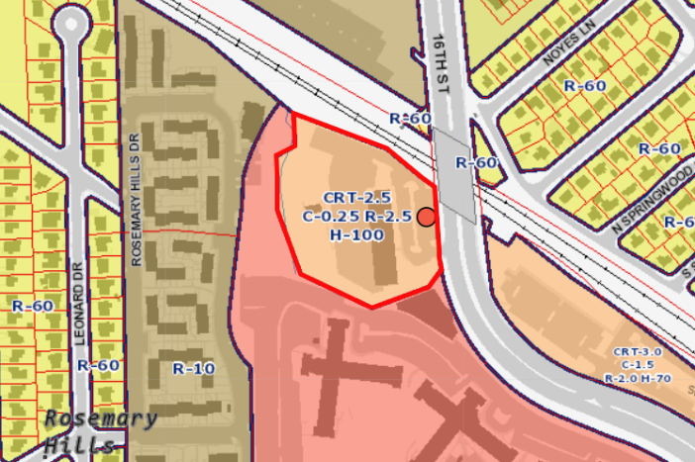
1433- PEPCO 788424-550660

Slide 6
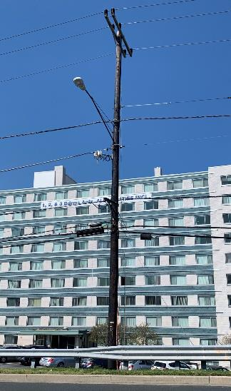
1433- PEPCO 788424-550660

Slide 7
T-Mobile @
PEPCO 786422-270810
(2021061476)

Slide 8
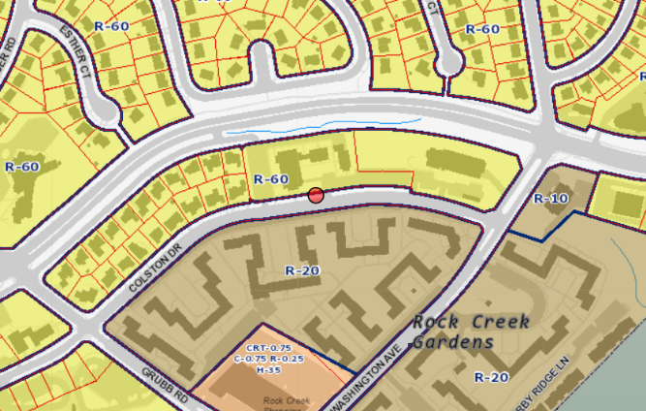
1476 – PEPCO 786422-270810

Slide 9
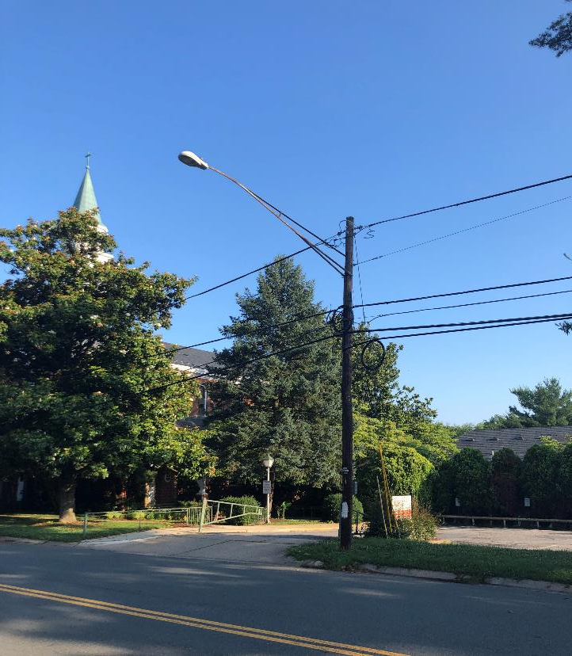
1476 – PEPCO 786422-270810

Slide 10
Permanent Monopole @ Woodward High School (Formerly Tilden Middle School) Application #2021081523

Slide 11
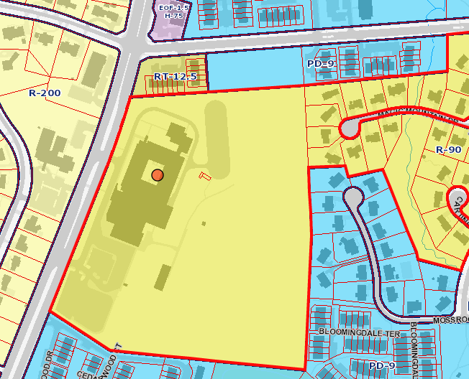
SBA Temporary Monopole @Tilden Middle School
Permanent Monopole @ Woodward High School (Formerly Tilden Middle School)
Notes:
The site is located on the east side of Old Georgetown Rd. The school is undergoing renovation requiring the dismantling of the existing monopole on the property. The zoning map on the left shows the zoning of the area and the outline of the old school building as per MCAtlas. The construction drawings on the right show the school redevelopment, with the old monopole location identified with a blue circle and the new monopole location circled in red.

Slide 12
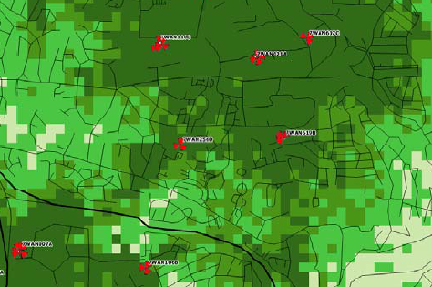
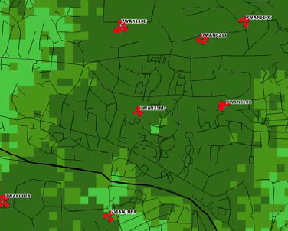
SBA Temporary Monopole @ Tilden Middle School
Coverage with Proposed Monopole
Existing Coverage
Notes:
T-Mobile has demonstrated coverage gaps without this site. RF Propagation maps have shown that existing sites in the area would not provide the same coverage. This map shows coverage with and without the Woodward High School Site (circled).

Slide 13
Notes:
The proposed monopole will be located behind the school building if facing the building from Old Tuckerman Ln. It will be set back approximate 131’ from the school building. All antennas will be colocated on the monopole at 115’ AGL.

Slide 14
SBA Temporary Monopole @ Tilden Middle School
Notes:
Visual impact is expected to be minimal as the wireless site will be at an active construction site, and the residential area on the west side of Old Georgetown Road is shielded by trees and foliage.

Slide 15
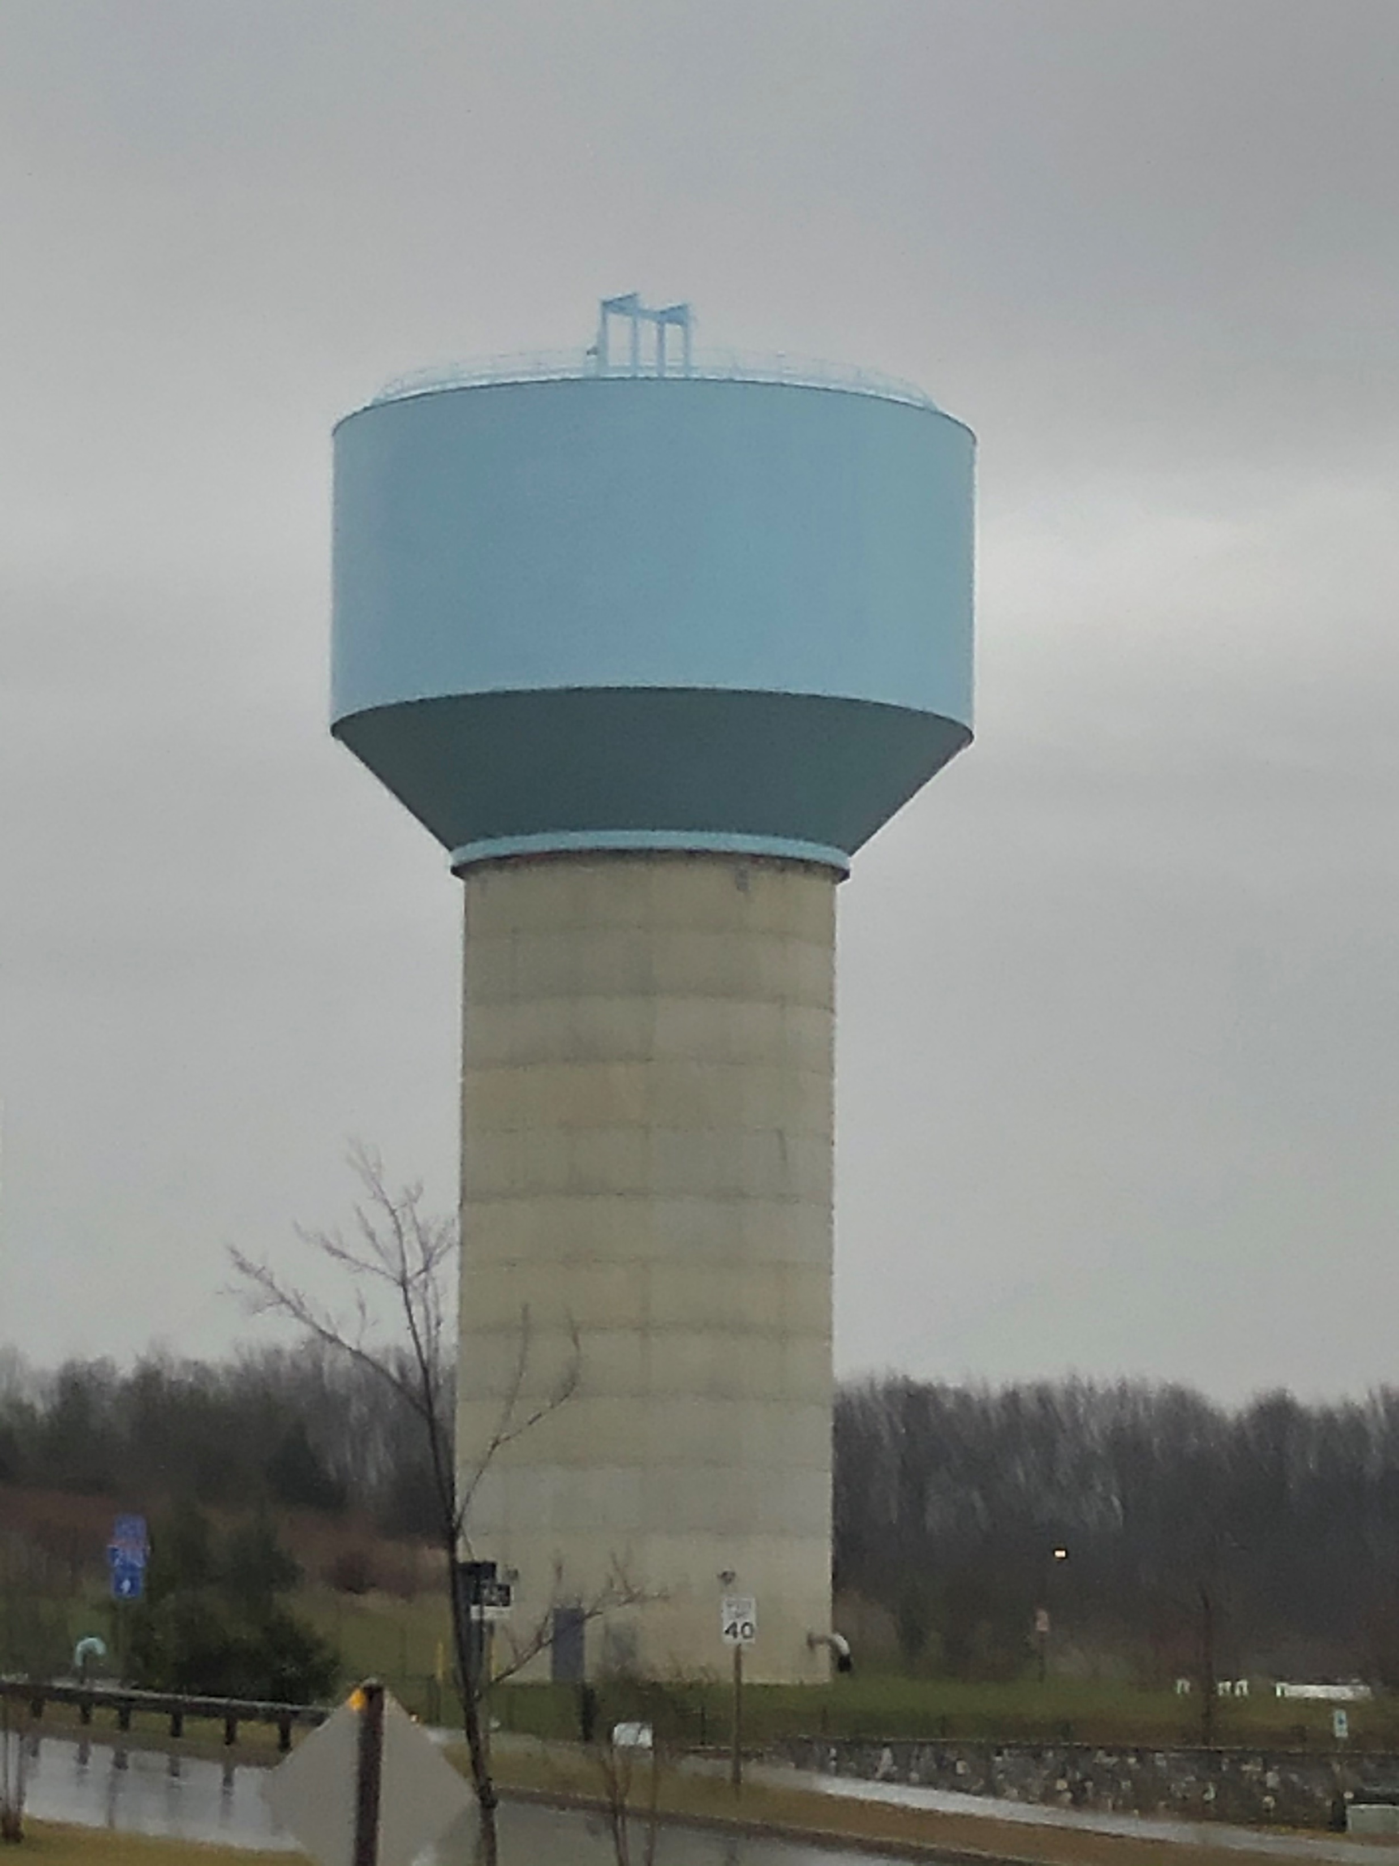
T-Mobile Temporary Monopole at Clarksburg Outlets Application #2021101579

Slide 16
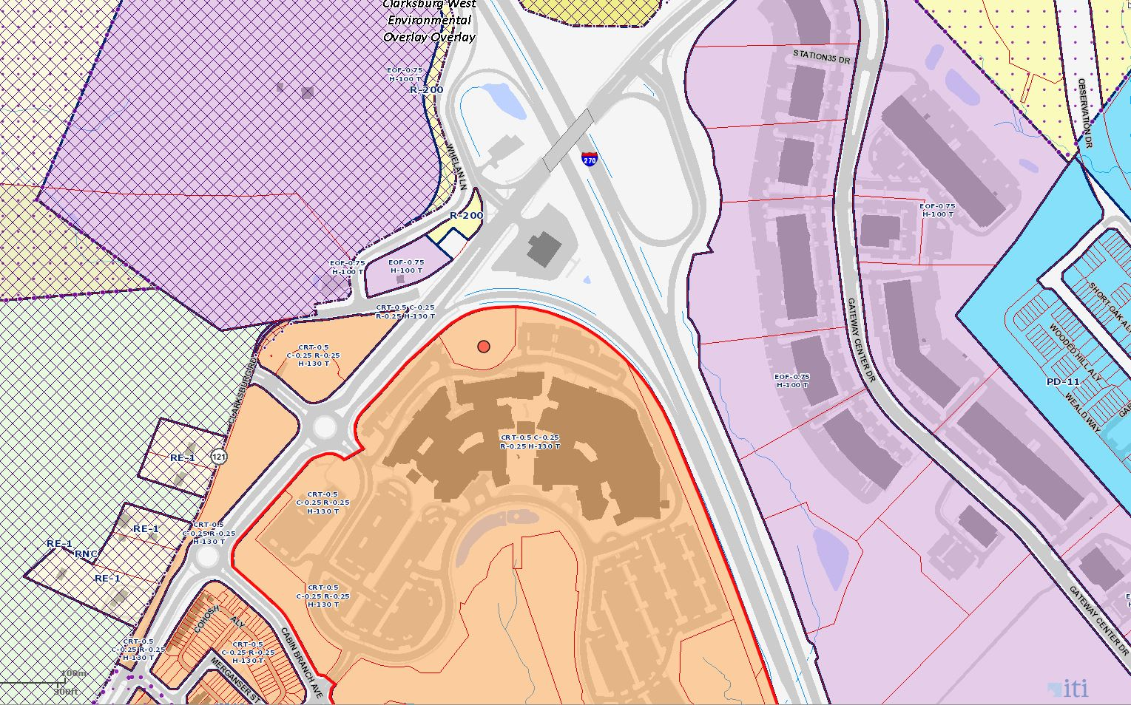
Clarksburg Premium Outlets
Notes:
The 129.9’ water tank is owned by WSSC. T-Mobile has applied to build a temporary monopole on the WSSC site next to the water tank. The WSSC site is located at the recent Clarksburg Premium Outlets center, zoned CRT-0.5.

Slide 17
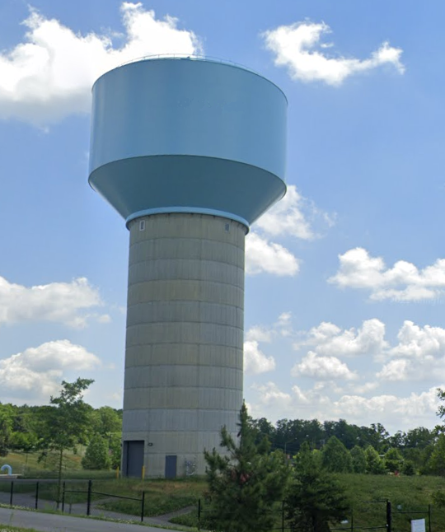
Clarksburg Outlets Temporary
Notes:
The red arrow on the photo here shows the approximate location and height of the proposed temporary monopole structure. The elevation profile drawings on the right show the proposed installation in more detail from the opposite site of the water tank.
The proposed attachments will be mounted at the top of the monopole at 102' and 90'. The equipment cabinets will be placed on a temporary non-penetrating 7' x 8' platform at ground level. All proposed antennas meet the length and volume requirements set forth in the Montgomery County Ordinance, with the maximum length of the proposed antenna being 95.9" for a total volume of 11.32 cu. ft.

Slide 18
Notes:
The equipment cabinets and support equipment will be placed on a temporary non-penetrating 7’ x 8’ concrete pad at ground level.
The proposed installation meets the County Zoning Code on Temporary Uses (Section 3.1.4) in which temporary uses are defined as 1) temporary in nature, 2) established for a fixed period of time, and 3) not involving construction of a permanent structure, and 4) requiring a temporary use permit. The applicant reports that this facility will be temporary and will not involve permanent construction, and per the letter submitted by WSSC, the temporary facility will occupy WSSC property for up to nine months.

