Slide 1

Welcome to
Training
Last Updated: 28 January 2014
1
Notes:
New Truck Delivery Pumper . ppt
1

Slide 2
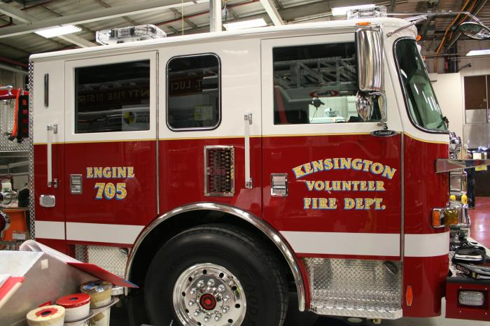
Kensington Volunteer Fire Department Engine Delivery Training

Slide 3
Objective:
Upon the completion of the Pierce Pumper Delivery Program the operators will be able to identify components and safely operate the pumping apparatus and it’s associated equipment.

Slide 4

Section 1
Vehicle and Safety
Information

Slide 5
Specifications
Arrow XT custom chassis, Aluminum body
GVW – 45,500 lbs.
Length – 30’ 4”
Height – 9’ 8”
DDC DD13, 500 hp., EPA2013
Allison 4000, 5 speed, w. aggressive downshift program
Hale QMAX-150, 1,500 GPM, Stainless Steel
Husky 12 foam system
Hercules CAFS-200, PTO
Water – 750 gal.
Foam cell – 25 gal. Class A
Fuel – 75 gal.
DEF – 4.5 gal.
Crew positions – 6
Governed speed – 67 mph.
5

Slide 6
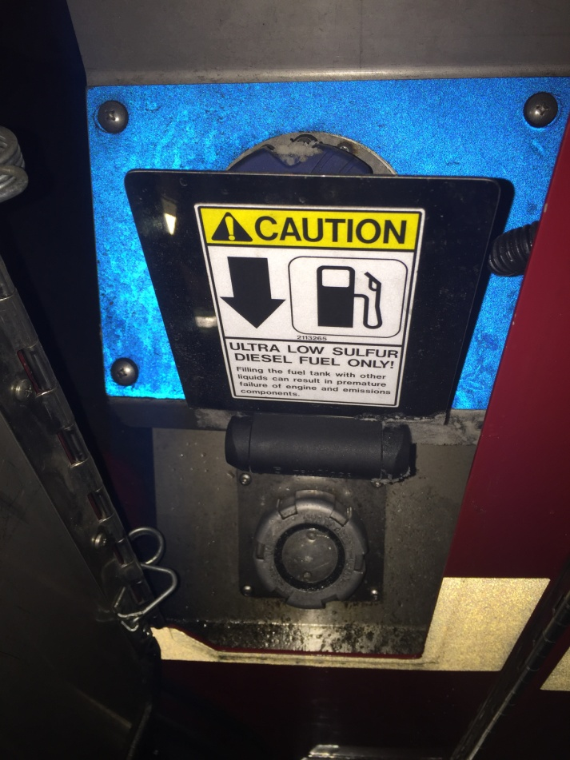
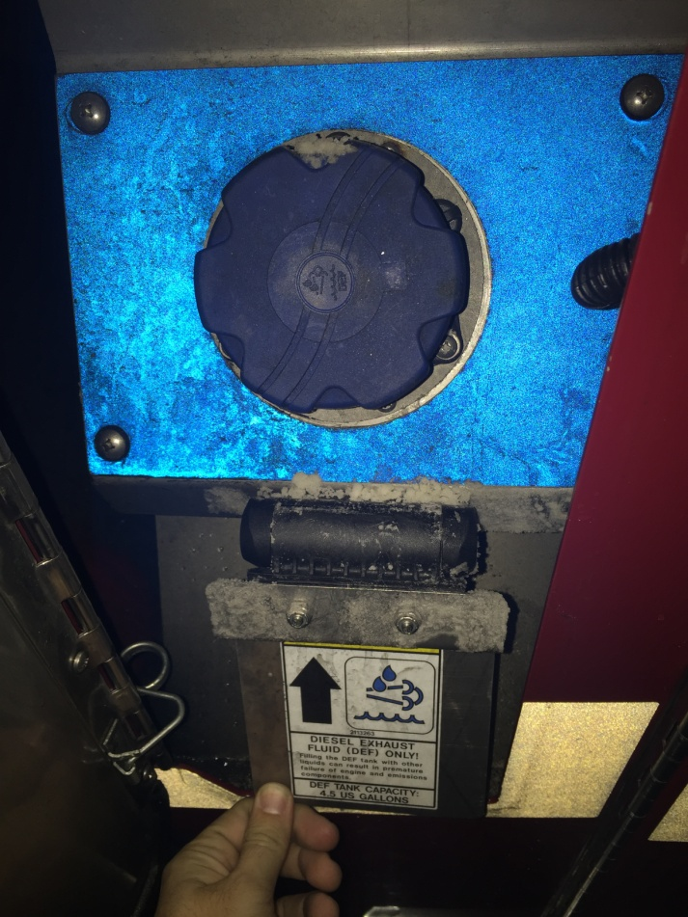
Fluid Fills
Diesel – 75 Gal.
DEF – 4.5 Gal.
6

Slide 7
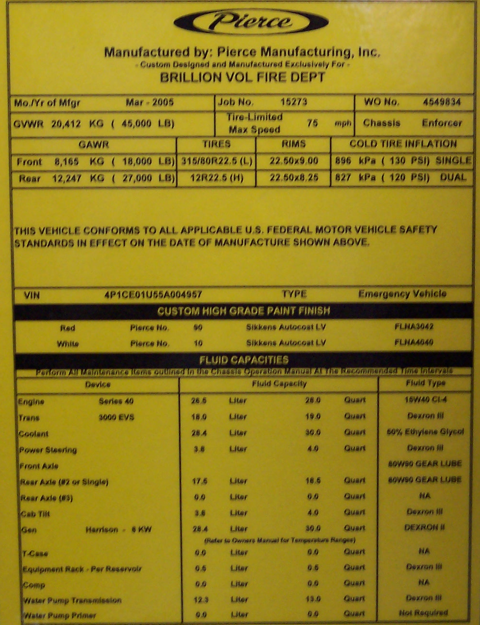
Vehicle Information Sticker
Vehicle Job Number
Axle Ratings
Vin Numbers
Paint Numbers
Device
Fluid Capacities
Fluid Types

Slide 8
Safety Equipment
Anti lock brakes (ABS)
Automatic Traction control (ATC)
Electronic Stability control (ESC)
Auxiliary Braking systems
  Compression brake (Jacobs)
Pierce recommendation – “When road conditions dictate that a driver change his/her driving pattern, the driver should disable auxiliary braking systems.”
Front Impact Protection Package
Side Roll Protection Package

Slide 9
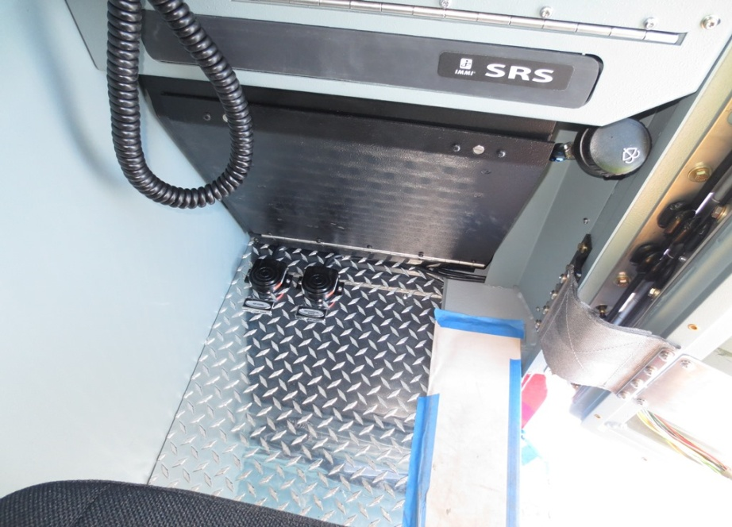
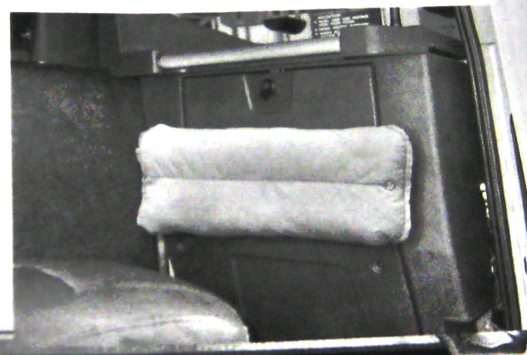
Knee Bolster Airbag – Officers side only
Do not hang and/or place anything in front of airbag

Slide 10

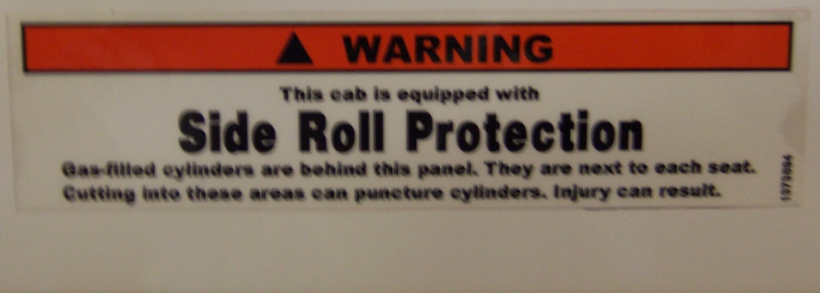

Side Roll Protection
It is a supplemental
restraint system
Side roll will not operate
in all crashes
If system is activated,
must be repaired by Pierce

Slide 11
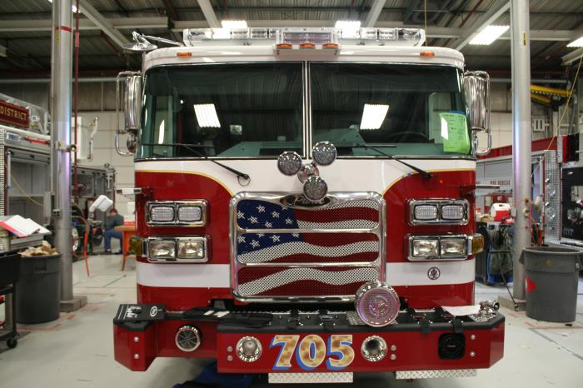
Section 2
Cab Controls

Slide 12
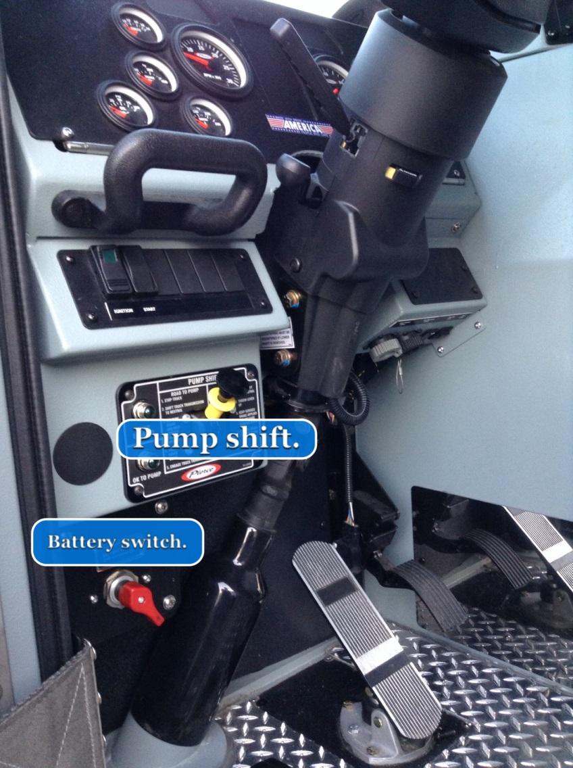
Cab Controls
Battery Switch
  On position
Ignition and Start Button.
  Transmission in neutral.
  Parking brake must be engaged.

Slide 13
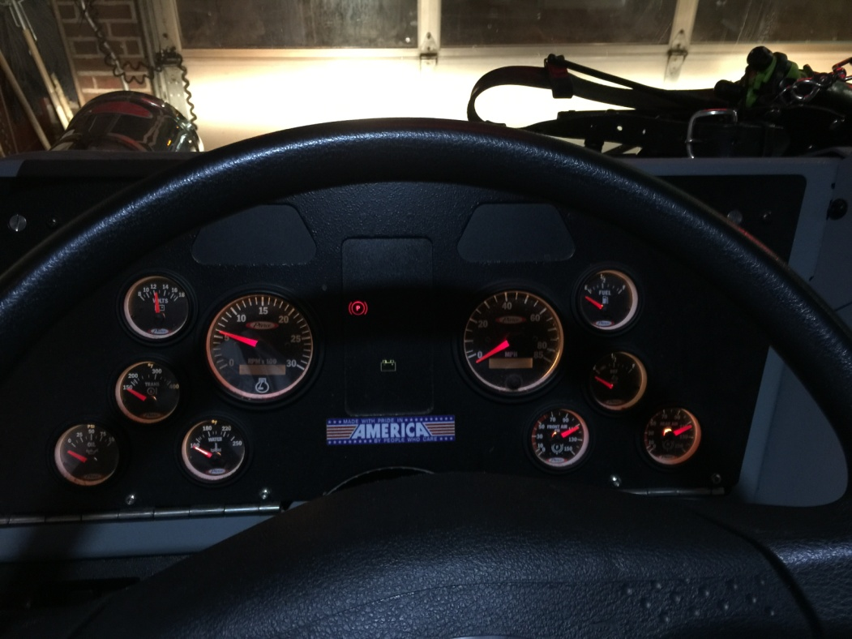
Starting Procedure
Battery switch ON
Ignition switch ON, wait for ignition PROVE OUT to complete 4-5 sec.
Start engine
Shut OFF engine using Ignition switch, leave Ignition OFF
Shut Battery switch OFF

Slide 14

Cab Controls
Gauges and Warning Lamps
Tachometer
Speedometer
Display Modules
Coolant Temperature
Voltage
Front Air Pressure
DEF level
Oil pressure
Rear Air pressure
Transmission Temperature
Fuel

Slide 15
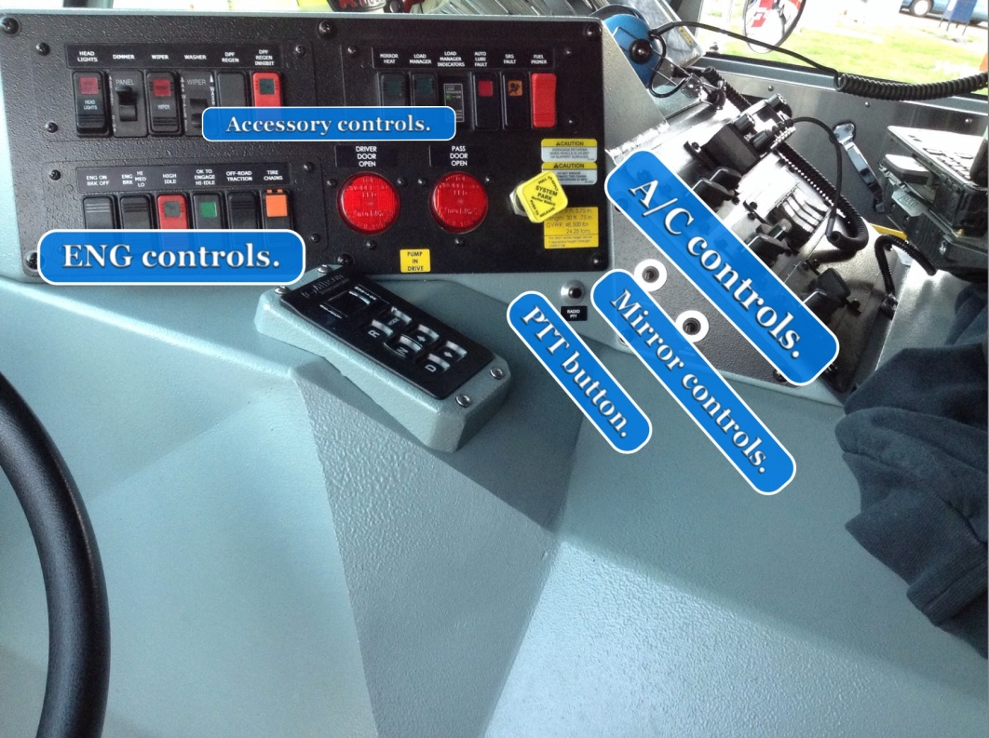
Cab Controls
Transmission Control
NOTE: Must have MODE button activated for Aggressive Downshift to activate

Slide 16
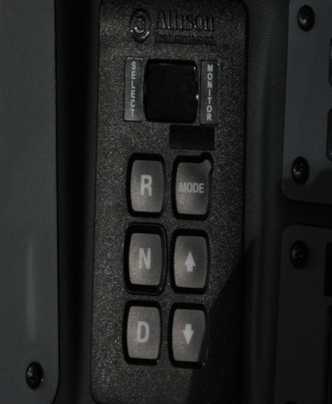
Transmission Fluid Check using shifter keypad
Transmission must be in neutral, fluid temp 140-220 F
Engine at idle.
Vehicle motionless for 2 minutes
Push both arrow buttons simultaneously, release
Read codes in windows
“o L”, “oK” – Fluid level OK
“oL”, “Lo”, “02” – Fluid level low 2 quarts
“oL”, “HI”, “01” – Fluid level 1 quart high
16

Slide 17
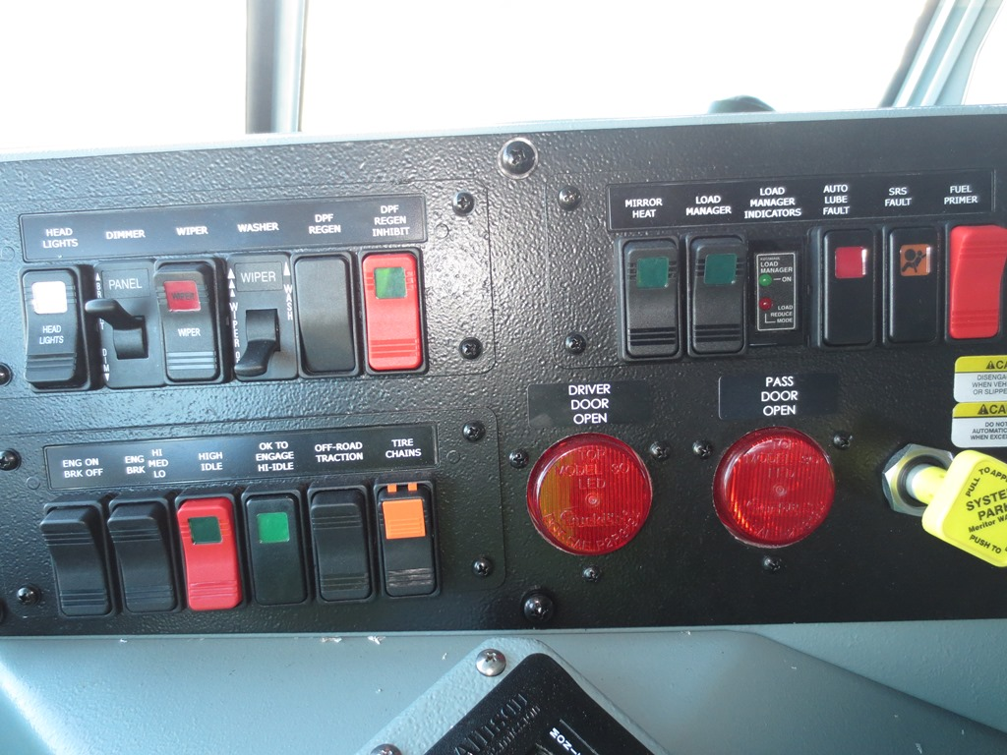
Cab Controls

Slide 18
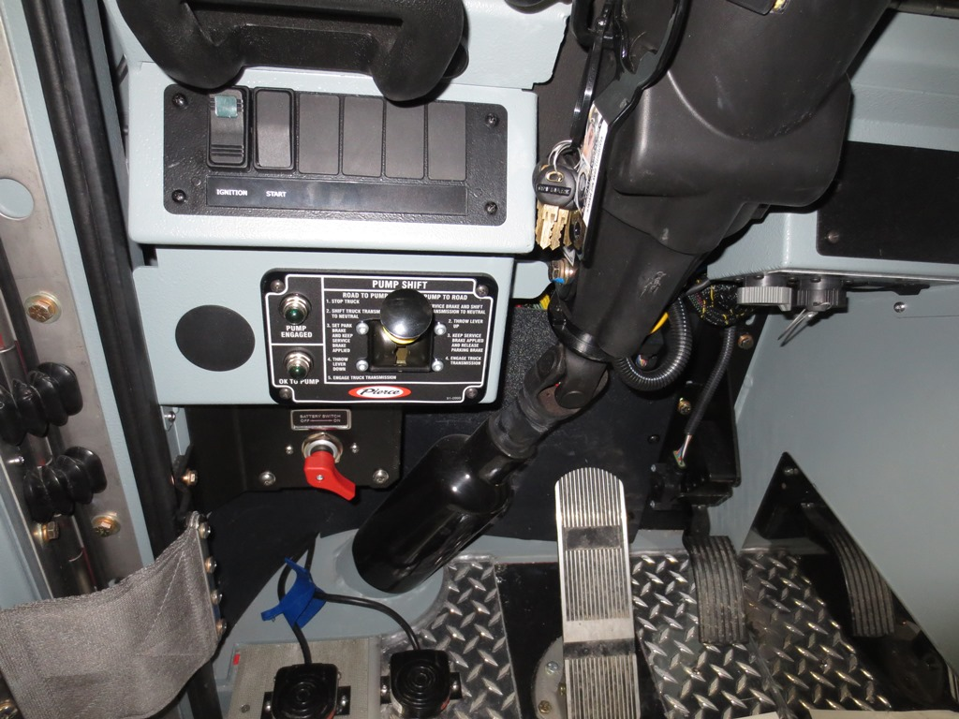
Cab Controls
Pump Shift

Slide 19
Cab Controls
Regeneration

Slide 20
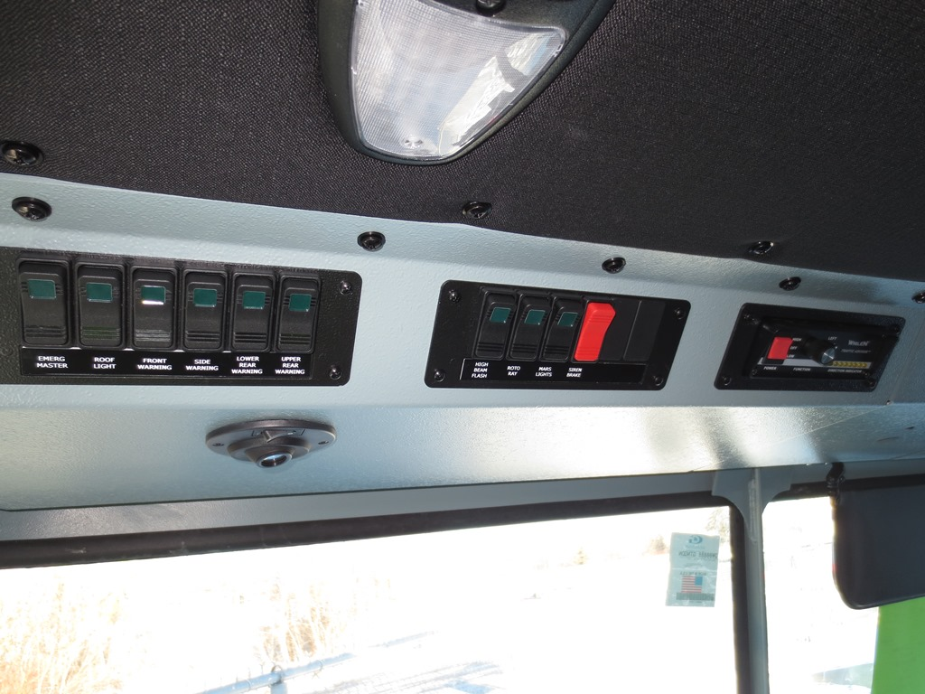
Cab Controls
Switch panels - DS

Slide 21
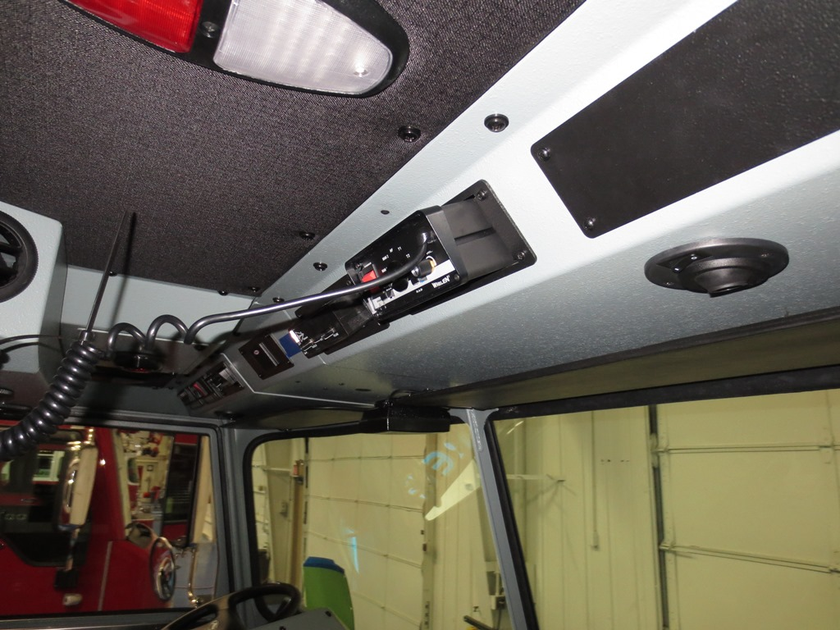
Cab Controls
Switch panels - OS

Slide 22
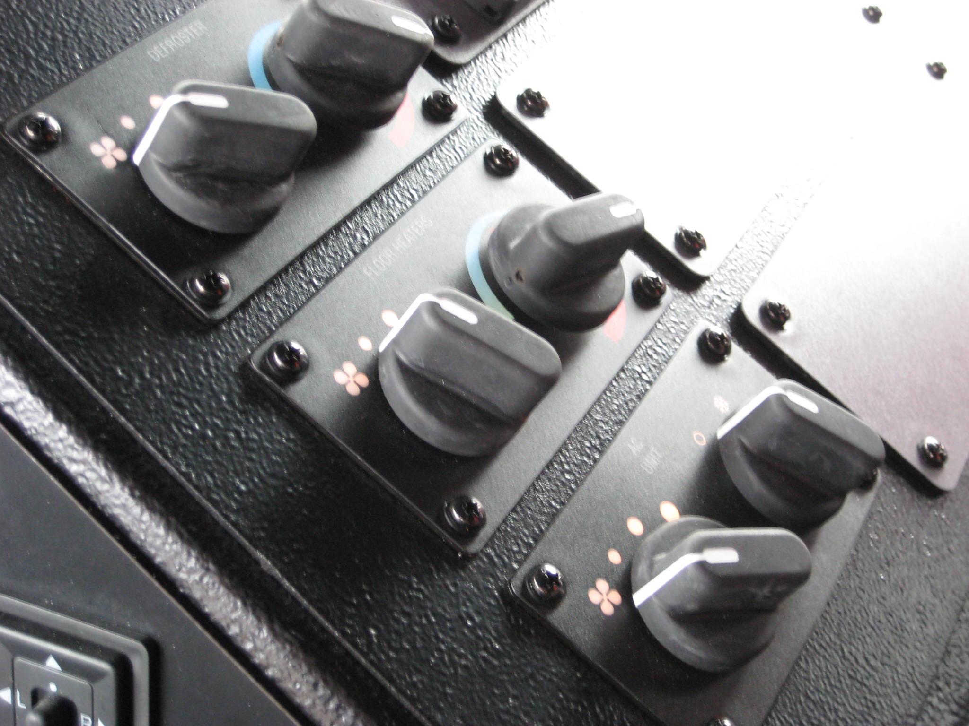
Heat and A/C

Slide 23
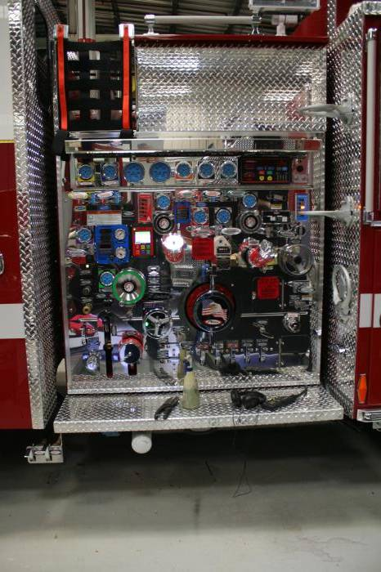
Section 3
Pump Panel Controls

Slide 24
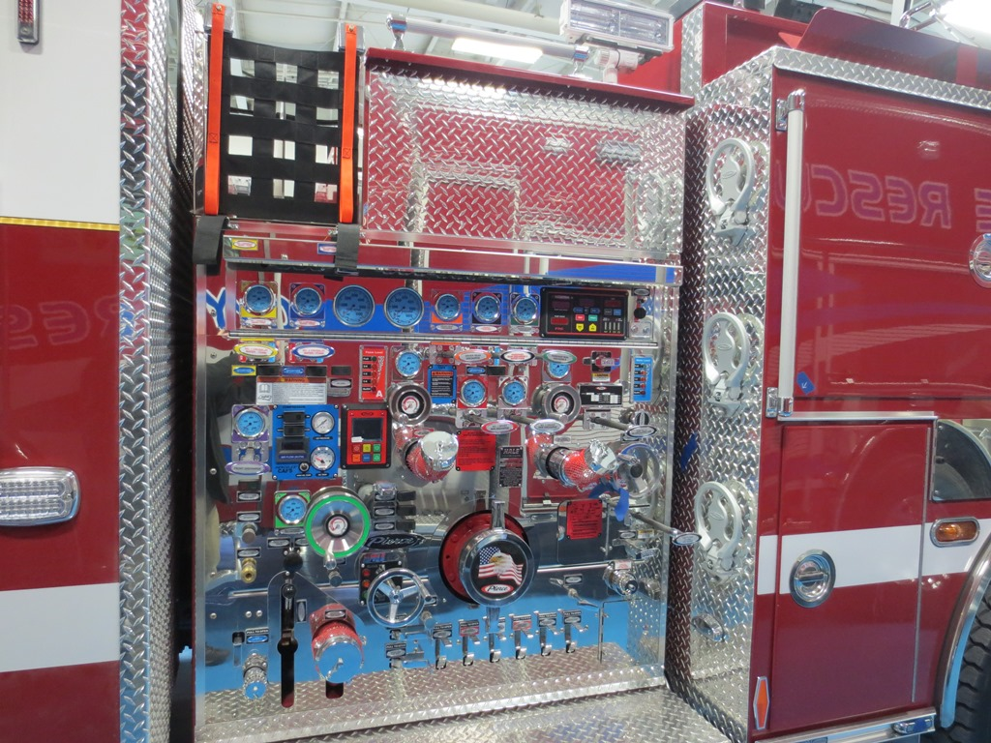
Pump Panel -DS

Slide 25
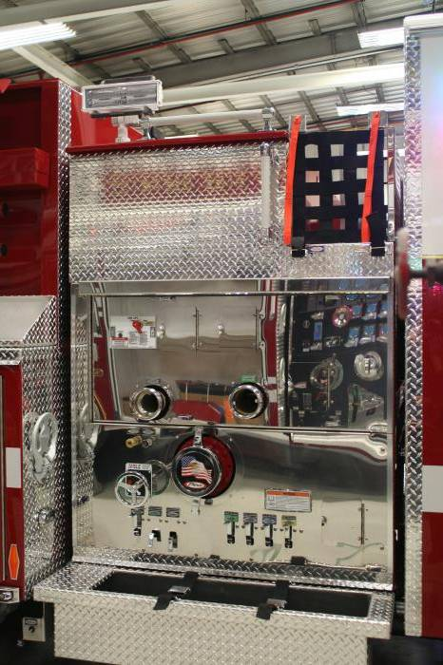
Pump Panel -OS

Slide 26
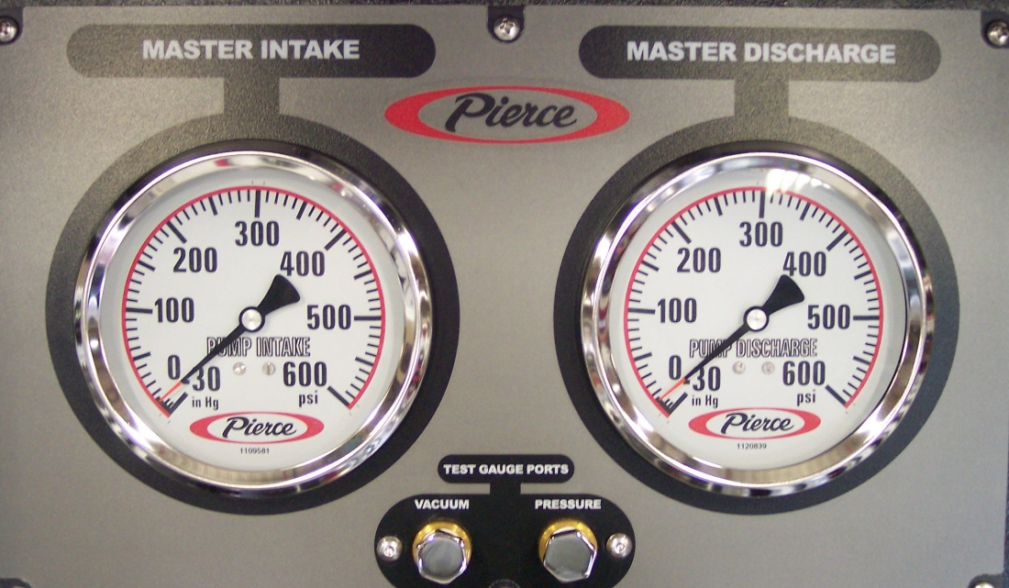
Pump Panel
Master Intake and Pump Discharge Gauges
Test Gauge Ports

Slide 27
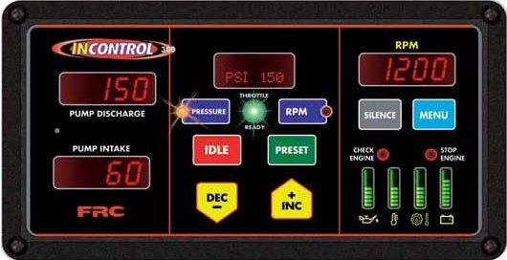
Pressure Control
Pressure Governor
Preset
  Pressure: 150 psi
  RPM: 1,000

Slide 28
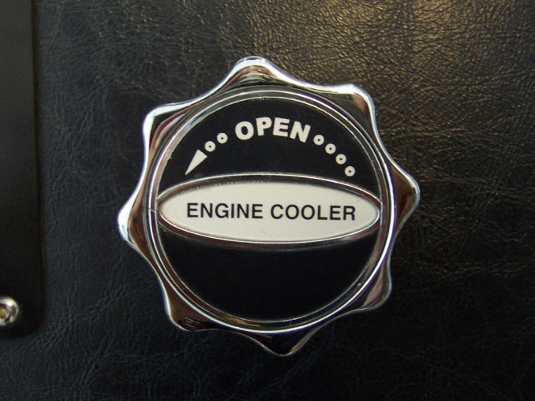
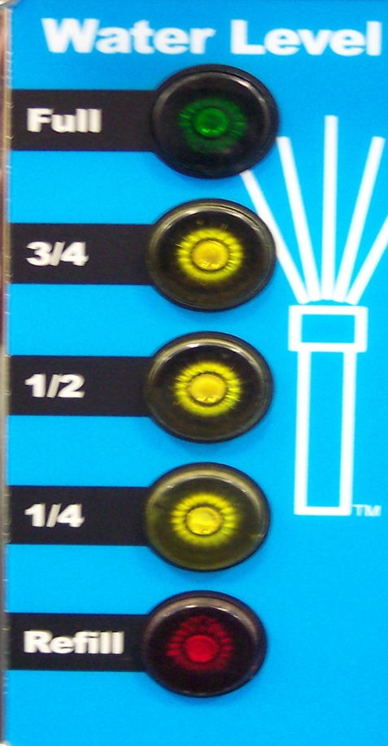
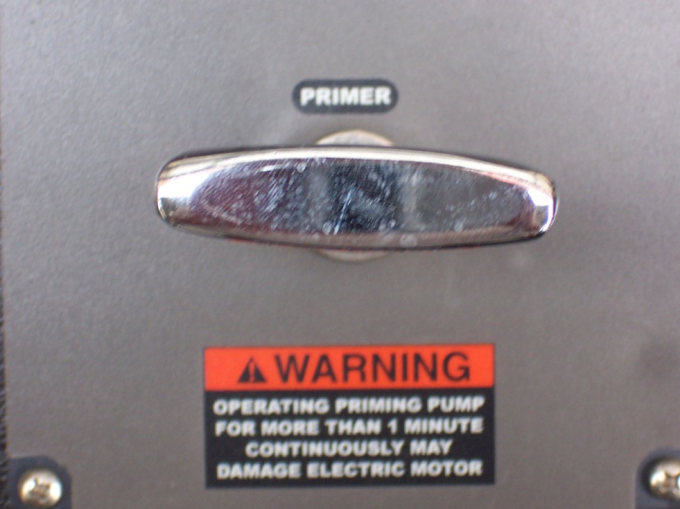
Pump Panel
Engine cooler valve
Tank level Gauge
Primer Valve

Slide 29
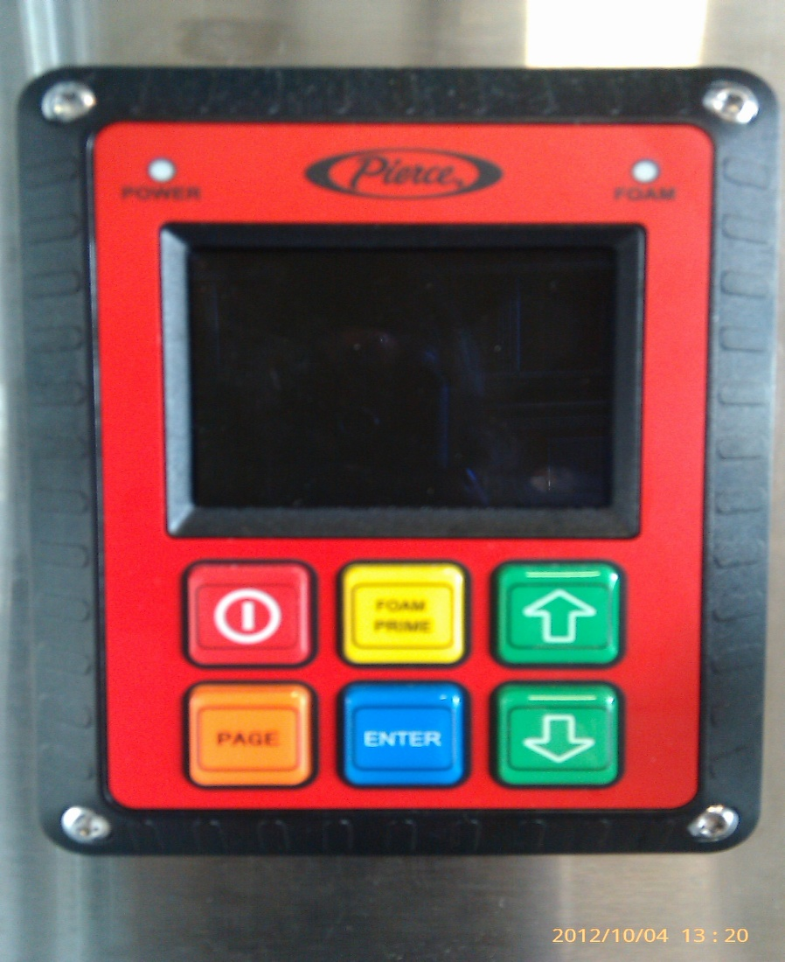
Foam Controls
Husky 12

Slide 30
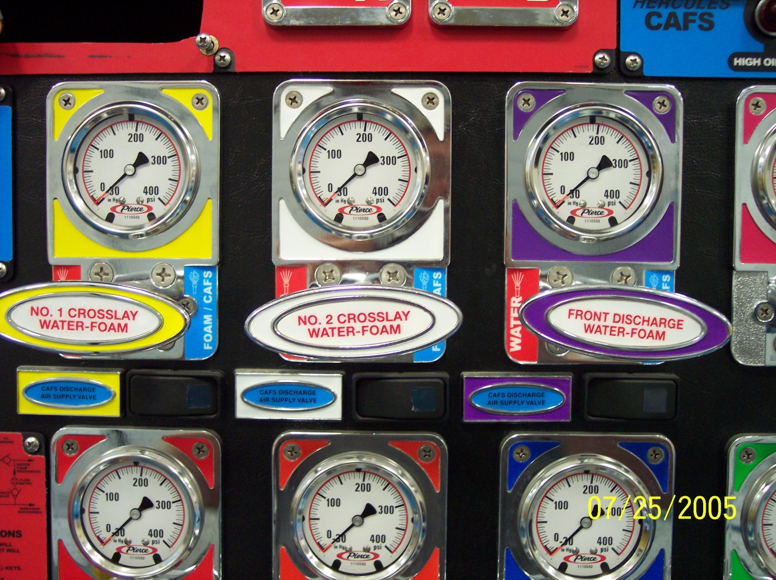
Pump Panel
Foam/CAFS Discharge Valves and Gauges
Foam/CAFS capable lines
2 crosslays (1-3/4” 200’)
Officers rear inboard discharge (2” 250’)

Slide 31
System Capabilities
200 GPM @ 6%
400 GPM @ 3%
1,200 GPM @ 1%
2,400 GPM @ 0.5 % *
4,000 GPM @ 0.3 % * (**)
At system pressures up to 250 PSI
* Piping limitations may alter these numbers
** Normal concentration for Class A foam
31

Slide 32
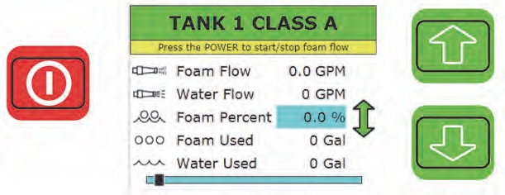
Class A Foam – Onboard Tank
Engage water pump (Engages foam system PTO)
Open tank to pump valve
Open discharge(s)
Turn on foam system (Red Button)
When completed, turn off foam system
Flow discharges until mostly clear of bubbles
Disengage water pump
32

Slide 33
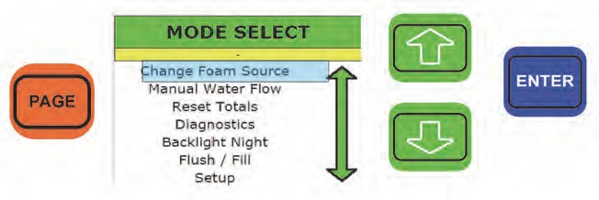
Other functions
33

Slide 34
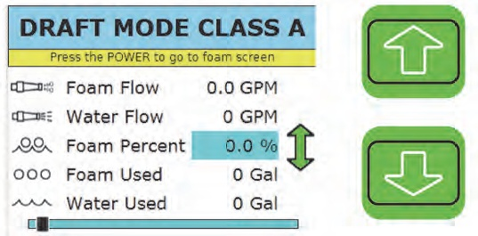
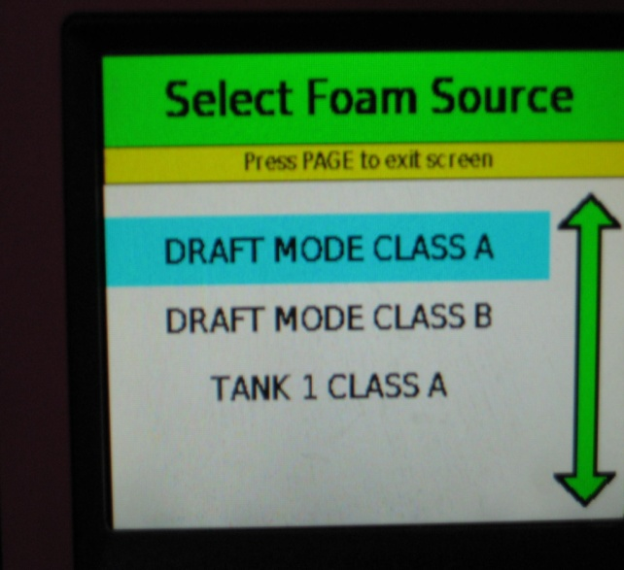
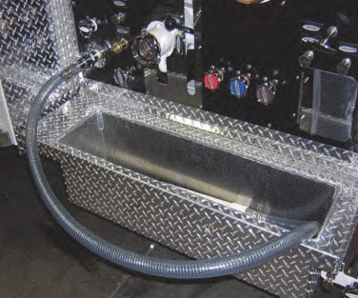
Class A Foam – External Pickup
Connect pickup tube, foam container
Engage water pump, open tank to pump valve
Push “PAGE” until “Select Mode” page appears
Up/Dn arrow to “Select Foam Source” , push “Enter”
Up/Dn arrow to “Draft Class A”, push “Enter”
Open discharge(s) or manifold drain
Turn on foam pump (Red Button)
Set Foam Percentage (if needed)
Push and hold “Prime” (if needed)
34

Slide 35
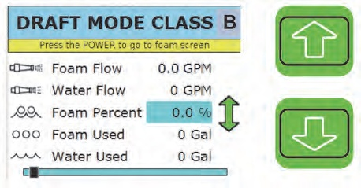
Class B Foam – External Pickup
Connect pickup tube, foam container
Engage water pump, open tank to pump valve
Select mode as per Draft Class A
Open discharge(s) or manifold drain
Turn on Foam pump (Red button)
Set Foam Percentage (if needed)
Push and hold “Prime” (if needed)
Flush system when completed
35

Slide 36
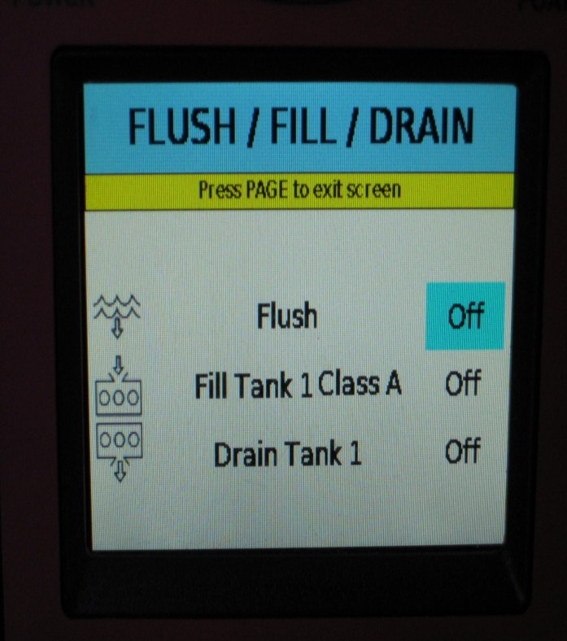
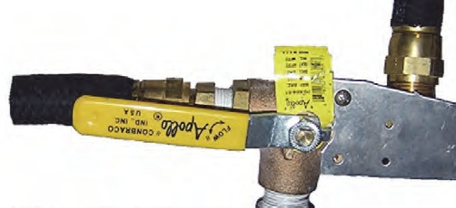

Onboard Tank Fill
“CHECK SELECTOR VALVE”
Pickup tube
Foam Selector Valve
36

Slide 37

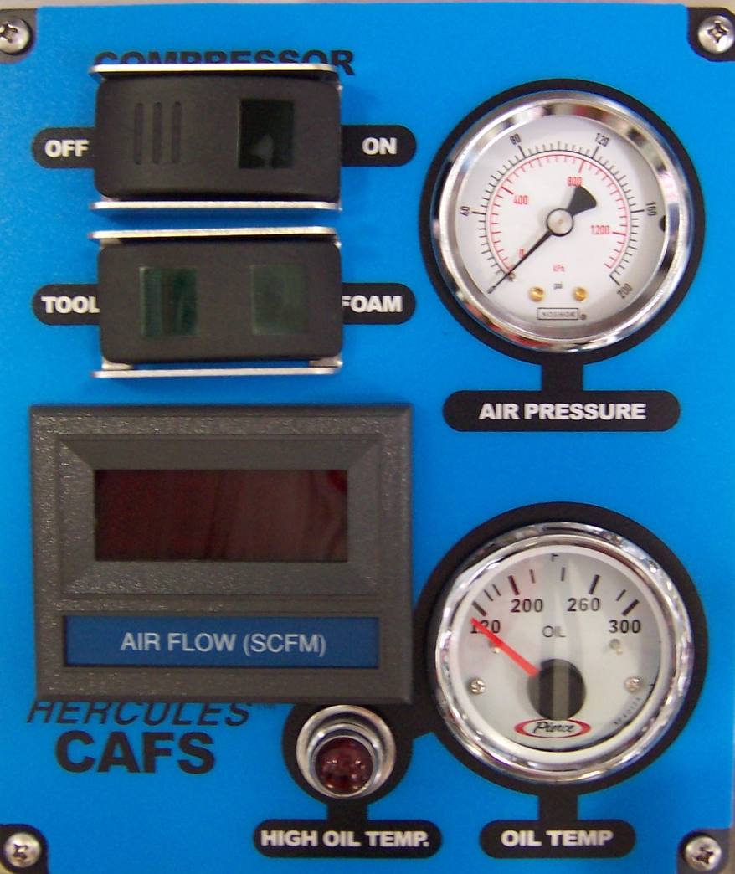
Foam Controls
For CAFS:
  Compressor switch to ON
  Switch at discharge to ON
Manual/Auto switch should always be set to Auto.

Slide 38
Hose Loads
(1) 100’ 1-3/4” bumper line
  15/16” smoothbore breakaway with 75psi fog nozzle
(2) 200’ 1-3/4” Crosslays preconnect (Foam Solution/CAFS capable)
  15/16” smoothbore breakaway with 75psi fog nozzle
(1) 400’ 1-3/4” Drivers side preconnect
  15/16” smoothbore breakaway with 75psi fog nozzle
  100’ Minuteman Shoulder Load (Nozzle Man)
  150’ Minuteman Shoulder Load (Backup/Officer)
  150’ Flat Load (Driver)
(1) 350’ 3” Flat Load with gated wye
  Loops at every 100’
(1) 800’ 4” Flat Load
(1) 1,000’ 4” Flat Load connected to Humat
(1) 250’ 2” preconnect (Foam Solution/CAFS capable)
  15/16” smoothbore breakaway with 75psi fog nozzle
(1) 250’ 2-1/2” stack-tip smoothbore
38

Slide 39
Hose Loads – Packing Bumper Line
100’ 1-3/4” bumper line
  Connect 50’ section to swivel
    Pack in front of tray making two loops on initial pass.
    Flat pack remainder.
  Donut roll with male coupling on inside
    Connect nozzle
    Place in rear of tray
    Connect female to initial 50’
39

Slide 40
Hose Loads – Packing 400’
150’ flat load Drivers Load
  Ear on second fold
  Full length of bed
150’ modified MinuteMan Middle Load
  Place male coupling on ground and then load remainder of hose on top
  2/3 length of bed
  Connect Drivers Load male to Middle Load female
  Push hose load into bed until it stops
100’ MinuteMan Shoulder Load
  Do not wrap nozzle
  Place nozzle flush with edge of hose bed with bail towards drivers side
  Connect Middle Load male hanging over tailboard to Shoulder female
40

Slide 41
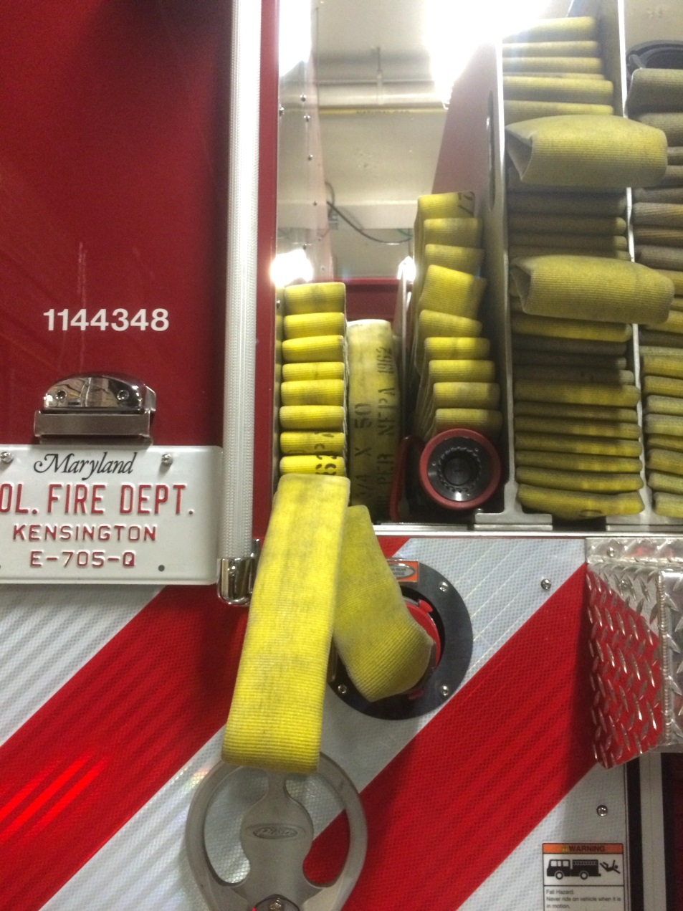
Hose Loads – 400’
41

Slide 42
Pump Inlets & Soft Sleeves
Front Intake
  5” with a 4” Stortz connection with 20’ 4” soft sleeve.
  Hydrant-Stortz adapter
  2-1/2” to 4” Stortz gate
  Hydrant wrench
  Mallet
Rear Intake – behind roll up door
  5” with a 4” Stortz connection with 20’ 4” soft sleeve.
  Hydrant-Stortz adapter
  Hydrant wrench
  Mallet
Side Intakes
  6” with 4” Stortz connection
  Officer side hose tray has 1 section of 50’ of 4”
  Drivers compartment behind pump panel has 2 sections of 25’ of 4”
42

Slide 43
Section 4
Accessory Controls
Cab Lift

Slide 44
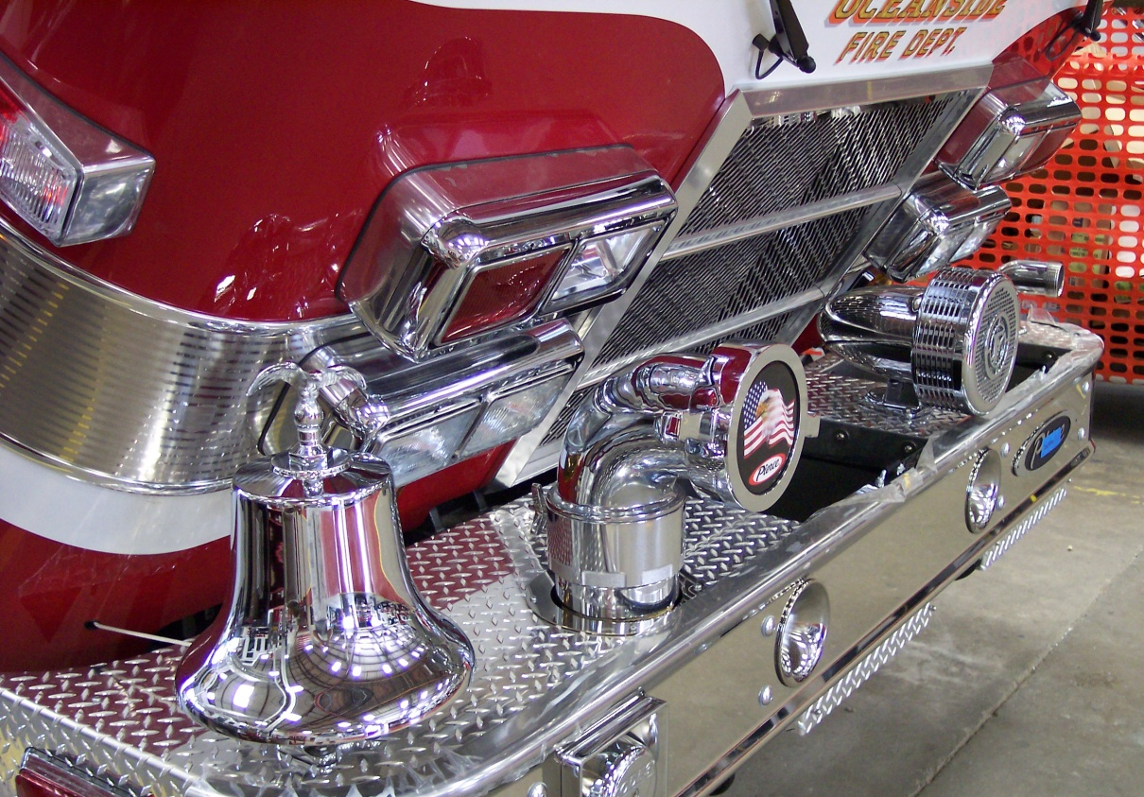
Cab Tilt Operation
Caution: Before raising any Pierce cab, ensure that all items on the front bumper have adequate clearance when the cab is tilted.

Slide 45
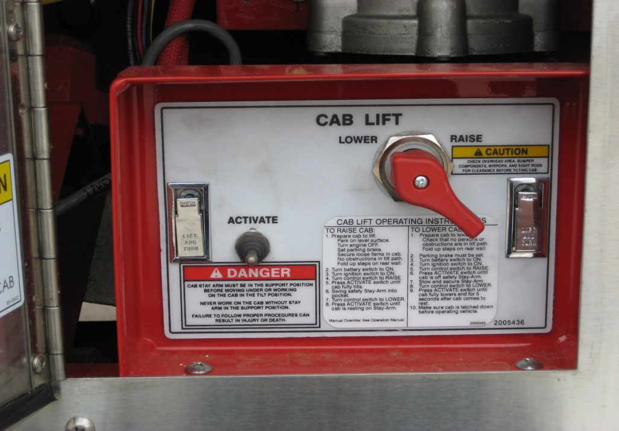
Cab Tilt Controls
Arrow XT
Pump Activate Switch
WARNING: Before raising cab, Remove all loose items from the cab as contents may shift
Control – Raise / Lower
CAUTION: Check bumper extension to ensure covers are down and plumbing swivels are facing forward.
CAUTION: Ensure vehicle is on flat ground to avoid interference with components
Operating Instructions

Slide 46

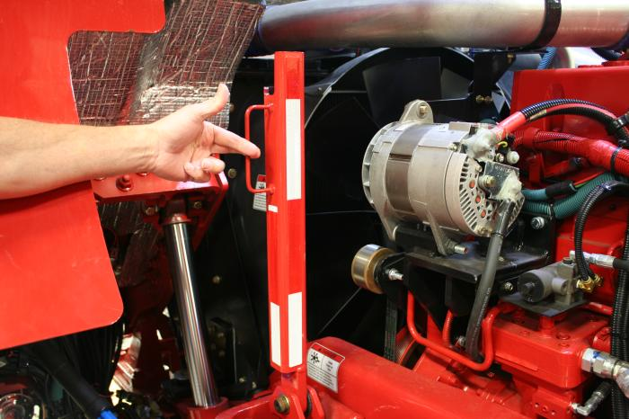
Cab Tilt Operation
Arrow XT
Raising
Battery and ignition “ON”, parking brake set
Control in raise position
Press activate switch
Stay arm engaged
Lower cab to bed stay arm
WARNING: Never work
under cab unless stay arm
or cab support is in place

Slide 47
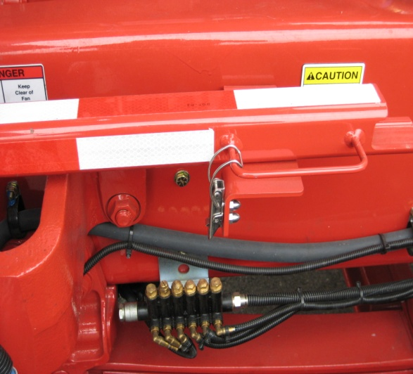
Cab Tilt Operation
Arrow XT
Lowering
WARNING: Before lowering cab, be sure all personnel and equipment are clear of the cab area
Battery and ignition “ON”, parking brake set
Turn control to ”raise” and activate pump
Raise cab
Secure stay arm
Control switch to “lower”
Push activate button
Ensure cab is down (3 count)

Slide 48
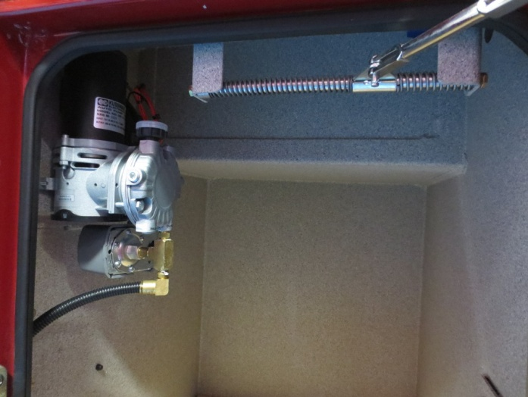
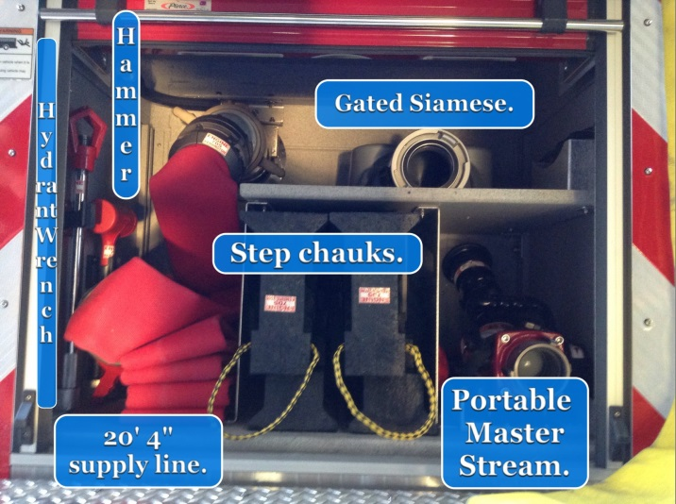
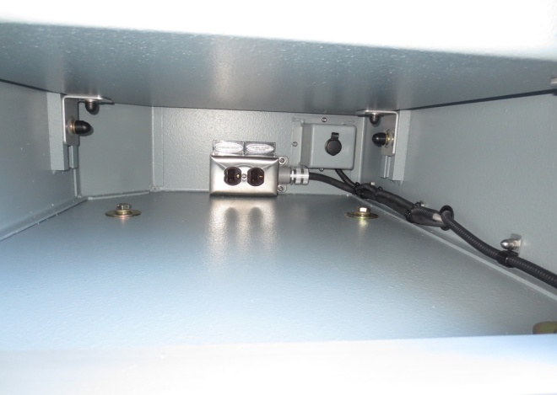
Additional Features
Make-up Air Compressor
(12v)
Rear Inlet
Shoreline powered 110vac outlet in EMS compartments
48

Slide 49
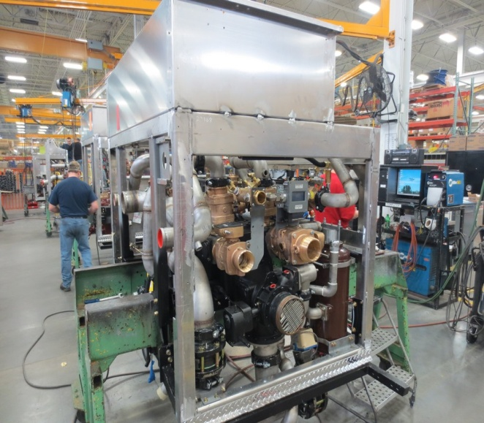
Section 5
PUMPS
Positioning and Operation

Slide 50
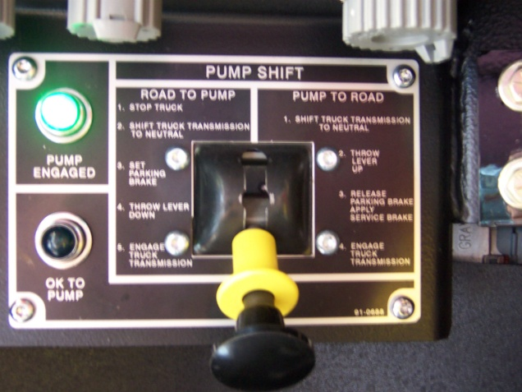
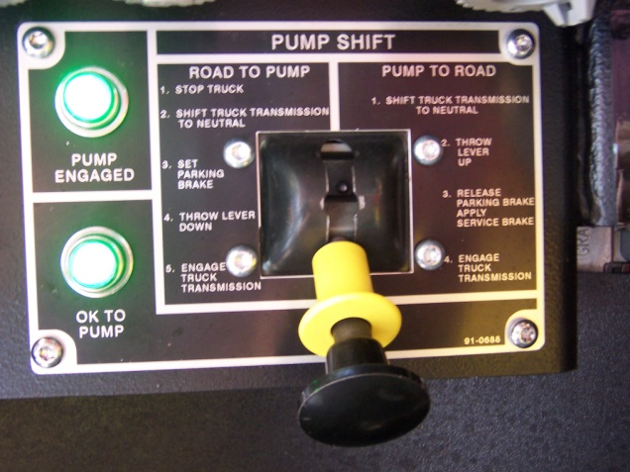
Pumping Operations
Engaging the Driveline pump
Stop and shift to neutral
Set brake
Apply service brake
Engage pump shift “down”
Check “pump engaged” light
Shift to drive
Check speedometer
Check “ok to pump” light
Conditions for “ok to pump” light
Set wheel chocks
CAUTION: Begin pumping right away and/or circulate water to keep pump from overheating
CAUTION: Running the pump dry for more than a few minutes will cause damage

Slide 51
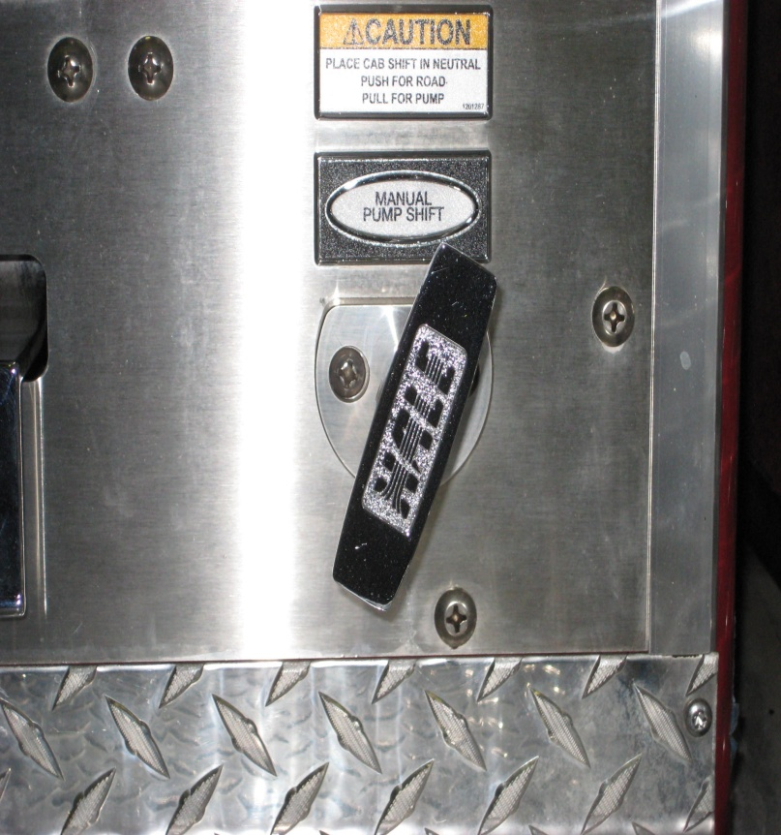
Manual Pump Shift
Transmission in NEUTRAL, parking brake applied
Foot on brake pedal
Move pump shift lever to middle position
Pull manual pump shift handle out
Move pump shift lever to lower position
Place transmission in DRIVE
51

Slide 52
Pumping Operations
Water Supply
Drafting
  Always 20 Hg. of vacuum or less
  Intake vacuum of more than 20 Hg. can cause cavitation
Hydrant
  Maintain intake pressure above 20 psi
  Provides safety factor for water system
  Intake pressure must be 20 psi below discharge pressure for governor to work properly
Consult department SOP/SOG”s

Slide 53
Pumping Operations
Controlling with Pressure Governor
Governor will maintain PSI/RPM’s automatically
To operate:
  Select mode
  Adjust by using “increase/decrease” control
Throttle mode: operates manually
Preset: automatically goes to preset PSI/RPM (150psi/1,000rpm)
Low water/No water protection
WARNING: Apparatus equipped with pressure governors normally do not have pressure relief valves. The pressure governor performs the function of the relief valve,
always pump in pressure governor mode.
Pumping in throttle mode can cause high pressure and/or pressure spikes. Pressure spikes can injure or kill.

Slide 54
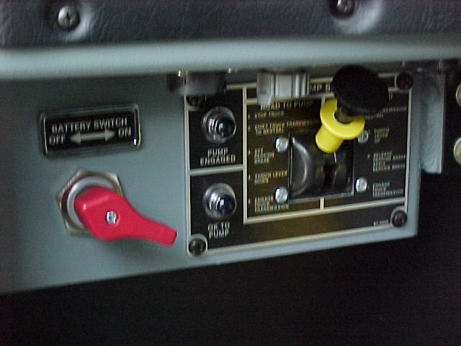
Pump Operations
Disengaging the Driveline Pump
Reduce engine speed and/or disengage pressure governor
Shift transmission to neutral
Speedometer must drop to 0 and then shift to “road”
Observe indicator lights, if both off, shift is successful, if not repeat procedure.

Slide 55
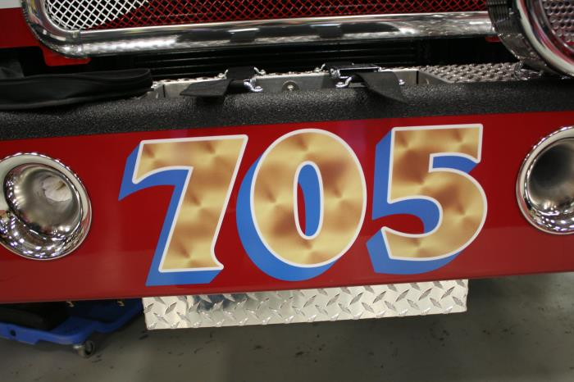
Section 6
Maintenance and Care

Slide 56
Service Bulletin
If it necessary to idle engine for more than FIVE minutes, the high-idle switch should be activated to increase the engine speed to at least 1000 RPM.

Slide 57






Vehicle Checks
Oil & Transmission Fluid
Coolant Expansion Tank
Radiator Sight Glass
Alternate Fluid Check Access
Power Steering Reservoir
Windshield Washer Reservoir

Slide 58






Vehicle Checks – con’d.
Circuit Breaker Panel
Vogel Lube
Front Axle Hubs
Cab Lift Reservoir
Air Tank Drains (4)
Accessory Drive Belts

Slide 59


Front Brake Check
Front brake pad wear indicator

Slide 60

Regional Concerns
Heat
  Properly maintain the cooling system
  Utilize auxiliary cooler when necessary
    Use with caution in cold temperatures
  Remove leaves from radiator in the fall

Slide 61
Regional Concerns
Cold Conditions
  Engine may not reach warm operating temperatures unless under load
Caution: As a result of not reaching operating temperature, operating a diesel engine at low idle for extended periods of time can result in engine damage.
Caution: Avoid extended idling (beyond 5 min. when possible)
Caution: Use a minimum 45 Cetane diesel fuel
Caution: Maintain a minimum of 1250 RPM idle
Remember: Water freezes, and can cause major pump and accessory damage

Slide 62
Care of Vehicle
Washing
  Can be washed any time after delivery
  Use mild non-abrasive liquid soap made for vehicles
    DO NOT USE DISH SOAP
  Avoid pressure washing
Waxing
  May be hand waxed 90 days after delivery
Caution: Do not wax any of the Goldstar, gold leaf, or other vinyl. Wax around it (refer to owners manual)

Slide 63

Tire Inflation Chart

Slide 64
2013 Spec Engines
Regeneration
&
DEF

Slide 65

Questions?

