Slide 1
Kensington Volunteer Fire Department
2018 Pierce Arrow XT
Short Wheel Base Pumper
In Service March 11, 2018

Slide 2
Purpose
This PowerPoint will briefly cover the differences between our 2014 and 2018 Pierce Arrow XT Short Wheel Base Pumpers.

Slide 3
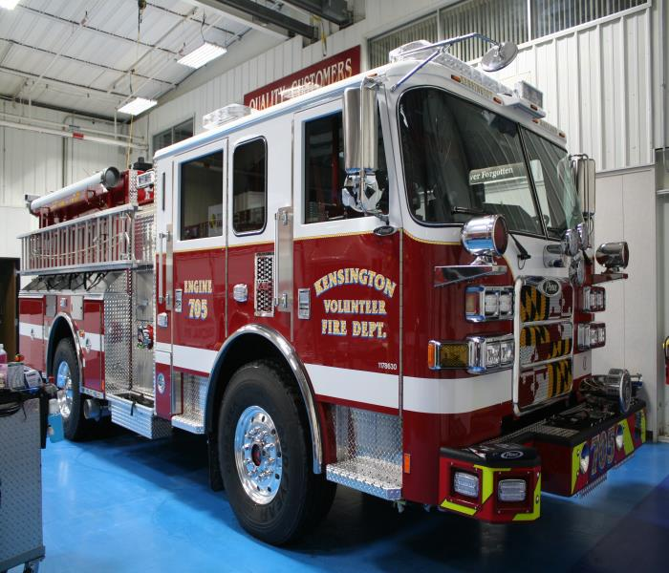
Stock Number 1-18-8630

Slide 4
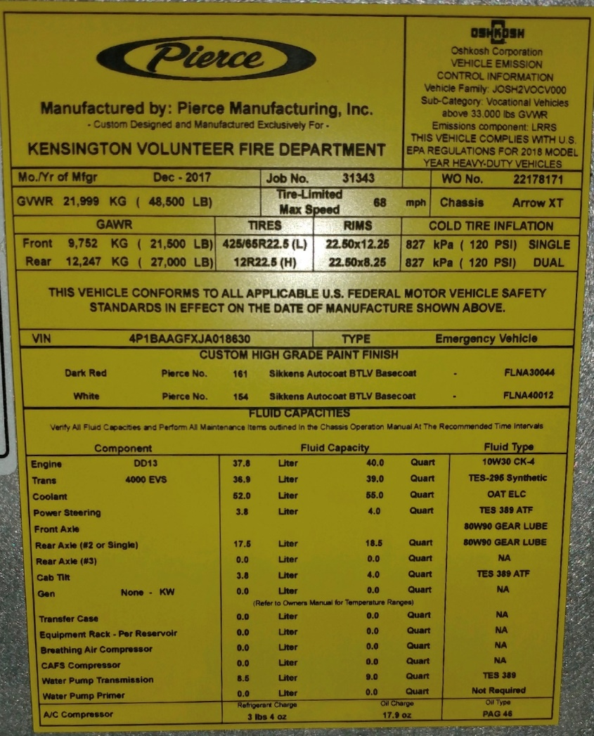
Fluids
2018 takes 10W30 CK-4 engine oil

Slide 5
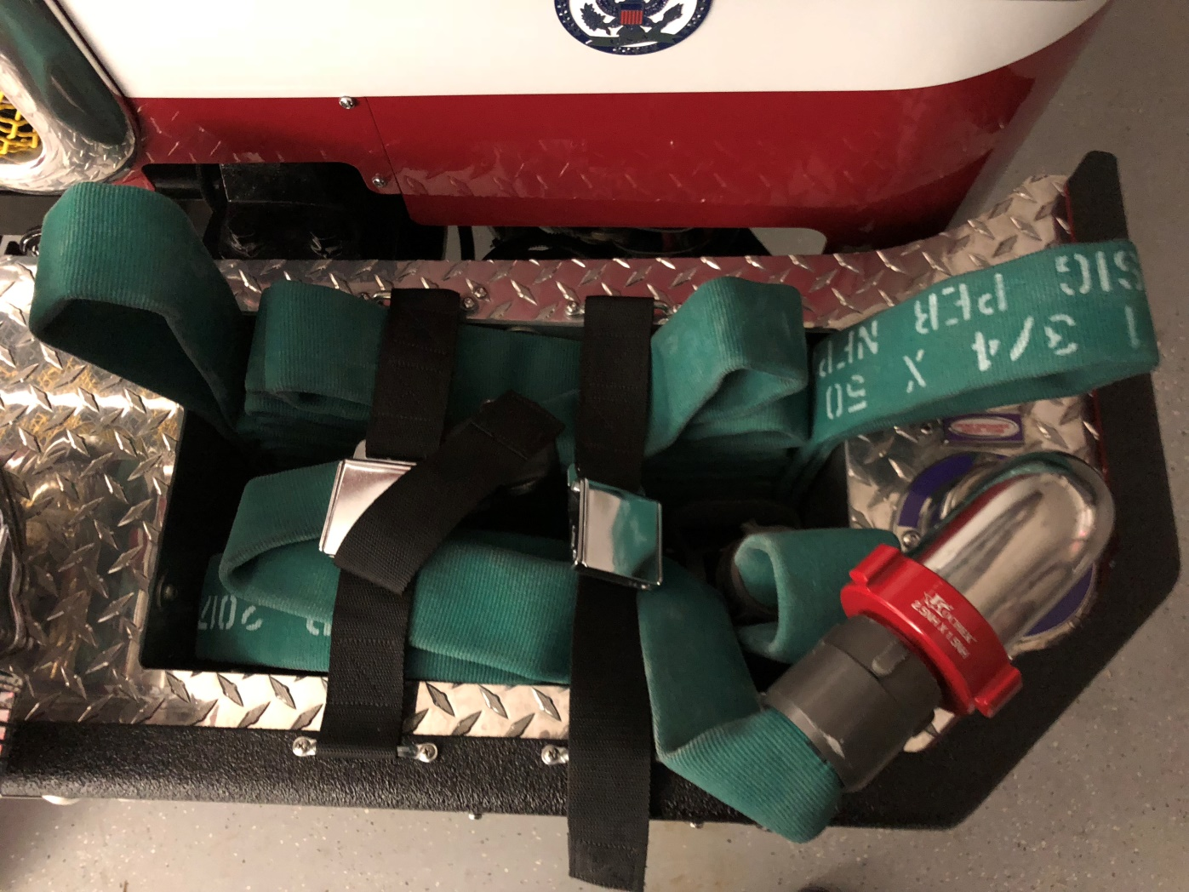
Cab Tilting
When tilting the cab, make sure the front bumper discharge is turned forward otherwise it will strike the cab.
Notes:
  Radiator hoses:
    2018 has rubber
    2014 has silicone
  Cab Tilt reservoir
    Do NOT fill when cab tilted. Will overflow when cab is lowered.

Slide 6
Vehicle Specifications
Arrow XT custom chassis, Aluminum body
GVW – 48,500 lbs.
Length – 29’ 9.75”
Height – 9’ 5.5”
DDC DD13, 525 HP, EPA2016
Allison 4000, 6 speed, w/aggressive downshift program
Waterous CSU, 1,500 gallons per minute, Single Stage
Husky 3 foam system
Water – 750 gal.
Foam cell – 25 gal.
Fuel – 75 gal.
DEF – 4.5 gal.
Crew positions – 6
Governed speed – 68 mph.

Slide 7
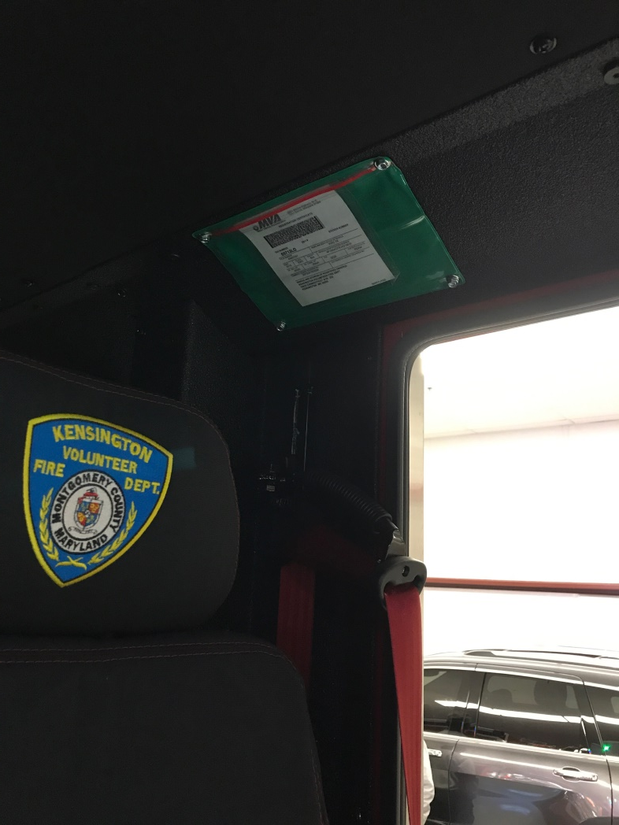
Insurance & Registration Card

Slide 8
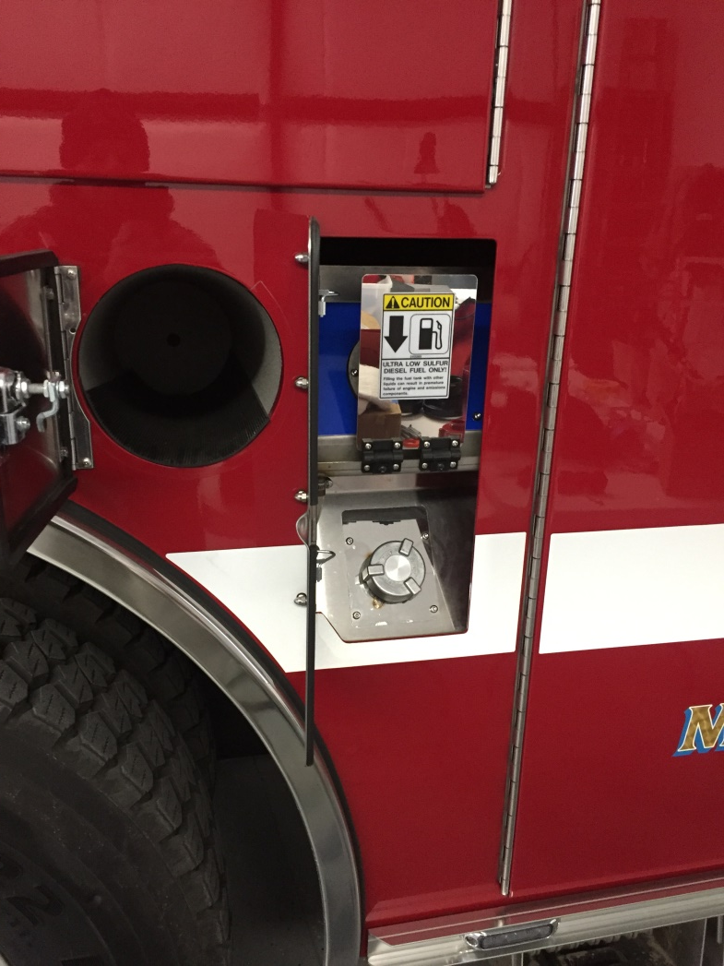
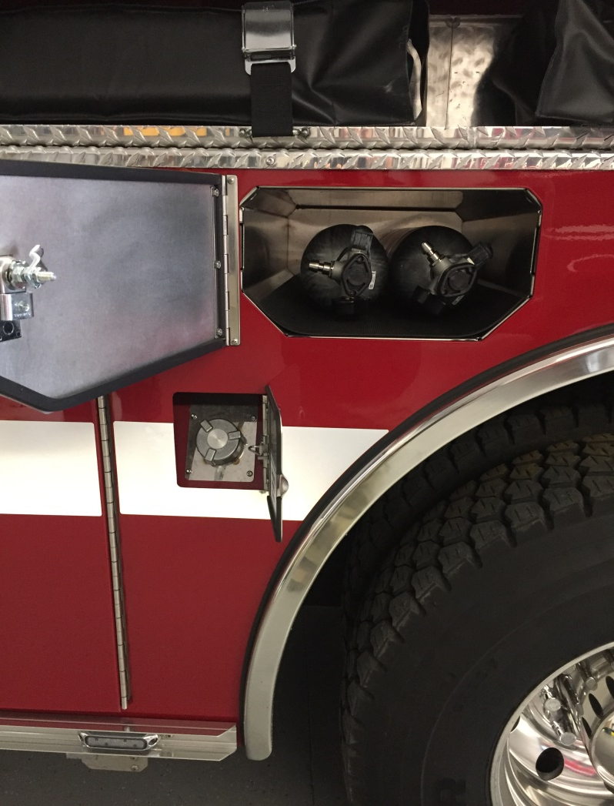
Fuel & DEF Doors
-4.5 gal. DEF tank
-75 gal. diesel tank w/fill on both sides

Slide 9
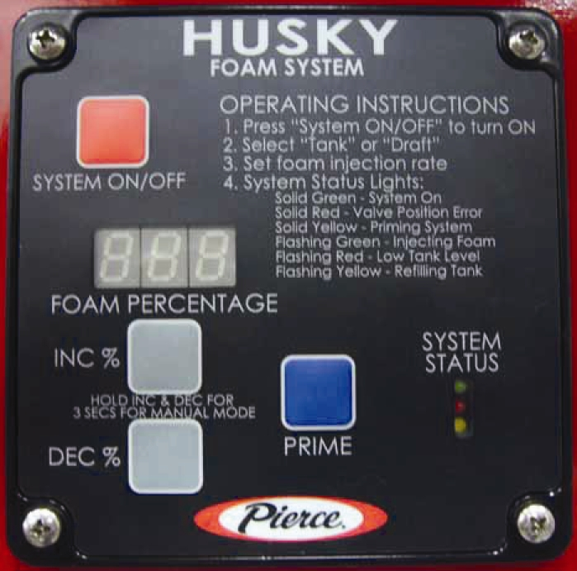
Foam Controls
Husky 3
Click to play a short video.

Slide 10
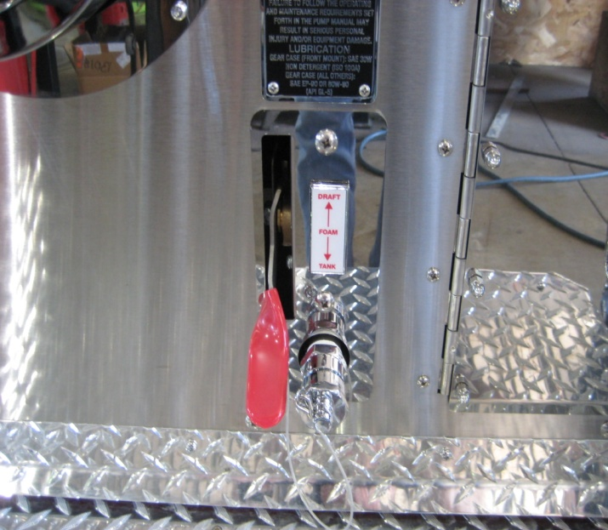
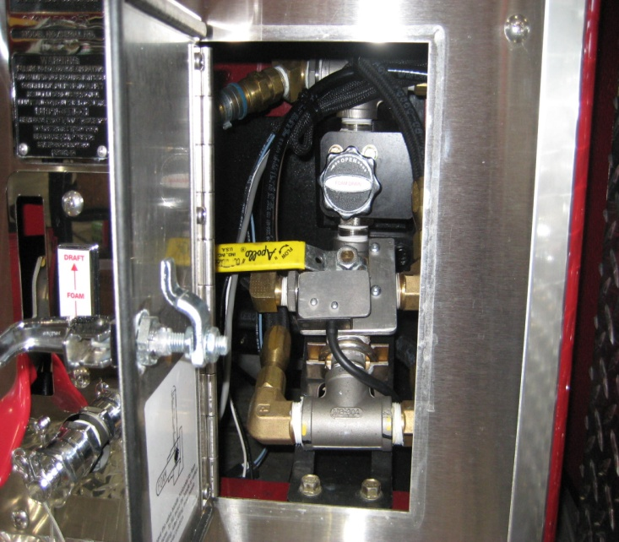
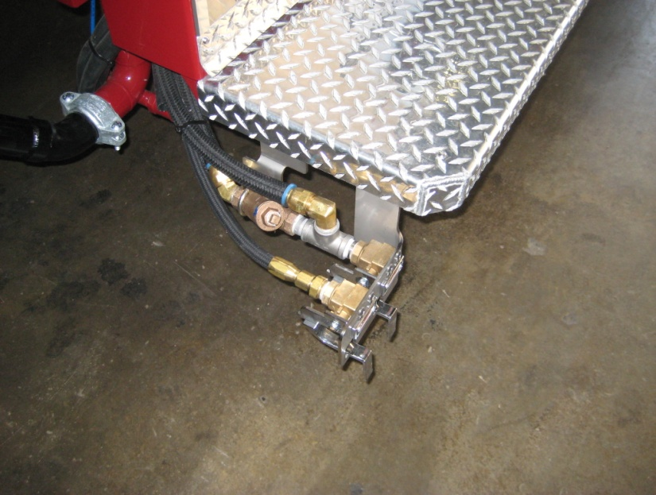
Foam System Parts
Foam Drains
Select Tank or Draft
Valve must be in the vertical position to draft foam
Note: Make sure the cap is on prior
to moving lever off the “draft” position
otherwise you will have foam come out
on your feet.

Slide 11
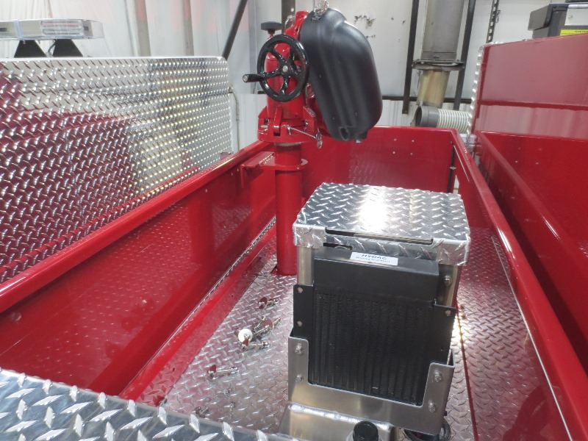
Foam Power Module

Slide 12
Foam System Capacity
Maximum Foam Solution Flow
0.01-3GPM
3% 100 GPM = 3 GPM of foam
1% 300 GPM = 3 GPM of foam
0.5% 600 GPM = 3 GPM of foam
0.3% 1000 GPM* = 3 GPM of foam
  *Maximum water flow will depend on plumbing restrictions*

Slide 13
What lines are capable of flowing foam?
Front Bumper
  100’ of 1 ¾ hose with a 175 GPM @ 75 psi NP breakaway with a 15/16 tip
Crosslays
  200’ of 1 ¾ hose with a 175 GPM @ 75 psi NP breakaway with a 15/16 tip
LHR (400)
  400’ of 1 ¾ hose with a 175 GPM @ 75 psi NP breakaway with a 15/16 tip

Slide 14
Maximum Foam Discharge Pump Pressure
This is VERY VERY VERY important:
The maximum Pump Discharge Pressure (PDP) when flowing foam is 150 psi.
This will affect the 400’ line off the rear.
*DO NOT EXCEED A PDP OF MORE THEN
150PSI WHEN FLOWING FOAM*

Slide 15
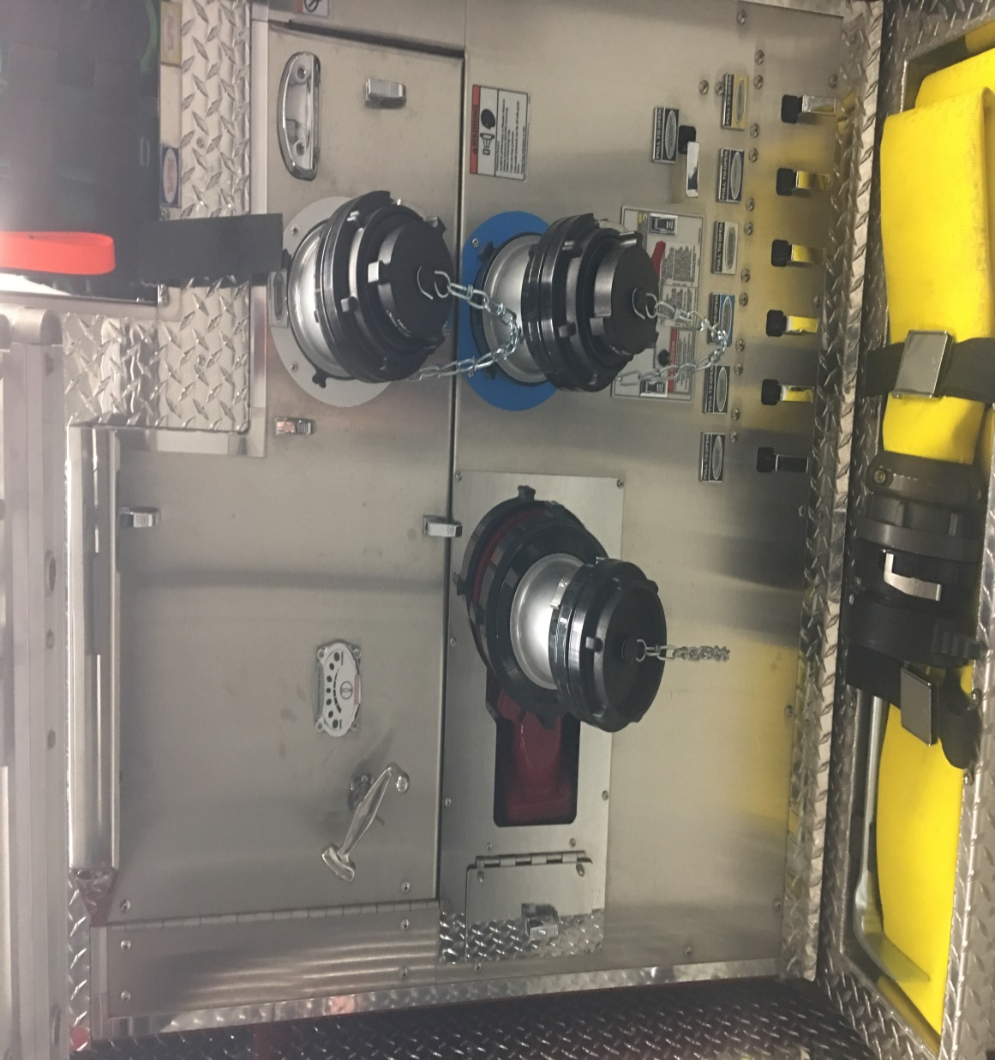
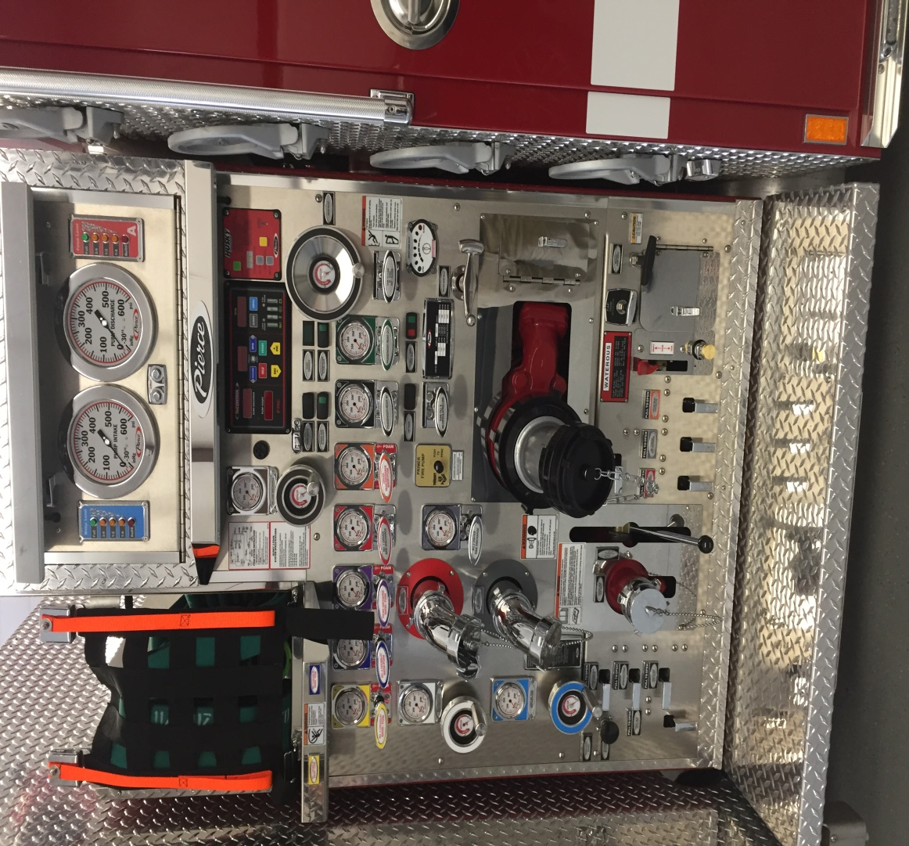
Pump Panel

Slide 16
Regeneration & Diesel Exhaust Fluid
Click to play a short video.

Slide 17
Inventory

Slide 18
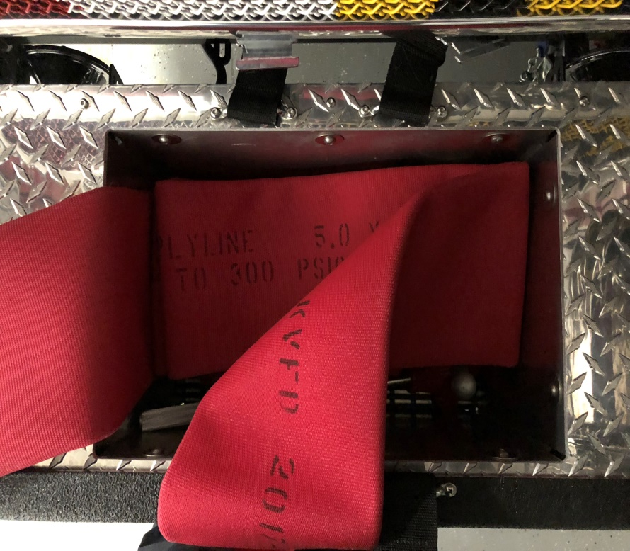
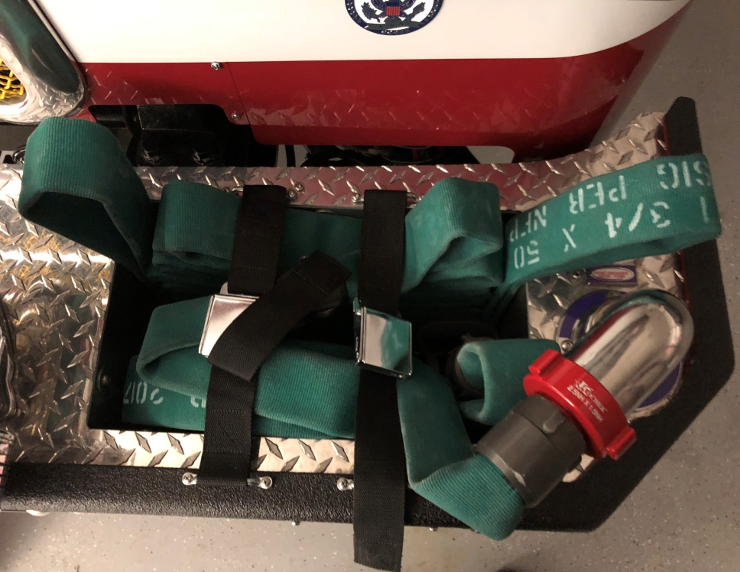
Front Bumper
25’ of 5” with Stortz. One end has 5” Stortz to 4.5” NST for hydrant hook up.
100’ of 1 ¾” hose with 175 GPM @ 75 psi NP with 15/16” break a way nozzle. This line is foam capable.

Slide 19
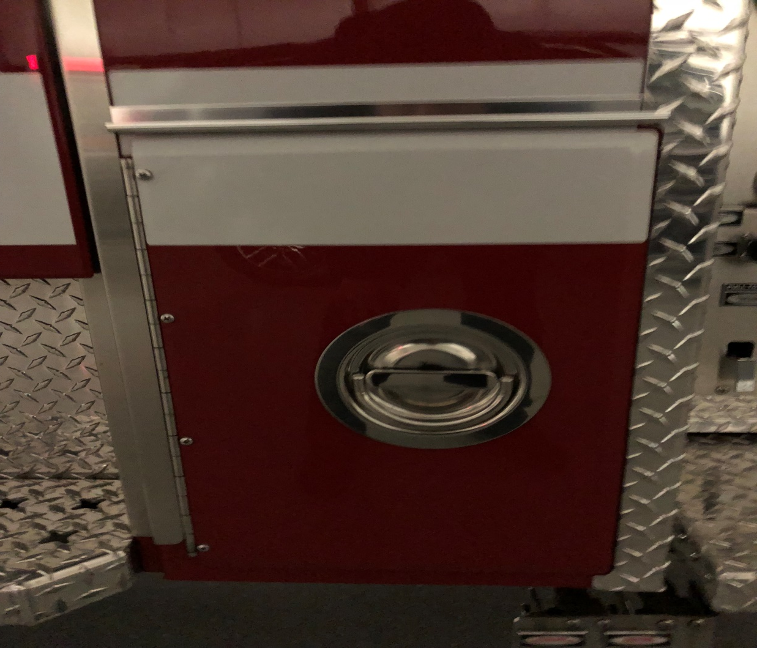
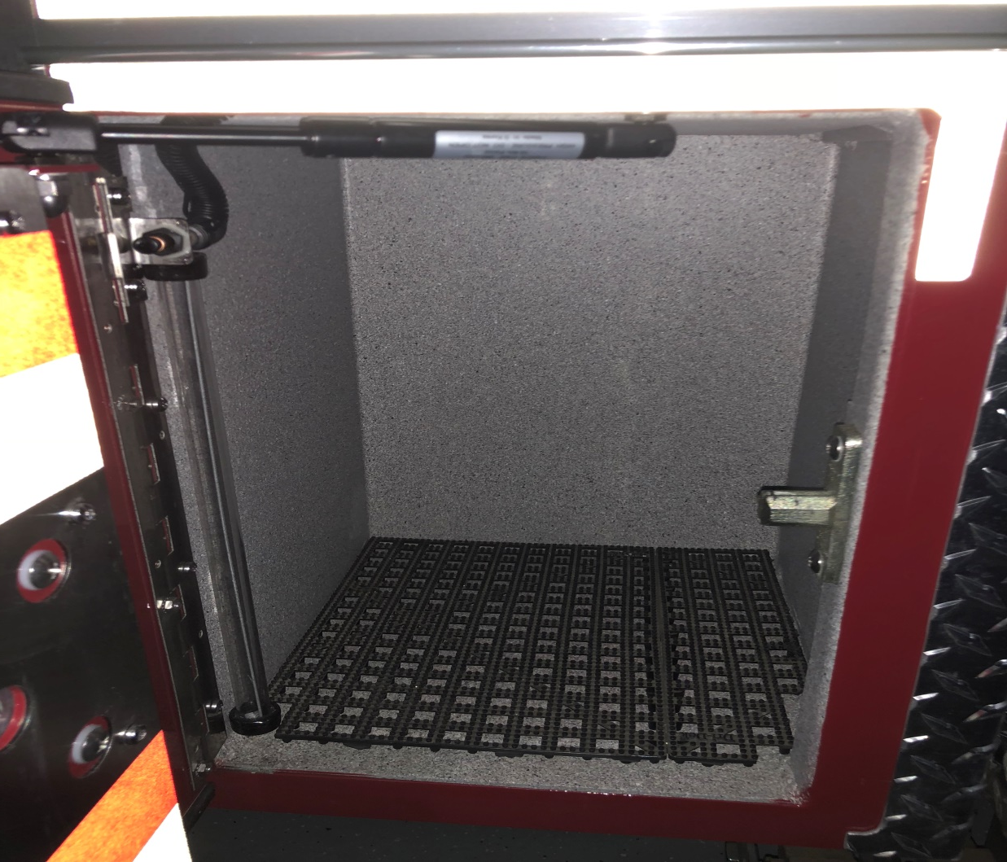
Driver Side Cab Compartment

Slide 20
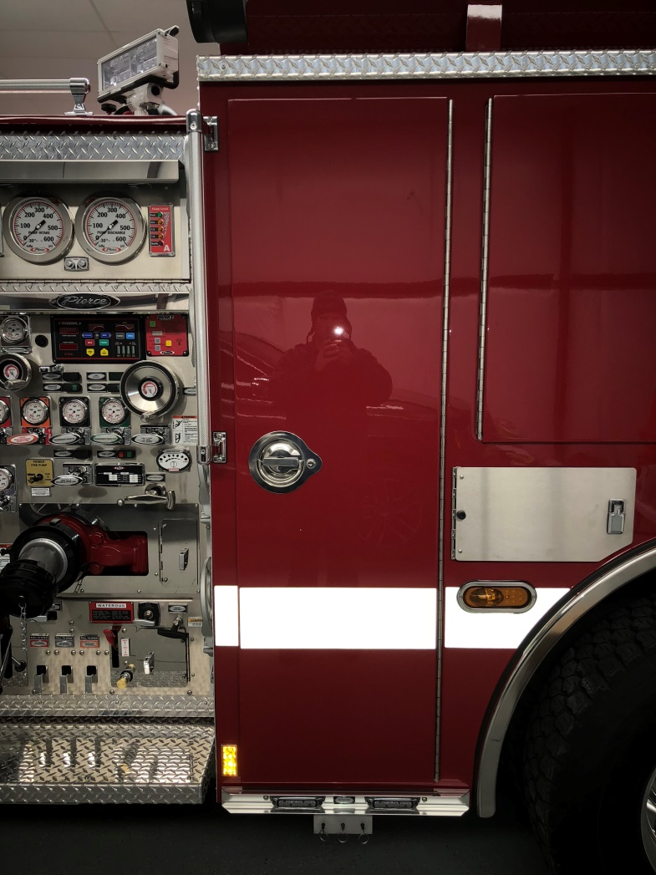
Drivers Side Compartment 1

Slide 21
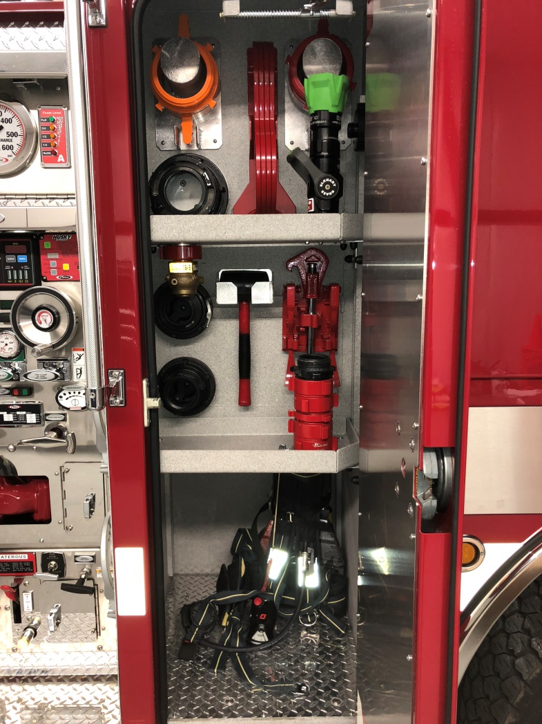
Drivers Side Compartment 1- Open
Drivers Gear Only!

Slide 22
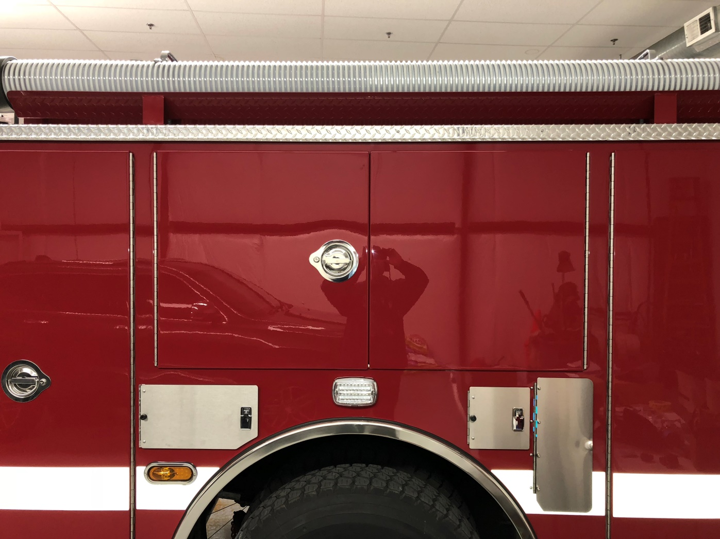
Drivers Side Compartment 2

Slide 23
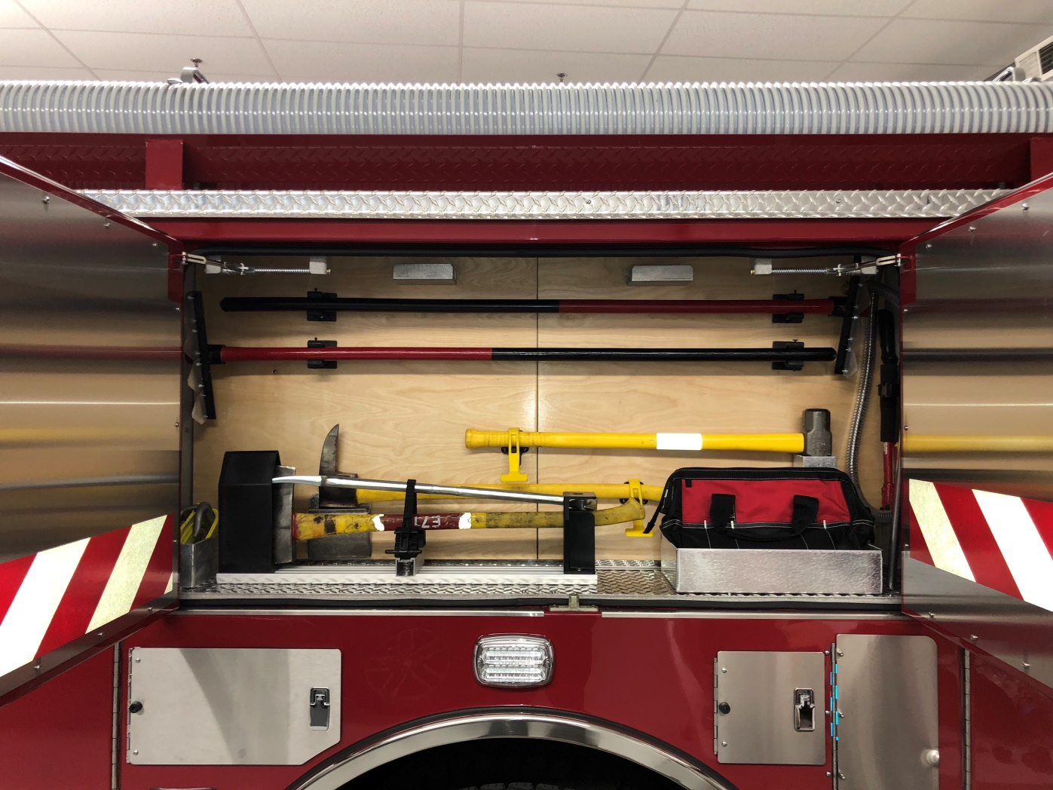
Drivers Side Compartment 2- Open
Hydra Ram with K Tool.

Slide 24
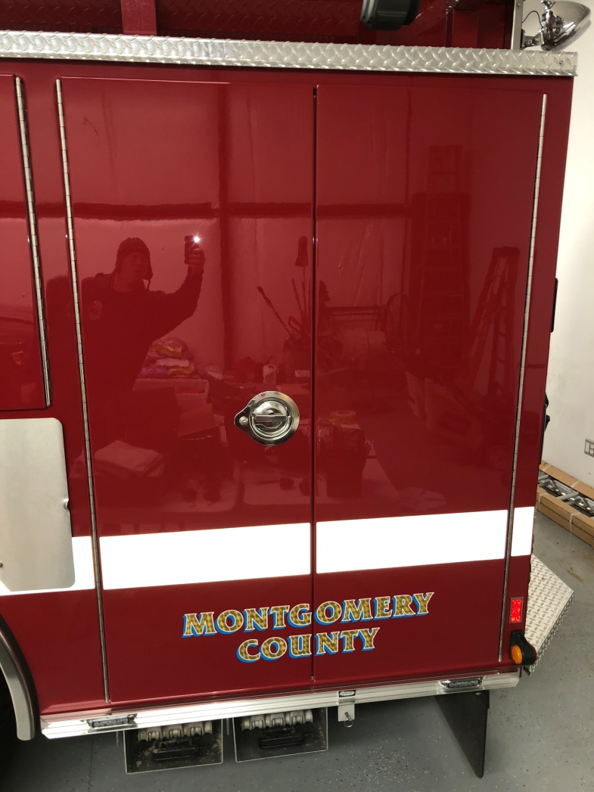
Drivers Side Compartment 3

Slide 25
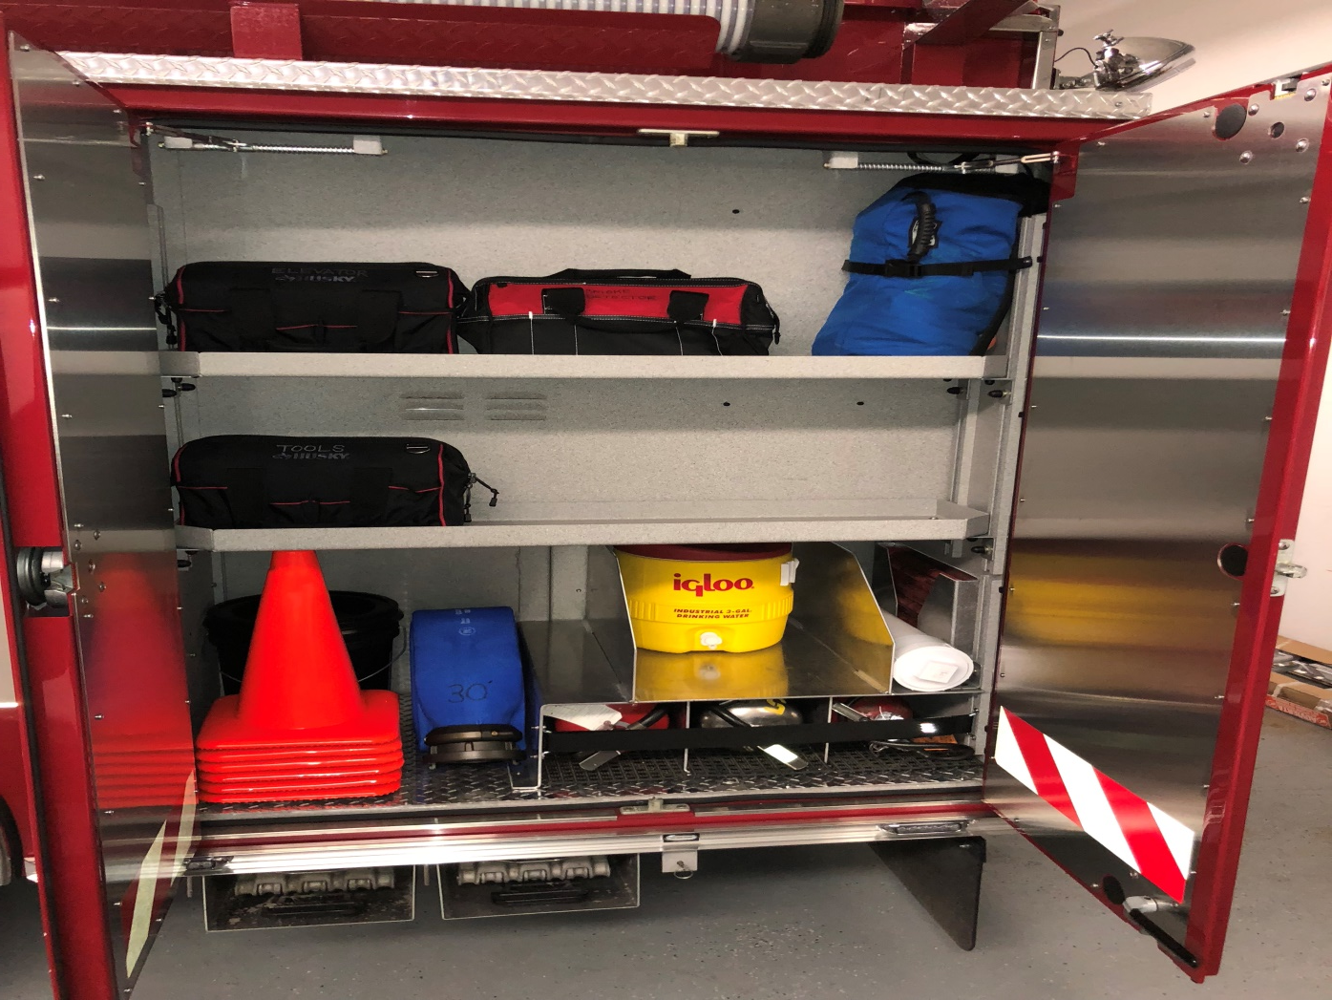
Drivers Side Compartment 3- Open
30’ of 4” hose

Slide 26
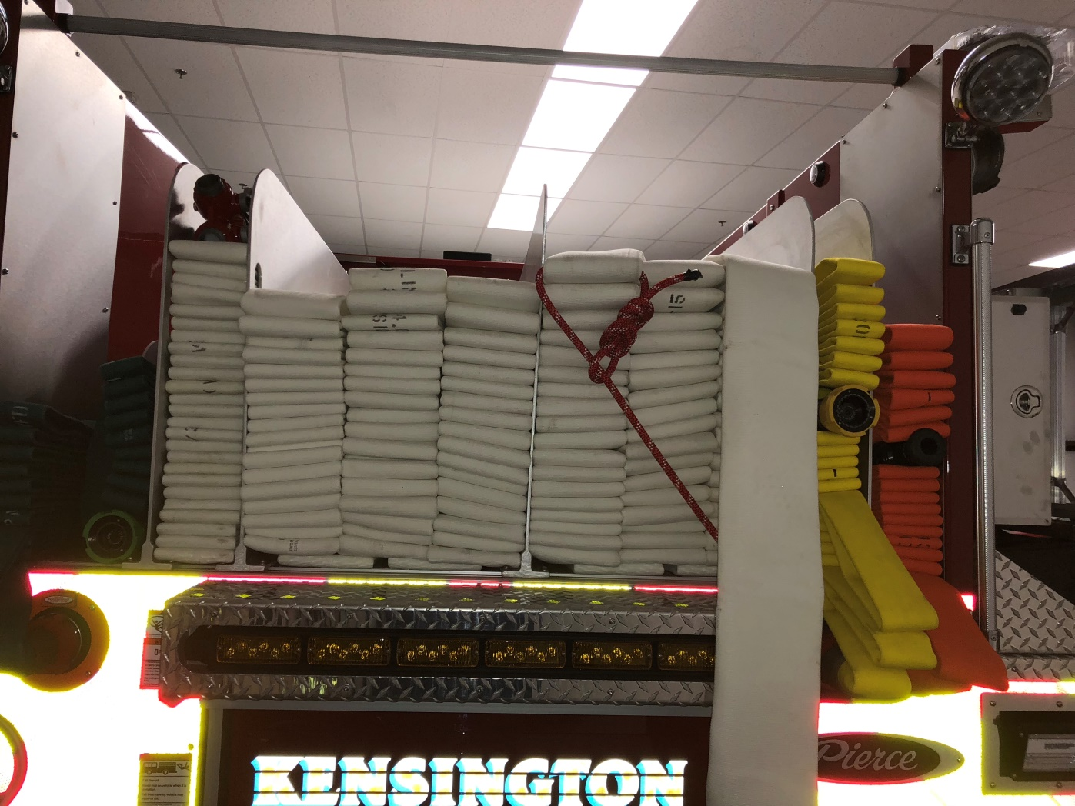
Rear
Left to Right:
-400’ of 1 ¾” with 175 GPM @ 75 psi NP with 15/16” tip (foam capable, however PDP must NOT exceed 150 psi when flowing foam)
-400’ of 3” with gated wye
-4” supply line
-4” supply line connected to the humat
-300’ of 2” of with 185 GPM @ 75 psi NP with 1 1/8 tip
-250’ of 2 ½ with 1 ¼ smooth bore

Slide 27
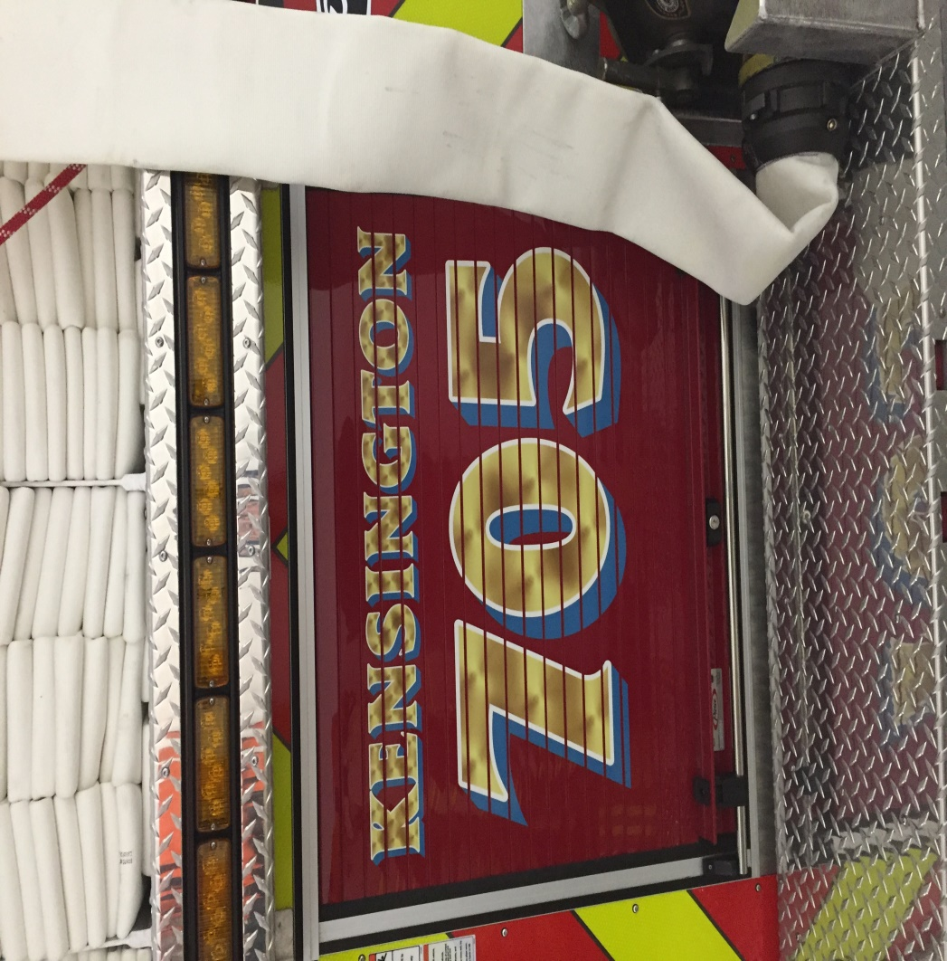
Rear Compartment

Slide 28
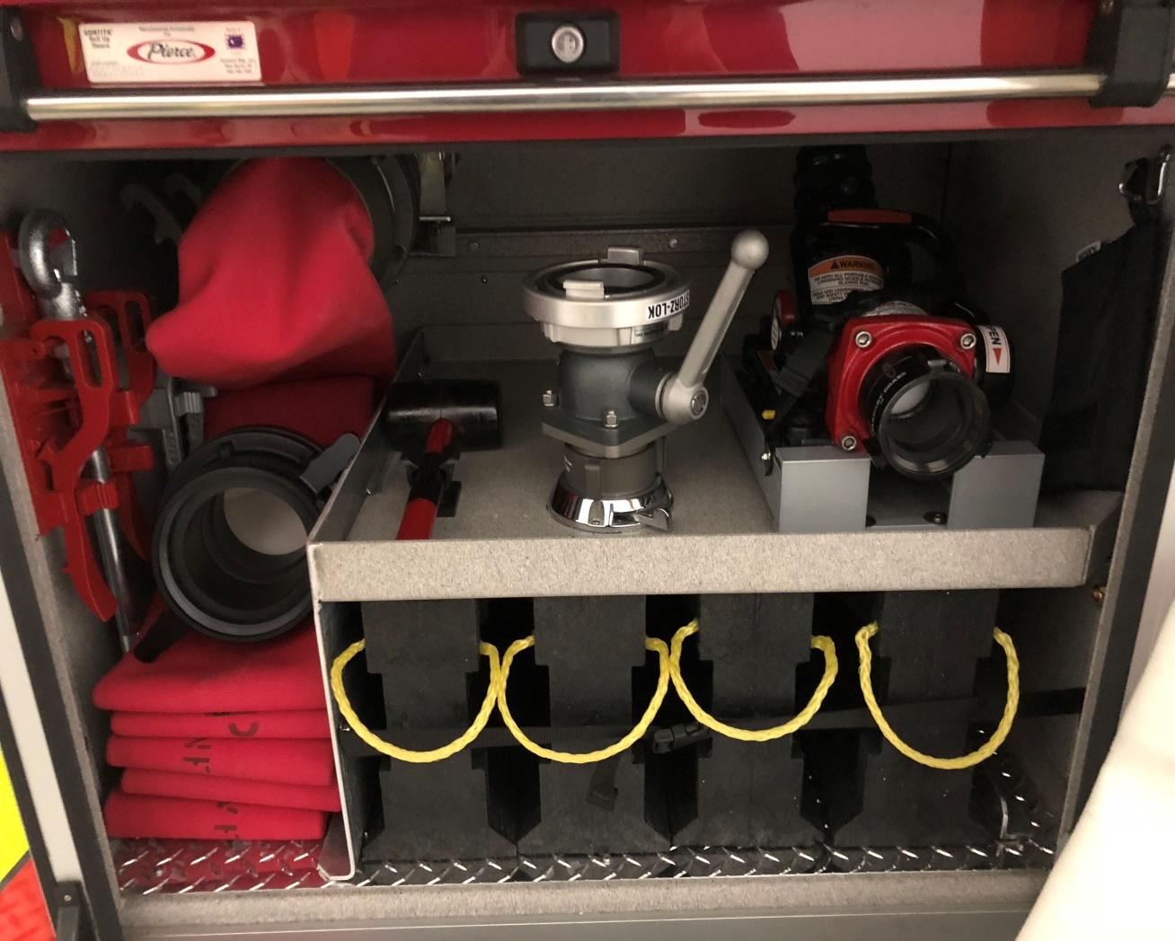
Rear Compartment Open
25’ of 5” with Stortz connections terminating to a 5” Stortz to 4.5” NST for hydrants
Remote Area Monitor Nozzle:
-500 GPM with fog tip

Slide 29
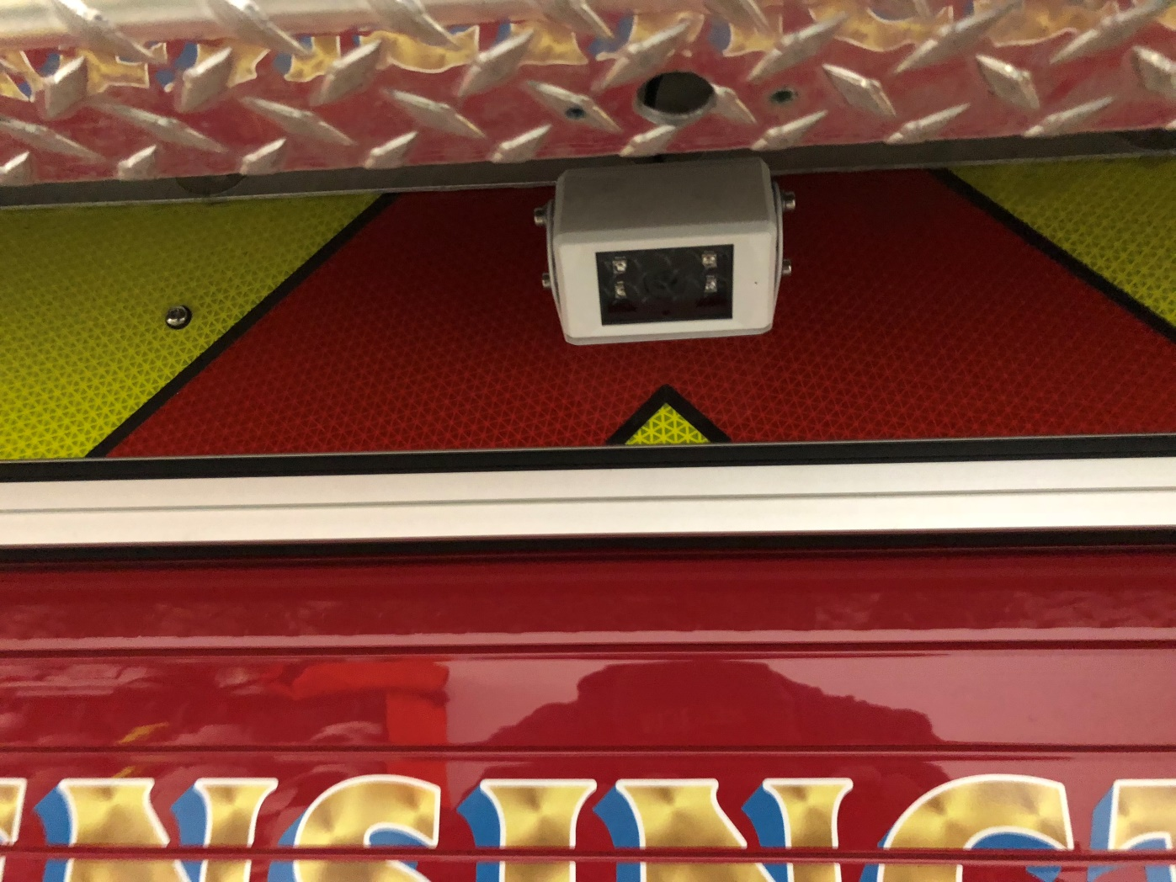
Rear Camera
This is NOT to be used in place of a back up person!

Slide 30
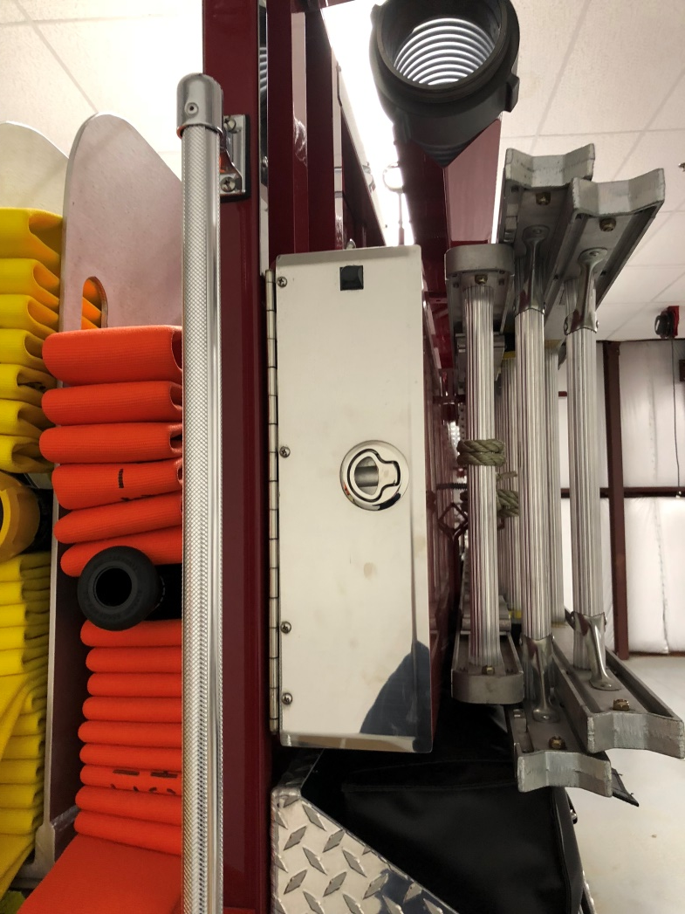
Rear Ladder Storage Compartment

Slide 31
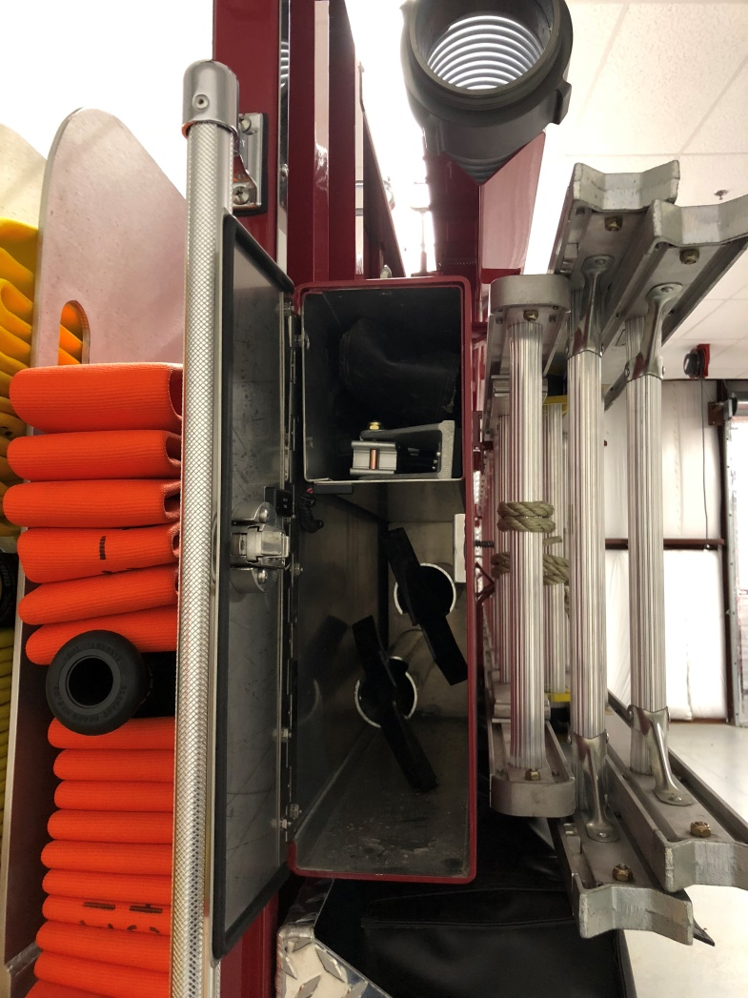
Rear Ladder Storage Compartment- Open
This box safely and securely holds the following:
-attic ladder
-elevator pole
-two hooks

Slide 32
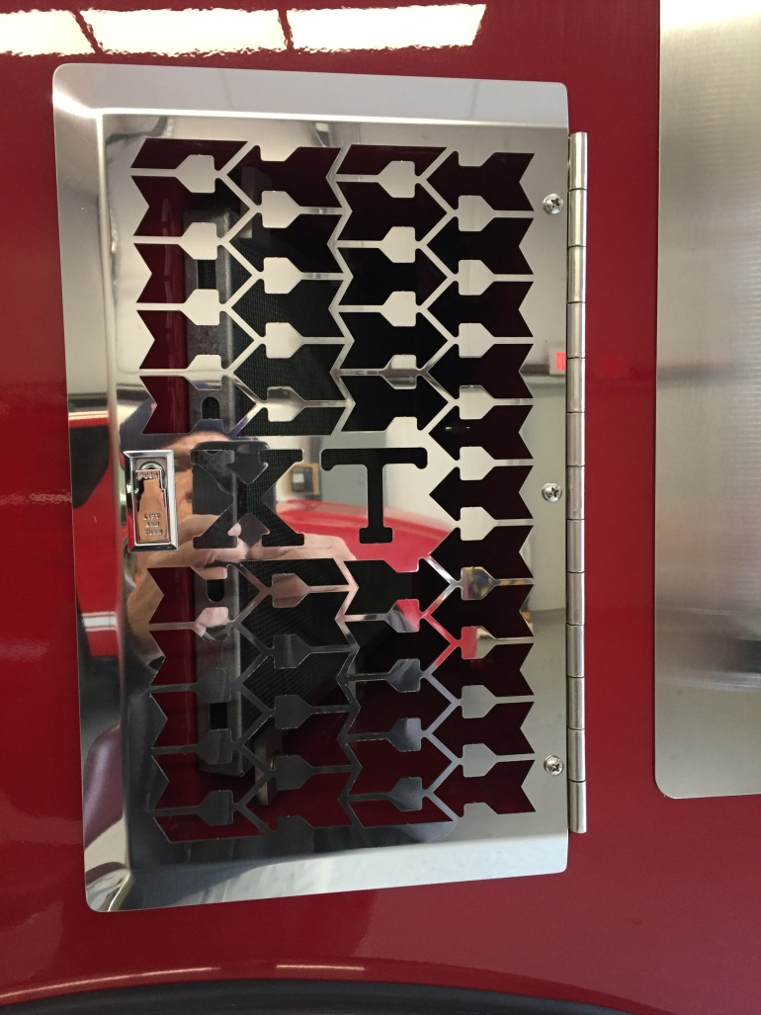
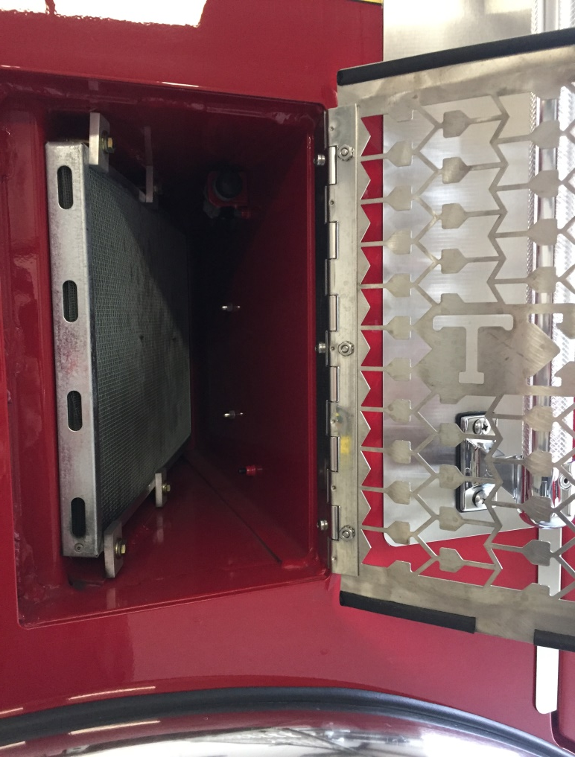
Air Intake

Slide 33
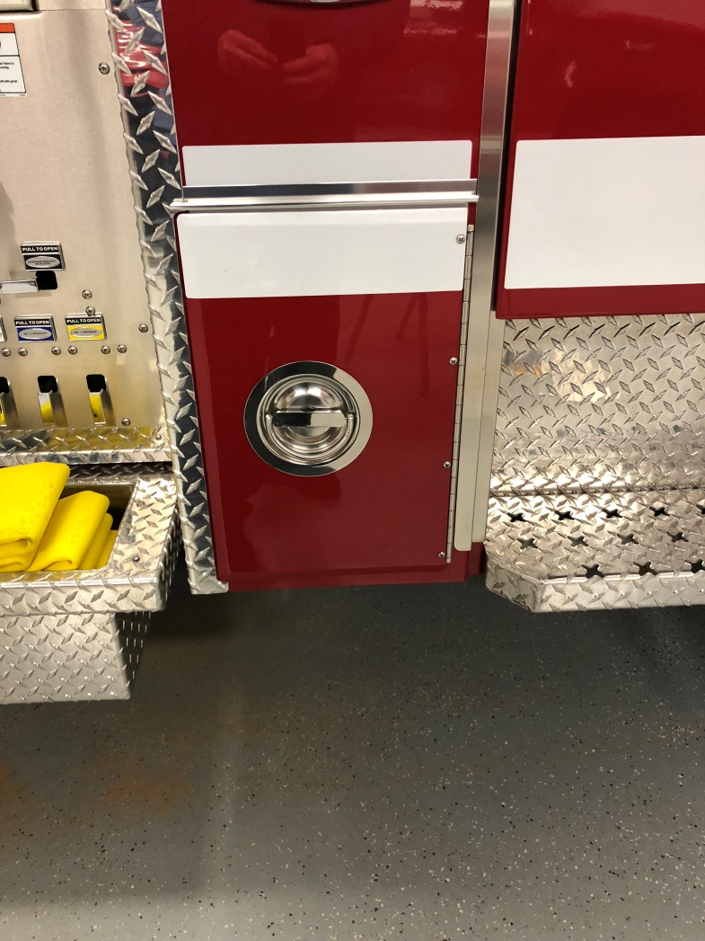
Officers Side Cab Compartment

Slide 34
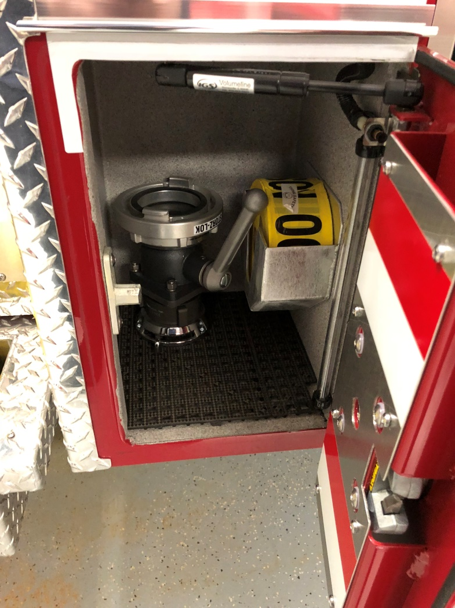
Officers Side Cab Compartment- Open

Slide 35
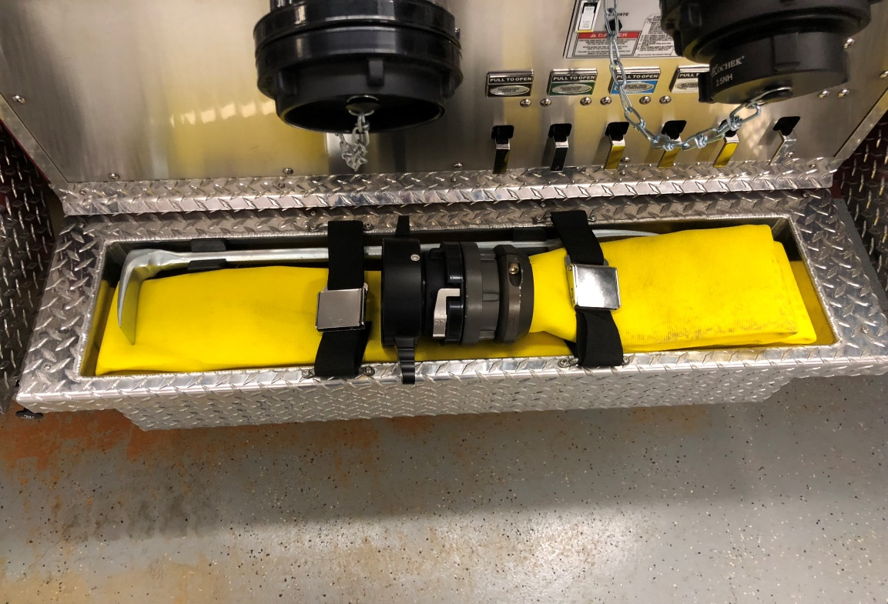
Officers Side Pump Panel
-50’ of 4” hose with Stortz to 4.5” NST for hydrants.
-Officers Halligan bar

Slide 36
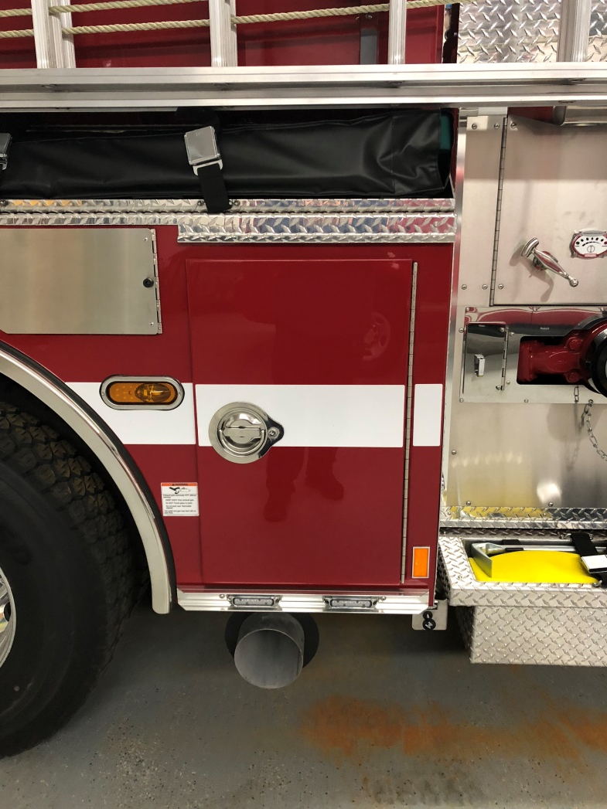
Officers Side Compartment 1

Slide 37
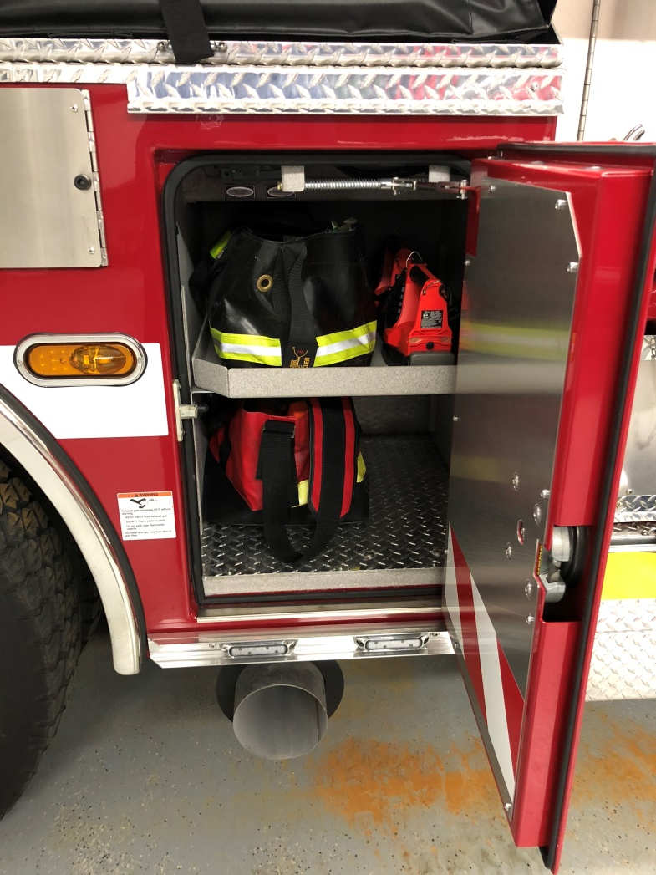
Officers Side Compartment 1- Open
Two LED Vulcans
Metro Bag
Officers Bag (this MUST be taken with the standpipe racks)

Slide 38
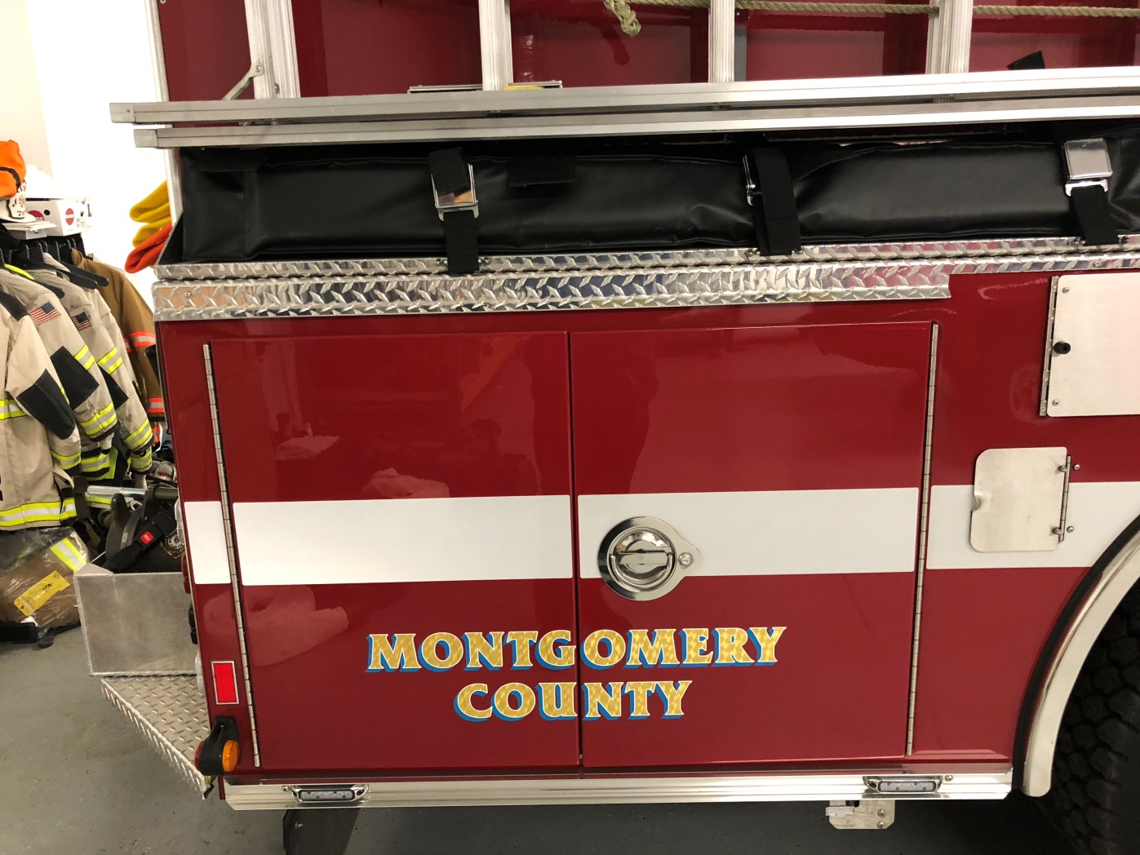
Officers Side Compartment 2

Slide 39
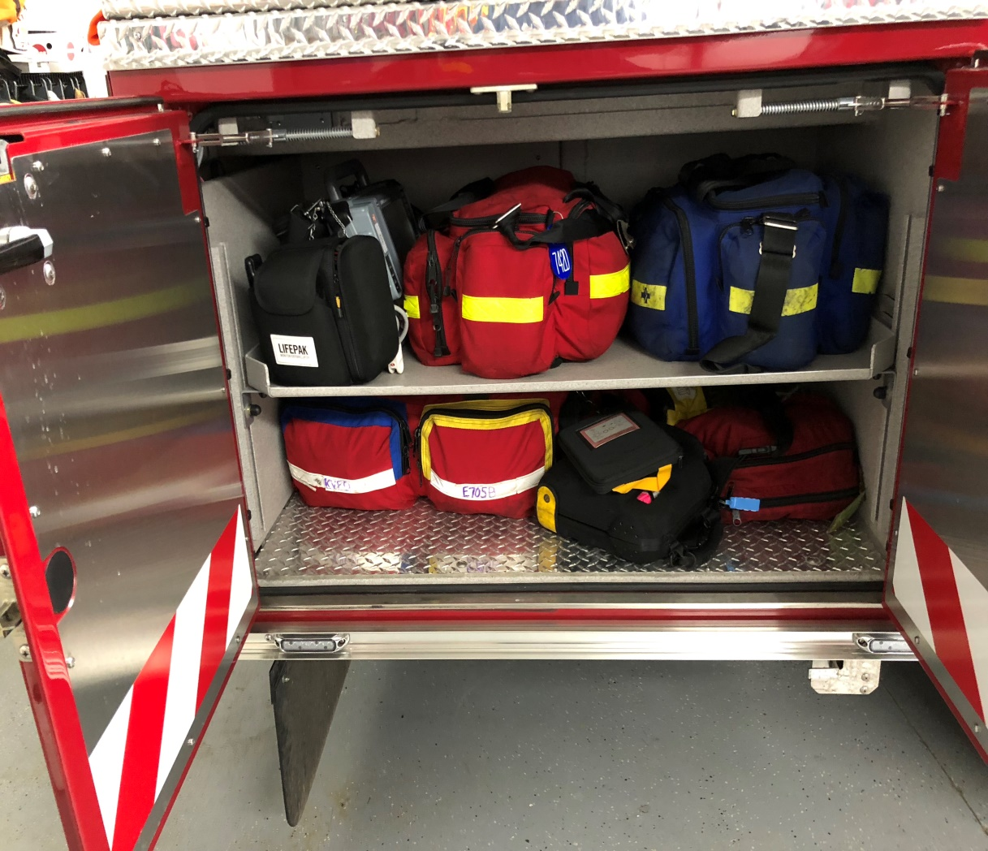
Officers Side Compartment 2- Open
ALL EMS equipment must stay in this compartment. The only exception to this will be the ALS drugs.

Slide 40
Questions?
Contact the following personnel:
  Deputy Fire Chief John “Red” Connell 301-641-1500
  FS05 (Captain Garcia and MFF Oliver)
  Chief Jayme Heflin

