Slide 1
LifePak 15 Damaged/Broken Screens
With new cots going into service, logistics is seeing a trend in broken LifePak 15 screens. This repair is a very time consuming (avg 1-2 hours). The damage is to the actual shell and the components must be removed to complete the repair

Slide 2
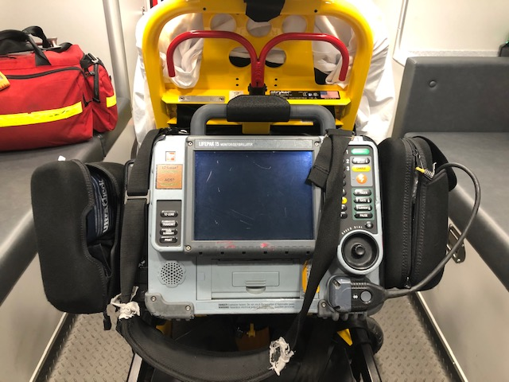
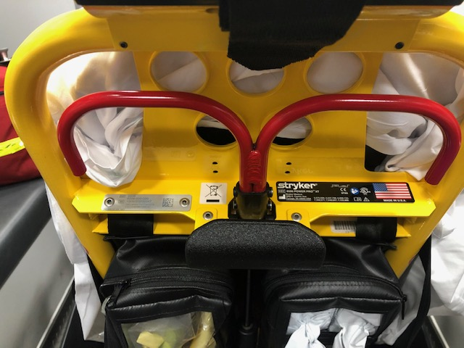
New Stryker Cots The cot back shows how the LP15 hangs off the new cots. The curved hook requires the LP15 to be lifted and rotated in.

Slide 3
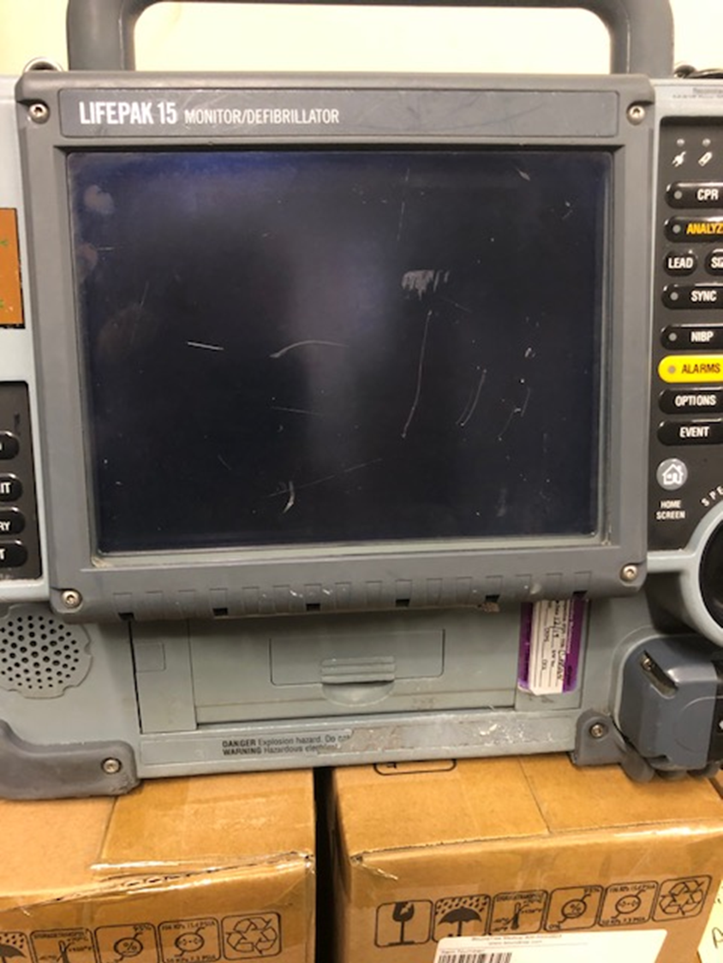
The LP15 screen is not a handle.
The screen is ripping out from the plastic shell or is cracking.
The bottom of the screen is being used as a handle which is causing the damage.

Slide 4
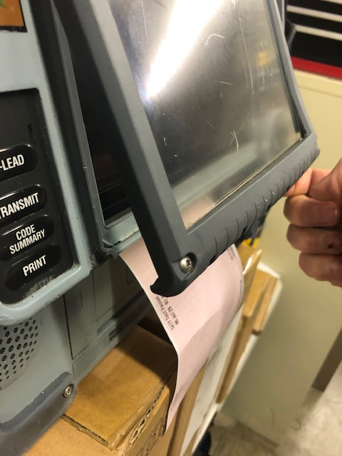
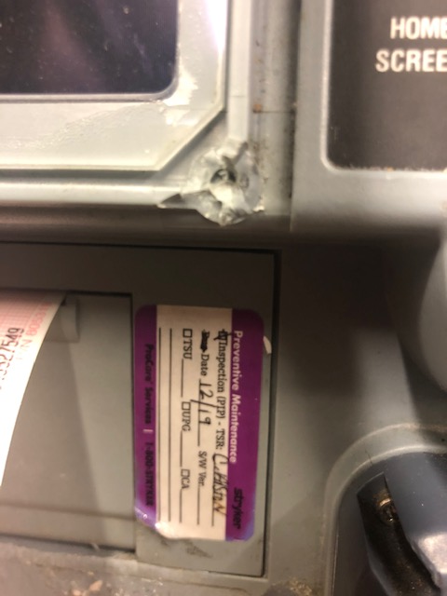
While grabbing the screen seems natural, the screen cover is getting ripped out of the shell. This is misuse and is damaging to the LP15.

Slide 5
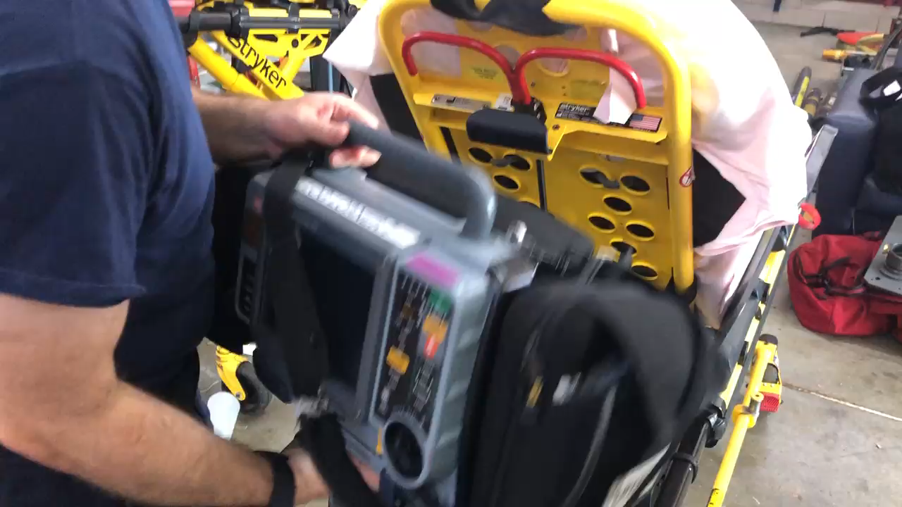
Proper way to Remove LP15 from Craddle

