Slide 1
Safe Transportation of Children in Ambulances

Slide 2
Safe Transportation of Children in Ambulances
Lieutenant Daniel Ballantine
MCFRS Station 31-A
Senior Technician Montgomery County Car Seat Program

Slide 3
Safe Transportation of Children in Ambulances

Slide 4
Safe Transportation of Children in Ambulances
Section #1:
Selection and locations of safety seats in ambulances

Slide 5
Safe Transportation of Children in Ambulances
Objectives:
Students shall be able to identify all appropriate standard inventory equipment that
are carried on Montgomery County Fire and Rescue EMS units, that allows for the
safe transport of children according to Maryland state law and Safe Kids Worldwide.
Students will be able to correctly identify the safest and most appropriate locations
for transporting children in the back of a Montgomery County Fire and Rescue EMS
unit according to Maryland State law and Safe Kids Worldwide.

Slide 6
Safe Transportation of Children in Ambulances
Maryland’s Child Passenger Safety Law (Effective October 1, 2012)
• Every child under 8 years old must ride in an appropriate child restraint* unless the child is 4 feet, 9 inches or taller.
• Every child from 8 to 16 years old who is not secured in a child restraint must be secured in a vehicle seat belt.

Slide 7
Safe Transportation of Children in Ambulances
National Highway Transportation Safety Administration conducted research of
Ambulance crashes over the past 20 years:
National average- 1500 Ambulances involved in collisions
29 of those collisions involved a fatality
46% of the injured were in the rear of the ambulance
EMSWorld.com (2015) A National Perspective on Ambulance Crashes and Safety.
Retrieved from file:///C:/Users/Morganliz/Documents/EMSWorldAmbulance
CrashArticlesSept2015.pdf

Slide 8
Safe Transportation of Children in Ambulances
“Of the Ambulance occupants who received fatal and incapacitating injuries,
Those in the rear compartment were most at risk, especially those who were
Unrestrained or improperly restrained”
Bull, M. J., Talty, J., Weber, K., & Manary, M., (n.d.) Crash Protection for Children in Ambulances.
Retrieved from file:///C:/Users/Morganliz/Documents/Crashprotectionambulance.pdf

Slide 9
Safe Transportation of Children in Ambulances
“In another study observations of over 200 Ambulances arriving at a
Large pediatric emergency department documented minimal if any effective
Use of restraints for child occupants, who were being transported by gurneys,
Bench seats, and adult laps as well in wheel chairs. Also noted was the potential
For injury from unrestrained equipment or other passengers. (Bull et al., nd)
Bull, M. J., Talty, J., Weber, K., & Manary, M., (n.d.) Crash Protection for Children in Ambulances.
Retrieved from file:///C:/Users/Morganliz/Documents/Crashprotectionambulance.pdf

Slide 10
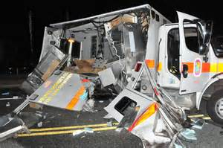
Safe Transportation of Children in Ambulances

Slide 11
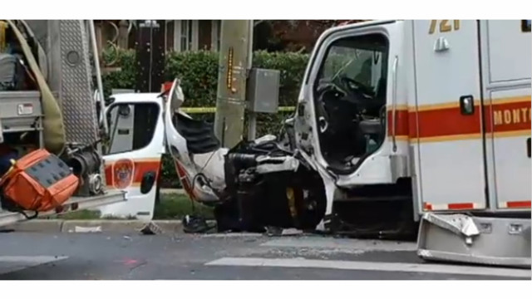
Safe Transportation of Children in Ambulances

Slide 12
Safe Transportation of Children in Ambulances
Child Passenger safety devices carried on Montgomery County EMS units
Convertible Car Seat
Integrated Harness in Captains Chair
Ferno Child Harness System

Slide 13
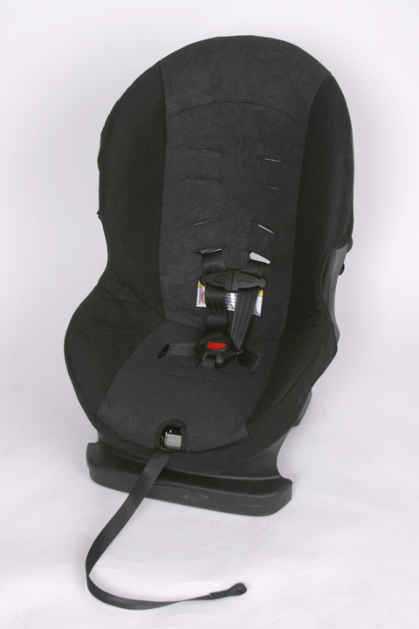
Safe Transportation of Children in Ambulances
Evenflo Titan 50 Car seat
5-50lbs and 54”
Fully adjustable
Installation on cot and bench
Highest rating
*when both belts used and cot head elevated

Slide 14
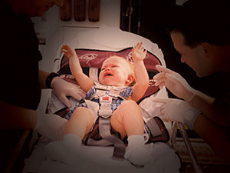
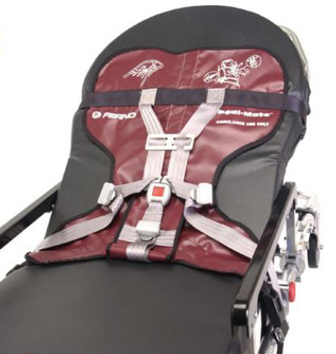
Safe Transportation of Children in Ambulances
Ferno Pedi-Mate Restraint System
10lbs - 40lbs limit, no height given
More provider friendly for patient care
Rolls up for storage
Easier to clean
Lowest rated

Slide 15
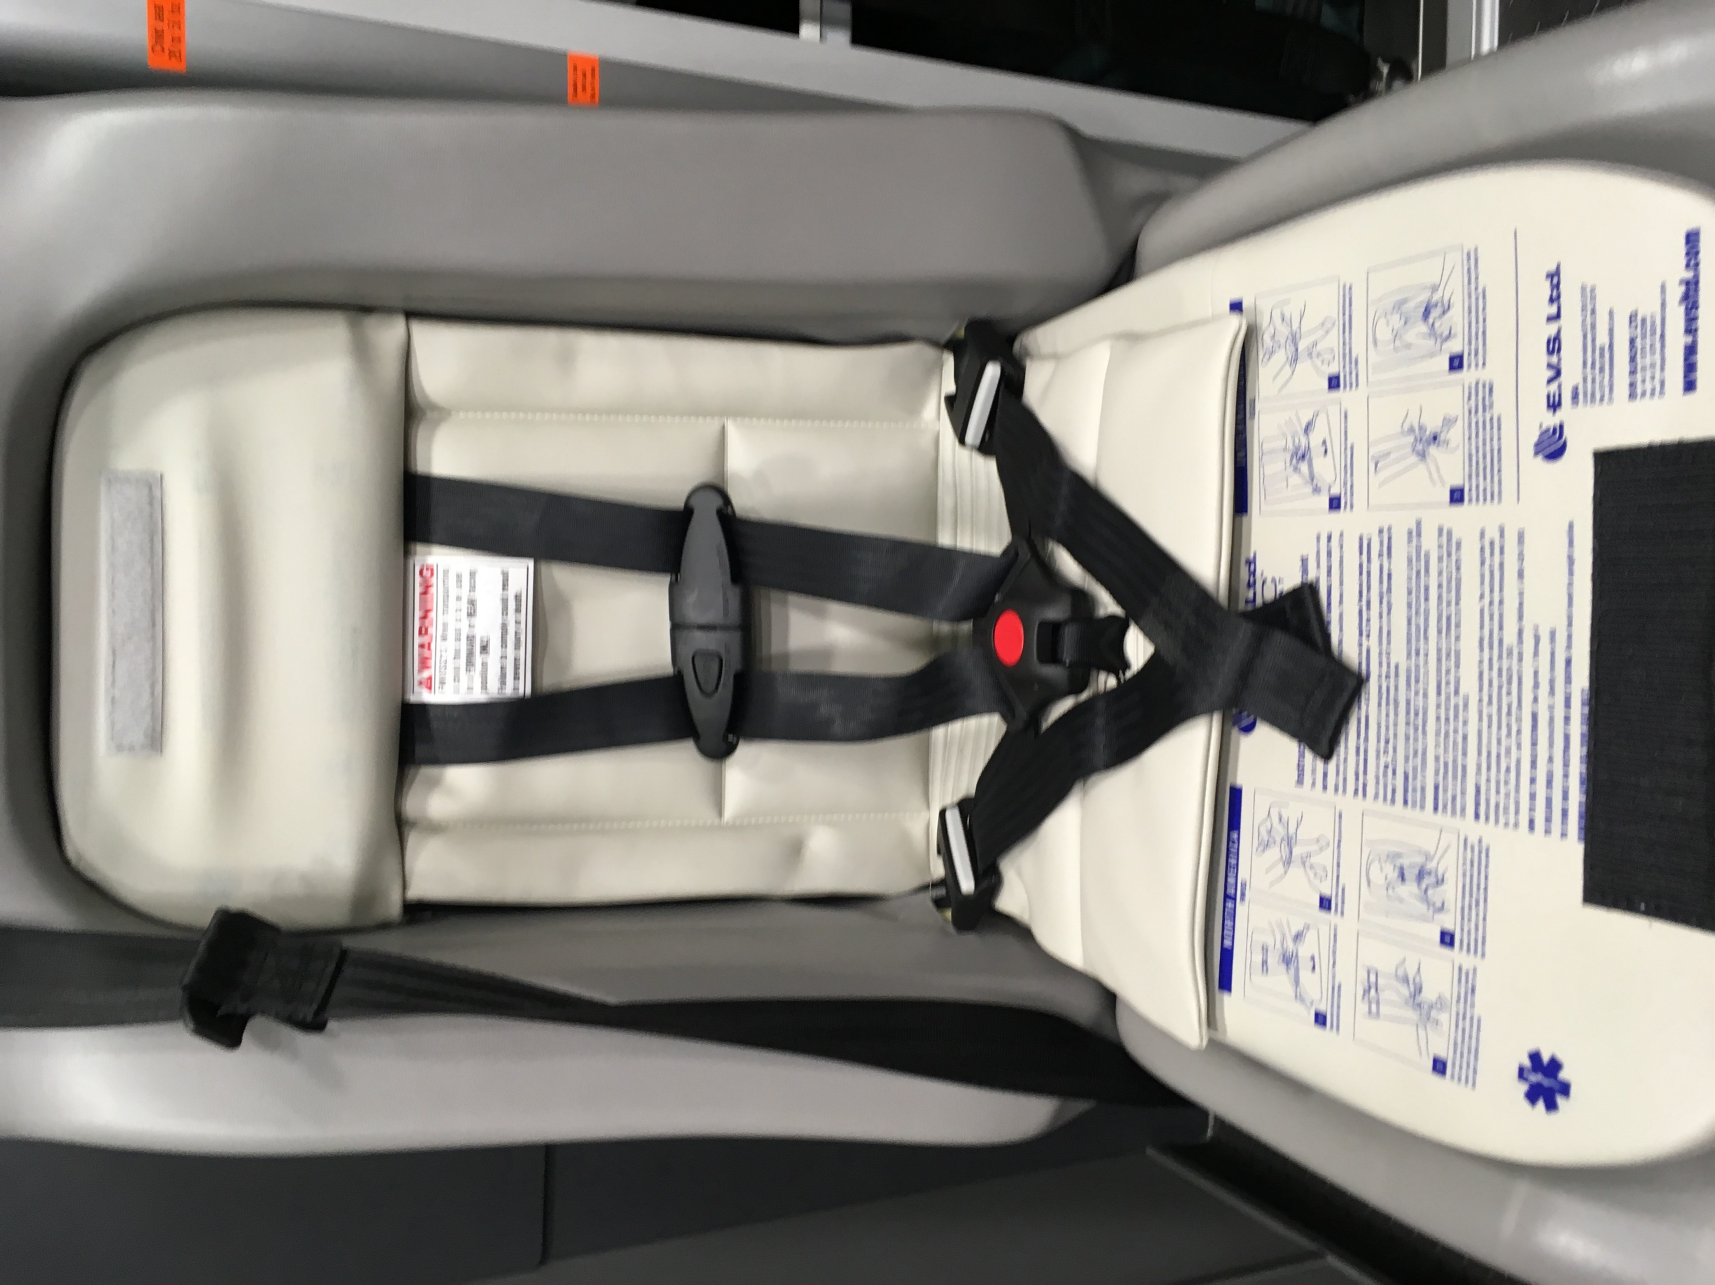
Safe Transportation of Children in Ambulances
Integrated Car Seat
20-50lbs and 28-47 inches
Easiest to use
Quickest to set up
Harder for provider to perform
patient care

Slide 16
Safe Transportation of Children in Ambulances
Safest locations for Children in Ambulances
Ambulance Cot
Captains Chair
Far Right of the Bench Seat

Slide 17
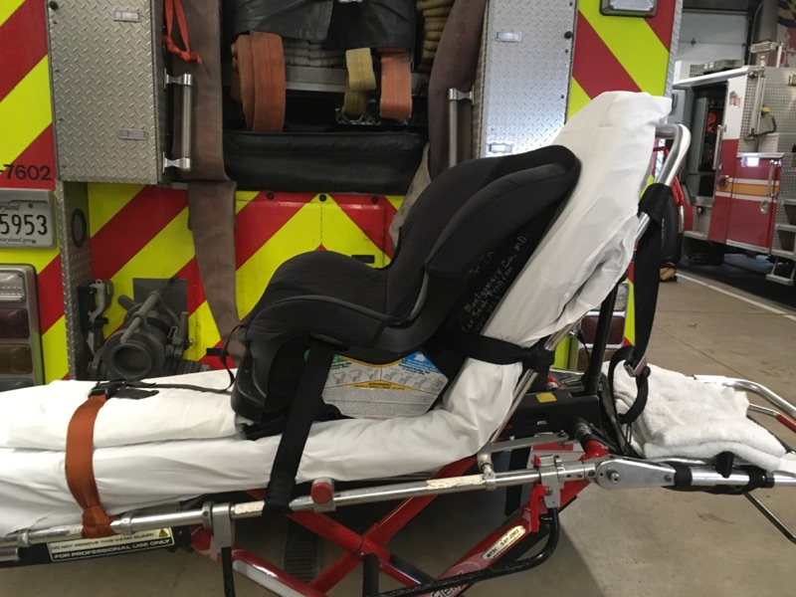
Safe Transportation of Children in Ambulances
Ambulance Cot
Most secure way to mount seat
Highest rated
Do not have to remove child to bring
Into ED
Provider can access the patient
Takes the most time for set up
May have to move waist belt

Slide 18
Safe Transportation of Children in Ambulances
Captains Chair
No installation need
Quick adjustment
Limited size range
Unable to install car seat with
provided lap and shoulder belt

Slide 19
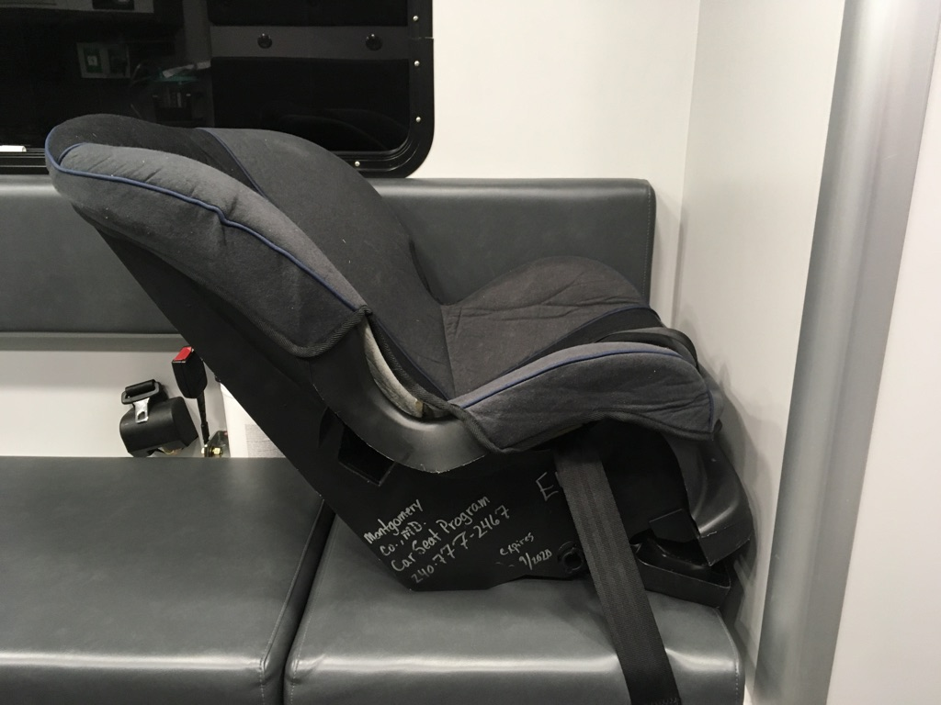
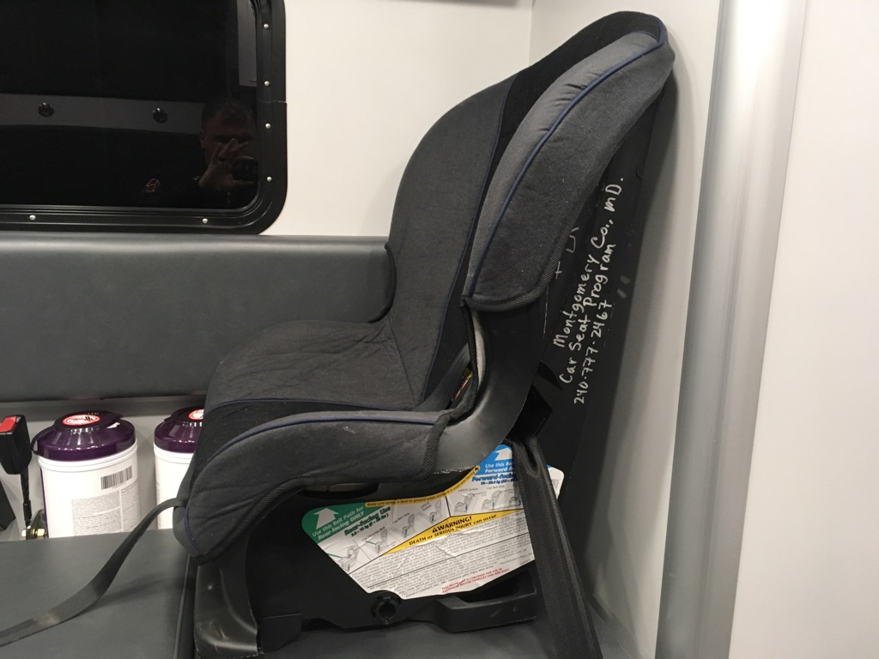
Safe Transportation of Children in Ambulances
Bench seat
Able to install FF or RF
Quicker install – Single belt
Frees up cot for another
patient
Only if there is nothing mounted
on wall behind seat
Child turned from you

Slide 20
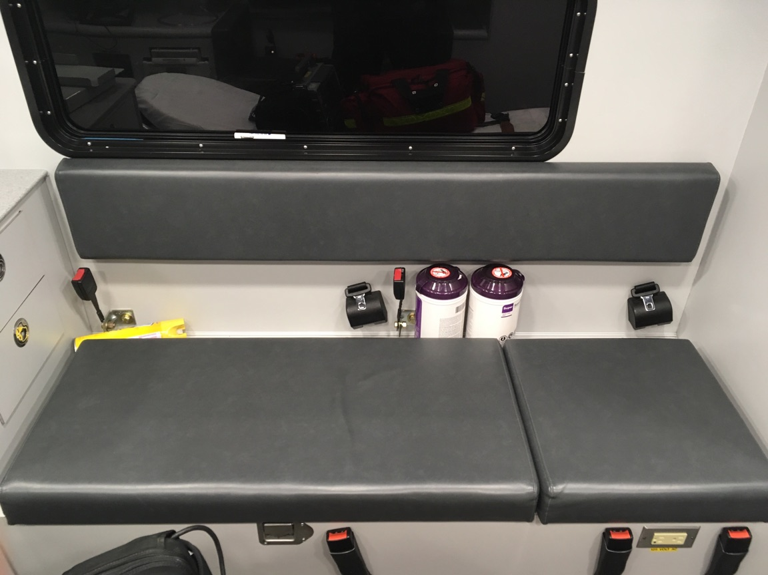
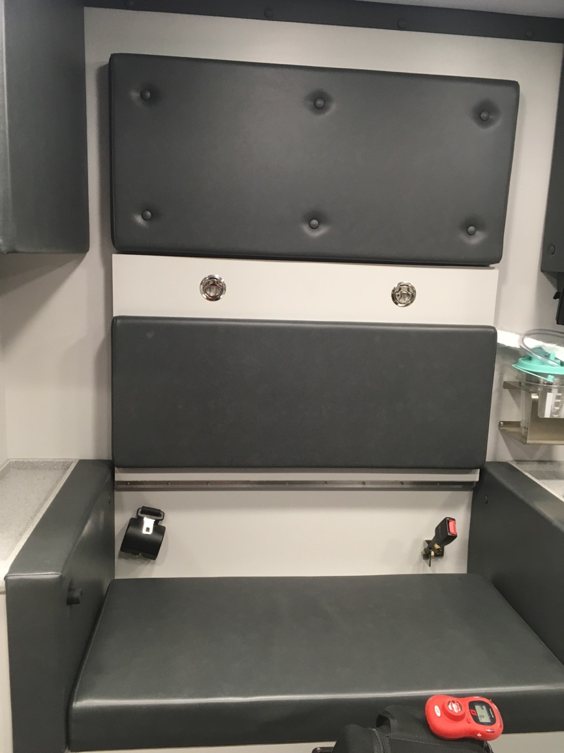
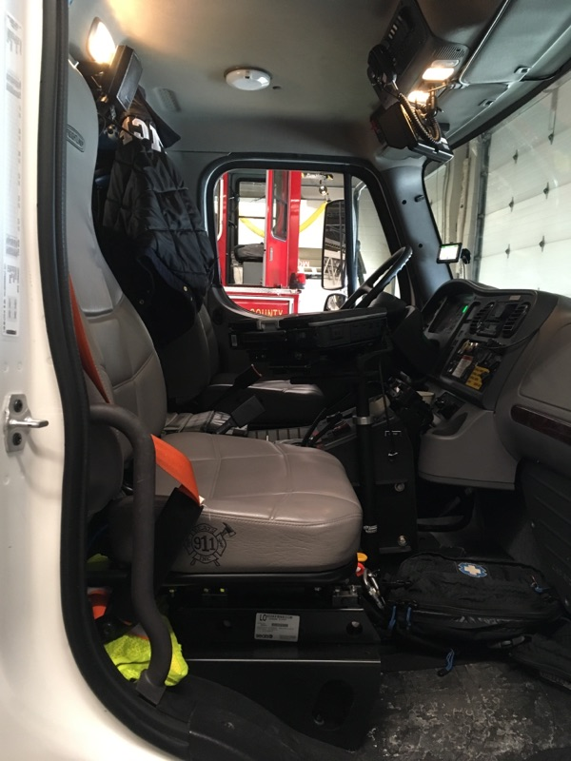
Safe Transportation of Children in Ambulances
Not approved locations
Middle of bench
CPR Seat
Front Seat

Slide 21
Safe Transportation of Children in Ambulances
Review:
How many belts should be used while installing a car seat on the cot?
What are the three approved child safety devices on a MCFR Ambulance?
Name two places that a car seat can not be installed in a MCFR Ambulance?

Slide 22
Safe Transportation of Children in Ambulances
Section #2:
Adjustment, usage, and installation of child safety device

Slide 23
Safe Transportation of Children in Ambulances
Objectives:
Students will be able to demonstrate how to properly adjust the child safety devices for the size of the child according to the recommendations of manufacturer and Safe Kids.
Students will be able to demonstrate how to correctly install and use the appropriate child safety devices provided by MCFRS in an EMS unit according to COMAR, Maryland Law, and Safe Kids recommendations.

Slide 24
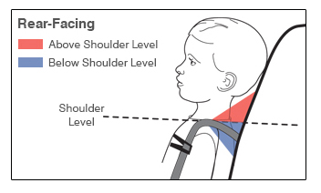
Safe Transportation of Children in Ambulances
Measuring and adjusting the harness height on the car seat
Harness slots

Slide 25
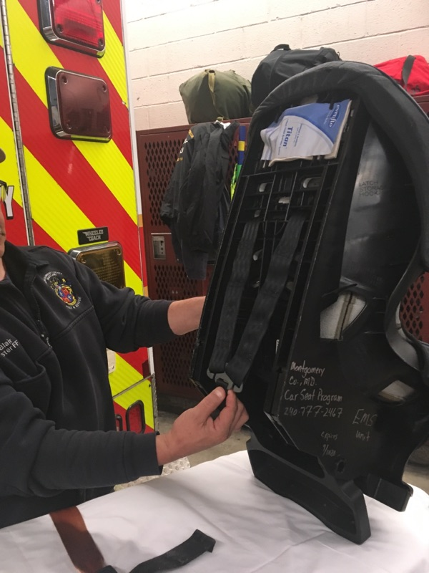
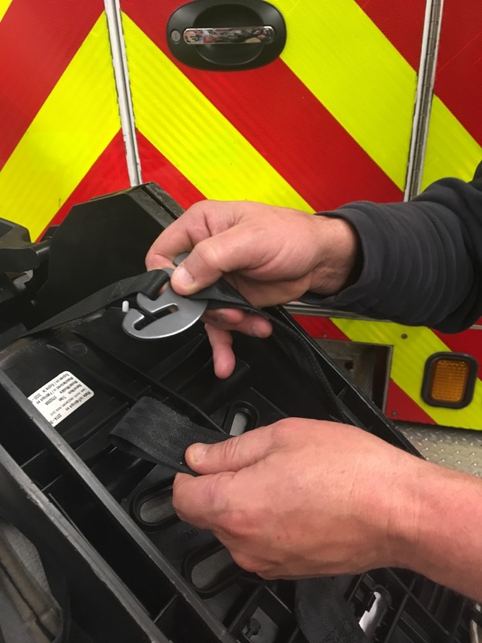
Safe Transportation of Children in Ambulances
Splitter plate
Removing Harness
Locate the harness straps to the rear of the car seat. Remove the harness from splitter plate. Relocate the harness and re-attach.

Slide 26
Safe Transportation of Children in Ambulances
Adjustment Practical: 5 minutes

Slide 27
Safe Transportation of Children in Ambulances
Installing a car seat on cot

Slide 28
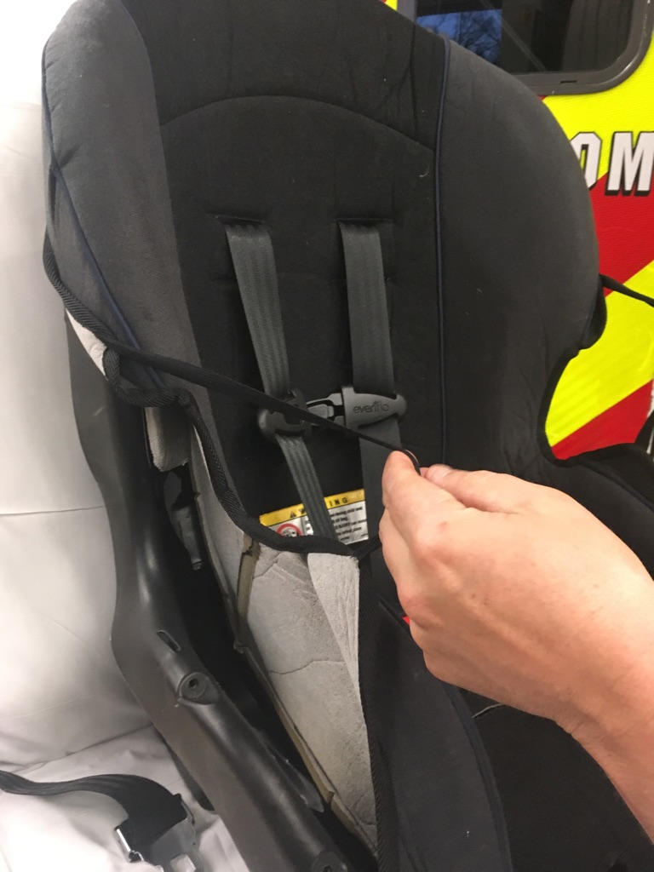
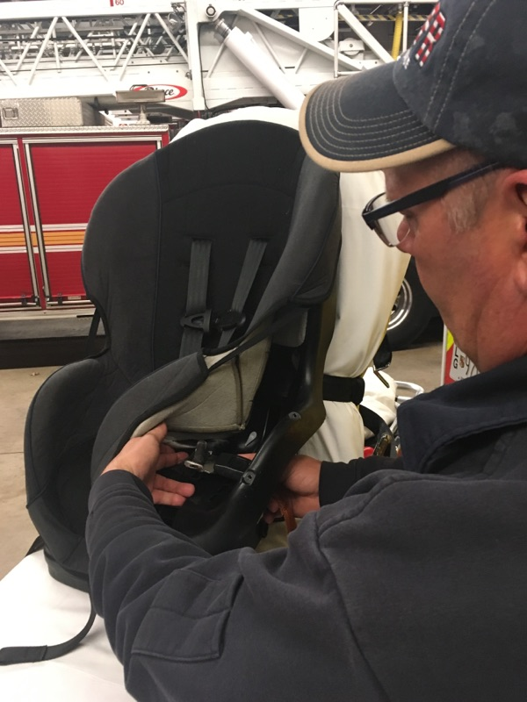
Safe Transportation of Children in Ambulances
Run belts through belt paths and tighten
Peel back cover

Slide 29
Safe Transportation of Children in Ambulances
Cot head raised
Both belts used for installation

Slide 30
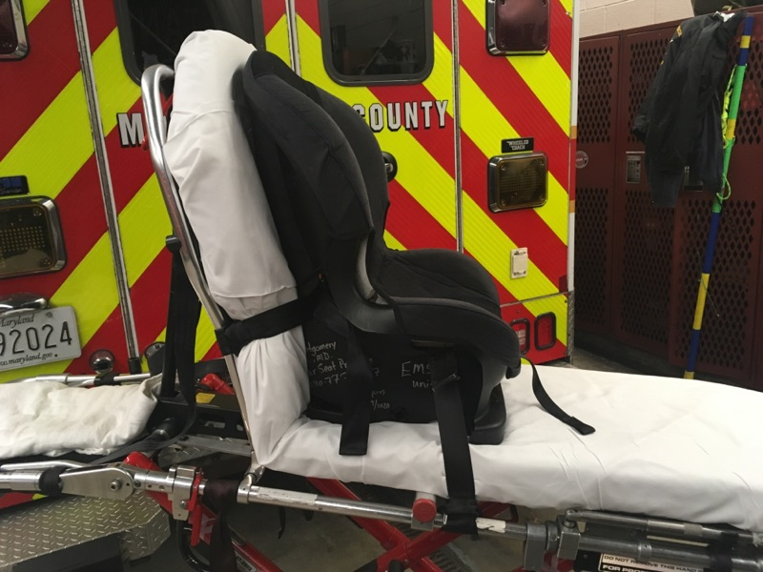
Safe Transportation of Children in Ambulances
Reclined for under two years Upright for over two years

Slide 31
Safe Transportation of Children in Ambulances
Car seat installation practical: 5 minutes

Slide 32
Safe Transportation of Children in Ambulances
Installing and usage of a Ferno Pedi-Mate

Slide 33
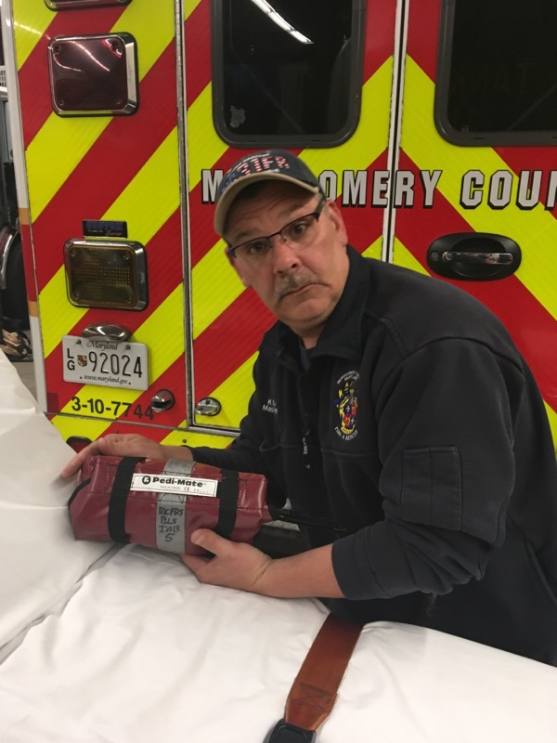
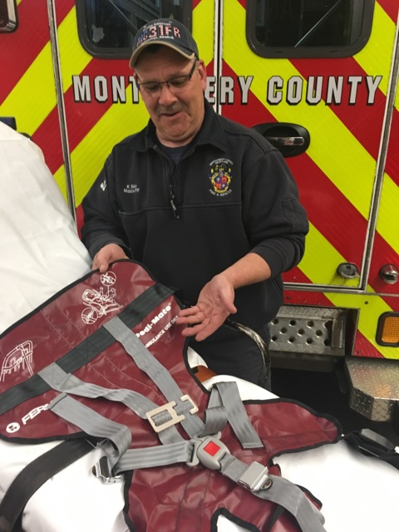
Safe Transportation of Children in Ambulances
Locate it
Unroll it

Slide 34
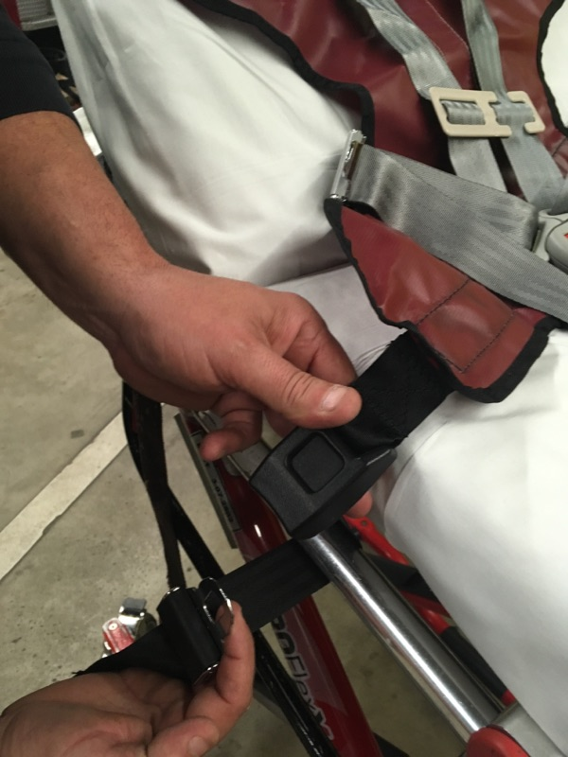
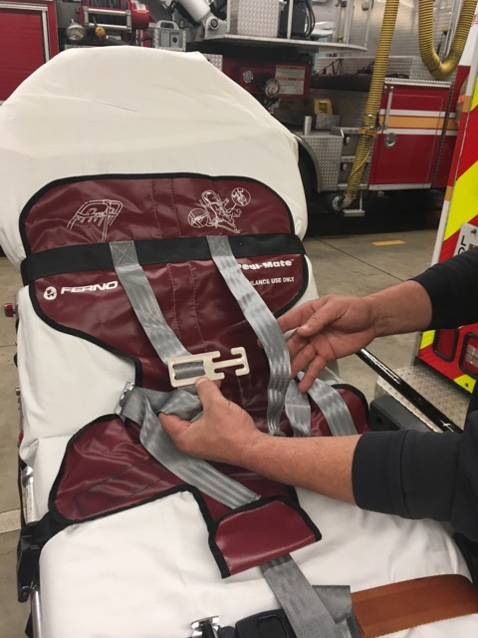
Safe Transportation of Children in Ambulances
Buckle it
Release Harness

Slide 35
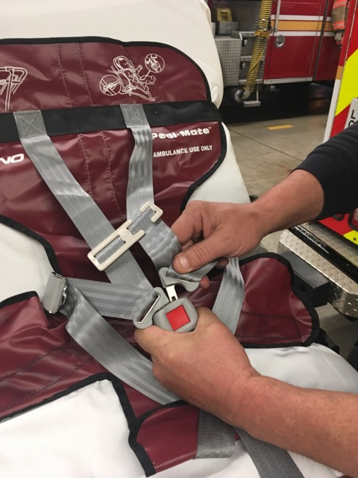
Safe Transportation of Children in Ambulances
Thread the chest clip
Adjust harness at the hip buckles
Adjust buckle adjustment
Ensure harness is 1” or less
Adjust chest clip
Retainer clip
Harness Adjustment
Buckle

Slide 36
Safe Transportation of Children in Ambulances
Ferno Pedi-Mate installation practical: 5-minutes

Slide 37
Safe Transportation of Children in Ambulances
Integrated Car Seat on
Captain’s Chair
Chest clip
Harness Adjustment
Harness adjustment

Slide 38
Safe Transportation of Children in Ambulances
Questions:
How many seatbelts are required for installation of the car seat on an
ambulance cot?
At what age does the car seat no longer need to be reclined?
Where does the Harness retainer clip (chest clip) have to be positioned?

Slide 39
Safe Transportation of Children in Ambulances
Questions?

