Slide 1
INLAND WATER RESCUE

Slide 2
What are We Covering
IOSR
Types of Water
On Scene Operations
Levels of Certification
PPE
What do I do now?
Lessons Learned

Slide 3
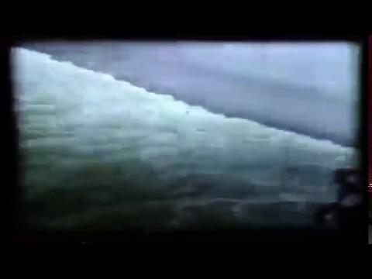
Water hydraulic and Lowhead Dams

Slide 4
Types of Water
Swift, Flat, Flood, and Ice
Types of Water Environments
  Flat
  Swift
  Flood
  Ice
Characteristics of Floods
  Flash
  River
  Urban

Slide 5
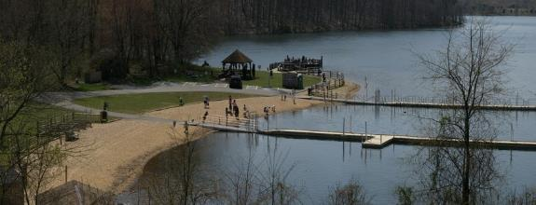
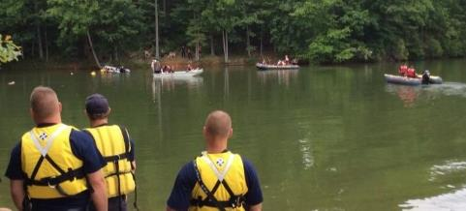
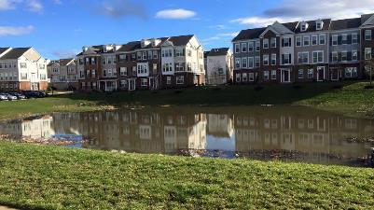
Types of Water
Flat/Static Water
Flat/Static Water
A body of water that does not travel in a specific direction
May be fed by alternate ground sources
Examples include: ponds, lakes, reservoirs, storm water retention ponds, and quarries
Black Hills Regional Park
Residential Sedimentation Pond
Tridelphia Reservoir

Slide 6
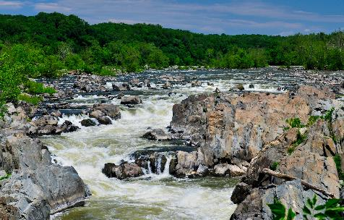
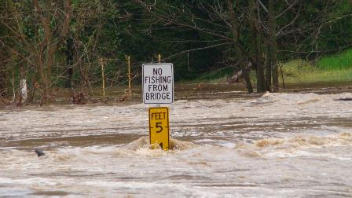
Types of Water
Swift Water
Swift Water
Predominantly predictable when not flooded
Any body of water with a consistent direction of flow
All moving water can be considered Swiftwater

Slide 7
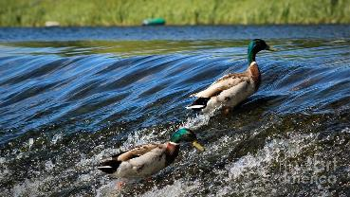
Swift-Water - Defined
NFPA 1670 – When water flows faster than 1.14 mph it is considered to be "moving" water or Swiftwater
  Average human walks 3 mph
  Water doesn't have to be travelling very fast at all to be considered "moving" water
Flood water can usually be classified as moving or swiftwater
If you have to move more quickly than a very slow walk, it is probably Swiftwater.
Be aware of the velocity of the water.
  Michael Phelps cannot make progress against a 2 knot current (2.3 MPH)
Source - Raven Rescue, ltd.
Notes:
Reiterate who can enter swiftwater

Slide 8
Types of Water
Flood Water
Flooding
Flooding in urban areas can be caused by Flash, Coastal, or River Floods
Urban flooding is specifically caused by lack of water drainage
There is little open soil that can be used for water storage
Nearly all the precipitation needs to be transported on the ground surface water or the sewage system
In any flooding situation you must wear a dry suit to keep contaminants off your body.

Slide 9
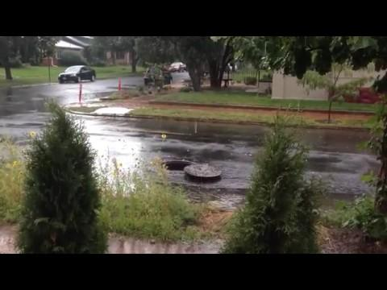
Types of Water
Flood Water - Urban Floods
Urban Flood
High intensity rainfall can cause flooding when the city sewage system and draining canals do not have the necessary capacity to drain away water volume
Water may even enter the sewage system in one place and then get deposited somewhere else in the city on the streets.

Slide 10
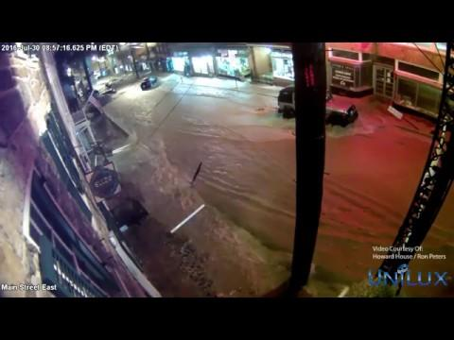
Types of Water
Flood Water - Flash Floods
Ellicott City Flash Flood 1 (Time Lapse)
Raining at 7:44 PM
Volume picks up at 7:50
Flooded at 7:55
Impassable at 8:00
Receding at 9:00
People emerge at 9:15
Water completely receded by 9:30

Slide 11
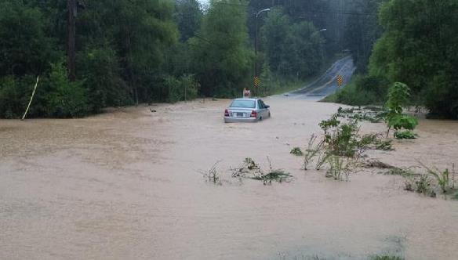
Consequences of Urbanization
Storm Water Management and Urban Sprawl
Flooding has Become More Frequent and Intense in 40 Years
  Urbanization generally increases the size and frequency of floods
  Volumes of large floods have increased by 100%
  Small flood volume increased 200%
Contee Road in Laurel, MD

Slide 12
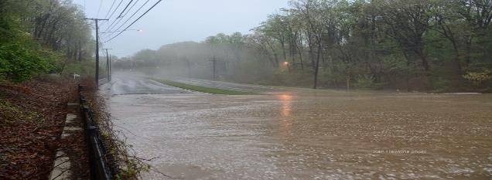
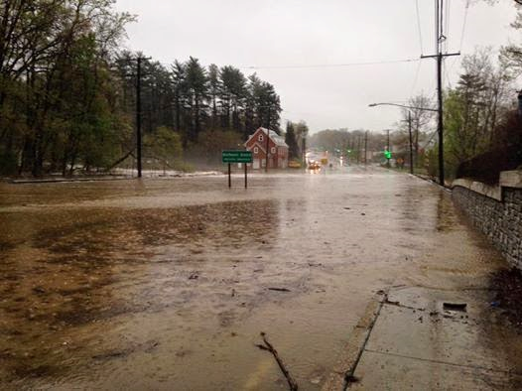
We Are Experiencing More Frequent and Intense Flooding in MoCo
The DC Metro Area is urbanizing the landscape
  Removing vegetation and soil, grading the land surface, and constructing drainage networks increase runoff to streams from rainfall and snowmelt
  Northeast branch of the Anacostia River in Maryland
    Flooding volume has increased 600% since the year 1950
Route 29 at Northwest Branch
Notes:
What does this mean for your running routes?
Commuting traffic?
Is the bridge safe to cross after the water recedes?

Slide 13
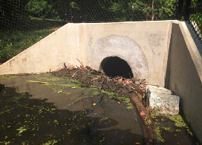
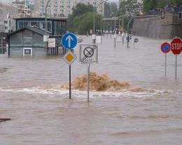
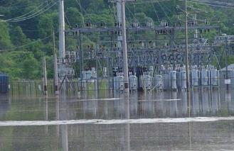
Flood Hazards for Rescuers
Objects Moving in Water
  Panicked swimmers
  Vehicles
  Trees
  Propane tanks
  Animals
  Clothing
Stationary Objects
  Signs, poles and fire hydrants
  Manholes
  Picnic tables
  Intake and culvert pipes
  Vehicles
  Guard rail, fencing and barbed wire
  Structures
  Utilities (power lines, gas service lines, etc.)
  Sloped shoreline, undercut objects and other items that could entrap

Slide 14
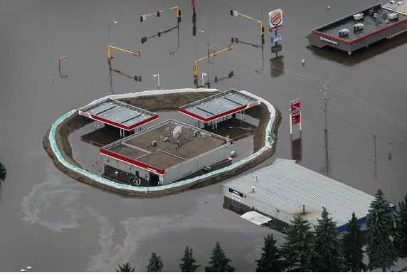
Hazardous Materials / Biological Hazards
Various chemical and biological waste products
Saturated ground, the overwhelming of sewage and septic systems, or industrial run-off
Rescuer contamination is always a consideration when entering FLOOD water
  Gross decontamination should be performed after each entry
  Completion of exposure reports are recommended for all entries into flood waters.

Slide 15
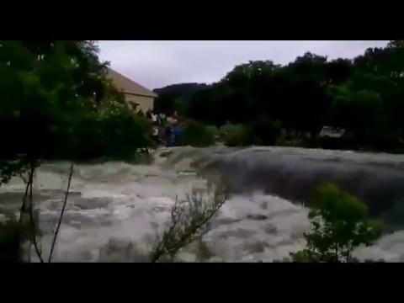
What Do I Do With This?
Don’t Drive on Flooded Roads
6” Water – Lose steering control
12-24” Water – Swept away
What do you do if you pull up to this?
How can you intervene, and how do you communicate what you are seeing to other units?

Slide 16
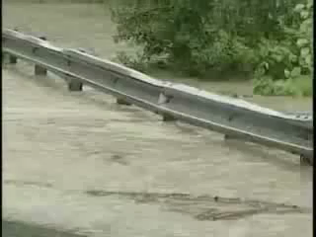
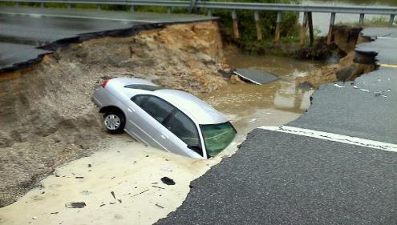
Beware of Flooding Creeks
- is that road washed out?
Roads Wash Out, and People Deposit Their Automobiles…
What do you do stop people from driving over this?
Notes:
What do you do stop people from driving over this?
We saw in Houston that people drive around barricades
This picture is from Charles County. The person drove in after the road washed out.
Ask the group if they would drive over the road in apparatus at various points in the video

Slide 17
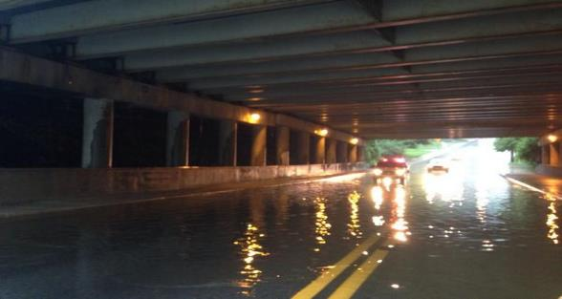
Locations Where Water Emergencies develop
There are very few water features in Montgomery County that have not been adapted by human engineering
Conventional Locations
  Low lying land or flood planes
  Streams and rivers
  Lakes, ponds and reservoirs
Manmade Features
  Residential neighborhoods
  Commercial properties
  Lakes, ponds and reservoirs
  Storm water retention ponds
  Roadways and bridges
  Low head dams
  Spillways and flood control channels
  Abandoned rock quarry which has filled with water
Rock Creek Park at Cedar Lane
Notes:
Is this still water?
Is it less than 18 inches deep?

Slide 18
Initial Response Operations
  No personnel shall be in, on or over the water while wearing structural firefighting gear.
  Ensure all responders are in proper PPE and flotation devices.
  Conduct upstream and downstream recon to identify hazards.
  Maintain awareness of the hazards in and around the incident location.
  Position upstream spotters to identify surface loads and debris.
  Position downstream safeties to ensure a back up plan.
  Spotters must work in Teams of at least 2 personnel

Slide 19
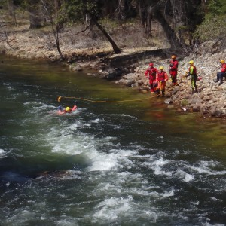
Zones
  Cold Zone –greater than 10 feet from the water. Any untrained personnel operate in the cold zone.
  Warm Zone –within 10 feet of the water. This area is also dangerous and PFD’s are required. Operations Level personnel and below operate in the Warm Zone.
  Hot Zone –in or over the water. This is considered the IDLH and PFD’s are required. It is recommended that only Swift Water Technicians operate in the Hot Zone.

Slide 20
Scene Size Up and Communication
Initial On-Scene Report/LCAN
  First arriving unit On Scene Report
  Confirmation of incident location
  Condition of water/type, hazards
  Number of people
  Best access and staging location
  Actions (water line, safeties, spotters?)
  Actions taken or needed to control access to the scene
  Establish command

Slide 21
Size Up Considerations
  Mark the water level and continual check to determine rise or fall
  Units should provide orientation during a water rescue incident based on direction of flow
  Determine location, number, and condition of victims
  Securing witnesses who may have valuable information on victim location
  Determine if this is a rescue or a body recovery
  Consider what will happen if responders do nothing and wait for water to recede
  Call for additional and specialized resources needed to accomplish the objectives

Slide 22
Water Rescuer Mentality and tactics
Risk/Benefit Analysis to Determine if Rescue or Recovery
  Risk Benefit – Rescue or Recovery?
  Victim recognition – Assess the patient’s physical and mental status to determine if they can self rescue or if of they need to be rescued.
  Victim viability – determine when the victim was last seen, how long they have been submerged and what is the water temperature.
  Hazards and environmental factors which can jeopardize rescuers.
  What factors will hinder or ease access to the victims?
  What is the training and experience of on-scene personnel?
  What are your on scene resources and what resources are enroute?

Slide 23
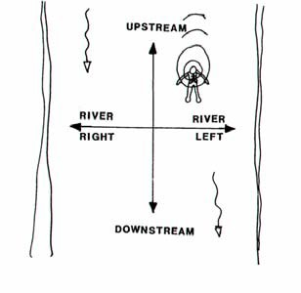
Use Common Terminology
Identifying Locations On The Water
River Left: The left side or river bank, looking down stream.
River Right: The right side or river bank, looking down stream.

Slide 24
  First Arriving Unit Considerations
Do I see a victim, and are they in immediate distress?
  Based on my training and experience, do I need to act immediately, or assemble comprehensive resources
Can I assemble a timeline of events that will help clarify the situation?
  How long has the person been missing, when were they last seen?
If I can not see a victim, are there visual or circumstantial clues?
  Footprints – animal or human?
  Personal effects in or near the water?
Are there reliable witnesses available?
  Ask them to remain on scene, interview them as time permits

Slide 25
Water Rescuer Mentality and tactics
Situation Update Report (SUR)
  SUR – Based on Size Up and Risk Assessment
  Confirmation and condition of victims in the water.
  Confirmation on the number of victims in the water, if possible?
  Is the water moving, how fast and in what direction if it flowing?
  Access points down/up stream.
  Conditions, actions and needs.
  Establish warm zone if possible.

Slide 26
  Interviewing Witnesses
Who
  Witness and victim name
  Clothes information – type, color. May be useful in determining victim buoyancy
  How many victims
  Did they appear to be able to swim at all, Disabilities
Where
  Attempt to interview witnesses at the same location where they observed the event
  Mark entry locations, and identify the victim(s) Point Last Seen (PLS)
  Interviewers are one part coach, one part psychologist, and two parts active listener
  Be cautious not to ask leading questions

Slide 27
  Interviewing Witnesses
How
  Was the victim struggling or swimming
  Were they ever yelling for help – this may suggest swimming ability
  How long did they struggle
  Did everything seem fine, and then the victim disappeared?
    Suggests possible medical episode
When
  How long ago
  Did the witness have to leave to get help and then return
  When possible, record witness remarks on paper so information is not lost or distorted.
  Consider all drownings to be crime scenes

Slide 28
Water Rescue Certification Levels
Awareness
Water Rescue Awareness Level
Does not include a manipulative skill component
Awareness personnel are not intended to perform in the capacity of rescuers
Objectives are to develop “Knowledge” competencies within the following subject areas:
  Scene Assessment and Size up
  Site Control and Scene Management
  Hazard Recognition and Mitigation Procedures
  Activation procedures for full water rescue response
Awareness Level members may only operate in the cold zone

Slide 29
Water Rescue Certification Levels
Operations
Water Rescue Operations Level
Builds on Awareness Level Knowledge
Develops skills required to safely perform as a shore-based rescuer
Operations personnel are limited to lower risk tasks and can operate in the warm zone
Operations personnel are capable having been trained and tested in the techniques of water self-rescue
Operations Level Training includes:
  Shore and boat Based Rescues
  Technical Rigging
  Victim Care and Packaging
  Transfer of Incident Information
  Scene evaluation

Slide 30
Water Rescue Certification Levels
Technician
Water Rescue Technician Level
Builds on Operations Level Knowledge
Trained to apply a full range of knowledge and provide the skills necessary to perform high risk tactics at water rescue incidents involving vehicles such as boats and helicopters.

Slide 31
Water Rescuer Mentality and tactics
Land Based Rescue Options – Yell!, Reach!, Throw!
Whenever possible, start your rescue from the land
Yell! Reach! Throw!
Yell!
  If you arrive to a viable victim, make verbal contact, and do not lose it
  Be forcefully positive and encourage them like a coach
  Your words of encouragement can be a lifeline!
  If staffing permits, assign one person to maintain continuous verbal and visual contact
  Coach them to self-rescue or to NOT GIVE UP!
Notes:
They will be in fight or flight, compensated shock and exhausted

Slide 32
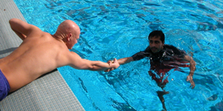
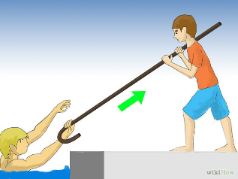
Water Rescuer Mentality and tactics
Land Based Rescue Options – Yell!, Reach!, Throw!
Reach
  Safest way without entering the water
  Pike poles – holding a 12’ pike straight out is hard
    Could consider strapping PFD to pike pole
  Inflated fire hose
  You are only limited by your common sense and imagination
    Look around the scene for options.
    Your creativity could save a life
  Be prepared for them to “pull back” if they grab your reach
    Do not fall in the water

Slide 33
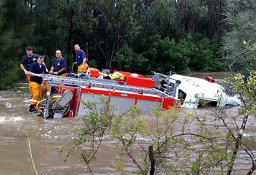
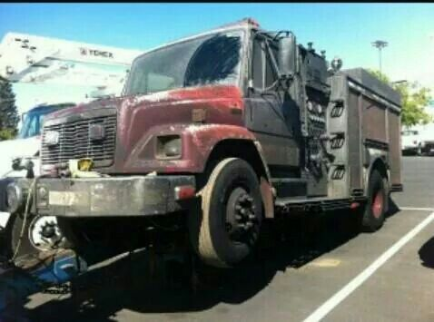
Water Rescuer Mentality and tactics
Land Based Rescue Options – Yell!, Reach!, Throw!
Reach (Con’t)
  Do Not Drive Fire Apparatus Into Water

Slide 34
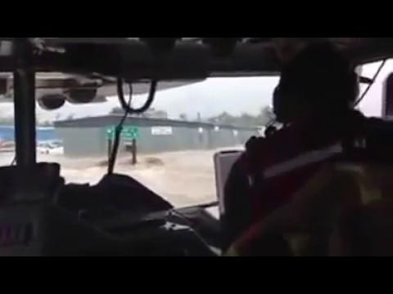
Water Rescuer Mentality and tactics
Land Based Rescue Options – Yell!, Reach!, Throw!
Reach (Con’t)
  Do Not Drive Fire Apparatus Into Water
  What are the risks here?
  How could this tactically fail, or be successful?

Slide 35
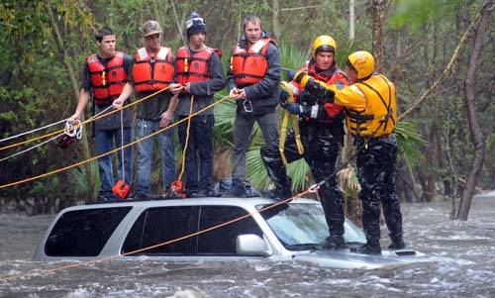
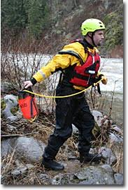
Water Rescuer Mentality and tactics
Land Based Rescue Options – Yell!, Reach!, Throw!
Throw
  Use throwbags
  May connect to flotation and send out
  Belay the rope, use a fixed object if needed
  Don’t get pulled in
  Wear your helmet and PFD

Slide 36
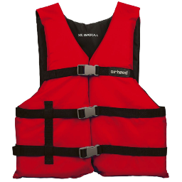
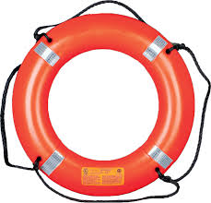
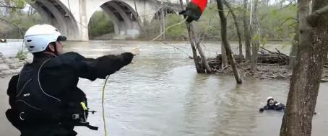
Throwable objects
Throwbags
Life Rings PFD

Slide 37

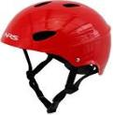
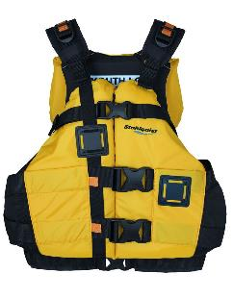
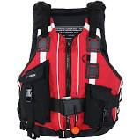
Personal Protective Equipment
Personal Flotation Devices and Helmets
Personal Flotation Devices
Type V with quick release strap; Coast Guard/Mil Spec approved PFD
  special use: sailboard harness, deck suit, paddling vest, commercial white water vest or float coats.
  Has blowout strap
Type III/V Coast Guard approved PFD
  Good for protected, inland water near shore, where chance of immediate rescue is good.
  Not suitable for extended survival in rough water. Not designed to turn unconscious people face up in water.
Water rescue helmets provide protection without trapping water.
Do not wear Structural Firefighting Helmets On Water Rescue Calls

Slide 38
Water Rescuer Mentality and tactics
When Do I Row or Go?
Yell, Reach, Throw Did Not Work, What Now?
  If your training, experience, and on hand equipment preclude you from executing a rescue with a reasonable probability of success while ensuring your safe return, then set up the scene for Technical Rescuers
  Work to set up access for additional resources and facilitate the deployment of inbound additional resources
  Do not enter the water out of desperation
    Only enter the water if you have proper equipment to execute the rescue, and if you know how to use that equipment
  Awareness and Operations Level Rescuers should not enter the water.

Slide 39
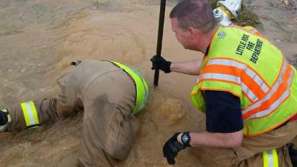
Most Rescuers enter the water by accident
  The possibility of accidental immersion exists
  Be careful on steep/slippery footing
  Properly don your PFD and Water Rescue Helmet
    Wear PFD and Helmet whenever you are within 10 feet of the water line
  We all get called to the scene, but we don’t all know how to swim
Notes:
Even strong swimmers will be challenged by the kinds of environments we will encounter
Getting Back to the shore is ½ the battle, climbing back on shore is the other half
Weak swimmers might be best served to conserve energy to simply stay afloat – now you are a part of the problem
Do not wear Structural Firefighting Gear near water

Slide 40

Not All Scenes are Urgent
What are your priorities as you approach?
If the victim is not in a hurry to get rescued, then do we need to be in a hurry to rescue them?
Notes:
Conversation topics:
Area knowledge/farmilirization – we know that creek isn’t deep
Cold exposure – Victims/Rescuers
Were is the hot, warm, cold zone?
It was -10, the entire scene was a cold zone
PPE VS Exposure – Use good sense

Slide 41
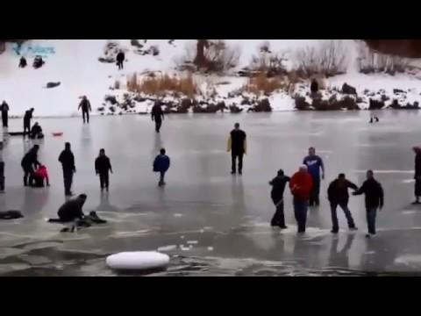
The Cost of Just Doing “Something”
Scenario 1

Slide 42
Scenario 1
California Lake Ice
Elements of this Emergency
What caused the Emergency?
What made the situation worse?
What made the situation better?
Enter Fire Rescue
Is there an imminent emergency?
Do we have a duty to act?
How could our actions make circumstances worse?
What strategies and tactics would make things better?
If the civilians best effort tactics are failing, then we should use a different approach.

Slide 43
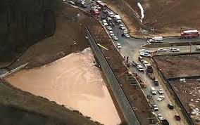
Lessons Learned
January 13, 2014 – Diamondback Dr.
  Ice rescue assignment dispatched for the report of 3 kids in the water.
  Units arrived on scene to find 1 on the shore, 1 on the ice and 1 missing.
    Witnesses saw the one child in the hole located on the ice.
    Personnel donned drysuits, entered the water and recovered the victim 29 minutes later
Lessons Learned:
  Need training with proper equipment
  carried on apparatus.
  Assure equipment is in proper working order.

Slide 44
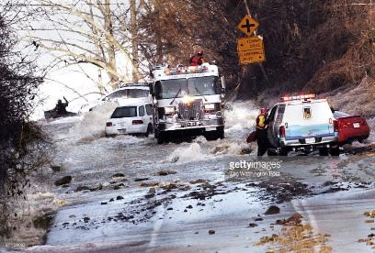
Lessons Learned
December 23, 2008 – River Rd. Water Main Break
  Broken 66 inch water main discharging 150,000 gal/min.
  9 stranded occupants in vehicles
Responders had proper training, equipment and knowledge
  A variety of rescues were made using several resources including fire engines, boats and helicopters.
  Had back up plans to mitigate problems that might have arose.

Slide 45
Additional Training
Further Water Rescue training can be completed through the PSTA classes currently offered:
  Surface Water BT Crew – Can respond to inland incidents as a crew member
  Surface Water BT Operator – Operates boats in flat water incidents
  Swiftwater Technician – Able to operate on all water incidents
To enter these classes a 200 yd. swimming test must be passed

