Slide 1
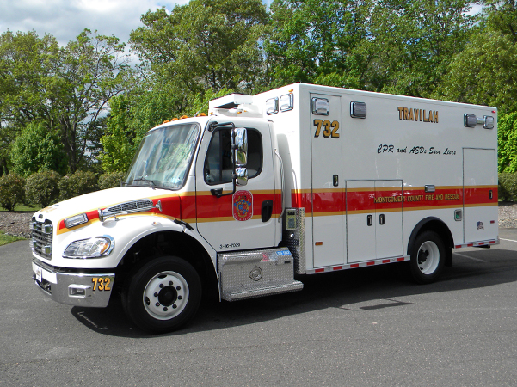

New EMS Units
2016 Freightliner/PL Custom

Slide 2
Specification Chart
Engine Cummins ISB 240 HP
Brakes Antilock – Disc - HYDRAULIC
Front Axle 8,000 lbs GAWR
Rear Axle 12,000 lbs GAWR
Curb Weight 15,300 lbs EMPTY
Unit Height 9’ 6”
Unit Length 24’ 5”
Unit Width 9’ 6”
Tire Pressure Front 85psi Rear 75psi
Coolant 11 Gallons Purple w/SCA
Engine Oil 20qts 15w40
Transmission Fluid 10.6qts Transynd
Power Steering Fluid 5qts Dexron III
Brake Fluid 5pts DOT 3
Diesel Exhaust Fluid 6 Gallons DEF

Slide 3
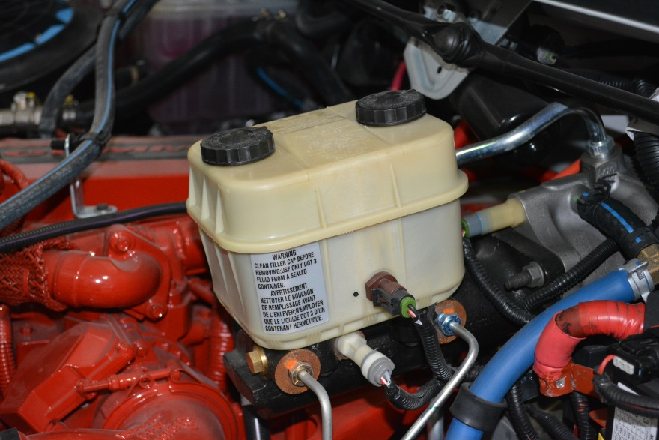
Braking System
ALL 2016 EMS units will be equipped with All-wheel HYDRAULIC Disc Brakes
Visualize fluid level through the translucent reservoir
Backlighting with a flashlight may improve visibility
DO NOT conduct DOT Air Brake Test
Master Cylinder
Check BOTH sides of the reservoir during your daily apparatus check. DO NOT remove caps and only add fluid upon direction from CMF.

Slide 4
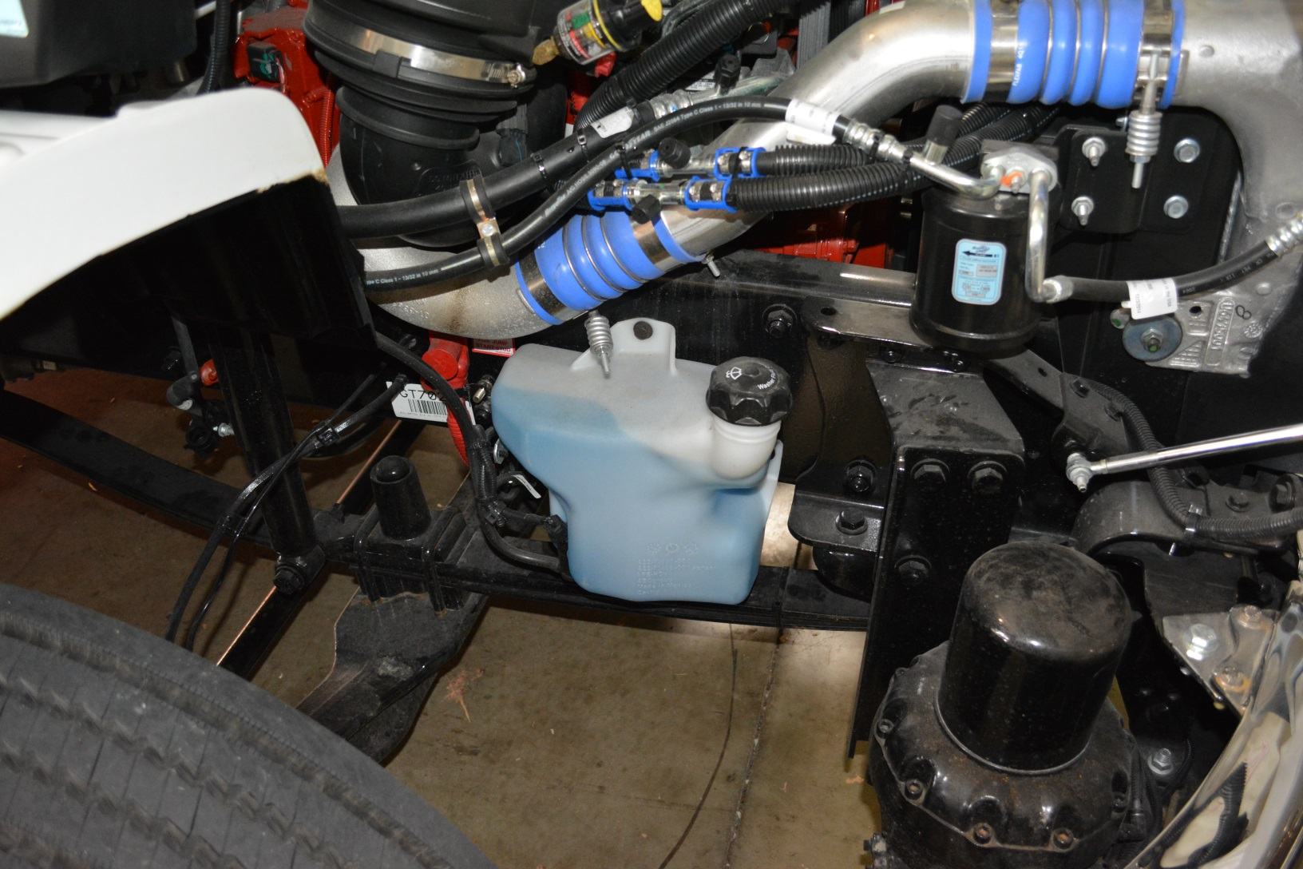
Washer Fluid Reservoir
Now located under the hood on the passenger side of the unit

Slide 5

Auxiliary Braking Device
This unit is equipped with an
Exhaust Brake.
The Exhaust Brake will not be used in low traction or slippery conditions.

Slide 6
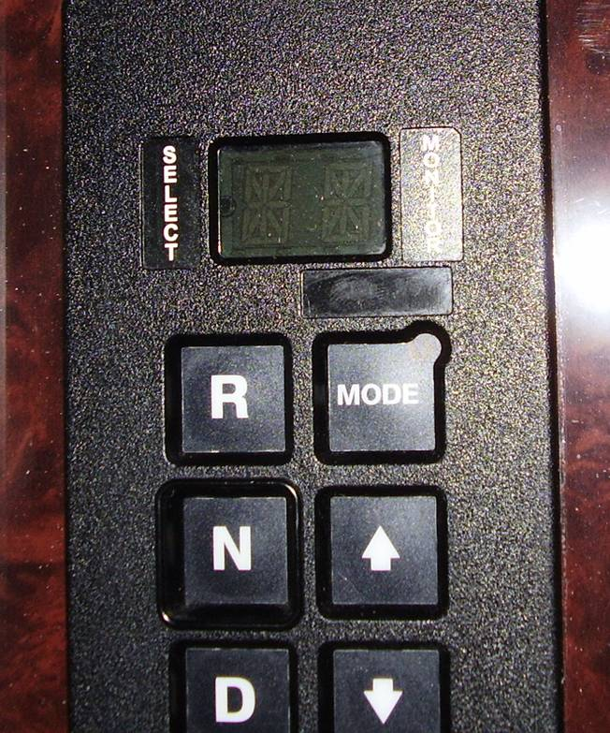
Transmission Fluid Check
The Transmission Fluid level may be checked in the cab through the keypad selector.
The engine must be running at idle and the unit must be on level ground.
The engine must idle at least five minutes from a cold start.
The transmission must heat to at least 140 degrees F.
Push both the up and down arrows simultaneously on the keypad.
Arrows

Slide 7
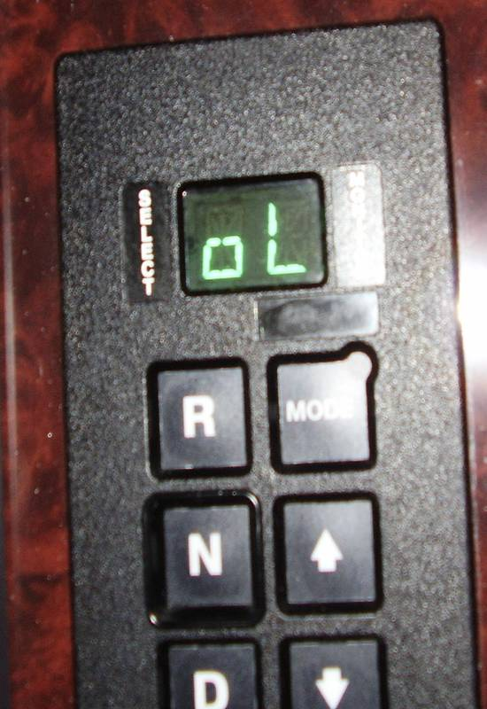
Transmission Fluid Check
After simultaneously pushing both buttons, the symbol “OL” will display on the screen.
OL will be followed by OK, -1 thru -7, or +1 thru +7. The – indicates under filled and the + indicates overfilled. The numeral indicates the number of quarts.
Any other message indicates a problem and CMF should be notified.
Always confirm the digital reading on the dipstick BEFORE adding fluid.
ONLY use Trans-Synd Fluid.

Slide 8
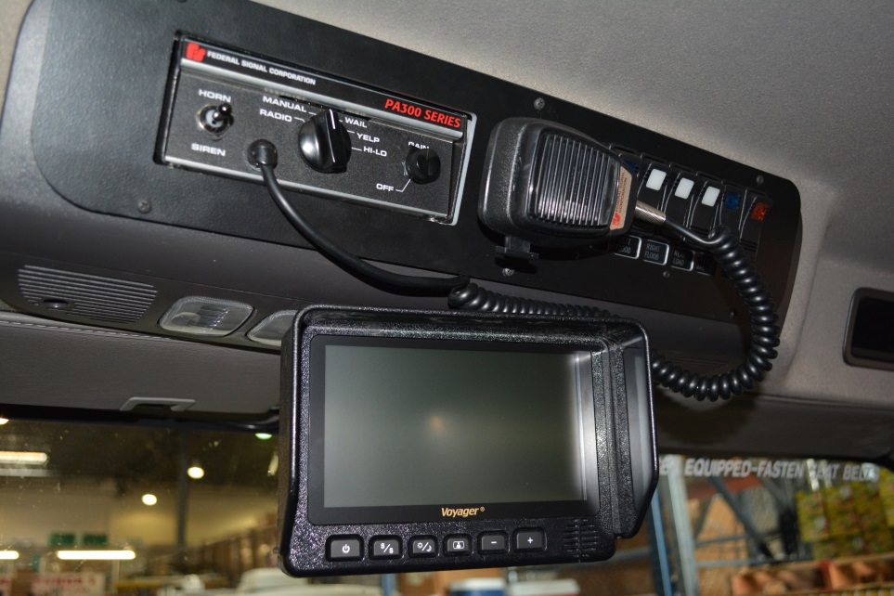
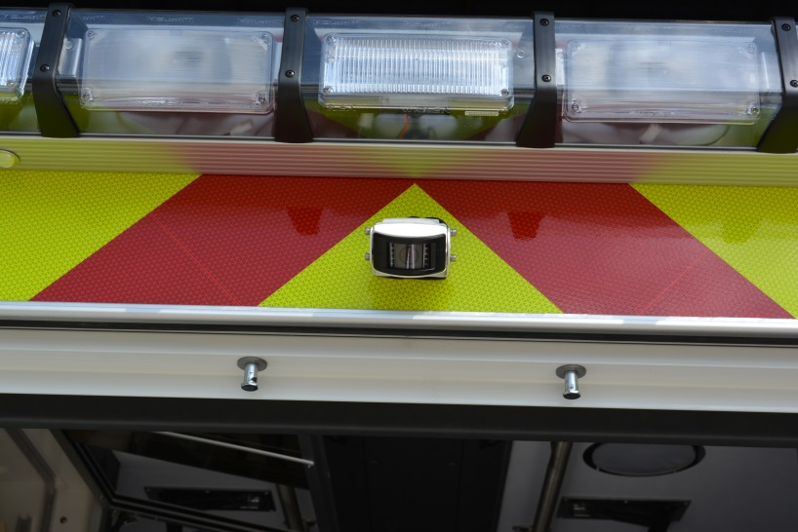


Reverse Camera
The camera is located just above the rear doors.
The video screen is located at ceiling level in the center of the unit.

Slide 9
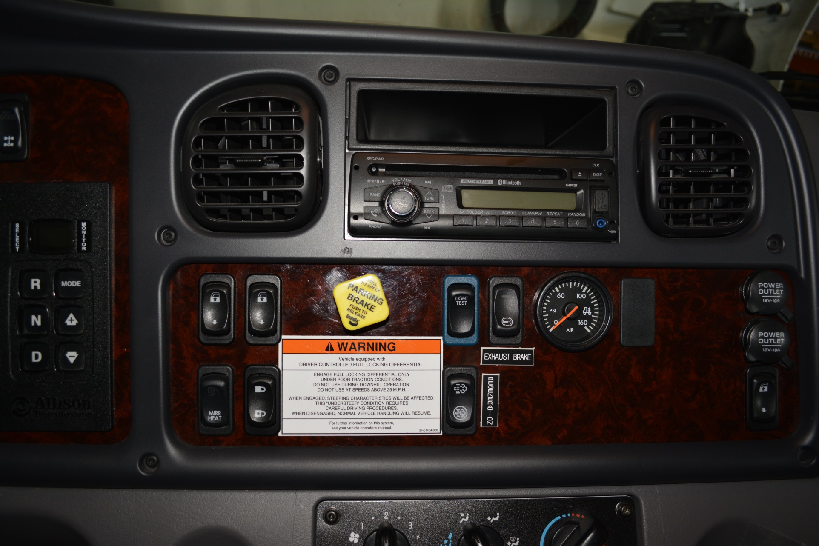
Cab Features

Slide 10
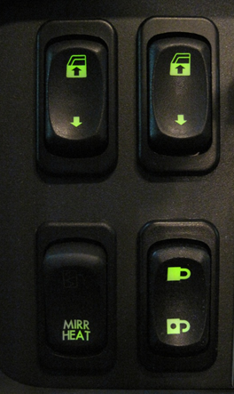
Cab Features
Driver’s Window
Passenger’s Window
Door Locks
Use of this switch will lock/unlock the entire unit. If the doors are inadvertently locked, they can be unlocked with the stealth switch on the rear of unit
Mirror
Heat

Slide 11
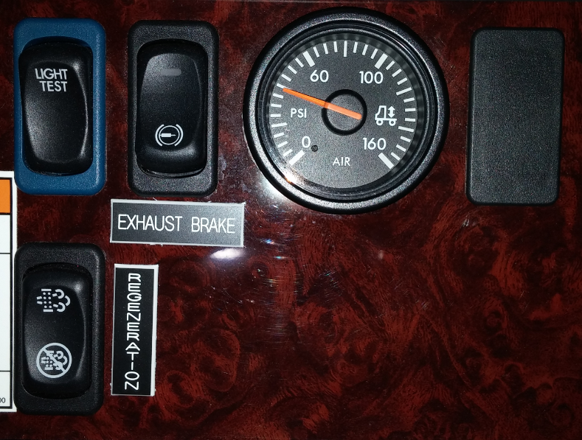
Cab Features
Light Test
Rear Suspension Pressure
Exhaust Brake
ON/OFF
Active
Regeneration

Slide 12
Cab Features
The Light Test switch will test only the DOT lights on the unit
  Press the switch
  Wait for countdown
  All DOT lights will begin to flash off and on until stopped by driver
All Emergency Warning lights must still be tested as usual

Slide 13
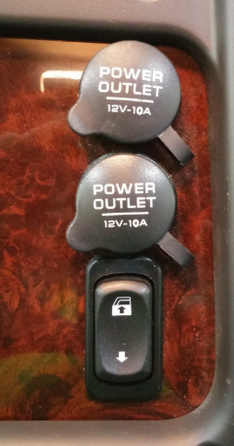
Cab Features
The 2016 EMS units have a second passenger window switch that is easily reached from the passenger seat.
12 Volt
Power Outlets
Passenger Window Switch

Slide 14
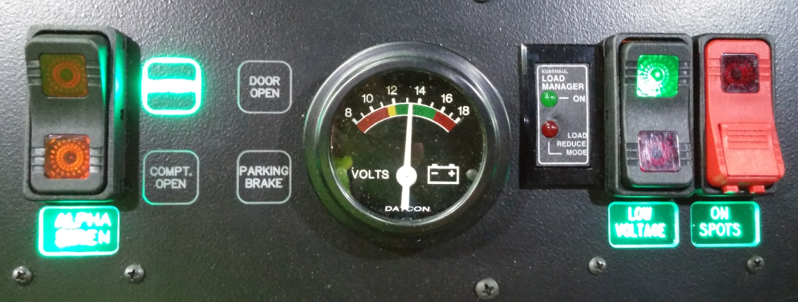
Cab Features
On-Spot
Tire Chains
Alpha Siren
Volt Meter
Indicator Lights
Load Manager & Low Voltage Indicators

Slide 15
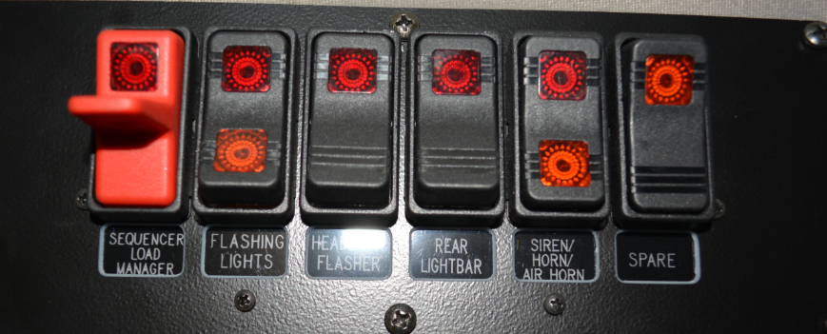
Cab Features
Emergency Warning Light panel located above windshield on Driver’s Side

Slide 16

Cab Features

Slide 17
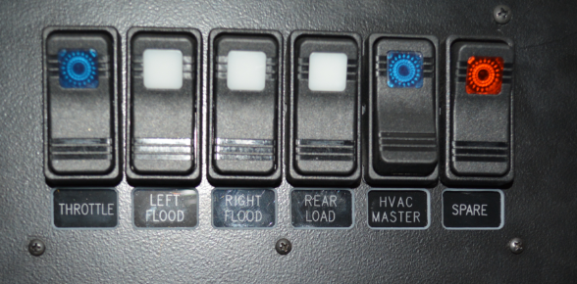
Cab Features
High Idle (Throttle), Scene Lighting, and HVAC Master all located above windshield near siren controls.

Slide 18
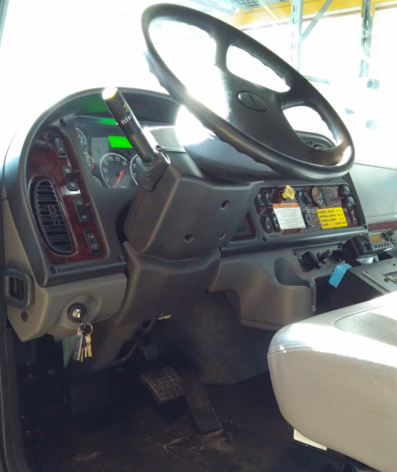
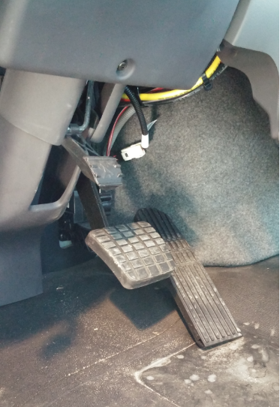
Cab Features
Steering Wheel Adjustment
Step on adjustment pedal for telescoping and tilt functions. Releasing the pedal will lock the steering wheel in place.

Slide 19
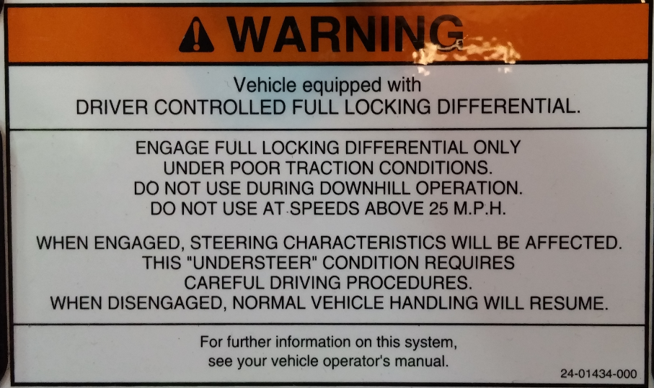
Cab Features
These units DO NOT have traction control
They only have a Locking Rear Differential

Slide 20
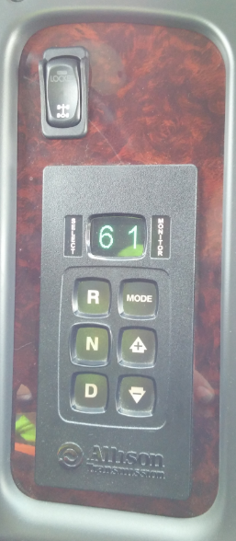
Cab Features
Locking differential switch located above transmission selector keypad

Slide 21
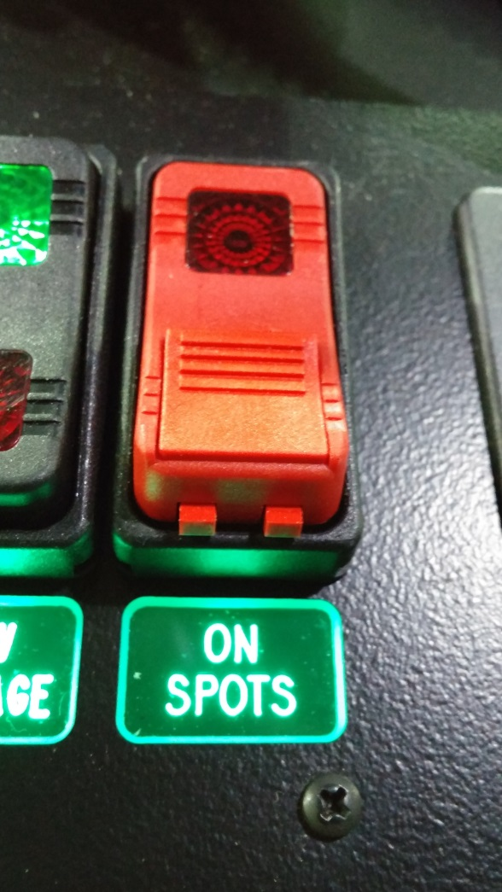
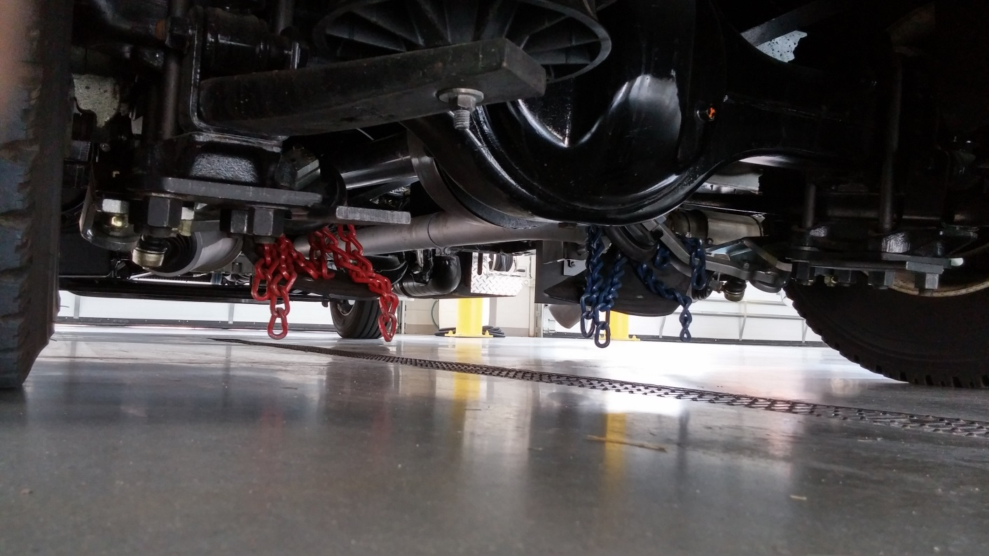
Cab Features
On-Spot Tire Chains
  Located in front of rear axle

Slide 22
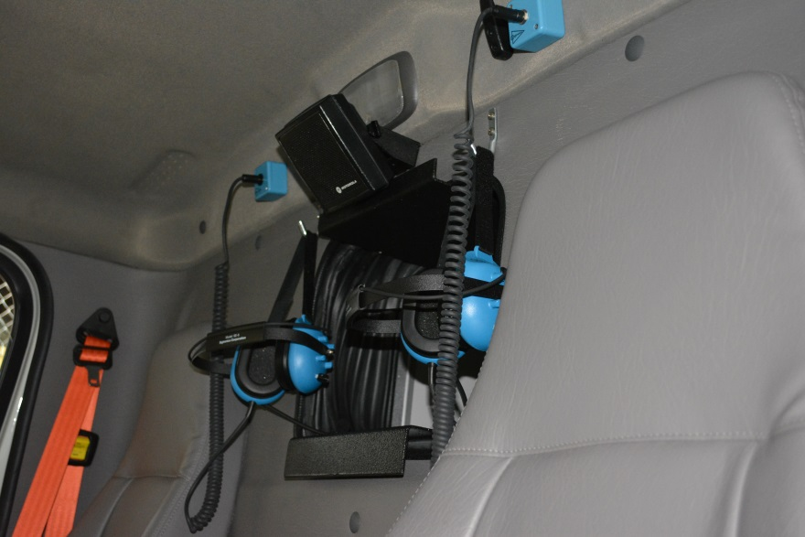
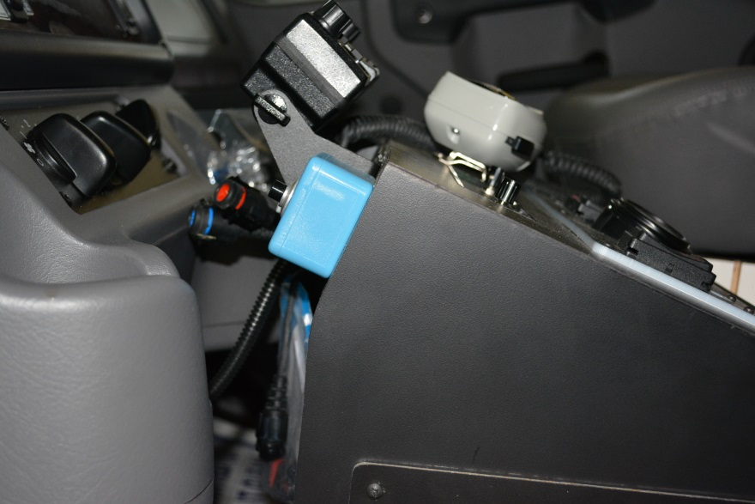
Cab Features
Sigtronic Headsets
  2 headsets supplied in the cab
  Push To Talk buttons located on front of console
  2 headsets supplied in the patient compartment
PTT Button

Slide 23
Cab Features
Windshield Wipers
  The windshield wipers are designed to disable when the parking brake is applied
  This is to prevent damage to the windshield and wipers while parked on scene
  If the parking brake is applied the wipers will only swipe once until the brake is released

Slide 24
Regeneration
All diesel exhaust systems must be fitted with a DPF and a regeneration system.
DPF is Diesel Particulate Filter which captures soot and ash from the engine exhaust.
Regeneration is the process of burning off the soot and ash.
There are two types of regeneration:
1. Passive which requires no driver involvement.
2. Active which requires driver involvement.
Warning lights in the dash cluster will advise the driver of what action is needed.

Slide 25
Regeneration
Active Parked Regeneration
When the DPF lamp is solid a parked regeneration may be needed.
When the DPF lamp is flashing a parked regeneration is REQUIRED AS SOON AS POSSIBLE
During a regeneration exhaust temperature can reach 1300 degrees. Select an appropriate location.
Park unit, place the transmission in neutral, chock the wheel, and toggle the regeneration switch. Engine rpm should increase to approximately 1100rpm.
Keep exhaust 5 feet away from all objects and pedestrians.
The driver must remain with the vehicle during regeneration.

Slide 26
Regeneration
Active Parked Regeneration
During the regeneration process the high exhaust temperature lamp will illuminate.
DO NOT complete regeneration in the Station or while connected to a Plymovent.
When the ECM determines the DPF has been regenerated engine rpm will decrease to normal rpm signaling the regeneration is over.
Remember exhaust components are still very hot.
If the regeneration process needs to be interrupted or stopped, depress the brake pedal.

Slide 27
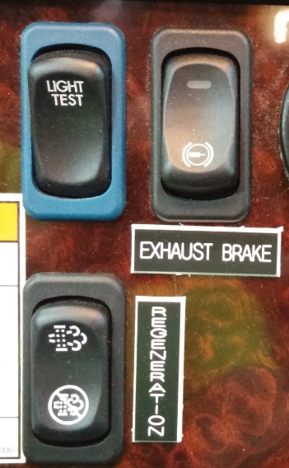
Regeneration
Active Parked Regeneration
The regeneration switch is located in the center of the dash below the Light Test switch.

Slide 28
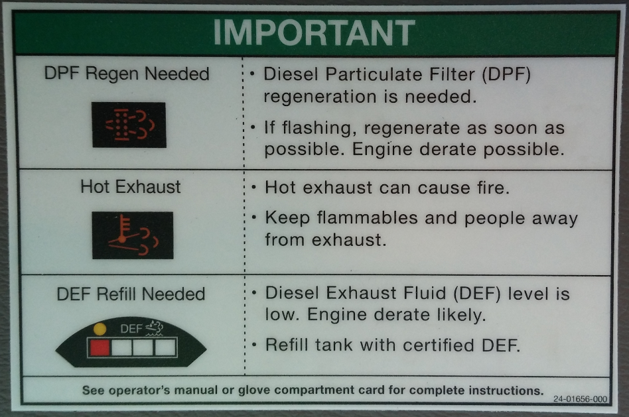
Regeneration
DPF/DEF Warning Lights

Slide 29
Regeneration
Passive Regeneration
  Passive Regeneration will only occur during highway driving
  It is unlikely that EMS units will drive enough highway miles for Passive Regeneration to complete it’s cycle

Slide 30
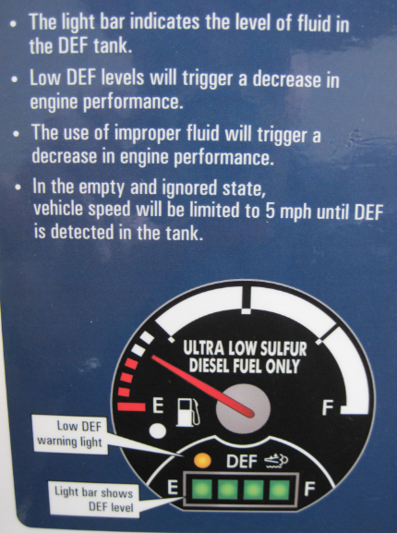
Diesel Exhaust Fluid
Diesel Exhaust Fluid (DEF)
  Urea based fluid
  Designed to lower Nitrous Oxides in exhaust
  Follow recommended storage procedures for fluid in station.

Slide 31
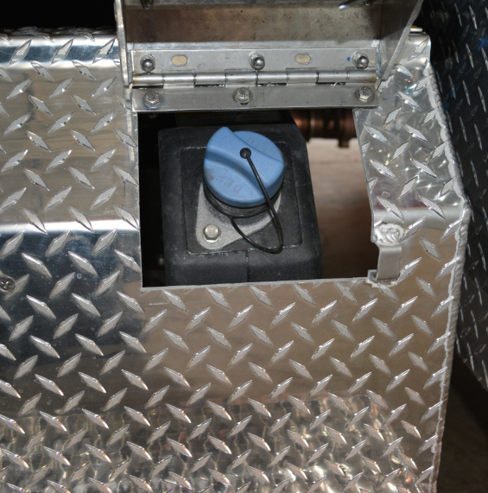
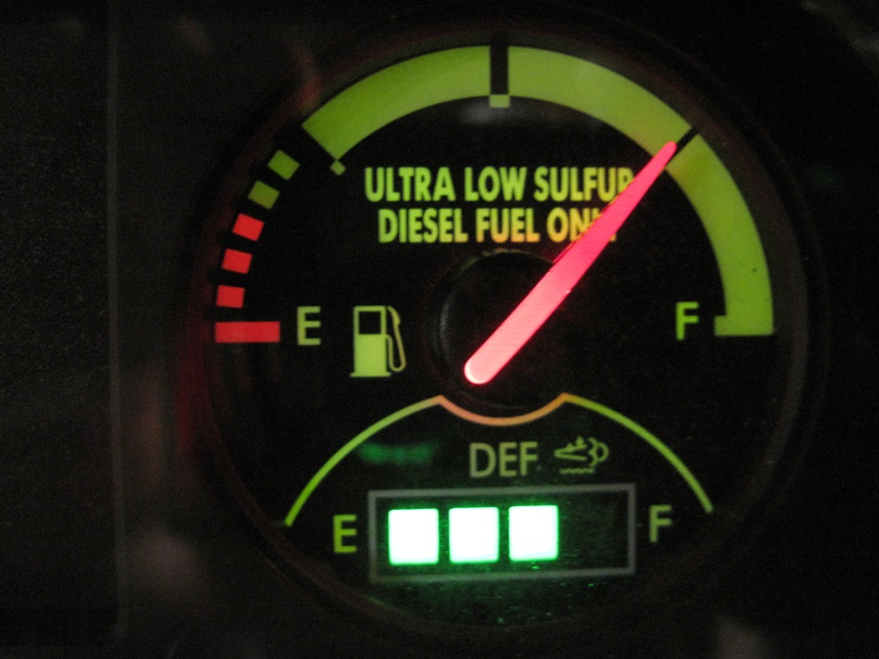
Diesel Exhaust Fluid
DEF Tank gauge located below fuel gauge on dash.
DEF Tank located rear of the batteries on the driver’s side of the unit.

Slide 32
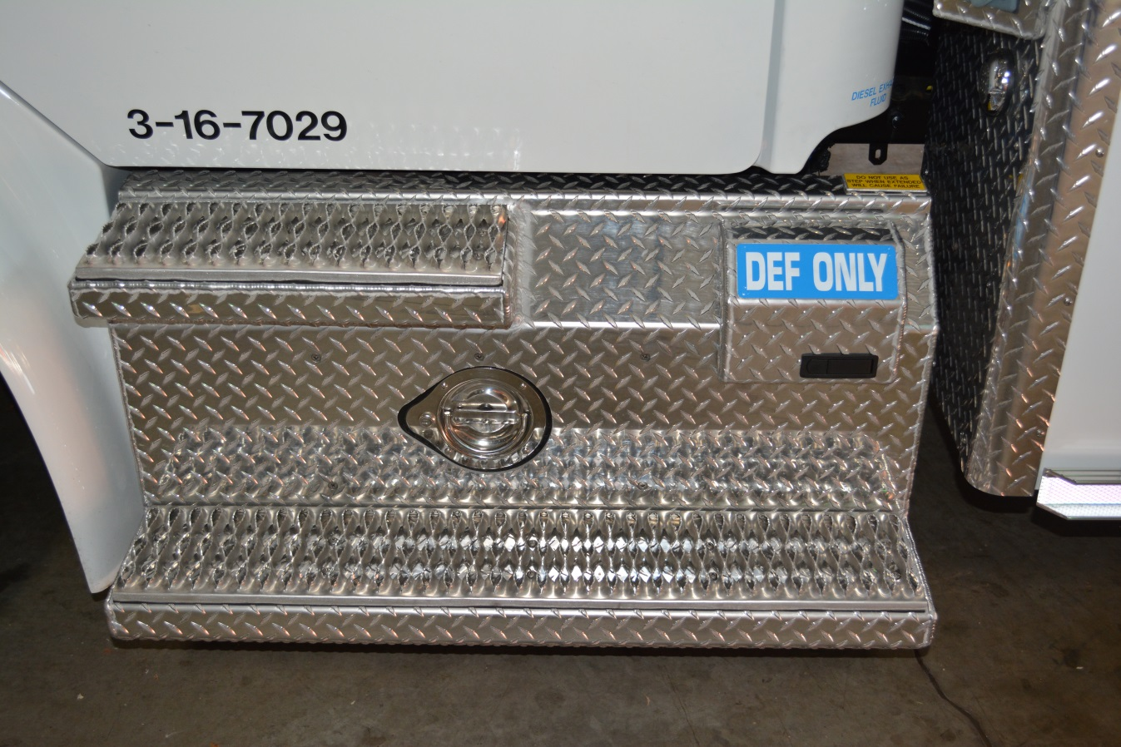
Diesel Exhaust Fluid

Slide 33
Diesel Exhaust Fluid
Refill Procedures
  CMF stocks DEF in industry standard 2.5 Gallon Containers
  2 containers per case
  Each case comes with 2 filler tubes
  DEF is requested when ordering Station Supplies or as needed through FMRS.
  Any DEF container or filler tube that shows any signs of crystallization MUST be immediately discarded to avoid vehicle damage
  Any DEF spills or splashes should be diluted with water

Slide 34
Diesel Exhaust Fluid
Refill Procedures
  Only add DEF to the appropriate DEF tank
  DO NOT add DEF to the fuel tank
  DO NOT add fluid until the DEF level is at HALF (1/2)
  When DEF level reaches HALF, only add a single 2.5 gallon jug to the DEF tank using the supplied filler tube
  DO NOT top off DEF
  The empty jug AND filler tube MUST be thrown away. DO NOT RE-USE!!!

Slide 35
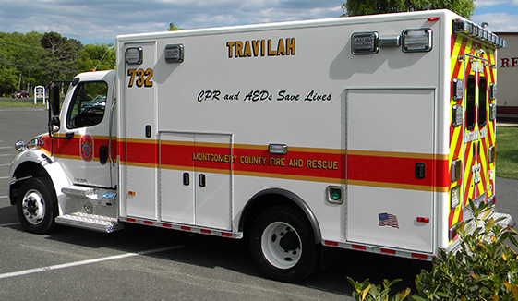
Diesel Fuel Tank
The fuel tank has been moved from the officers side step to under the rear of the unit.
Fuel Fill is located on the driver’s side, rear of the drive axle.
Tank Capacity is 40 Gallons
Fuel Fill

Slide 36
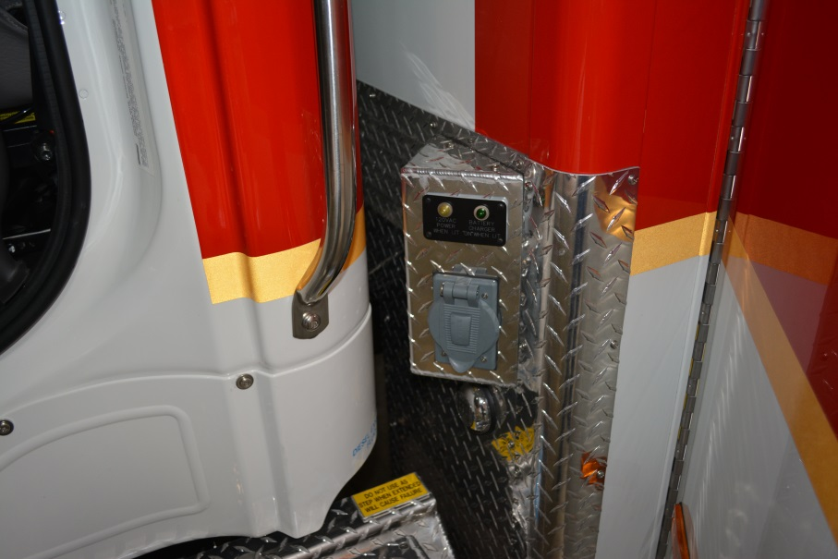
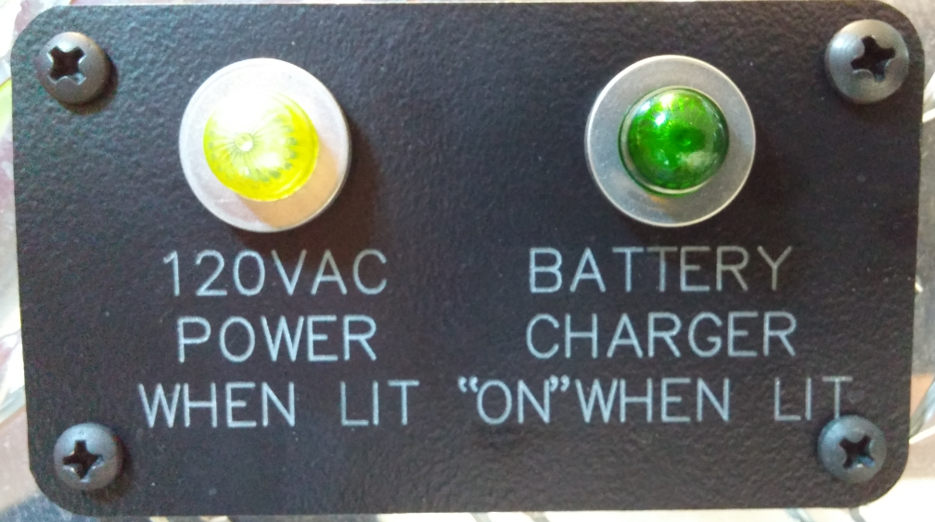
Shoreline Connection
The shoreline connection has changed from previous EMS units
BOTH indicator lights should be illuminated when the unit is plugged in.

Slide 37
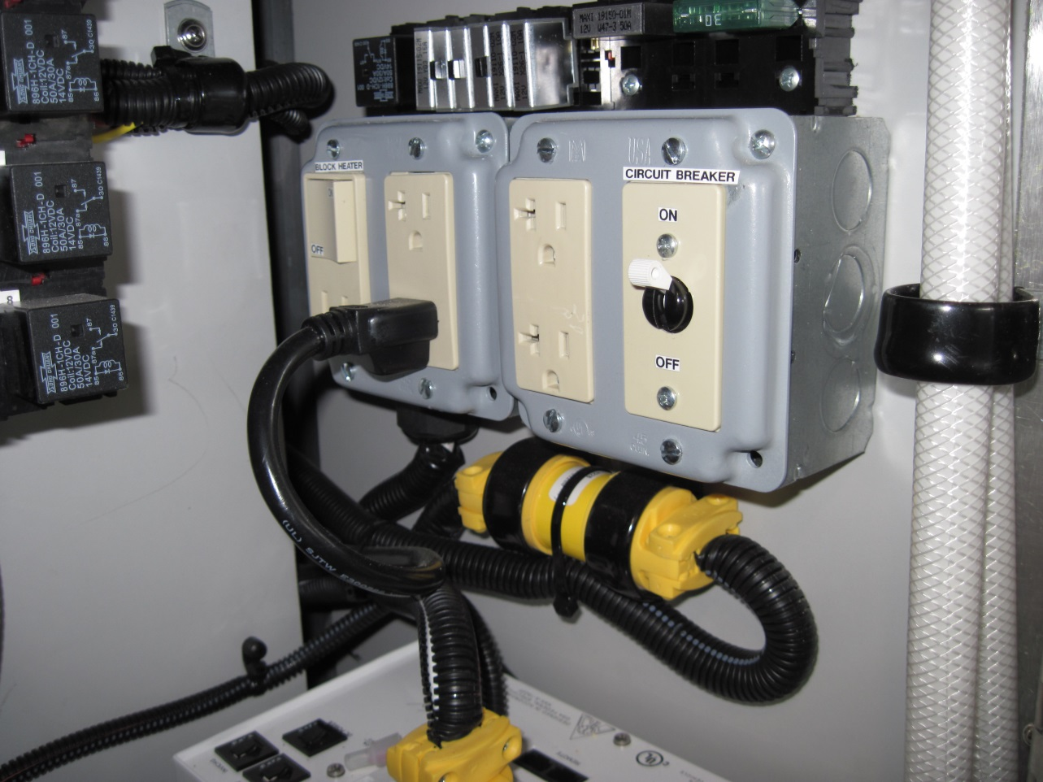
Shoreline Connection
If BOTH lights are not illuminated the interior breaker must be reset.
Breaker is in the compartment behind the Captain’s Chair.
Circuit Breaker

Slide 38
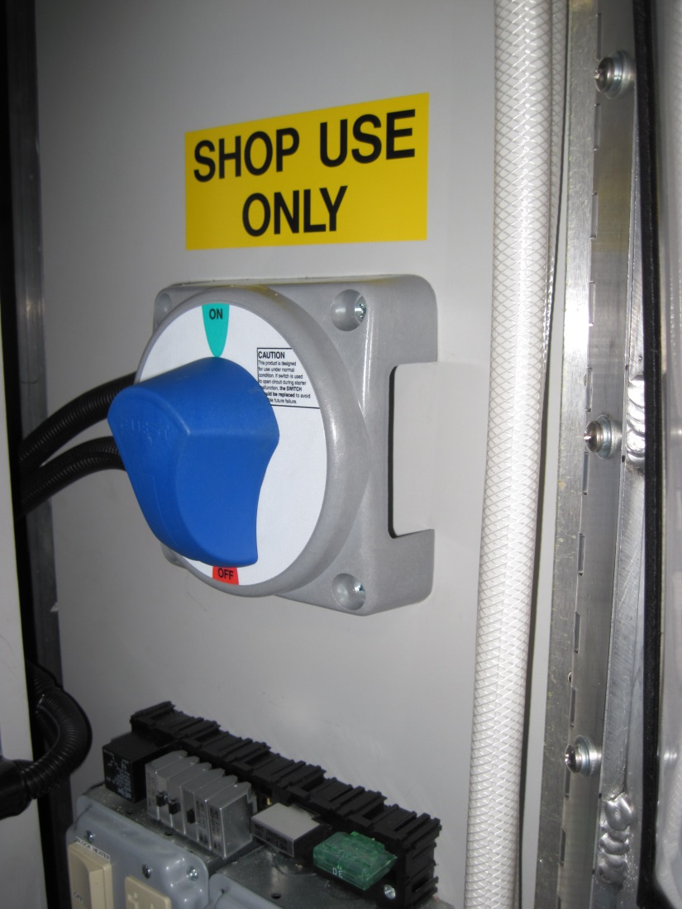
Timer Bypass Switch
As labeled, the battery switch in this compartment is for SHOP USE ONLY. DO NOT TURN ON!!!

Slide 39
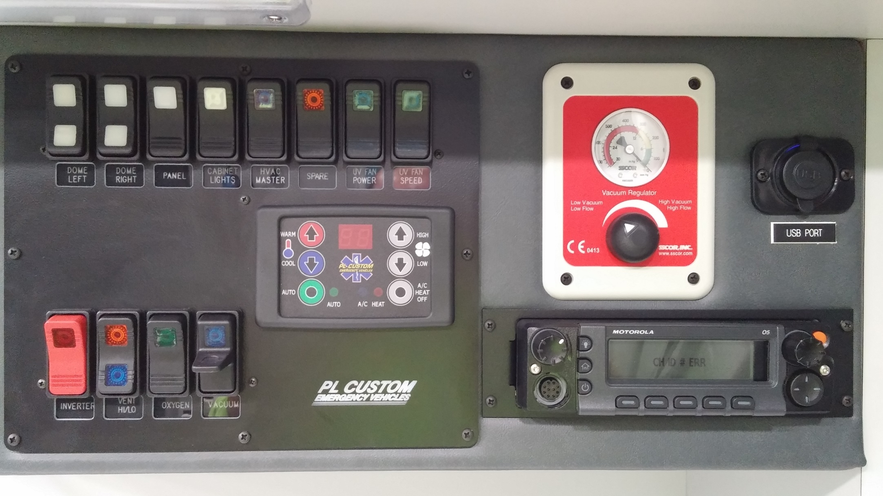
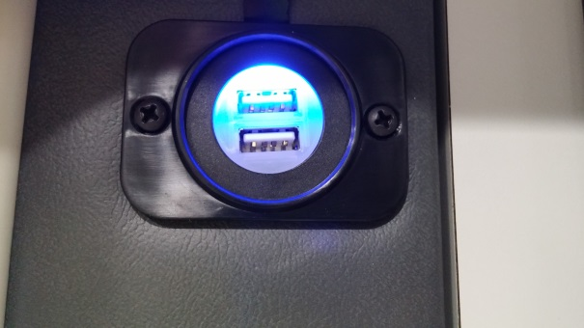
Patient Compartment Features

Slide 40
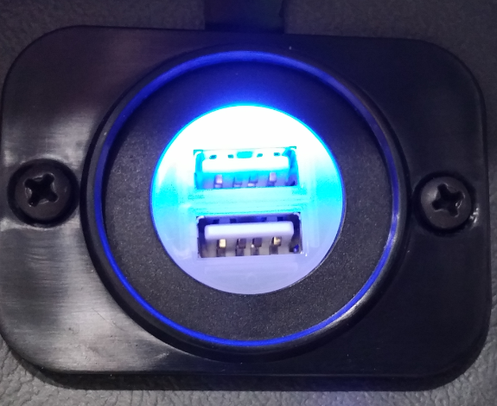
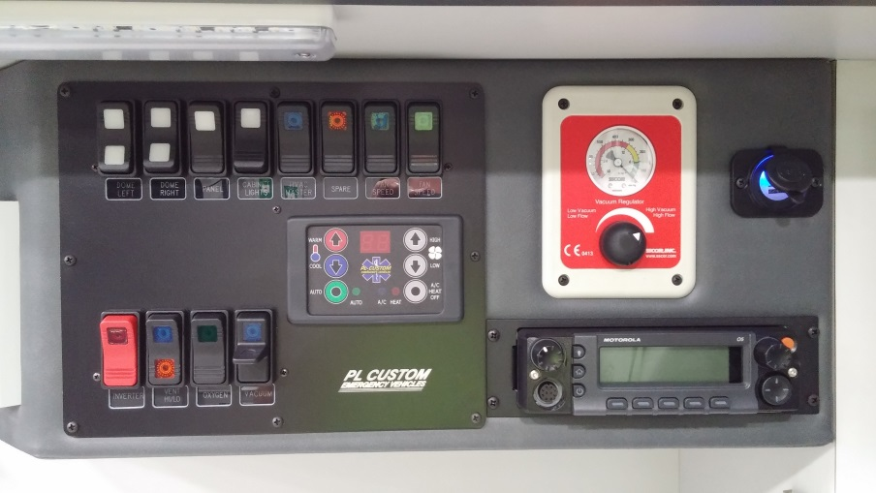
Patient Compartment Features
USB Ports
  Please use provided USB ports for charging mobile devices
  DO NOT charge personal
  devices through MDC or
  EMEDS computers.

Slide 41
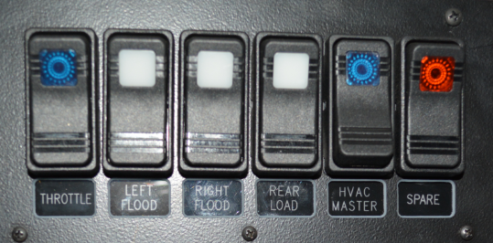
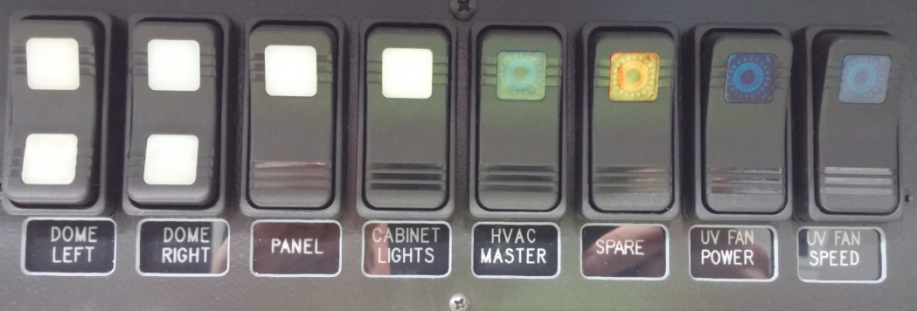
HVAC Controls
HVAC Master Switch
  One located in switch cluster above passenger seat
  One located on panel in patient compartment
  Either one must be on for rear HVAC to function
Front HVAC Master
Rear HVAC Master

Slide 42
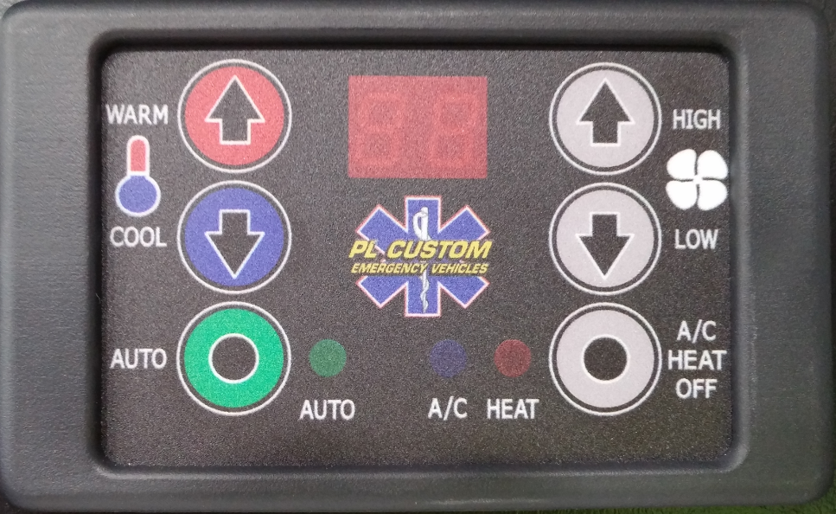
HVAC Controls

Slide 43
HVAC Controls
Mode Selector
  Press once for AIR CONDITIONING
  Press again for HEAT
  Press once more to turn OFF

Slide 44
HVAC Controls
Blower Motor
  3 settings
  F1 – Low
  F2 – Medium
  F3 – High

Slide 45
HVAC Controls
Temperature Setting
  Range between 50⁰ F and 99⁰ F
  Set by pressing appropriate arrow to desired temperature
  Will show set temperature for 2 to 3 seconds then toggle back to ambient temperature

Slide 46
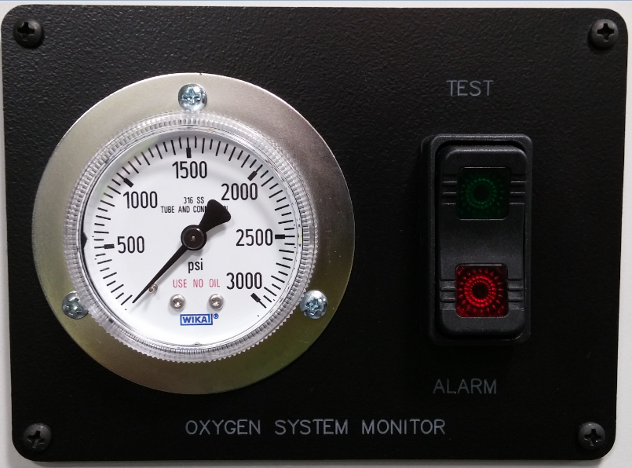
Oxygen Monitoring System

Slide 47
Oxygen Monitoring System
Analog Gauge
  Monitors Pressure even when vehicle power is OFF
  Audible and Visual Alarm set to 250psi

Slide 48
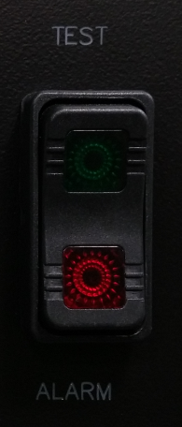
Oxygen Monitoring System
Lights
  Green Light indicates Oxygen Level is OK
  Red Light indicates Oxygen level is low – Below 250psi
Switches
  Green switch tests lights
  Red switch silences alarm

Slide 49
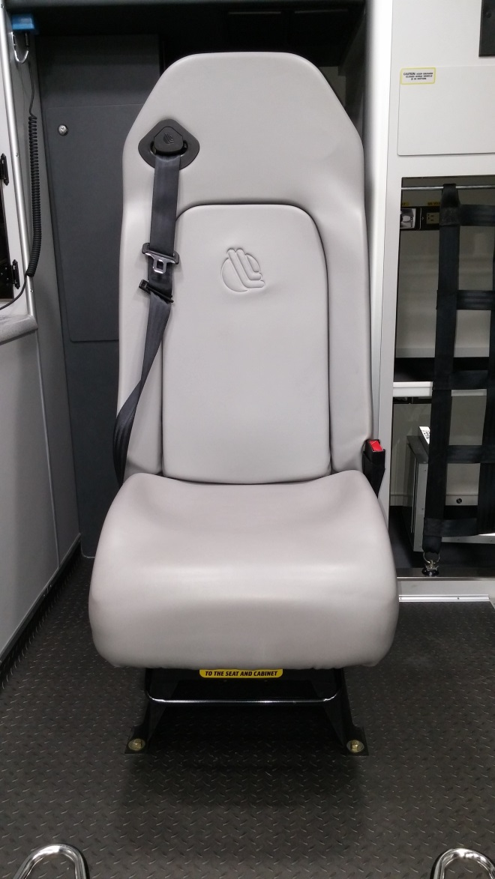
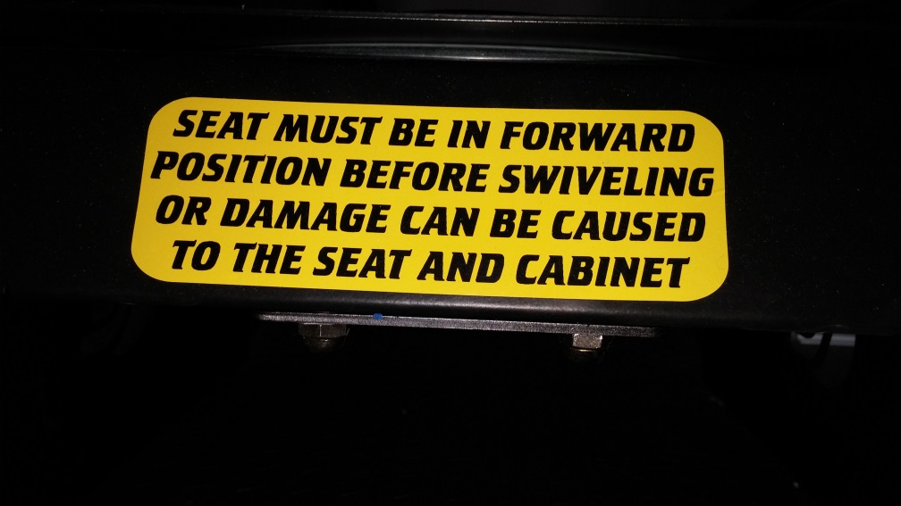
Captain’s Chair
The Captain’s Chair can be used in the fully rearward facing or fully forward facing positions.

Slide 50
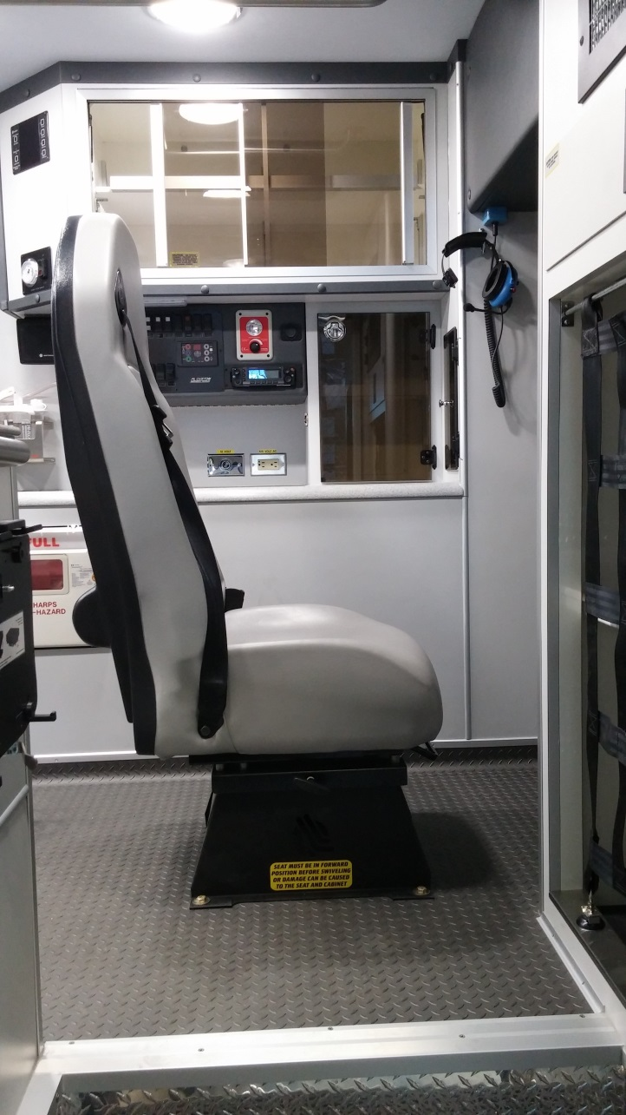
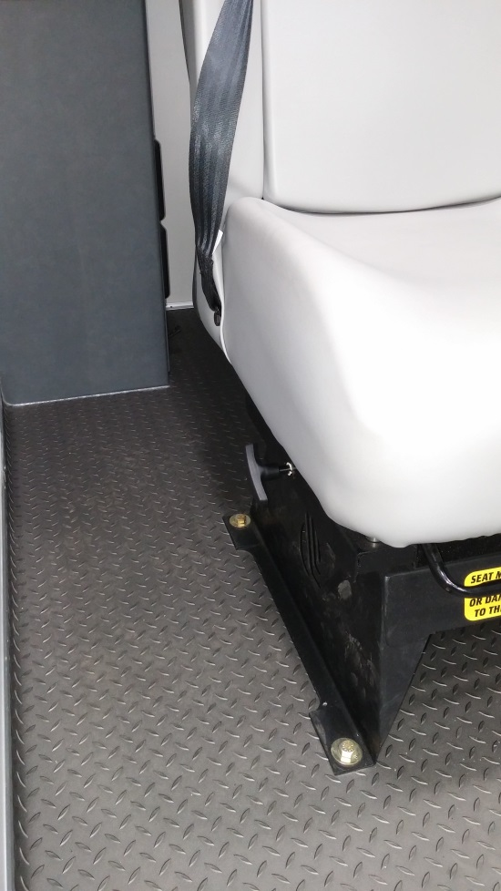
Captain’s Chair
The handle to release the seat can be found on the right side of the seat.

Slide 51
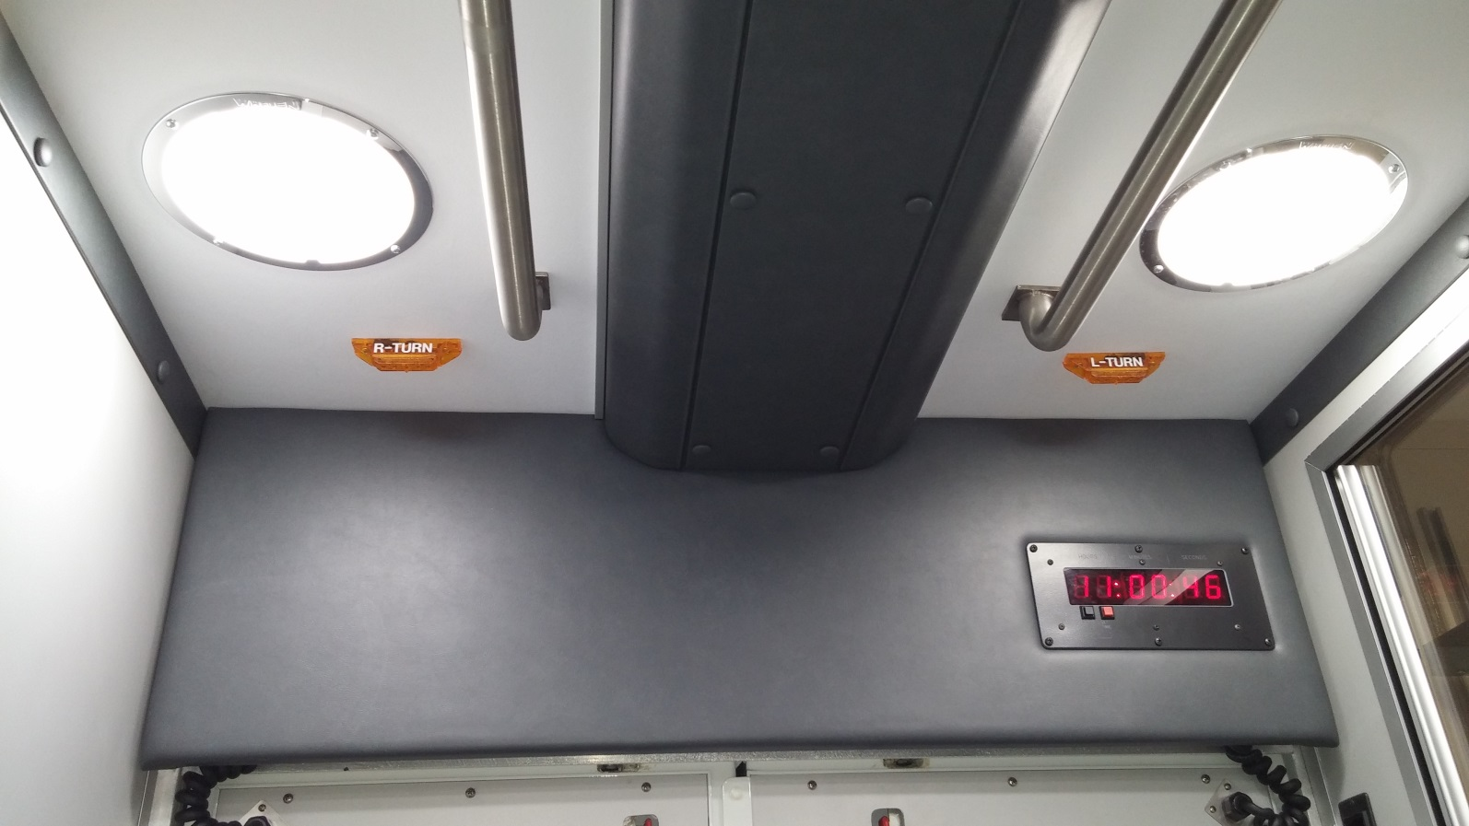
Rear Turn Signals
A set of turn signal indicators has been added to the ceiling of the patient compartment just inside the rear doors.
This will give the provider advance warning for upcoming turns.

Slide 52
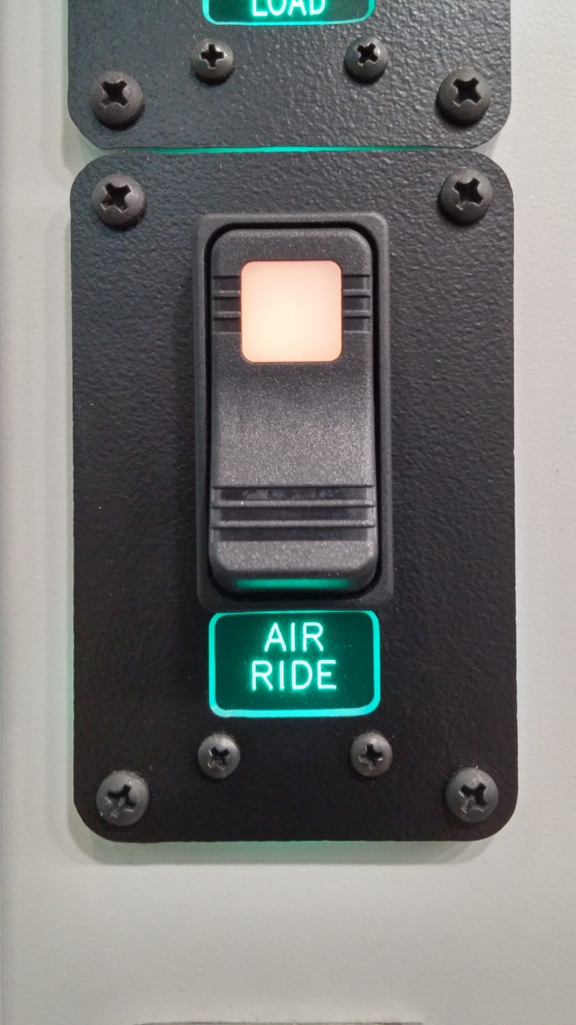
Rear Air Dump
The rear suspension is still utilizing airbags.
The suspension will dump when the rear doors are open.
The override switch is inside the LEFT door.

Slide 53
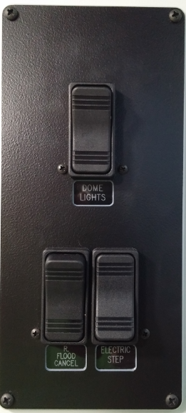
Side Door Automatic Step
The side step is now controlled by a switch
Switch is located inside the side door
If this switch is in the off position the step WILL NOT extend when the door is opened.

Slide 54
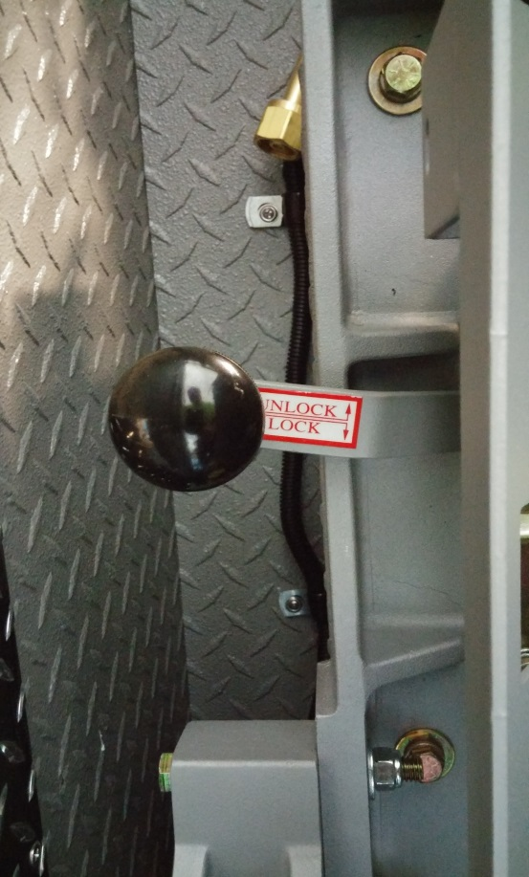


Zico Oxygen Lift
Similar to existing units
Remember to UNLOCK
Control mounted in compartment
Control

Slide 55


Zico Oxygen Lift
Stored
Deployed

Slide 56

Lifepak Clamp
The units will be equipped with a mount for the Lifepak

Slide 57

Lifepak Clamp

Slide 58

Lifepak Clamp

Slide 59

Toughbook Clamp
The EMEDS Toughbook clamp works similarly to all existing clamps.
All electrical connections have been removed from the mount.
The Toughbook must be plugged in with the pigtail

Slide 60

Backboard Grips
Place the bottom of the backboard in the channel first
Push the top of the backboard firmly in the channel
Remember to fasten seat belt

Slide 61



Backboard Grips
Place Bottom
Push in channel
Secure Belt

Slide 62

Rear Stealth Button
Similar to existing units
Switch will Unlock AND Lock all cab, compartment, and patient compartment doors.
  Press DOWN to unlock
  Press UP to lock

Slide 63


LED Scene Lighting
Scene lights on both sides of the unit are 12 volt LED style.

Slide 64

LED Scene Lighting
Rear scene lights are standard bulbs in the rear light bar.
Also illuminates
the LED reverse
lights.

Slide 65



LED Compartment Lighting
All interior compartments have LED lighting that is controlled by a switch on the panel labeled “Cabinet Lights”

Slide 66


Car Seat Installation Review
All of the convertible car seats that are carried in the outside compartment were provided by the car seat program and meet all of the federal requirements

Slide 67

Car Seat Installation Review
The primary place that the seats should be secured is rear facing on the cot.

Slide 68
Car Seat Installation Review
When the seat is secured rear facing, a cot strap should go through each belt path on the seat.

Slide 69

Car Seat Installation Review
The lower strap MUST be moved past the folding handle.

Slide 70

Car Seat Installation Review
The buckles should be moved so they are not positioned underneath the child.

Slide 71

Car Seat Installation Review
The buckles may also have to be shortened for proper placement.
This can be done by twisting the buckle portion NO MORE THAN 3 complete twists

Slide 72

Car Seat Installation Review
The straps on the car seat should be properly adjusted based on the size of the child.
Refer to owners manual or certified car seat technician for help with this.

Slide 73

Car Seat Installation Review
Infant carriers must NEVER be used on the cot as they cannot be properly secured.

Slide 74

Car Seat Installation Review
The car seat that is incorporated into the Captains chair can only be used for a child that is:
  Between 20 pounds and 50 pounds
  Between 28 and 47 inches in height
  Over 1 year old
  Can sit up on their own.

Slide 75

Car Seat Installation Review

Slide 76


Car Seat Installation Review
Place the top buckle at armpit level first
After the lower buckles are buckled, all adjustments are made on the lower straps.

Slide 77

Car Seat Installation Review
If it is absolutely necessary, the seat can be placed forward facing at the end of the bench seat against the wall, provided that it can be secured with less than one inch of movement left or right at the belt path AND the child is at least a year old and over 22 lbs.

Slide 78
Car Seat Installation Review
This will take 2 people to install
The seat belt must be fully extended and passed through the car seat forward facing belt path (back of seat)
While one provider is placing weight in the seat the other will attach the belt

Slide 79
Car Seat Installation Review
After the belt is attached and the belt has retracted it must be tightened
Unlatch the belt and allow it to retract a few clicks while holding it.
Place weight in the seat and buckle it again
Repeat until TIGHT

Slide 80
Car Seat Installation Review
As an absolute last resort, the seat can be placed in the front seat of the unit, forward facing only with the seat as far back as possible from the airbag.
Only use for an child who is not a patient
This method requires a special locking clip
THIS MAY ONLY BE DONE BY A CERTIFIED CAR SEAT TECHNICIAN.

Slide 81
Comments, Questions, Suggestions
Please contact the Driver’s Training Office with any training related questions
Please contact Emilie Crown with any Car Seat related questions at 240-777-2467.

