Slide 1
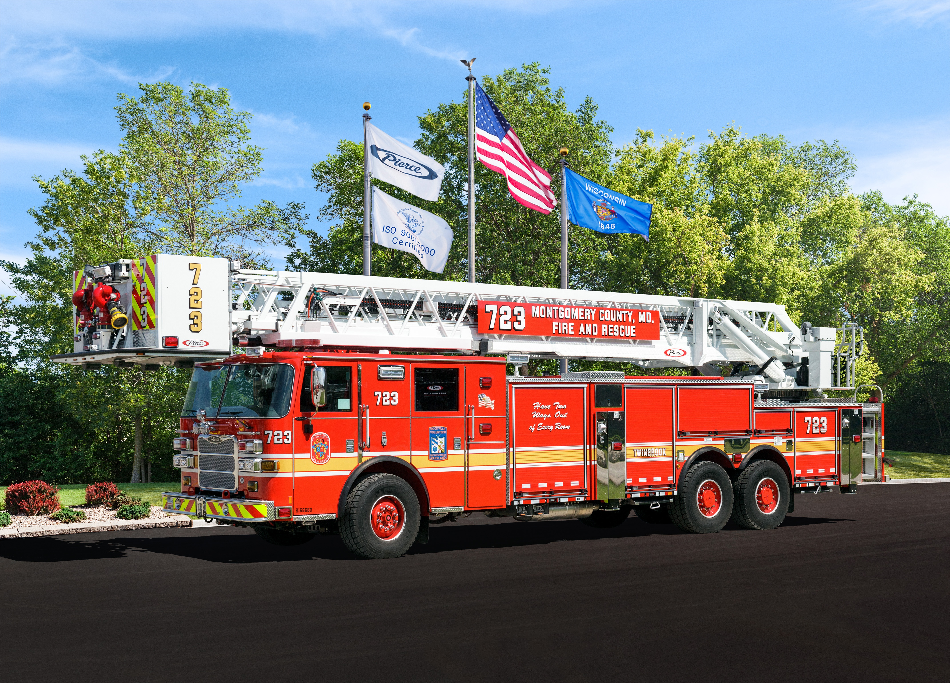

3rd Generation All Steer Tower
2016 Pierce Arrow XT Aerial Operations

Slide 2

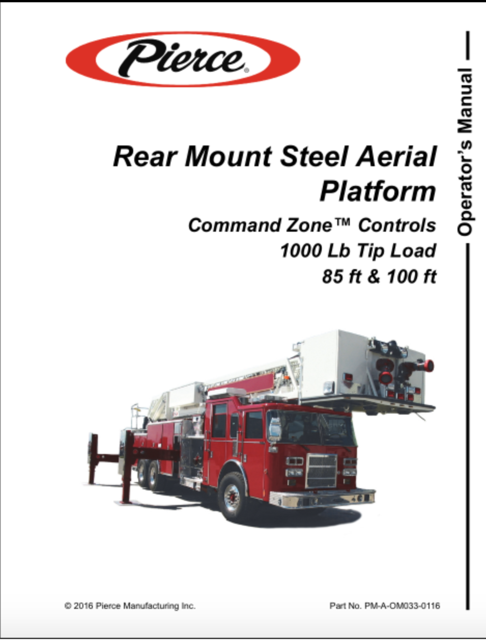
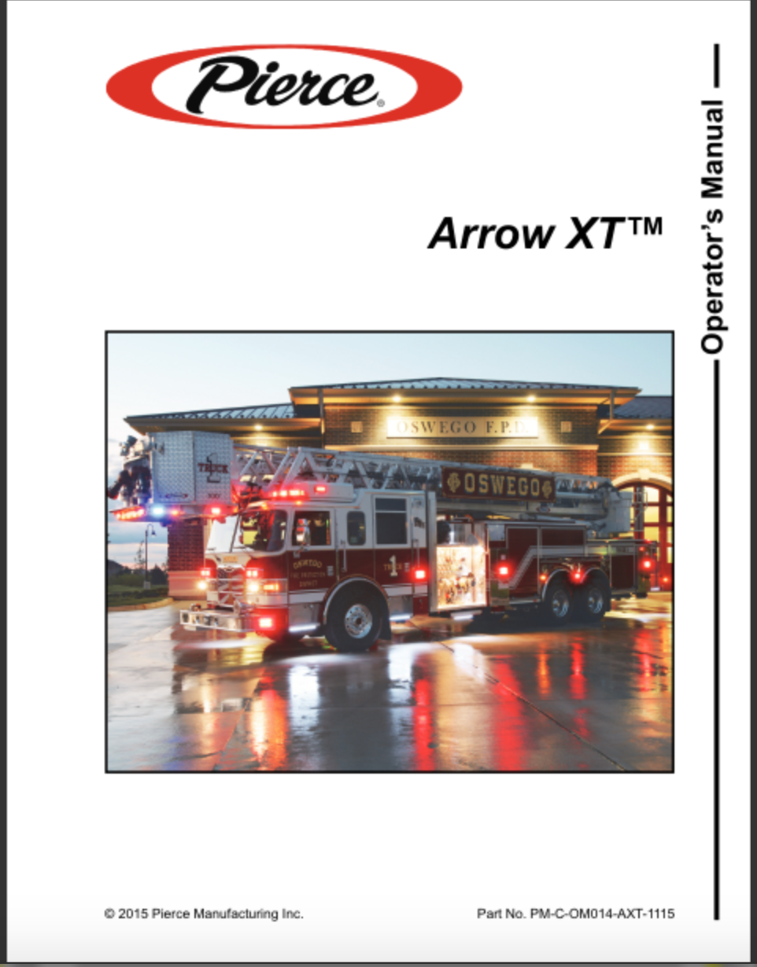
3rd Generation All Steer Tower
In addition to this presentation the following manuals should be read by all operators before operating the aerial
Service Manual
Aerial Operations Manual
Chassis Manual

Slide 3
Table of Contents
Ladder Specifications
In Cab Controls
Set Up Procedures
Outrigger Controls
Pedestal Controls
Tower Bucket Controls
Ladder Auto Stow
Emergency Operations

Slide 4
Ladder Specifications
Vertical Operating Height: 100 feet
Horizontal Reach: 93’ at 0 Degrees
Operating Range: -5 to 75 Degrees
Tip Load: 1000 Pounds (DRY) 500 Pounds (Wet)
Outrigger Spread: 19’ 6”
Ladder Pipe Rating: 2000 gpm
Maximum Wind Speed: 35 mph

Slide 5
In Cab Controls
The Aerial PTO is always engaged therefore there is NO Aerial PTO switch in the cab
The Black Plunger for your front wheel lock has been replaced with a toggle switch
  This switch can be left turned on at all times. As soon as you set your parking brake the front wheel lock will activate.
The Aerial Master Switch will give you electronic power to your outrigger and turntable pedestal controls

Slide 6
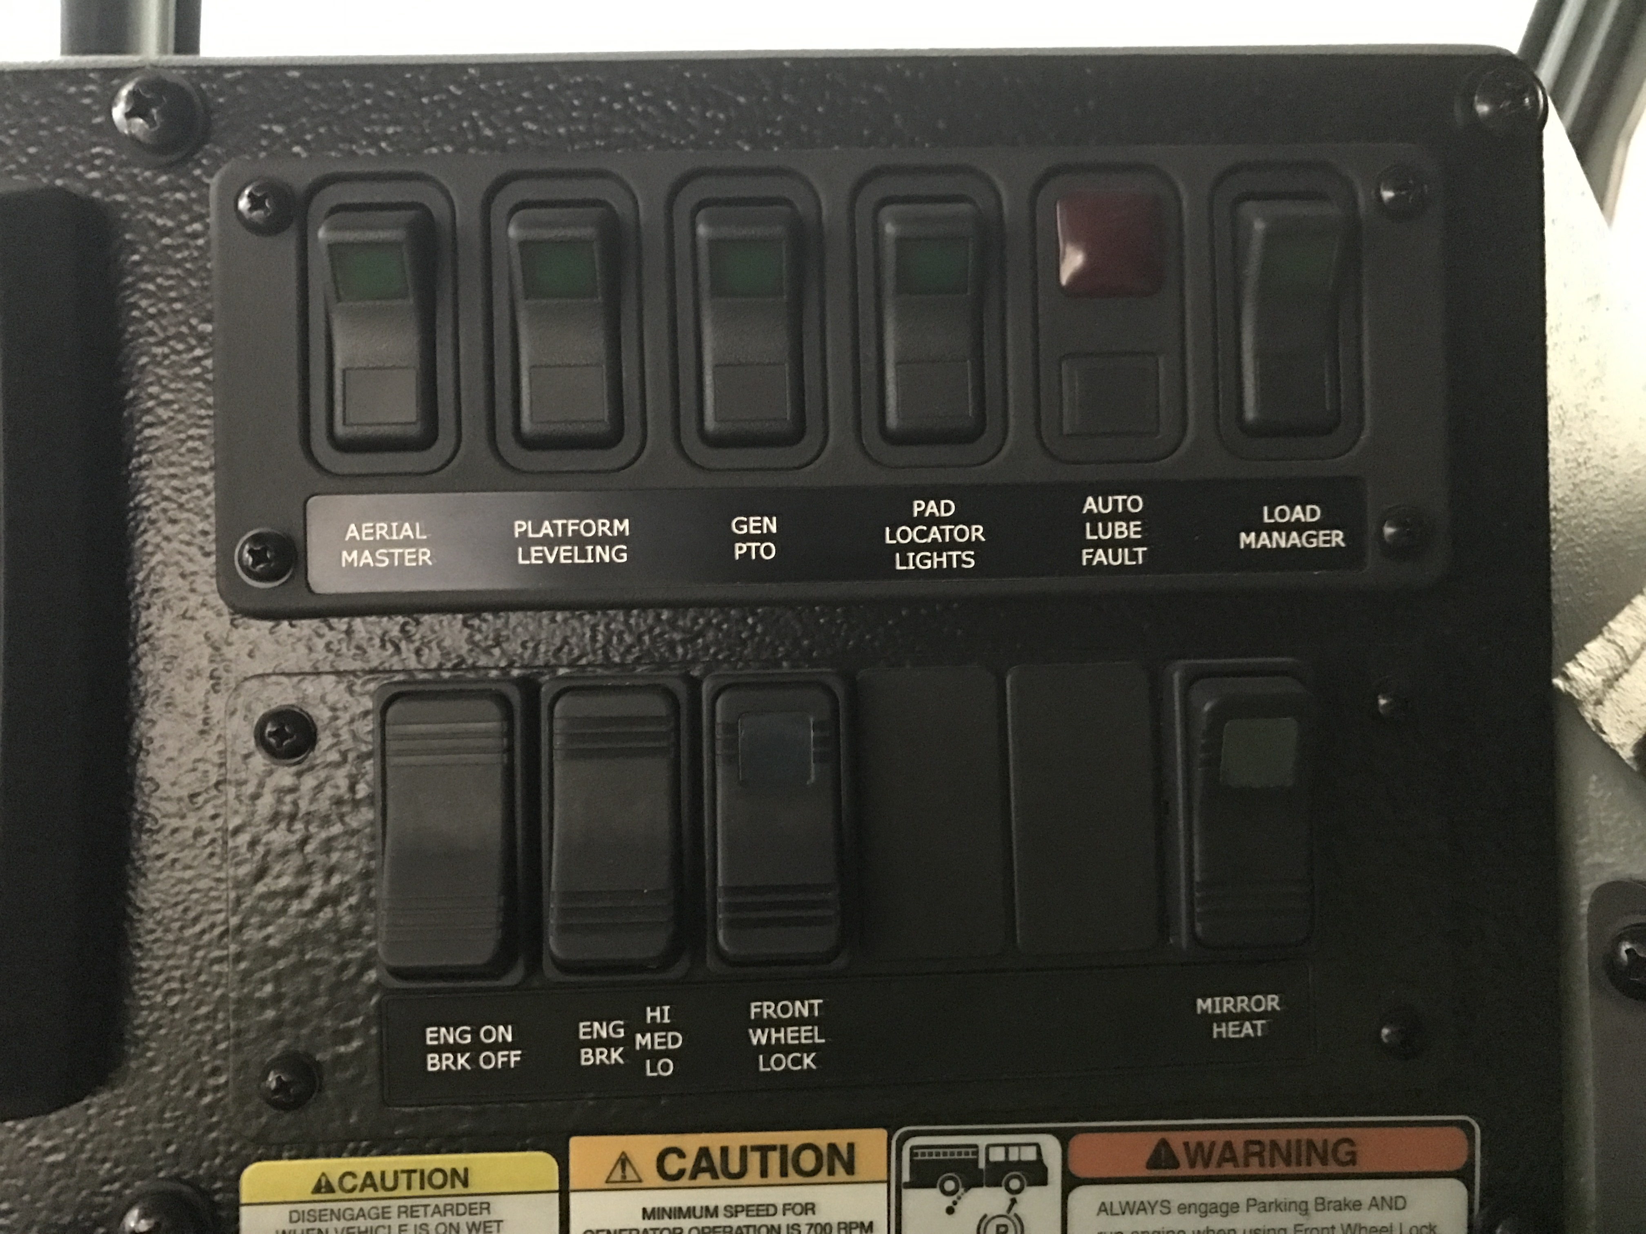
In Cab Controls
Aerial Master Switch
Front Wheel Lock

Slide 7
Set Up Procedures
Set your parking brake, turn on your front wheel lock on.
Turn your Aerial Master switch on.
Full extension of your outriggers on both sides is the preferred method of set up.
  Outriggers can be short jacked on the non-working side of the truck if need be
  If the outriggers are short jacked the truck will not allow you to operate the ladder over the short jacked side.
Raise the vehicle enough to take the suspension out of play. If possible leave all tires in contact with the ground.
If positioning on a hill attempt to position facing up hill, this will allow you to adjust the level of the truck rear to front.

Slide 8
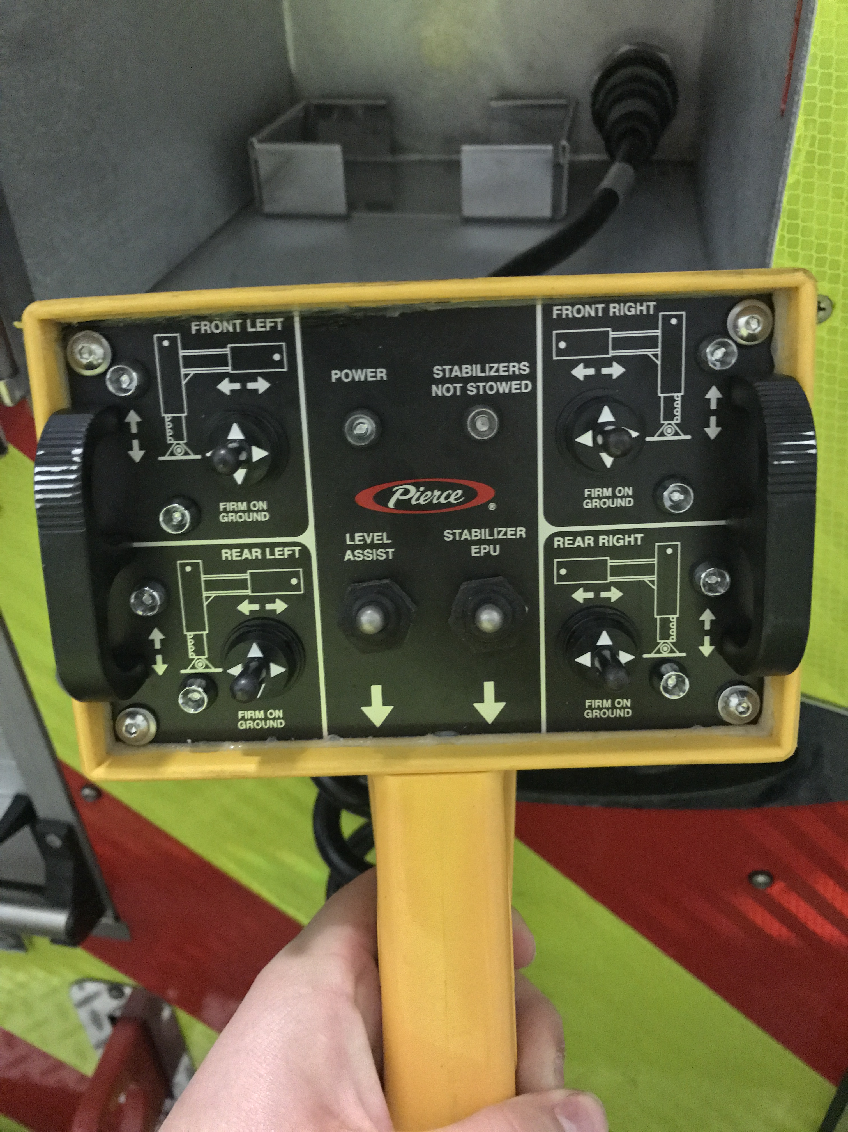
Outrigger Controls
Located on the rear of the truck, just to the right of the ladder compartment.
Use power switch in the compartment to turn power on to your remote.
Truck is stable when all for outriggers light up ”firm on ground”.
The level assist switch is supposed to use the computer to help you level the truck however it tends to raise the truck to its highest position bringing all of your axles off of the ground. This is NOT a recommended procedure.

Slide 9
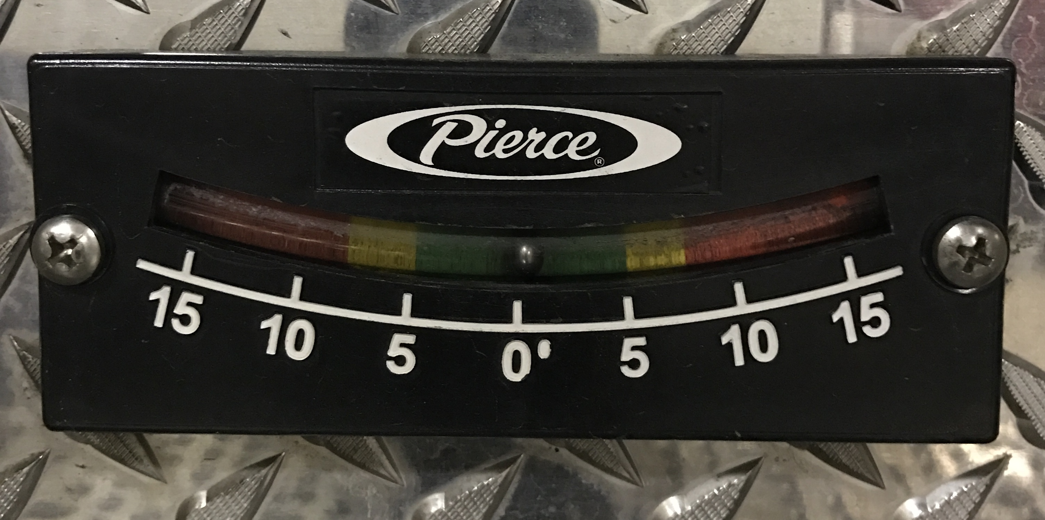
Outrigger Controls
Side to Side and Front to Back Inclinometer
  Green: 0 to 5 degrees either side will allow 100% tip load capacity
  Yellow: 5 to 8 degrees either side will allow 50% tip load capacity
  Red: More than 8 degrees to either side DO NOT OPERATE

Slide 10
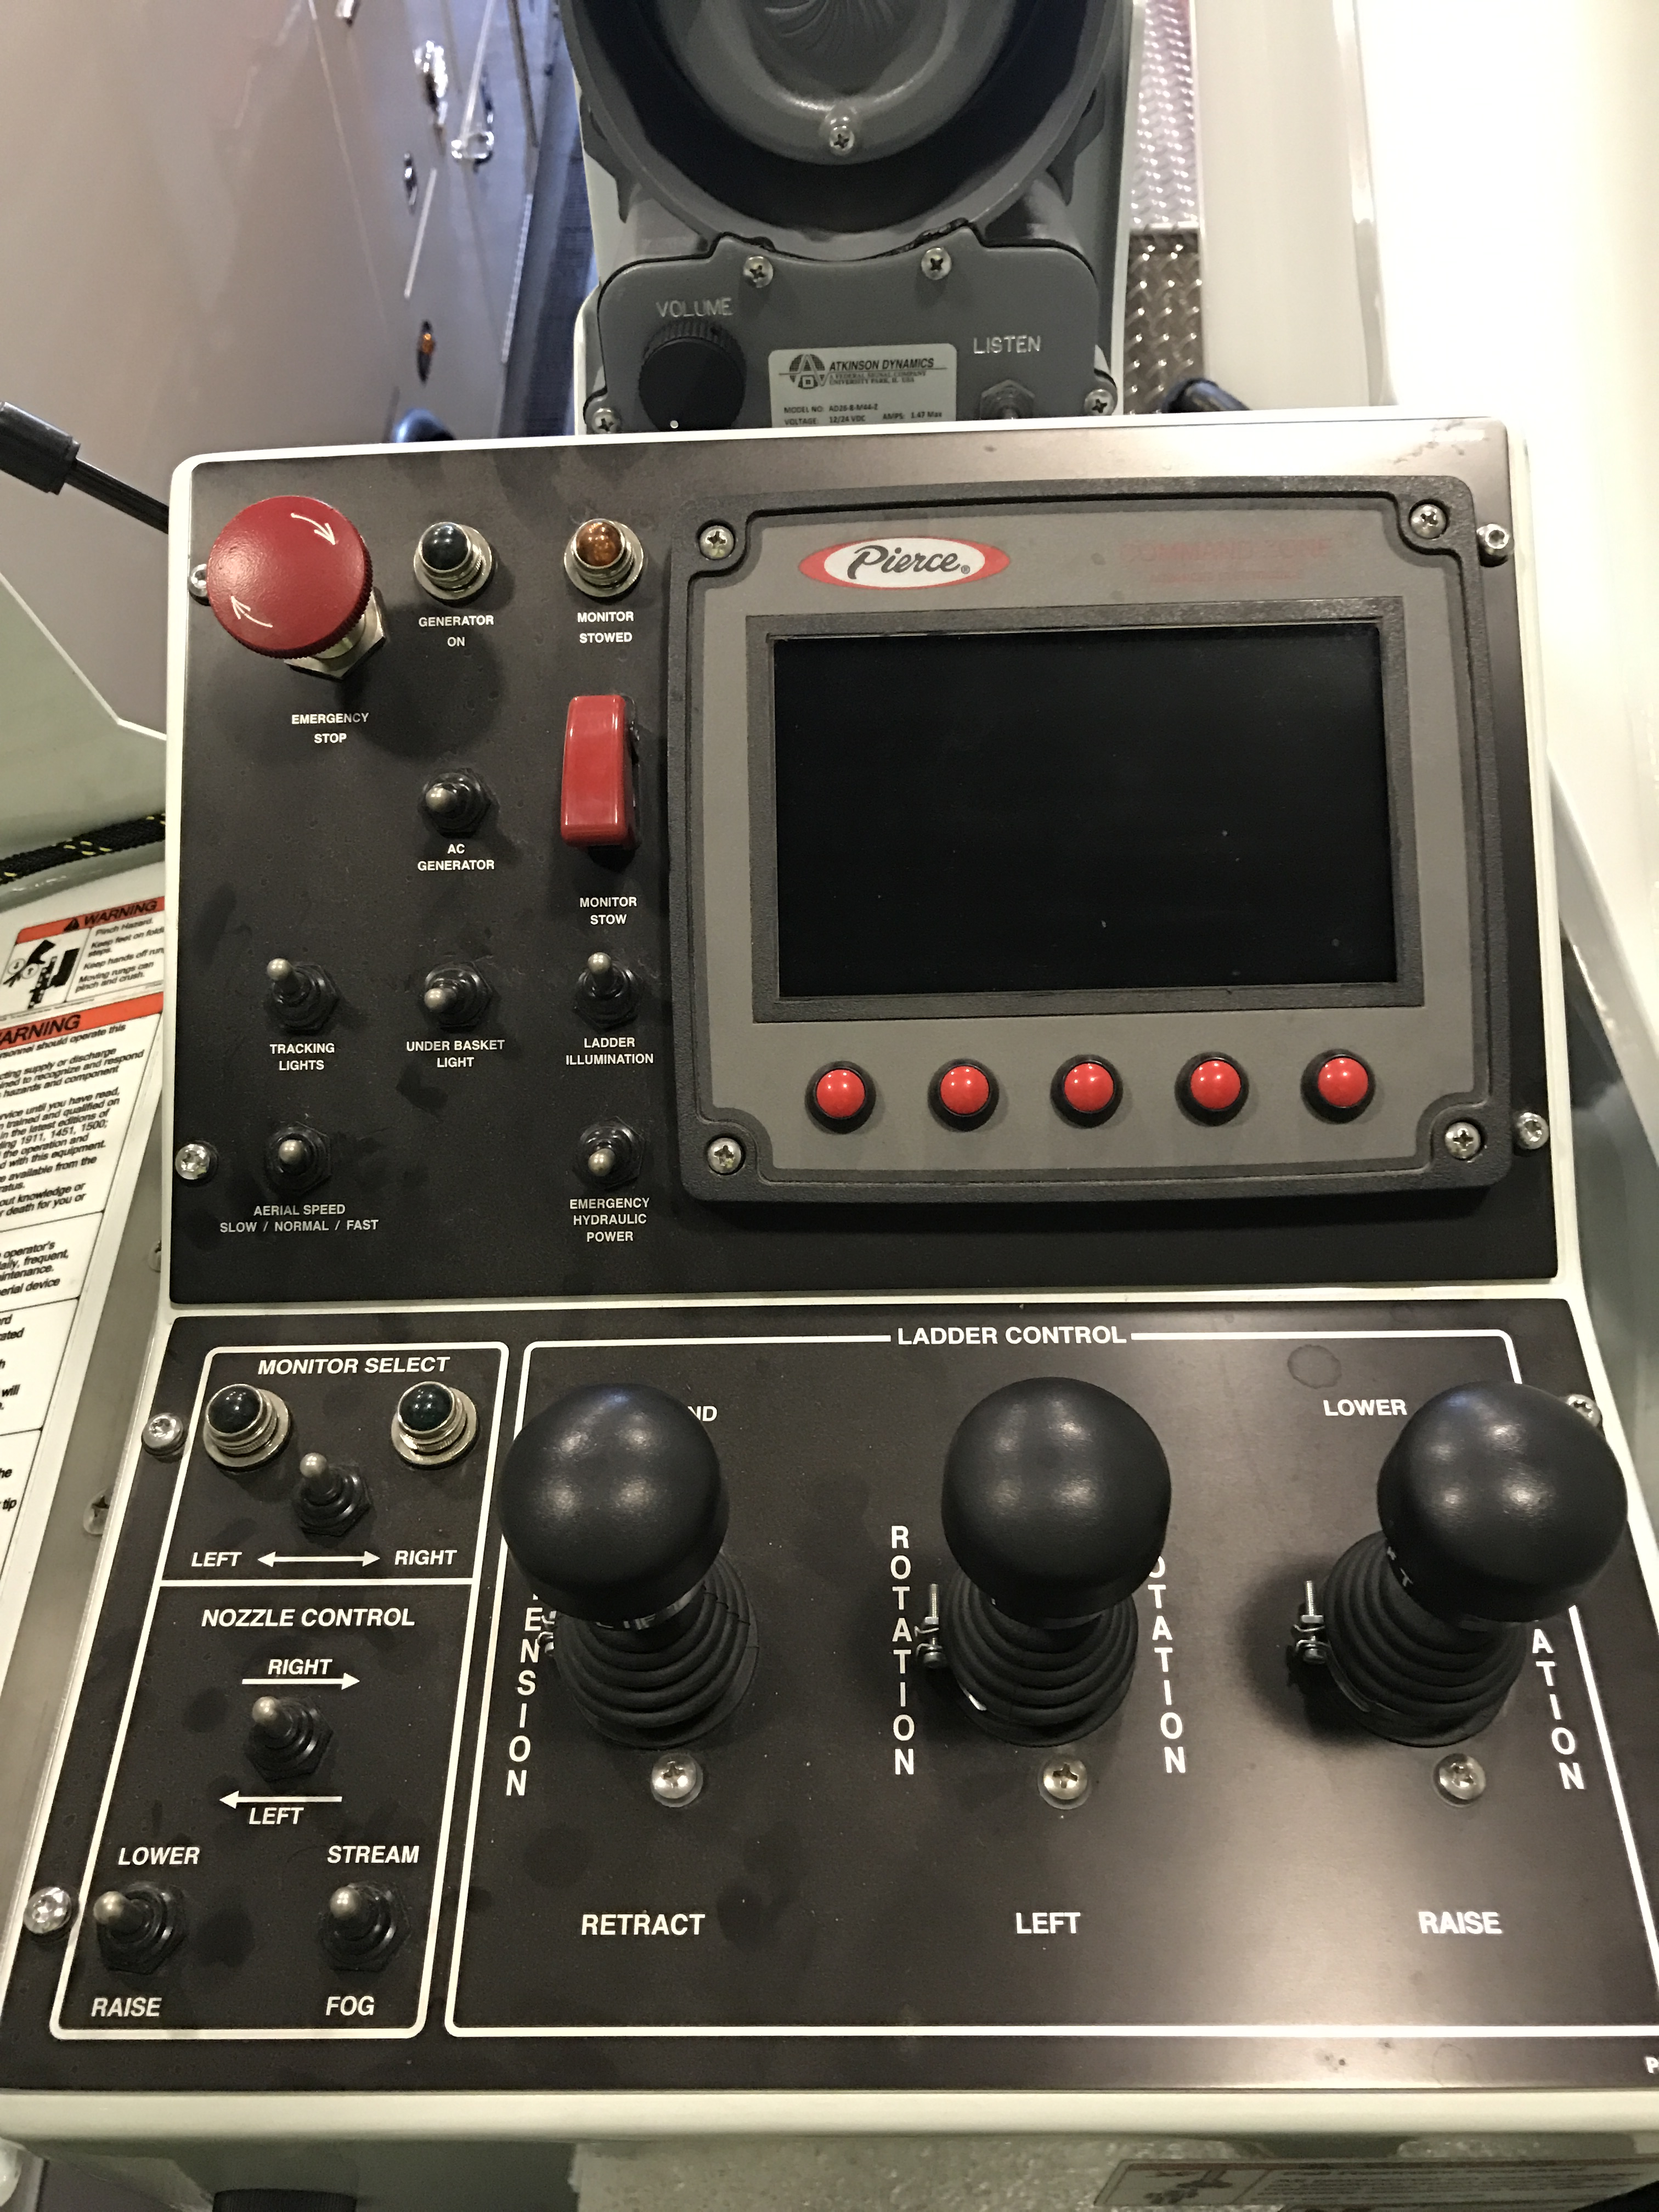
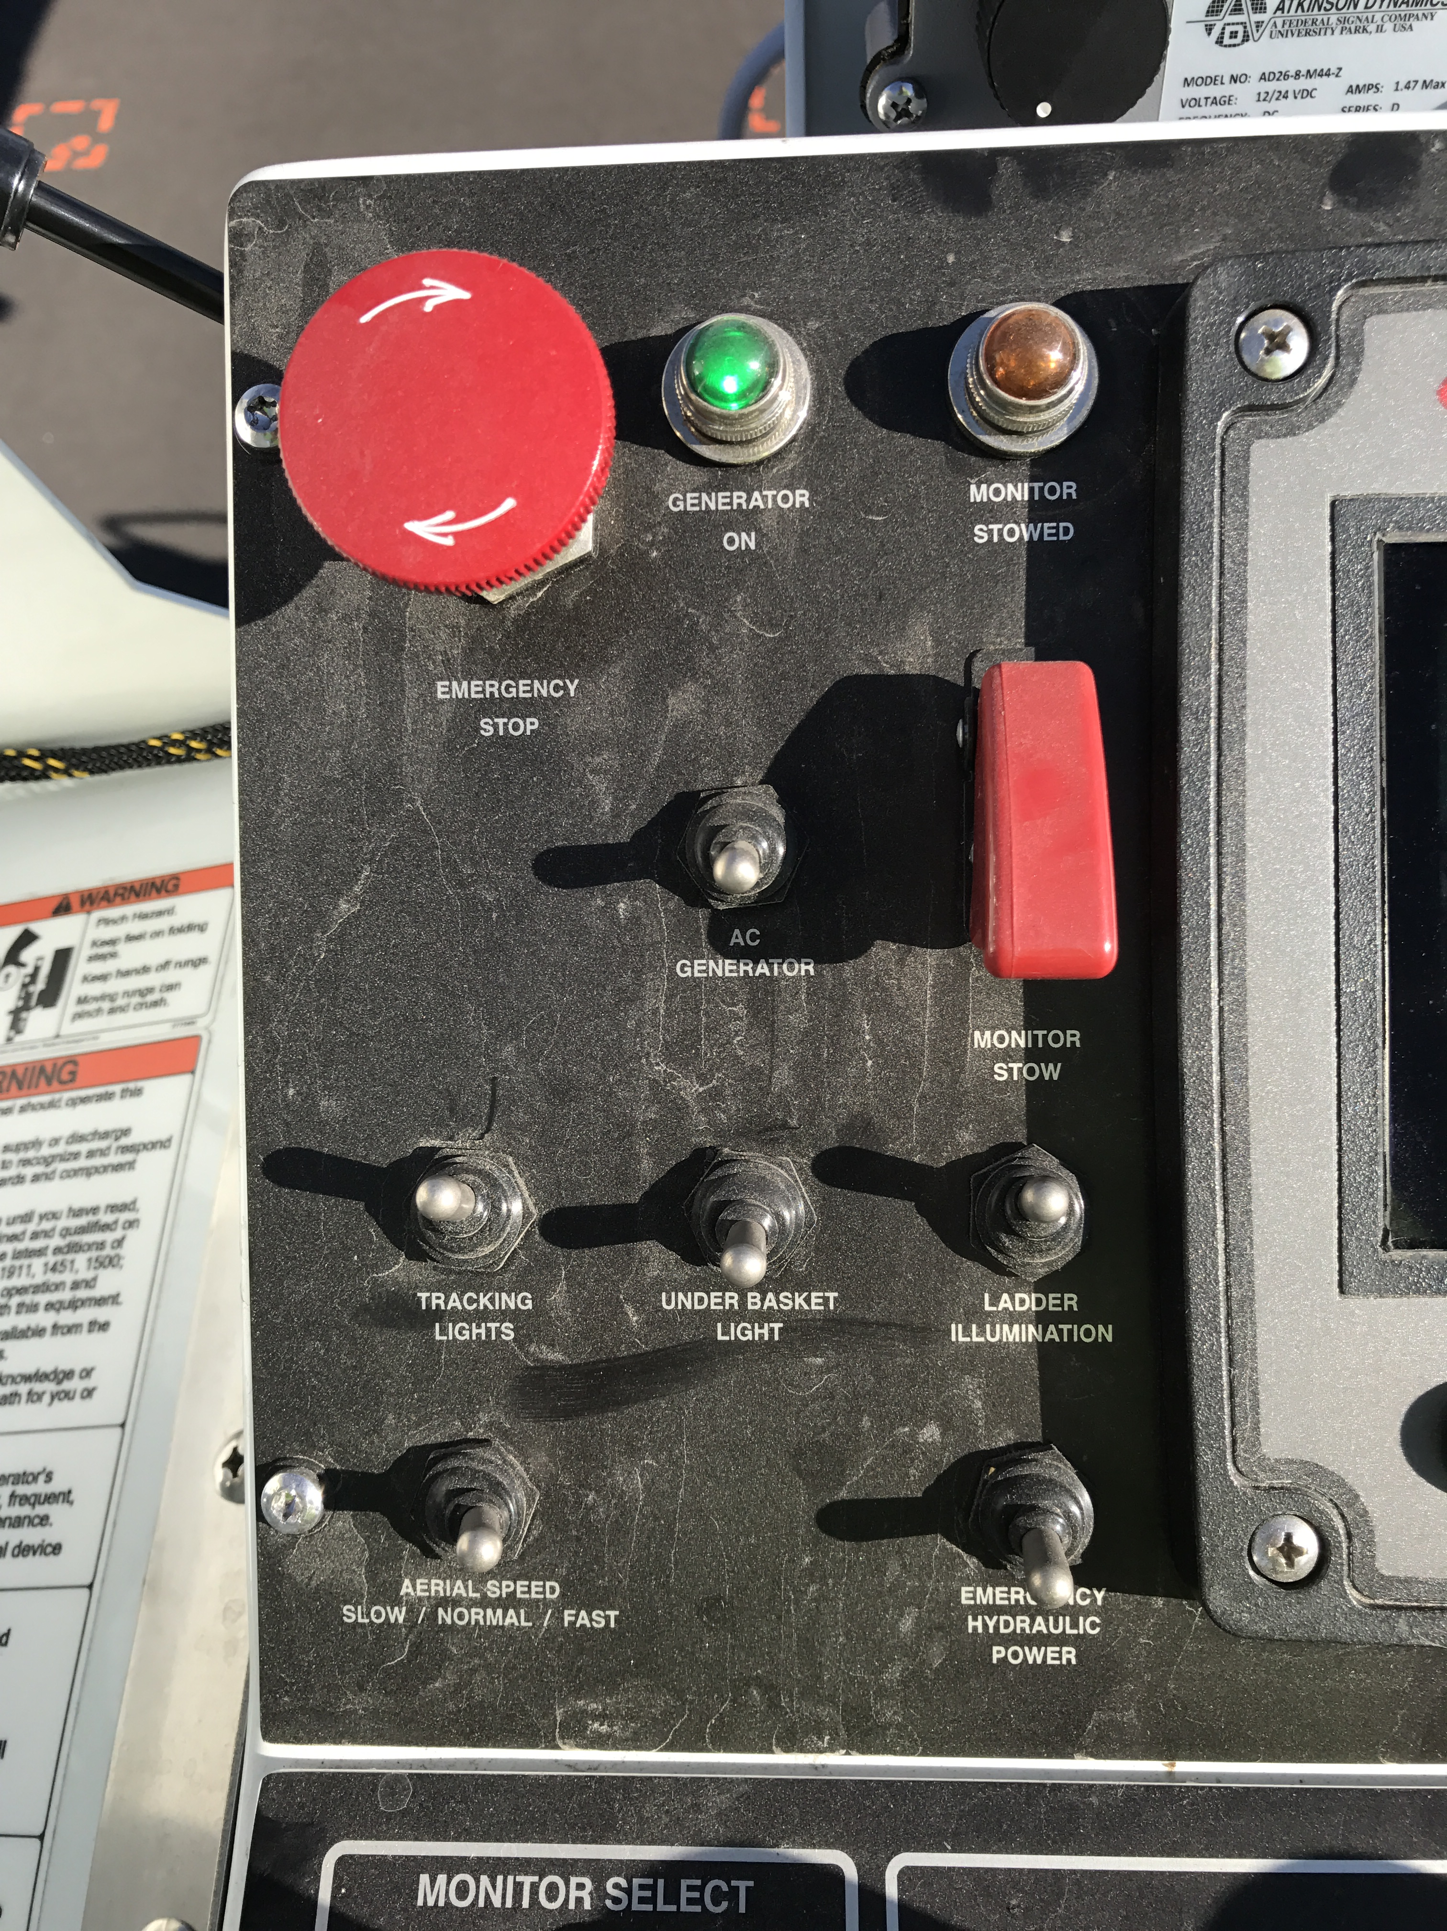
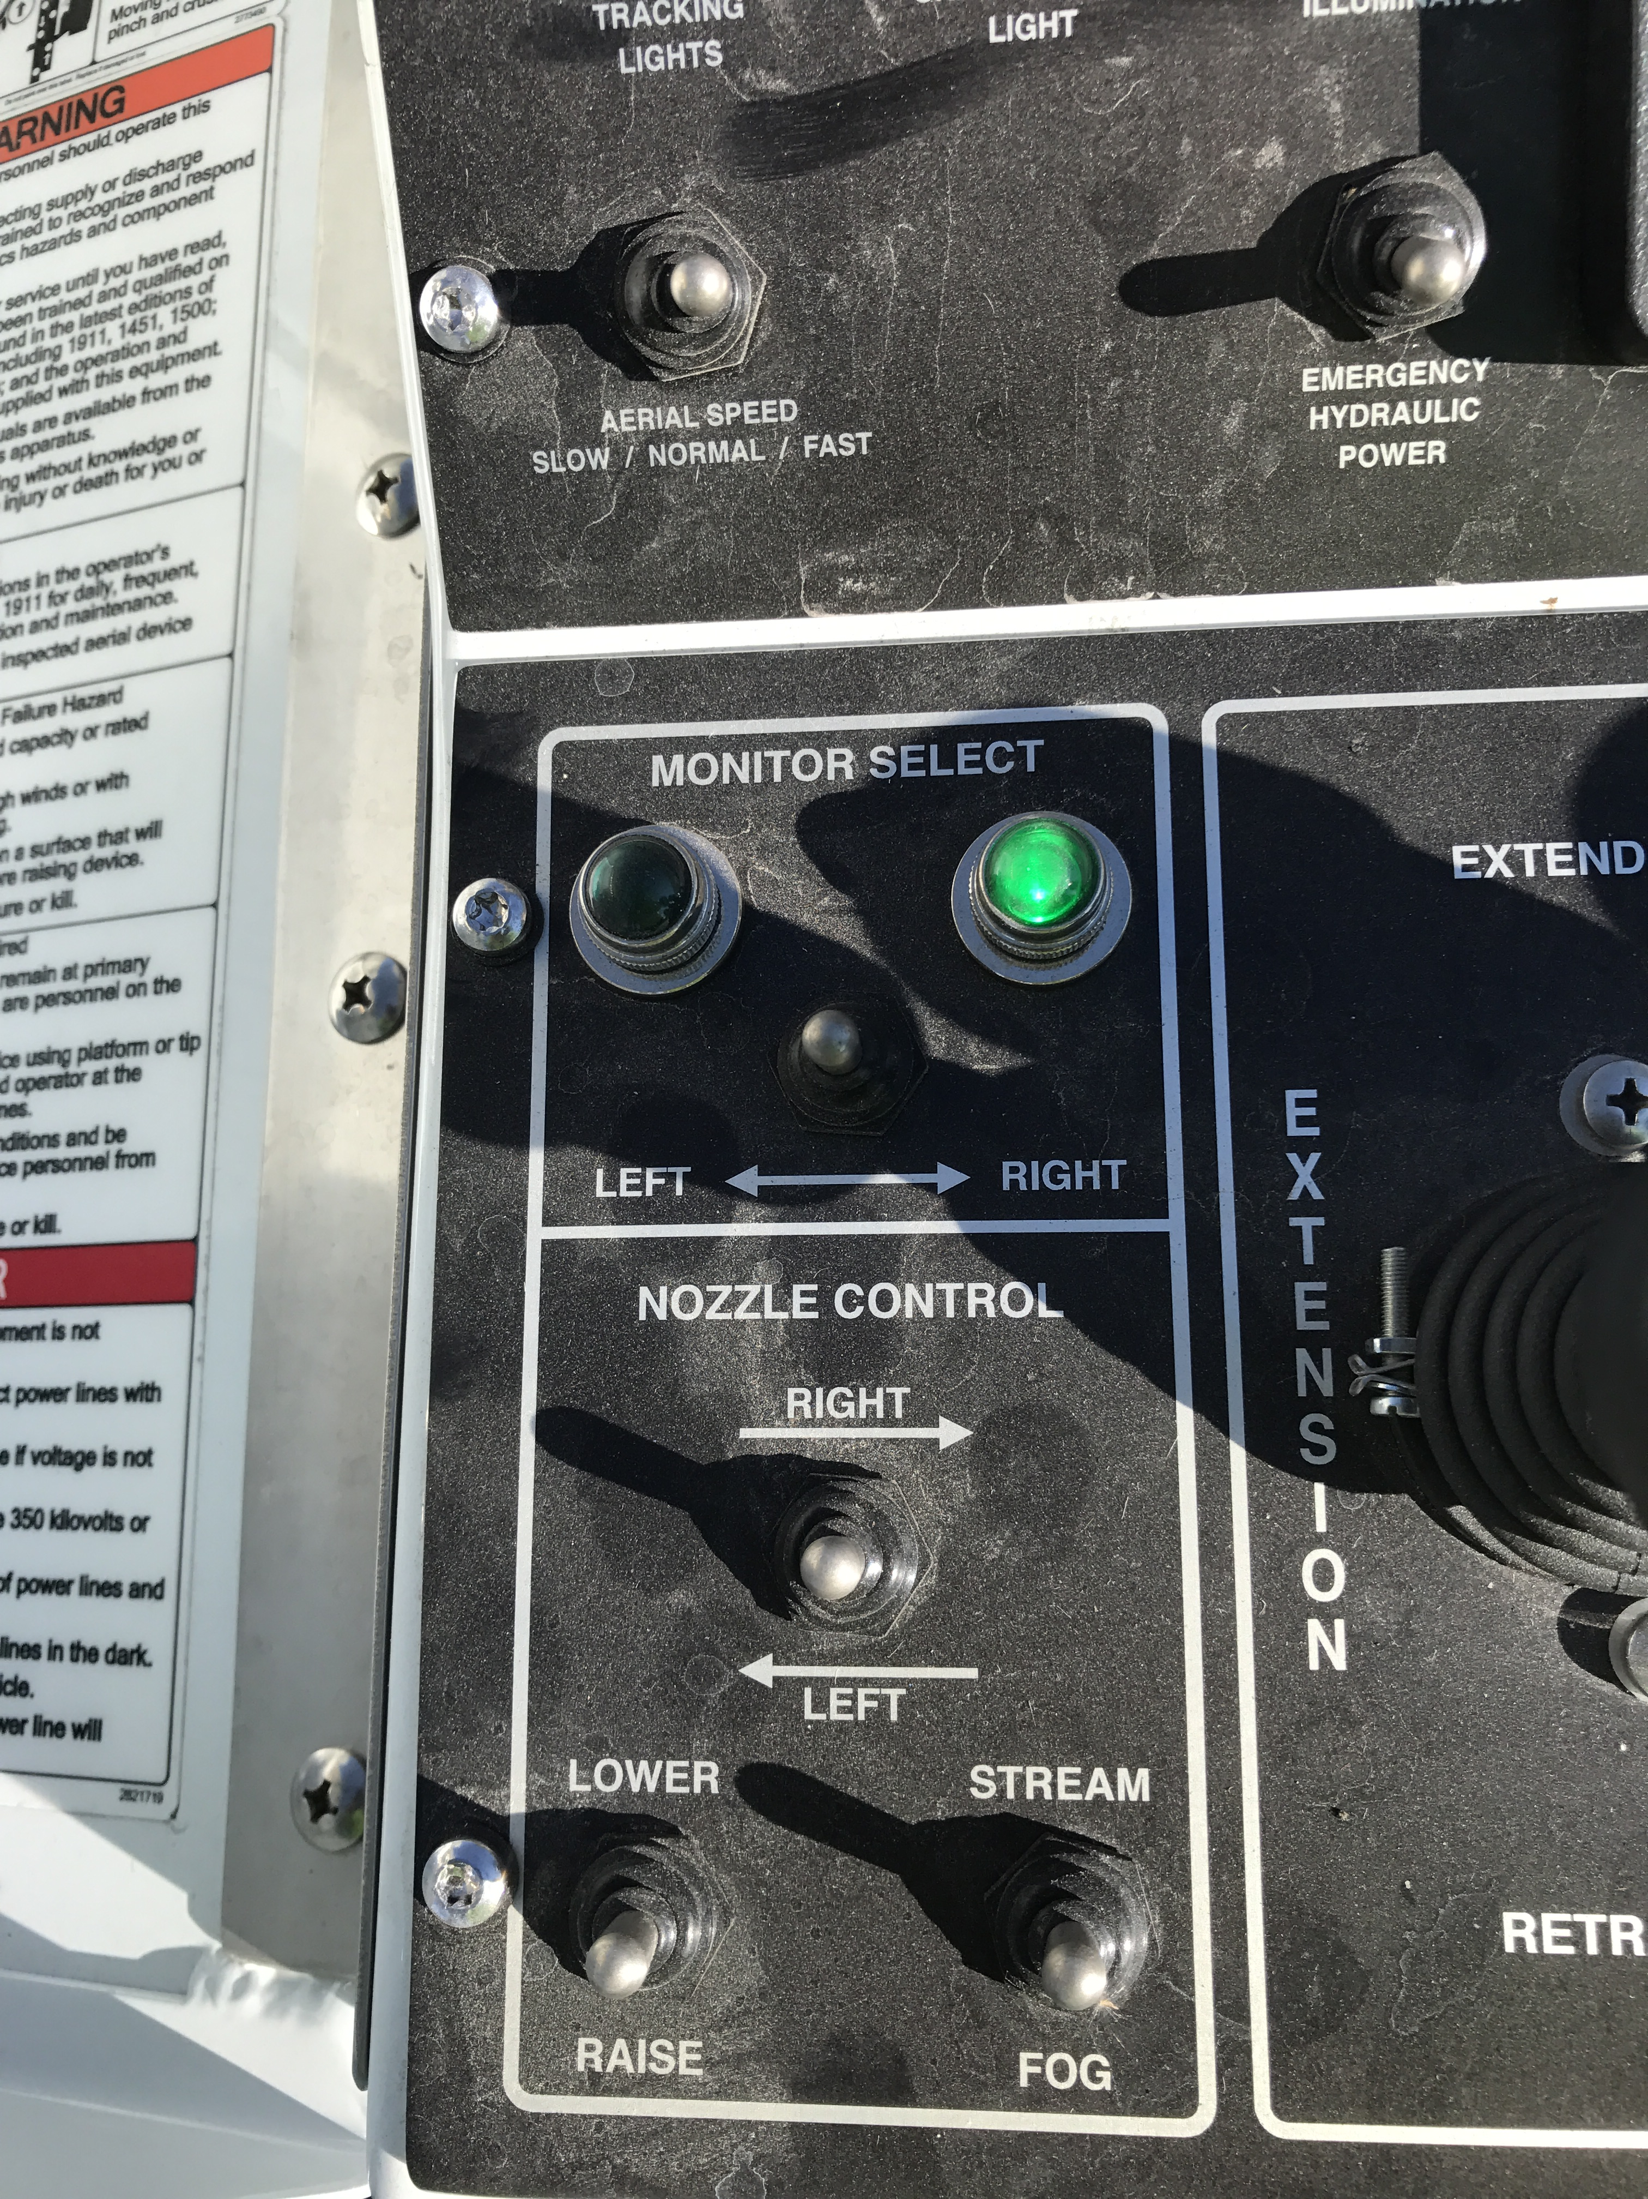
Pedestal Controls

Slide 11
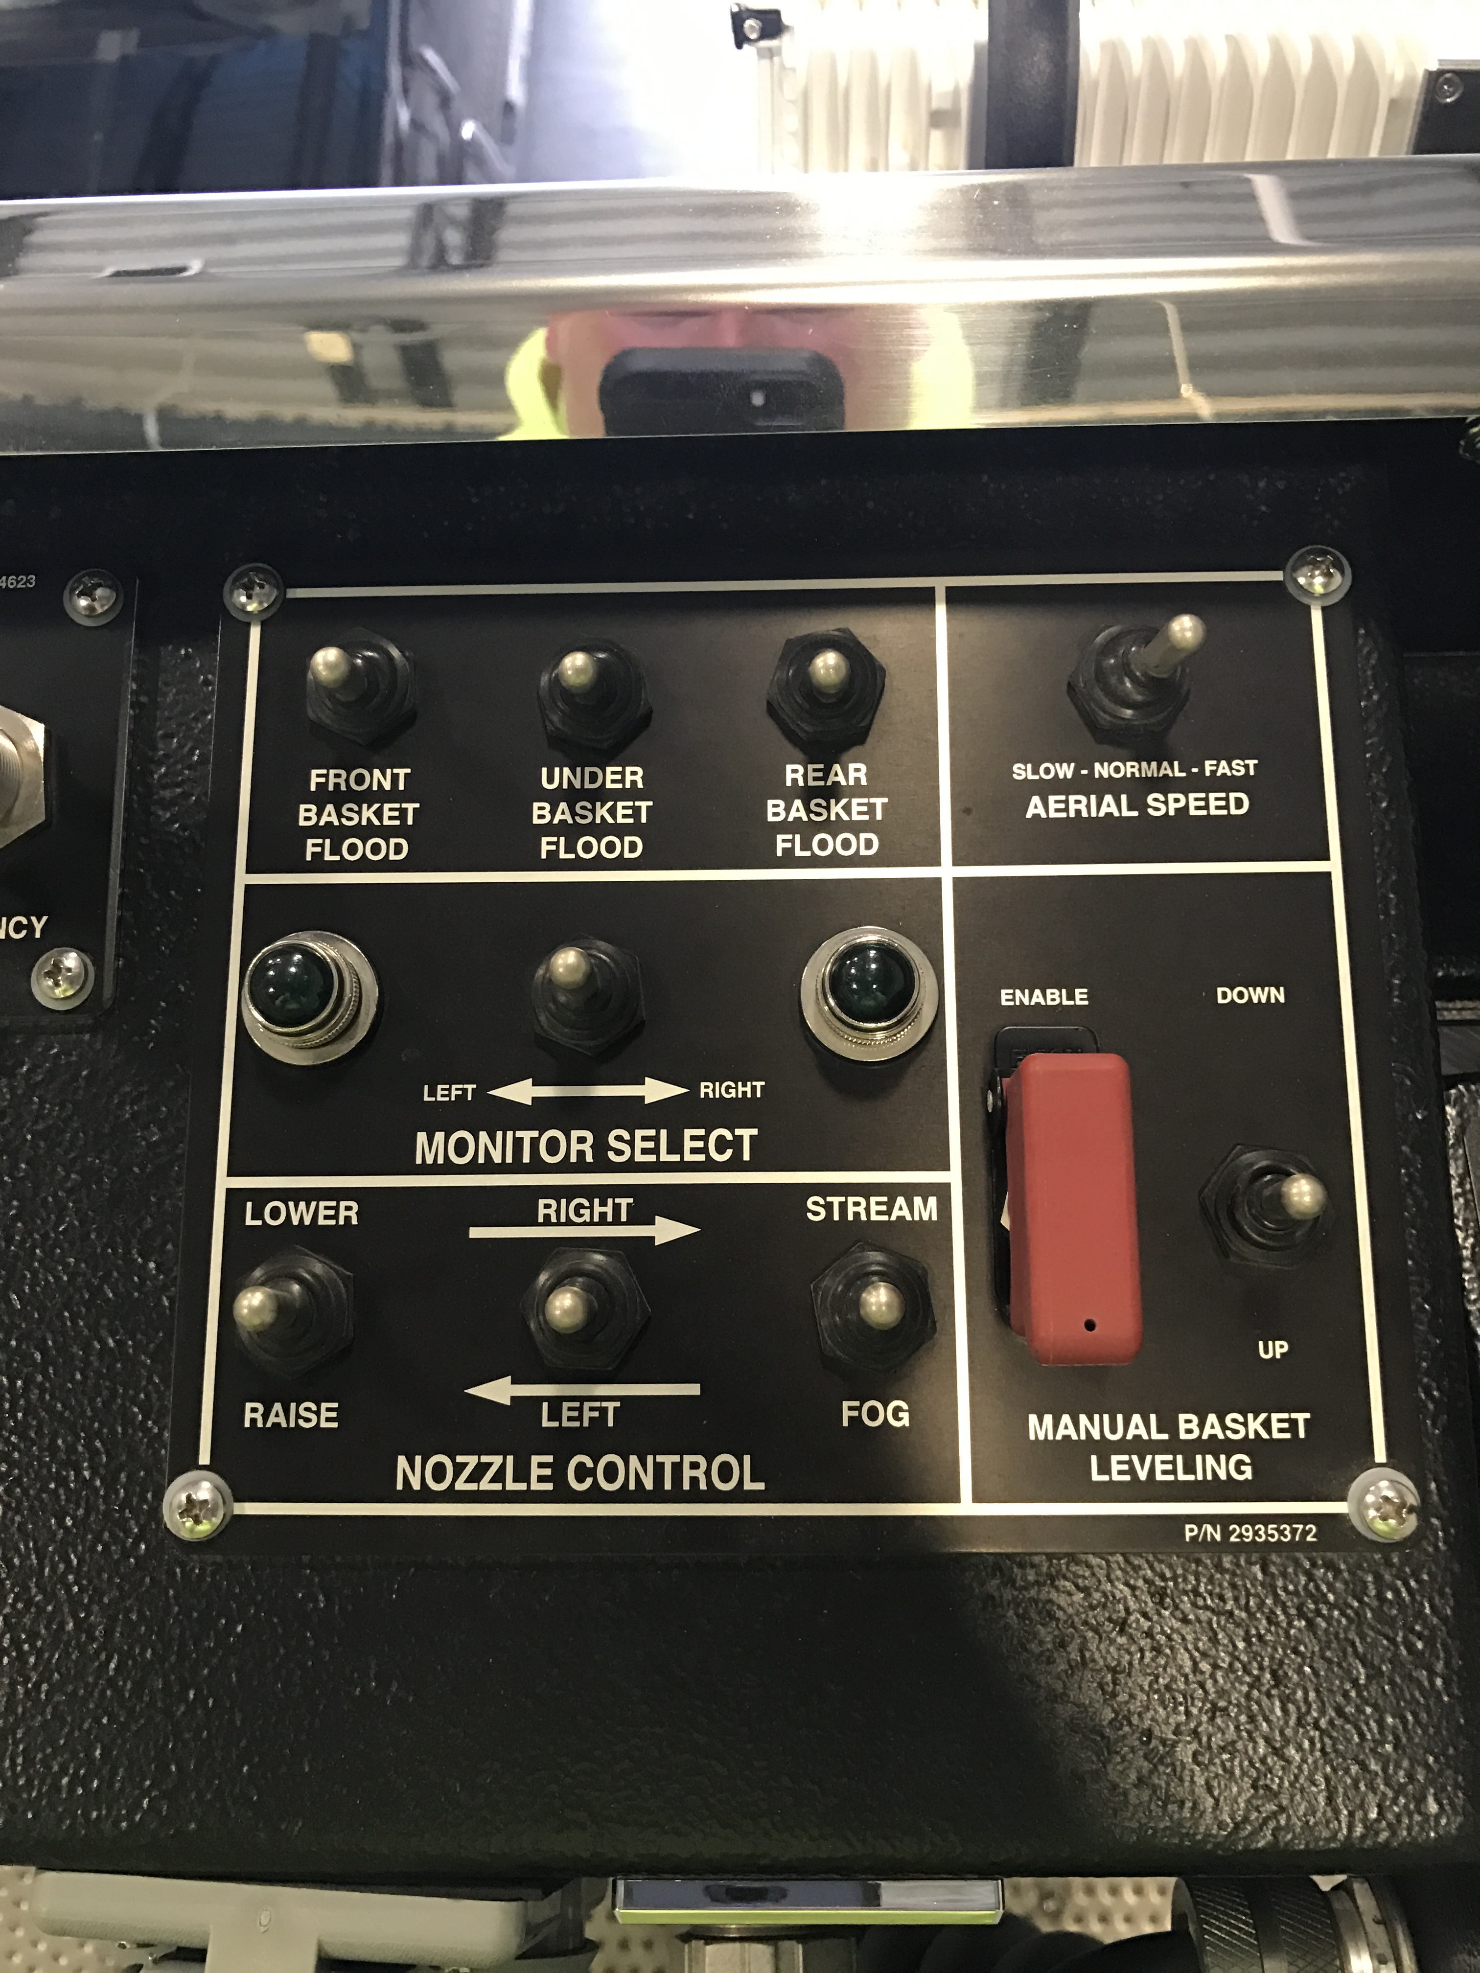
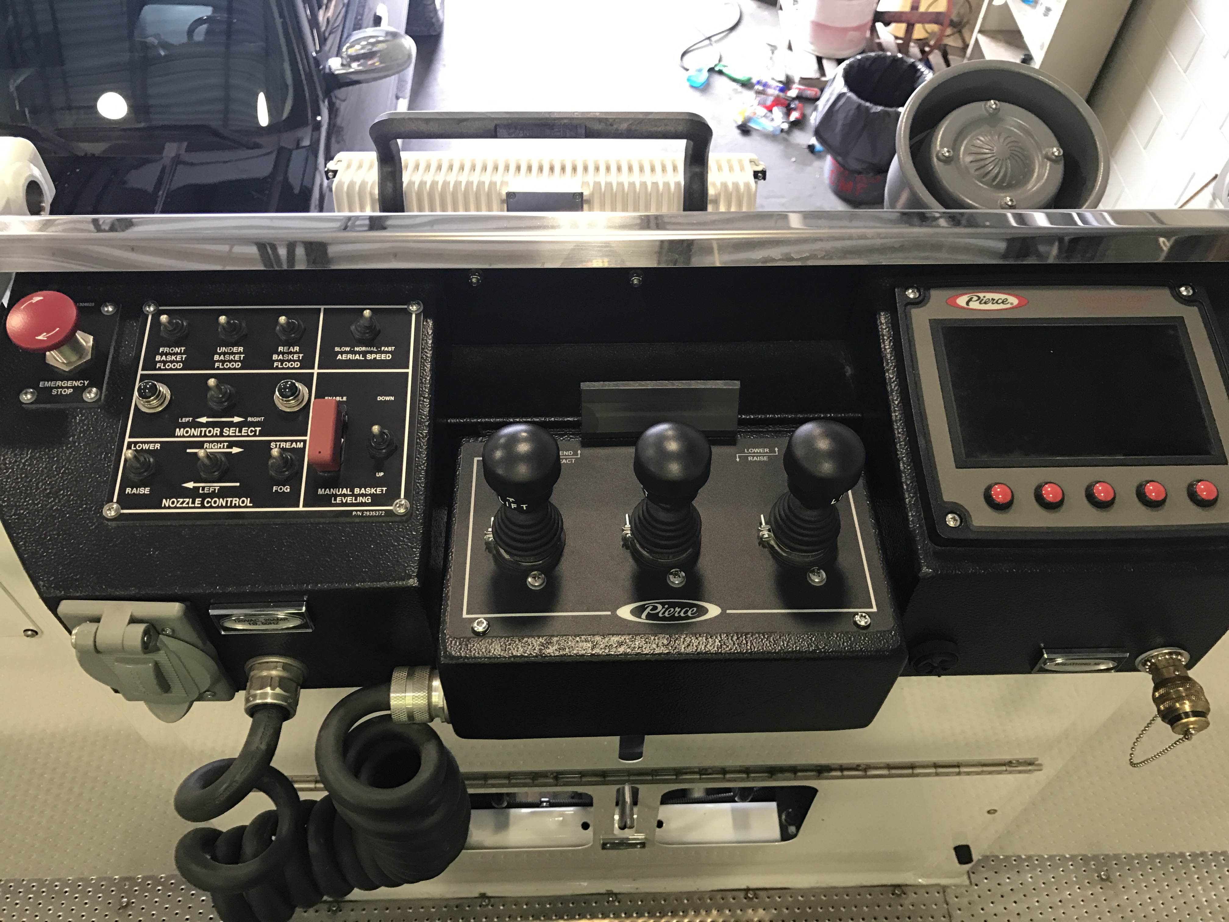
Tower Bucket Controls

Slide 12
Ladder Auto Stow
When you are lowering the ladder back into the cradle the Auto Stow feature will activate.
Auto Stow Activates when you are close to the centerline of the cab and when the ladder elevation reaches 10 degrees.
Hold Lower and the ladder will line itself up to the cradle
  Always keep an eye on the ladder and the cradle when lowering just in case the alignment is off.

Slide 13
Emergency Procedures
There are two possible failures with the aerial system.
  Electronic
  Hydraulic
  It is possible for both systems to fail together
DO NOT run the EPU for more than 30 minutes without allowing 30 minutes for cooling down. Limiting loads and pressures will allow for more efficient use of the EPU and will also generate less heat.

Slide 14
Emergency Procedures
If you have a hydraulic failure you can still use your electronic controls such as your outrigger remote and pedestal raise, rotate and extend controls to operate the outriggers and aerial. This will be using the Emergency Hydraulic Pump (EPU).
Activates Emergency Hydraulic Pump

Slide 15
Emergency Procedures
If you have a hydraulic failure you can still use your electronic controls such as your outrigger remote and pedestal raise, rotate and extend controls to operate the outriggers and aerial. This will be using the Emergency Hydraulic Pump (EPU).
Activates Emergency Hydraulic Pump

Slide 16
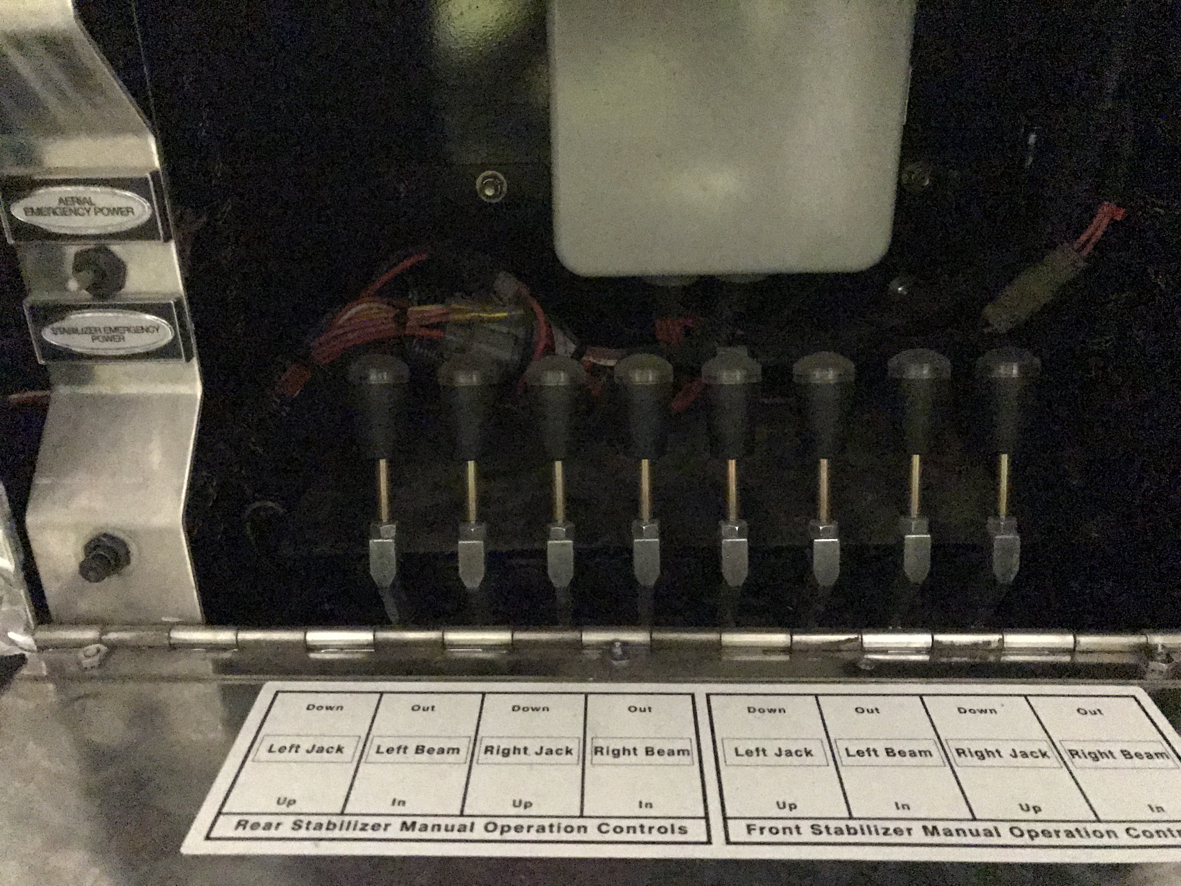
Emergency Procedures
If you have an electronic failure you will still be using the main hydraulic pump off of the aerial PTO but will have to use the emergency controls under the officers side ladder to the turn table and at the base of the ladder.
These can be operated without the emergency power switch since you are still operating under the PTO power.

Slide 17
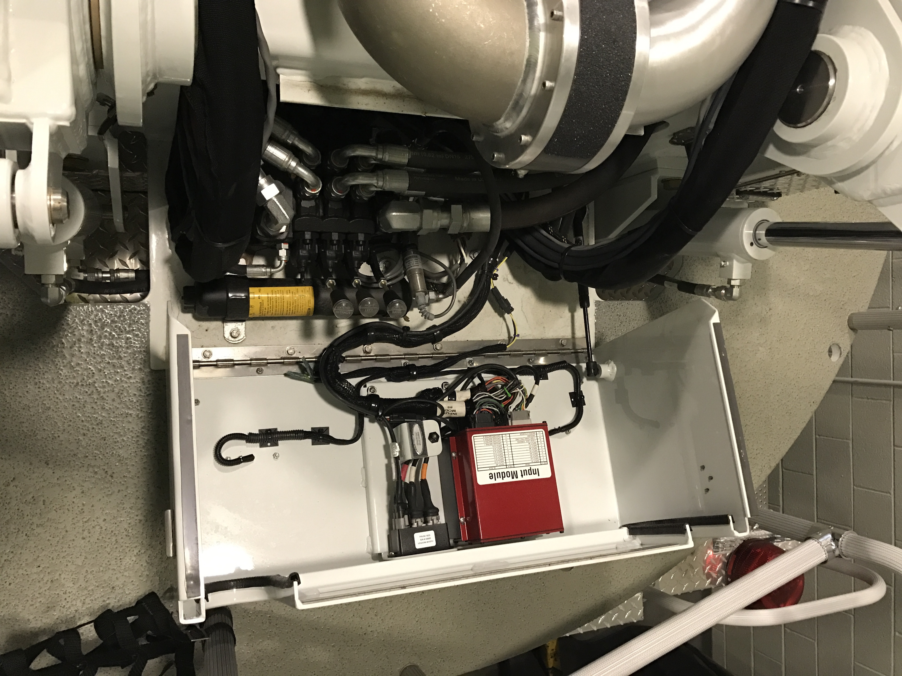
Emergency Procedures
If you have an electronic failure you will still be using the main hydraulic pump off of the aerial PTO but will have to use the emergency controls under the officers side ladder to the turn table and at the base of the ladder.
These can be operated without the emergency power switch since you are still operating under the PTO power.

Slide 18
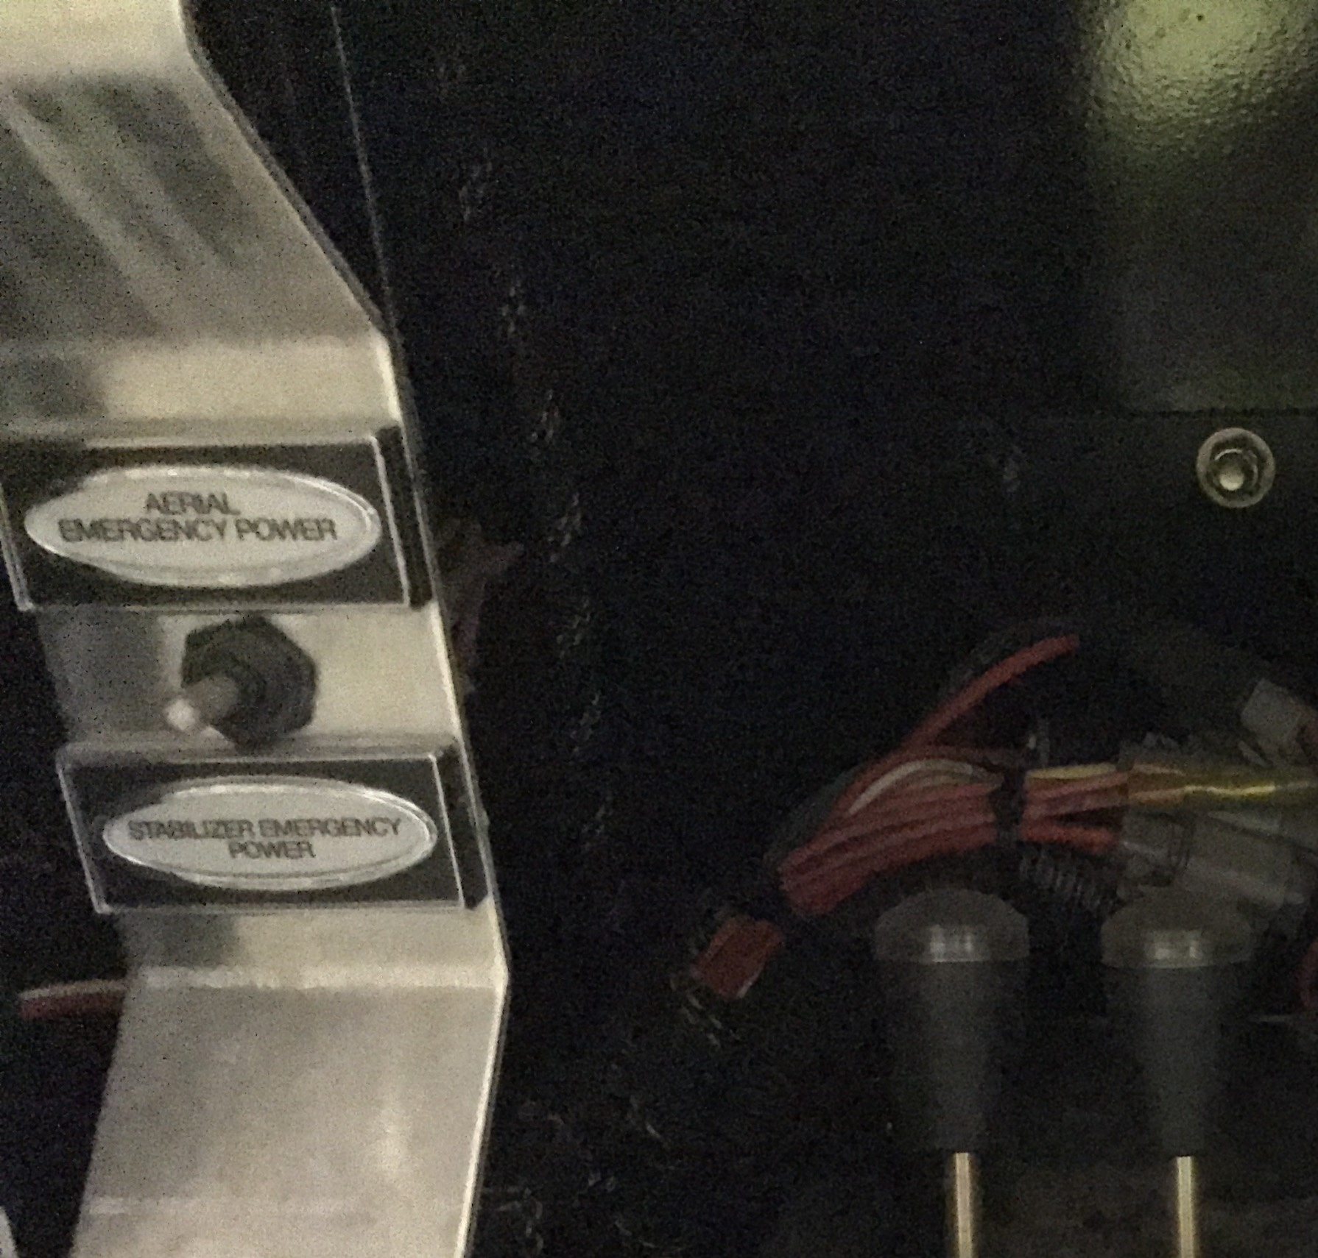
Emergency Procedures
If both systems fail you can use the emergency controls plus operate the EPU.
Access the same controls under the right side access ladder and at the base of the aerial ladder.
Operate the emergency power switch located with the emergency outrigger controls and choose emergency aerial or emergency stabilizer power.

Slide 19
Emergency Procedures
When operating the aerial emergency power you will need one person on the ground to hold the switch and one person on the turntable to operate the lever.
For both the aerial controls and the stabilizer controls you will activate the lever for the action you want to take (i.e. right front stabilizer down) then activate the emergency pump to complete the action requested. When the action is complete release the switch for the emergency pump and then return the action lever back to its normal position.

