Slide 1
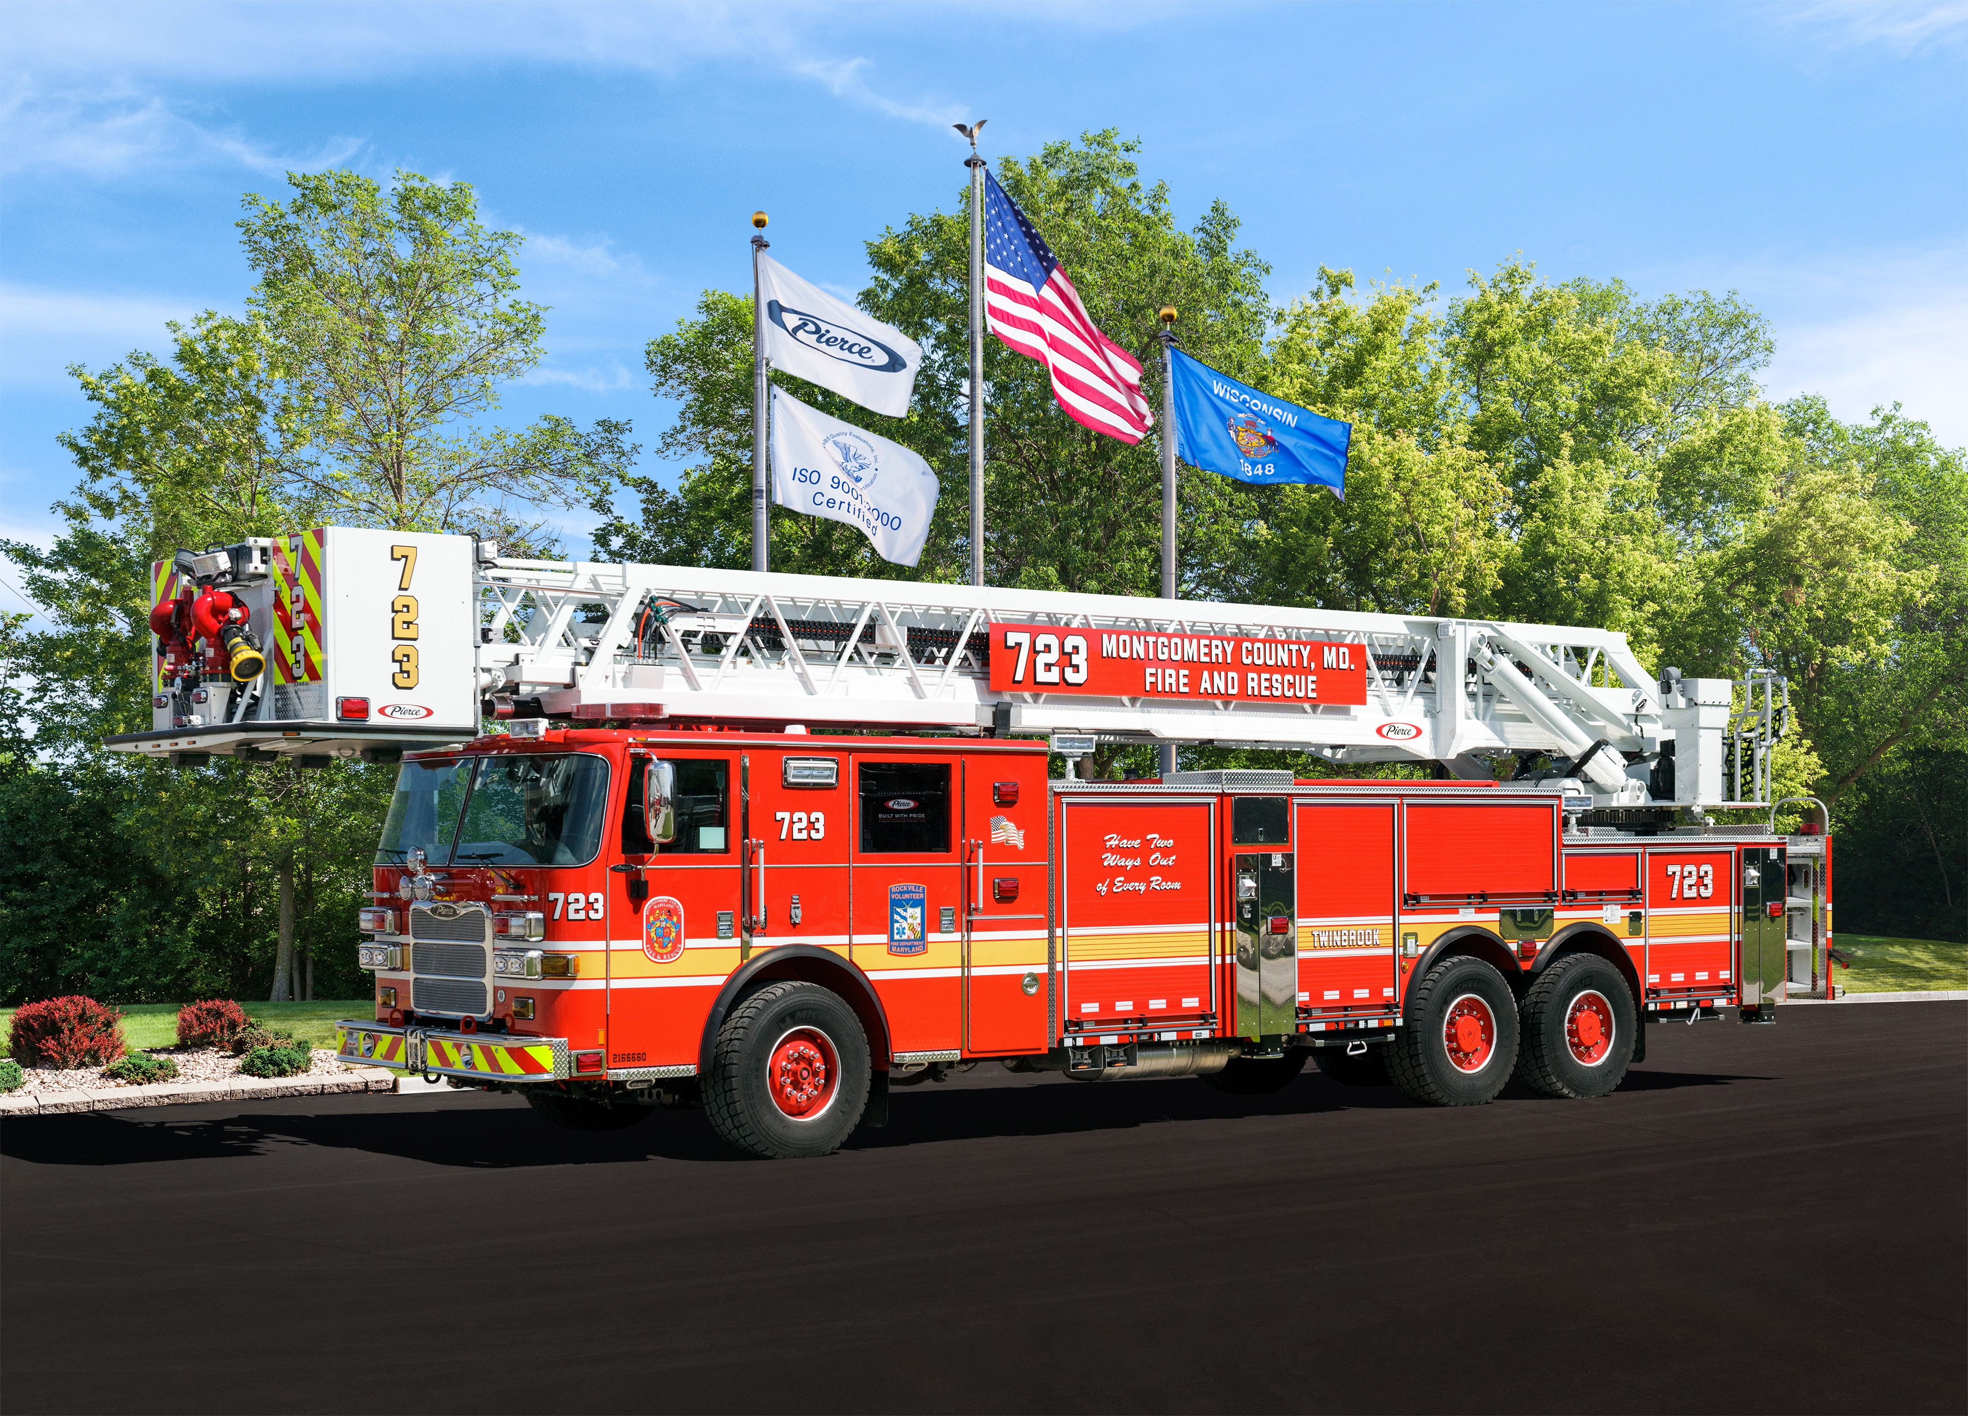
3rd Generation All Steer Tower
2016 Pierce Arrow XT Chassis

Slide 2
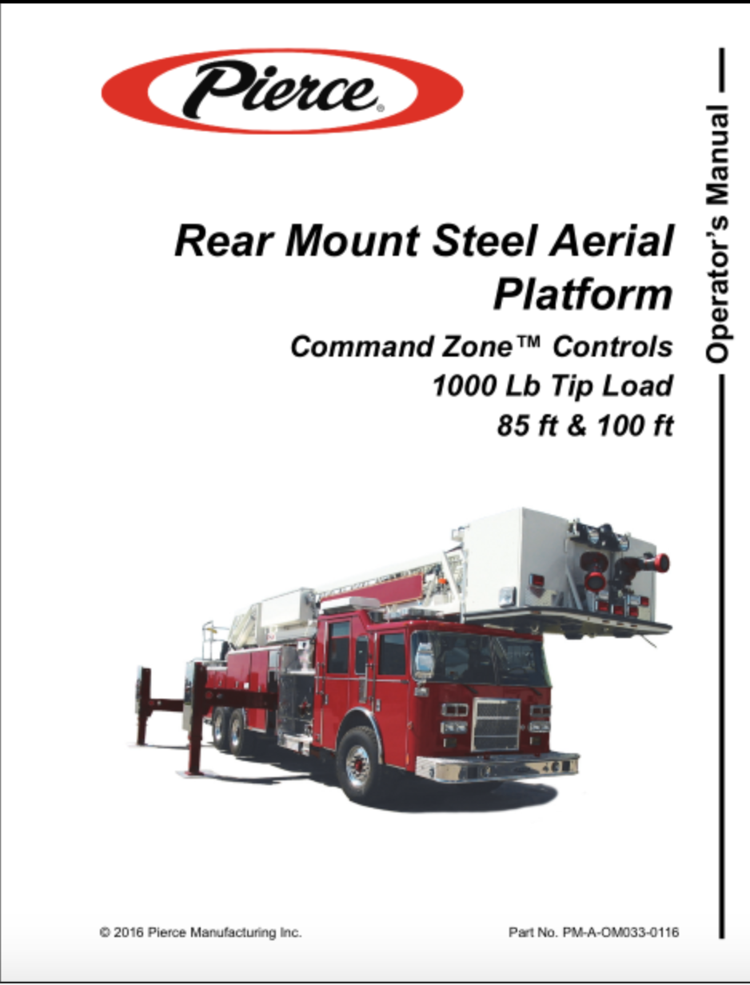
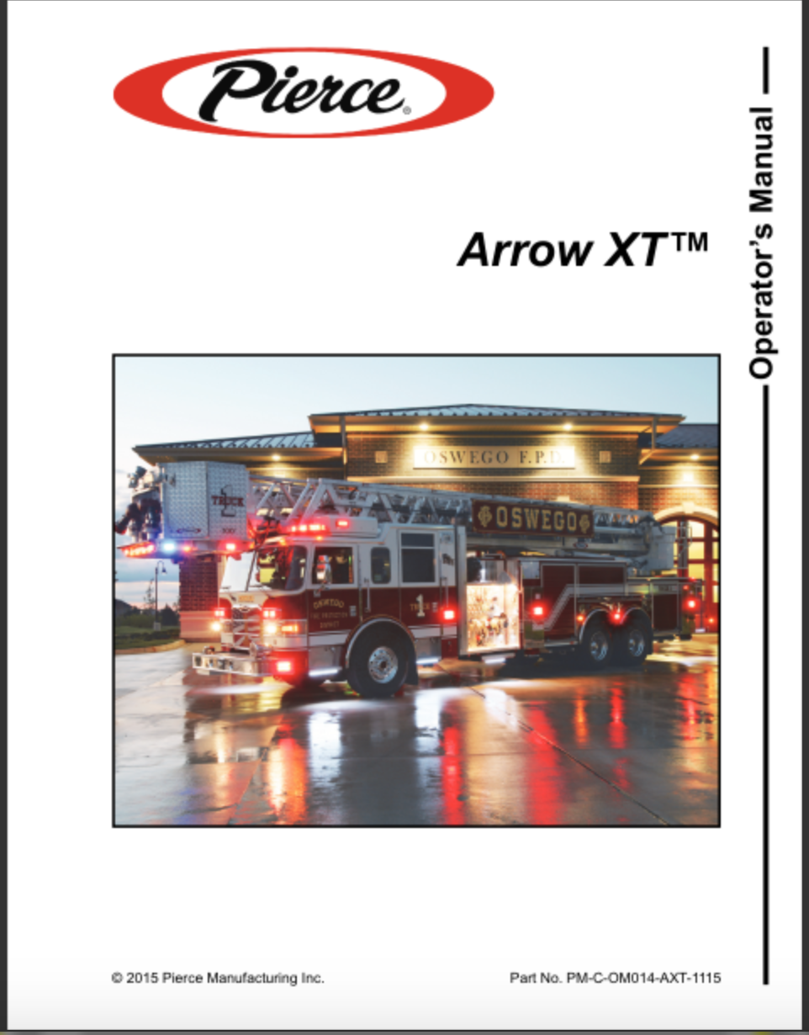
3rd Generation All Steer Tower
In addition to this presentation the following manuals should be read by all operators before operating the aerial
Aerial Operations Manual
Service Manual
Chassis Manual

Slide 3
Table of Contents
Unit Specifications
Chassis
TAK-4 Suspension
Cab Controls
Command Zone III Display
Transmission Fluid Check
Regeneration
Diesel Exhaust Fluid
Generator

Slide 4
Unit Specifications
GVWR: 74,800
Front Axle Rating: 22,800
Mid Axle Rating: 26,000
Rear Axle Rating: 26,000
Unit Height: 12’ 2”
Unit Length: 46’ 11”
Unit Width: 9’ 8” Mirror to Mirror

Slide 5
Unit Specifications
Engine: Detroit Diesel Series 13
Brakes: Front- Disc Rears- Drum
Tire Pressure: 120 psi All Tires
Coolant: OAT ELC 60 Quarts
Engine Oil: 15w-40 42 Quarts
Transmission Fluid: TES-295 39 Quarts
Power Steering Fluid: Dexron III 4 Quarts
Diesel Exhaust Fluid: 4.5 Gallons DEF

Slide 6
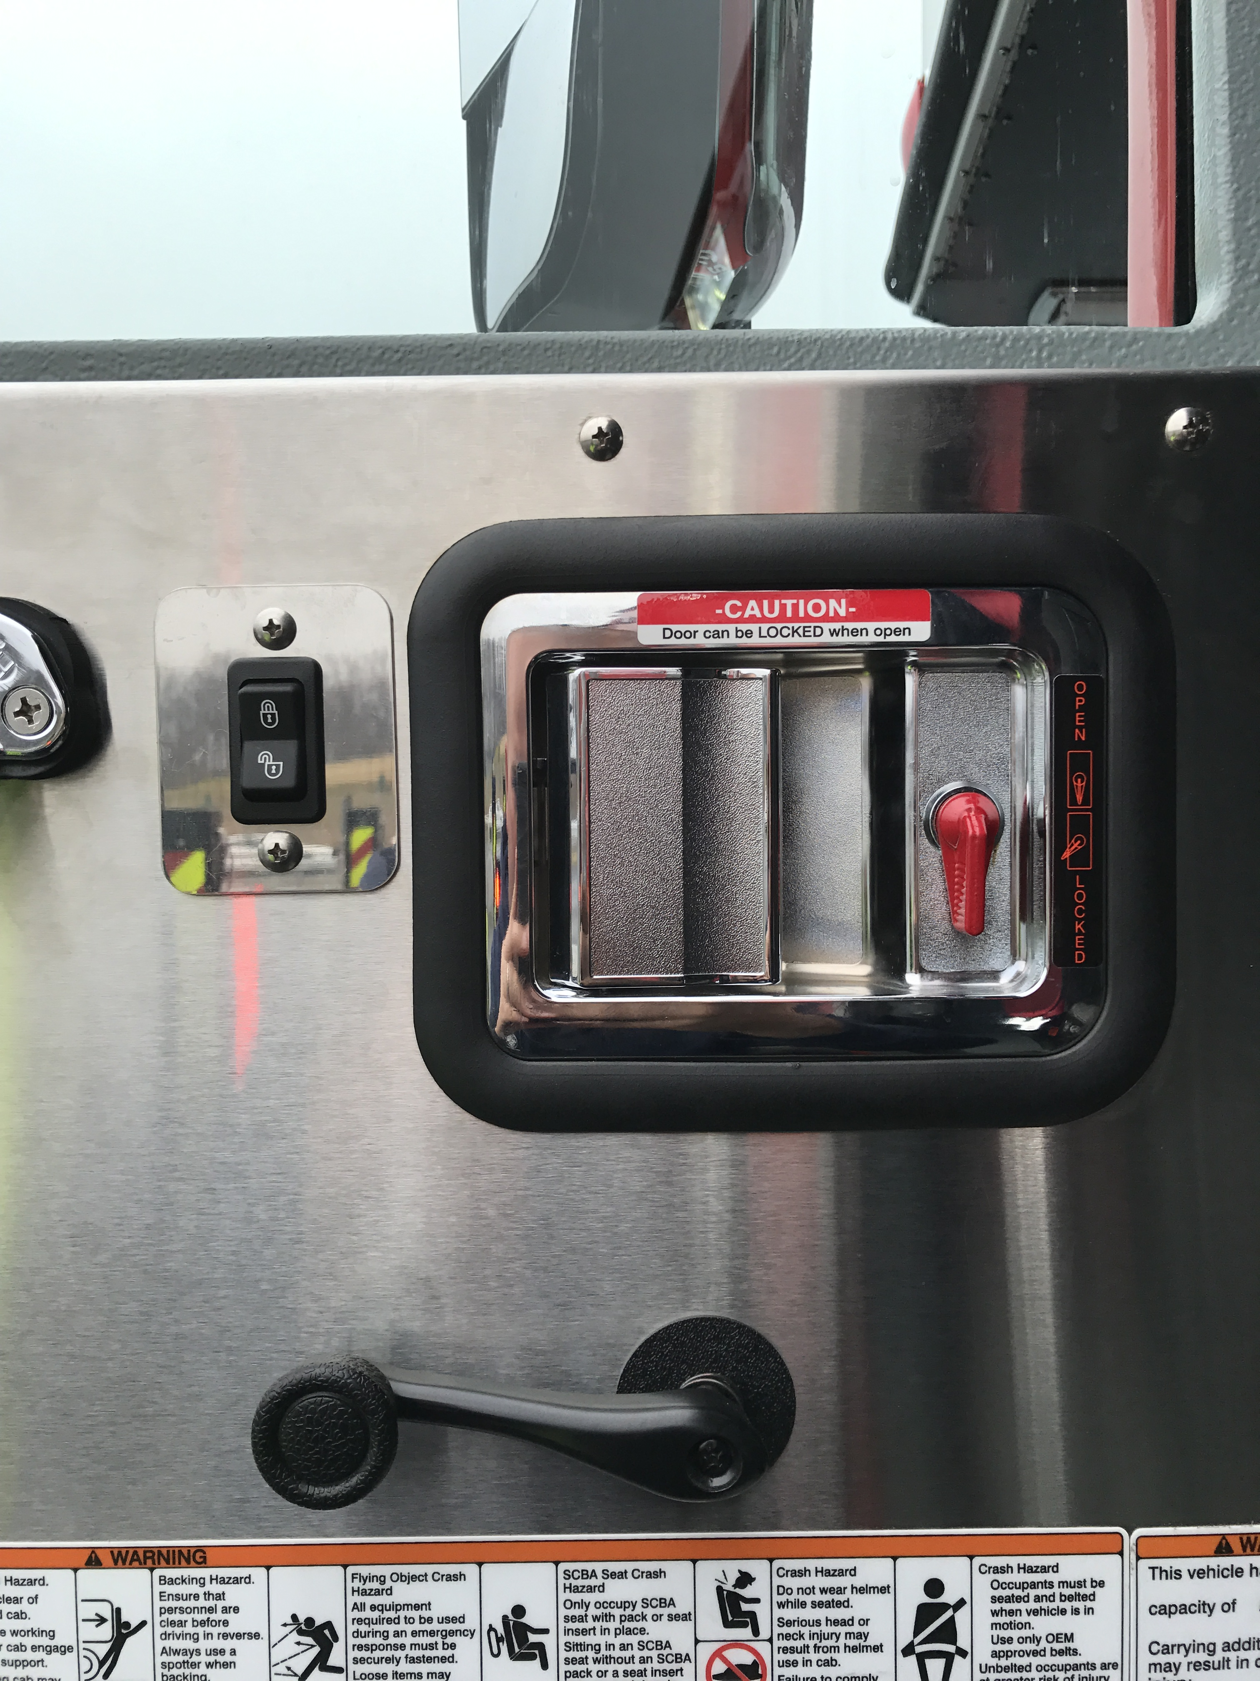
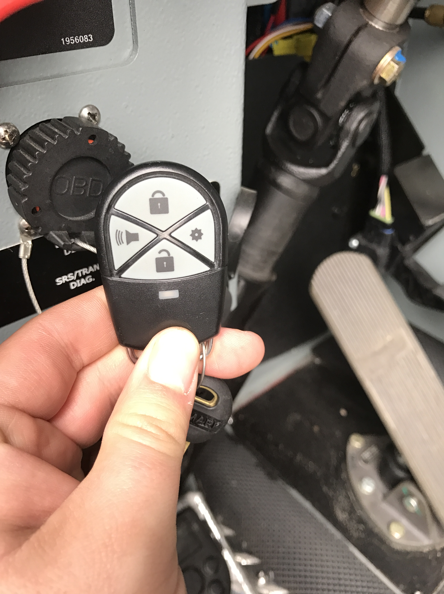
Chassis
Door Locks
All locks on the cab have electric locks
Switches are located on the driver and officer doors
Key fobs can also be used to lock the T1, T2, T3 and T4 doors

Slide 7
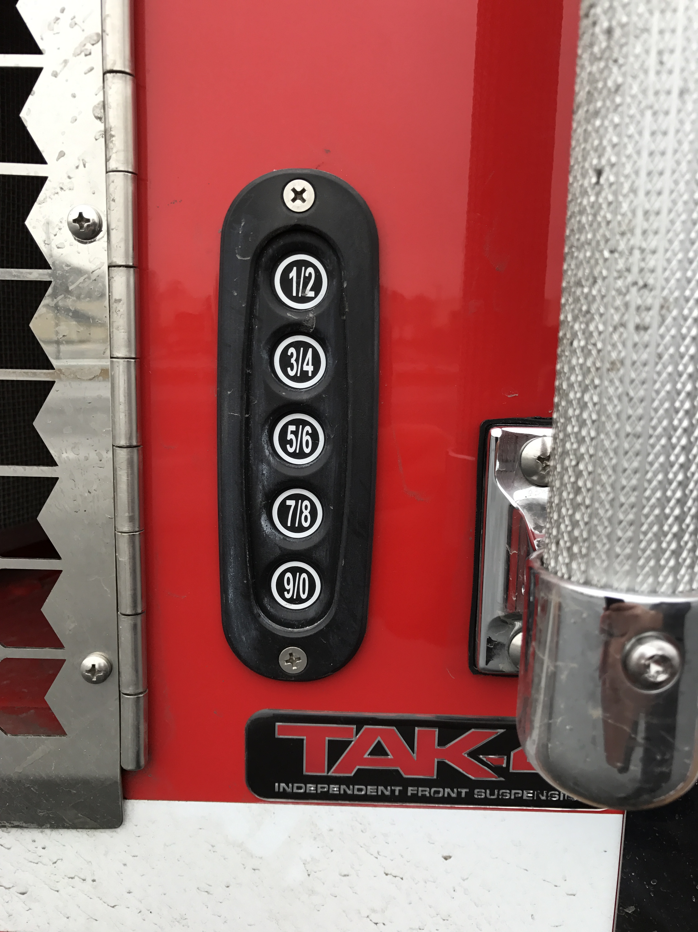
Chassis
Door Locks
Key Pad Combination locks are located on the exterior at the driver and officer door
Waiting on Info from vendor to see how these are programmed.

Slide 8
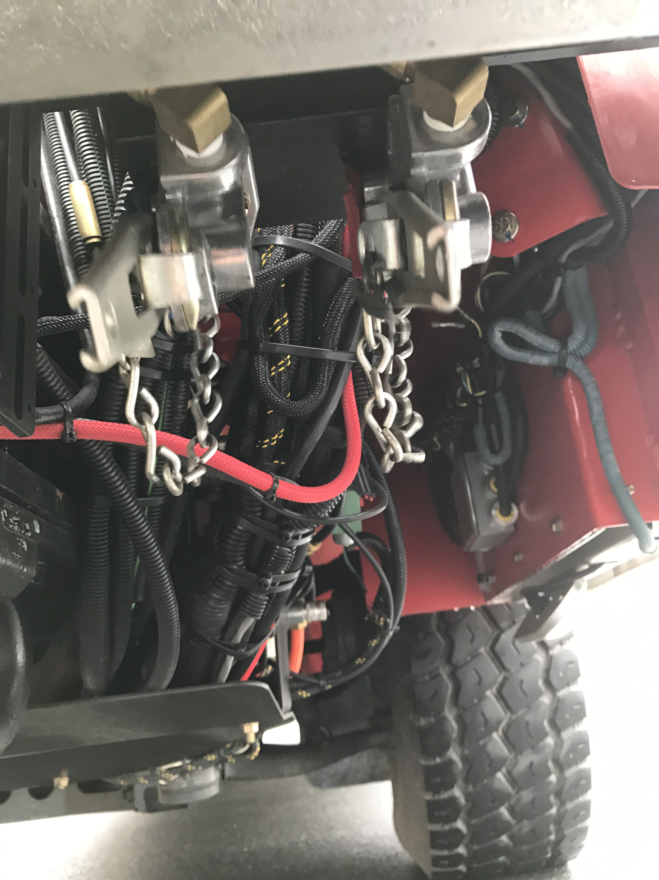
Chassis
Glad Hands
Located Under the drivers side front bumper
Used by Tow Truck drivers to operate the braking system on the truck

Slide 9
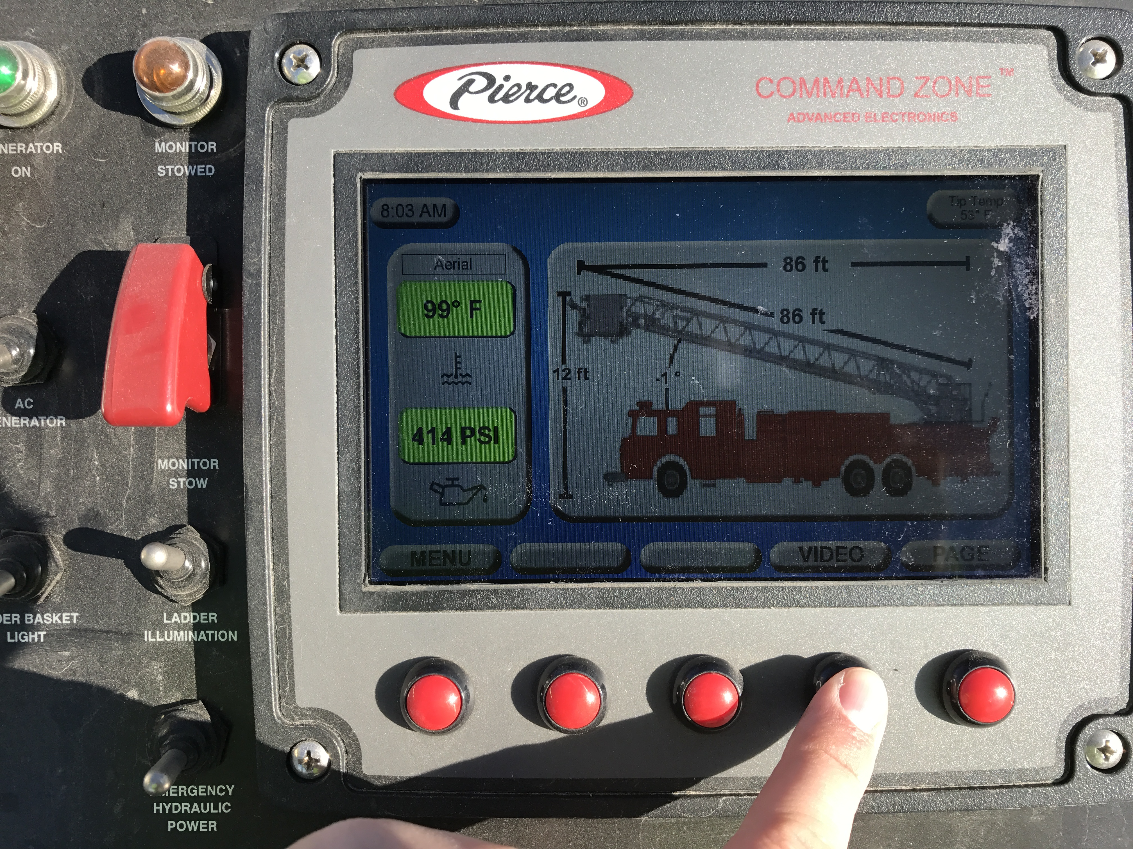
Chassis
Cameras
This vehicle is equipped with two cameras
Rear body mounted camera
Comes on automatically in reverse or can be turned on manually via the Command Zone III Display
Front camera mounted on the tower basket
Can be turned on using the video button on the turntable Command Zone Display
Front Camera Activation

Slide 10
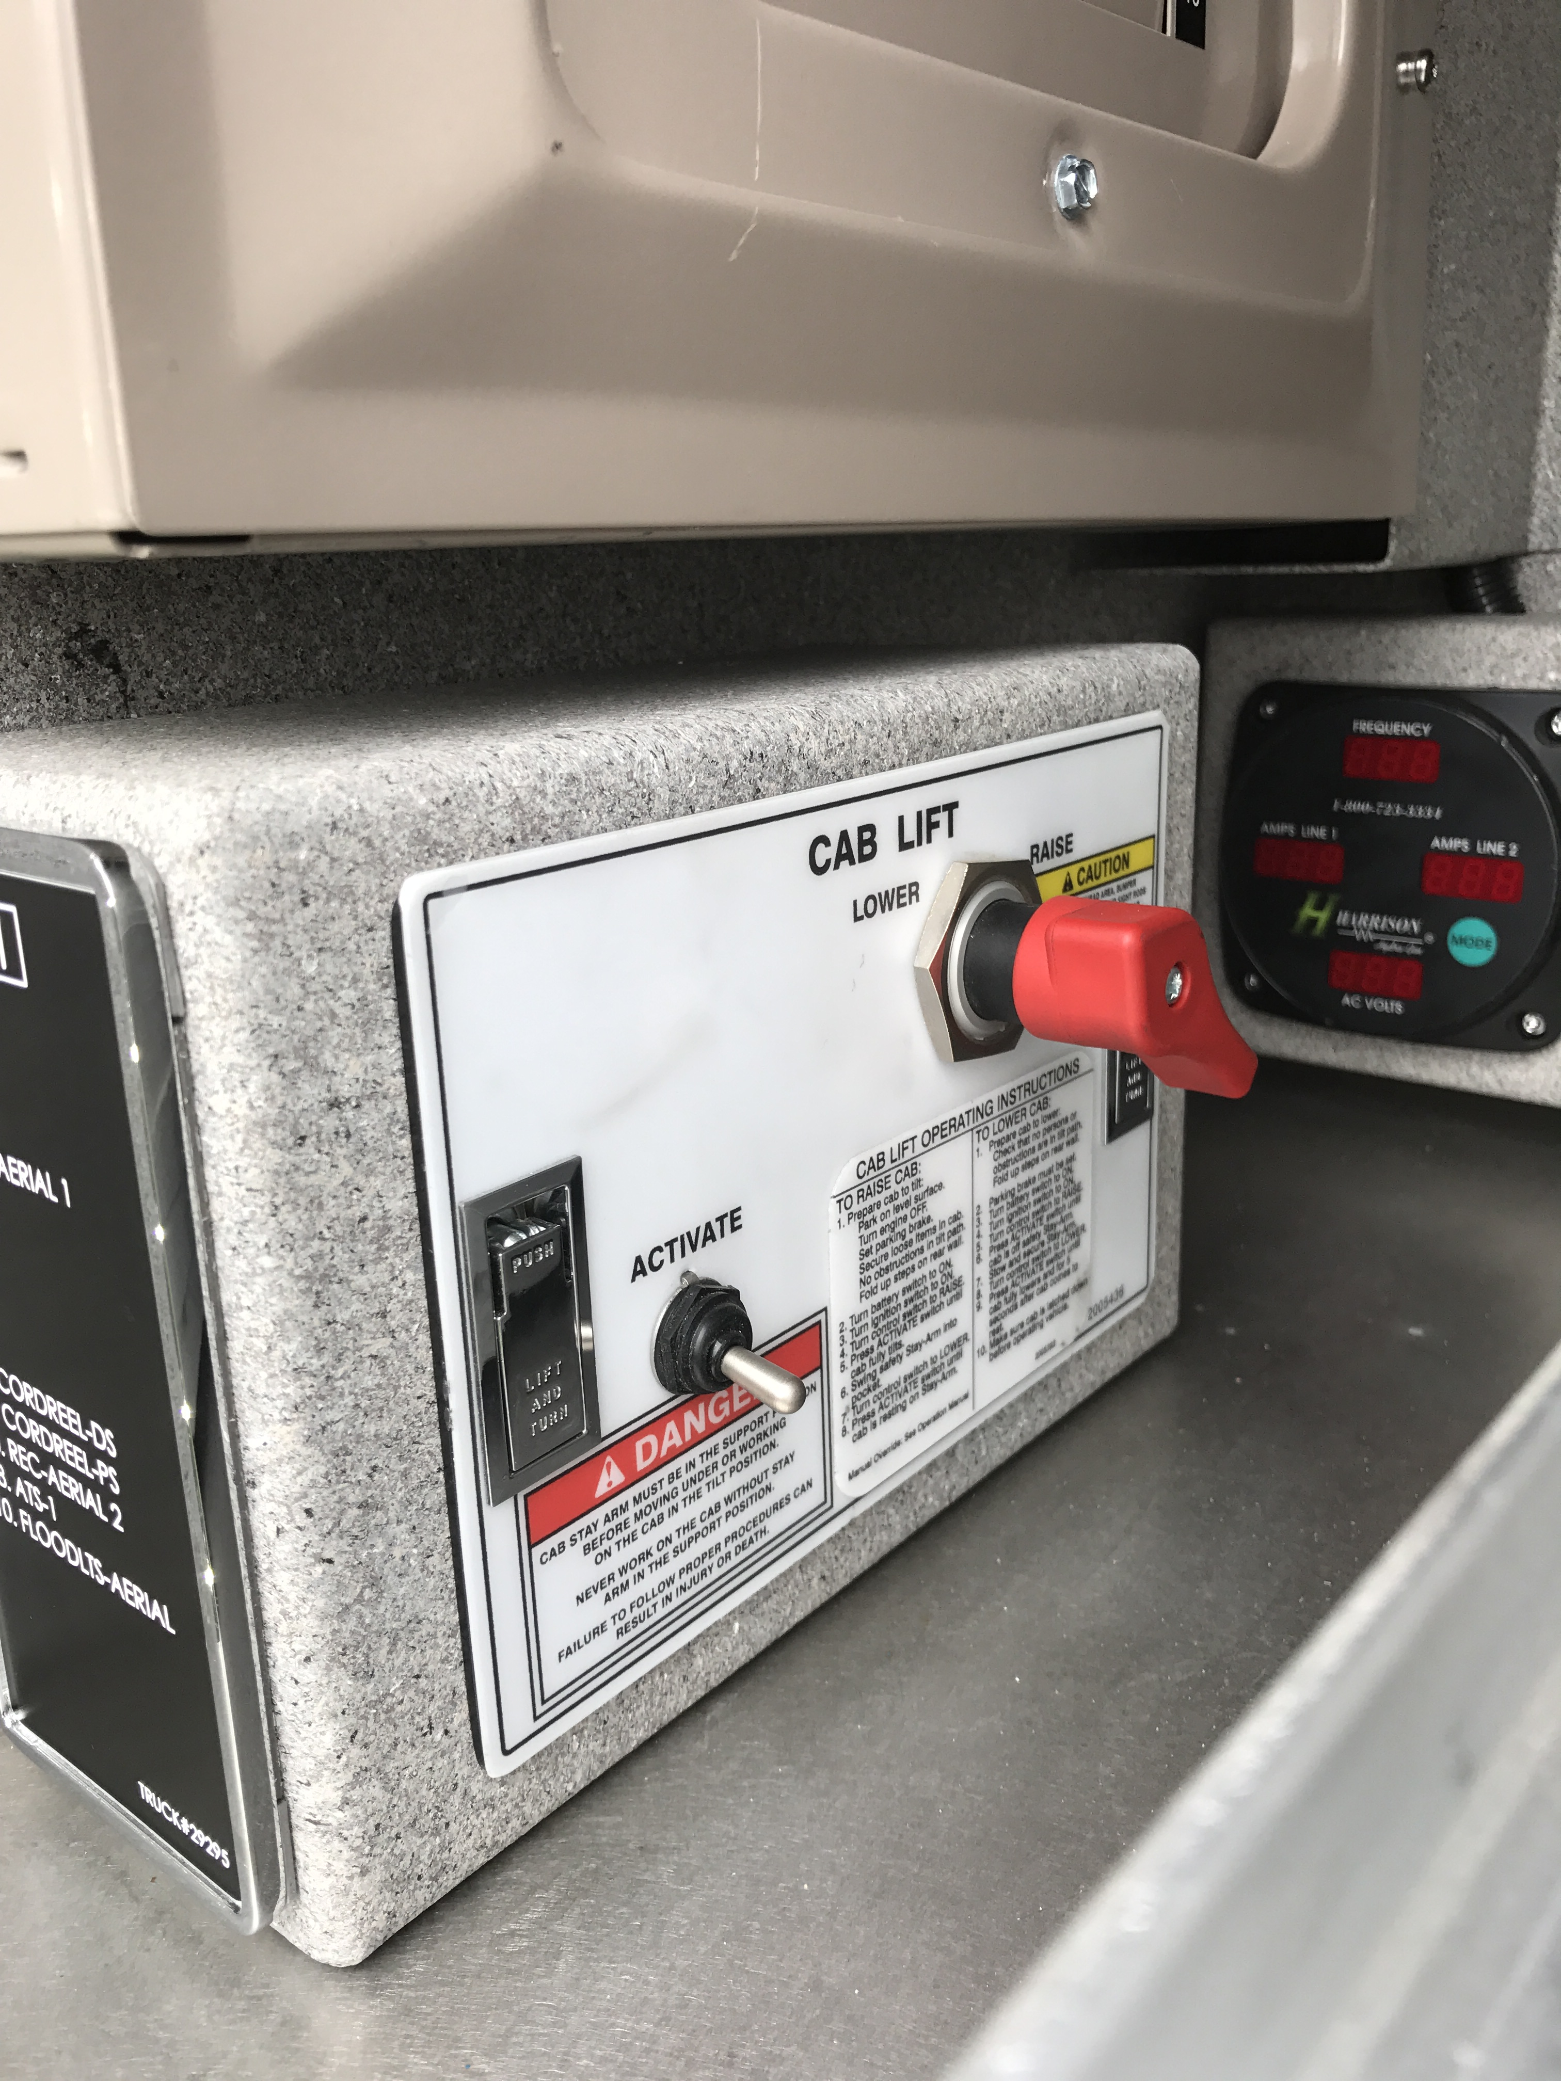
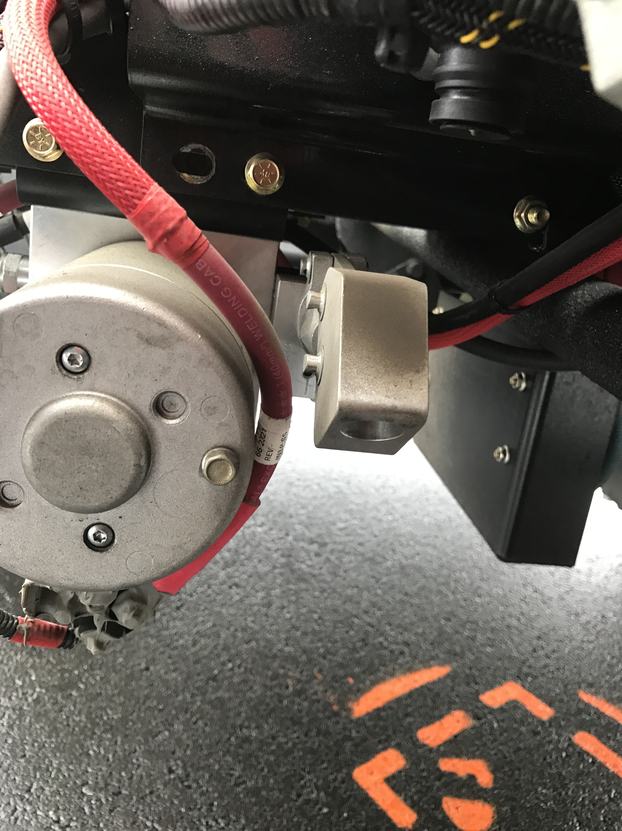
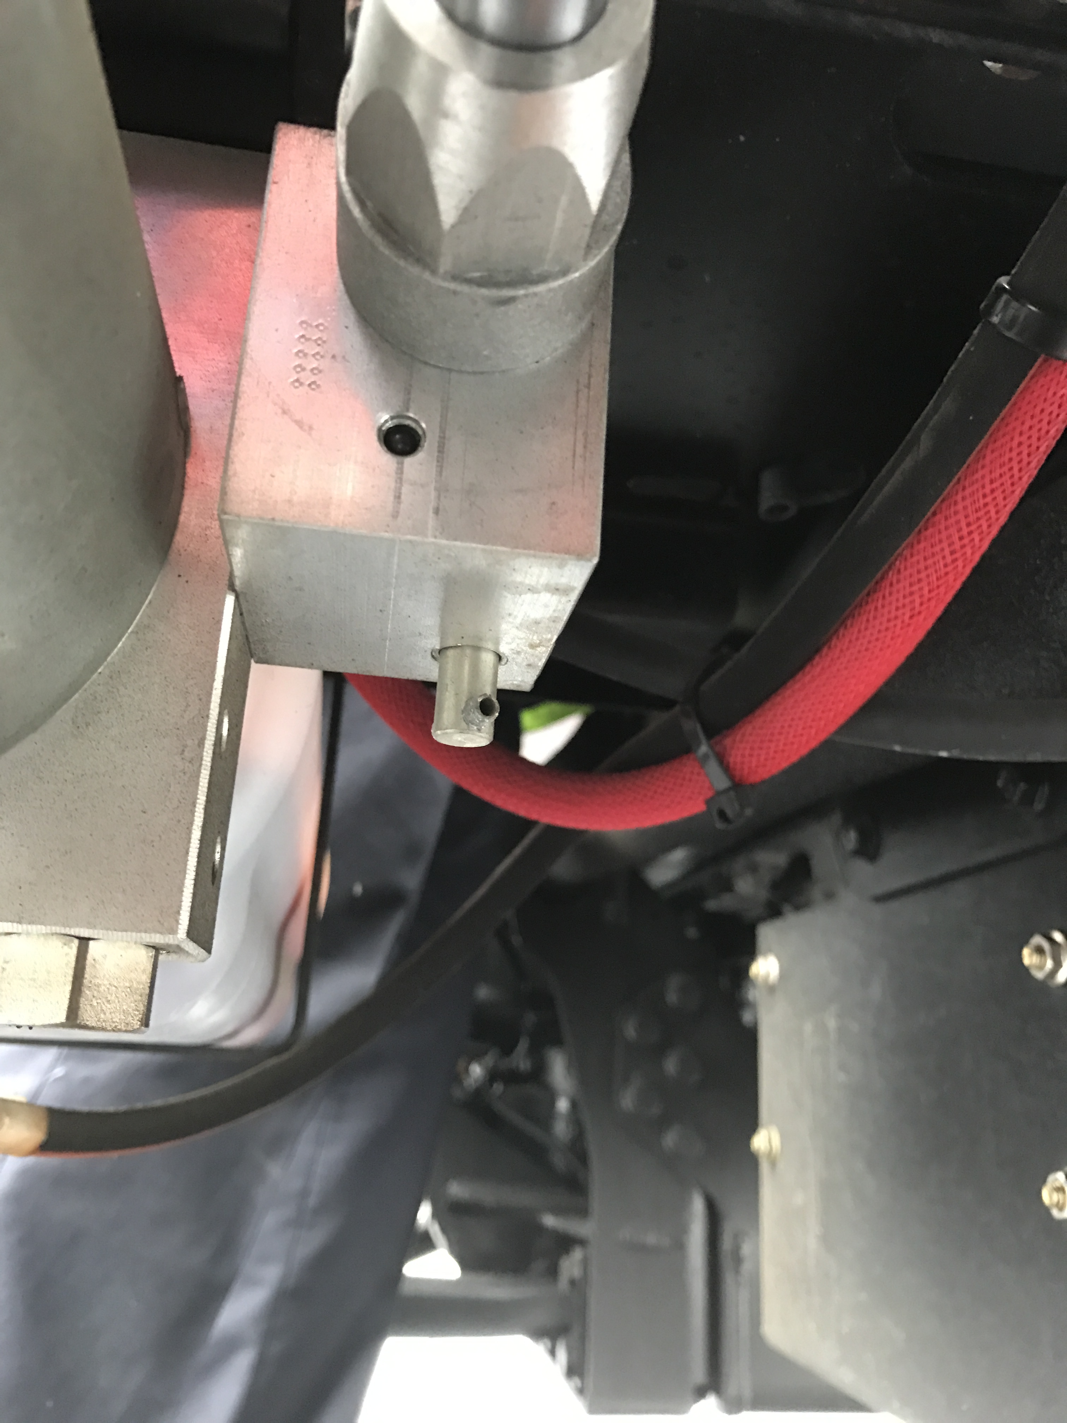
Chassis
Cab Tilt
Normal Operations
Located in the drivers side first roll up compartment
Manual Operations
Located on the drivers side under the cab tilt motor
Manual Pump to Raise Cab
Valve to Lower Cab

Slide 11
Chassis
Cab Tilt Normal Operations
Secure all contents in the cab, have the aerial raised to clear the cab
Turn battery switch and ignition to the on position
Access the cab tilt controls
Turn the selector knob to raise
Hold the activate switch to raise the cab
There is no automatic cab lock, raise cab until it stops
Place manual cab lock in position and DO NOT lower the cab back onto the cab lock

Slide 12
Chassis
Cab Tilt Manual Operations
In the event of a 12v system failure the cab can be manually raised and lowered using the hand pump located on the drivers side by the cab tilt motor.
To raise the cab use a bar (located behind the drivers seat) to pump it up
To lower the cab turn the valve to release the pressure

Slide 13
Chassis
Manual Cab Lock
Cab Lock in Stored Position
Cab Lock in Engaged Position

Slide 14
Chassis
Lowering the raised cab
Make sure nothing was left in the engine compartment that does not belong there
Remove the cab lock, place it back into the stored position
Turn the cab tilt control to lower and hold the activate switch
There are no visual indicators that let you know if the cab is locked down onto the frame
Leave the selector knob in the lower position

Slide 15
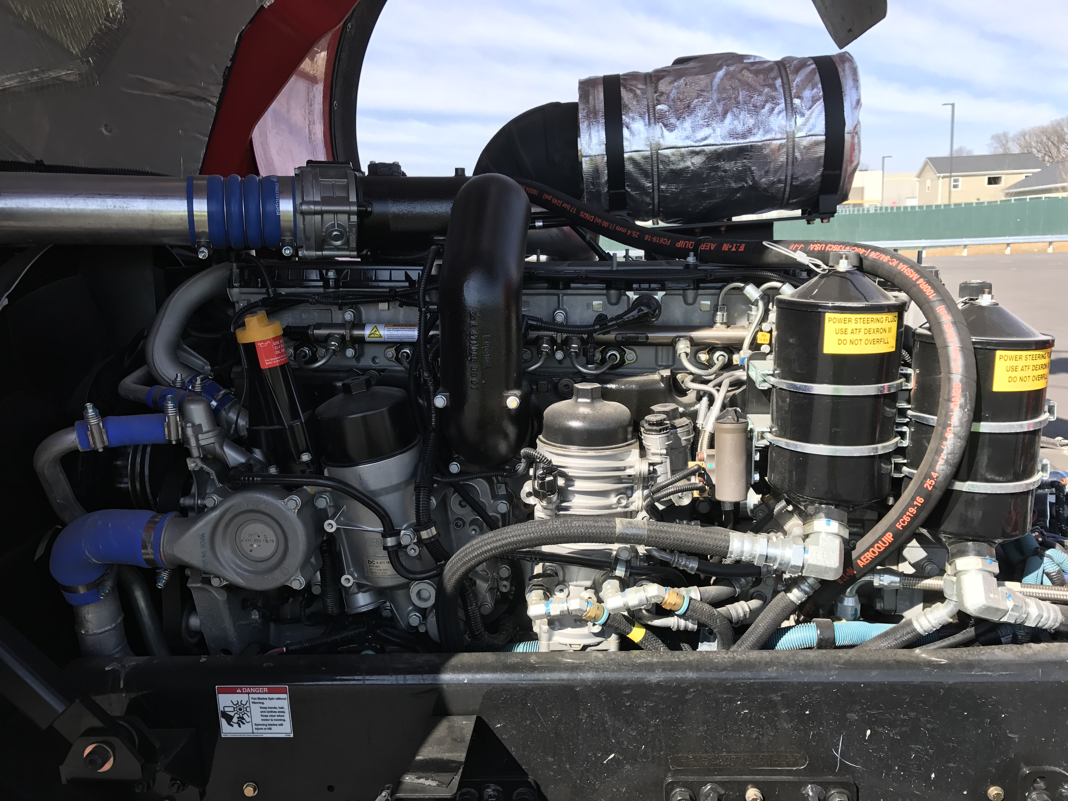
Chassis
Engine Overview
Drivers side

Slide 16
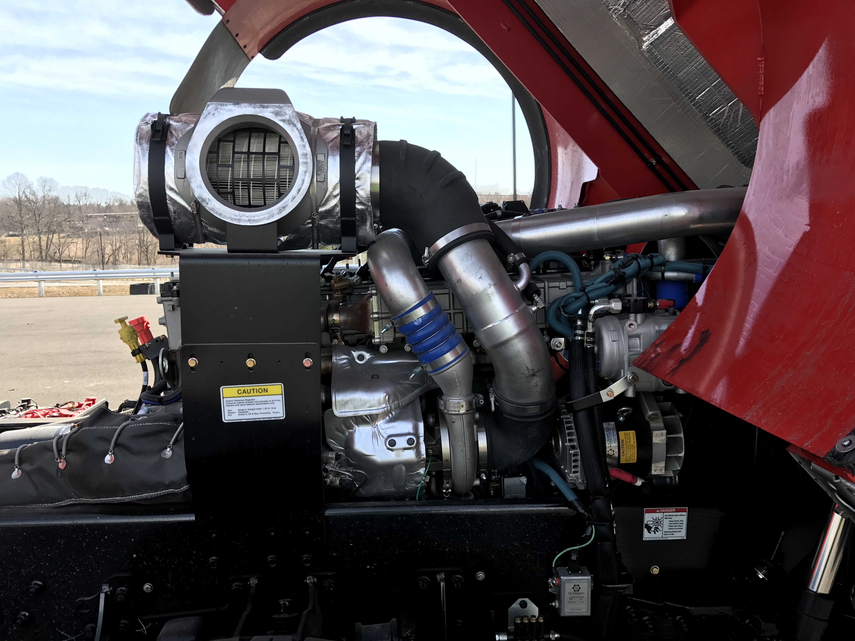
Chassis
Engine Overview
Officers side

Slide 17
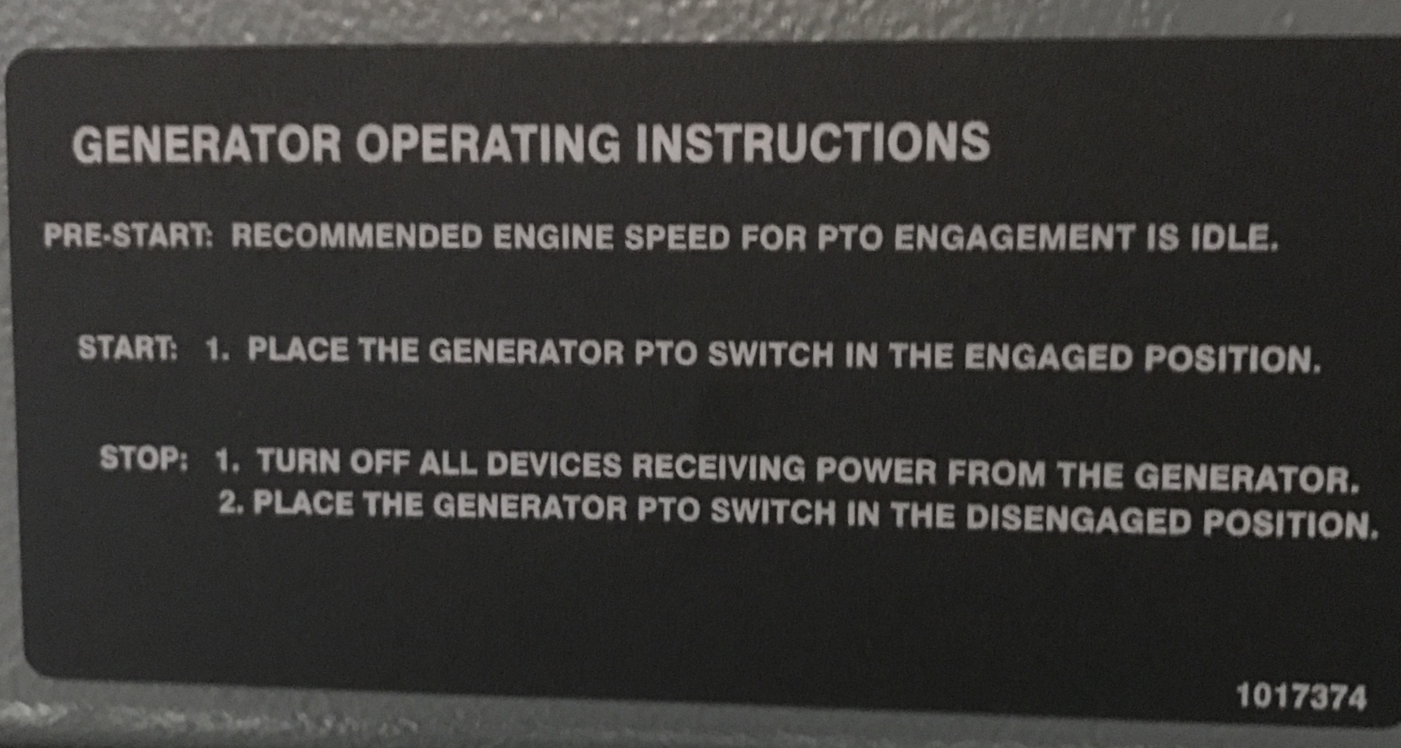
Chassis
Generator PTO
Can be activated in the cab or on the turntable
Should only be engaged with engine at an idle

Slide 18
Chassis
Aerial PTO
Located on the drivers side of the transmission
Always engaged, there is no more Aerial PTO switch on the dash
Aerial master switch gives you electric power to your outrigger remote and pedestal controls

Slide 19
TAK-4 Suspension
Unit is equipped with TAK-4 suspension on the front and rear
TAK-4 is an independent suspension system
Allows for a 45 degree cramp angle in your front steering for tighter turning angles
This is available with the 22,800 lb. front axle
Allows for shorter stopping distances over a conventional suspension system

Slide 20
TAK-4 Suspension
T3 Rear Suspension and Steering
This system replaces the current “All Steer” system that we have in the Generation 1 and 2 units in the field
This is a mechanical over hydraulic system and uses no computers to assist in the steering of the rear axles
Generation 1 and 2 units have the following driving modes:
Front mode (Straight Truck)
Coordinated mode
Fire Ground mode
Crab Mode
The T3 system operates in one mode at all times. This mode is equivalent to our current coordinated mode as far as steering capabilities. When turning you will have a maximum of a 4’ swing at the rear corner of the vehicle.

Slide 21
TAK-4 Suspension
Front Suspension

Slide 22
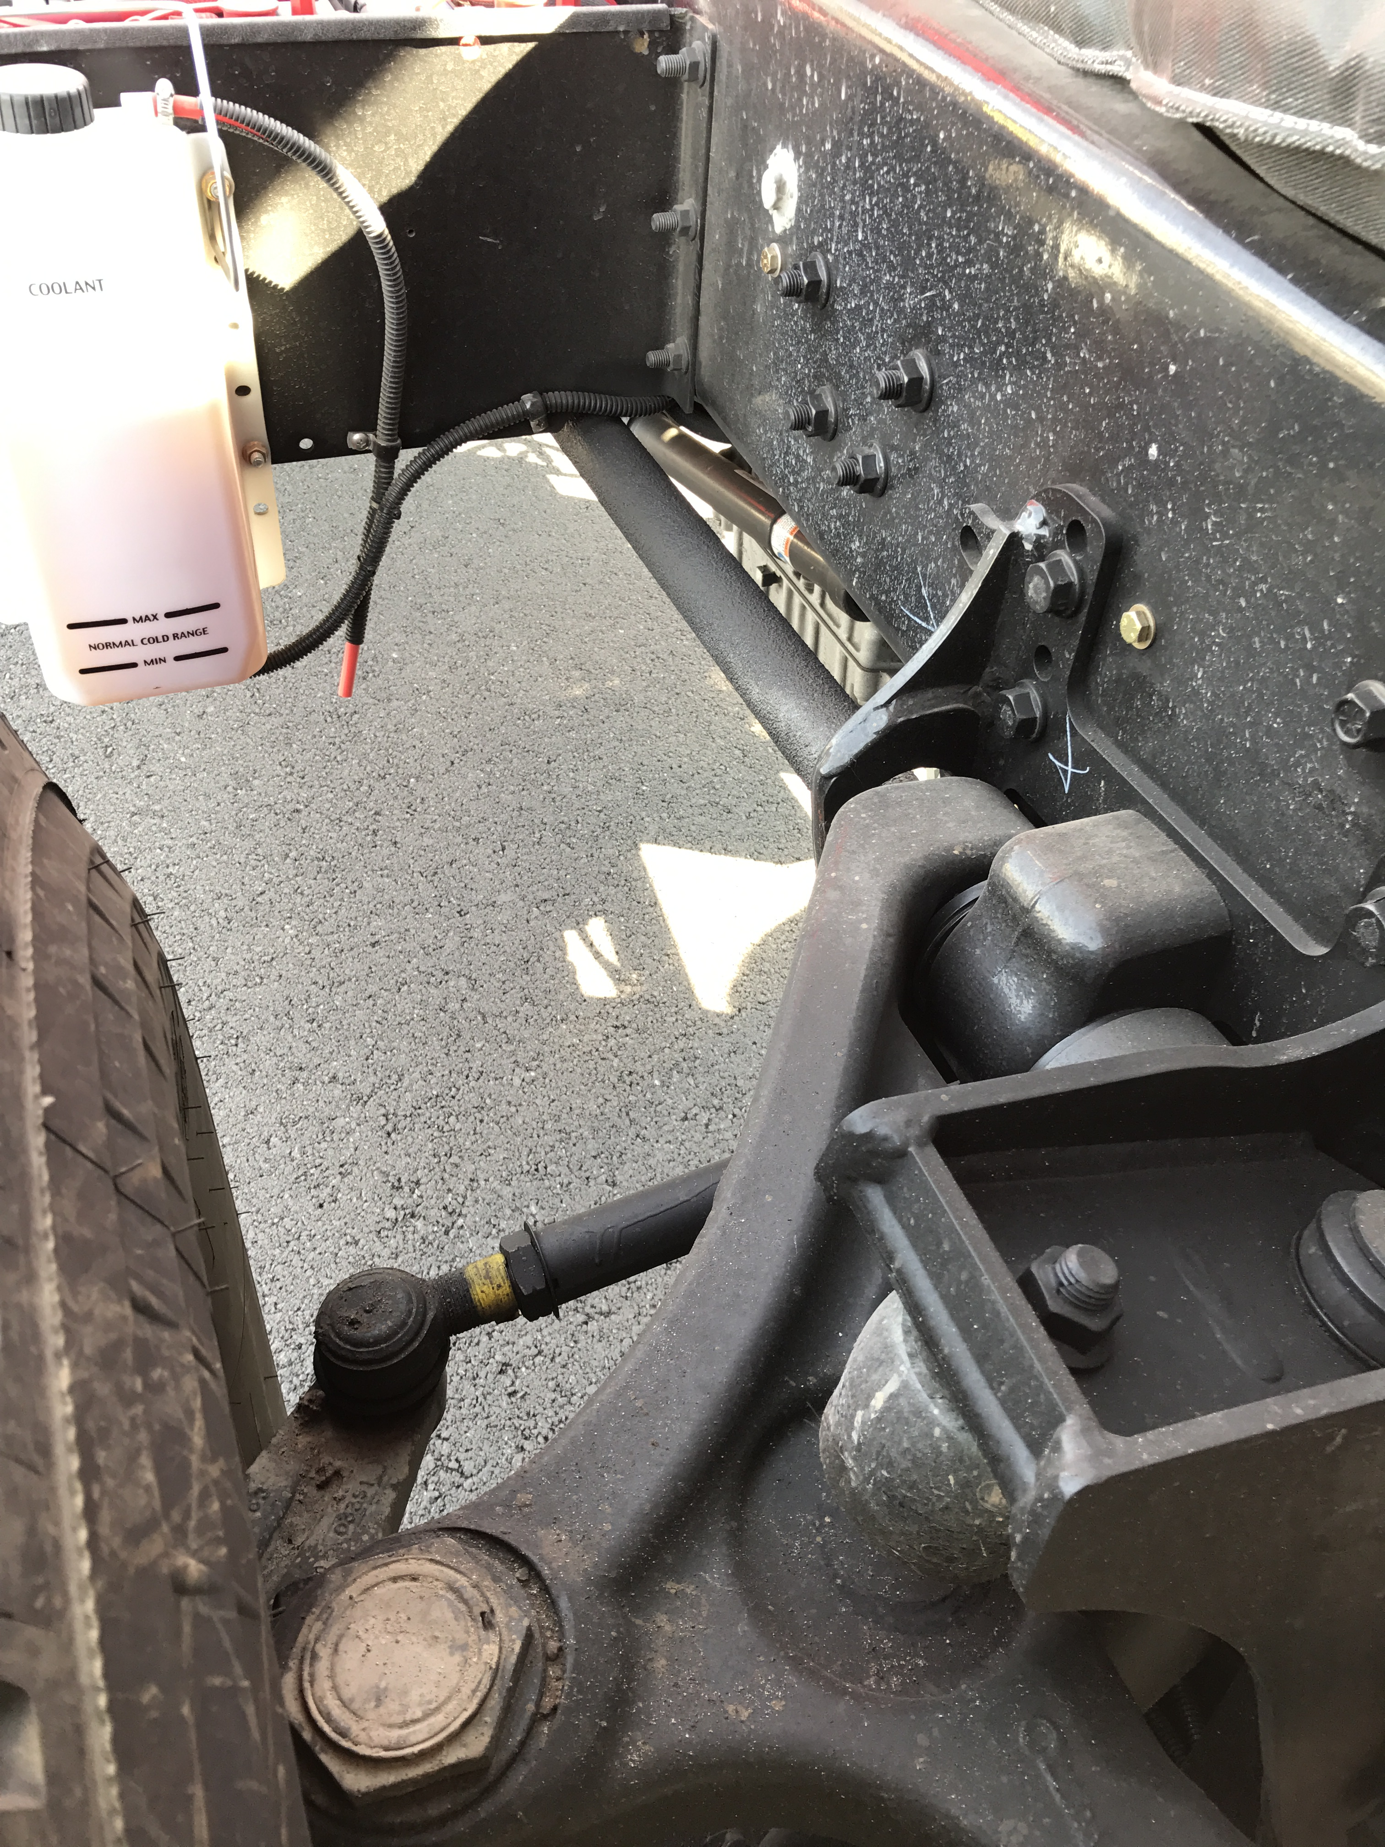
TAK-4 Suspension
Front Suspension
Rubber Jounce Stop
Upper Control Arm
Shock Absorber
Torsion Bar
Lower Control Arm

Slide 23
TAK-4 Suspension
Rear Suspension
Rear Steering Components

Slide 24
TAK-4 Suspension
Out of Service Criteria
Damaged or Broken Control Arms
Damaged, Bent or Broken Torsion Bar
Torsion bar has a Rhino Lining type coating on the outside. Check this coating for cracks, cuts or any missing chunks that may expose the torsion bar to the elements.
Things to keep your eye on
Check the Rubber Jounce Stop
Check the bolts on the Torsion Bar Mounts
Check the bolts on the Control Arm Mounts
Check the ball joints to make sure they haven’t torn which would allow water or dirt to get inside.

Slide 25
Cab Controls

Slide 26
Cab Controls

Slide 27
Cab Controls

Slide 28
Cab Controls

Slide 29
Command Zone III Display
Home screen will show as displayed with Fuel level, DEF level, and Seatbelt status
Can be used to turn on flood lights, emergency lights
Can operate HVAC controls
Turn on back up camera
Start Generator

Slide 30
Transmission Fluid Check
Transmission fluid can be checked with the dipstick through the access hatch in the cab.
The Transmission Fluid level may be checked in the cab through the keypad selector.
The engine must be running at idle and the unit must be on level ground.
The engine must idle at least five minutes from a cold start.
The transmission must heat to at least 140 degrees.
Push both the up and down arrows simultaneously on the keypad.
ARROWS

Slide 31
Transmission Fluid Check
After simultaneously pushing both buttons TRANS OIL will show on the screen
It will be followed by OK, -1 thru -7, or +1 thru +7. The – indicates under filled and the + indicates overfilled. The numeral indicates the number of quarts.
Any other message indicates a problem and CMF should be notified.
Always confirm the digital reading on the dipstick BEFORE adding fluid.

Slide 32
Regeneration
All diesel exhaust systems must be fitted with a DPF and a regeneration system.
DPF is Diesel Particulate Filter which captures soot and ash from the engine exhaust.
Regeneration is the process of burning off the soot and ash.
There are two types of regeneration:
Passive which requires no driver involvement.
Active which requires driver involvement.
Warning lights in the dash cluster will advise the driver of what action is needed.

Slide 33
Regeneration
Waiting on manual regeneration procedure from Vendor

Slide 34
Diesel Exhaust Fluid
Diesel Exhaust Fluid (DEF) is a urea based fluid
It is designed to lower Nitrous Oxides in the exhaust
Follow your recommended storage procedures in station

Slide 35
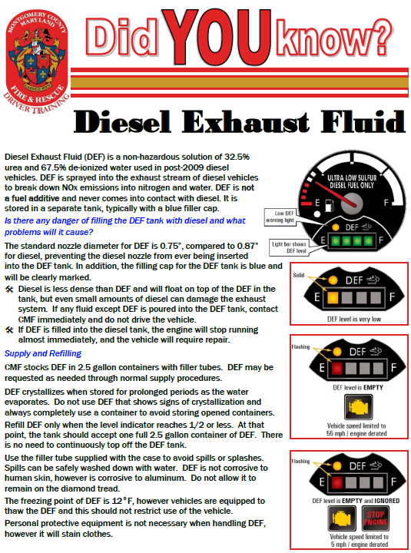

Slide 36
Diesel Exhaust Fluid
Refill Procedures
CMF stocks DEF in industry standard 2.5 Gallon Containers
2 containers per case
Each case comes with 2 filler tubes
DEF is requested when ordering Station Supplies or as needed through FMRS.
Any DEF container or filler tube that shows any signs of crystallization MUST be immediately discarded to avoid vehicle damage
Any DEF spills or splashes should be diluted with water and cleaned

Slide 37
Diesel Exhaust Fluid
Refill Procedures
Only add DEF to the appropriate DEF tank
DO NOT add DEF to the fuel tank
DO NOT add fluid until the DEF level is at or below HALF (1/2)
When DEF level reaches HALF, only add a single 2.5 gallon jug to the DEF tank using the supplied filler tube
DO NOT top off DEF
The empty jug AND filler tube MUST be thrown away. DO NOT RE-USE!!!

Slide 38
Generator
10 kW PTO driven Harrison hydraulic generator
Generator is located on top of the body underneath of the ladder
PTO can be engaged from the Drivers seat with a toggle switch or on the Command Zone III Display, or from the Pedestal Controls on the turntable. The generator can no longer be started on the generator itself.
Generator powers two 200’ cord reels (one on each side of the tower), 120v outlets on the body, and 2 Quartz lights that are mounted on the rear of the tower basket
Remainder of the body mounted scene lights operate off of the 12v system and do not require the generator to run

Slide 39
Generator
Recommended Starting Procedures
Since the generator is PTO driven it is recommended that the generator only be started with the vehicle at Idle speed.
Recommended Shut Down Procedures
Turn off all lights or equipment that is using power from the generator
Place the generator PTO switch in the disengaged position

