Slide 1


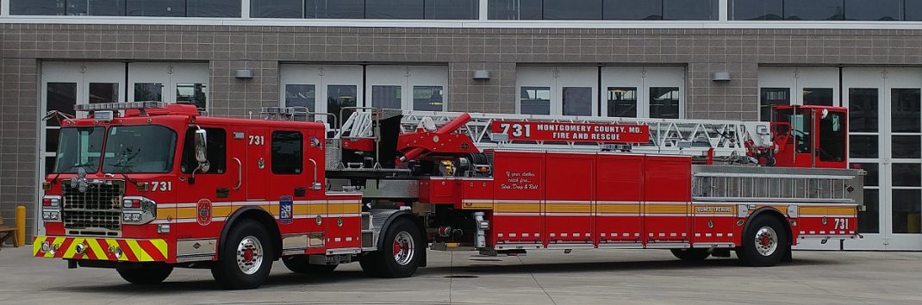


Tractor Drawn Aerial
2016 Spartan ER
Aerial Operations

Slide 2
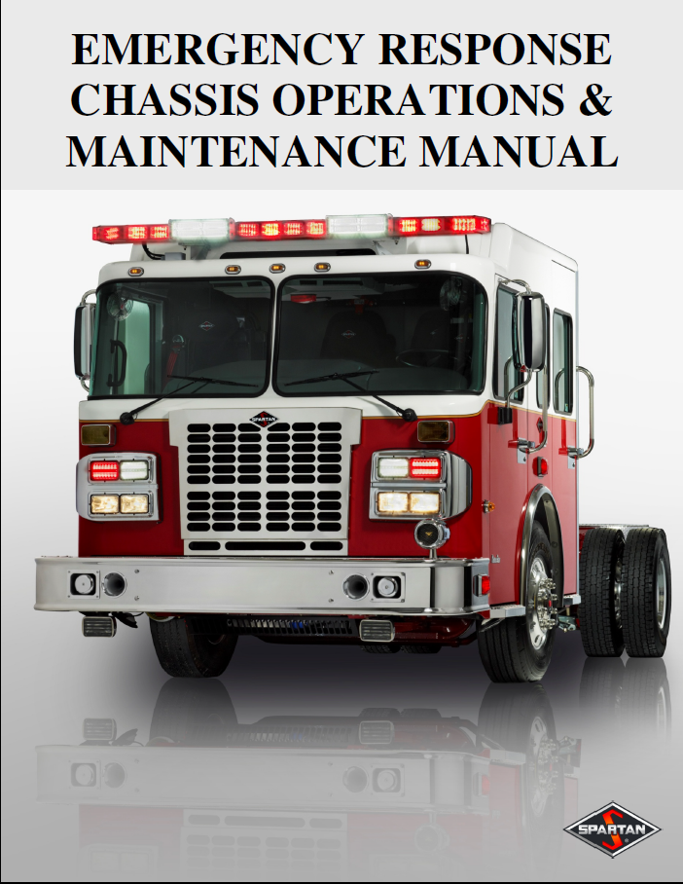
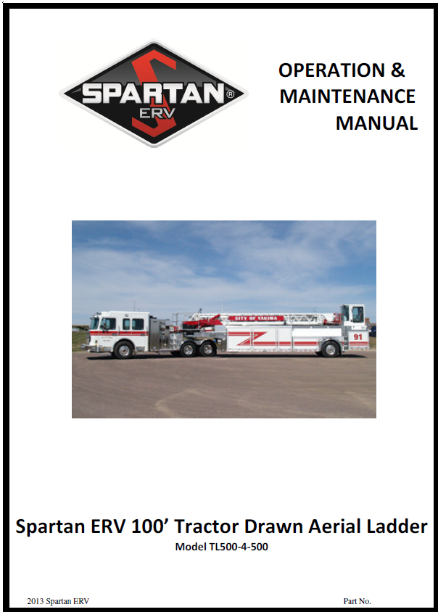
Tractor Drawn Aerial
In addition to this presentation the following manuals should be read by all operators before operating the aerial.
Chassis Manual
Operators Manual

Slide 3
Table Of Contents
Positioning Considerations
PTO Engagement
Outriggers
5th Wheel Lock
Short Set
Aerial Ladder
Load Chart
Pedestal Controls
Waterway
Additional Features
Emergency Procedures
Maintenance

Slide 4
Positioning Considerations
Park on level surface or with cab facing up hill or downhill. (Cab facing downhill will allow for more front to rear correction)
Position the tractor (Cab) of the unit so it is within 45 degrees of the centerline of the tiller trailer. Jackknifing of the unit is not required, nor recommended.

Slide 5
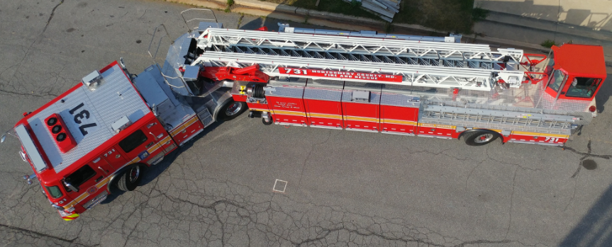
Positioning Considerations
Angle of Cab
  Tabs on Tractor are visual indicator for 45 degrees

Slide 6
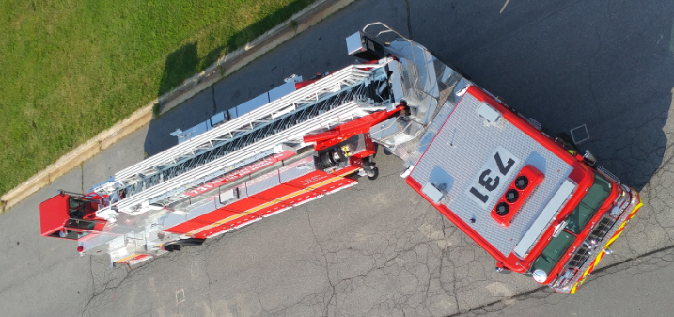
Positioning Considerations
Angle of Cab
  Tabs on Tractor are visual indicator for 45 degrees

Slide 7
Positioning Considerations
Stay on solid ground like concrete or blacktop. Ground needs to be capable of fully supporting 75 PSI.
Keep unit three or more feet away from manhole covers, storm sewers & other buried pipes and wires or underground parking facilities .
ALWAYS use provided ground pads

Slide 8
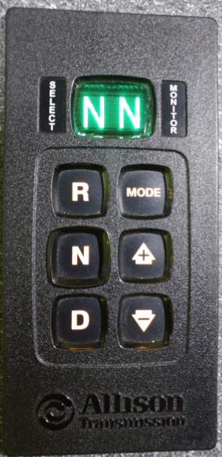
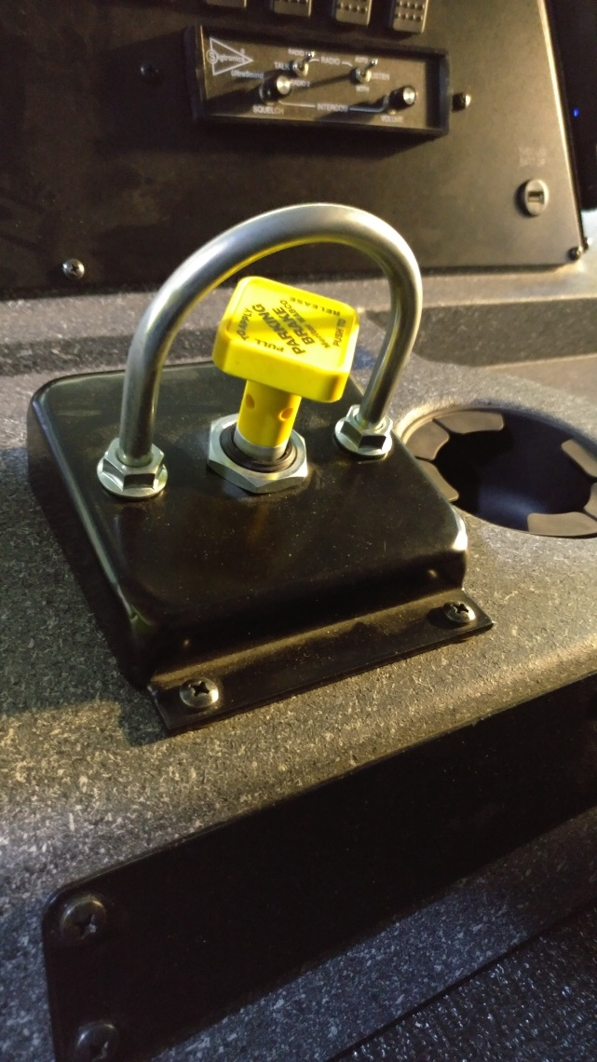
PTO Engagement
Place Unit in Neutral and Set Parking Brake

Slide 9
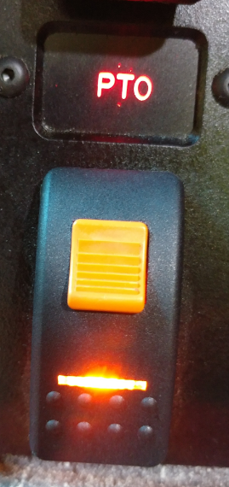
PTO Engagement
Engage Aerial Power switch
  Indicator light on switch must illuminate.
  This indicates that the PTO has engaged.

Slide 10
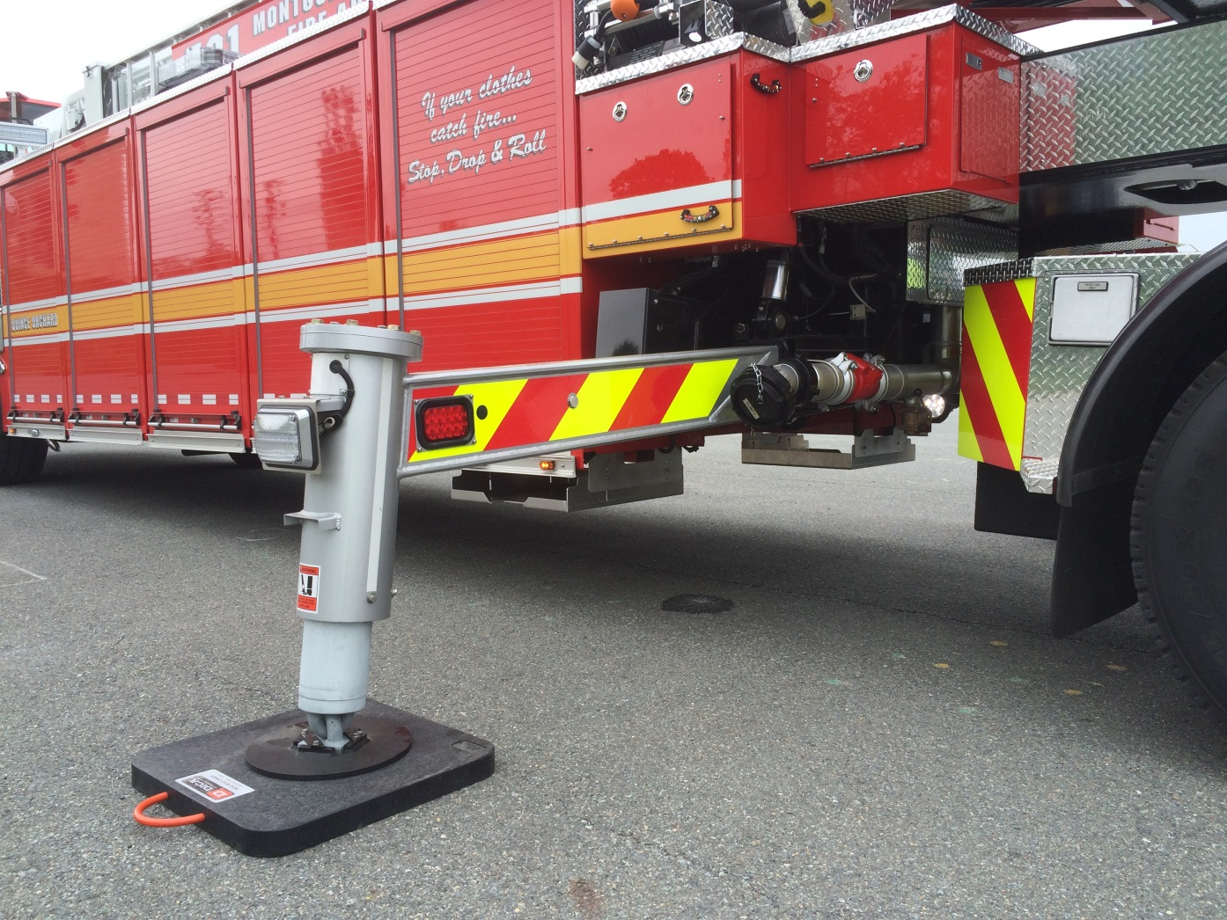
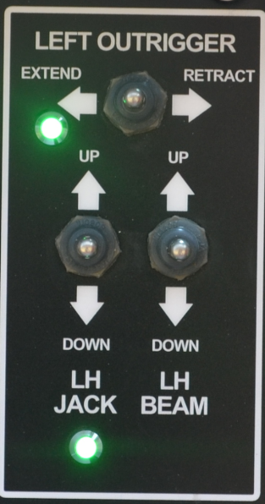
Outriggers
X-style outriggers
  Outrigger
  Jack
  Beam

Slide 11
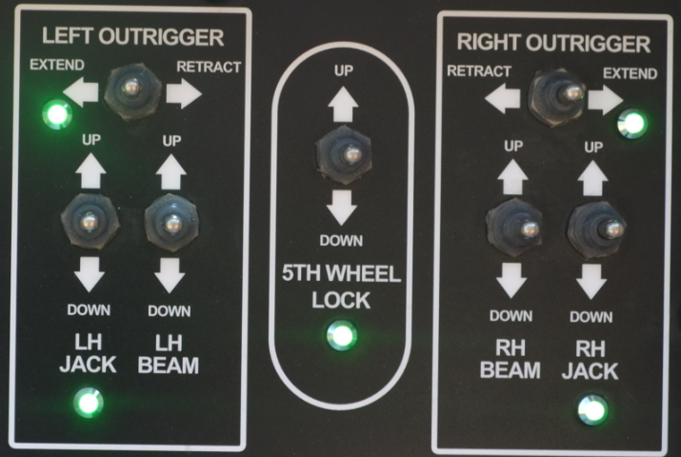
Outriggers
Control Panel

Slide 12


Outriggers
Deployment
  Fully extend outriggers
  Run jacks completely down
  Finish by lowering beams
  Weight should be removed from drive axle suspension
  Take bulge out of tire side wall
NOTE:
Weight MUST be removed from the drive axle for the truck to be considered stabilized

Slide 13
Outriggers
Jack MUST be lowered before beam
Improper order will decrease outrigger footprint by over a foot
Aerial capacity will be reduced

Slide 14
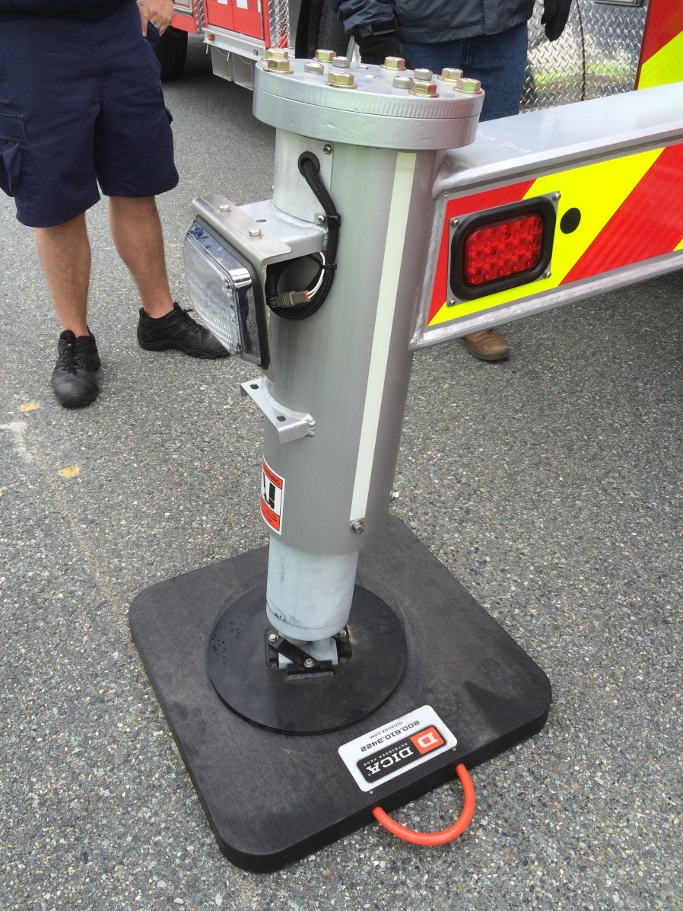
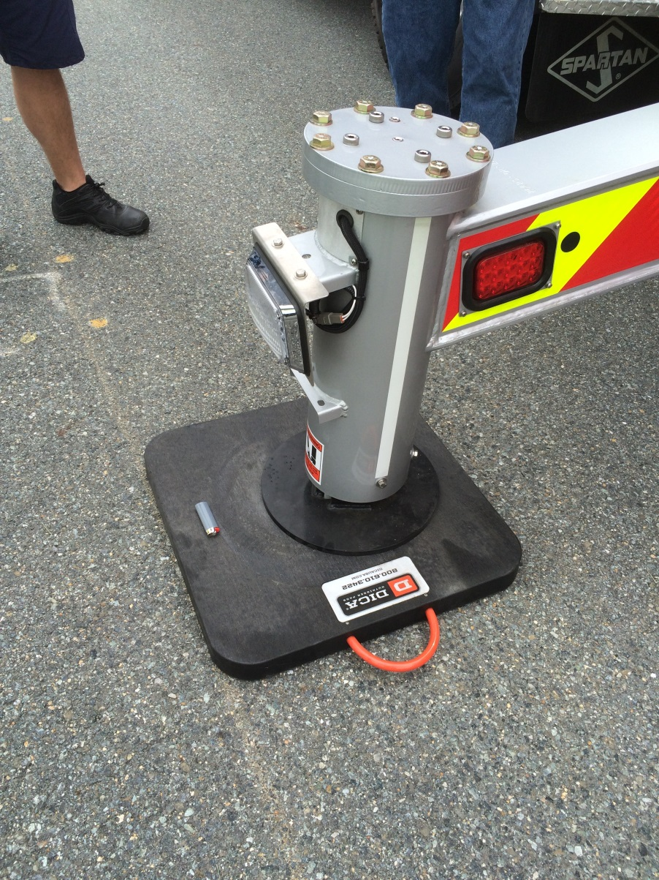
Outriggers
Lost Space
Deployed Correctly
Deployed Incorrectly

Slide 15
Outriggers
Manufacturer Recommendations
  Level truck side to side FIRST
  Level truck front to back LAST
  Set outrigger on “working” side first
  Completely extend “working” side until light is on
  Light is required on “working” side
  Once outriggers are out, jacks can be lowered together

Slide 16
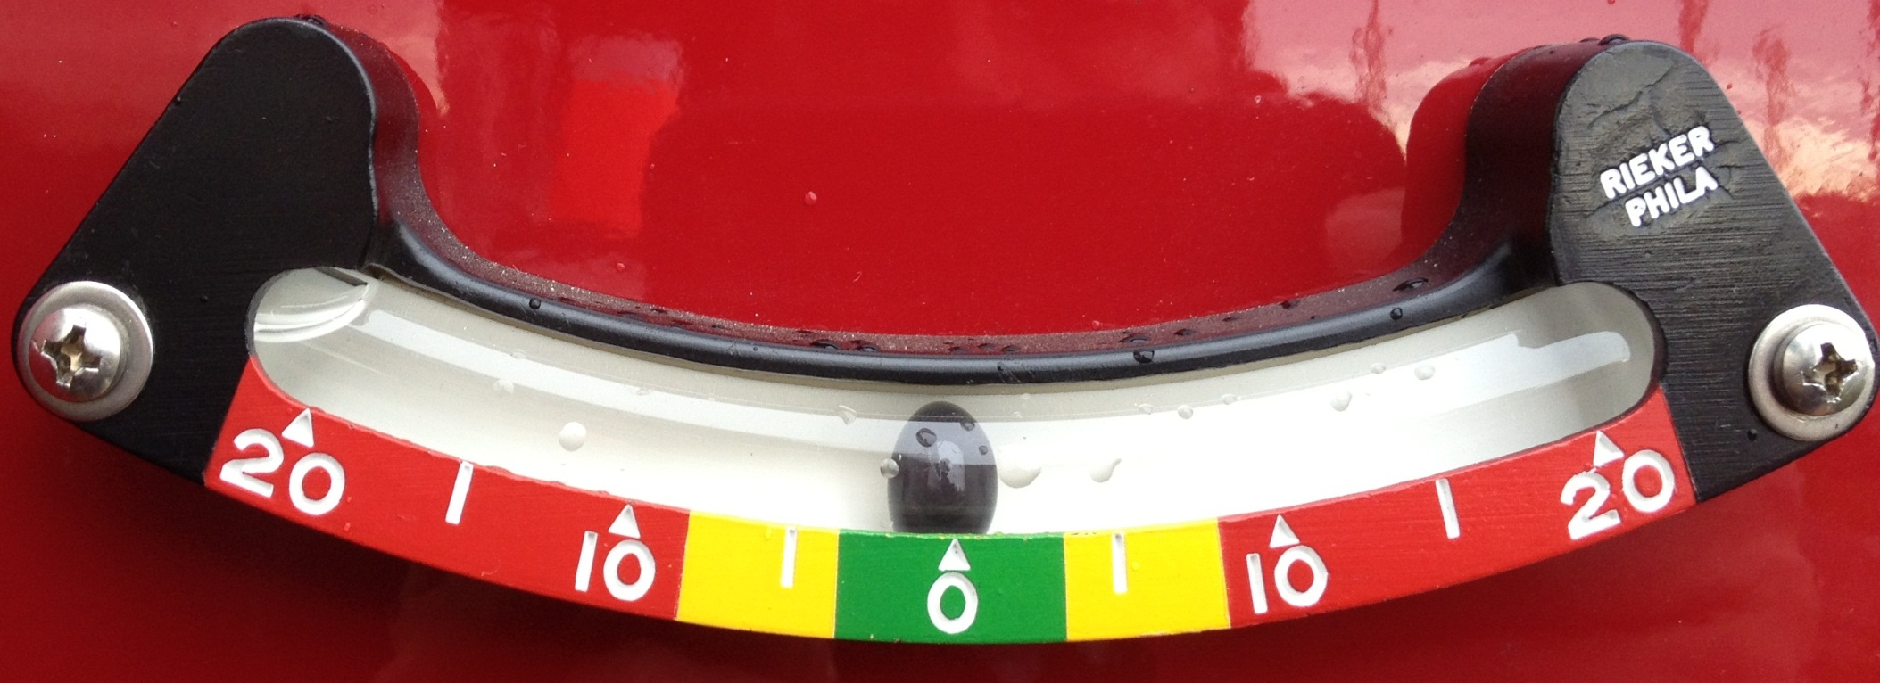
Outriggers
Side to Side Inclinometer
NOTE:
Side to side ranges are different than Pierce TDA’s

Slide 17
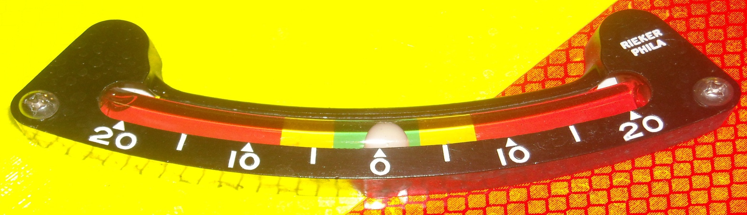
Outriggers
Side to Side Inclinometer
0 to 3.5 degrees either side is 100% capacity (Green)
3.5 to 8 degrees either side is 50% capacity (Yellow)
Above 8 degrees DO NOT OPERATE!!! (Red)

Slide 18
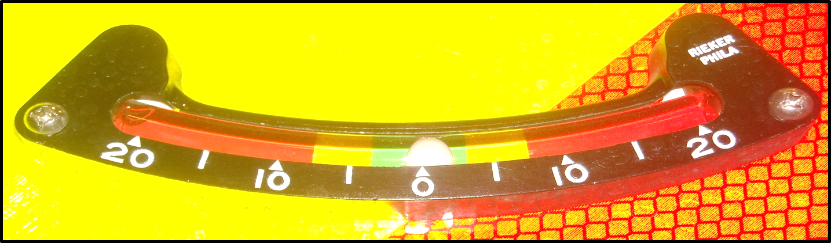
Outriggers
Side to Side Inclinometer
  If the indicator is in the green when starting set the beam on the high side first
  If the indicator is in the red or yellow when starting, set the beam on the low side of the truck first
  This will prevent the truck from “walking” on the jack pads

Slide 19
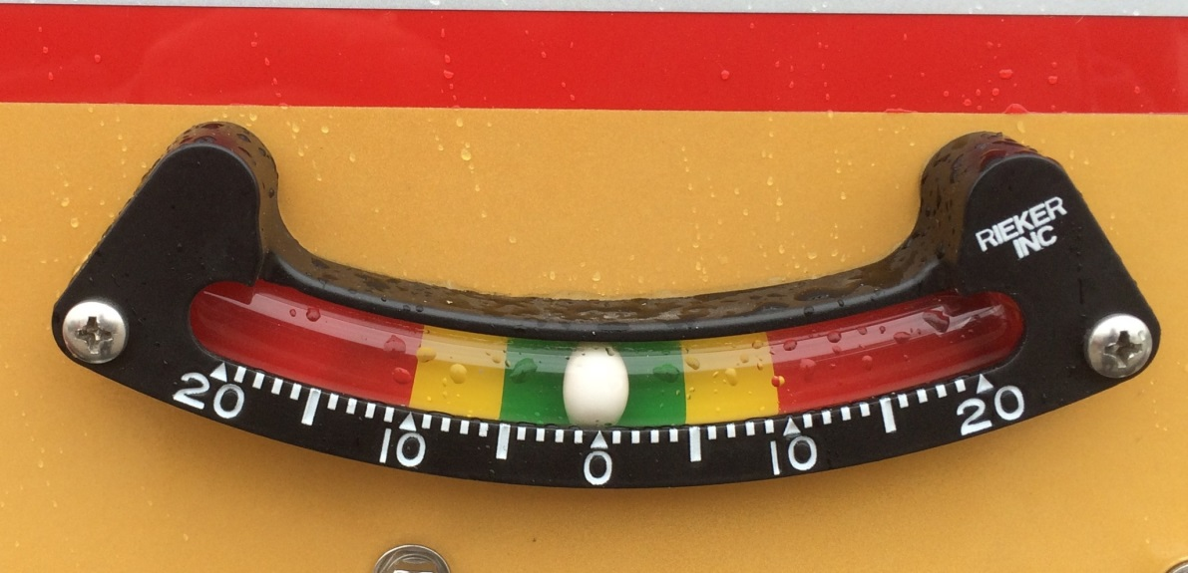
Outriggers
Front to Back Inclinometer
0 to 5 degrees either side is 100% capacity (Green)
5 to 10 degrees either side is 50% capacity (Yellow)
Above 10 degrees DO NOT OPERATE!!! (Red)
NOTE:
Front to back ranges are different than Pierce TDA’s

Slide 20
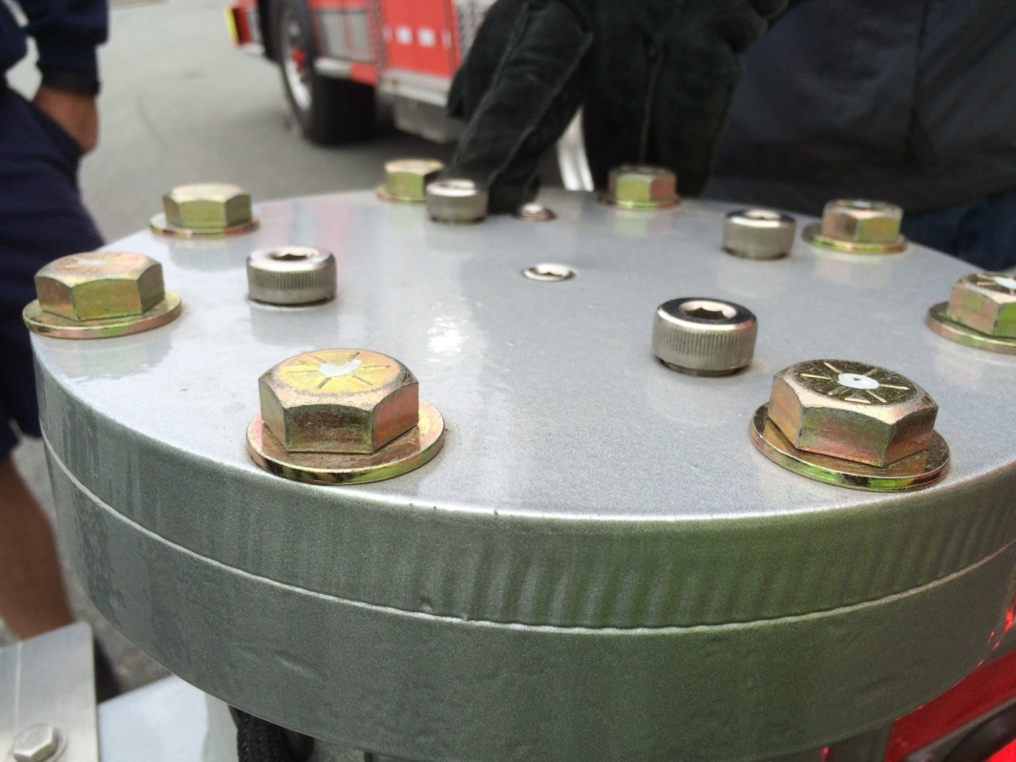
Outriggers
4 hex head bolts on top of outrigger
  These bolts may rise when pressure is applied
  This is normal
2 recessed bolts on top of outrigger
  Sensors for jack
NOTE:
NEVER make any adjustments to any of the bolts on the top of the outrigger

Slide 21
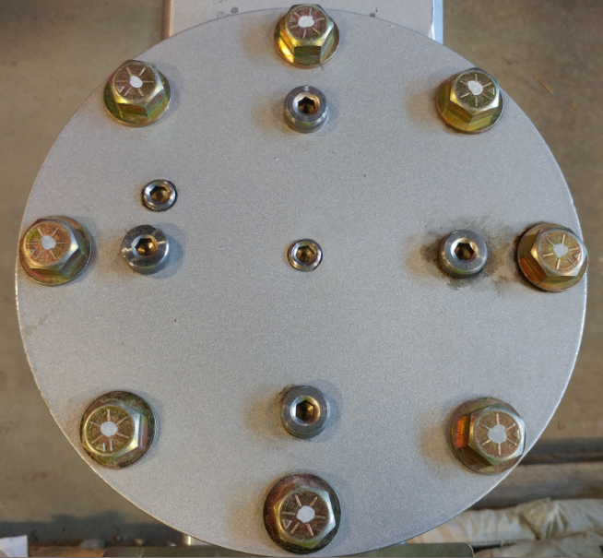
Outriggers
These are the 4 bolts that may rise when pressure is applied on the outrigger

Slide 22
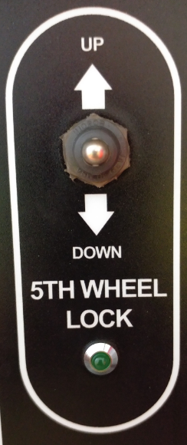
5th Wheel Lock
Four hydraulic pistons that lower to marry the tractor and trailer for stability
  Press and release switch to deploy
  Audible alarm while deploying
  Light will illuminate when properly deployed
  REQUIRED for aerial operation
  If contact is lost during aerial operation pistons will automatically adjust
  Jacks cannot be adjusted once 5th Wheel Lock is engaged

Slide 23
Setup Complete
When setup is complete both “Extend” and “Jack” deployed lights as well as the 5th wheel lights should be on. (Unless “Short Jacked”)

Slide 24
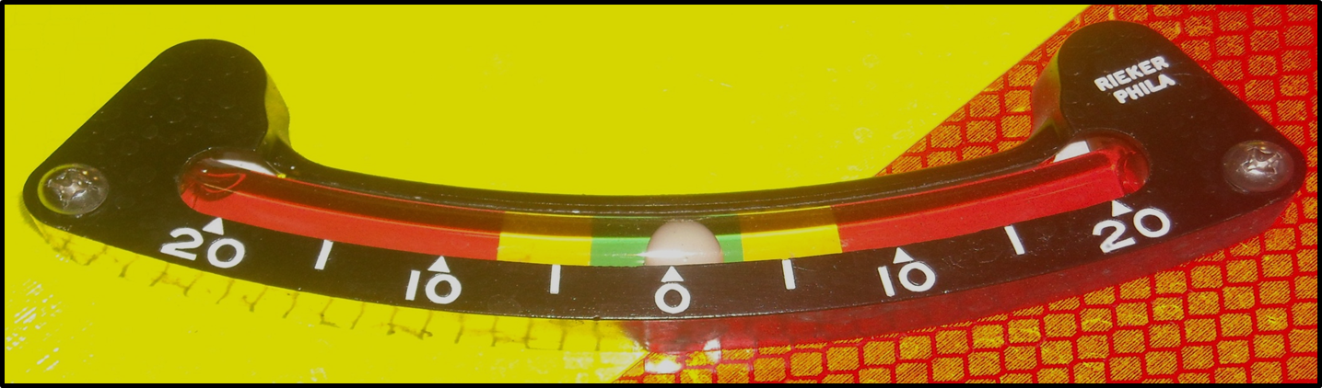
Setup Complete
After weight is off the suspension look at the inclinometers again:
  Green = 100% capacity
  Yellow = 50% capacity
  Red = DO NOT operate
In order to maintain 100% capacity ALL inclinometers must be in the Green

Slide 25
Short Set
Short Set – aka Short Jacking
  Outriggers must be fully deployed on working side
  Outriggers can be short jacked on the non-working side
  Short jacked side must have jack slightly extended before lowering beam
  Rotation Inhibit System will stop aerial rotation to short jacked side
  Light on pedestal will indicate which side is short jacked
  Override switch on pedestal must be pressed to raise ladder out of cradle

Slide 26
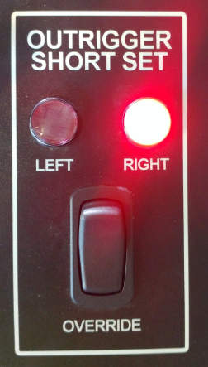
Short Set
Short Set – aka Short Jacking
  Illumination of this light indicates that the right outrigger is not fully extended

Slide 27
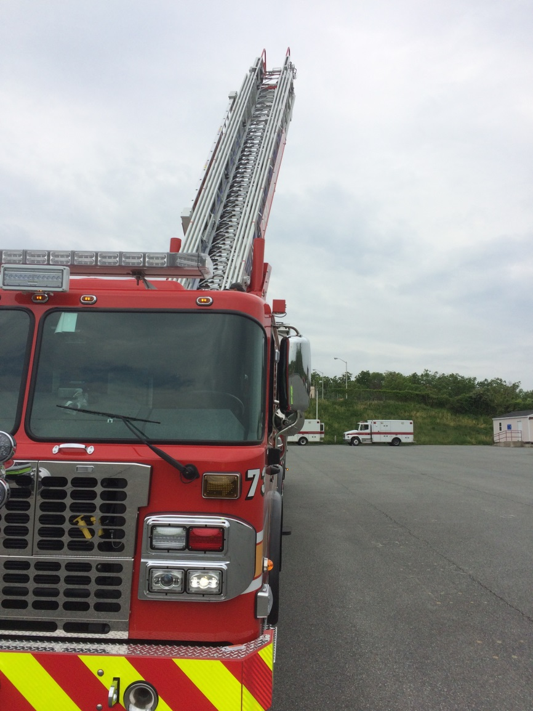
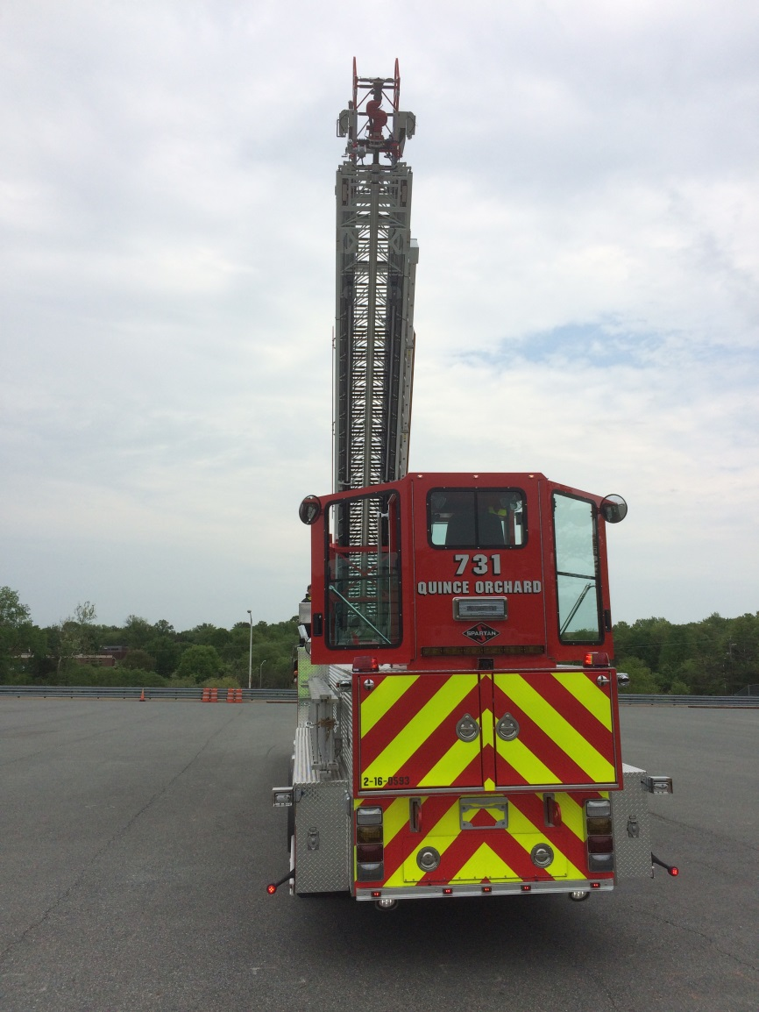
Short Set
Rotation inhibit has restricted rotation over the short jacked side

Slide 28
Aerial Ladder
Tip Loads – When properly stabilized
  500 pounds in any configuration
  250 pounds when flowing water
Distributed Loads – When properly stabilized
  Refer to load chart

Slide 29
Aerial Ladder
All capacities are based on the following:
  Outriggers are fully extended
  Outriggers are placed on firm ground
  Weight must be relieved from chassis suspension
  50mph maximum wind conditions

Slide 30
Aerial Ladder
Best Practices
  NEVER use hydraulics to push down on objects with the aerial device
  AVOID any type of upward load
  AVOID any type of torsional load
  ALWAYS use high idle when using two aerial functions
  ALWAYS chock both front tires against grade
  When bedding ladder hold in “lower” position until movement stops to lock ladder in cradle

Slide 31
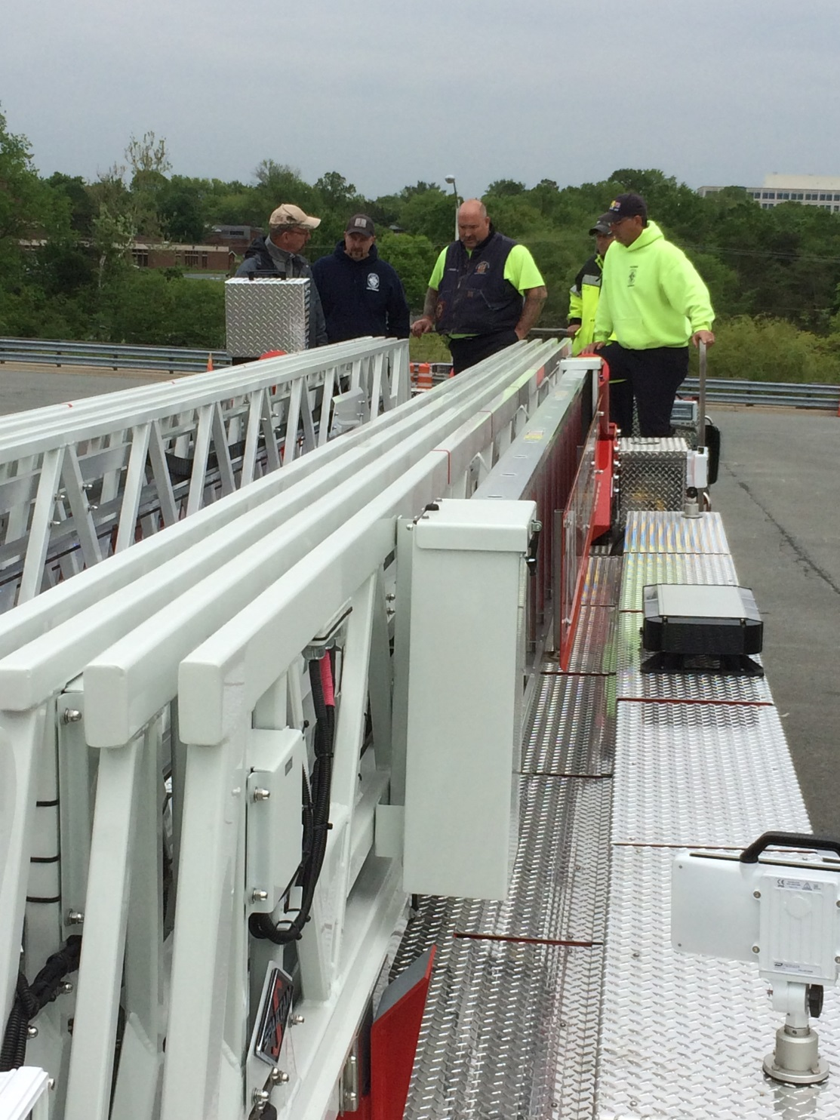
Aerial Ladder
Ladder Sections
  Fly
  Outer Mid
  Inner Mid
  Base

Slide 32
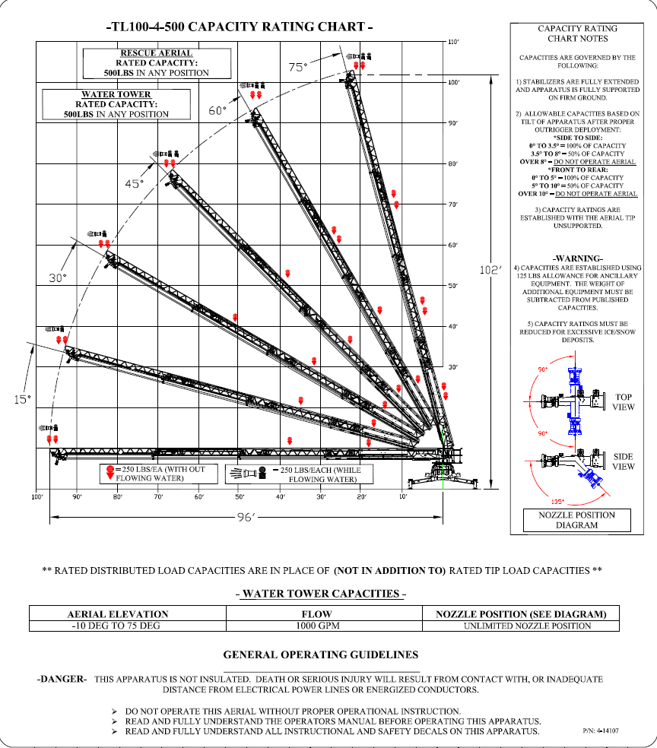
Load Chart
1. Capacity Rating Chart
Chart Notes
Water Tower Capacities/General Operating Guidelines
Notes:
We will go over the following parts of the Load Charts: Capacity Rating Chart, Chart Notes and Water Tower Capacities.

Slide 33
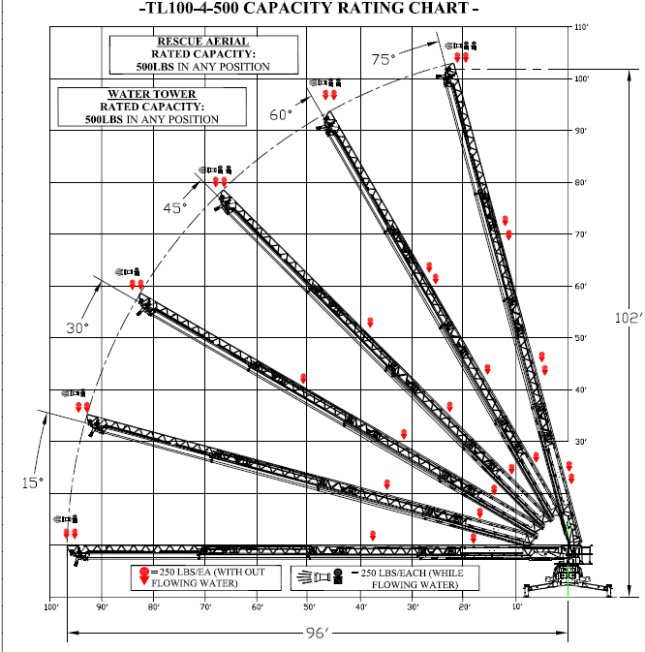
Load Chart
Truck placement can be determined from the Load Chart.
If you need to reach an elevation of 50 feet you can be no more than approximately 85 feet from the structure.
If you need to reach an elevation of 70 feet you can be no more than approximately 75 feet from the structure.
Notes:
Capacity Rating Chart: Explain that it is a four section ladder, names for the section are Base, Inner Mid, Outer Mid, & Fly
The dotted line is the Extension arch which is used as a guide to determine angle you are working at and how close you need to be to where you want to go. To reach the 5th floor of a building you must be within 88 feet of the building.

Slide 34
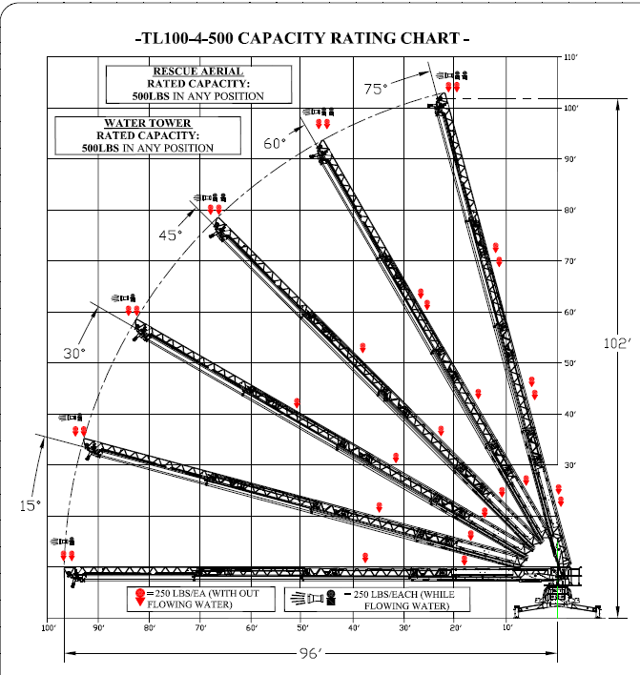


Load Chart
TIP LOAD
Notes:
The rated capacity or tip load is 250 lbs dry basically one person on tip with no water flowing where ever you can put the aerial. -10 to 80 degrees. The capacity flowing water is 250 lbs water while flowing rated capacity of the waterway of 1000 GPM. 250 lbs is the NFPA weight of an average firefighter in turnout gear.

Slide 35
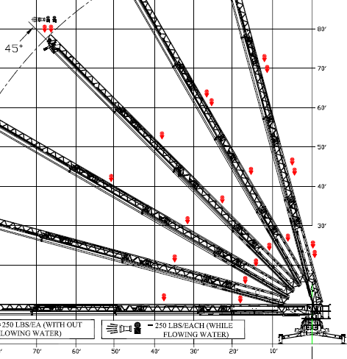
Load Chart
At 45 degrees the distributed load is 750 pounds. You can have 3 firefighters (250lbs each) evenly distributed over the length of the ladder IN PLACE OF your tip load.
Notes:
Distributed load is 750 LBS which means you can have 3 firefighters or 750 lbs evenly distributed over the length of the ladder in place of your tip load.

Slide 36
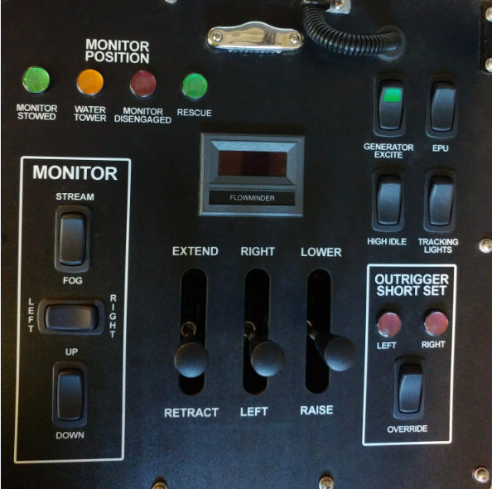
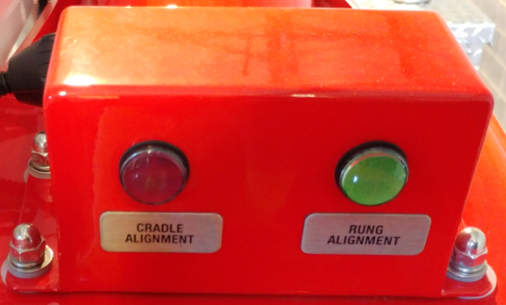
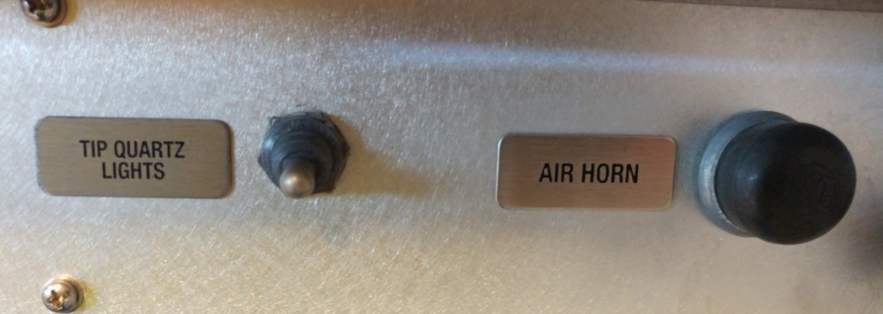
Pedestal Controls
Aerial Controls and Indicators
Right Lift Cylinder
Console Lid
Turntable Console

Slide 37
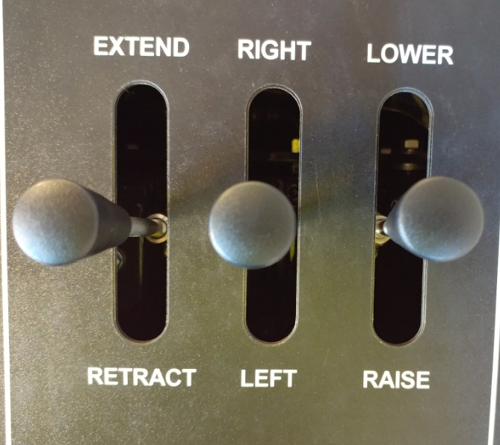
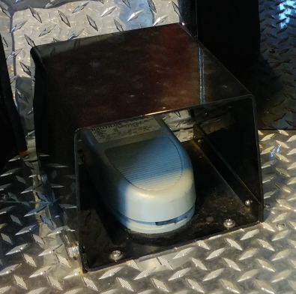
Pedestal Controls
Pedestal
To begin aerial operations engage the Deadman pedal.

Slide 38
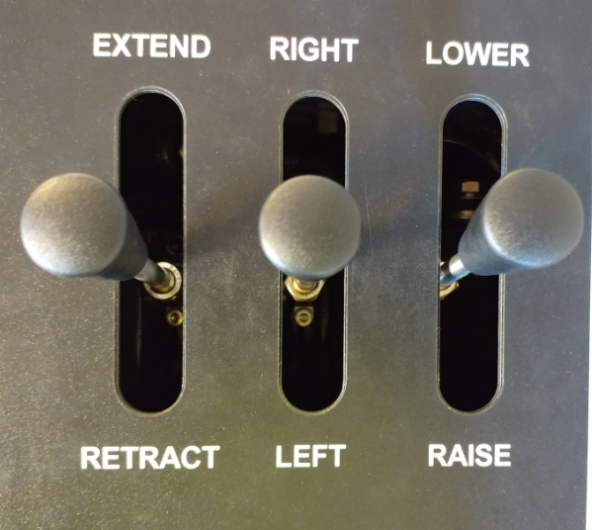
Pedestal Controls
Controls are all true hydraulic valves
  When operating, always feather on and off the controls
  Raise
  Rotate
  Extend

Slide 39
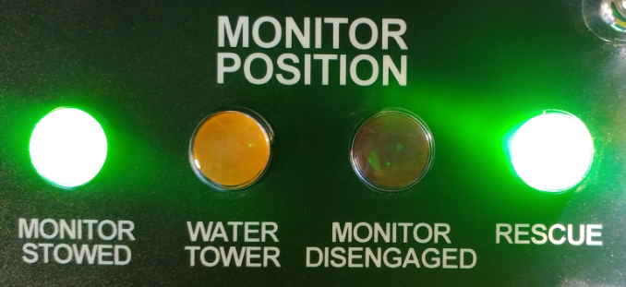
Pedestal Controls
Monitor Position Indicator Lights
Monitor Stowed: Indicates the Monitor is properly stowed for Aerial placement in the cradle
If the light is not illuminated, it means that the Monitor is not in the stowed position. DO NOT bed the aerial.

Slide 40
Pedestal Controls
Monitor Position Indicator Lights
If the light is flashing the monitor is in the process of stowing itself.
NOTE: During the stowing process the aerial will not function. Release lower control until nozzle is stowed.

Slide 41
Pedestal Controls
Monitor Position Indicator Lights
Once the light stops flashing and illuminates solidly, this indicates that stowing is complete, aerial functions can resume.

Slide 42
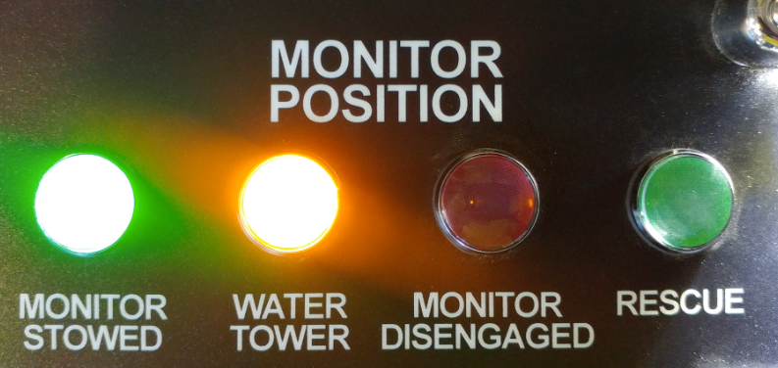
Pedestal Controls
Monitor Position Indicator Lights
Water Tower: Indicates that the Monitor is “pinned” to the Fly section for Water Tower operations.

Slide 43
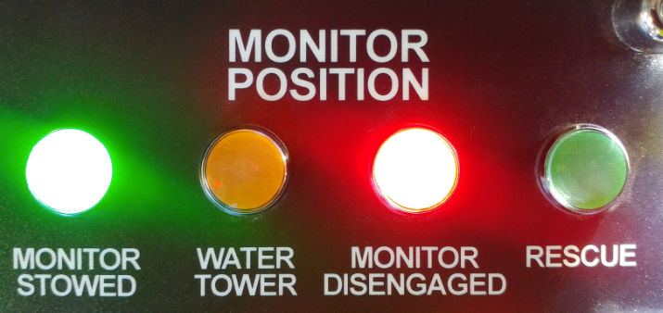
Pedestal Controls
Monitor Position Indicator Lights
Monitor Disengaged: Indicates that the Monitor is not connected to either the “Fly” or “Outer Mid” ladder sections. DO NOT operate ladder or flow water if this indicator is active.

Slide 44
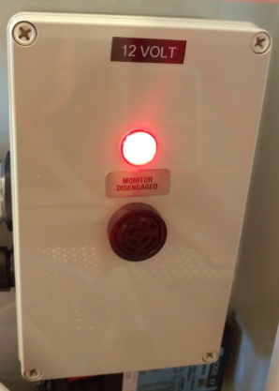
Pedestal Controls
Monitor Position Indicator Lights
Monitor Disengaged: There is also a Monitor Disengaged light and alarm located on the left side at the tip of the ladder.

Slide 45
Pedestal Controls
Monitor Position Indicator Lights
Rescue: Indicates that the Monitor is “pinned” to the outer-mid section of the ladder for Rescue operations.

Slide 46
Short Jacking Reminder
If unit is “Short Jacked” the Override switch for the
Outriggers must be pressed and held until the Aerial has
cleared the cradle. It can then be released.

Slide 47
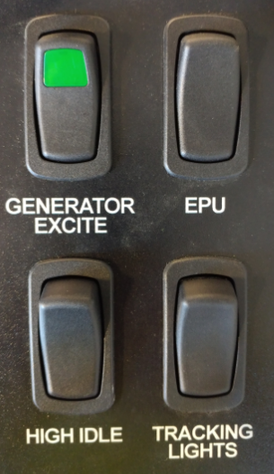
Pedestal Controls
Generator Excite
  One of 4 locations to excite generator
EPU
  Emergency Power Unit is used to bed the aerial in case of hydraulic failure
High Idle
  Engages high idle for multiple functions
Tracking Lights
  Turns on the blue LED ladder illumination lights

Slide 48
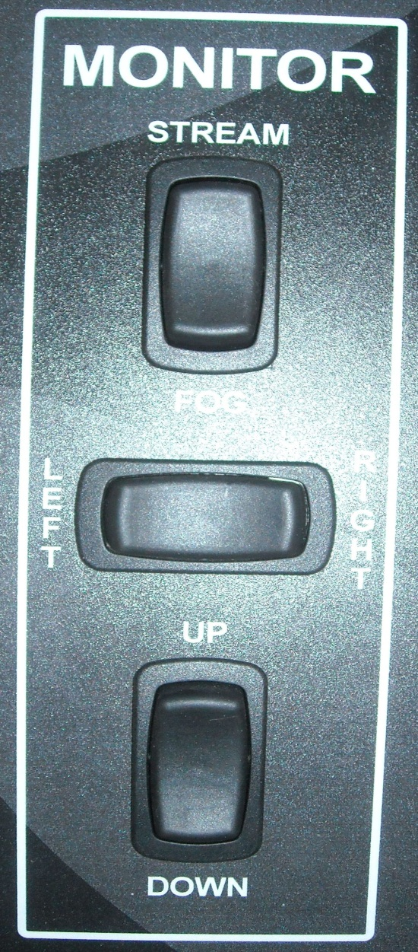
Pedestal Controls

Slide 49
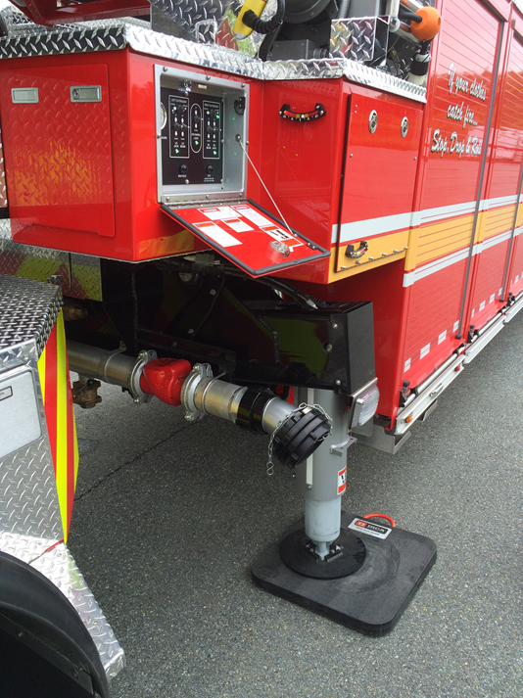
Aerial Ladder
Waterway
  5” Storz connection
  Use 5” short shot to gated wye on one side only for supply

Slide 50
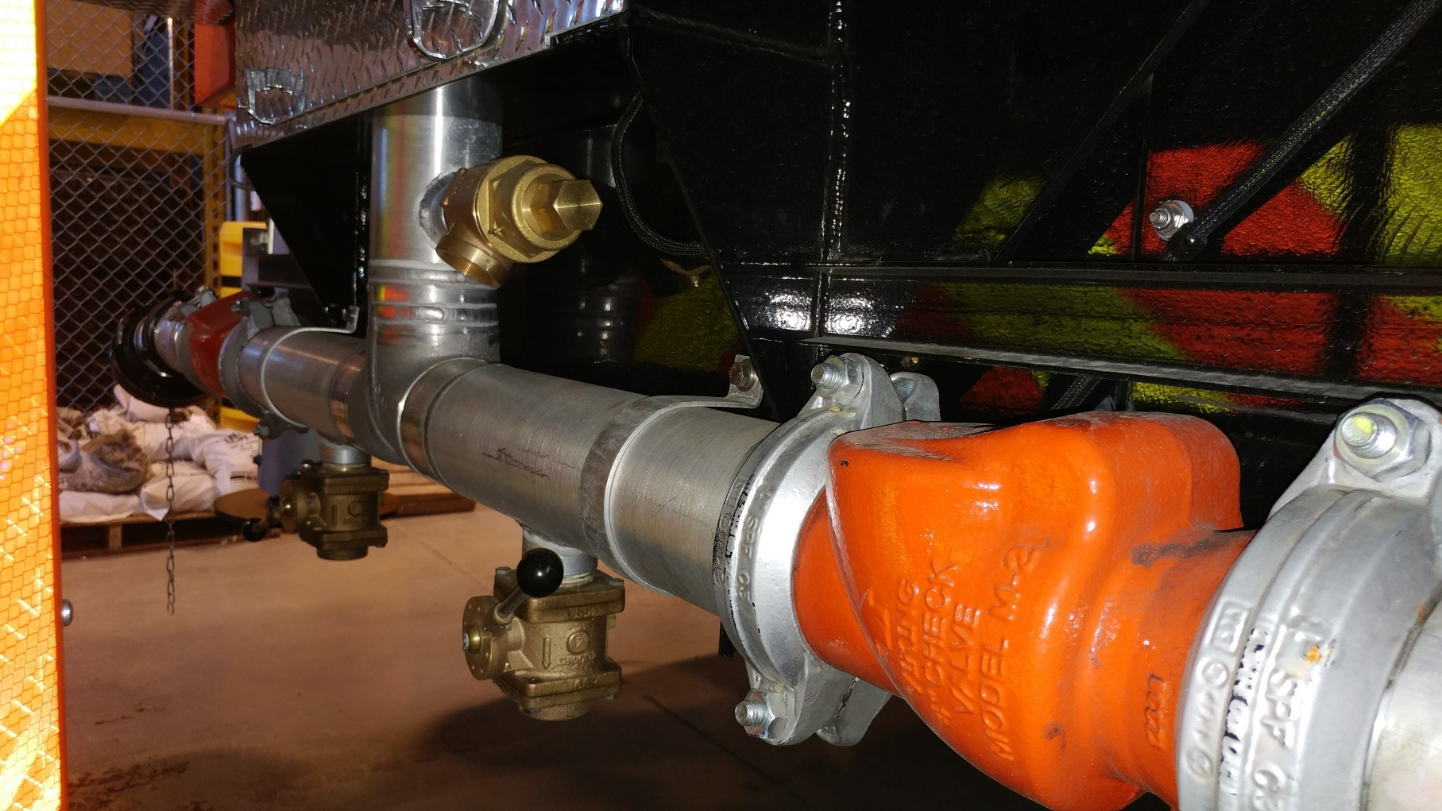
Aerial Ladder
Waterway
Relief Valve
Check Valves
Drains

Slide 51
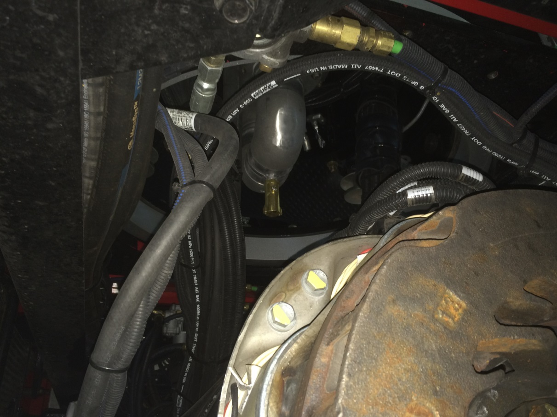
Aerial Ladder
Waterway
  Automatic drain located at lowest point of waterway piping

Slide 52
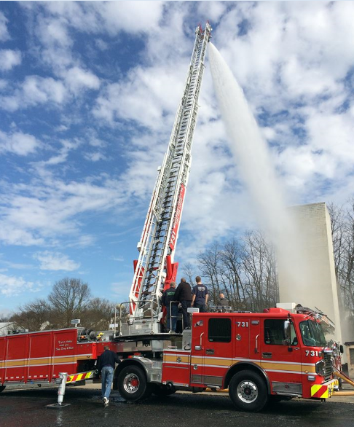
Aerial Ladder
Waterway
  Piping
    5”
    4.5”
    4”
    3.5”
  Grease after every use
  Wipe entire waterway with 30w non detergent oil twice a year

Slide 53
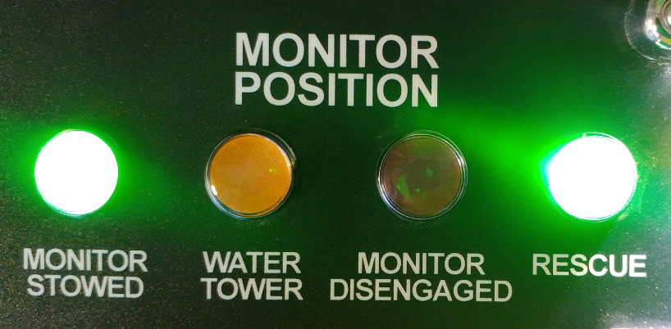
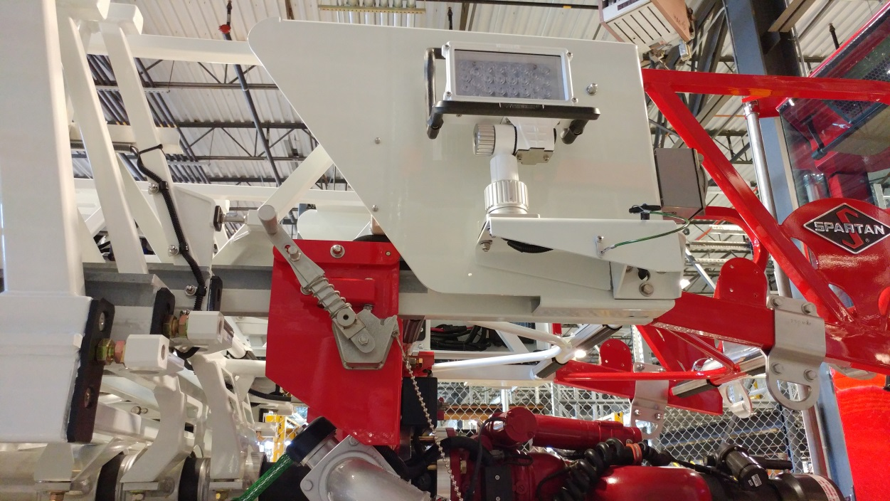
Aerial Ladder
Pin-able Waterway
  Rescue Position

Slide 54
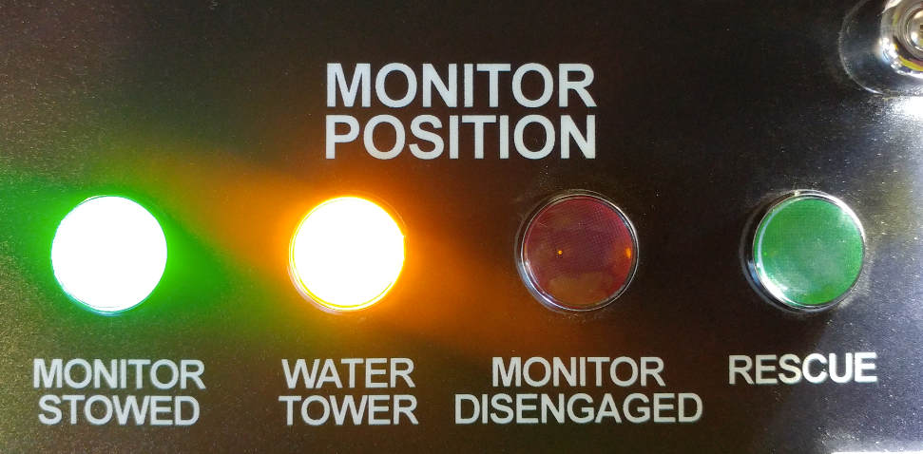
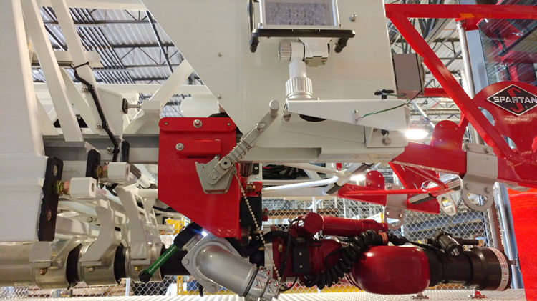
Aerial Ladder
Pin-able Waterway
  Water Tower Position

Slide 55
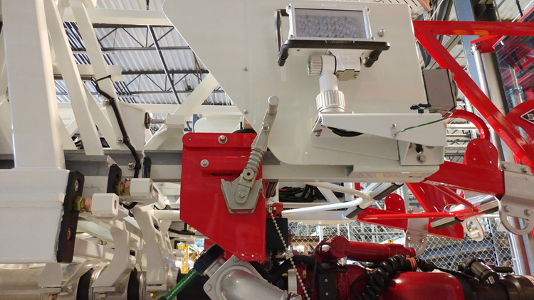
Aerial Ladder
Pin-able Waterway
  Monitor Disengaged

Slide 56
Aerial Ladder
Waterway
  Monitor has Auto Stow feature
  Aerial ladder will not bed until monitor is stowed
  Fog Stream ONLY
  DO NOT keep a smooth bore on
  Damage to trailer will occur from smooth bore
  If you must retract ladder while flowing water do so VERY slowly to avoid blowing seals on piping

Slide 57
Aerial Ladder
Waterway
  2 ½” discharge outlet
  Used for “flying standpipe”
  Has quarter turn ball valve
  Remember to close master stream device

Slide 58


Aerial Ladder
Flood Lights

Slide 59

Aerial Ladder
Ladder Illumination

Slide 60

Aerial Ladder
Rope Roller
  Designed to be used in same configuration as Pierce Lyfe Pulley
  Rated at 500 pounds

Slide 61
Aerial Ladder
Emergency Procedures
  Emergency Power Unit – EPU
  Blocking Solenoids
  Outrigger Manual Controls
  Override Controls

Slide 62

Aerial Ladder
Emergency Procedures
  Emergency Power Unit – EPU
    Designed as back-up to hydraulic pump in event of failure
    Intended for no-load use to stow aerial and outriggers
    Powered by chassis 12v electrical system
    1.5 gpm @ 2000 psi
    2 minutes on, 10 minutes off duty cycle
EPU Switches located at outrigger control panels and on pedestal controls

Slide 63
Aerial Ladder
Emergency Procedures
  Emergency Power Unit – EPU
    While operating the desired aerial or outrigger function the operator must simultaneously press and hold the EPU switch
    Only use 1 function at a time

Slide 64

Aerial Ladder
Emergency Procedures
  Outrigger Override and Aerial Override Solenoids
    2 Blocking solenoids locating in 1st compartment on driver’s side of trailer
    SHOP USE ONLY!!!

Slide 65


Aerial Ladder
Emergency Procedures
  Outrigger Manual Controls
    Used during failure of electric outrigger switches
    Located on officer’s side in compartment above outrigger
    Corresponding valve for each switch on outrigger panel

Slide 66
Aerial Ladder
Emergency Procedures
  Manufacturer recommends that ALL emergency procedures are exercised and tested monthly

Slide 67
Maintenance
Grease Less Ladder
  This DOES NOT mean that the ladder does not need greased
  It is greased less often
  Uses a zinc coating on slides and sheaves
  Grease should be applied to last 4 feet of each section once per year
  Grease to be provided by CMF

Slide 68

Maintenance
Zinc coating

Slide 69

Maintenance
Zinc coating

Slide 70

Maintenance
Zinc coating

Slide 71
Maintenance
Inspect sheaves for wobble
  Indicates wear of bearings inside of sheaves
  Very little clearance so early identification is imperative

Slide 72
Maintenance
DO NOT grease planetary gear
  Grease will attract dirt
  Bearing is attached to Vogel lube system
DO NOT pressure wash aerial ladder
  Preservation of zinc coating is imperative

