Slide 1
Tractor Drawn Aerial
2016 Spartan ER
Chassis

Slide 2
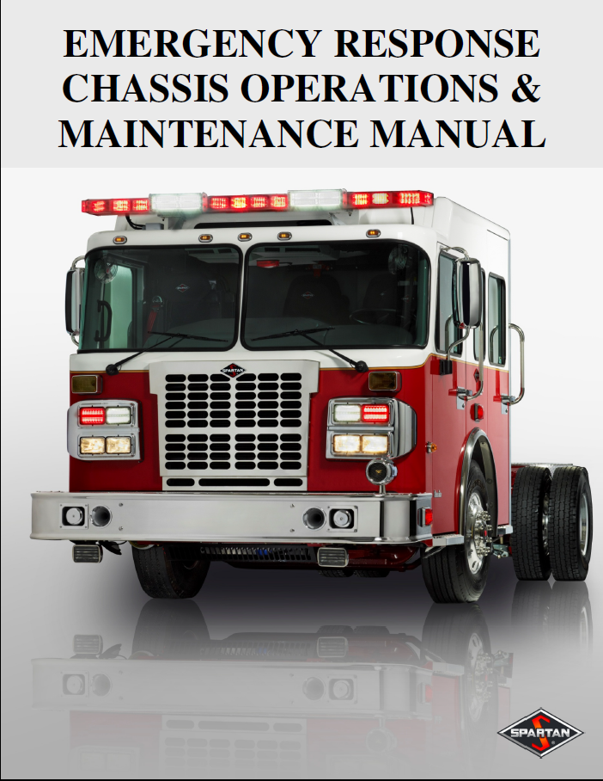
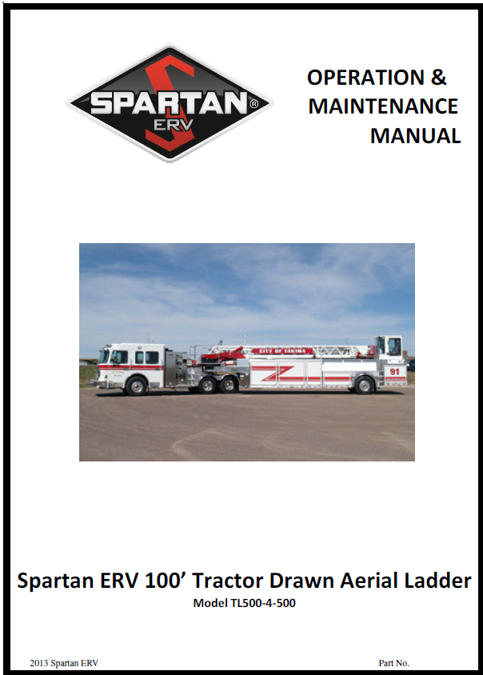
Tractor Drawn Aerial
In addition to this presentation the following manuals should be read by all operators before operating the aerial.
Chassis Manual
Operators Manual

Slide 3
Table Of Contents
Specifications
Chassis
Jackknifing
Cab Controls
Vista Display
Transmission Fluid Check
Regeneration
Diesel Exhaust Fluid
Generator
Tiller Cab

Slide 4
Specification Chart
GVWR 74,500 pounds
Front Axle 21,200 pounds
Rear Axle 29,000 pounds
Tiller Axle 24,300 pounds
Unit Height 11’ 3”
Unit Length 59’ 3”
Unit Width 9’ 11” mirror to mirror
Note – There are two vehicle placards in the Driver Compartment. The second placard has the most accurate axle weights after the Spartan Tiller axle modification.

Slide 5
Specification Chart
Engine Cummins 500 HP
Brakes F-Disc R-Drum T-Disc
Tire Pressure F-115 R-125 T-130
Coolant Purple
Engine Oil 15W-40 48 Quarts
Transmission Fluid TES-295 39 Quarts
Power Steering Fluid Dexron III 8 Quarts
Diesel Exhaust Fluid 6 Gallons DEF

Slide 6
Ladder Specifications
Vertical Operating Height 100 feet
Horizontal Reach 96 feet
Operating Range -10 to 75 degrees
Tip Load 500 pounds
Outrigger Spread 16 feet
Beam Extended
with Jacks Up 17 7 feet ½”
Ladder Pipe Rating 1000 gpm
Maximum wind speed 50 mph

Slide 7
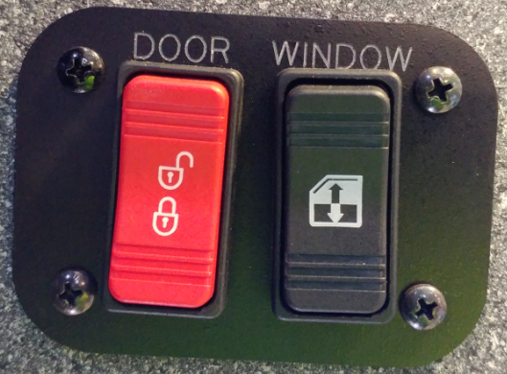
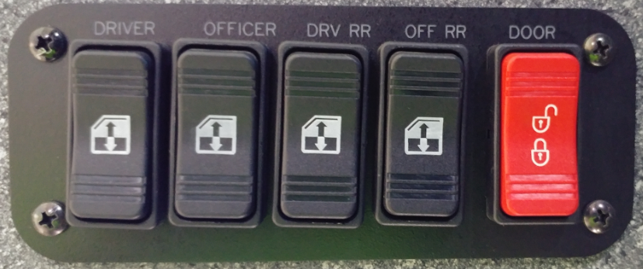
Chassis
Cab Locks
All cab doors and compartments have electric locks
Switches on Driver’s and Officers doors
Officer’s Door
Driver’s Door

Slide 8
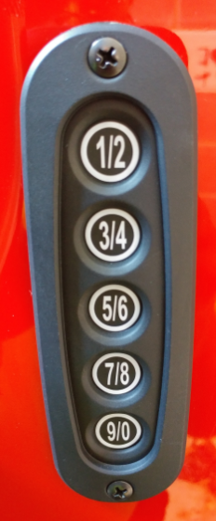
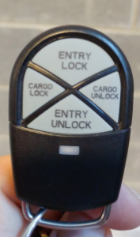
Chassis
Cab Locks
Keypads located at driver and officer doors
Key FOB also provided
Stealth Switch

Slide 9
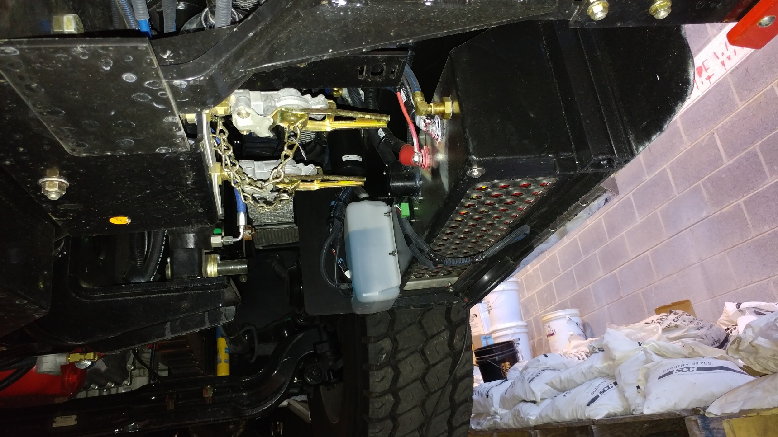
Chassis
Glad Hands
Located under driver side

Slide 10
Chassis
Cameras
The vehicle is equipped with 5 cameras to improve driver and tiller visibility
Driver’s Mirror – facing rear
Officer’s Mirror – facing rear
Driver’s Rear Corner – facing front
Officer’s Rear Corner – facing front
Center Rear of Trailer – Back-up Camera

Slide 11
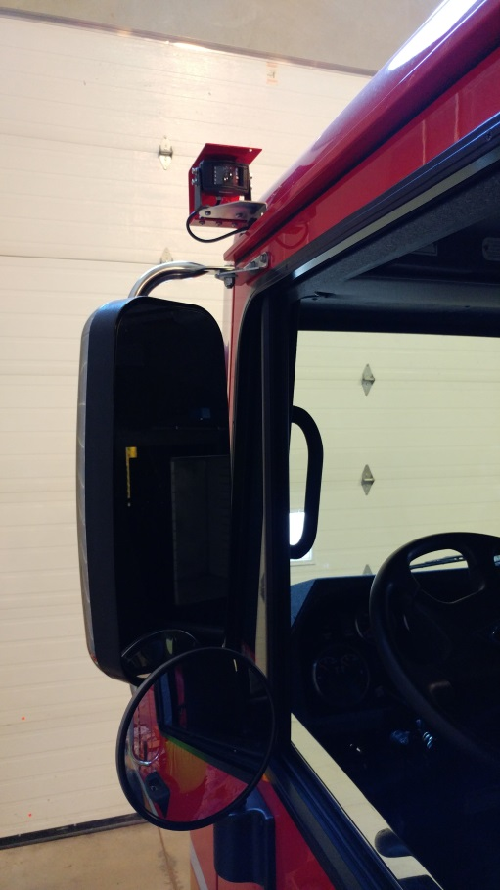
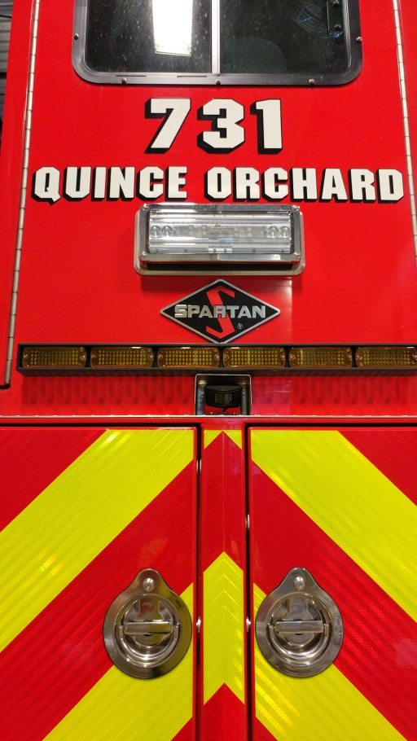
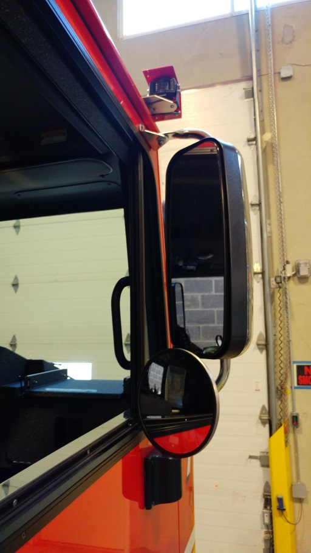
Chassis
Cameras
Driver’s Mirror
Back-up Camera
Officer’s Mirror

Slide 12
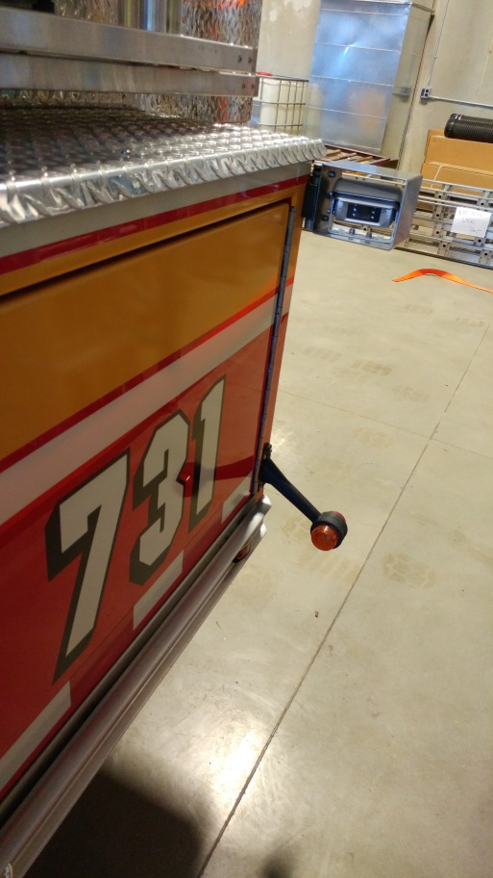
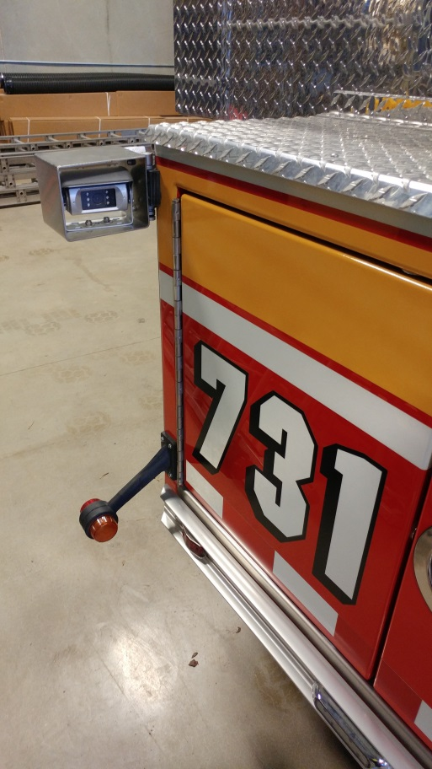
Chassis
Cameras
Driver’s Side Tiller Camera
Officer’s Side Tiller Camera

Slide 13
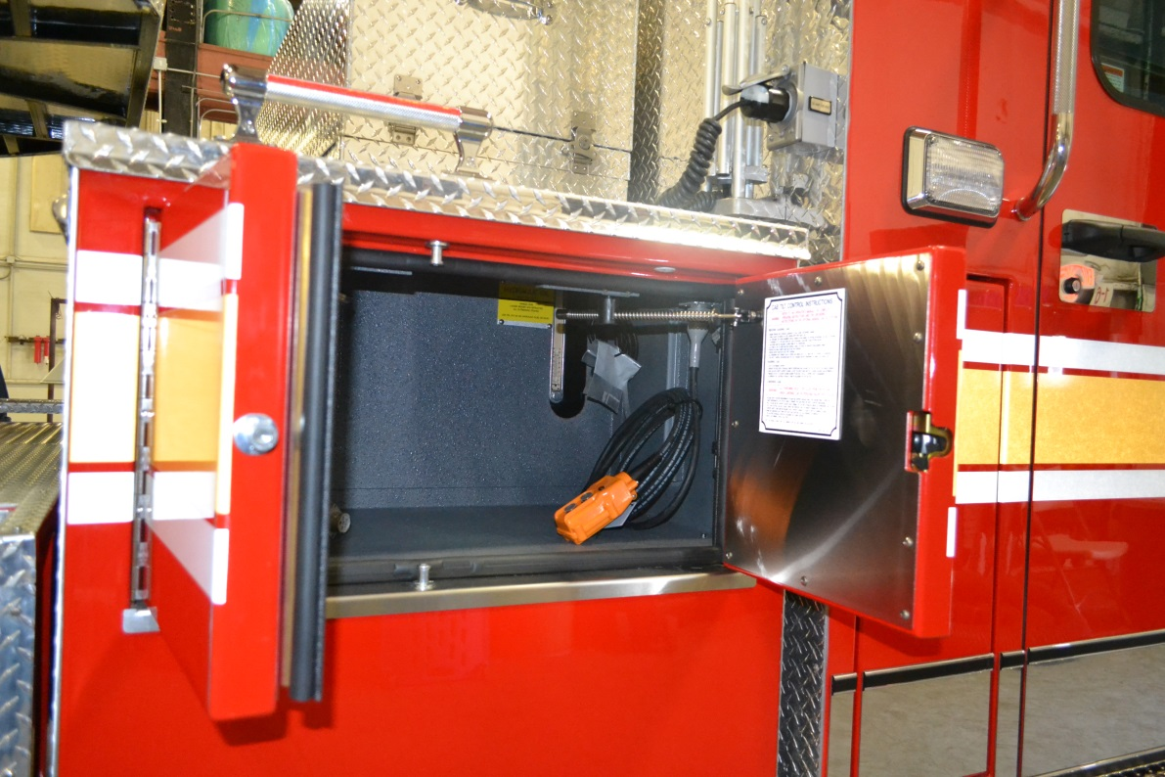
Chassis
Cab Tilt
Normal Operation
Manual pump
Direct 12v Override
No Access Hatch

Slide 14
Chassis
Cab Tilt
Normal Operation
Works same as Crimson Engine
Battery switch on, ignition switch off
Press up button until cab lock engages then stop
DO NOT lower cab back onto lock

Slide 15
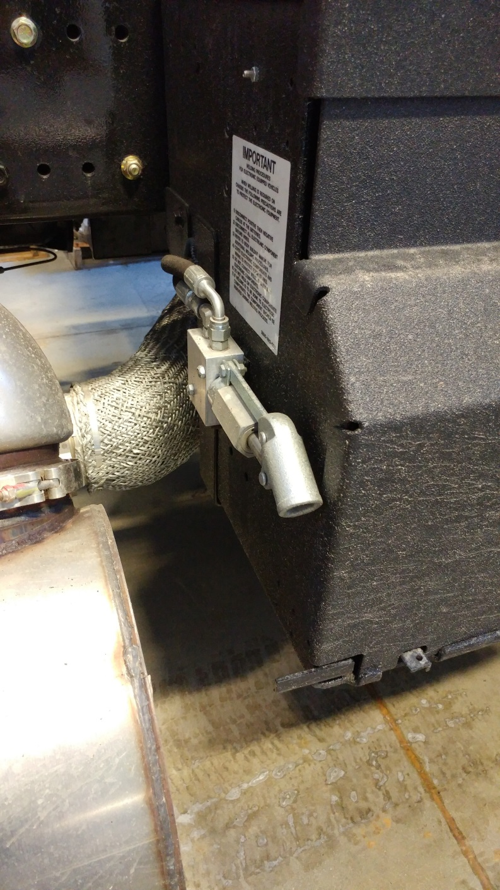
Chassis
Cab Tilt
In the event of 12v failure the cab can be manually raised
Pump located rear of Officer Side Battery Box

Slide 16
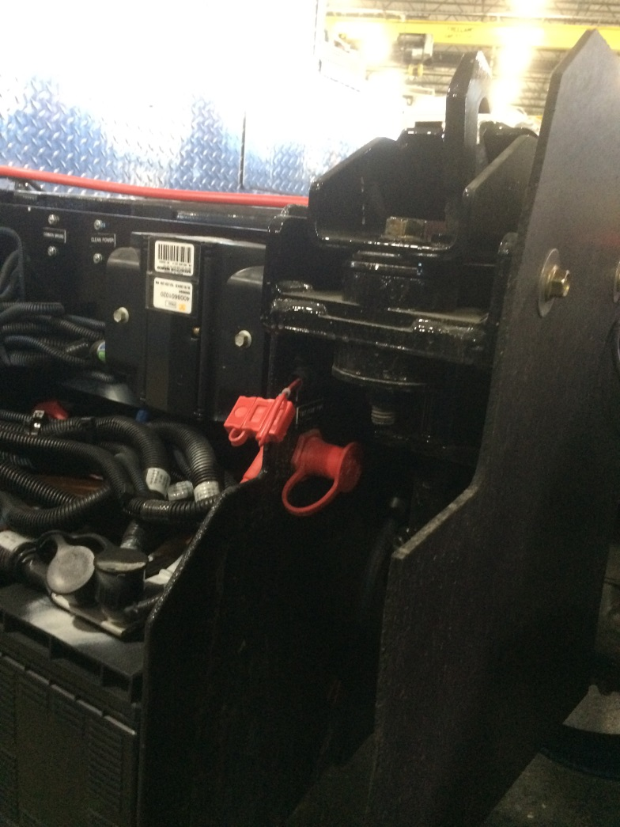
Chassis
Cab Tilt
Direct 12v Override (SHOP USE ONLY)
NOT a jumper stud

Slide 17
Chassis
Cab Tilt
There is no access hatch in the cab to check fluids
Only tilt cab on weekly checks or when a defect requires it

Slide 18
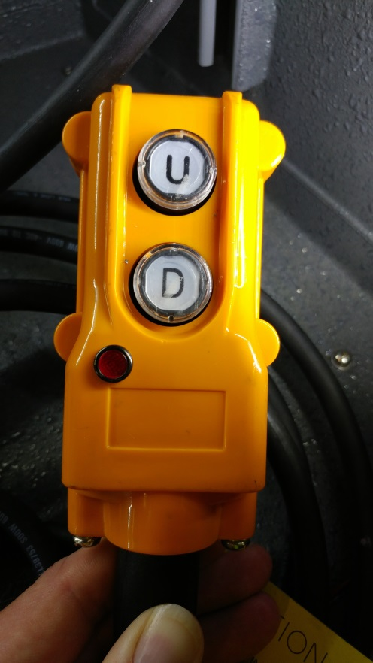
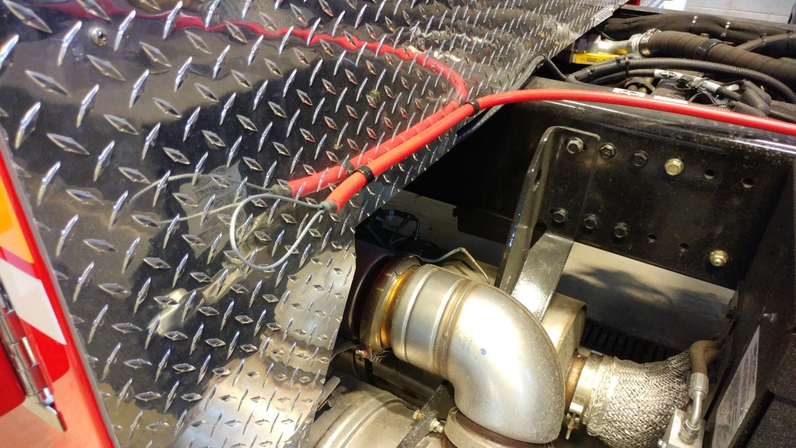
Chassis
Cab Tilt
To lower cab pull cable attached to safety bar
Press “D” button on cab tilt controller
Continue to hold “D” button until light on controller turns off
Light WILL NOT flash like Engines
Safety bar release cable

Slide 19
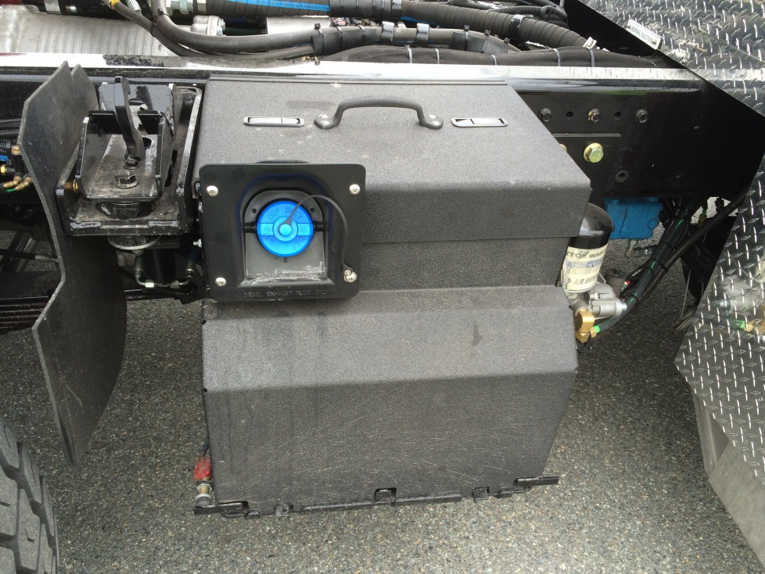
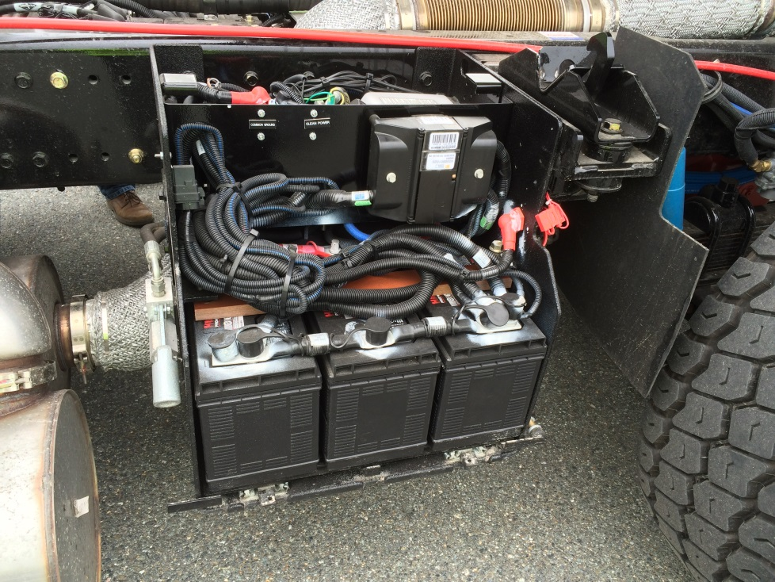
Chassis
Battery Box
Cover replacement important
Climate control for batteries and DEF
No sensors on covers

Slide 20
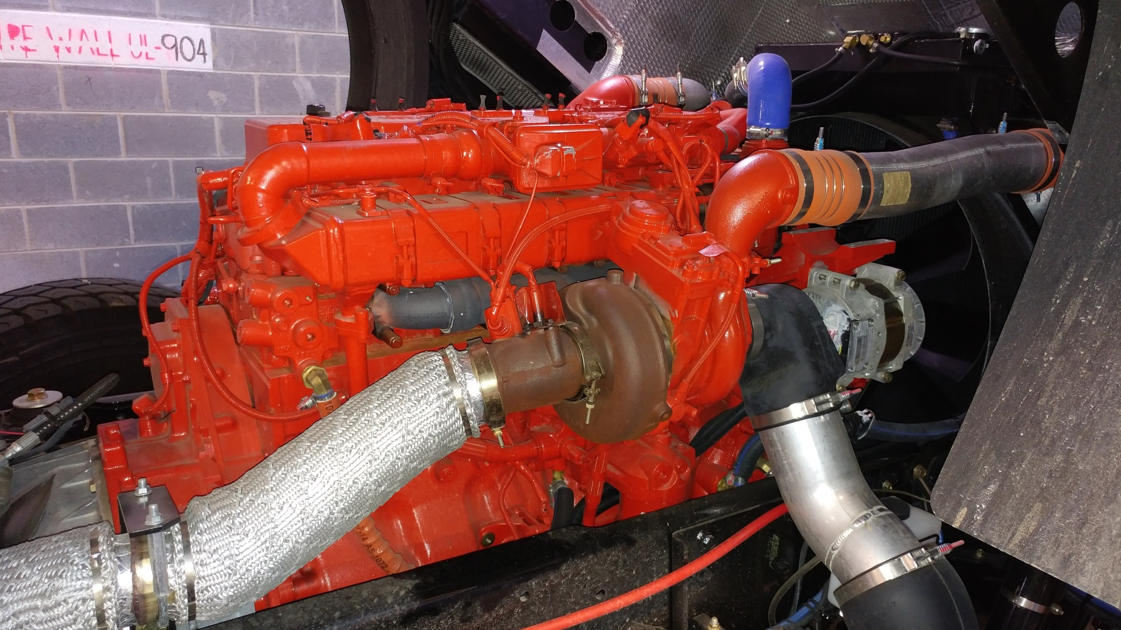
Chassis
Engine Overview
Officer’s Side

Slide 21
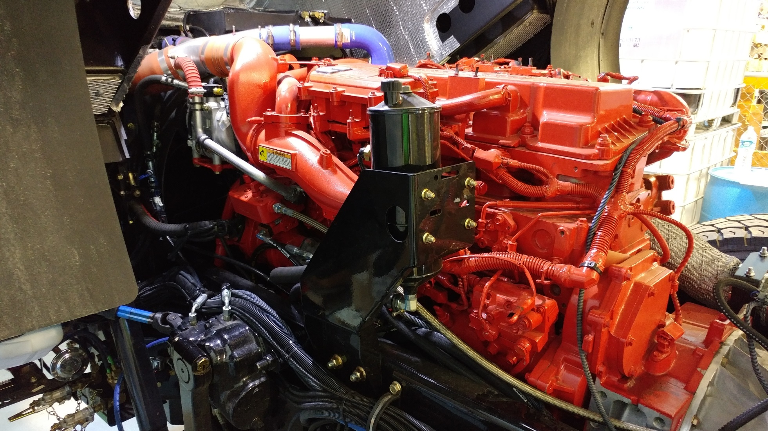
Chassis
Engine Overview
Driver’s Side

Slide 22
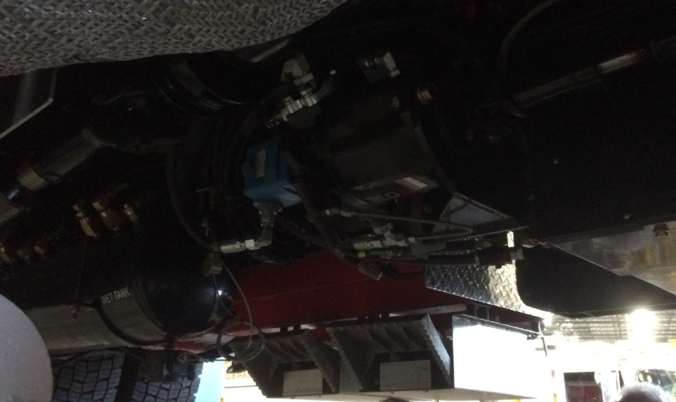
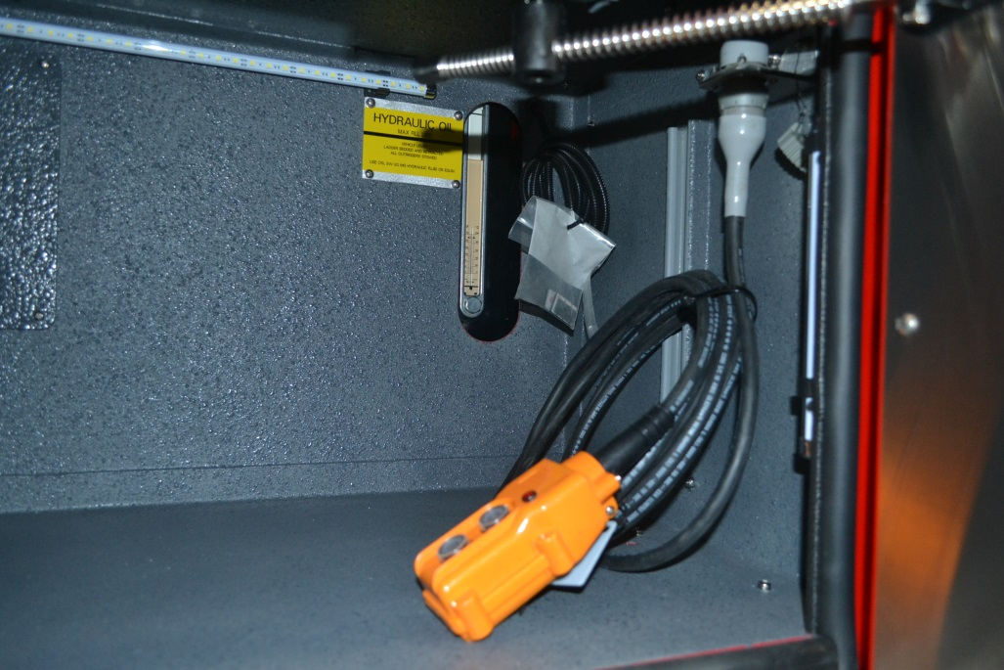
Chassis
Generator PTO/Tiller Power Steering
Always engaged
Tiller Power Steering uses hydraulic fluid from the aerial system
Fluid sight glass in compartment behind cab on officer’s side with cab tilt

Slide 23
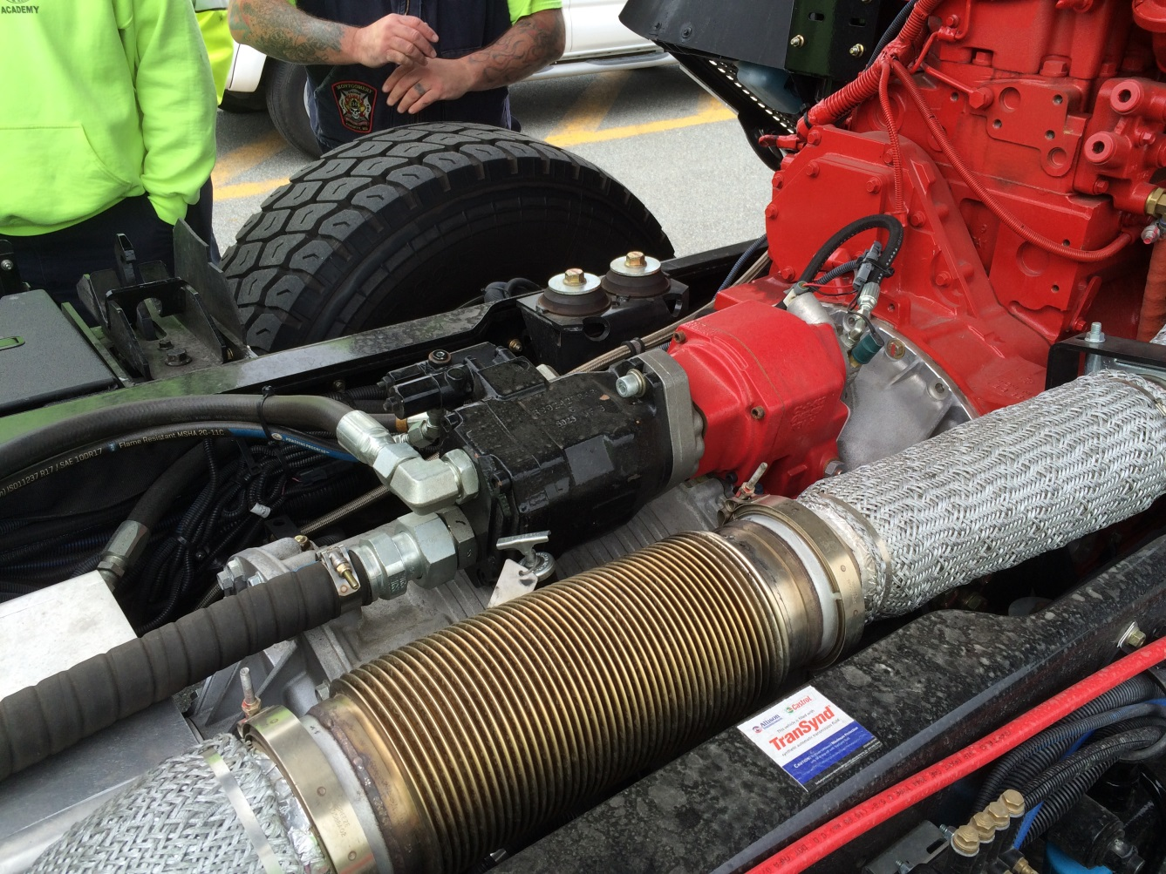
Chassis
Aerial PTO
Switched on Dash

Slide 24
Chassis
Parking Brake
When protection valve is applied it applies the spring brake to the drive and tiller axles
Service brake is applied to front steering axle
Front Wheel Lock is eliminated

Slide 25
Auxiliary Braking Device
This unit is equipped with an
Engine Brake AND Telma Retarder.
They will not be used in low traction or slippery conditions.

Slide 26
Chassis
Locking Differential
Drive axle has a true locking differential
Makes both sides turn together
Come to complete stop
Activate on Vista Display
Proceed at low speeds until traction is regained
Come to a complete stop
Disengage before continuing to drive

Slide 27
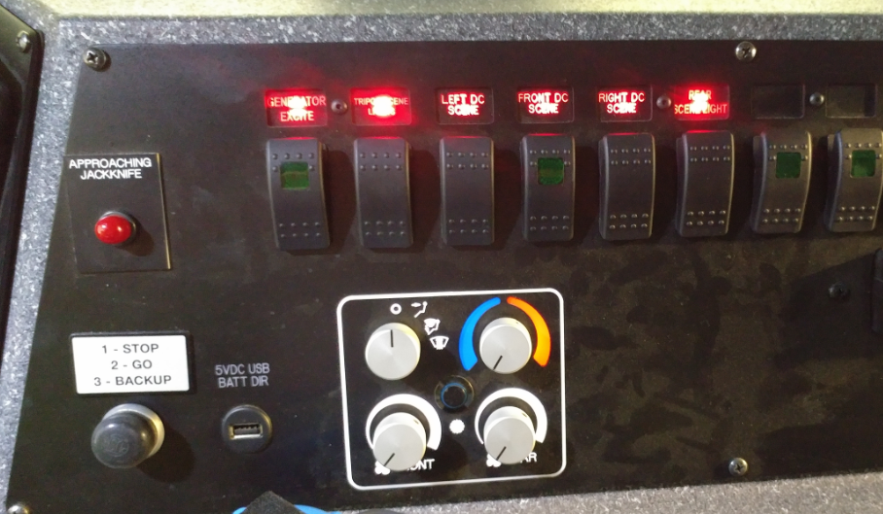
Jackknifing
There are audible and visual jackknife indicators in both the cab and tiller cab
Tractor Jackknife Alarm

Slide 28
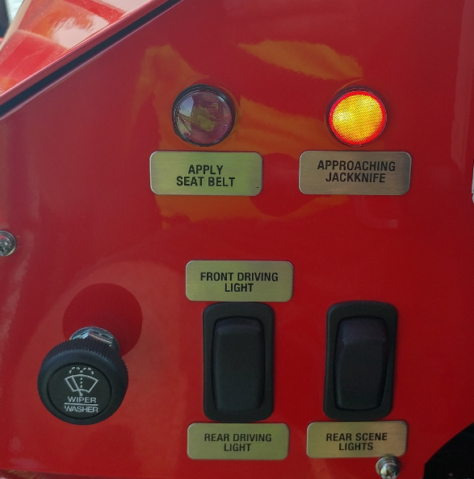
Jackknifing
There are audible and visual jackknife indicators in both the cab and tiller cab
Trailer Jackknife Alarm

Slide 29
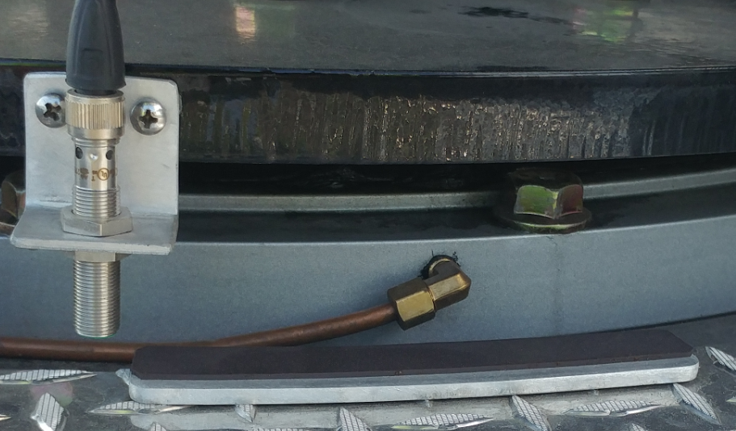
Jackknifing
Two proximity sensors are located below the 5th wheel

Slide 30
Jackknifing
The alarms are labeled “Approaching Jackknife”
The alarm begins to sound when you are approaching jackknife
The alarm continues to sound for the range of the sensor
The alarm STOPS when you have passed the sensor
Passing the sensor will cause damage to the vehicle

Slide 31
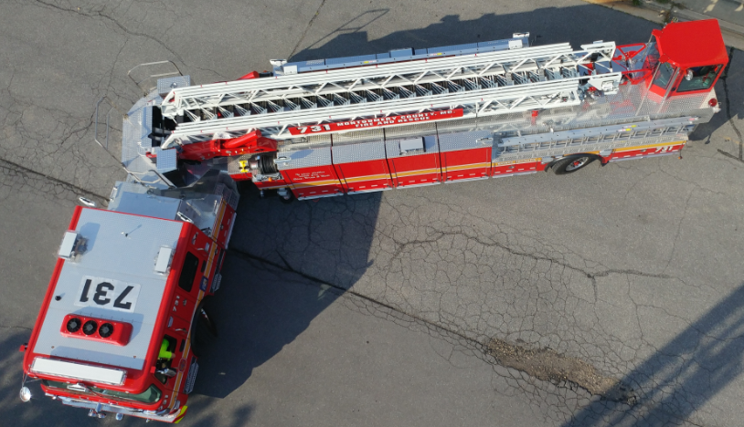
Jackknifing
Jackknife alarm begins to activate

Slide 32
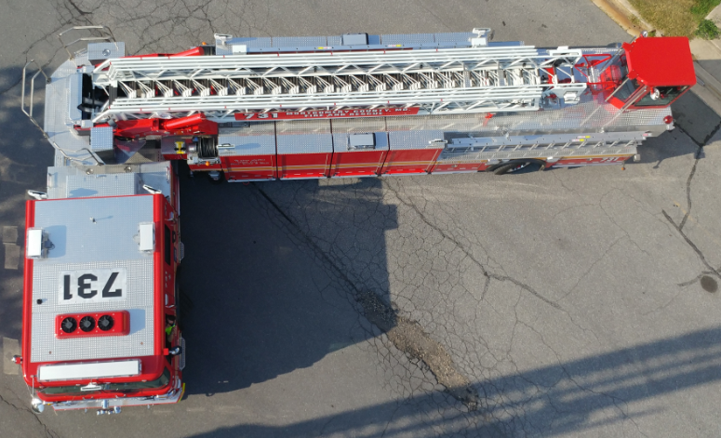
Jackknifing
Jackknife alarm stops

Slide 33
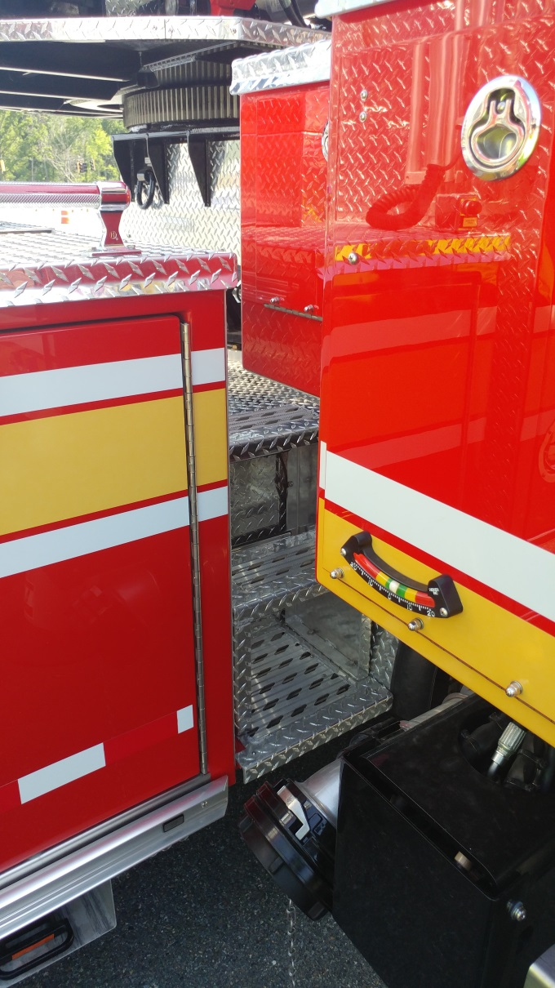
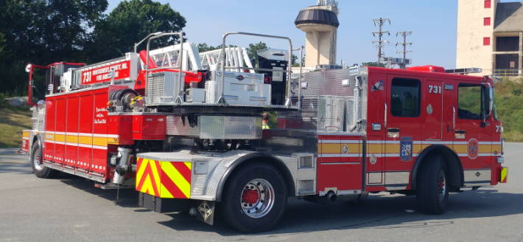
Jackknifing
Outside View
Inside View

Slide 34
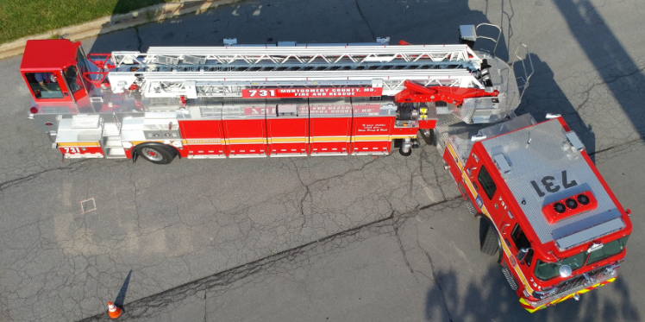
Jackknifing
Jackknife alarm begins to activate

Slide 35
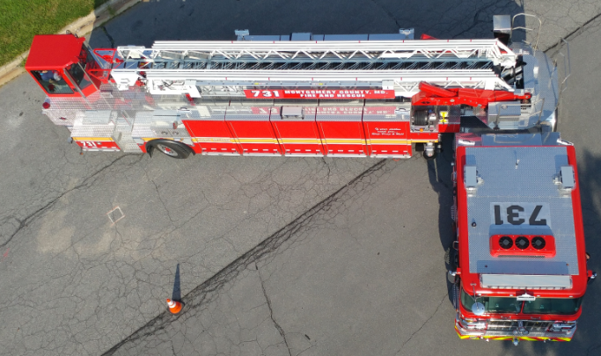
Jackknifing
Jackknife alarm stops

Slide 36
Jackknifing
The unit MUST come to an IMMEDIATE STOP upon activation of the “Approaching Jackknife” alarm
The unit officer MUST disembark the unit and watch the inside pinch point until the unit has exited the jackknife

Slide 37
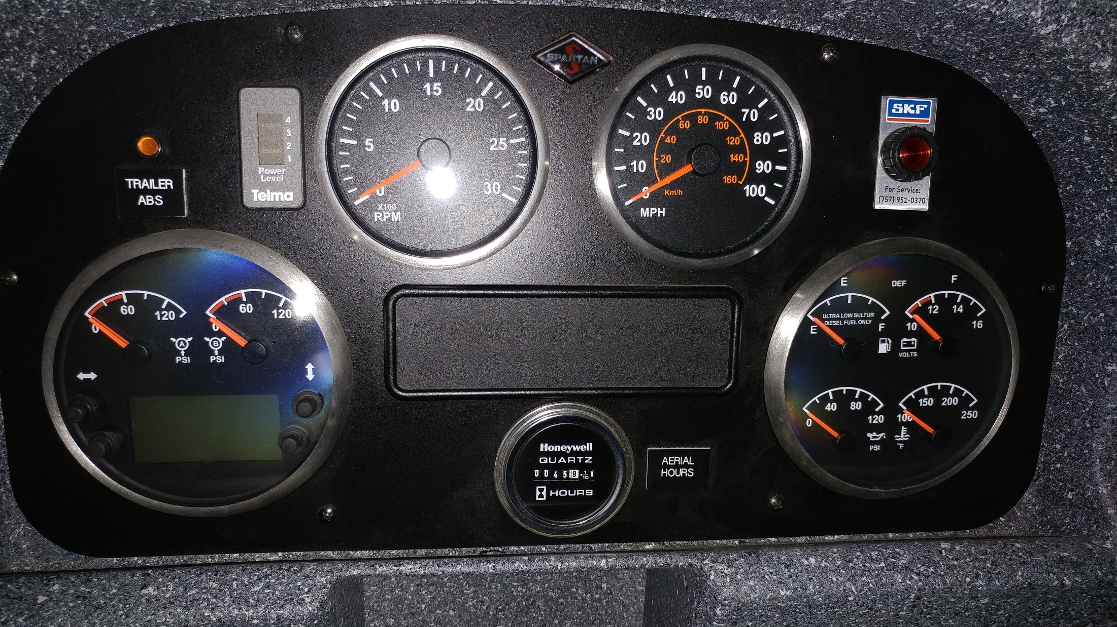
Cab Controls

Slide 38
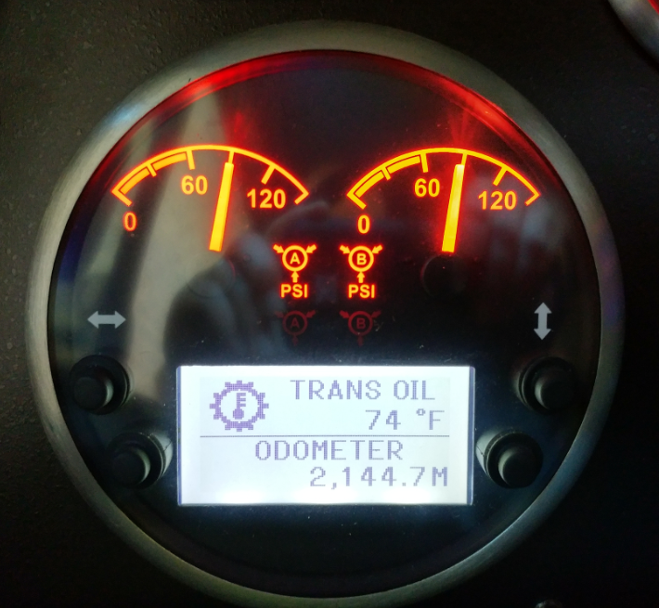
Cab Controls
Display can toggle between:
Vehicle
Trip Odometer 1
Trip Odometer 2
Trip Odometer 3
Settings
EFLC Levels
Diagnostics

Slide 39
Cab Controls
Vehicle Screen will display:
Transmission Oil Temp
Engine Oil Temp
Exhaust Temp
Engine Coolant Temp
Engine Oil PSI
Turbo Boost PSI
Primary Air Pressure
Secondary Air Pressure
Engine Load %
Engine Torque %
Battery Volts
Fuel Level
Vehicle Speed
Engine Speed
DEF Level
Instant Fuel Economy
Average Fuel Economy
Engine Hours

Slide 40
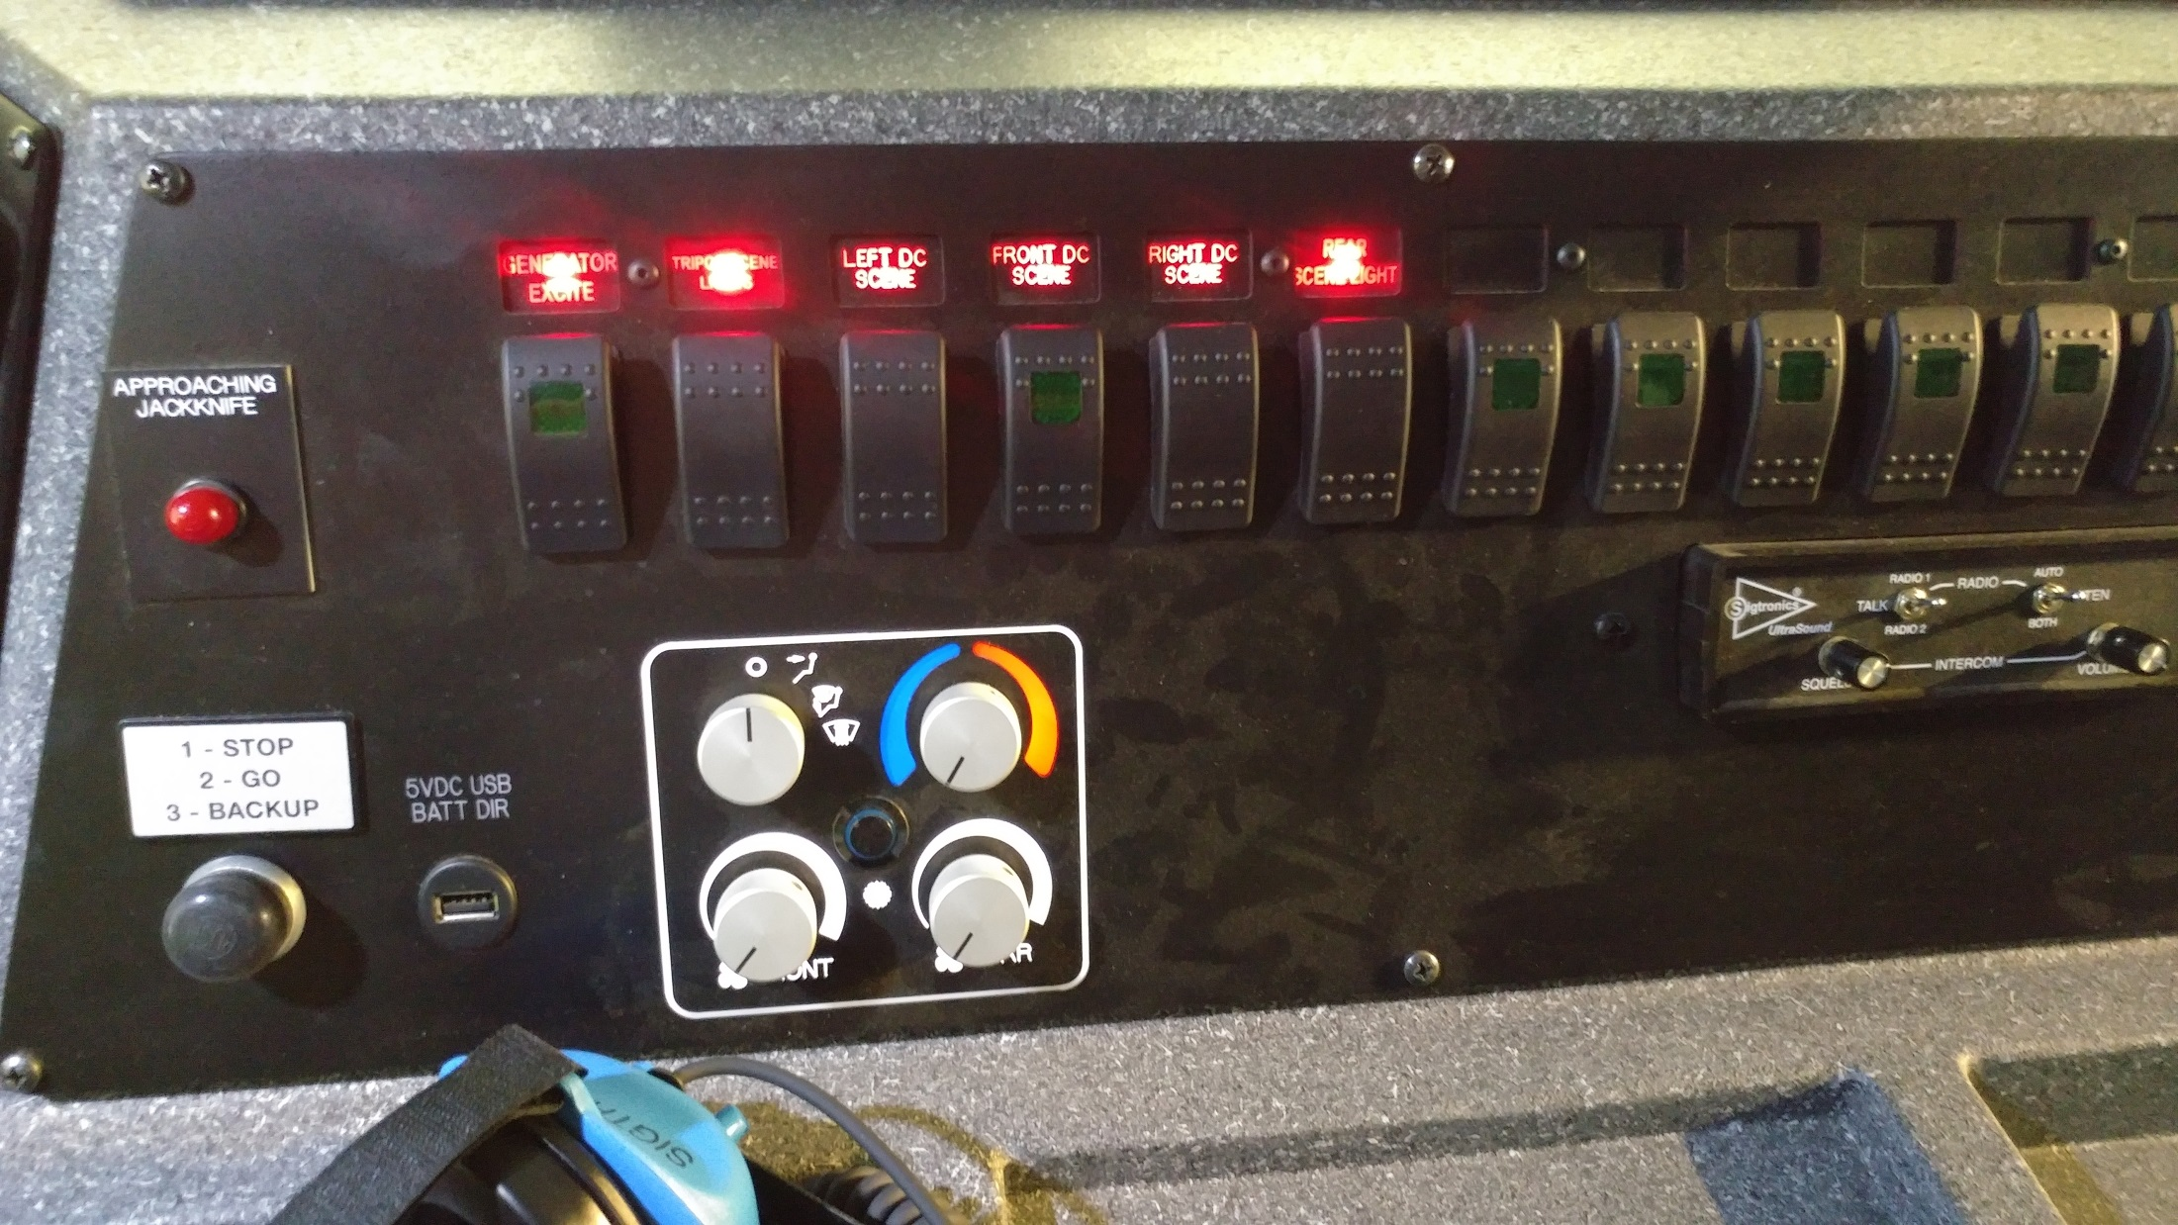
Cab Controls

Slide 41
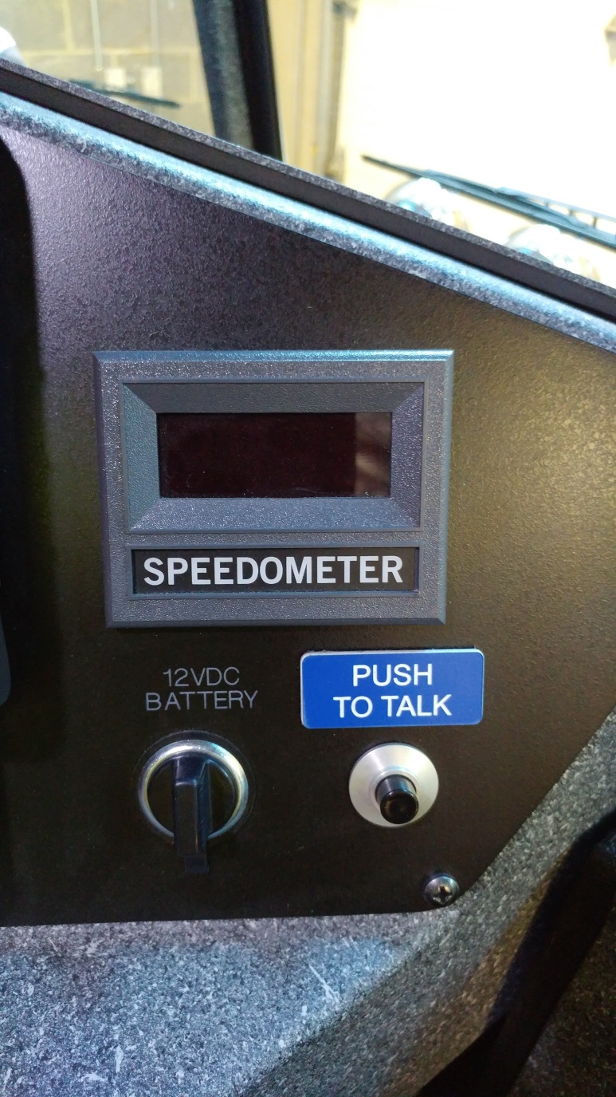
Cab Controls

Slide 42
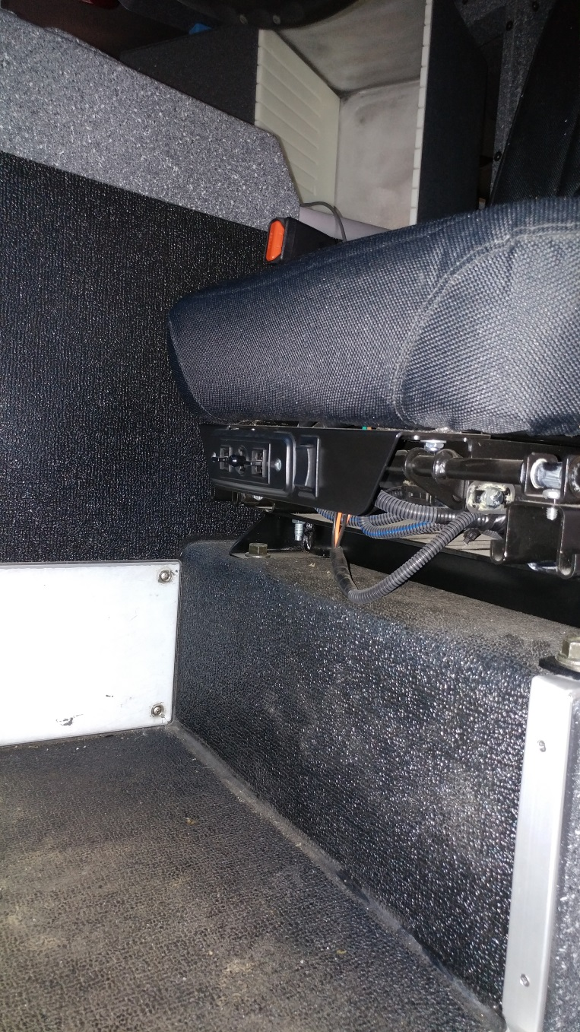
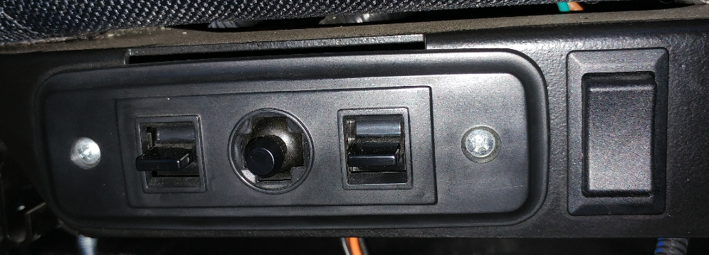
Cab Controls
All Electronic Switches
Seat Controls
Driver seat is fully electrically adjusted

Slide 43
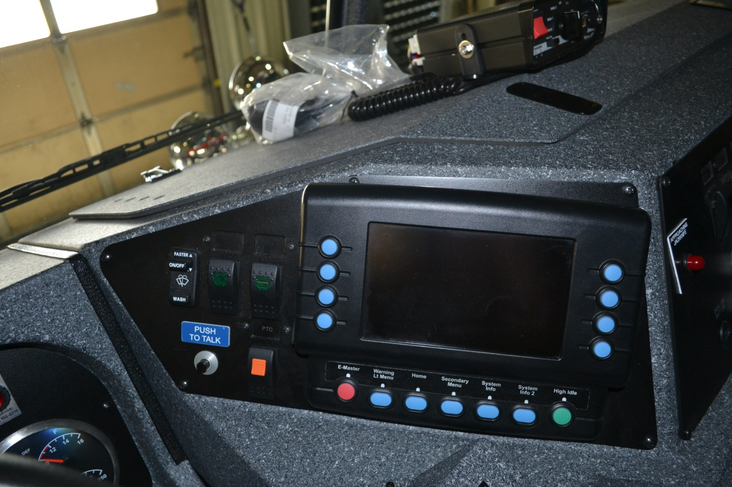
Vista Display
Unit is equipped with multiplex wiring system
Display panel located on dash
Controls most major chassis electrical functions

Slide 44
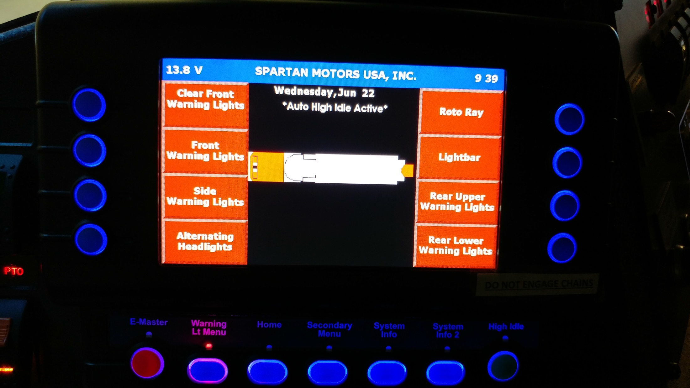
Vista Display

Slide 45
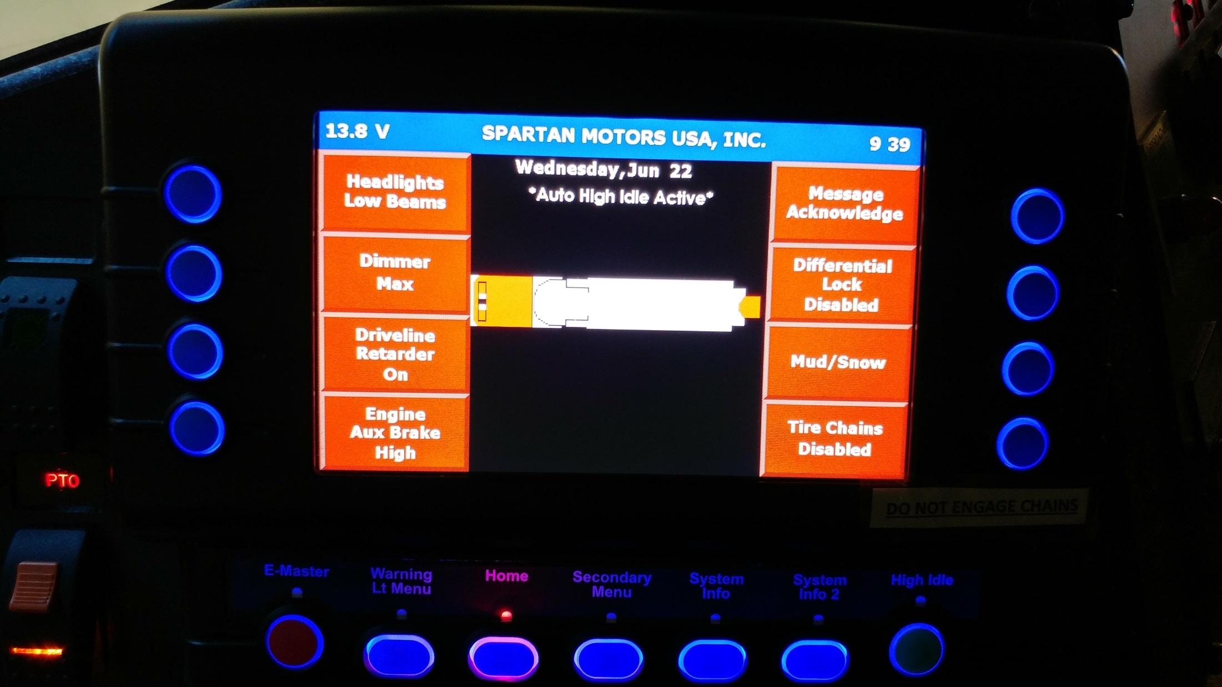
Vista Display

Slide 46
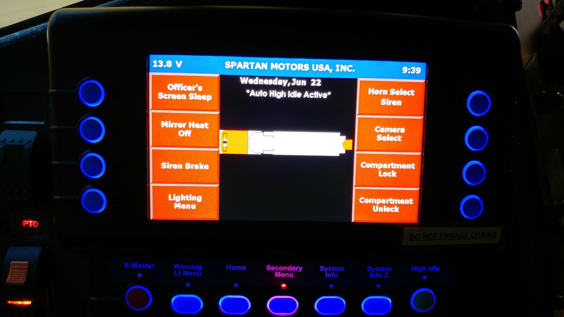
Vista Display

Slide 47
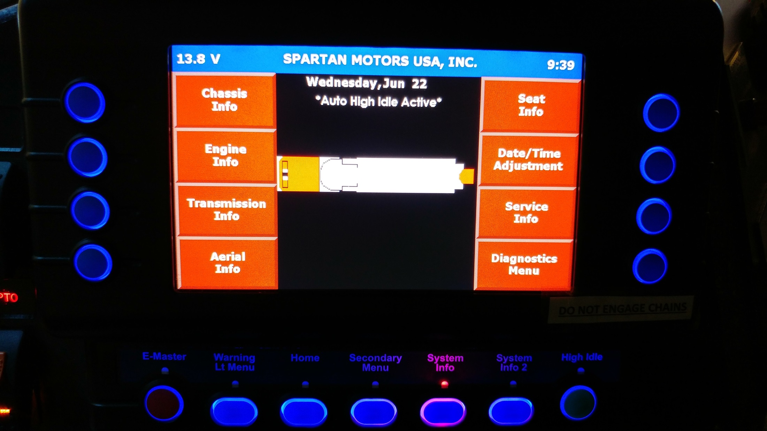
Vista Display

Slide 48
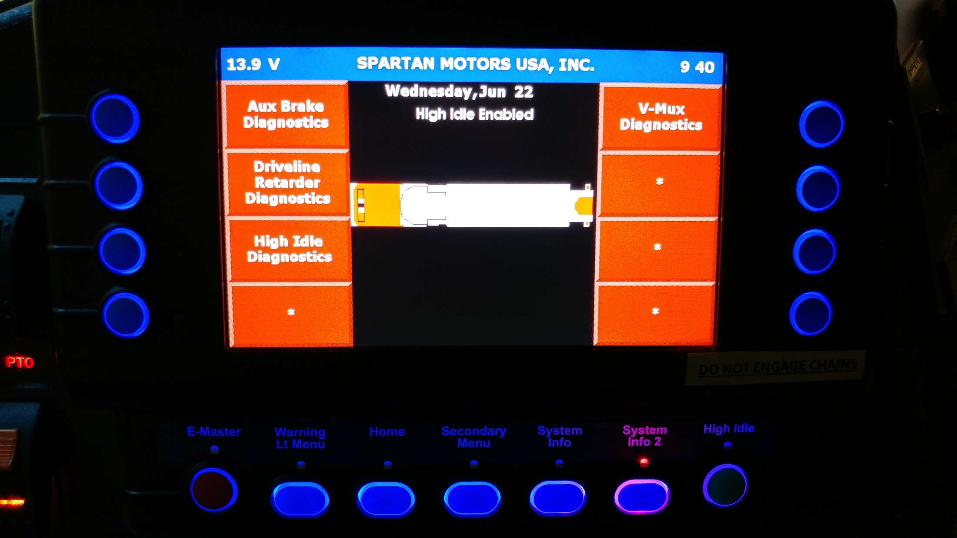
Vista Display

Slide 49
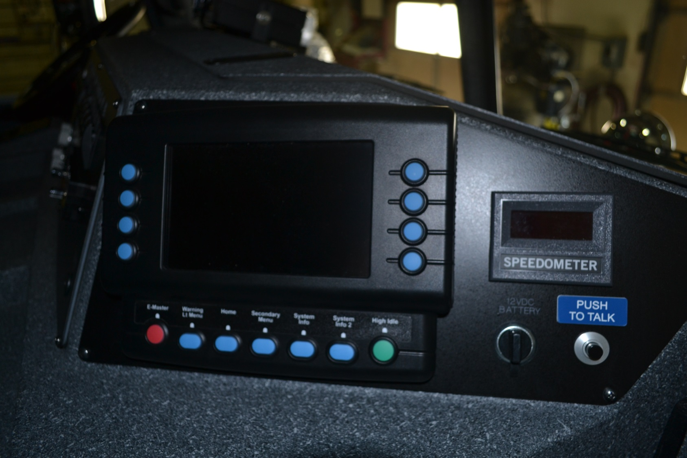
Vista Display – Officer’s Side

Slide 50
Vista Display – Officer’s Side
Officer CAN NOT control:
Headlights
Engine Brake
Driveline Retarder
Differential Lock
Mud/Snow Setting
Tire Chains

Slide 51
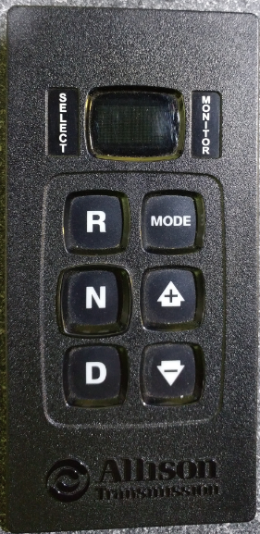
Transmission Fluid Check
The Transmission Fluid level may be checked in the cab through the keypad selector.
The engine must be running at idle and the unit must be on level ground.
The engine must idle at least five minutes from a cold start.
The transmission must heat to at least 140 degrees F.
Push both the up and down arrows simultaneously on the keypad.
Arrows

Slide 52
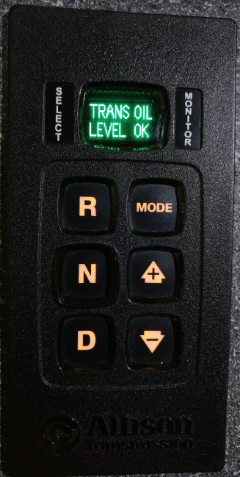
Transmission Fluid Check
After simultaneously pushing both buttons TRANS OIL will show on the screen
It will be followed by OK, -1 thru -7, or +1 thru +7. The – indicates under filled and the + indicates overfilled. The numeral indicates the number of quarts.
Any other message indicates a problem and CMF should be notified.
Always confirm the digital reading on the dipstick BEFORE adding fluid.
ONLY use Trans-Synd Fluid.

Slide 53
Regeneration
All diesel exhaust systems must be fitted with a DPF and a regeneration system.
DPF is Diesel Particulate Filter which captures soot and ash from the engine exhaust.
Regeneration is the process of burning off the soot and ash.
There are two types of regeneration:
1. Passive which requires no driver involvement.
2. Active which requires driver involvement.
Warning lights in the dash cluster will advise the driver of what action is needed.

Slide 54
Regeneration
Active Parked Regeneration
When the DPF lamp is solid a parked regeneration may be needed.
When the DPF lamp is flashing a parked regeneration is REQUIRED AS SOON AS POSSIBLE
During a regeneration exhaust temperature can reach 1300 degrees. Select an appropriate location.
Park unit, place the transmission in nuetral, engage parking brake, chock the wheel, and toggle the regeneration switch. Engine rpm should increase to approximately 1100rpm.
Keep exhaust 5 feet away from all objects and pedestrians.
The driver must remain with the vehicle during regeneration.

Slide 55
Regeneration
Active Parked Regeneration
During the regeneration process the high exhaust temperature lamp will illuminate.
DO NOT complete regeneration in the Station or while connected to a Plymovent.
When the ECM determines the DPF has been regenerated engine rpm will decrease to normal rpm signaling the regeneration is over.
Remember exhaust components are still very hot.
If the regeneration process needs to be interrupted or stopped, depress the brake pedal.

Slide 56
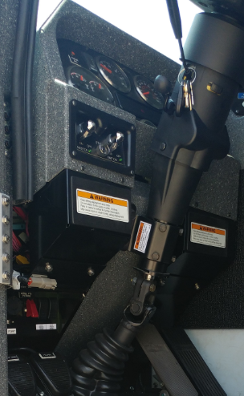
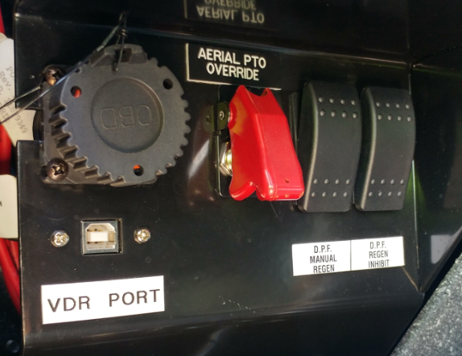
Regeneration
Active Parked Regeneration
Manual Regen Switch Location

Slide 57
Regeneration
DPF/DEF Warning Lights

Slide 58
Regeneration
Passive Regeneration
Passive Regeneration will only occur when driving over 40mph
It is unlikely that these trucks will drive enough highway miles for Passive Regeneration to complete it’s cycle

Slide 59
Regeneration
Regeneration system will be disabled when the Aerial PTO is engaged

Slide 61
Diesel Exhaust Fluid
Diesel Exhaust Fluid (DEF)
Urea based fluid
Designed to lower Nitrous Oxides in exhaust
Follow recommended storage procedures for fluid in station.

Slide 62
Diesel Exhaust Fluid
DEF Tank located in compartment inside left rear cab door
DEF Tank gauge located above fuel gauge on dash.

Slide 63
Diesel Exhaust Fluid
Refill Procedures
CMF stocks DEF in industry standard 2.5 Gallon Containers
2 containers per case
Each case comes with 2 filler tubes
DEF is requested when ordering Station Supplies or as needed through FMRS.
Any DEF container or filler tube that shows any signs of crystallization MUST be immediately discarded to avoid vehicle damage
Any DEF spills or splashes should be diluted with water and cleaned

Slide 64
Diesel Exhaust Fluid
Refill Procedures
Only add DEF to the appropriate DEF tank
DO NOT add DEF to the fuel tank
DO NOT add fluid until the DEF level is at or below HALF (1/2)
When DEF level reaches HALF, only add a single 2.5 gallon jug to the DEF tank using the supplied filler tube
DO NOT top off DEF
The empty jug AND filler tube MUST be thrown away. DO NOT RE-USE!!!

Slide 65
12 Volt Scene Lighting
All but 2 body mounted scene lights are 12 volt
Do not require generator power

Slide 66
Generator
10kW PTO driven hydraulic generator
Generator located on trailer under aerial ladder
PTO always engaged
Can be excited from Driver’s seat, Officer’s Seat, Tiller Cab, and Pedestal
Powers tripod lights on back of cab, 120v outlets on body, cord reels, tiller HVAC

Slide 67
Generator

Slide 68
Generator
Generator control panel and circuit breaker panel located in small compartment above driver’s side outrigger

Slide 69
Tiller Cab
“Push To Drive” Pedal
Camera Display
Switches
Axle Position Gauge
HVAC
Seat Controls

Slide 70
Tiller Cab

Slide 71
Tiller Cab
“Push To Drive” Pedal
Must be pressed to place transmission in gear
Must be done to come out of neutral EVERY time

Slide 72
Tiller Cab
“Push To Drive” Pedal
If the pedal is not pressed the driver will see the following indicators in the cab
“Range Inhibit” on dash
Flashing 6 on keypad

Slide 73
Tiller Cab
Camera Display

Slide 74
Tiller Cab

Slide 75
Tiller Cab

Slide 76
Tiller Cab
HVAC
Both Air Conditioning AND Heat are run from the generator
Uses a single residential style thermostat
No diesel heater or fuel tank in the rear
Generator can be turned on from tiller cab

