Slide 1



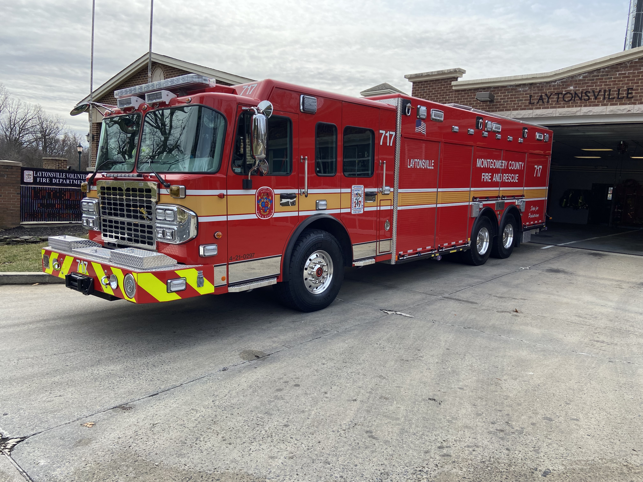
2021 Spartan/Rescue 1
Rescue Squad 717

Slide 2
Key Differences vs. 2008 Pierce
Taller, Longer, Heavier
Manual generator transfer switch
Rated high anchor points
Stronger winches
Cab changing room

Slide 3
Dimensions & Weight
Overall height: 10' 6"
Overall width:
100" Body
9' 8" Mirror to Mirror
Overall length: 39' 8”
Actual Weight – May 2022???
Fully equipped with all tanks full and no personnel onboard
Front axle – 23,000 lbs (GAWR)
Rear axles – 54,000 lbs (GAWR)

Slide 4
Safety Systems
Automatic Traction Control (ATC)
applies the service brake to a spinning wheel so that the torque can be transferred through the differential to the wheel that has the traction
reduces engine torque when both wheels are spinning to improve traction
ATC light located in the cab will light when the ATC feature is active
May be momentarily disengaged by “Offroad Traction” switch
Electronic Stability Control (ESC)
stabilizes the vehicle during cornering maneuvers
Compares where you are steering and where the vehicle is actually going
Intervenes by applying the brakes to individual wheels asymmetrically in order to create torque about the vehicle's vertical axis
system may reduce engine power or operate the transmission to slow the vehicle down

Slide 5
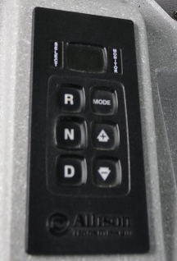
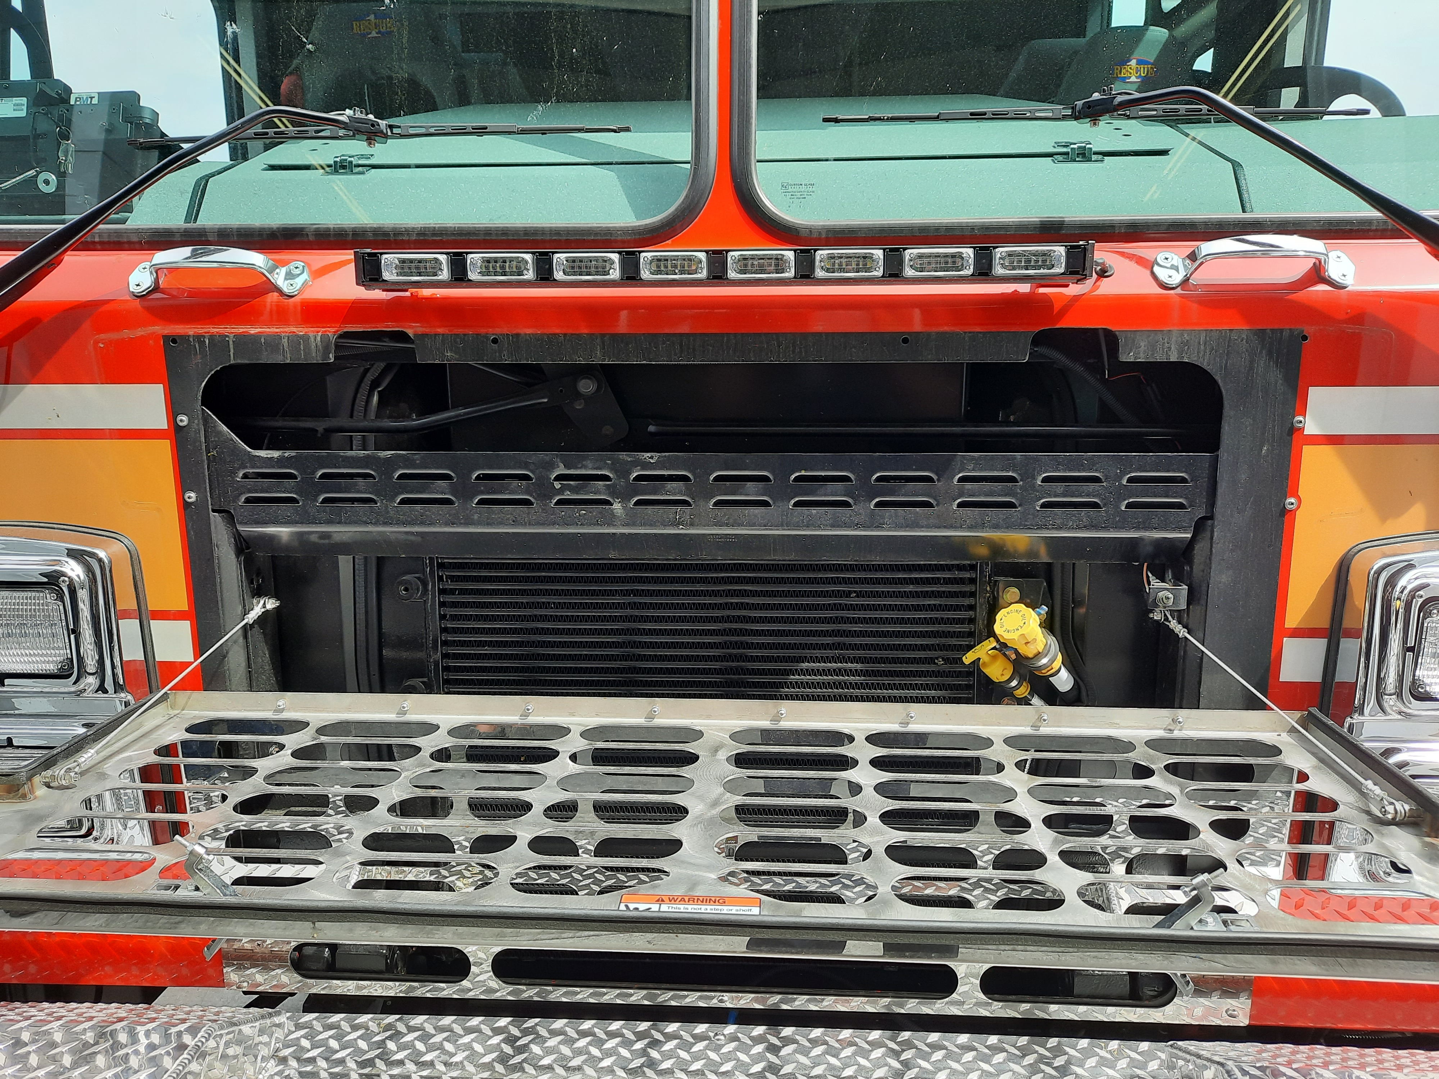
Powertrain Systems
Motor: Cummins X12 500hp
Transmission: Allision 4000 EVS 5-speed
TES-295 synthetic fluid
Maximum speed is 60 mph
Motor oil checked via front grille
Transmission level can be checked via the keypad

Slide 6
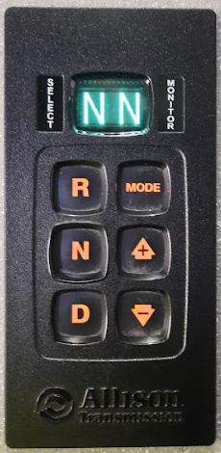
Transmission Fluid
Fluid level check
Selector in Neutral
Temperature 140 to 220°F
Engine at idle and parked for >2 minutes
Level ground
Press both arrow buttons simultaneously to check fluid level; status displayed on selector pad screen
OL will be followed by OK, -1 thru -7, or +1 thru +7.
The – indicates under filled and the + indicates overfilled.
The numeral indicates the number of quarts.
Any other message indicates a problem and CMF should be notified.
Always confirm the digital reading by visually checking the dipstick BEFORE adding fluid.

Slide 7
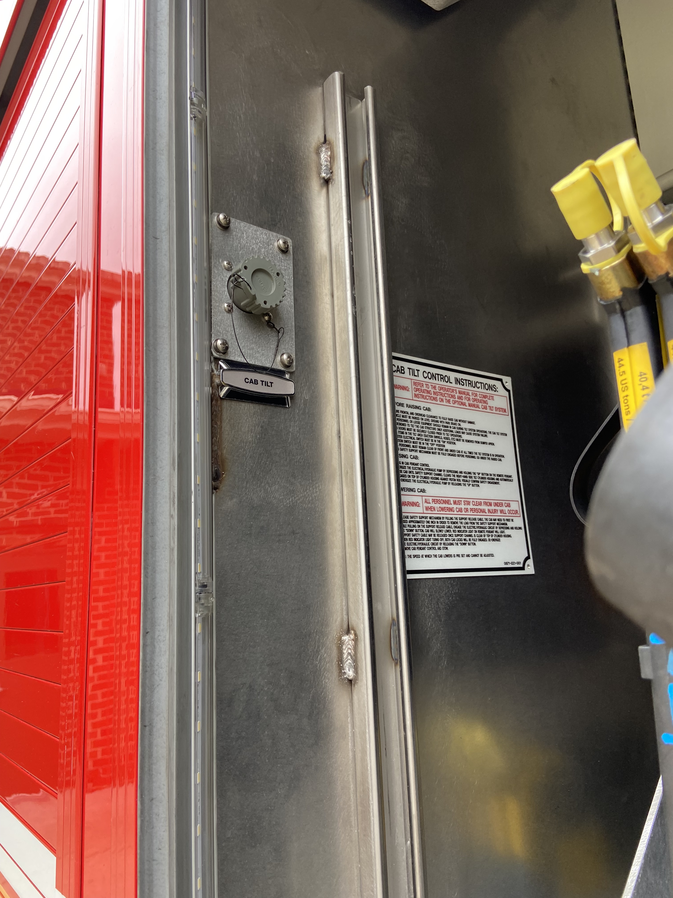
Cab Tilt
Confirm no overhead or front bumper obstructions
Turn ON cab master (battery) switch
Plug in controller
Press UP on controller until safety arm engages
Turn OFF master (battery) switch

Slide 8
Cab Lowering
Turn ON cab master (battery) switch
Plug in controller
SLIGHTLY raise cab
While pulling release cable press and hold DOWN until red light goes out
Turn off Master (battery) switch

Slide 9
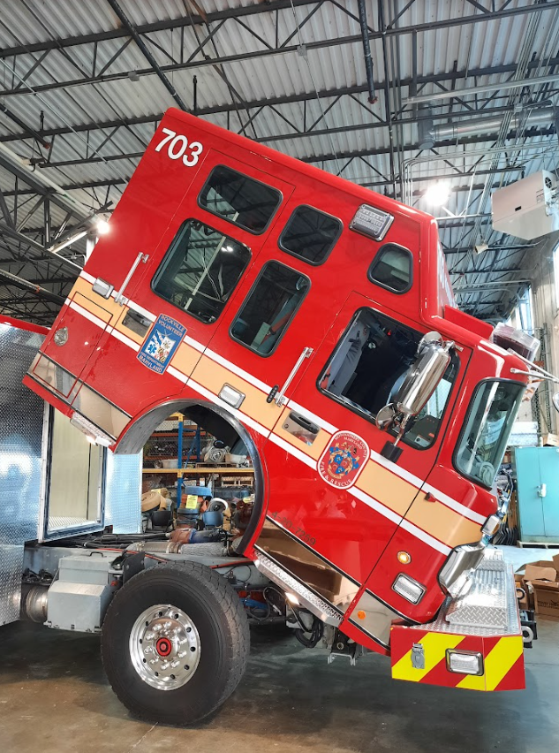
Cab Tilt CAUTIONS
THIS CAB IS MUCH LONGER AND TALLER
Cab MUST be tilted outdoors
Always….verify clearances, secure loose items, and engage the safety arm
16 FEET
REQUIRED

Slide 10
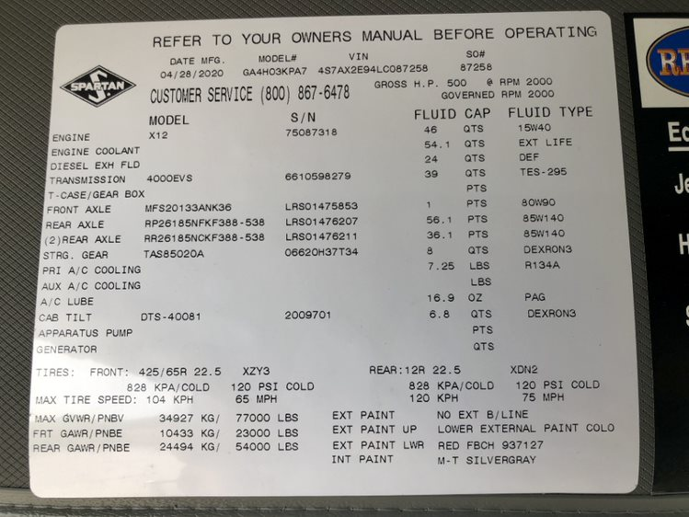
Data Plate

Slide 11
Fluids
Motor oil – 45 quarts of 15W-40
Transmission fluid – 39 quarts of TES-295
Coolant – 54 quarts of Ext. Lift 50-50
Power Steering – 8 quarts of Dexron 3
Cab tilt – 6.8 quarts of Dexron 3
Fuel – 68 gallons of Diesel
Diesel Exhaust Fluid – 6 gallons of DEF
Generator oil – 10 quarts of 15w-40
Generator coolant – 14 quarts of Ethylene Glyco 50/50
Hydra-Qube (Winches) - 3-5 quarts of AW46 Hydraulic fluid

Slide 12
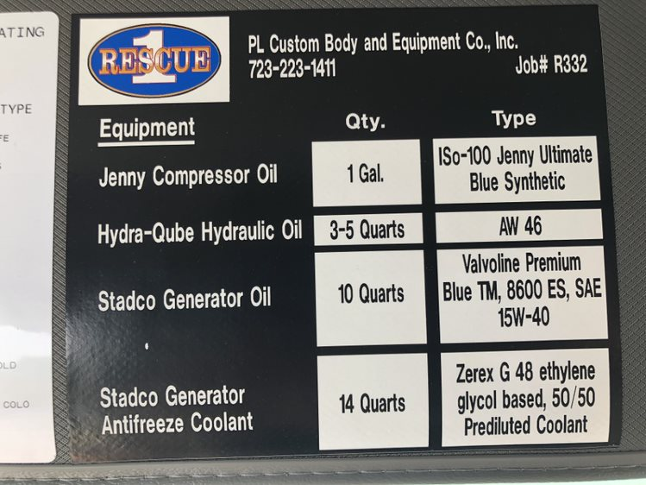
Data Plate

Slide 13
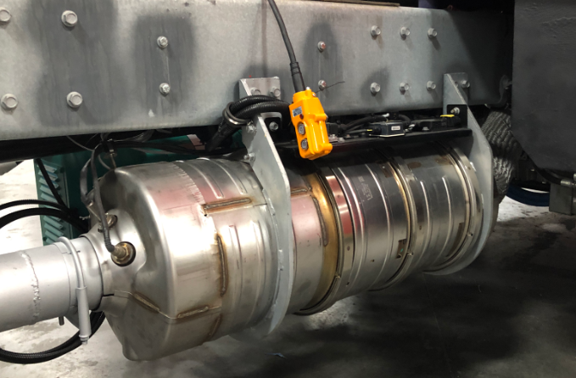
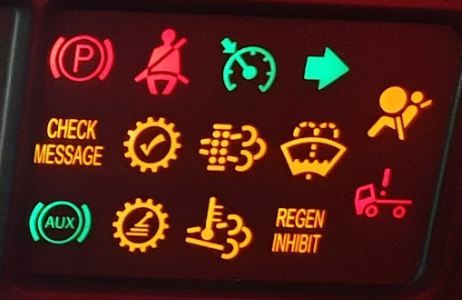
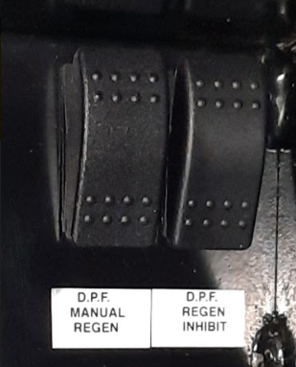
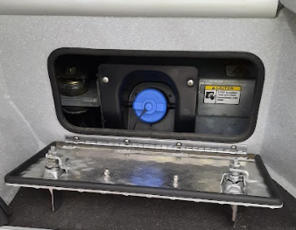
After-Engine Exhaust Treatment
Vehicle is equipped with diesel exhaust fluid and a diesel particulate filter
See Cummins After-Engine Treatment Brochure for more info.
Regeneration switches
DPF and exhaust temp warnings

Slide 14
Regeneration Indicators

Slide 15
Active Regeneration
Prevents system from entering or continuing in active regeneration mode; used when regen may engage in an undesirable location
Due to the type of travel typical of fire apparatus “active regeneration” is most common
Active regeneration occurs:
When an intervention by the operator during travel or pumping operations creates correct conditions for regen
Requires sufficient exhaust flow and temperatures
Speedometer >5mph
NO engine speed variations will occur when pumping or driving
Manually by activating the DPF Regen switch while parked
Used to manually initiate a parked regeneration; DPF lamp must be illuminated to engage
Regeneration will not effect motor RPM during PTO operations if it engages automatically.

Slide 16
Parked Regeneration
Do not perform regen inside a building or while attached to an exhaust removal system!
A minimum of 5 feet of clearance is required to the exhaust outlet.
When operating it may be necessary to inhibit regen if clearances to the exhaust are not available!

Slide 17
Fuel & DEF
Diesel Fuel
Fills on both sides of the apparatus at the rearmost wheel well
68 gallon capacity
Diesel Exhaust Fluid (DEF)
Fluid level displayed on dashboard gauge
6 gallon tank
Fill inside left rear cab door
Must open access panel
Light blue cap

Slide 18

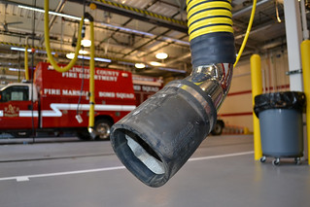
Exhaust System
Exhaust outlet is 6” diameter
Pierce is 5”
PlymoVent boots will accept up to 6 ¼” exhaust outlets
The fit is tight!
Check your mirror to ensure the hose disengages from the exhaust when exiting the station
Until the rubber molds to the larger tailpipe the boot may need to be manually disengaged
Slow and steady departures from the bay are necessary.

Slide 19
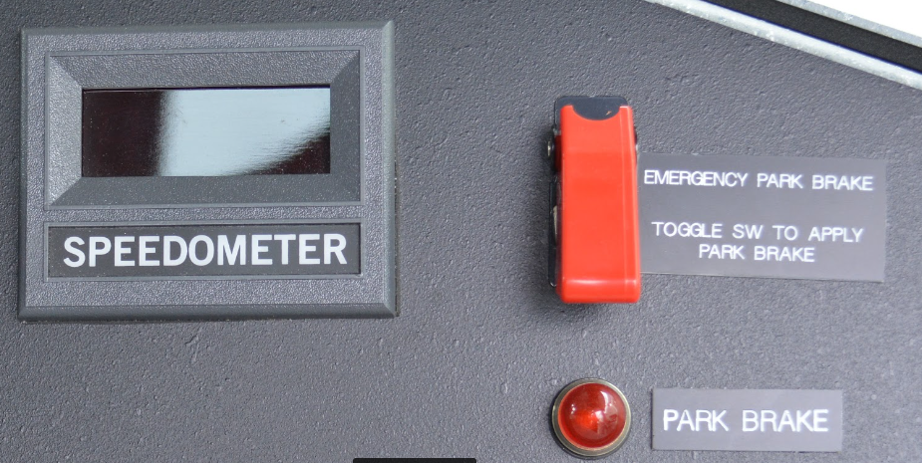
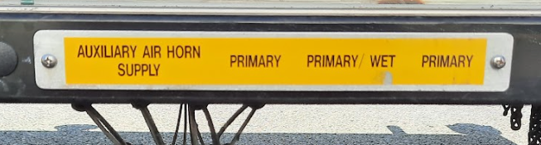
Suspension & Brake Systems
23,000lb front axle
54,000lb rear axles
Parking brake
2nd actuator located on officer's dash
Supplemental Brake for front axle
Anti-lock disc air brakes front and rear axle
26 cfm air compressor
12v auxiliary air compressor behind driver seat
Powered by shoreline to maintain brake system while parked
Heated air dryer
Air tank drain actuators – driver side under D2 compartment
Officer side parking brake switch

Slide 20
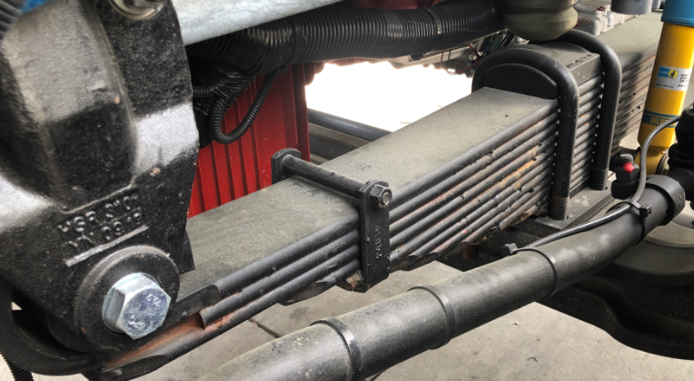
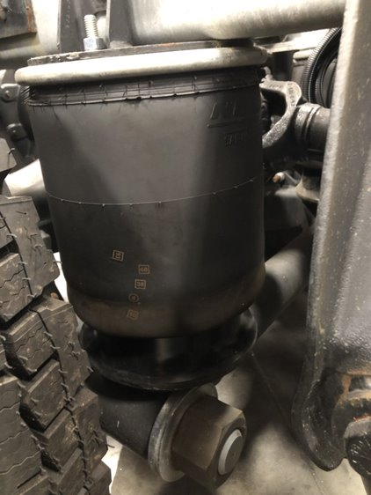
Suspension & Brake Systems
Front axle has traditional leaf springs
Rear axles have Neway AD-254 air suspension
Axles independently suspended
Dual height control valves ensure equal frame height regardless of loads

Slide 21
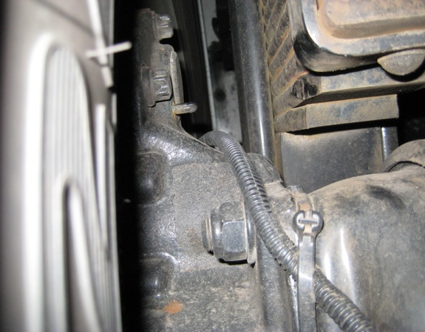
Brakes – Front & Rear Axle
Meritor DiscPlus EX225 Disc
Wear indicator
Pads must be replaced at 3mm (approximately 1/8”)
For additional information go to the Meritor Maintenance Manual

Slide 22
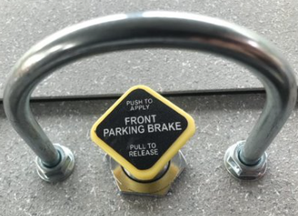
Brakes – Front Axle
Front axle has supplemental parking brake
Requires rear parking brake to be set first
Protection valve located in center of dash
HIGHLY Recommended for winching

Slide 23
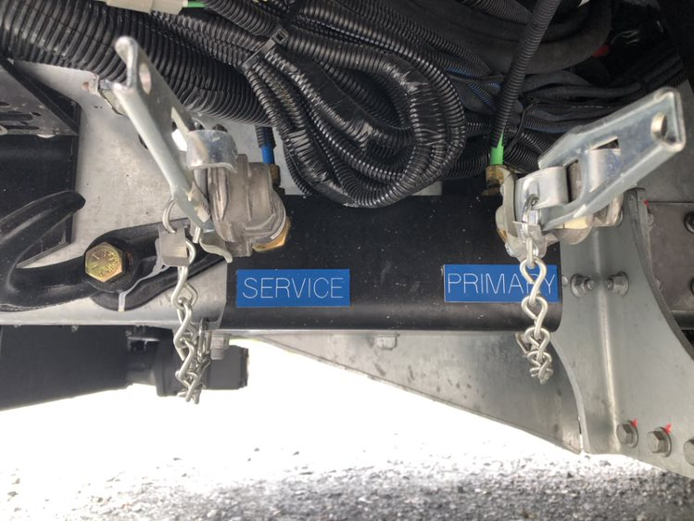
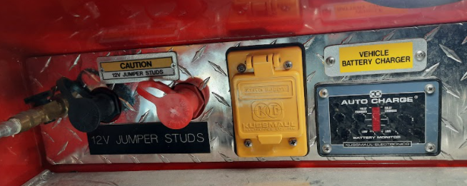
Jumper Studs & Glad Hands
Glad hands located under front of unit
Jumper studs located in driver door step well near shoreline

Slide 24
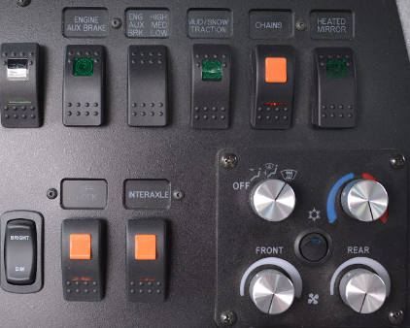
Snow Chains
OnSpot automatic snow chains on drive axle
Locking switch located on dashboard above HVAC controls
The On-spot chains have a 5 second delay before they activate. This is done to prevent accidental activation.

Slide 25
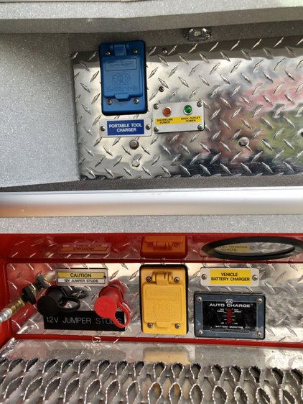
Shoreline
2 Independent 20-amp inlets
Lower yellow cover is for chassis shoreline
Vehicle charging
Power to two M18 chargers in the D2 and P2 compartments
Upper blue cover is for portable tool charging
These are not auto-eject plugs.
Must be unplugged manually before closing the cab door.

Slide 26
Shoreline
20 amp, 120v NEMA 5-20 plug with Kussmaul display
Driver’s door must remain open when shoreline is connected
Supplies Kussmaul 35 amp battery conditioner and auxiliary air compressor
This is not an auto-eject plug.
Must be unplugged manually before closing the cab door.

Slide 27
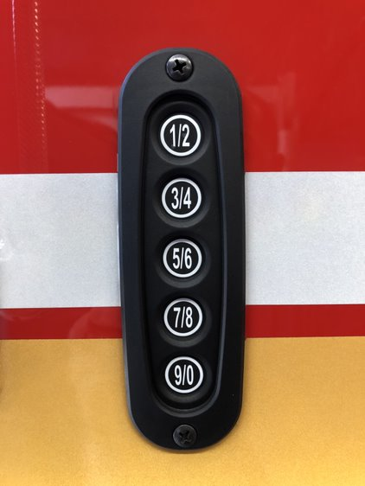
Keyless Entry
Holding down the ½ button will lock the cab doors.

Slide 28
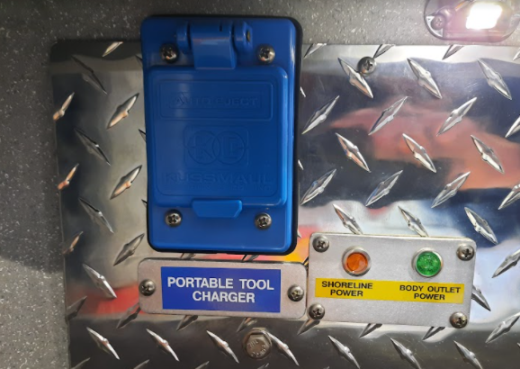
Portable Tool Power
Only provides power to power strips in crew compartment for equipment charging
Blue cover
This is not an auto-eject plug.
Must be unplugged manually before closing the cab door.

Slide 29
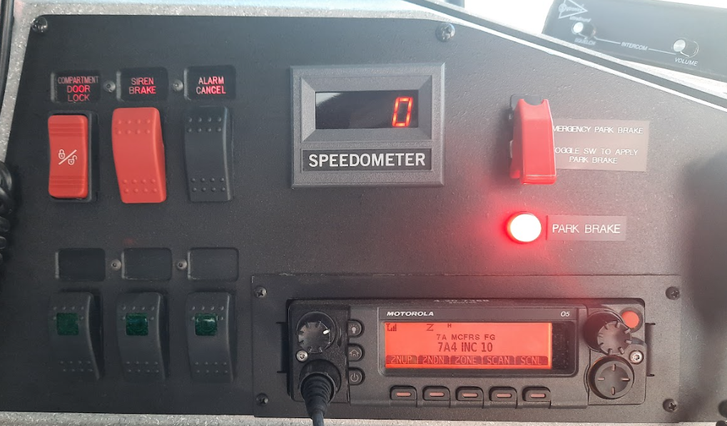
Officer Seat Area
Cab Compartment Door Locks
Speedometer
Siren Brake
Parking brake control
Chassis alarm acknowledge

Slide 30
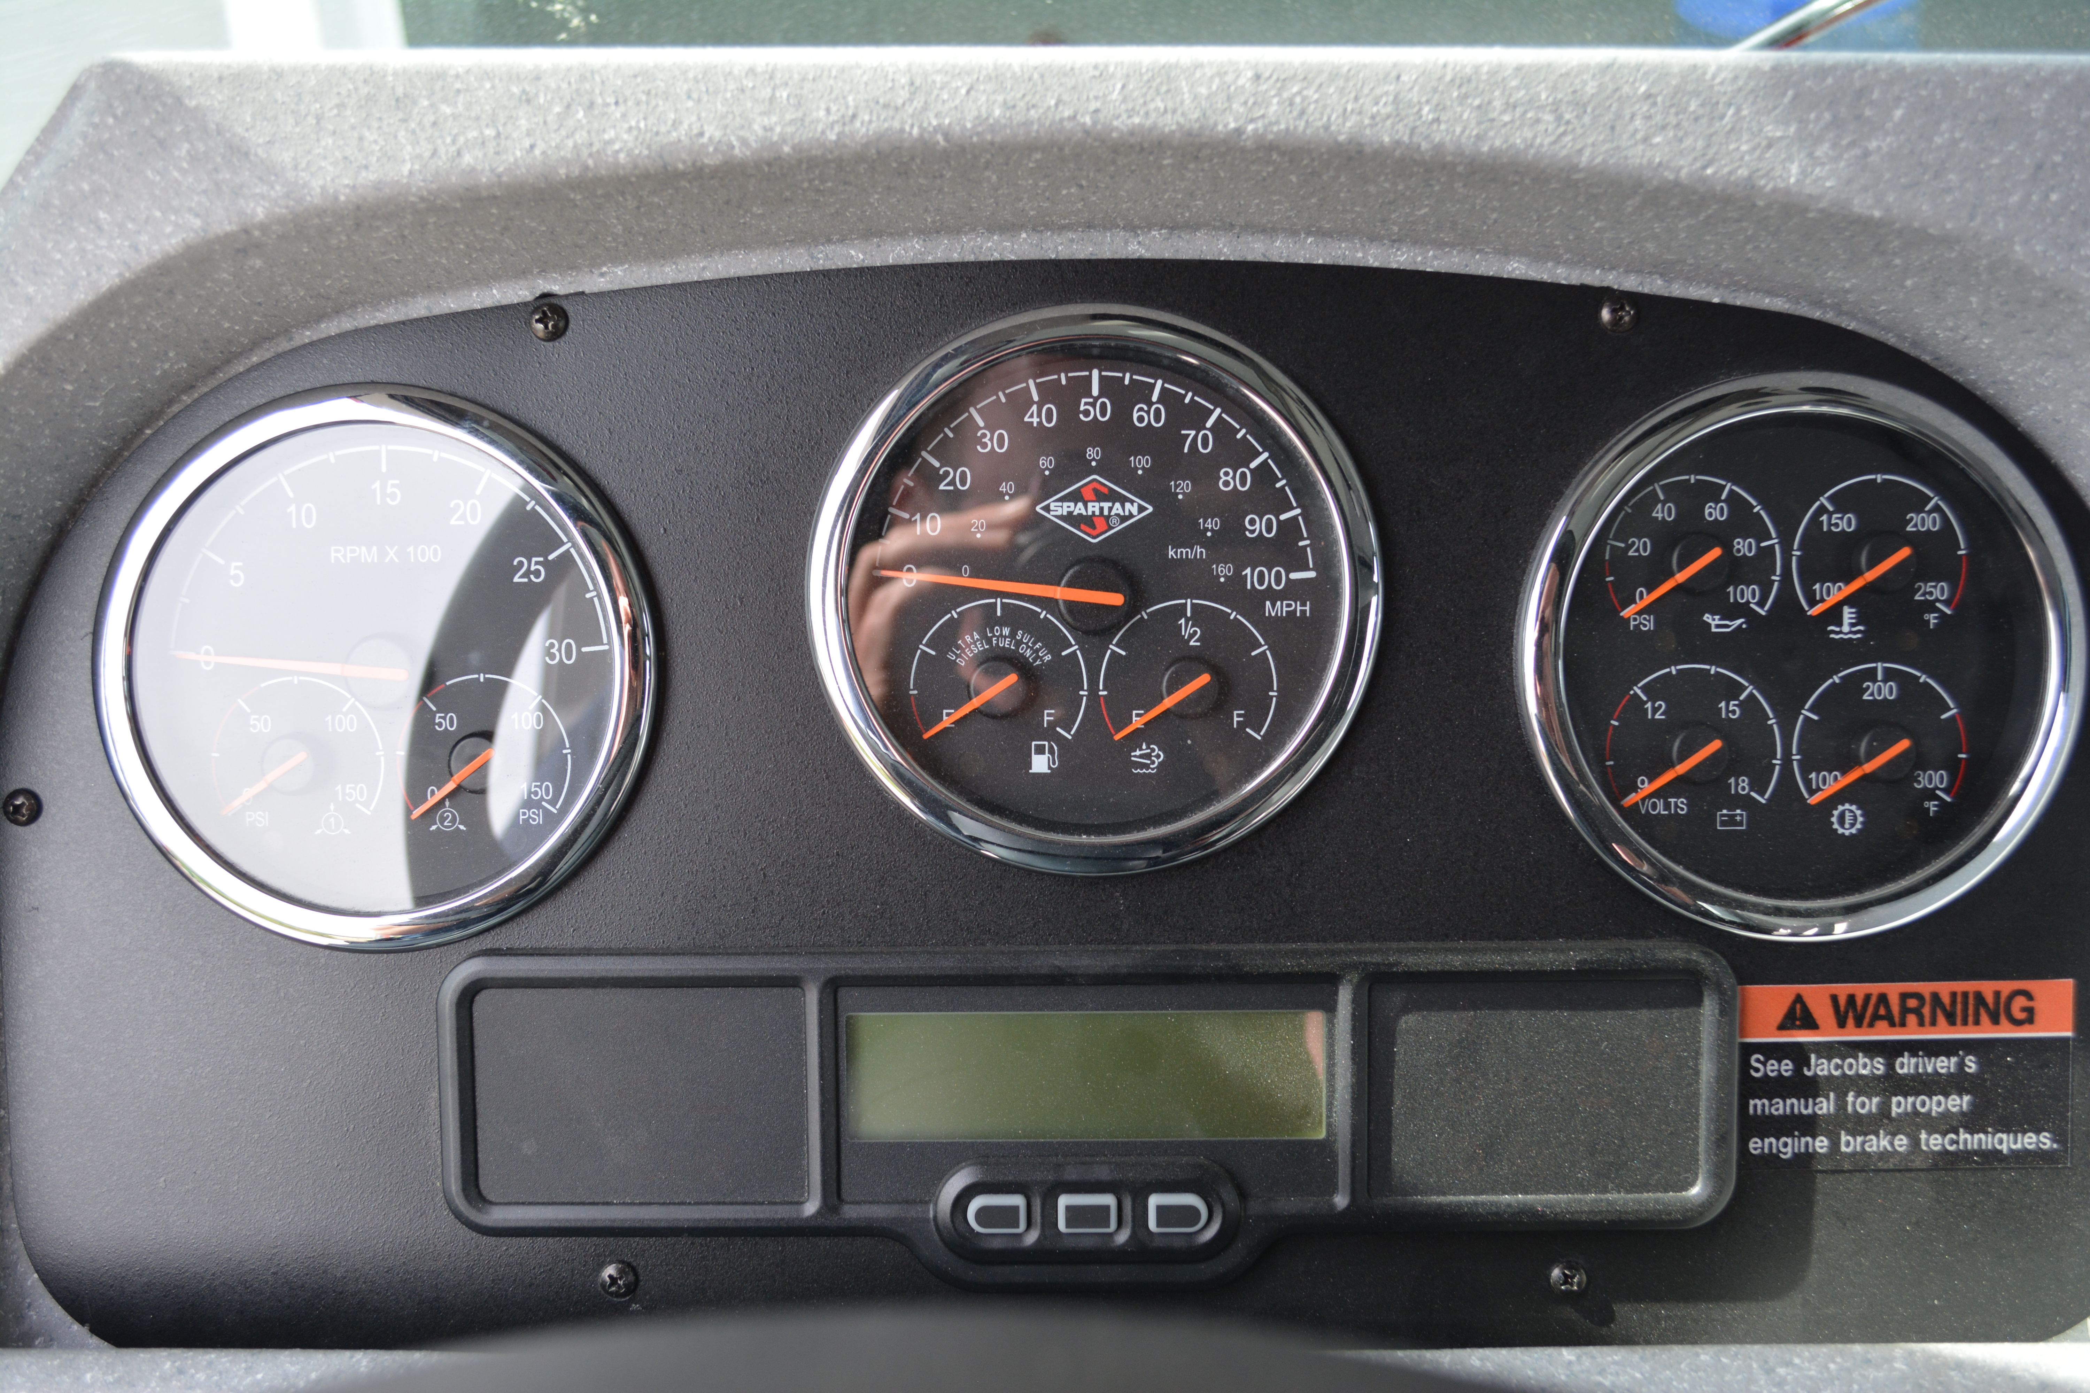
Dashboard Display

Slide 31
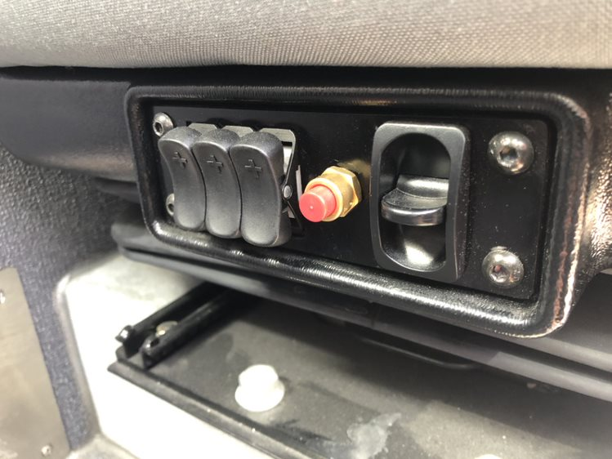
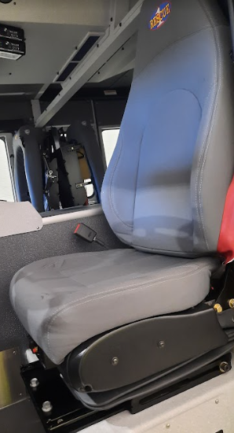
Driver’s Seat
Pnuematic
Lumbar
Support
Pnuematic release
Press to release lock to adjust seat forwards and backwards
Pnuematic
Lumbar
Support

Slide 32
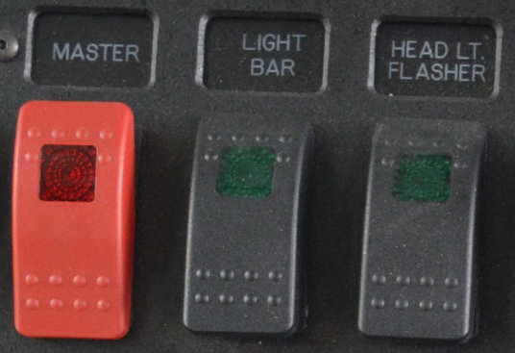
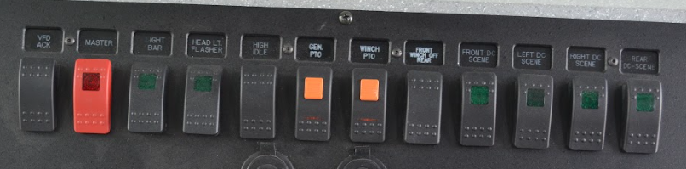
Warning Light Controls
Master switch located on center dash

Slide 33
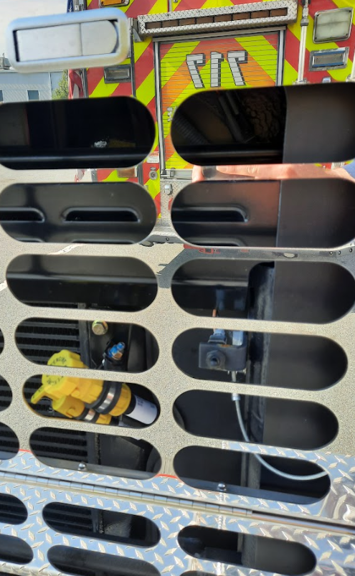
Cab/Compartment Door Locks
Electric door locks on cab entry doors
Not connected to body compartments
Lock-out switch located behind front grill near oil fill
Key FOBs also provided
Lock-out button

Slide 34
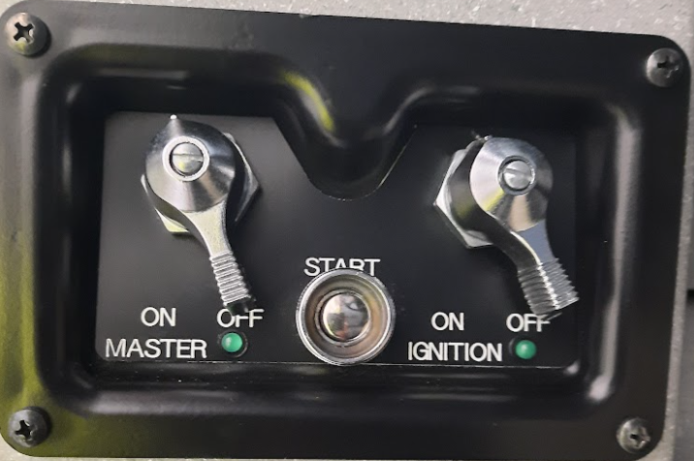
Starting & Stopping the Motor
Battery switch (MASTER), ignition switch, and start button are all grouped to left of steering wheel
Battery switch
Ignition switch
-ON for run
-OFF to shut off
Press to start the motor.
Engage for no more than 15 seconds.
Allow gauges to complete their sweep before attempting to start the motor. Failure to wait can result in false sensor alarms.
In addition to the battery, ignition switch must be “on” for most electrical functions to work (like cab tilt)

Slide 35
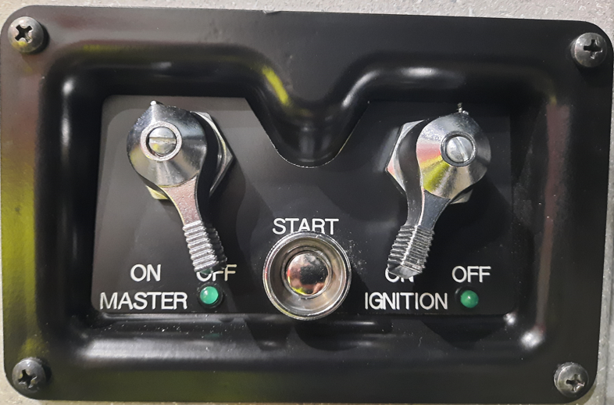
Starting & Stopping the Motor
DO NOT leave the ignition switch in the ON position when the vehicle is not running.
Sequence of Master then Ignition is critical for Start-up

Slide 36
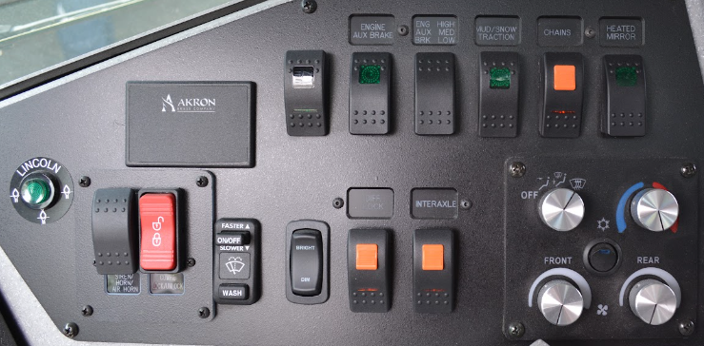
Driver's Dash Controls

Slide 37
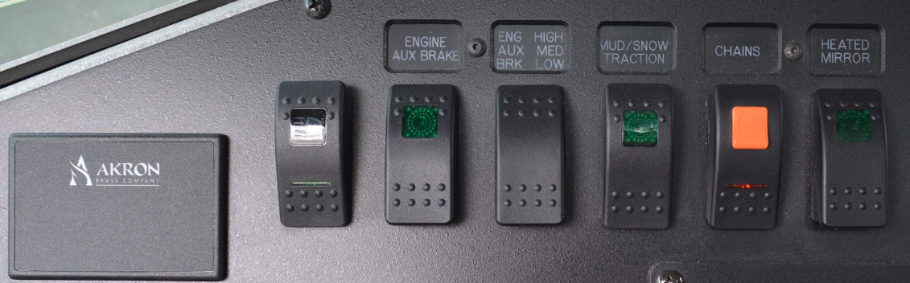
Driver's Dash Controls
Headlights
Up – Headlights
Middle – Marker Lights
Down - OFF
Mud/Snow
Momentarily impairs ATC to allow more wheel spin; may be desirable in extra soft surfaces like snow, gravel, or mud
Chains
Pressing the switch up activates On-Spot Chains
Seatbelt Indicator
Engine Brake
Up – High
Middle - Medium
Down - OFF
Engine Brake
Up – ON
Down - OFF
Heated Mirror
Pressing the switch up turns on mirror heat

Slide 38
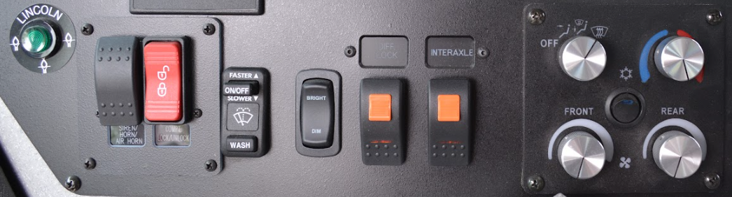
Driver's Dash Controls
Auto Lube
Fault???
Compartment
Locks
Differential Lock
Locks drive axle side to side for improved traction
Interaxle Lock
Engages secondary rear axle for improved traction
Horn Function
Up – Siren
Middle - Horn
Down – Air Horn
Wiper
Controls
Dash
Dimmer
HVAC Controls

Slide 39
VFD Information Display
Need info if there is any relevance about this

Slide 40
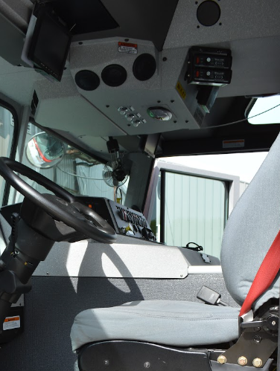
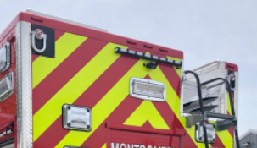
Rear Camera
Located above the rear floodlight
Monitor flips down
Always active

Slide 41
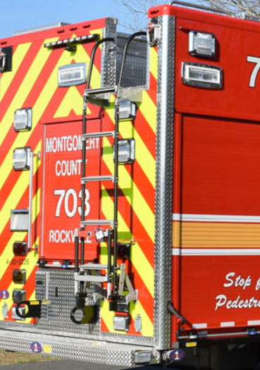
Reverse Floodlights
Floodlights activate when transmission placed in reverse
Rear flood
Rear-most flood on both sides

Slide 42
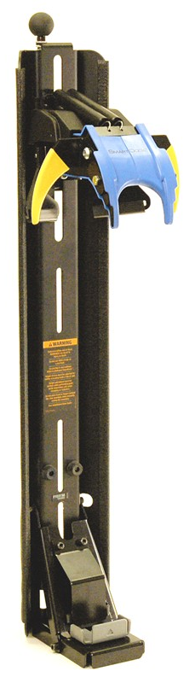
SCBA Brackets – SmartDock
No straps or levers to restrain the SCBA or to release the SCBA - blue latching mechanism holds the SCBA in place during transit.
In the event of a collision, inertial forces cause the top latching mechanism to lock the SCBA in place, preventing it from becoming a projectile.
To release the SCBA, a smooth motion is required. Slow is smooth; smooth is fast.
With the SCBA straps donned, the wear should bend forward at the waist and stand up to release the tank from the upper claw.
If the tank is too loose or too tight within the claw there is an adjustment knob on top of the bracket.
For additional information view a quick video at https://www.youtube.com/watch?v=y43vJK3bsVo&app=desktop or check out the manufacturer’s website at https://www.imminet.com/products/fire-ems/smartdock/

Slide 43
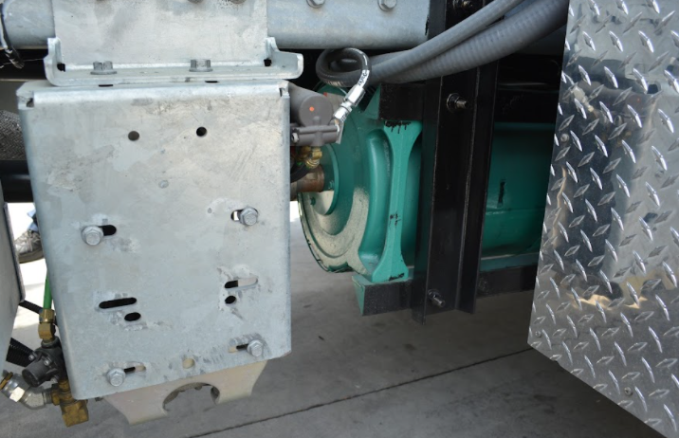
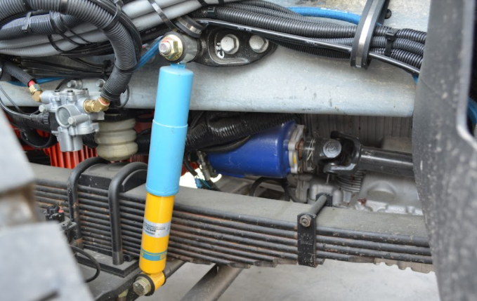
PTO Generator
35kW Onan
Located under walk-in behind D1 compartment
PTO located at 8 O'clock on transmission
Requires parking brake activation to engage
Engine speed under 900rpm to engage
Disengages over 1440rpm

Slide 44
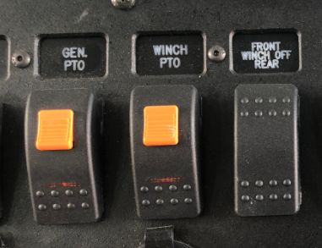
PTO Generator
Locking switch on center of dash to start
NOT to be used with vehicle in motion

Slide 45
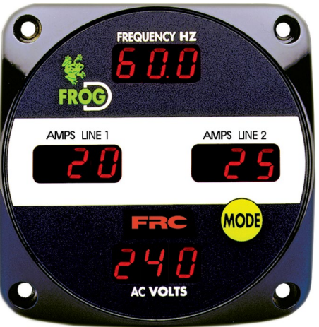
PTO Generator
Display above breaker panel in D1 compartment
FROG-D (Frequency Readout of Generator Display)
Displays Frequency, AMPS, and Volts
MODE button toggles to generator hours

Slide 46
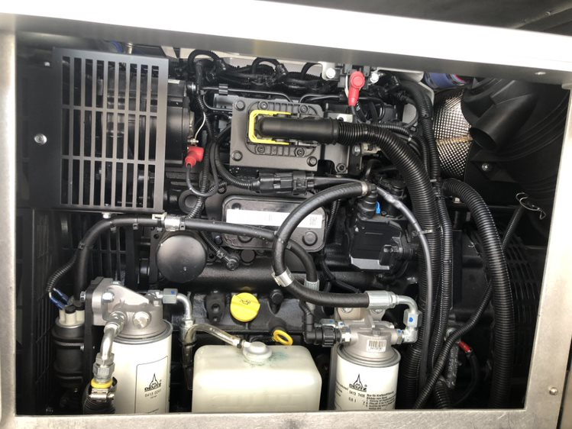
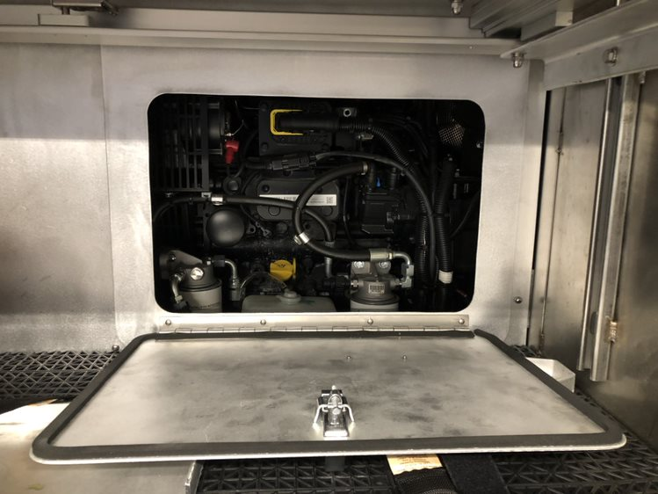
Diesel Generator
Stadco 18kW run, 22kW peak
Can only be started in P2 compartment
Generator located in center of body behind D2 and P2 body compartments
Access panel is located in D3 compartment

Slide 47
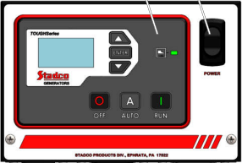
Diesel Generator Start-up
Set Main load circuit breaker to "OFF"
Set Transfer Switch to position 2
Move toggle switch position to "ON"
Press "RUN"
Display can be used to check hours and load

Slide 48
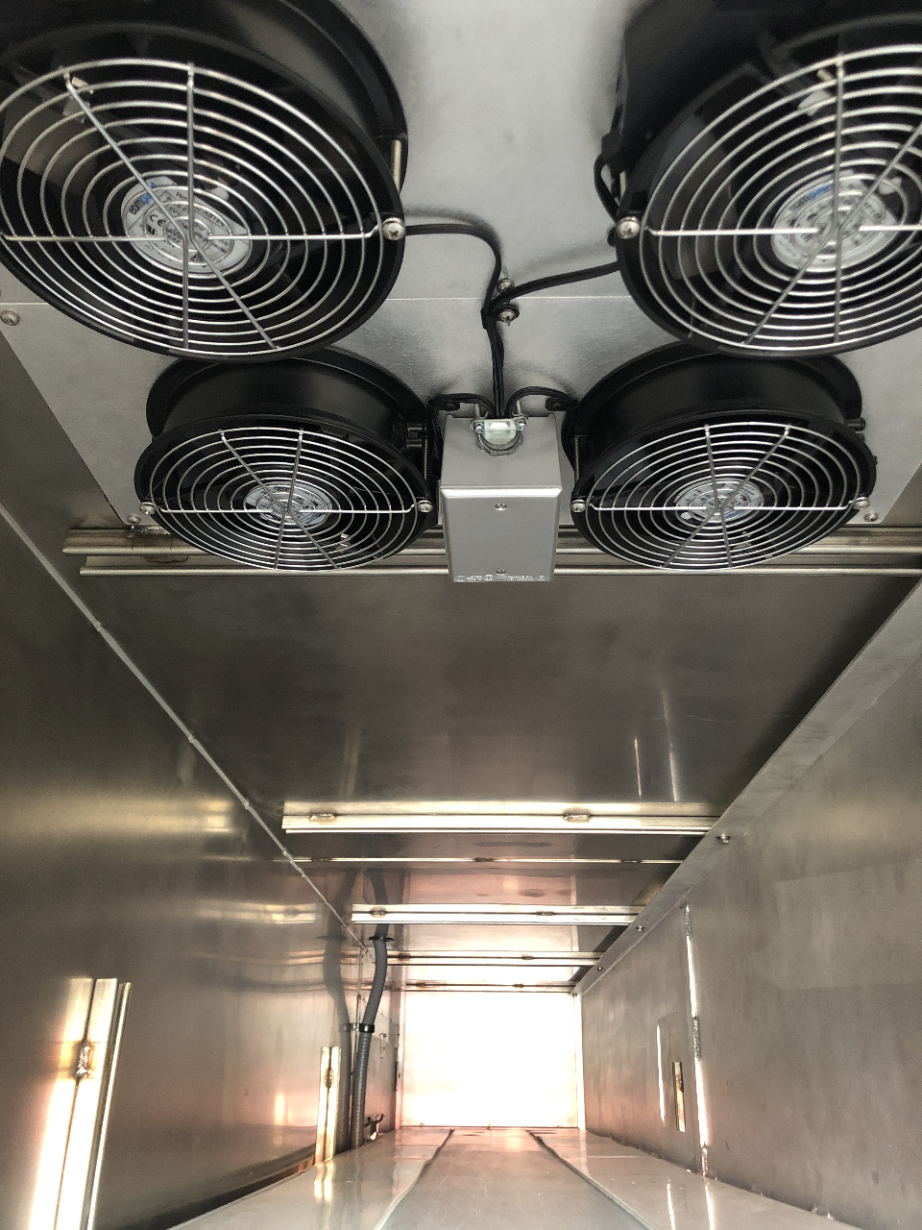
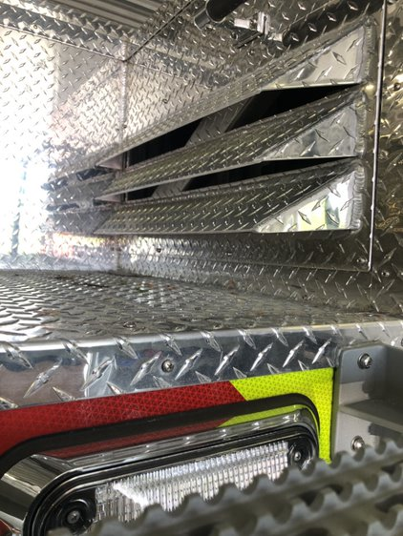
Diesel Generator
Has air plenum with 4-120v AC Fans
Fans draw air from intakes at top right rear of vehicle
Air cools generator
Bottom right breaker in panel MUST be on when generator is running

Slide 49

Power Distribution
Breaker Panel in D1 Compartment
All breakers clearly labeled
Major items requiring AC power:
Light Tower
Air Compressor
Plasma Cutter

Slide 50

Cord Reels and Outlets
Hannay cord reels located in D2/O2 compartments
200 feet of 10/4 wire
Outlets located on both sides of body
Each side of front bumper
Each side at rear wheel well
20 foot pigtail for plasma cutter
250V / 100 Amp, 2-pole/3-wire watertight plug

Slide 51



Scene Lighting
All body mounted scene lights are 12v LED
Controlled in the cab
2 Brow Lights
3 Body Lights per side
1 Rear Light

Slide 52


Light Tower
Will-Burt Night Scan PowerLite
6 150W LED light heads
Controller in D1 compartment
Tower operates on chassis air and 12v DC power
Lights operate on 120v AC power

Slide 53



Light Tower
Controller Functions

Slide 54
Light Tower – Start-up
Parking Brake MUST be engaged
Ensure no overhead obstructions
Ensure generator is on
Ensure E-Stop is not activated
Press Green Start button to power-up the mast

Slide 55
Light Tower – Start-up
Raise Mast
Double tapping "Mast Up" will take mast to 90 and turn on all lights
Pressing and holding "Mast Up" will only operate while pressing the button (lights must be manually activated)
Raise mast to desired height
Tilt and Pan as desired

Slide 56
Light Tower – Stowing
Double tap "Mast Down" button to Auto Stow
Auto Stow is recommended
If not using Auto Stow press and hold "Mast Down" button until all LED's on controller turn off

Slide 57


Manual Transfer Switch
Located on wall of the D1 compartment.
Transfer should be made under NO electrical load
Complete transfer before starting generators or turn off main breaker first

Slide 58

Air Compressor
Jenny Air Compressor
Rated to produce 27.2cfm at 175psi
2 air storage tanks located in the Light Tower area.
15 gallons each

Slide 59


Air Compressor
Compressor located suspended in the P1 Compartment
Fans integrated into compartment for cooling

Slide 60

Air Compressor
Controls to start compressor in D2/O2 compartments

Slide 61

Air Compressor
Tank drain located on front wall of O2 compartment

Slide 62

Air Compressor
Weekly maintenance requirements marked on compressor

Slide 63


Air Distribution
Controls in D2 compartment for
Driver air reel (200' ½" hose, 120psi)
Rear body connection

Slide 64


Air Distribution
Controls in O2 compartment for:
Officer air reel (200' ½" hose)
Front bumper connection
NOTE difference between compressor and chassis connections

Slide 65

Winches
Front and Rear winches are BOTH PTO driven
Same controller works both winches
Uses Harrison Hydra-Qube hydraulic system
PTO located at 8 O'clock on transmission
Only able to operate one at a time

Slide 66

Winches – Hydra-Qube
All-in-one system
Reservoir
Heat Exchanger
Filter
Mounted on roof near light tower
Contains 4.75 gallons of AW-46 hydraulic fluid

Slide 67

Winches - Operation
Transmission MUST be in neutral
Parking brake MUST be applied
Turn on Winch PTO locking switch
Select desired winch
Up for Front
Down for Rear

Slide 68
Front Winch
Ramsey H-600 Hydraulic Worm Gear Winch
Manual lever style clutch
12,000 pound pull rating
225 feet of 12 strand ½" Plasma Rope

Slide 69
Rear Winch
Ramsey H-800 Hydraulic Worm Gear Winch
Air controlled clutch
25,000 max pull rating
135 Feet 12 strand 7/8" Plasma Rope

Slide 70

Anchor Points
Crosby Swivel Tie Points (Upper Body)
3 on each side of body
2 on rear
3500lb Working Load Limit
Rigging Receivers
2 on each side of body
1 centered between rear axles in body
1 below body at rear corner
12,000lb straight pull rating
Rear Rings (Tow Hooks)
25,000 straight pull rating

Slide 71
Additional Resources
This document and other supporting documents are available at
https://www.montgomerycountymd.gov/mcfrs-psta/driver/DriverTrainingPierceEnforcer.html
Members of the apparatus committee:
Assistant Chief Pete Friedman
Program Manager Steve Lamphier
Battalion Chief Monte Fitch
Captain Mike Green (Station 29)
Emergency Services Coordinator Ernie Krouse

