Slide 1
Chapter 5 – Inspecting the Vehicles
Proper inspection uncovers potential
problems with the structural integrity and
mechanical function of the trailer. A proper
inspection procedure will systematically
insure the trailer is ready when needed for
service.

Slide 2
Important Safety Considerations
The tow vehicle and trailer must match. A trailer can not be “force fit” onto any vehicle. Knowing how to inspect both vehicles insures that the tow vehicle and the trailer are properly matched.

Slide 3
Inspecting The Vehicles
Driver should follow a routine pattern of inspection prior to departing on an emergency response.
Detailed inspection should occur on a regular basis.
Areas needing inspection – body, suspension, brakes, coupler, electrical, fenders, lighting, safety equipment, tires, tongue jack, wheels and hubs, winch assembly.

Slide 4
Preparation For Trailer Towing
  “Walk around” visual inspection for damage or obvious deficiencies to the body
  Suspension
  Brake system if applicable
  Check coupler and chains for proper operation.
  Inspect electrical connector

Slide 5
Preparation For Trailer Towing (Cont’d)
  Check fenders, license plate, wheels and axles
  Check tires
  Ensure lighting is functioning
  Check inside trailer to assure all equipment is properly secured
  Check auxiliary battery on trailers equipped with electric brakes
  Check winch assembly

Slide 6
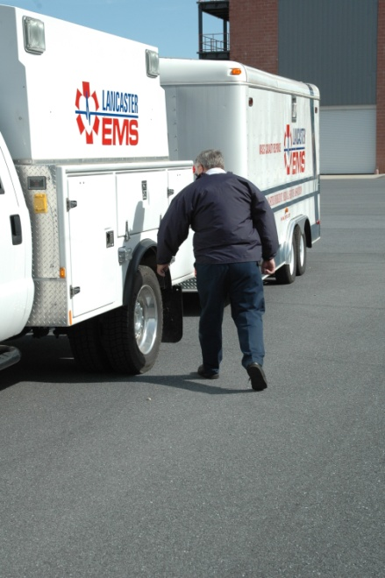
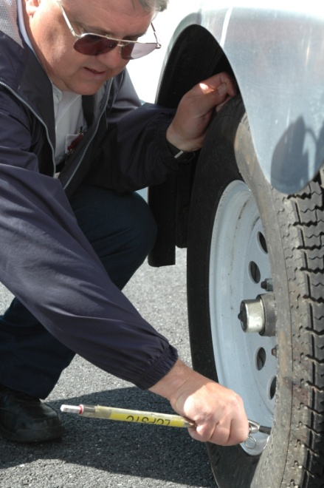
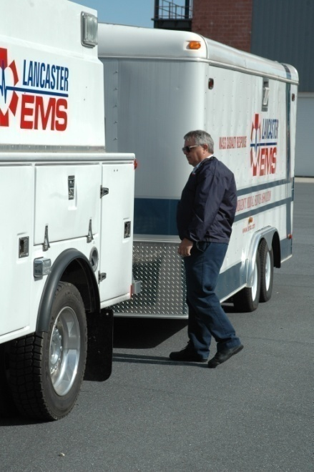

Inspection
All mechanical, electrical, suspension and moving parts must be inspected.

Slide 7


Slide 8
Practical Application
Hands on practice will reinforce the concepts of inspections. Using preprinted sheets will help students understand how to conduct a proper inspection. Take time to conduct a walk-around inspection.

Slide 9
Chapter 5 – Summary
Trailer inspection is essential to proper
operations. Knowing the trailer is
mechanically prepared prior to service
avoids the consequences of having an event
occurring as a result of mechanical failure.

Slide 10
Chapter 6 – Loading the Trailer
Loading the trailer is a planned event that is
performed methodically to ensure proper weight
distribution front to back, side to side and low to
high. Loading must be done correctly to ensure
that the load does not shift while driving and the
trailer handles correctly.

Slide 11
Loading The Trailer
According to reports involving truck drivers, more
than half the deaths in crashes occur as the result
of rollovers. When cargo is loaded high in the
trailer, the center of gravity moves higher up from
the road. Fully loaded trailers are 10x more likely
to roll over in a crash than an empty trailer.
Source: National Highway Traffic Safety Administration

Slide 12
Loading The Trailer
To safely load a trailer the following
elements must be considered:
overall load weight
load weight distribution, both horizontal and vertical
proper tongue weight
load securing measures

Slide 13

Example Of Improperly Loaded Trailer

Slide 14
Loading The Trailer
Trailer axles carry most of the weight of the trailer and its contents.
Remainder of the weight is carried by the tow vehicle hitch.
Total weight must be properly distributed and balanced, otherwise the trailer can swing wildly while towed.

Slide 15
Loading The Trailer
Consider the rating of the tires, wheels, frame and axles.
Towing stability also depends on keeping the center of gravity as low as possible.
  Load heaviest items on the floor and over the axles.
  When loading additional items, maintain an even side-to-side weight distribution.

Slide 16
Loading The Trailer
Top heavy loads can cause problems in a hard
braking situation.
Trailer “dive” – sudden movement increases the tongue weight and can decrease towing vehicle front axle load.

Slide 17
Weighing The Vehicle
Determining Tongue Weight – ESO is responsible
to determine not only the total weight of the loaded
trailer, but also the tongue weight when loaded.
Tongue weight is the amount of the trailer’s weight
that presses down on the trailer hitch.

Slide 18
Trailer Weight Classes
Class I
  2000 lb. maximum
  Load carrying hitch
Class II
  3500 lb. maximum
  Single axle, small to medium length (up to 18 feet in length)

Slide 19
Trailer Weight Class (Cont’d)
Class III
  5000 lb. maximum
  Dual axle or larger single axle
  Weight distribution hitch not required unless specified for a particular vehicle
Class IV
  12,000 lb. maximum
  Weight distribution hitch required

Slide 20
Weighing The Trailer
Pull the unloaded trailer onto the scale and position the trailer such that just the wheels are on the center of the scale.
This number should be subtracted from the GVWR. The number derived is the maximum available cargo capacity of the trailer.
Move the trailer so only the hitch is on the scale
Disconnect the trailer from the towing vehicle and weigh the front of the trailer, at the hitch.
This will give you the empty hitch weight. This will be important once the trailer is loaded.

Slide 21
Weighing The Trailer
Determining Hitch Weight
Hitch weight is the percentage of the trailer weight that is placed on the trailer coupler of the tow vehicle. Payload and hitch weight must be divided evenly between the axles to conform with weight limits and avoid over-steering problems.
Approximately 10 to 15% of the trailer’s gross weight is designed to be loaded in front of the axle and onto the hitch mechanism.

Slide 22
Weighing The Trailer
Method to Determine Hitch Weight:
Step 1 - Park the loaded trailer on a scale so that the hitch coupler extends beyond the end of the scale, but the tongue jack post (the post on the front of the trailer that rests on the ground when unhitched) is on the scale.
Step 2 - Chock the trailer vehicle wheels, unhitch the trailer and obtain the weight. This is the curb weight of the trailer alone. Note this weight.

Slide 23
Weighing The Trailer
Method to Determine Hitch Weight (Cont’d):
Step 3 - Place a jack stand under the coupler so the tongue jack post is supported off of the scale and the trailer is level. Note this weight.
Subtract the reading in step 2 from the reading in step 3 and derive the hitch weight.

Slide 24
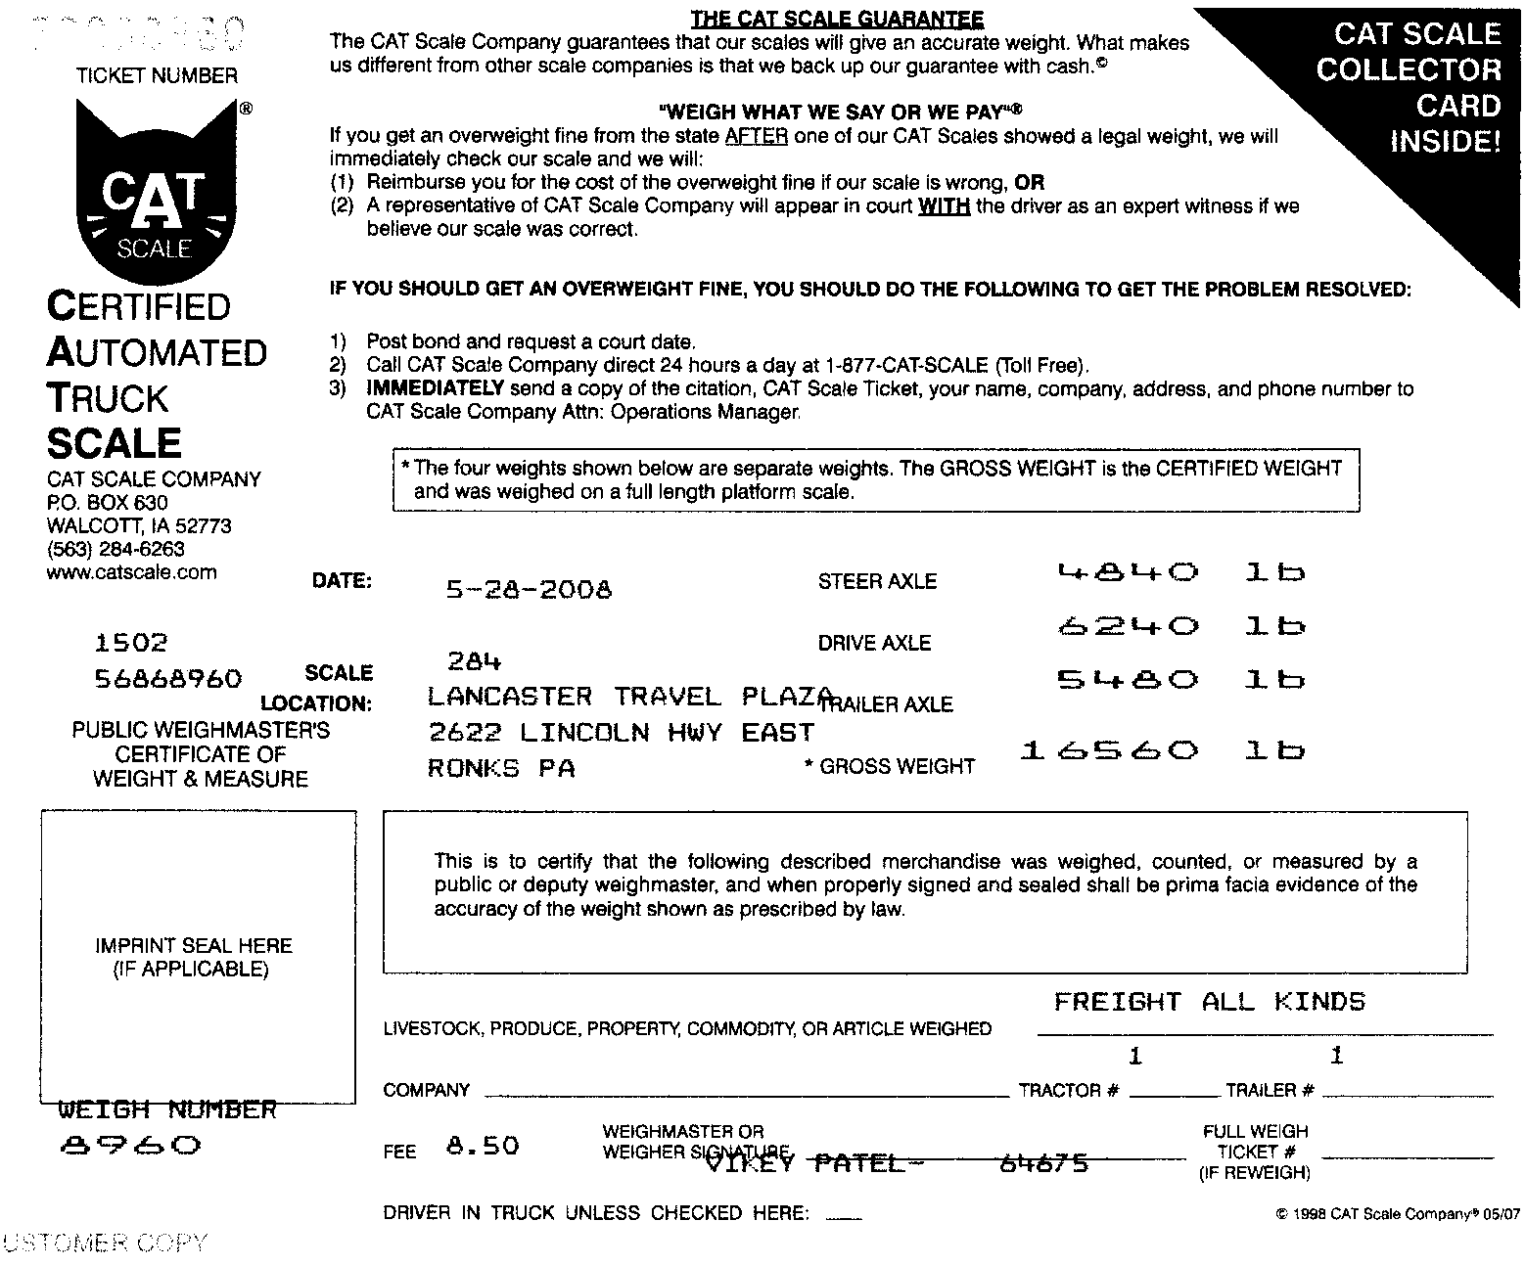
Example: Total Weight – Tow Vehicle & Trailer Combined

Slide 25


Slide 26
Weighing Summary
The key idea to remember –
An improper load distribution will greatly affect the
handling of the tow vehicle and trailer. If the tongue
weight is miscalculated it can result in loss of control
of the trailer. Positioning of the load should take into
account even distribution:
  front to back to provide proper tongue weight.
  left to right to avoid tire or suspension overload.
  top to bottom to maintain a low center of gravity.

Slide 27
Chapter 6 – Summary
Both the tow vehicle and the hitching system have
weight capacities which affect the safe handling of
the vehicle. The tow vehicle’s GVWR must never
be exceeded. This includes the curb weight of the
vehicle, payload, and hitch weight.

