Slide 1
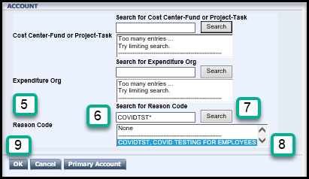
Adding COVIDTST Reason Code – HTML
How do I add the COVIDTST Reason Code to my timecard?
Add a row by clicking the “Add a Row” button
Select the Pay Code: Hours Worked for the new row;
Enter the amount of Hours to designate as COVIDTST for the day and reduce hours on the old row, so total daily hours equal scheduled hours.
Under the Transfer column, click the magnifying glass to Search
Look to the Reason Code section
Enter COVIDTST* (The asterisk is required to search)
Click Search
Highlight the words “COVIDTST, COVID TESTING FOR EMPLOYEES”
Click OK
Page 1

Slide 2
Adding COVIDTST Reason Code - HTML
After the initial search, the Reason Code will be remembered in your last five Transfers Dropdowns (Note: This gets periodically cleared)
The timecard will look like this:
The COVIDTST Reason Code should be used for travel time from County work site to the appointment and back to the County work site, appointment time and any appointment wait time should be captured as Hours Worked. Travel time from home to the appointment and returning home is considered your normal work commute and should not be recorded.
Hours Worked with the reason code: COVIDTST are not considered ‘on site” and this time is not eligible for any on-site differential.
Questions related to how to enter a Project Task, Expenditure Org or Reason Code should be directed to MCtime at MCtime.Finance@montgomerycountymd.gov.
Note – If you find that you are not able to utilize any of the drop-down features of MCtime, it is most likely a compatibility and trusted sites issue. On the MCtime Informational website, www.montgomerycountymd.gov/MCtime, is a Job Aid: Technical Issue Checking Compatibility. If you are not comfortable troubleshooting on your own, please contact the Help Desk at 240-777-2828, for assistance.
Page 2

