Slide 1


Minority Business Event
May 24, 2022
www.montgomerycountymd.gov/pro
Follow us @MoCoProcure on Facebook and Twitter

Slide 2
Agenda
9:00am: Welcome Remarks
9:15am: How to do Business with Montgomery County, MD
9:45am: Minority Business Resources Panel Discussion
10:45am: Short Break
11:00am: Success Stories from MFD Owned Businesses
12:00pm: Adjourn

Slide 3
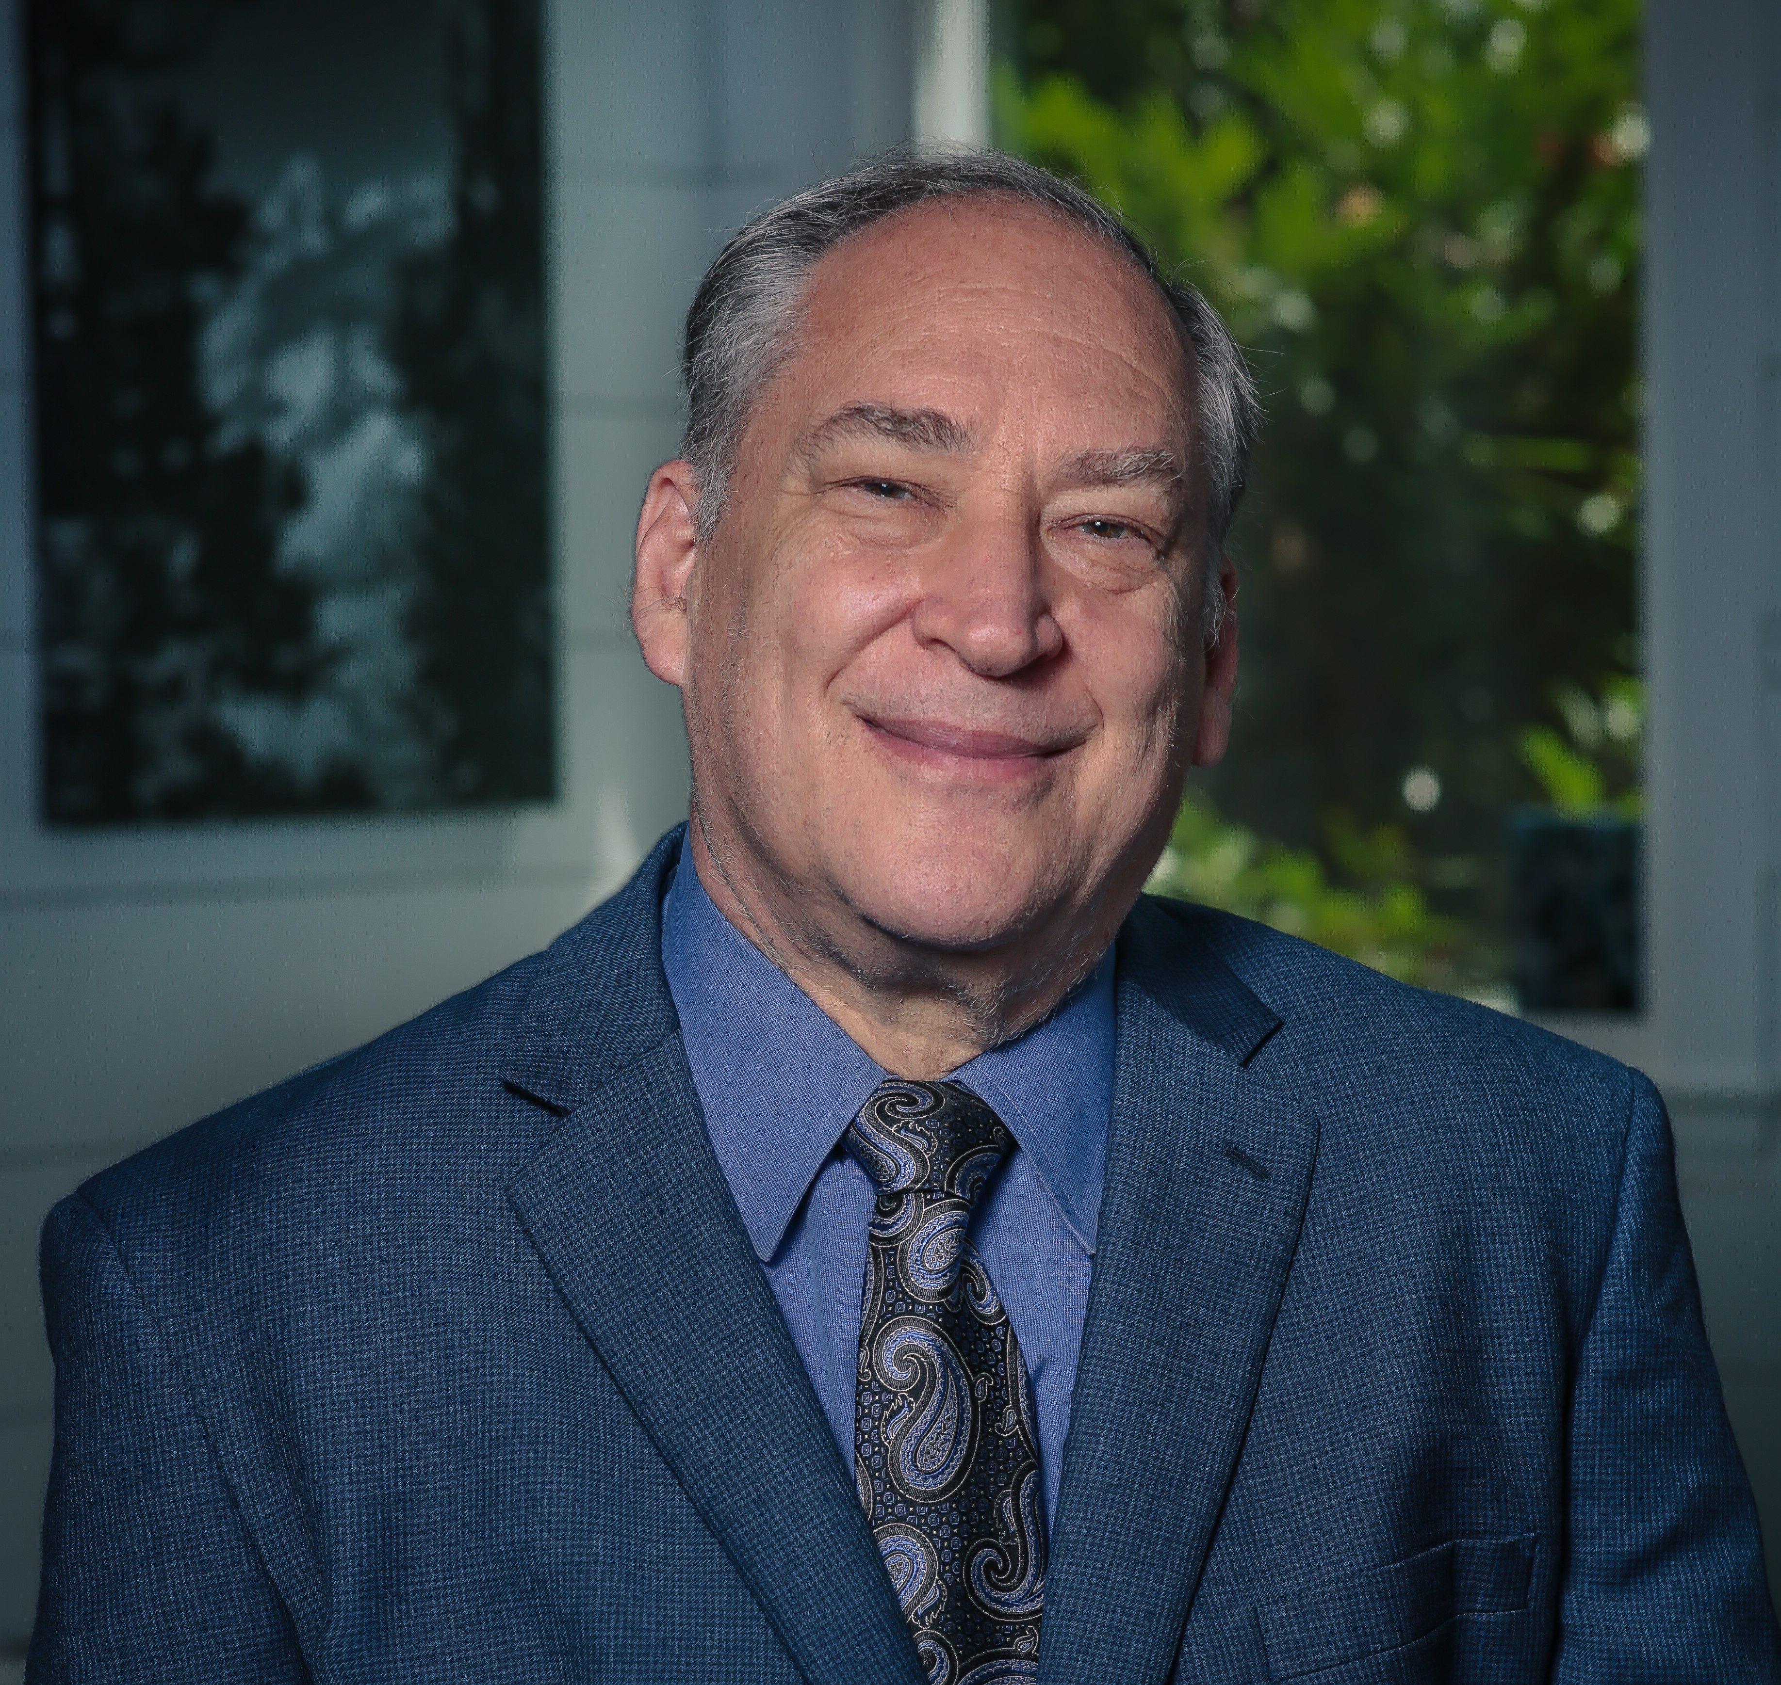
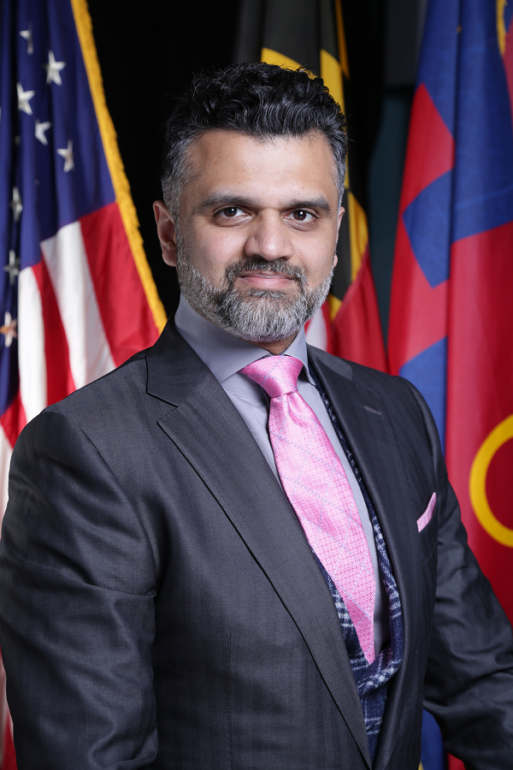
Welcome Remarks
County Executive Marc Elrich
Ash Shetty
Director
Office of Procurement

Slide 4
How to do Business with Montgomery County

Slide 5
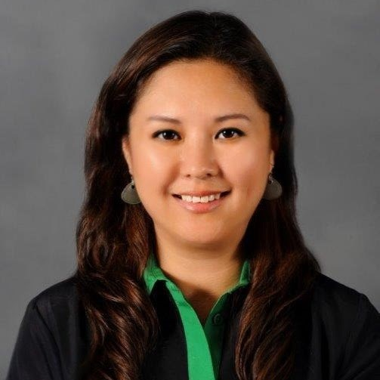
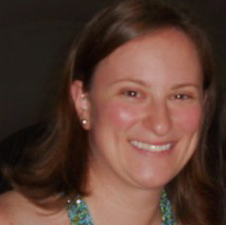

How to do Business with Montgomery County, MD
Grace Denno
Chief, Division of Business Relations and Compliance
Office of Procurement
Melissa Garner
Chief, Operations Division
Office of Procurement
Michael Brown
Local Business Program Manager
Office of Procurement

Slide 6

Ash Shetty
Director, Office of Procurement
Procurement Process
Businesses
Office of Management and Budget
Department of Finance, Division of Risk Management
Office of the County Attorney
Business Relations and Compliance
Procurement
Operations Division
Using Departments
EMPATHY
PROCUREMENT CORE VALUES
TRANSPARENCY
COLLABORATION
EFFICIENCY

Slide 7
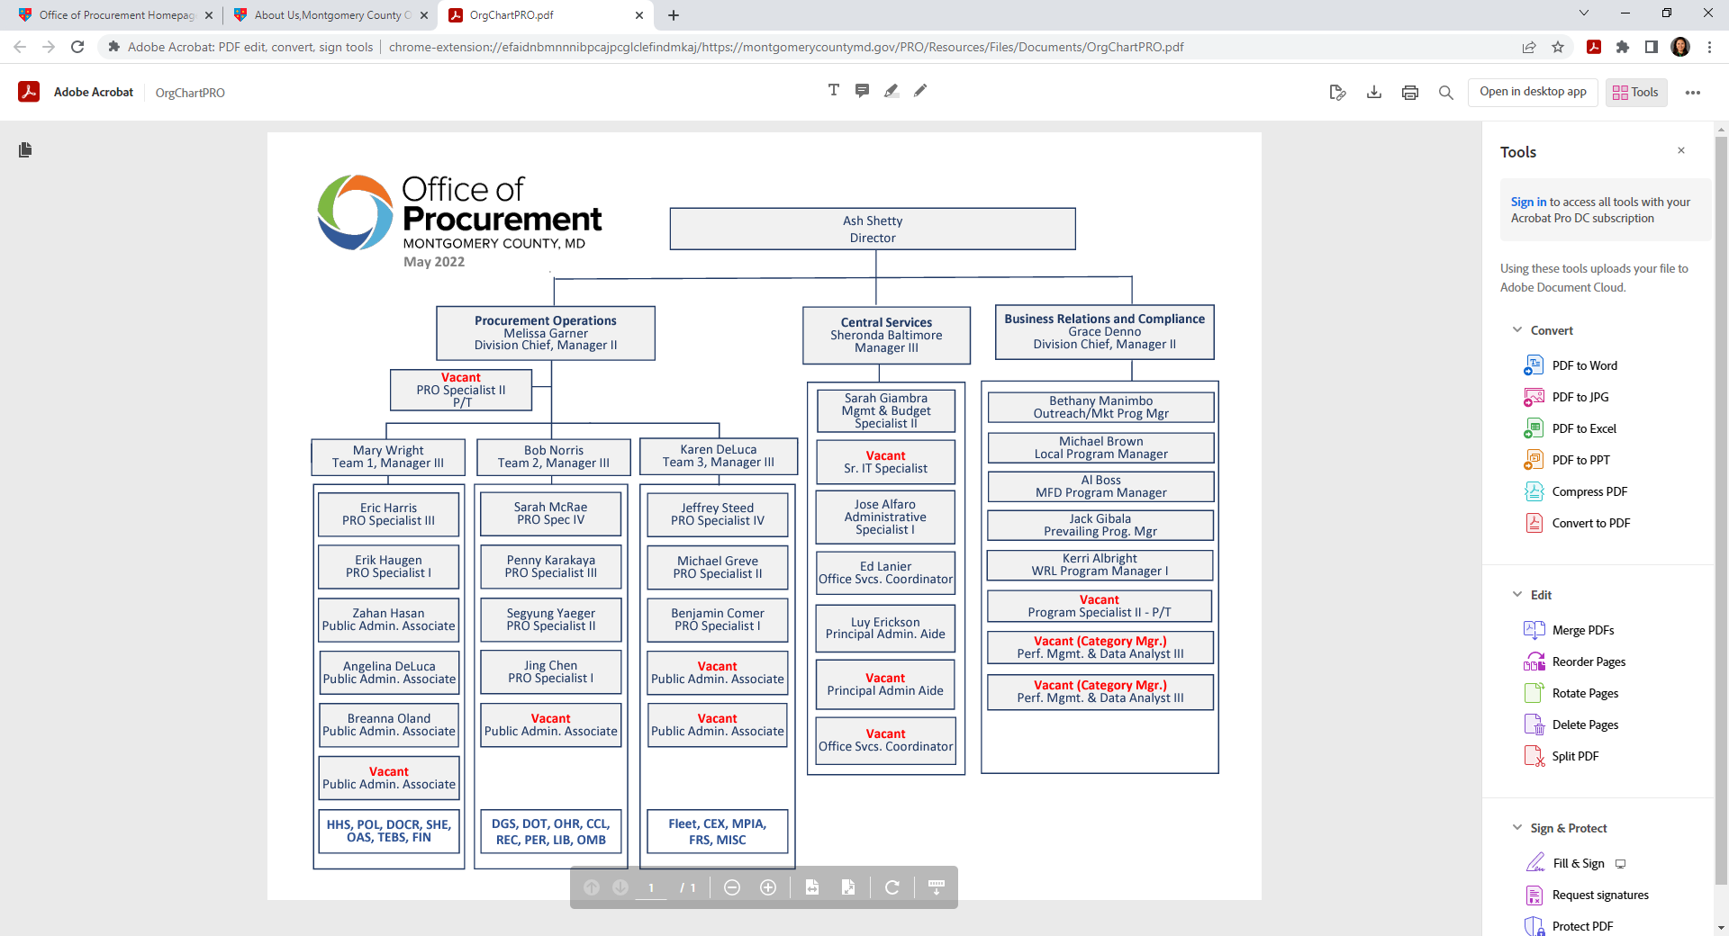

Montgomery County Office of Procurement

Slide 8
Montgomery County Office of Procurement
Formal Solicitations (>$100K)
  IFBs – Invitations for Bids
  RFPs - Request for Proposals
  REOIs – Request for Expressions of Interest
Informal Solicitations (> $10K, < $100K)
  All reserved under the LSBRP
  >$50K all subject to MFD requirements
  >$50K services contracts subject to Wage Requirements Law
Direct Purchase (departments buy directly) (< $10K)

Slide 9
Montgomery County Office of Procurement
Minority, Female, Disabled Business Program (MFD)
 | Construction | Professional Services | Non-Professional Services | Goods
CY 2022 | 21% | 19% | 22% | 10%
Agency | Program | Description | Contact
NEW! U.S. Department of Veterans Affairs (VA) | Service-Disabled Veteran Owned Small Business | Service-Disabled Veteran Owned Small Business | 1-866-584-2344 website link
Maryland Department of Transportation | Minority Business Enterprise | MDOT Directory of Certified MBE and/or DBE firms (MDOT-MBE) | 1-800-544-6056 website link
Federal Small Business Administration | 8(a) Program | Directory of Certified 8a firms (SBA)-8a | 1-202-272-0345 website link
Women's Business Enterprise National Council | Women's Business Enterprise | Women's Business Enterprise (WBENC) | 1-202-595-2632 website link
Capital Region Minority Supplier Development Council | Minority Business Enterprise | Minority Business Enterprise (MSDC) | 1-301-593-5860 website link
City of Baltimore | Minority and Women's Business Opportunity Office | Minority and Women's Business Opportunity Office (MWBOO) | 1-410-396-4355 website link

Slide 10
Montgomery County Office of Procurement:
Local Business Programs
  Local Small Business Reserve Program (LSBRP)
  Local Business Preference Program (LBPP)
  Local Business Subcontracting Program (LBSP)

Slide 11
Montgomery County Office of Procurement:
Resources
Procurement website www.montgomerycountymd.gov/PRO
Vendor Registration System www.mcipcc.net
Vendor Resources https://www.montgomerycountymd.gov/PRO/vendor-resources/index.html
PROjection (Forecasting tool)
  https://www.montgomerycountymd.gov/PRO/solicitations/projections.html
Subscribe to weekly newsletter
  https://content.govdelivery.com/accounts/MDMONTGOMERY/bulletins/2fb9c49
Monthly Virtual Open House (Third Wed 10AM-11AM)
  Check the event calendar on www.montgomerycountymd.gov/pro)

Slide 12
Montgomery County Office of Procurement:
Contact Information
Procurement Operations
Melissa Garner 240-777-9911
Melissa.Garner@montgomerycountymd.gov
Procurement Business Relations and Compliance
Grace Denno 240-777-9959
Grace.Denno@montgomerycountymd.gov

Slide 13

Q&A

Slide 14
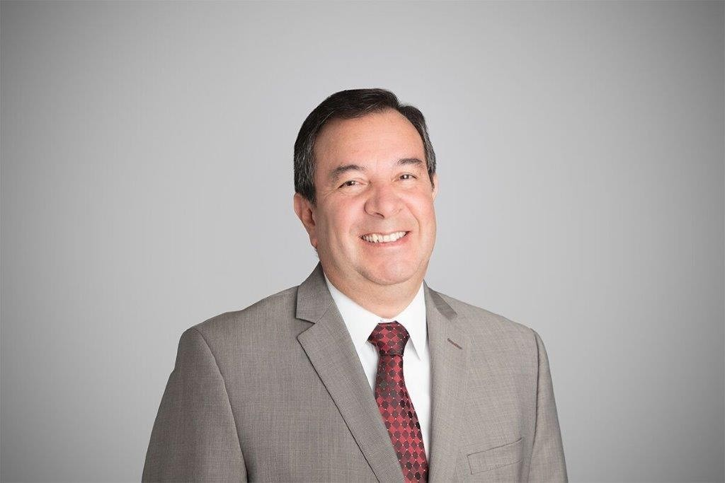
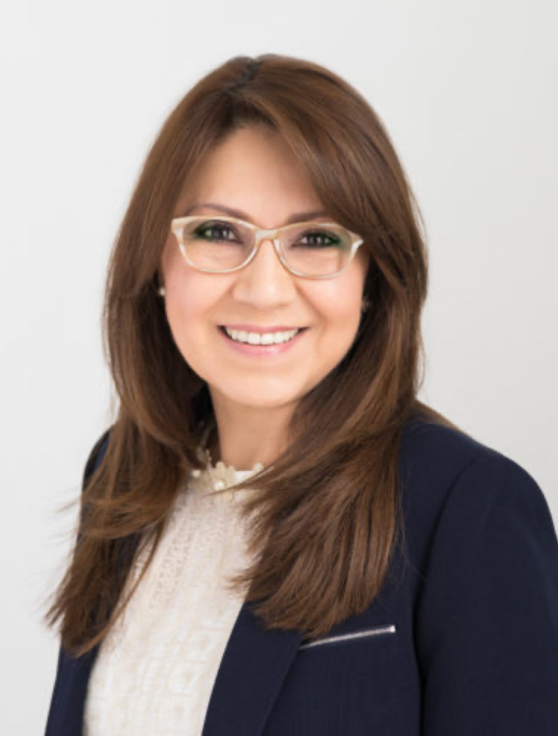
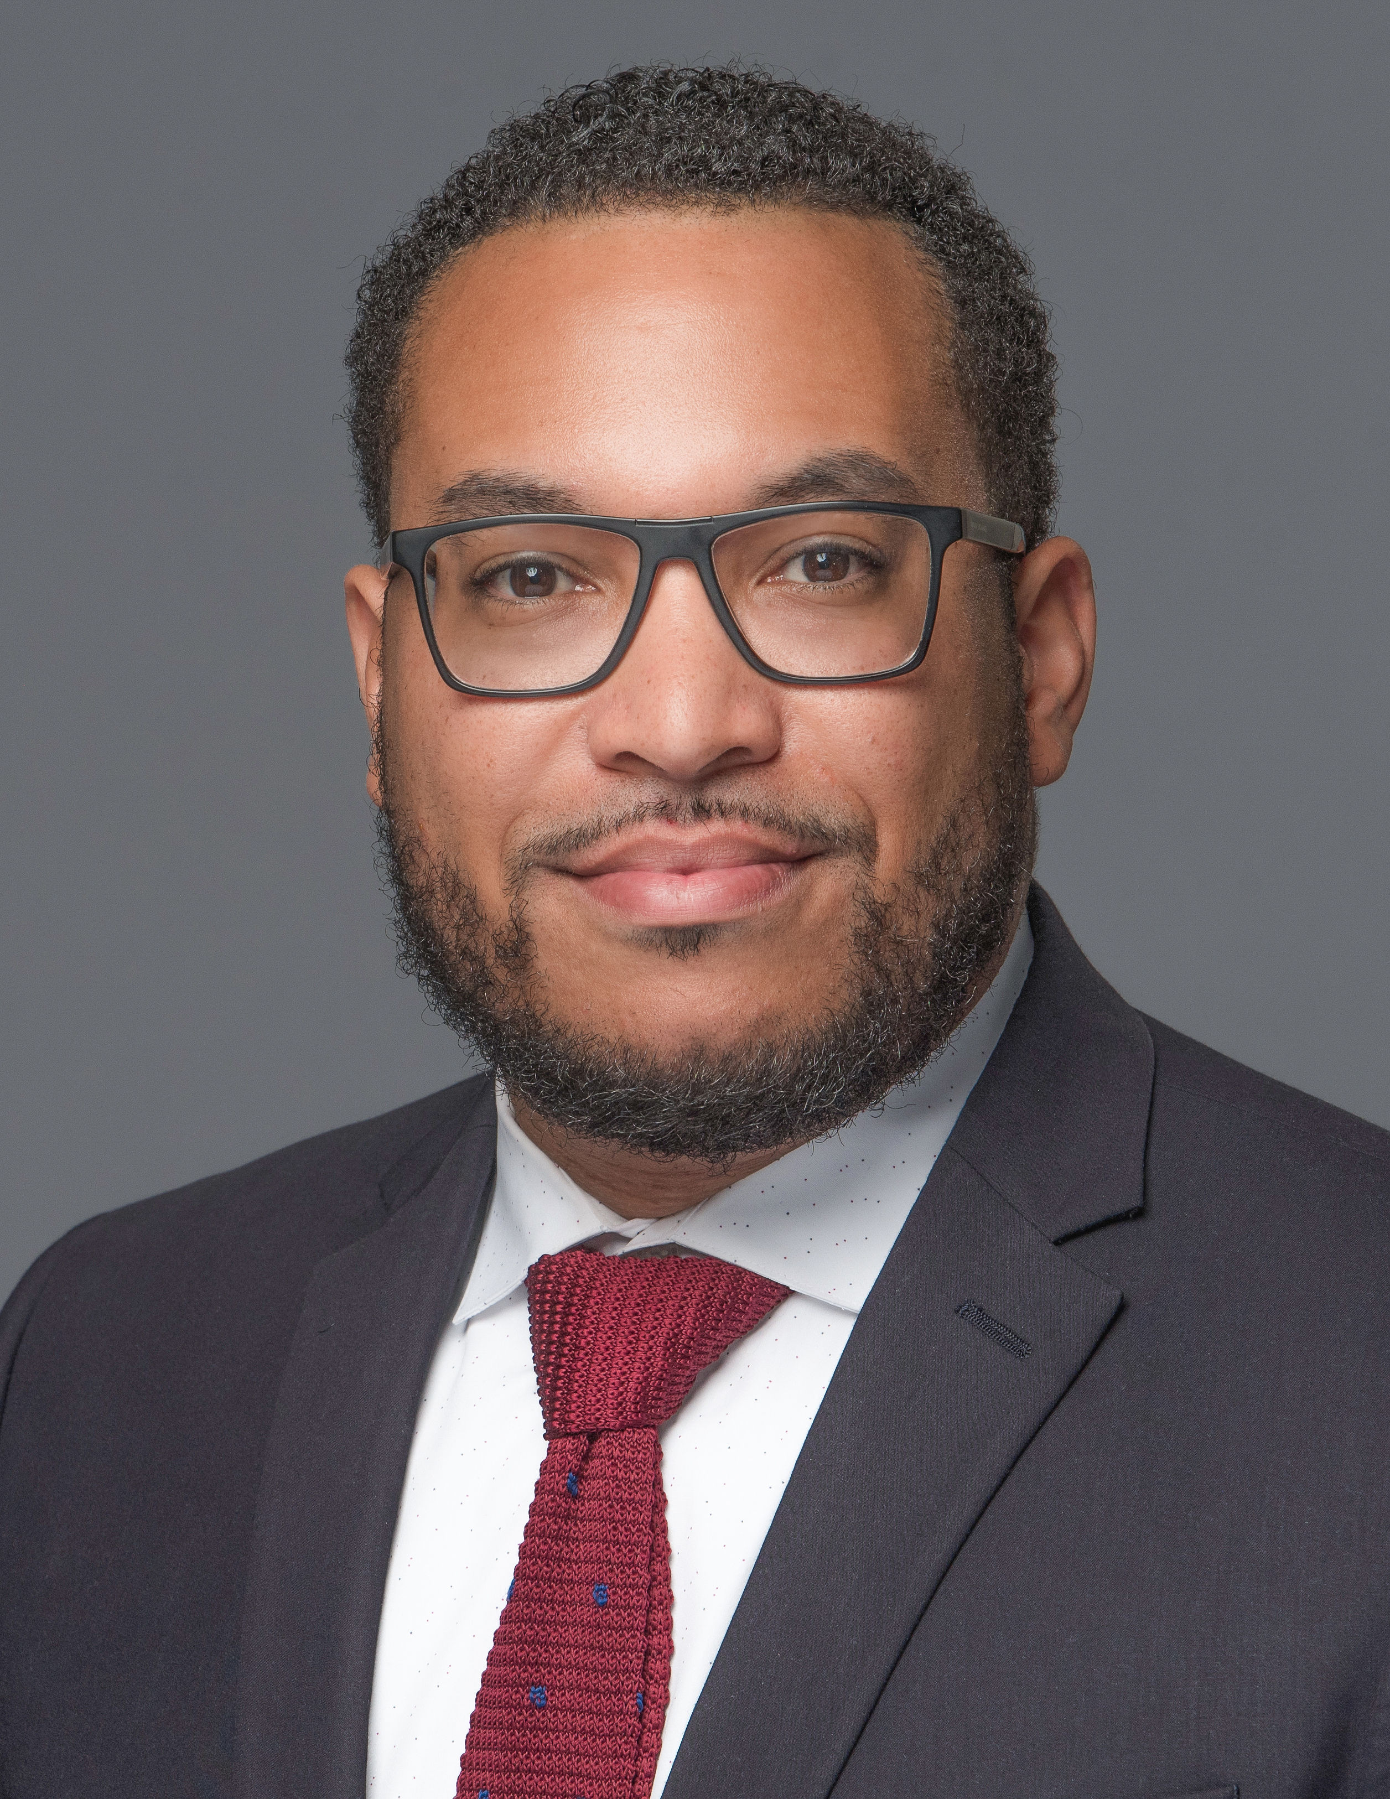
Minority Business Resouces Panelists
Daniel Parra
Martha Jimenez
Anthony Featherstone
MONTGOMERY COUNTY ECONOMIC DEVELOPMENT CORPORATION
MARYLAND WOMEN’S BUSINESS CENTER
WORKSOURCE MONTGOMERY

Slide 15
Hello!
I am Daniel Parra
Director of Business Diversity and Inclusion
Montgomery County Economic Development Corporation
www.thinkmoco.com

Slide 16


MoCo Office of Procurement
Priming the
County’s
Economic Engine
Presented by Daniel Parra,
Director of Business Diversity and Inclusion
Montgomery County Economic
Development Corporation
May 2022

Slide 17
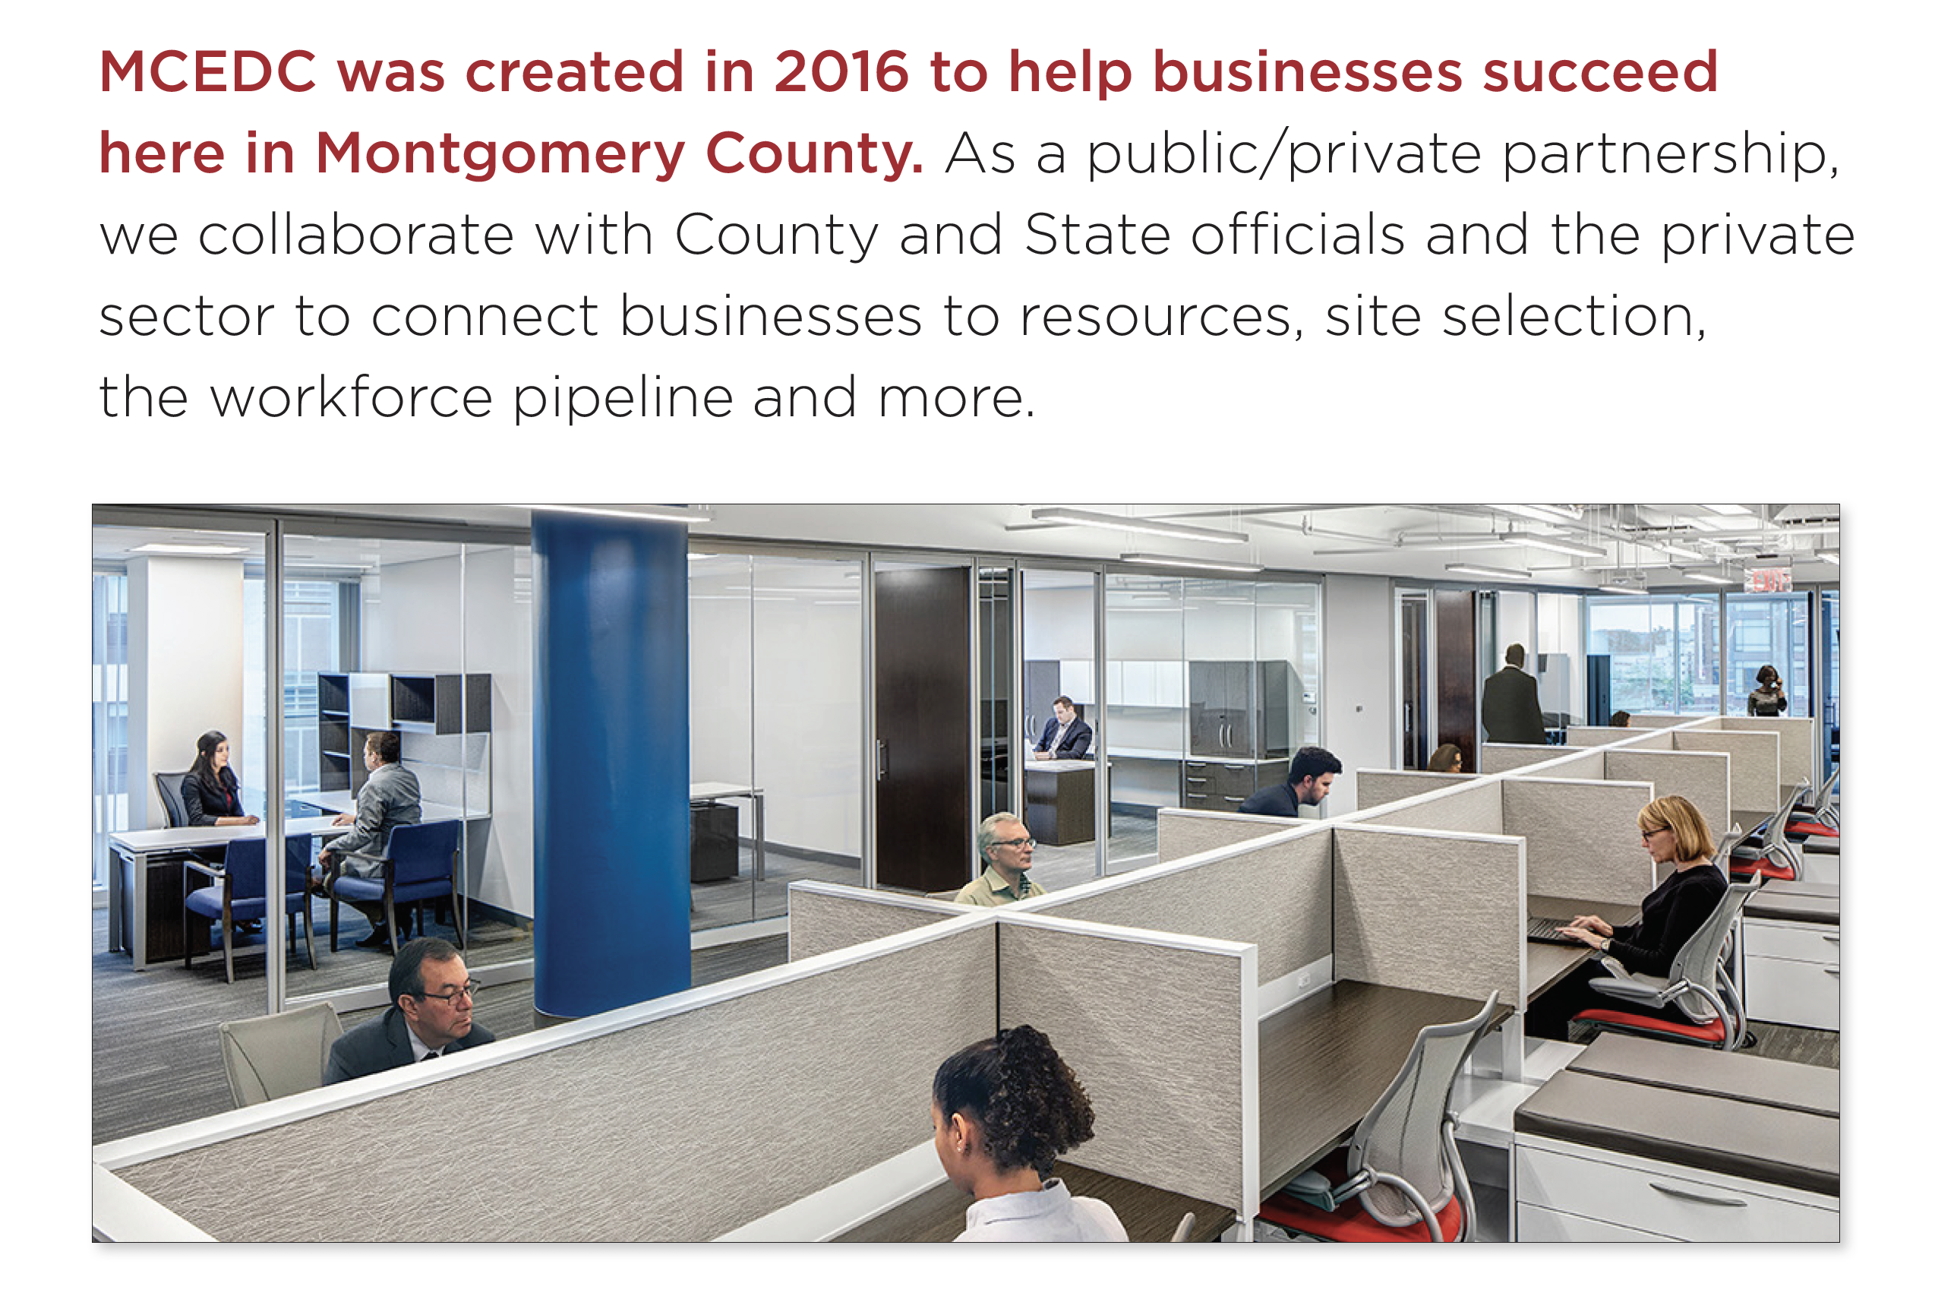
About MCEDC
The official public-private economic development
organization representing Montgomery County, MD
How does MCEDC help?
We help make connections to:
– Gain market intelligence
– Link business owners to aligned
partnerships
– Find the ideal business address
– Explore available incentives
– Attract talent and help with
workforce training
– Help companies relocate here
Led by a board of directors, our mission is to
help businesses start and grow in the county,
or help companies relocate here
M O N T G O M E R Y C O U N T Y E C O N O M I C
D E V E L O P M E N T C O R P O R A T I O N

Slide 18

Helping in Pandemic Recovery Efforts
During the pandemic, in addition to ongoing business support, MCEDC has pivoted to help the economic recovery for our businesses. Support grant programs include:
Bio Lab Pilot – $96,000 grant program to six small
life science companies (administered pre-pandemic)
—
Restaurant Relief Fund – 3 rounds of relief for a total of $16.5M dollars distributed to over 900 restaurants
—
Telework Fund – $1M to help businesses purchase telework equipment and software
—
Local Production Fund – $200,000 fund to help businesses
pivot to making Personal Protection Equipment (PPE) to support
local pandemic needs
—
3R Initiative Restaurant & Retail Grants – $1M program to assist restaurants and retailers before the 2020 holiday season and winter
M O N T G O M E R Y C O U N T Y E C O N O M I C
D E V E L O P M E N T C O R P O R A T I O N

Slide 19

MCEDC can help you navigate and find the resources you need for success including the 3 Ps.
1
Permitting
Recent Speed-to-Market Initiative helps streamline the approval process for development projects by consolidating the processes of planning and land-use approvals.
Faster services in both permitting and planning.
montgomerycountymd.gov/dps/about.html montgomerycountymd.gov
2
Planning
What’s new? Montgomery Planning React Map, where you can
weight in on plans for downtown Silver Spring. mcreactmap.com
The Planning Department is also implementing the Speed-to-Market streamlining process to help businesses.
3
Procurement Opportunities for the County,
Montgomery College and MCPS
Montgomery County montgomerycountymd.gov/PRO/vendor-resources/vip.html
Montgomery College info.montgomerycollege.edu/offices/procurement/index.html
MCPS montgomeryschoolsmd.org/departments/procurement/vendors.aspx
M O N T G O M E R Y C O U N T Y E C O N O M I C
D E V E L O P M E N T C O R P O R A T I O N

Slide 20
Additional County Resources
to Support Business
Business Starter Kits
montgomerycountymd.gov/Biz-Resources/starter-kit.html
Resources for Small Businesses
montgomerycountymd.gov/Biz-Resources/small-biz-resources.html
The Business Solutions Group
Business Advancement Team
montgomerycountymd.gov/Biz-Resources/contact.html
Regional Services Center
Liaison between the County and its residents and businesses
to provide information, identify issues and recommend solutions.
montgomerycountymd.gov/Government/rsc.html
Other resources:
MD Women’s Business Center (MWBC)
Works with entrepreneurs across Maryland's capital region
to help women start, sustain and grow their businesses
Latino Economic Development Center (LEDC) – Drives economic
and social advancement to underserved local Latino communities
MD Small Business Development Center (SBDC)
Offers support to entrepreneurs and small businesses, including training, consulting and research
The Governor's Office of Small, Minority & Women
Business Affairs (GOSBA) – Connects the small business community with greater economic opportunities in both the
public and private sectors.
MD Department of Commerce – Dedicated Montgomery County office to help businesses with retention, relocation and expansion needs and finding opportunities.
Maryland Business Express (MBE) – Plan, start, manage and
grow your business with help from the business express service.
SCORE – Free confidential business advice and mentoring via
a network of 10,000 volunteer business experts through the SBA.
M O N T G O M E R Y C O U N T Y E C O N O M I C
D E V E L O P M E N T C O R P O R A T I O N

Slide 21














Chambers of Commerce
Montgomery County has dozens of chambers and business membership organizations to support your business. Access this page to learn more: thinkmoco.com/choose/support-resources
M O N T G O M E R Y C O U N T Y E C O N O M I C
D E V E L O P M E N T C O R P O R A T I O N

Slide 22
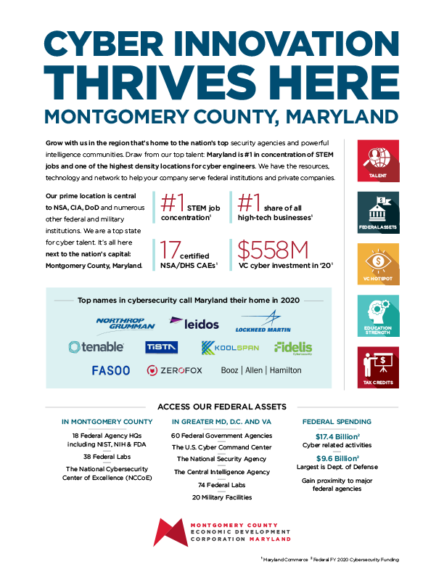
Major Industries
thinkmoco.com/key-industries
Click on images to download
BioHealth and Life Sciences
—
Cybersecurity
—
Tech & Quantum Computing
—
Advanced Manufacturing
—
Hospitality & Tourism
—
Financial Services
—
Agribusiness
—
Nonprofits
M O N T G O M E R Y C O U N T Y E C O N O M I C
D E V E L O P M E N T C O R P O R A T I O N

Slide 23

Tax Credits & Incentives
MOVE Grant – One-time grant available to new businesses that move to the county with a signed commercial lease.
Find other tax credits and incentives information here: thinkmoco.com/incentives
—
Biotech Investment Tax Credits
—
Local matching SBIR grants
We work with new companies to
create incentive packages customized
to specific needs.
M O N T G O M E R Y C O U N T Y E C O N O M I C
D E V E L O P M E N T C O R P O R A T I O N

Slide 24
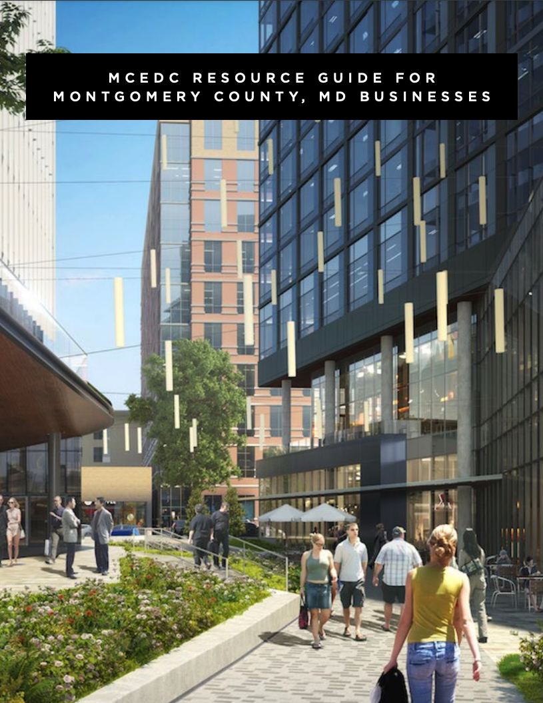
MCEDC Resource Guide
(English and Spanish versions available)
Includes:
Funding and Access to Capital
Training
Diversity, Equity and Inclusion-Oriented
Assistance
Site Selection
Industry-Specific Support
Shared Spaces
Workforce Development
Chambers of Commerce
English version
Spanish version
M O N T G O M E R Y C O U N T Y E C O N O M I C
D E V E L O P M E N T C O R P O R A T I O N

Slide 25
Resources and Support Organizations
The Maryland Business Relief Wizard –
The reliefwizard.net is a business tool to connect businesses
with resources and programming, streamlining the process of finding support.
Maryland Tech Council (MTC) – A collaborative community engaged in building strong tech and life science industries and supporting its membership. For more, visit mdtechcouncil.com
Venture Mentoring of the MTC – Team-based mentoring to help STEM CEOs with development, funding
and beyond. Careful matching to help ventures gain success.
Go to mdtechcouncil.com/vms
TEDCO – Provides Maryland entrepreneur funding,
resources and connections that early-stage technology and life sciences companies need to thrive in the state. tedcomd.com
The MD Entrepreneur Hub – An interactive
portal to find the resources your business needs,
from funding to talent. Over 2,000 resources to build your business in MD. Go to marylandentrepreneurhub.com
BioHealth Innovation (BHI) – Helps with private
and public early-stage capital; active commercialization
talent networks; tech transfer and soft landings for
international companies. Visit biohealthinnovation.org
Opportunity Zones in Maryland –
A national program that provides federal tax
incentives for investment in distressed, local
communities. Find out more at
dhcd.maryland.gov/Pages/OZ/OpportunityZones.aspx
M O N T G O M E R Y C O U N T Y E C O N O M I C
D E V E L O P M E N T C O R P O R A T I O N

Slide 26

Welcome to a diverse
and inclusive community
Four of our communities are ranked among the 10 most diverse in the nation:
Gaithersburg • Silver Spring
Germantown • Rockville
—
One in three residents are foreign born
—
138 languages spoken by county residents
—
Montgomery County public schools support gender identity
—
54% of residents are non-white
—
45% of businesses are minority-owned
M O N T G O M E R Y C O U N T Y E C O N O M I C
D E V E L O P M E N T C O R P O R A T I O N

Slide 27

THANK YOU
Visit us at thinkmoco.com
Daniel@thinkmoco.com
Sign up for our newsletter for ongoing business news and support
Send us your updates so we can help promote your business — email us at connect@thinkmoco.com

Slide 28
Q&A

Slide 29
Hello!
I am Martha Jimenez
Supervising Senior Business Consultant
Maryland Women’s Business Center
www.marylandwbc.org

Slide 30

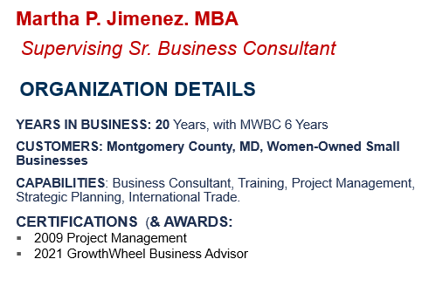
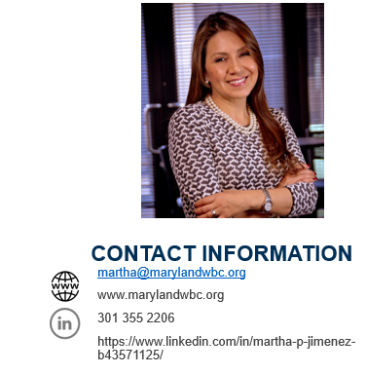
Maryland Women’s Business Center

Slide 31
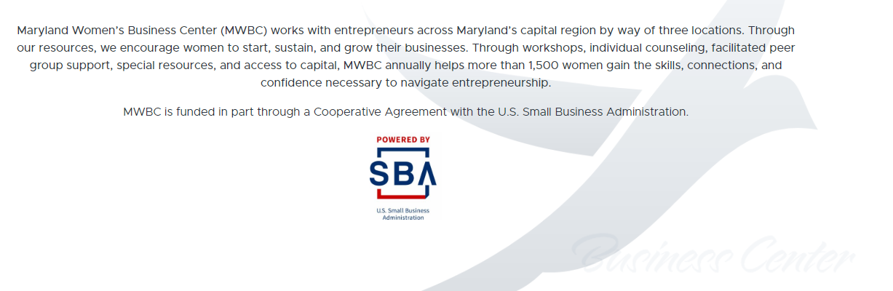
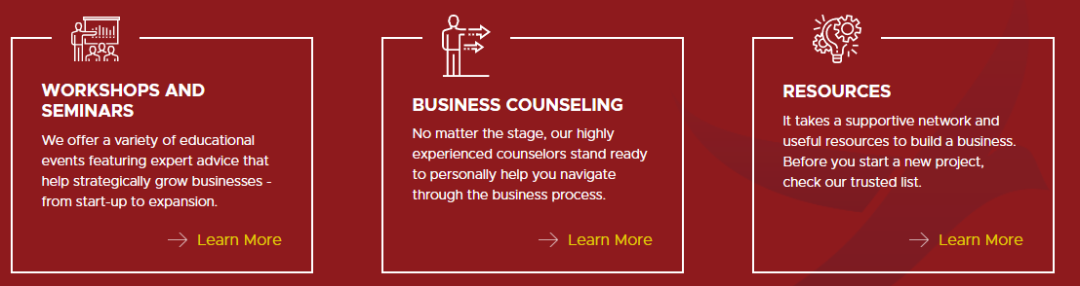
Maryland Women’s Business Center

Slide 32
Q&A

Slide 33
Hello!
I am Anthony Featherstone
Executive Director
WorkSource Montgomery
www.worksourcemontgomery.com

Slide 34


Minority Business Resource Panel
Anthony Featherstone, Executive Director,
WorkSource Montgomery, Inc.
May 24, 2022

Slide 35
WORKSOURCE MONTGOMERY
WorkSource Montgomery (WSM) focuses on linking local and regional economic development and workforce efforts in Montgomery County, Maryland. WSM develops a deep understanding of target and emerging industry demands, creating sustainable workforce solutions that are tailored to the region. This increases the ability of individuals to compete for higher-quality jobs and employers to compete within the marketplace.
Vision
Economic development, education, and the system of talent development are aligned locally and regionally to sustain a vibrant economy in Montgomery County.
Mission
To meet the talent attraction, development, and retention needs of strategic industries.
To meet the needs of the underemployed and unemployed.
To develop career pathways that lead to sustainable wage jobs and support a thriving mission.

Slide 36
Financial Support for Business
No cost candidate pre-screening, candidate matching, retention strategies and labor market research
No cost recruitment events, job fairs and occupation exploration information sessions
No cost advertising on WSM website, Maryland Workforce Exchange database, workforce partner websites, social media
No cost workforce professional assistance plus a virtual recruiting system, to free you up for day-to-day business needs

Slide 37
Let WSM Assume Your New Hire Risk
GROW (Grant Relief for Onboarding Workers)
  To assist in hiring & training costs those industries with front-line workers and others hard hit by COVID
  Be a Montgomery County based business hiring Montgomery County residents
  Earn a grant award for a long-term FT or PT, W-2 worker
  Hire up to 8 workers for an award cap of $45k (subject to availability)
  Must register (no cost) on the Maryland Workforce
  Exchange database, https://mwejobs.maryland.gov
  Apply within 30 days after hiring at:
  https://worksourcemontgomery.com/covid-19-recovery/grow-grant
  Questions? Email grow@worksourcemontgomery.com

Slide 38
Let WSM Assume Your New Hire Risk
Earn ‘n Learn New Hire Subsidy
  Finding the perfect person is practically impossible and challenging in a limited timeframe
  Many high performing people have decided to switch careers and have transferable skills but may lack the new industry skills needed
  Train someone the way you like and be reimbursed by WSM for a portion
  Fill out WSMs On-the-Job Training referral form today and a Business Solutions Consultant will follow-up to clarify your needs and begin a candidate search
  https://form.jotform.com/wsmontgomery/business-services-
  ojt-referral-form

Slide 39
DESCRIPTION
For non-profit and for-profit W-2 employers in Montgomery County, MD and surrounding areas (Washington Metro) are eligible
Business cannot be associated with recreation, religion or gambling, and must be in good standing with the state
WSM will subsidize the starting salary using three tiers:
  Employers over 100 employees = 50% subsidy
  Employers with 50 or less employees = 90% subsidy
  Employees in between = 75% subsidy
Pay your new hire up to $21 per hour (wages); be reimbursed every pay period
Train your new employee anywhere from 6 weeks to 3 months
Once trained, the salary should be bumped to match an incumbent worker with
the same training
WSM can send resumes to consider, or you can find your own candidate and
WSM will check eligibility (unemployed, county resident, US citizen)

Slide 40
UpSkill Existing Workers
Incumbent Worker Training Subsidy
  Broaden employee skill set to make W-2 workers more versatile
  Available to businesses with 100 or fewer employees
  Employees slated for training must have worked for at least 6 consecutive months
  Annual wages for employees to be trained must not exceed $80k
  Employees must sign an agreement to remain with the employer a min. of 18 mos. post training
  Training provided must be essential to the business
  Employer must cost share 50% up to $20k, eligible once every
  three years

Slide 41
Advice & Three Things to Know
Make use of Montgomery County Services and the many subject matter
experts available to you – just ask
Take a chance on hiring and training talent you may not typically consider
Take advantage of the abundance of free training options to make your
employees more competitive, thus increasing your credibility
Think of WSM as your connector to Montgomery County and surrounding
area resources
No cost services
Easy grant money - few requirements

Slide 42




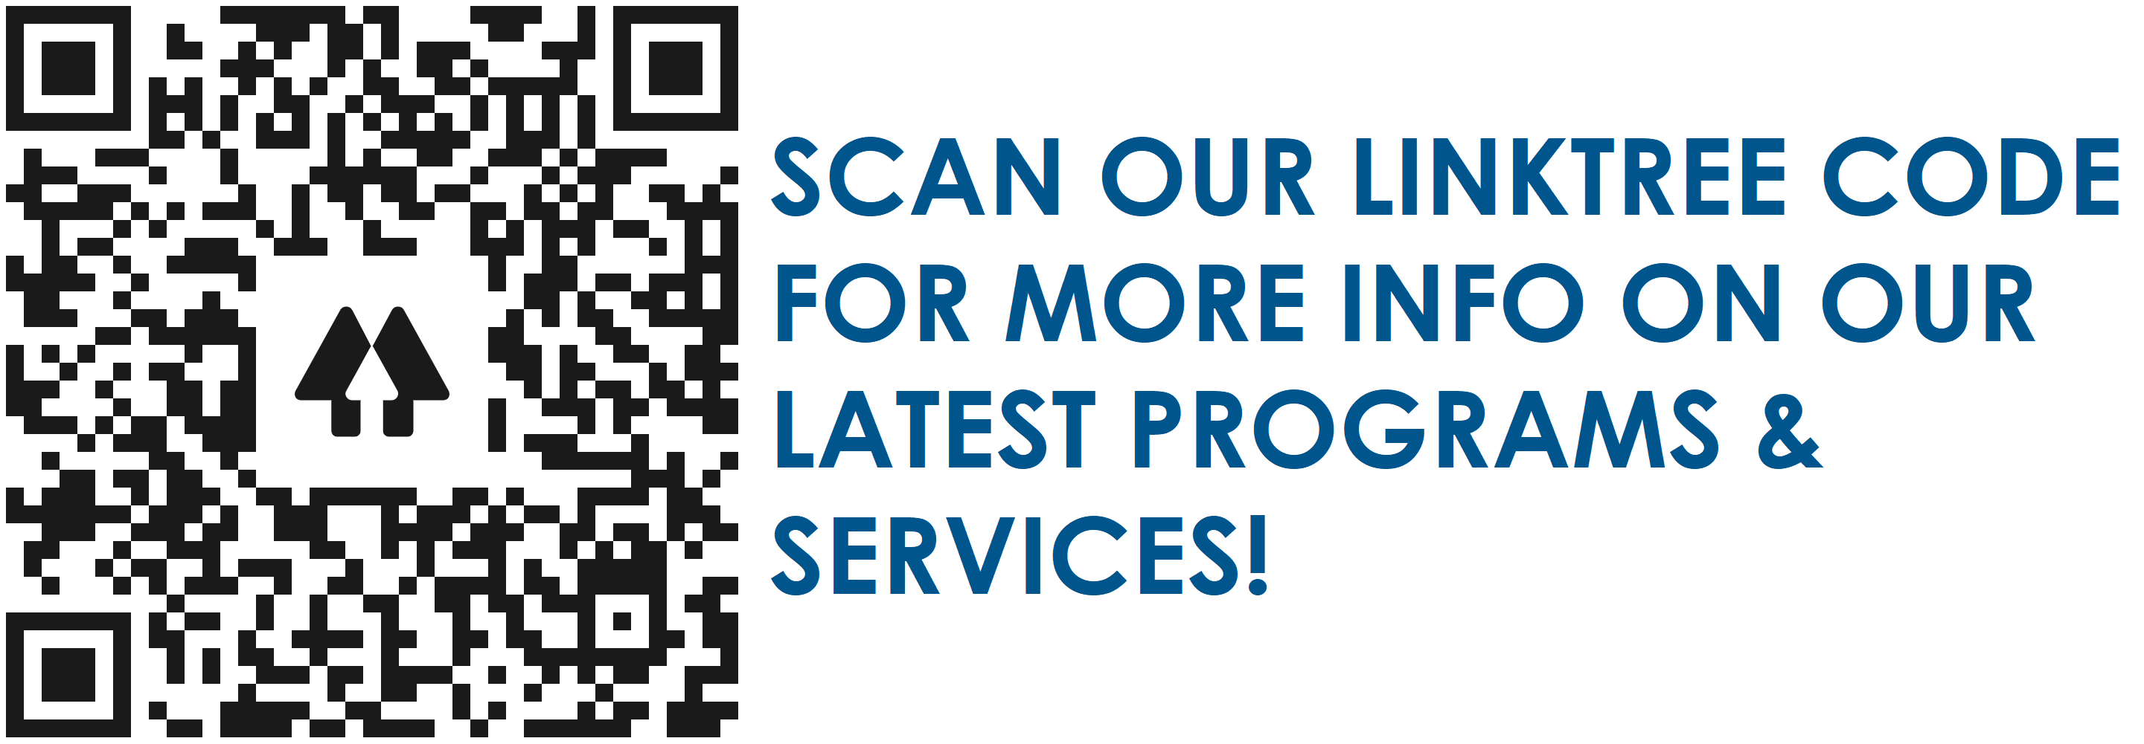
THANK YOU!
Connect with us on Social Media!
FACEBOOK
/WorkSourceMontgomery
TWITTER
@WorkSourceMD
INSTAGRAM
@WorkSourceMD
LINKEDIN
WorkSource Montgomery
WEBSITE
www.worksourcemontgomery.com

Slide 43
Q&A

Slide 44
Short Break

Slide 45
Success Stories from MFD Owned Businesses

Slide 46
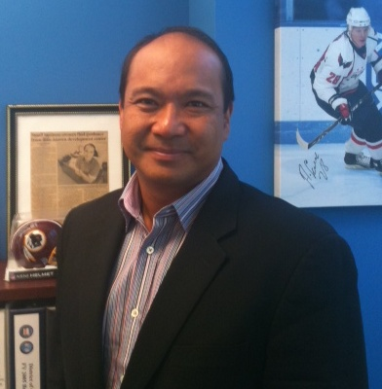
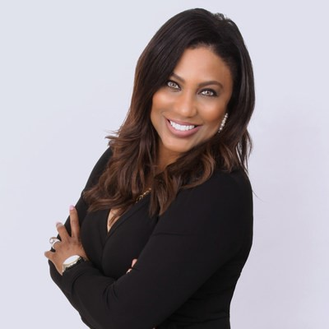
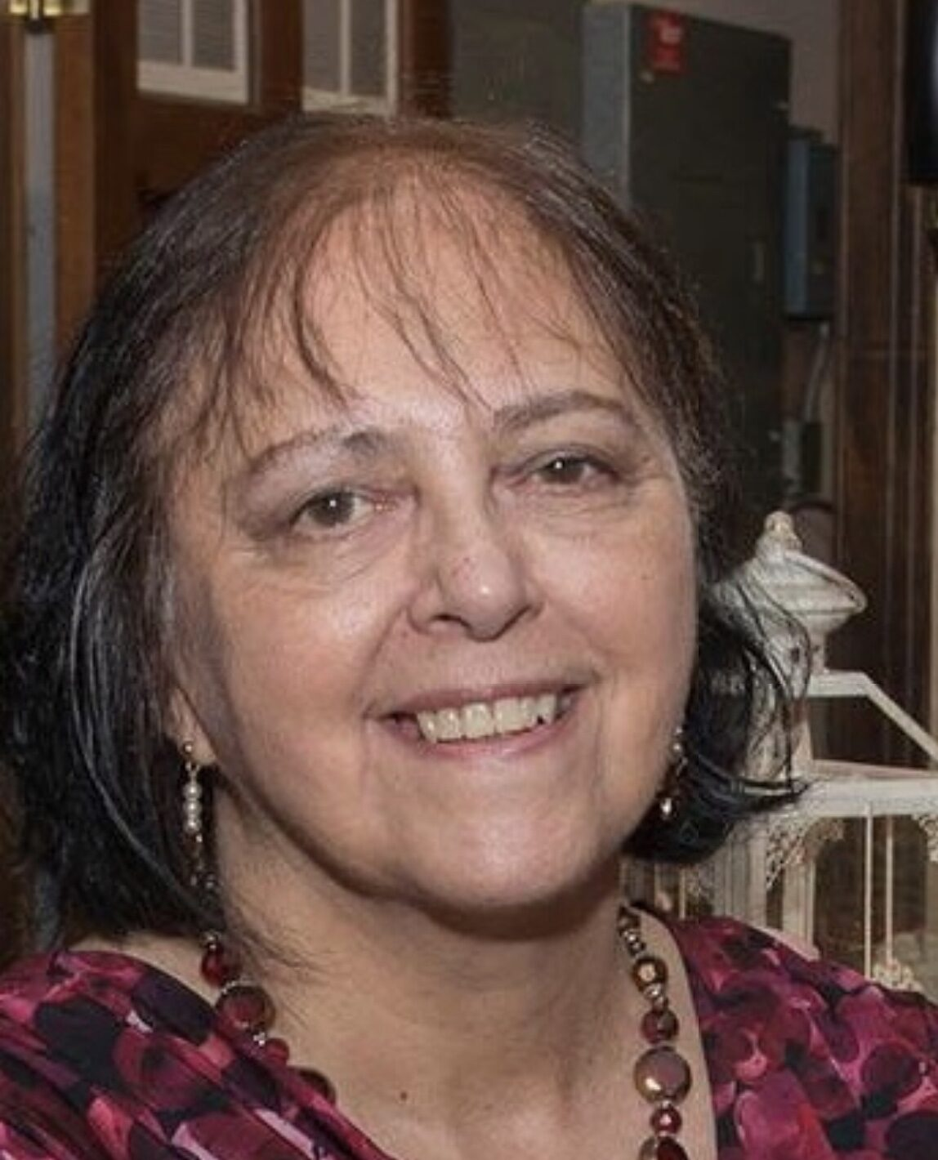
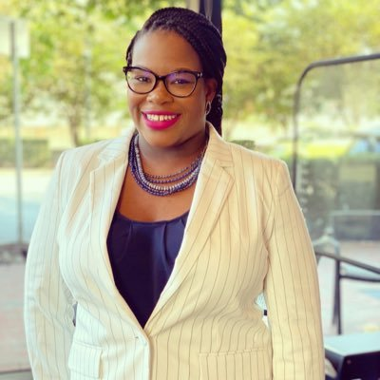
Success Stories Panelists
Toby Studley
President
SPS Consulting
Anglea Bradley
President
BTI Security
Carmen Larsen
President
Aquas, Inc.
Durecia Moorer
Managing Partner and Chief Marketing Officer
ABCD & Company

Slide 47
Hello!
I am Toby Studley
President
SPS Consulting
www.spsconsult.com

Slide 48
SPS Consulting
SPS specializes in Program Management, Management Consulting and Staffing Support for the contiguous United States. SPS headquarters has been located in Montgomery County, MD, since it was established in 1996.
SPS Consulting, LLC, can assist minority business’ by sharing some of our experiences that have resulted in winning valuable and important work to Montgomery County.

Slide 49
SPS Consulting: Tips for Success
1) Get involved in the Community
2) Attend Networking Events put on by the County
3) Get involved with Montgomery Chamber of Commerce and Montgomery County Economic Development Corporation.

Slide 50
SPS Consulting: How do you Network?
1) Have a really good “Elevator Pitch”
2) Be an excellent listener
3) Set up the next meeting for near future

Slide 51
Q&A

Slide 52
Hello!
I am Angela Bradley
President
BTI Security
www.btisecurity.com

Slide 53
BTI Security: Our Mission and Core Values
Be a trusted partner, providing responsive security solutions to our customers and community and encouraging growth through quality leadership.
✓ Provide Outstanding Service
✓ Be Responsible and Accountable
✓ Act with Integrity and Honesty
✓ Be Respectful and Professional

Slide 54
Q&A

Slide 55
Hello!
I am Carmen Larsen
President
Aquas, Inc.
www.aquasinc.com

Slide 56
Aquas, Inc.
We identify potential improvements in quality, cost and productivity, and help them define and put in place solutions, based on a customer’s stated needs for improvement or support. Established in 1990, located in Montgomery County.

Slide 57
Aquas, Inc.: Profile
• Based in Kensington, Maryland (Montgomery County) since 1990
• Received 3 contract awards as a prime contractor from Montgomery County
• Registered in the LSBRP program and in the MFD program
• Certified by the Maryland Department of Transportation in the MBE and DBE programs
• Certified by the US Small Business Administration as a Woman Owned Small Business

Slide 58
Aquas, Inc.: Types of Projects
Help an organization and its staff adapt to new computer systems and automation
Represent the customer’s interests in understanding and selecting software and systems
Audit computer systems and how they are used to ensure compliance with regulations
Design and build computer systems and database applications using Web, Internet, Cloud, Mobile
Conduct research, gather information from different sources, report on findings

Slide 59
Aquas, Inc.: 10 Things That Help Win Contracts
1. Register your business with the State Maryland Business Express and stay in good standing
2. Register in the County LSBRP program AND the MFD program
3. Look for and bid on opportunities in which you have experience and capacity
4. Look for opportunities to develop partnerships with other companies that complement you
5. Learn about the potential customer, do your homework, find out what they are about

Slide 60
Aquas, Inc.: 10 Things That Help Win Contracts (cont’d)
6. If there is a pre-proposal meeting, go to it and try to find out about your competition
7. Check the proposal site for Amendments, Questions and Answers, Date Changes
8. Make sure you fill out the required forms, and provide the required information
9. Pay attention to details and never assume that the proposal reader knows what you mean
10. If you do not win, ask for a meeting to understand your proposal’s strengths and weaknesses

Slide 61
Q&A

Slide 62
Hello!
I am Durecia Moorer
Managing Partner and CMO
ABCD & Company
www.abcdandcompany.com

Slide 63
ABCD & Company: Our Why
Our singular focus is cultivating relationships that touch lives and create a better world.
That’s why we intentionally turn every interaction into a stunning experience that leads to trust.
Marketing and events is what we do; a team of inspiring leaders is who we are.

Slide 64
ABCD & Company
The Core Four
Marketing and Advertising
Digital Solutions
Events
Creative Services

Slide 65
Q&A

Slide 66
Thank you for attending!

Slide 67
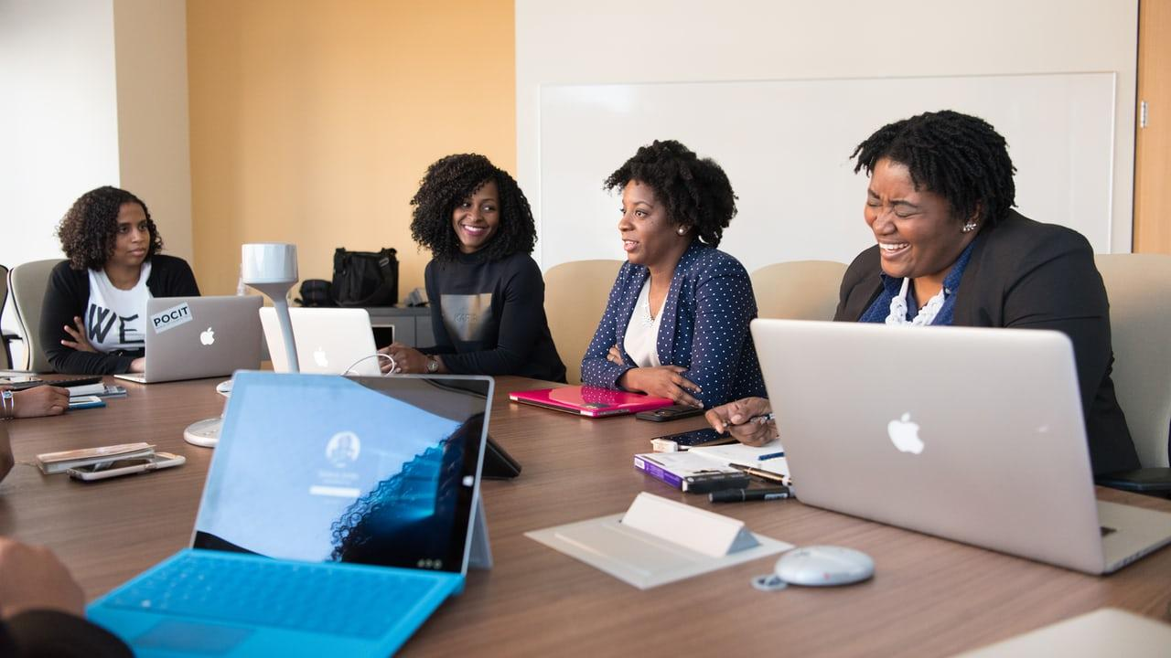
Tell us what you really think.
Please fill out our survey!

Slide 68
Credits
Presentation template by SlidesCarnival
Photographs by Unsplash

