Slide 1
Welcome!
Upper County Community Recreation Center Thursday, February 18, 2024 6:00 p.m.

Slide 2
AGENDA
Sports Advisory Committee
Upper County Community Recreation Center
8201 Emory Lane, Gaithersburg
Thursday, February 22, 2024 6:00 p.m.
6:00 p.m. Welcome and General Announcements - Tom Cove
6:05 p.m. Review and Approve Agenda
6:10 p.m. Review and Approve January Minutes
6:15 p.m. Team Building
6:30 p.m. Debriefing of Committee testimony at County Council
6:45 p.m. Montgomery Parks Report – Historical Use Briefing and Survey
7:00 p.m. Working Group Recommendation Proposals
7:45 p.m. Next Steps
7:50 p.m. Administrative Items:
Nominating Committee
Operating Budget Calendar
7:55 p.m. Action Items
Next Meeting: March 22 at TBD
SSRAC Ribbon Cutting – February 24, 10:00 am
8:00 p.m. Adjourn

Slide 3
Athletic Field Use Policy Review
Carl Weber, Athletic Field Planner
Notes:
Introduction-Carl Weber that Athletic Field Coordinator. I am the Project Manager for the Athletic Field Use Policy Review. I am coordinating the team that is working on this project.

Slide 4
What is the Athletic Field Use Policy
The Montgomery Parks Athletic Field Use Permit Policy is the document that establishes procedures for the use and reservation of Montgomery Parks athletic fields for practices, games, tournaments, and special events.
Policy Statement
The purpose of this policy is to establish an orderly and fair procedure for the reservation of athletic fields for practices, games, tournaments, and special events. It is the intent of this policy to balance the increase in demand for such organized uses with the maintenance, renovation, and rest necessary to protect the long-term playability of our fields and ensure user safety.
Notes:
If you have a question about athletic fields and permitting, this policy has the answer.
Who-Can Permit the fields and in what priority. What-fields can be permit. Where-all fields are in Montgomery County owned or in agreement with Montgomery Parks. When-Established dates and time from permitting for each field category. How-how user groups can reserve fields

Slide 5
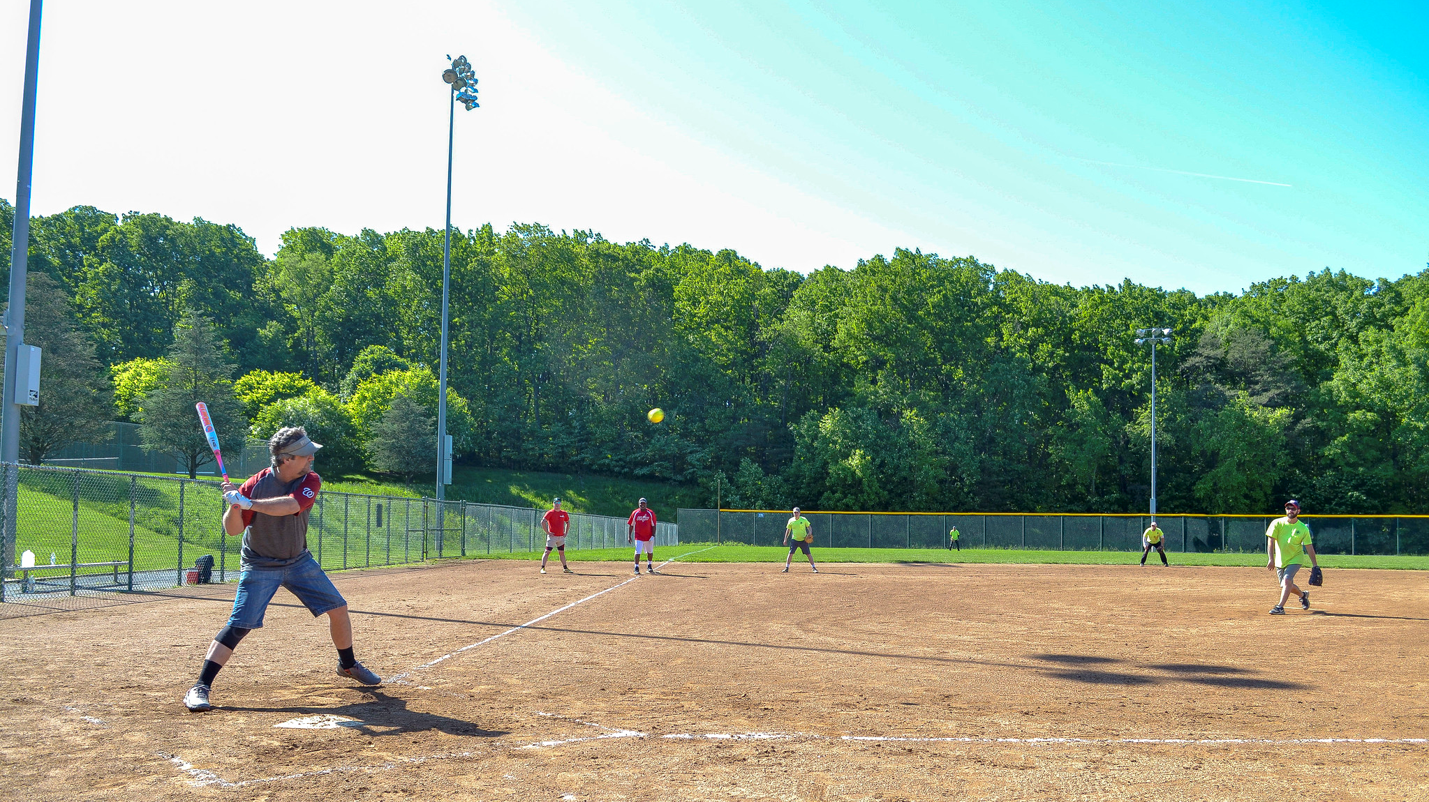
Why review & update the policy
The policy was last updated more than 10 years ago
Technology has changed
Field use and demand has changed
Field inventory and improvements have changed
Notes:
We believe there are some opportunities to make this policy better to align with the current needs and goals of Montgomery Parks, athletic field user groups, and the larger community.

Slide 15
Facilities Working Group

Slide 16
Case Study Proposal
A case study is an in depth investigation into a particular bounded unit or “case”.
For the purpose of the exploratory case study proposed the bounded unit will be an identified zip code within the county.
Steps in this process
Identify the case
Identify the data collection strategies and research questions
What can we do with case study findings?

Slide 17
Identify the case
A holistic single case is appropriate at this time because the 20901 zip code represents a case that is
Unusual - Montgomery Blair High School
Common - Long Branch Recreation Center; areas of both underserved and “well” served communities

Slide 18
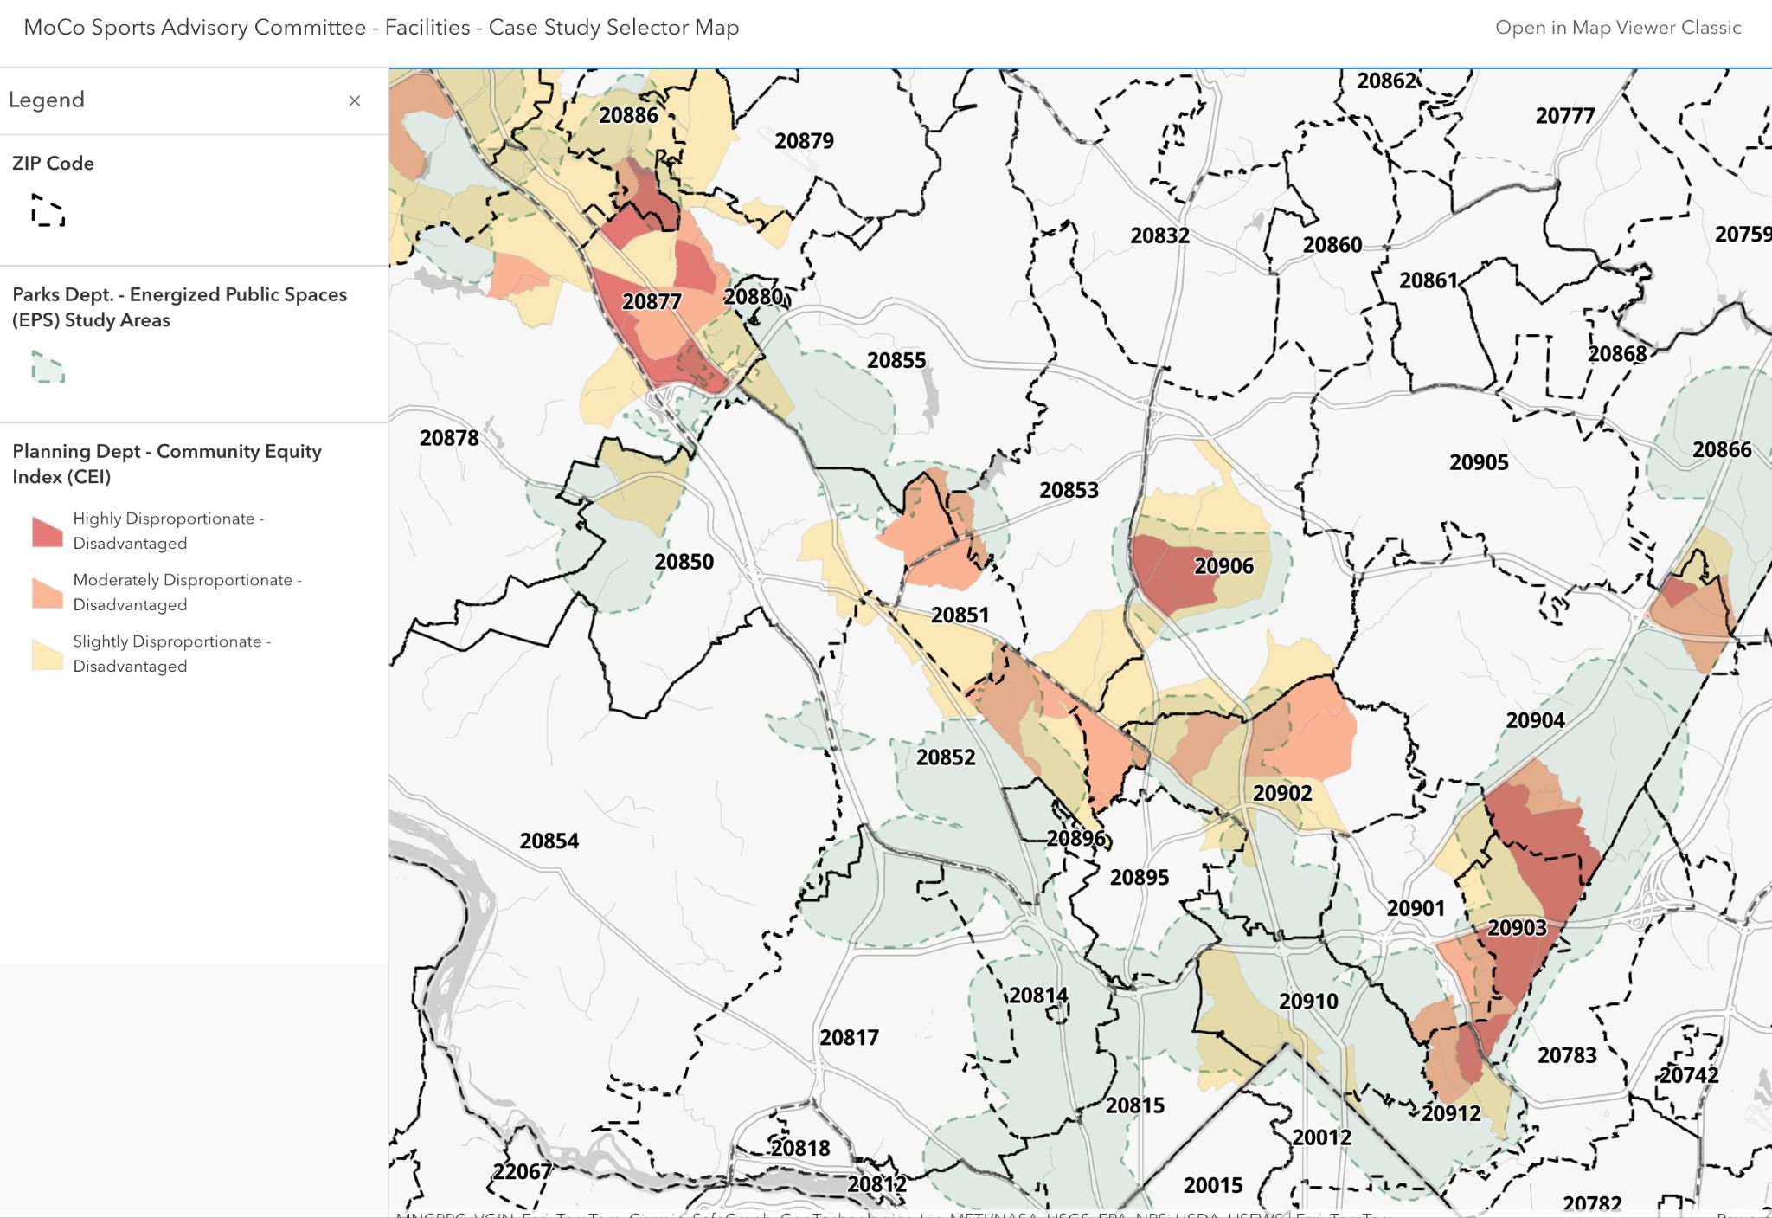

Slide 19
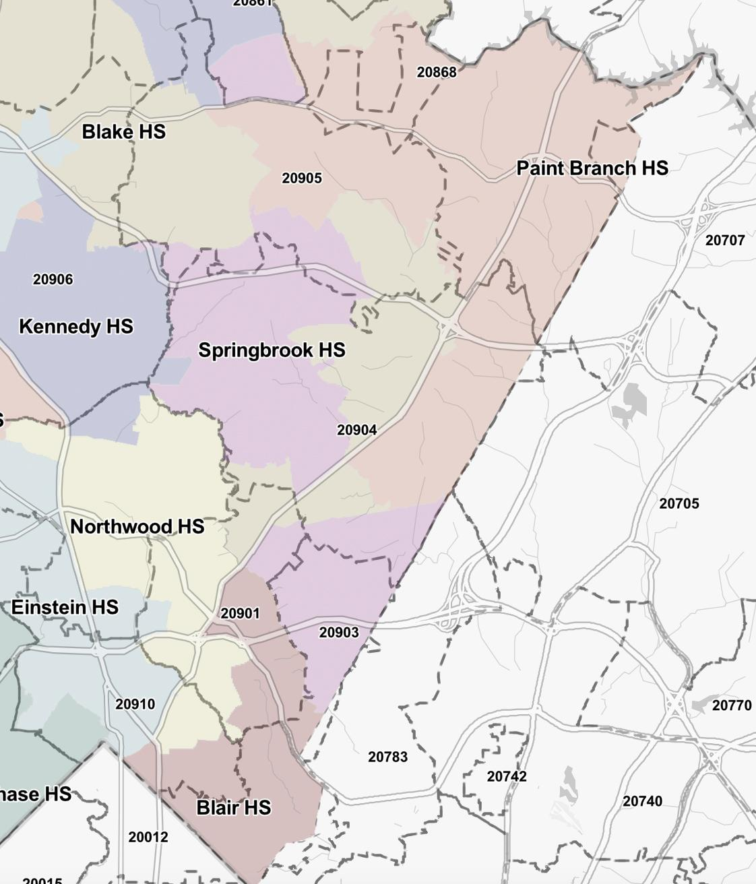

Slide 20
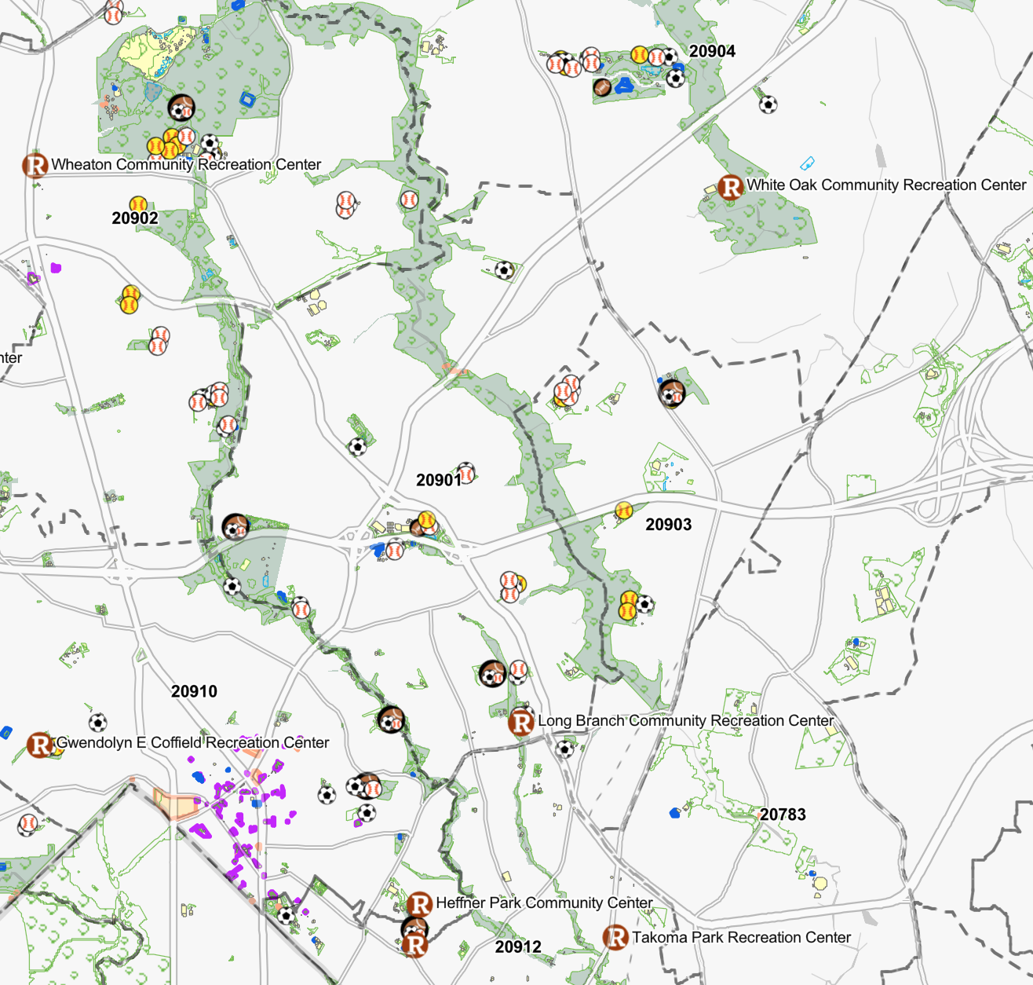

Slide 21
Research Questions
For an exploratory case study, the research question is broad intentionally.
What are the existing conditions of sport participation within the case?
What do we know about sport participation in this zip code? What don’t we know?
Who participates (and who doesn't)? How often? What sports? In what ways (informal, organized leagues)?
What are the specific barriers to participation within the case? (How do we know?)
What are the specific enablers and barriers to participation in this community?

Slide 22
Data Collection
Appropriate data collection strategies for case studies include:
Documentation
Comprehensive list of facilities and programs available/offered in this zip code
What rosters are smaller than the county average (e.g. girls varsity softball roster at Blair)
Population or census data
Archival records (of participation rates in this zip code)
Interviews
Community Members, including participants and non-participants
Community Leaders
School leaders and administrators
Existing sport program administrators including those managed by Rec, non profits,
and other entities
Direct observation
Physical artifacts

Slide 23
What might the findings show?
The findings from the case study will inform future research hypotheses or pilot programs. Case studies can help:
Explain a social phenomenon
Describe an intervention in a real world setting
Illustrate certain ideas or strategies in action
Enlighten or better understand the implications of a particular intervention ¹
1. Yin, R.K (2014). Case study research: Design and methods (5th). Sage

Slide 24
Next Steps
Work with Rec staff to develop an RFP
Work to identify the scope of the project, including identifying comparable projects completed in the county
May include existing data from OLO reports as part of a literature review
Request for Proposal (RFP) will help determine the total cost of this project and who will conduct the research
Likely that a third party will conduct the study

Slide 25
Participation Working Group

Slide 26
Programs Working Group

Slide 27
Programming Working Group
Draft Recommendations for 2024 Annual Report

Slide 28
Sports Programming Directory
Recommendation
The County Council should direct the Montgomery County Recreation to develop and advertise a publicly accessible directory that includes information on sports programs in Montgomery County offered by both public and private entities.
Background
To increase awareness of private entities that provide sports programming to Montgomery County residents, the County Council should develop a publicly available directory.
The directory would allow residents to learn about available sports programming offered by the county, municipalities within the county’s jurisdiction, and by private entities. It would also provide Montgomery County Recreation with information on where programs are offered as well as where they are not. The Sports Advisory Committee believes this information could help inform discussions about how to best target available county resources for sports programs, and could also be used to collaborate with private entities, as appropriate.

Slide 29
Sports Programming Directory (cont’d)
The directory should include contact information for each entity and also include information on whether they charge for their programs.
The directory should be dynamic and publicly available online via Montgomery County Recreation’s website (https://www.montgomerycountymd.gov/rec), Active Montgomery (https://web1.myvscloud.com/wbwsc/mdmontgomeryctywt.wsc/splash.html), or as a mobile app.
Montgomery County Recreation would need resources to develop, implement, and advertise the directory. This would include collecting, posting, and regularly updating information. This would also include identifying and targeting county residents through the marketing of the directory who may be in most need of increased access to youth sports programs.
To mitigate any concerns about which entities are listed, the directory could include a disclaimer, such as: "The directory includes information on organizations in Montgomery County that offer opportunities to participate in sports. These are private entities and operate independently from the county. The following directory is provided as a public service for county residents."

Slide 30
Sports Programming Directory (cont’d)
Montgomery County Public Schools and Community Use of Public Facilities currently collect information on entities that apply for a facilities permit which could be used for the directory, such as their name, phone number, email, and reservation purpose. An opt-out option could be offered to apply for and receive permit for facilities use.
Examples of jurisdictions with sports program directory are listed here:
https://www.fairfaxcounty.gov/neighborhood-community-services/athletics/sports-directory
https://www.somdathleticalliance.org/somd-sports-directory
https://www.pwcva.gov/department/sports-leagues
https://www.charlescountyparks.com/recreation/sports

Slide 31
Sports Programming Directory (cont’d)
Measures
If approved, launch online directory within 6 months (output)
Track visits of and time spent on the directory pages (output)
Ask listed organizations to canvas new clients about awareness of the directory (output)
Develop qualitative questions on usefulness and other feedback and implement in a short online (pop-up) survey or other existing survey (outcome)

Slide 32
Recognition Working Group

Slide 33
Recognition Group Updates
Unsung heroes
Document outlining recommendations and considerations
Program overview
Recommended list of awards
Sample selection criteria
Selection committee recommendations
Nomination & selection process
Recognition event
Budget considerations
Sample Nomination Form
Next Steps
Connect with Recreation Department to discuss recommendations
What’s realistic? Barriers? Considerations?
Update Recommendations and Considerations document for SAC review
Finalize scope / phased approach (e.g., “beyond county” - do we recognize private school conference champions?)

Slide 34
Recommendation
The Recognition Group recommends the initiation of annual "Unsung Heroes Awards" to recognize individuals or groups who have made significant, yet under-unrecognized, contributions to the development and growth of sports programming within and throughout Montgomery County, especially where opportunities are lacking for residents to play and compete together.
We recommend that the recipients of these awards be honored at the annual Montgomery County Sports Hall of Fame Induction Ceremony.

Slide 35
Administrative Items
Nominating Committee
Next Meeting: Thursday, March 22, 6:00 p.m.
SSRAC Ribbon Cutting: Saturday, February 24, 10 a.m.

