Slide 1
Montgomery Parks Budget Overview
Nancy Steen, Budget Manager (Operating Budget) Montgomery County Department of Parks

Slide 2
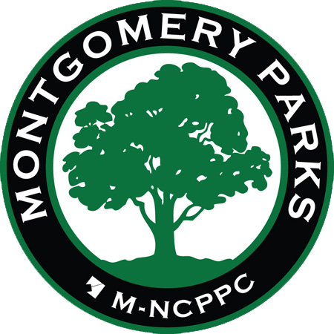
Montgomery Parks is part of the Maryland-National Capital Park & Planning Commission, a bi-county agency chartered by the State of Maryland in 1927 to acquire, develop, maintain and administer a regional system of parks and to provide community development and land use planning.
Mission Statement – Montgomery Parks
Protect and interpret our valuable natural and cultural resources; balance the demand for recreation with the need for conservation; offer a variety of enjoyable recreational activities that encourage healthy lifestyles; and provide clean, safe and accessible places for leisure-time activities.

Slide 3
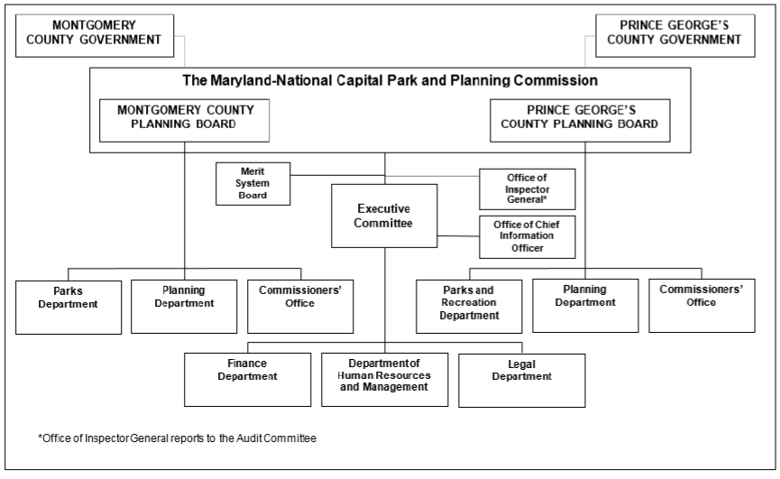
M-NCPPC Organizational Structure

Slide 5
Montgomery County Budget
Parks’ budget status in terms of the County budget.
Park and Planning – dedicated tax on property tax bill which is incorporated into County budget.
Council adjusts Parks tax rate to increase or reduce taxes for citizens, or to free up room to increase county tax rate.
Our budget is in direct competition with all other departments and agencies.
County’s budget must be balanced. No deficit spending.

Slide 6
Budget Components
Revenues
Property Taxes
Fees and Charges
Grants
Interest Income
Transfers/Subsidies
Reserves
Expenditures
Personnel Compensation Fringe Benefits
Operating Expenses Supplies & Materials Services & Charges
Debt Service
Grants
Capital Equipment
Chargebacks

Slide 7
FY23 OPERATING BUDGET
TAX SUPPORTED FUND
Park Fund - $124,446,478
NON-TAX SUPPORTED FUNDS
Property Management -$1,737,800
Enterprise Fund - $10,613,078
Special Revenue Fund -$3,177,222

Slide 8
FY24 PROPOSED OPERATING BUDGET
TAX SUPPORTED FUND
Park Fund - $134,266,824 - an increase of $9,820,346
NON-TAX SUPPORTED FUNDS
Property Management - $1,757,600 – an increase of $19,800
Enterprise Fund - $10,833,205 – an increase of $220,127
Special Revenue Fund - $3,598,590 - an increase of $421,101

Slide 9
FY24 Budget – Next Steps – County Council Discussion/Review
Montgomery County FY 24 Park Fund Budget
 | $$ | % Change
FY23 Adopted Budget (excluding grants, CIP debt service transfer, and CIP transfer) | 117,024,459
Compensation Adjustments (salary, retirement, benefits, merit/COLA marker, OPEB) | 5,599,725 | 4.8%
Known Operating Commitments Excl Compensation | 2,202,327 | 1.9%
WQPF Mandate | 241,183 | 0.2%
Program Enhancements | 1,184,068 | 1.0%
FY 24 Requested Budget (excluding grants, CIP debt service transfer, and CIP transfer) | 126,251,762 | 7.9%
County Executive's Recommended Budget | 121,940,777
Increase Amount above the FY23 budget included in the CE Recommended Total for FY 24 | 4,916,318 | 4.2%
Pro rata adjustments County-wide M-NCPPC | 380,268
Revised Recommended Budget Amount After M-NCPPC Pro-Rata Adjustment | 4,536,050
Reduction Amount from FY24 Proposed Needed to Meet CE Recommendation | 4,691,253 | 3.9%

Slide 10
Budget Time Line
Date | Action
July-Nov | Staff develops proposed budget
Mid-Nov | Planning Board approves proposed budget
December | Commission approves proposed budget
January 15 | M-NCPPC submits proposed budget to County Executive
Jan – Mar | Co. Exec. makes budget recommendation County Council
April | Council holds public hearings to review budget
April – May | County Council review budget
May | Mont Co and Prince George Co Councils meet for bi-county budget discussions
May | County Council adopts budget

Slide 11
Questions

