Slide 1

Welcome!
Nancy H. Dacek N. Potomac Community Recreation Center
Thursday, April 17, 2025
6:00 p.m.

Slide 2
AGENDA
N. Potomac Community Recreation Center • Thursday, April 17, 2025
6:00 p.m. Welcome and General Announcements
6:05 p.m. Review and Approve Agenda
6:08 p.m. Review and Approve March Minutes
6:10 p.m. Working Group Discussions
  Advocacy: Ben, Jay, Tom, Tony, Steve (ex-officio)
  Community Engagement: Samantha, Princess, Amy, Joe, Rick
  Operations: Tina, Mary Kate, Christopher
  Recognition: David, Trish, Princess, Steve (ex-officio)
  Communications: Mary Kate, Christopher
7:00 p.m. Follow up on presentations from Collaboration Council and MCPS Athletics
7:35 p.m. Sports Programming Directory
7:50 p.m. New Business
8:00 p.m. Adjourn

Slide 3
Working Group Discussions
Advocacy: Ben, Jay, Tom, Tony, Steve (ex-officio)
Community Engagement: Samantha, Princess, Amy, Joe, Rick
Operations: Tina, Mary Kate, Christopher
Recognition: David, Trish, Princess, Steve (ex-officio)
Communications: Mary Kate, Christopher

Slide 4
SAC Nominations Process
April 17, 2025

Slide 5
Committee voting membership: Quick refresh
17 voting members
Moving forward, all will serve 3-year terms and for no more than 2 consecutive terms
This spring—terms end for original 2-year appointees:
Ben • Doug S. • Joe • Mary Kate • Tina • Tony K.
Next spring—terms end for original 3-year appointees:
Amy • Christopher • Sam • Tom • Trish • and one appointment to complete an initial 3-year term • Jay

Slide 6
What does the Nominating Committee do?
Operations Working Group conducts a call for the Nominating Committee, which will then:
  Review and amend vacancy post as needed
  Review returning members’ applications (no interview required)
  Review and score new applications
  Interview new applicants
  Discuss and recommend applicants
  Save all documentation
  Update full committee at monthly meetings

Slide 7
What’s the role of the County?
SAC staff liaison/BCC liaison works with the Nominating Committee and county staff to:
  Review, revise, and post vacancy announcement
  Review, interview, and support selection process (schedule interviews, etc.)
  Draft recommendation memo for county exec
County Exec staff/County Exec/County Council:
  Post vacancy announcement
  Vet applicants and transmit applications to staff liaison
  Approve, notify, and confirm appointees

Slide 8
PHASE 1/5:
Launch Nominating Committee
>
NOVEMBER: Operations Working Group puts out call for members:
  At least 3 SAC members needed for committee:
  each applicant interview needs 2 members,
  so 3+ means people don’t have to attend every interview
  Ideally those with most time left in their term
  SAC Chair should not participate
  Members up for re-appointment are not eligible to serve
DECEMBER: Full SAC votes on Nominating Committee members

Slide 9
PHASE 2/5:
Solicit applications
>
DECEMBER–JANUARY: Staff Liaison and County Exec Staff develop, review and post the vacancy notice
JANUARY–FEBRUARY: County Exec Staff send applications to liaison/committee

Slide 10
PHASE 3/5:
Review applications
>
FEBRUARY–MARCH: Nominating Committee reviews applications:
  Review and score applications using rubric
  Review returning members
  Select applicants to interview

Slide 11
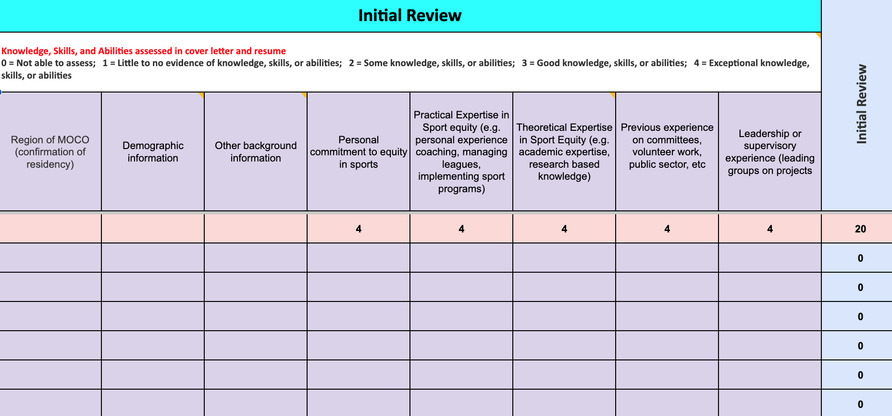

Slide 12
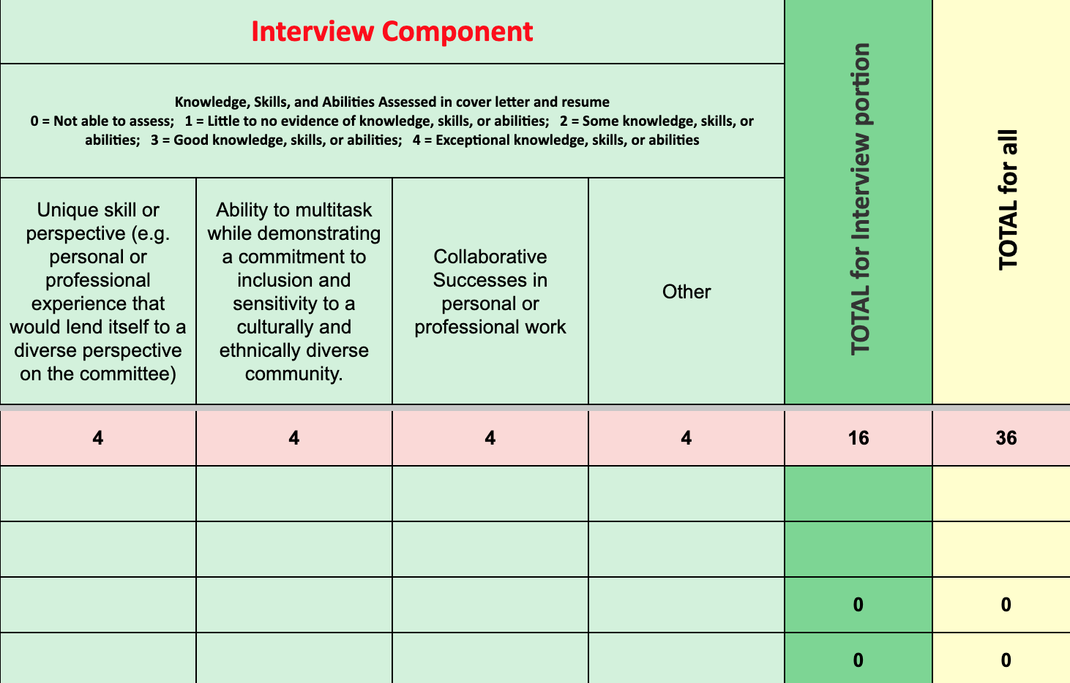

Slide 13
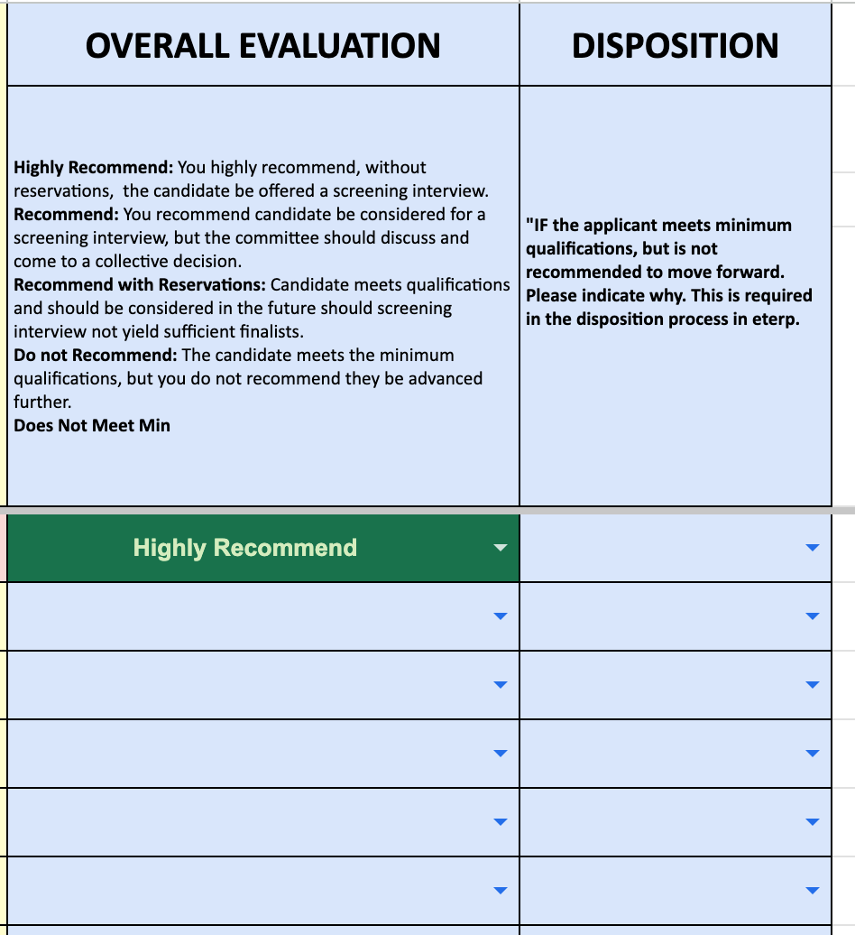

Slide 14
PHASE 4/5:
Interviews and final selection
>
MARCH: Nominating Committee and staff liaison interview candidates
Nominating Committee discusses and selects candidates
MARCH–APRIL: Staff liaison prepares and sends recommendation memo to BCC for County Exec to review and approve

Slide 15
PHASE 5/5:
Final approvals
>
APRIL+: County Executive reviews and approves recommendations and signs appointment letters
County Executive Staff/BCC: Sends letters to appointees and non-select applicants
County Executive Staff and County Council:
BCC sends recommendations to the County Council for final confirmation

