Slide 1
Welcome!
Ross Boddy Neighborhood Recreation Center
Thursday, October 19, 2023 6:00 p.m.

Slide 2
AGENDA
Sports Advisory Committee
Ross Boddy Neighborhood Recreation Center - Thursday, October 19, 2023
6:00 p.m. Welcome and General Announcements - Tom Cove
6:05 p.m. Review and Approve Agenda
6:10 p.m. Review and Approve September Minutes
6:15 p.m. Field permitting presentation and Q&A (CUPF, Parks, City of Gaithersburg)
6:45 p.m. Reports from Ad Hoc Working Groups
7:45 p.m. New Business - Committee Discussion of Presentations
7:55 p.m. Action Items
Working Group Deliverables for Next Meeting
Next Meetings: November 16, December 14, January 18
2024 Meeting Dates
8:00 p.m. Adjourn

Slide 3
Permitting of Facilities
CUPF
Montgomery Parks
City of Gaithersburg
Q & A

Slide 5
High Volume Use
CUPF offers advanced priority placement for groups considered as high volume based upon specified criterion in each category below, due to the volume of residents impacted, and size and scope of the activities. These are uses not suited for online reservations and therefore require oversight by CUPF staff. For CUPF to offer this level of service, large/ high volume user groups must adhere to established guidelines so that CUPF may ensure a high level of accountability and provide the highest level of customer service to all user groups.
Administrative fee: The use described herein is considered by CUPF as an advanced priority placement reservation. Each advanced priority placement contract containing reservations issued is subject to a $50.00 administrative fee.
Payment plan: A payment plan may be requested for advanced priority placement contracts.
Additional reservation needs: A group receiving advanced priority placement is eligible to request any additional space they need outside of these parameters as ‘General Public’ requests via ActiveMONTGOMERY (see details herein for ‘General Public’ reservation process).
Representative: High volume priority designation requires each group to provide CUPF a single point of contact for their scheduling needs, to ensure user accountability and clear communication between all parties.

Slide 6
Requirements: In each category below, there are specific criterion in which a group must meet in order to be considered for of advanced priority placement.
Weekly Weekend Cultural and Religious Educational Use
Weekly Weekend Cultural and Religious Assembly Use
Summer Camp Use *County and municipal recreation departments, licensed childcare providers with a current agreement with MCPS or in-County parent-teacher associations.”
Large Events

Slide 7
Indoor and Outdoor Sports League and Athletic Sports Club Use
The term “Sports League and Athletic Sports Club” is defined for CUPF purposes as:
a group of sports teams that may be members of different sports clubs that compete against each other in a schedule of games, or an athletic sports club for the purpose of playing one or more sports, and
intends to utilize sports facilities appropriate for their specific sport(s) including fields, tracks, tennis courts, and or gymnasiums, and
generally, are seasonal or operate year-round, and
may host or organize leagues and other competitive events such as track meets, tournaments, club vs. club competitions, etc., and
may be affiliated with or has a membership within a national or local sports association or similar organization, and
does not include after-school enrichment programs, and
does not include pickup games, a single team, groups of independent players not part of a team, etc.

Slide 8
Additional information: Current season team rosters, and corresponding game schedules, must be available for CUPF to review within thirty calendar days of the start of each scheduling season in order to justify the number of practice hours, should such be necessary. Rosters should be site specific and organized by team with applicable number of team members based upon the sport in which the reservations were issued. Further, rosters should indicate each participant’s name, address, and phone.
How to reserve:
• Existing leagues and clubs will receive an email before each season stating that we will begin processing historical use reservations based upon last year, same season use. CUPF will create a contract of reservations for each site showing dates and times. CUPF will send all use in a spreadsheet for review and ability to sort reservations. Leagues and clubs will be provided a deadline to submit any discrepancies and confirm acceptance of reservations.
• NEW leagues and clubs must submit a Priority, High Volume and Other Bulk Use Request Form for consideration.
For more information on the process to reserve space within this advanced priority placement,
send an email to: cupf@montgomerycountymd.gov.

Slide 10
City of Gaithersburg Field Permitting

Slide 11
City Inventory:
Lakelands Park:
Turf rectangle (full size soccer)
2 little league baseball fields
Small aux fields (no lights)
Robertson Park:
Large grass open space
Turf rectangle (240 x 138)
Morris Park:
2 adult softball fields
Kelley Park:
2 90 ft baseball fields
Turf rectangle (205 x 130, no lights)
Activity Center:
2 basketball courts
Other:
8 outdoor basketball courts
12 tennis courts / 19 pickleball overlays

Slide 12
Application Process
Spring: April 1 through June
Applications accepted January 15 – February 15
Summer: July through August
Applications accepted March 15 – April 15
Fall: September through November
Applications accepted June 15 – July 15
Winter: December through March
Applications accepted (for turf only) October 15 – November 15

Slide 13
Priorities:
MCPS Programs / City Programs
Gaithersburg Organizations (non-profits)
Historic usage (non-profits)
Gaithersburg Residents
All other requests
“Historic” meaning: Proven history of meeting our application requirements. Could be:
501c3 status
Updated COI
Resident versus non resident percentage
Proven use of field needs/cancellations
Rosters provided
Proven payment history

Slide 14
Field Rates:
Fees: | Res – NC | Res – Com | Non Res – NC | Non Res – Com | Hours x Cost = Total
Admin Fee (x1): □ | $20 | $30 | $25 | $40 | 1 X ______ = _____
Field Fee (per hour): Grass Field Fee □ Criswell BB Field □ Lakelands Turf □ Robertson Turf □ Kelley Turf □ | $15 $20 $100 $60 $50 | $15 $30 $160 $95 $80 | $20 $40 $120 $70 $60 | $20 $60 $185 $110 $90 | _____ X _____ = _____
Field Staff (per hour) □ | $20 | $20 | $25 | $25 | _____ X _____ = _____
Lights (per hour): Criswell BB Field □ Robertson Turf □ All Others □ *Kelley Turf has no lights yet | $50 $25 $37 | $50 $25 $37 | $50 $25 $37 | $50 $25 $37 | _____ X _____ = _____

Slide 15
Gym Rates:

Slide 16
Ad Hoc Working Groups
Facilities
Participation
Programs
Recognition

Slide 17
Facilities
Mary Kate Crawford, Chair
Ricardo James
Doug Schuessler
Christopher Wajda

Slide 18
Facilities Working Group (Review from Sept. mtg)
Vision: Indoor and outdoor facilities in the county are easily accessible and available to all levels of skill and commitment level for a variety of sports. Facilities are well-maintained, durable, and serve as welcoming gathering spaces for communities. They serve the cultural needs of the communities and promote health and well-being across demographics.
Underserved Defined:
casual/novice/beginner participants do not have the same access to sport facilities (quality of facility, proximity of facilities to home, availability of conveniently located facilities).
Further, some geographic locations and the communities within them have access to fewer facilities, both as a result of proximity and as a result of existing processes and policies (e.g. historial use permitting)
“Communities of Concern”

Slide 19
Feedback Received & Considerations
Exploration of large indoor track complex similar to PG County. This could serve as a revenue generator for the County and reduce the need to travel outside the County for some activities (indoor track, high school graduations)
Workgroup Considerations:
Initial Costs (funding from FedEx Field contract)
Revenue (about $1million a year)
Tool for Equity (could support the community in which it’s located, but issues of transportation, among others, would persist)
Further investigation and conversation regarding Adopt-a-field program and Parks-owned fields at Blair High School
Workgroup Considerations
Adopt-a-field - field maintenance is a roadblock; program/agreement updates could be beneficial to expansion
Parks is planning to improve/renovate 16 more elementary and middle school fields over the next few years

Slide 20
Additional Conversation/Considerations
Met with Carl Weber (Parks) to discuss adopt a field program, plans, perspectives, etc.
Utilization of Moco Fields
Lighting vs no lights
About 700 hours/year difference
Grass vs Synthetic Fields
About 1000 hours/year difference
Natural grass fields
Not permitted Dec 1-Mar 15
Rain, recovery, etc

Slide 21
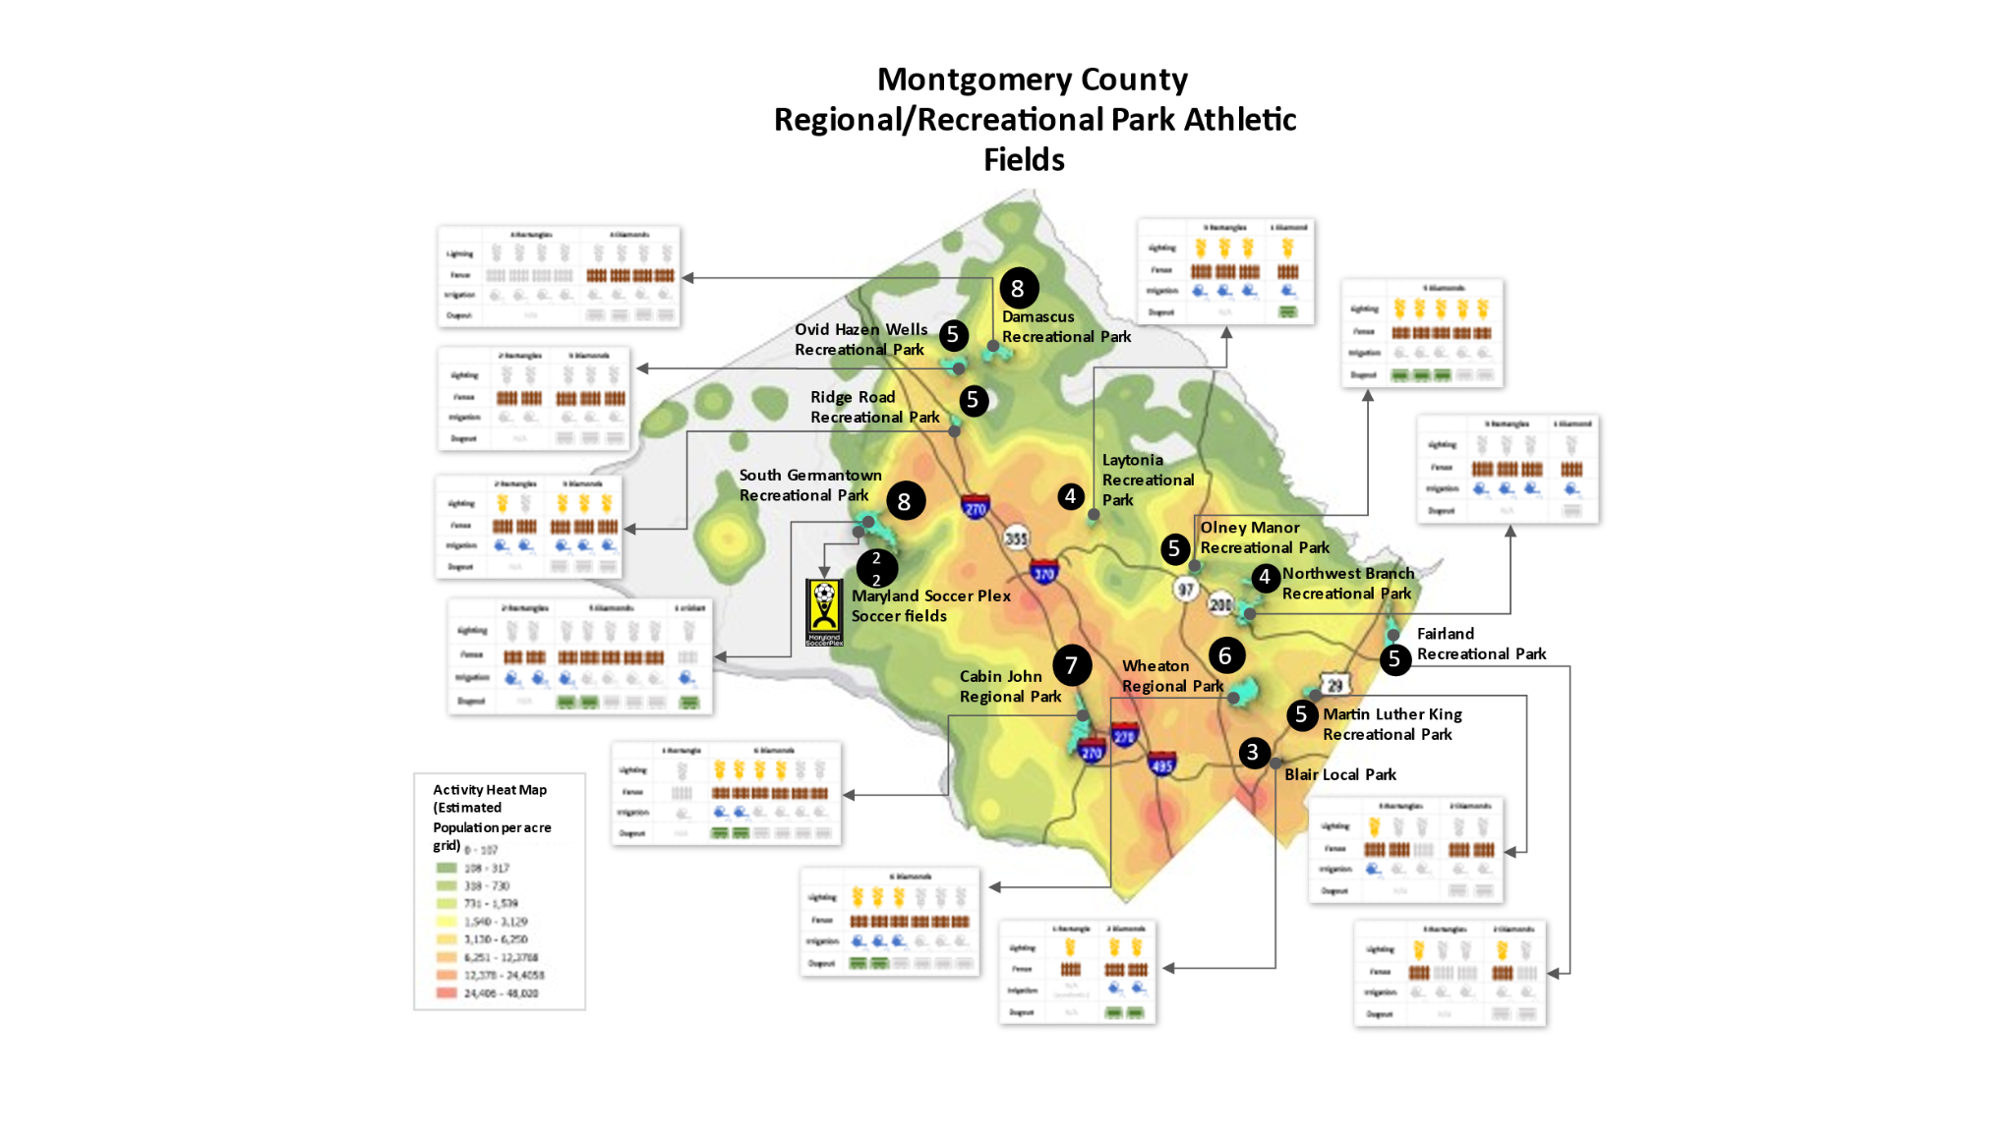

Slide 22
What’s next for us to consider?
How can we/the County align MCPS And CUPF inventory in order to increase equity/accessibility?
How can we/the County increase permitting at school fields (this may require making fields more inviting to users)?
How can we/the County make parks hubs of physical activity and social connection?
Make Space for Girls
OLO Study on Artificial Turf Fields
Case Study Proposal

Slide 23
Case Study Proposal
Option 1: Identify a ‘Community of Concern’ and make recommendations for facility, program, and participation changes that would increase equity in sport participation for the community
Option 2: Identify a specific community (e.g. Julius West Middle School or Blair High School) and investigate the implications of such partnerships (adopt a field or moco parks maintained) as a potential for other communities to emulate
Option 3: Investigate public-private partnerships such as Discovery Zone in Germantown and explore the impact of that facility on sport equity in the surrounding community. Explore as a potential for similar partnerships as a solution (e.g. Marriott, Lockheed Martin)

Slide 24
Participation
Doug Remer, Chair
Tom Cove
Samantha Griffin
Max Levitt
Amy Lopez

Slide 25
Programs
Tony Korson, Chair
Joe Hooks
Dustin Jeter
Tina Won Sherman

Slide 26
Recognition
David Schardt, Chair
Princess Clemente
Ben Corb
Trish Heffelfinger

Slide 28
Action Items
Working Group Deliverables for Next Meeting
Next Meetings: November 16, December 14, January 18
2024 Meeting Dates

