Slide 1
Welcome!
Potomac Community Recreation Center Thursday, November 16, 2023 6:00 p.m.

Slide 2
AGENDA
Sports Advisory Committee
Potomac Community Recreation Center, 11315 Falls Road, Potomac
Thursday, November 16, 2023
6:00 p.m. Welcome and General Announcements - Tom Cove
6:05 p.m. Review and Approve Agenda
6:10 p.m. Review and Approve October Minutes
6:15 p.m. Montgomery County Recreation Presentation and Discussion
Carmen Berrios Martinez, Manager, Communications and Public Outreach
7:15 p.m. Reports from Ad Hoc Working Groups (Recognition, Facilities)
7:50 p.m. New Business - Committee Discussion of Presentations and Working Group Deliverables for Next Meeting
7:55 p.m. Action Items
Next Meetings: December 14, January 18
2024 Meeting Dates
8:00 p.m. Adjourn

Slide 3
Carmen Berrios Martinez
Manager, Communications and Public Outreach

Slide 5
Ad Hoc Working Groups
Participation
Programs
Facilities
Recognition

Slide 6
Recognition
David Schardt, Chair
Princess Clemente
Ben Corb
Trish Heffelfinger

Slide 10
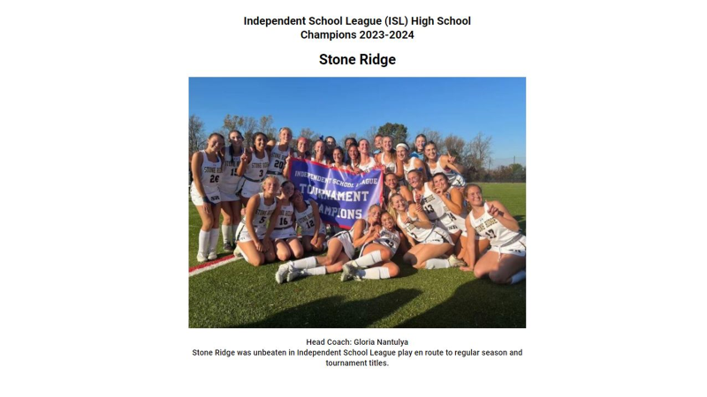

Slide 13
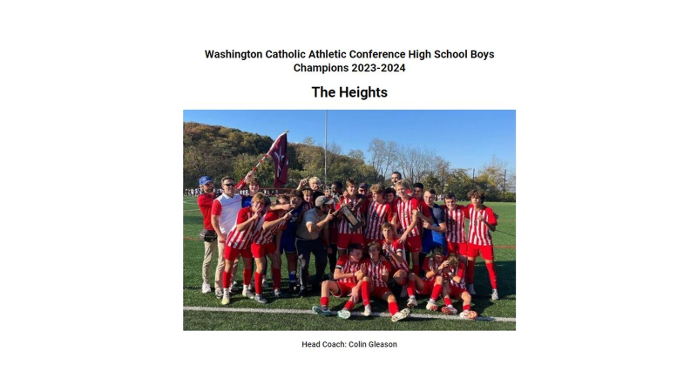

Slide 15
Facilities
Mary Kate Crawford, Chair
Ricardo James
Doug Schuessler
Christopher Wajda

Slide 19
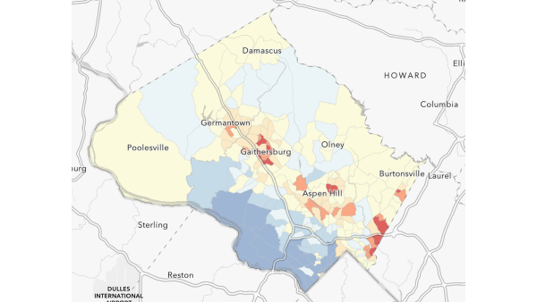

Slide 20
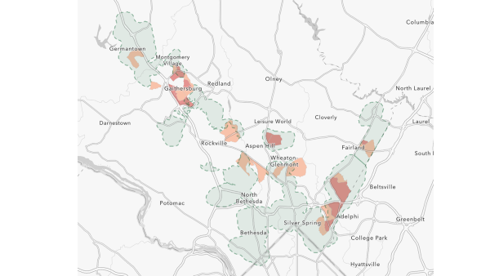

Slide 21
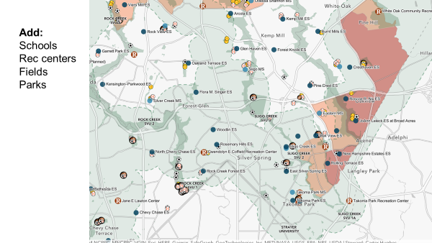

Slide 22
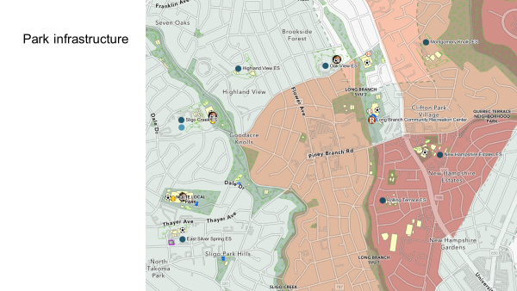

Slide 23
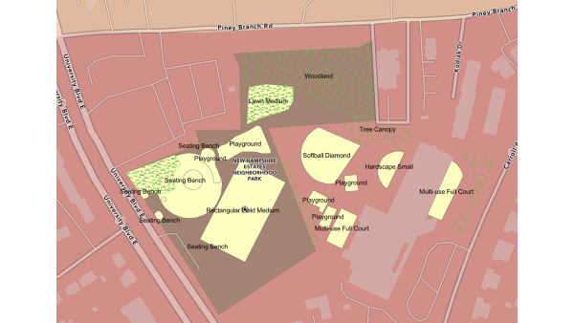

Slide 25
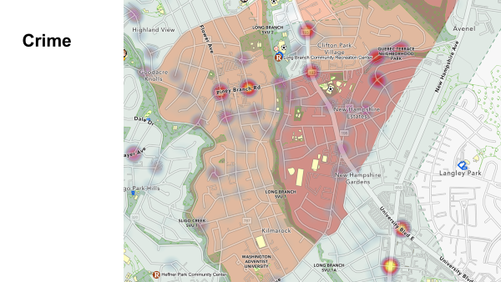

Slide 26
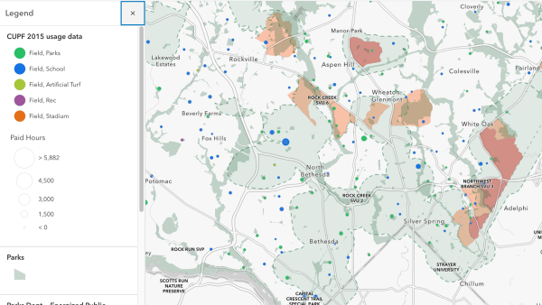

Slide 27
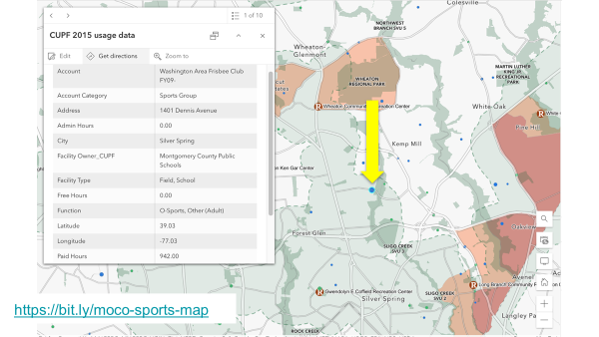

Slide 28
Action Items
Meeting Times

