Slide 1
Welcome!
White Oak Community Recreation Center Thursday, January 18, 2024 6:00 p.m.

Slide 2
AGENDA
Sports Advisory Committee
White Oak Community Recreation Center
1700 April Ln, Silver Spring
Thursday, January 18, 2024 6:00 p.m.
6:00 p.m. Welcome and General Announcements - Tom Cove
6:05 p.m. Review and Approve Agenda
6:10 p.m. Review and Approve December Minutes
6:15 p.m. Working Group Recommendation Proposals (15 min/group)
7:15 p.m. Opportunities for Committee Action
7:45 p.m. Administrative Items:
Annual Report Update
Attendance Policy
Committee Member Nomination Calendar
Nominating Committee
One-year appointments
Officer Election Calendar
7:55 p.m. Action Items
Next Meeting: February 15 at TBD
SSRAC Ribbon Cutting – February 24, 10:00 am
8:00 p.m. Adjourn

Slide 3
Facilities Working Group

Slide 4
Case Study Proposal
A case study is an in depth investigation into a particular bounded unit or “case”.
For the purpose of the exploratory case study proposed the bounded unit will be an identified zip code within the county.
Steps in this process
Identify the case
Identify the data collection strategies and research questions
What can we do with case study findings?

Slide 5
Identify the case
A holistic single case is appropriate at this time because the 20901 zip code represents a case that is
Unusual - Montgomery Blair High School
Common - Long Branch Recreation Center; areas of both underserved and “well” served communities

Slide 6
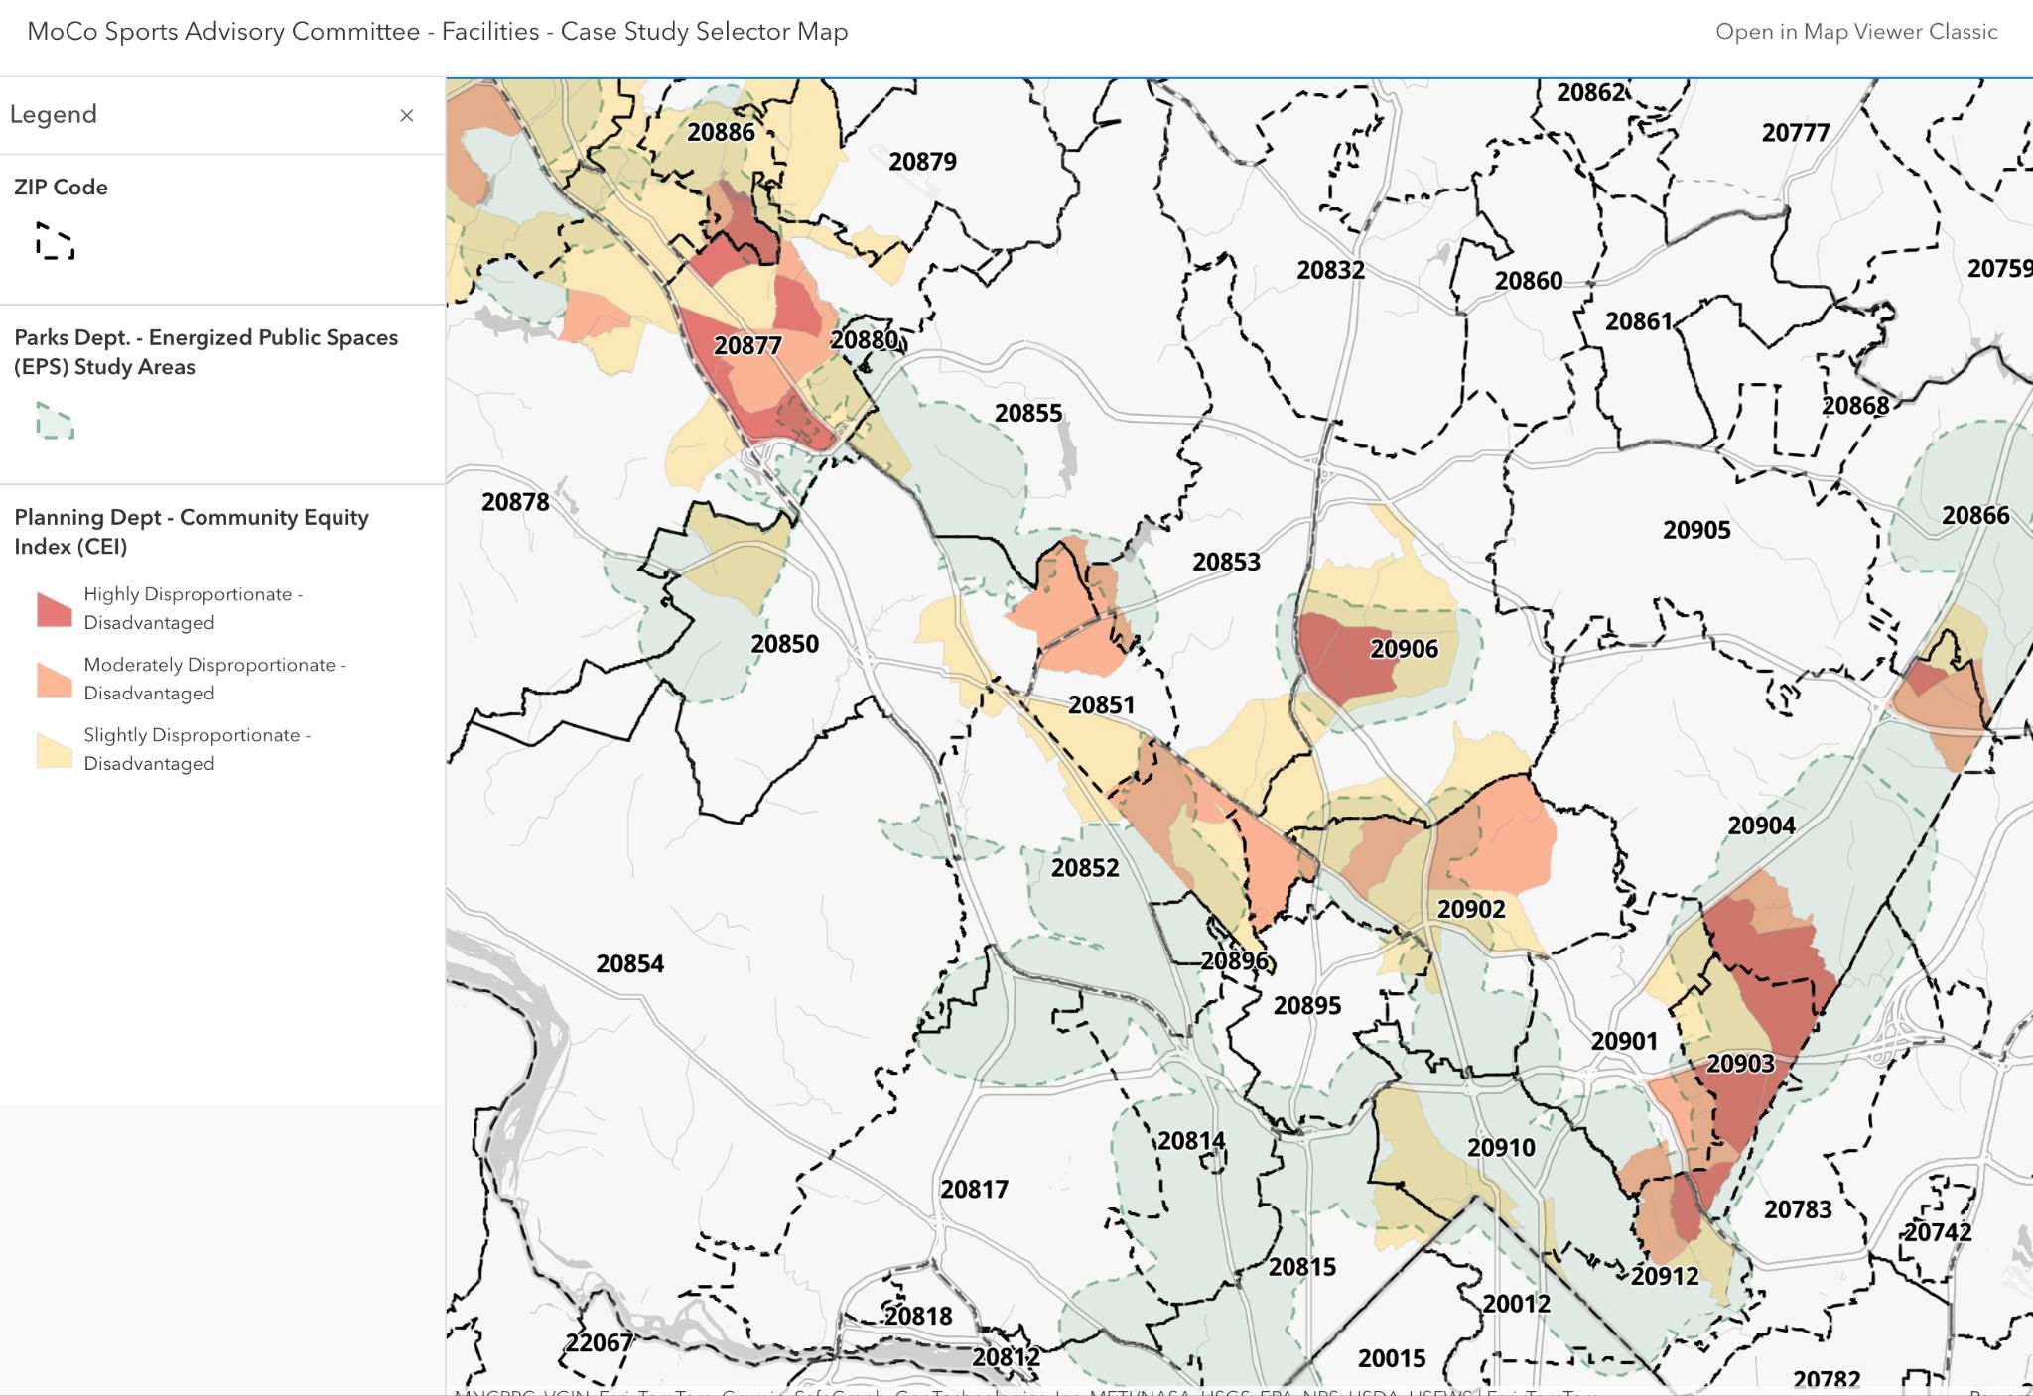

Slide 7
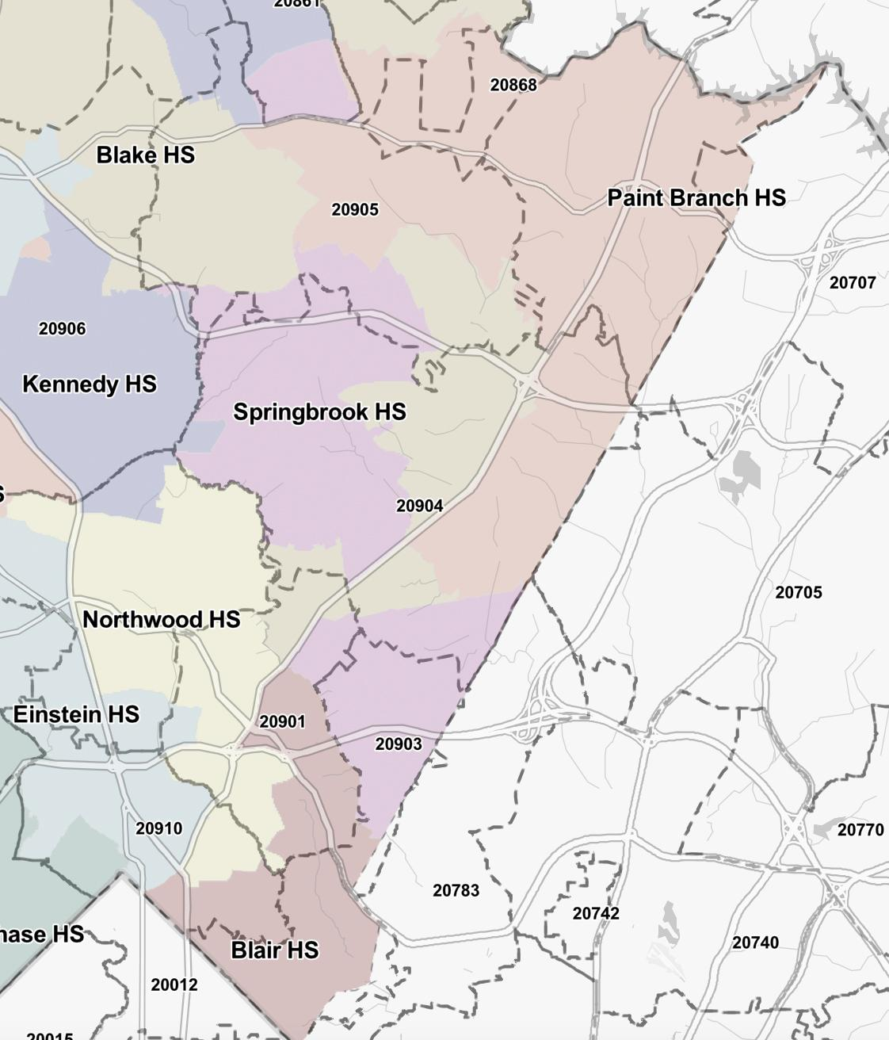

Slide 8
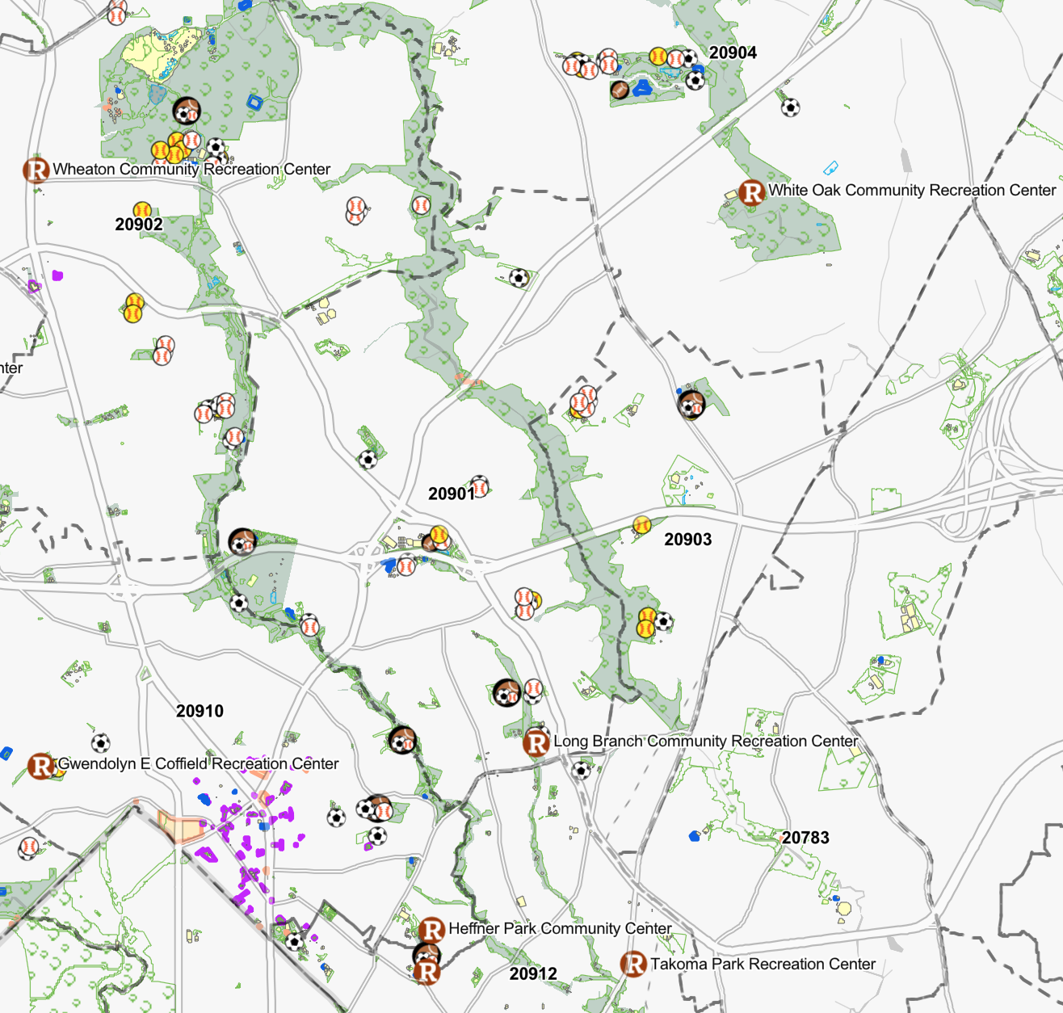

Slide 9
Research Questions
For an exploratory case study, the research question is broad intentionally.
What are the existing conditions of sport participation within the case?
What do we know about sport participation in this zip code? What don’t we know?
Who participates (and who doesn't)? How often? What sports? In what ways (informal, organized leagues)?
What are the specific barriers to participation within the case? (How do we know?)
What are the specific enablers and barriers to participation in this community?

Slide 10
Data Collection
Appropriate data collection strategies for case studies include:
Documentation
Comprehensive list of facilities and programs available/offered in this zip code
What rosters are smaller than the county average (e.g. girls varsity softball roster at Blair)
Population or census data
Archival records (of participation rates in this zip code)
Interviews
Community Members, including participants and non-participants
Community Leaders
School leaders and administrators
Existing sport program administrators including those managed by Rec, non profits,
and other entities
Direct observation
Physical artifacts

Slide 11
What might the findings show?
The findings from the case study will inform future research hypotheses or pilot programs. Case studies can help:
Explain a social phenomenon
Describe an intervention in a real world setting
Illustrate certain ideas or strategies in action
Enlighten or better understand the implications of a particular intervention ¹
1. Yin, R.K (2014). Case study research: Design and methods (5th). Sage

Slide 12
Next Steps
Work with Rec staff to develop an RFP
Work to identify the scope of the project, including identifying comparable projects completed in the county
May include existing data from OLO reports as part of a literature review
Request for Proposal (RFP) will help determine the total cost of this project and who will conduct the research
Likely that a third party will conduct the study

Slide 13
Participation Working Group

Slide 14
Expand the role of the Montgomery County Rec Liaisons to increase sports participation county-wide, encompassing all sports opportunities, not just Dept. of Rec. programs.
Participation Subcommittee Recommendation

Slide 15
Expand the role of the Montgomery County Rec Liaisons to increase sports participation county-wide, encompassing all sports opportunities, not just Dept. of Rec. programs.
1. Engage with other county agencies and organizations to reduce silos, driving participation in all agencies including but not limited to:
MCPS support staff (eg. Parent Community Coordinators)
Community (eg. Collaboration Council)
Nonprofits (eg. Identity, So What Else)
Faith-based (eg. congregations, youth groups)
Foundations (eg. Montgomery Village Foundation)

Slide 16
Expand the role of the Montgomery County Rec Liaisons to increase sports participation county-wide, encompassing all sports opportunities, not just Dept. of Rec. programs.
2. Collect data and evaluate- report on community needs to inform sports programs and initiatives as well as report on outcomes twice per year to both Rec and the Sports Advisory Committee as well as create a feedback mechanism for conversations within communities.
Number of youth participants signed up
Barriers to participation
Progress on initiatives

Slide 17
Expand the role of the Montgomery County Rec Liaisons to increase sports participation county-wide, encompassing all sports opportunities, not just Dept. of Rec. programs.
3. Target communities of concern and identify barriers to participation as well as best practices to facilitate sports participation including but not limited to:
Language
Location
Ability
Gender

Slide 18
Expand the role of the Montgomery County Rec Liaisons to increase sports participation county-wide, encompassing all sports opportunities, not just Dept. of Rec. programs.
4. Build capacity
Identify gaps in service to determine what programs need to be created, expanded, etc.

Slide 19
Expand the role of the Montgomery County Rec Liaisons to increase sports participation county-wide, encompassing all sports opportunities, not just Dept. of Rec. programs.
5. Create a mechanism for Liaison feedback and activities to be made part of the annual budget process.

Slide 20
Proposed Participation Recommendation
Expand the role of the Montgomery County Rec Liaisons to increase sports participation county-wide focusing, encompassing all sports opportunities, not just Dept. of Rec. programs.
Engage with other county agencies and organizations to reduce silos, driving participation in all agencies including but not limited to:
MCPS support staff (eg. Parent Community Coordinators)
Community (eg. Collaboration Council)
Nonprofits (eg. Identity, So What Else)
Faith-based (eg. congregations, youth groups)
Foundations (eg. Montgomery Village Foundation)
Collect data and evaluate- report on community needs to inform sports programs and initiatives as well as report on outcomes twice per year to both Rec and the Sports Advisory Committee as well as create a feedback mechanism for conversations within communities.
Number of youth participants signed up
Barriers to participation
Progress on initiatives
Target communities of concern and identify barriers to participation as well as best practices to facilitate sports participation including but not limited to
Language
Location
Ability
Gender
Build capacity
Identify gaps in service to determine what programs need to be created, expanded, etc.
Create a mechanism for Liaison feedback and activities to be made part of the annual budget process.

Slide 21
Programs Working Group

Slide 22
Recognition Working Group

Slide 23
Recognition Group Updates
Website up to date: sacrecognition.org
20 champions
8 public schools
7 out of 8 provided team photo and commentary
12 private schools
8 out of 20 school teams responded
Missing: The Heights, Good Counsel, St. Andrews, Georgetown Prep, Stone Ridge, and Holy Cross
If there was a public or private state championship, county or conference championships were excluded (e.g., cheerleading, cross country, golf, volleyball)
List of State and County Championships

Slide 24
Recognition Group Updates
Unsung heroes
Document outlining recommendations and considerations
Program overview
Recommended list of awards
Sample selection criteria
Selection committee recommendations
Nomination & selection process
Recognition event
Budget considerations
Sample Nomination Form
Next Steps
Connect with Recreation Department to discuss recommendations
What’s realistic? Barriers? Considerations?
Update Recommendations and Considerations document for SAC review
Finalize scope / phased approach (e.g., “beyond county” - do we recognize private school conference champions?)

Slide 25
Committee Member Appointments
Nominations were approved by the County Council in April 2023
5 SAC members have one-year terms that end on July 31, 2024.
One-year members can apply to be re-appointed to a full 3-year term.
Members can serve up to two 3-year terms

Slide 26
Nomination Calendar
Elect/select Nominating Committee (3 current members)
BCC posts openings
Candidate interviews conducted by the Nominating Committee (members seeking reappointment do not need to interview)
Nominations are sent to CE for approval
County Council reviews and confirms nominations

Slide 27
Administrative Items
Next Meeting: Thursday, February 15, 6:00 p.m.
SSRAC Ribbon Cutting: Saturday, February 24, 10 a.m.

