Slide 1
Welcome!
Gwendolyn E. Coffield Community Recreation Center Thursday, April 18, 2024 6:00 p.m.

Slide 2
AGENDA
Sports Advisory Committee
Gwendolyn E. Coffield Community Recreation Center
2450 Lyttonsville Rd, Silver Spring, MD
Thursday, April 18, 2024 6:00 p.m.
6:00 p.m. Welcome and General Announcements - Tina Won Sherman
6:05 p.m. Review and Approve Agenda
6:08 p.m. Review and Approve March Minutes
6:15 p.m. FY25 Operating Budget – Public Hearing Testimony
6:30 p.m. Finalize Working Group Recommendations for June Report
7:45 p.m. Next Steps
7:50 p.m. Administrative Items
Nominations Update
7:55 p.m. Action Items
Next Meeting: May 16, location TBD
8:00 p.m. Adjourn

Slide 3
Facilities Working Group

Slide 4
Facilities Working Group
Mary Kate, Chris, Rick, and Doug
April 18, 2024

Slide 5
Problem #1: Limited data
Although helpful in understanding some aspects of sport participation in the County, the recent sports OLO reports were limited in collecting data and providing recommendations/insight on specific communities of concern:
Limited responses/insights from Hispanic/Latino residents | Limited responses from residents living in the White Oak community (and East County broadly)
No specific information on how residency status affects participation, regardless of race/ethnicity (see report page 2 for more on these limitations) | Limited data on individuals who are not currently involved in sport in the County

Slide 6
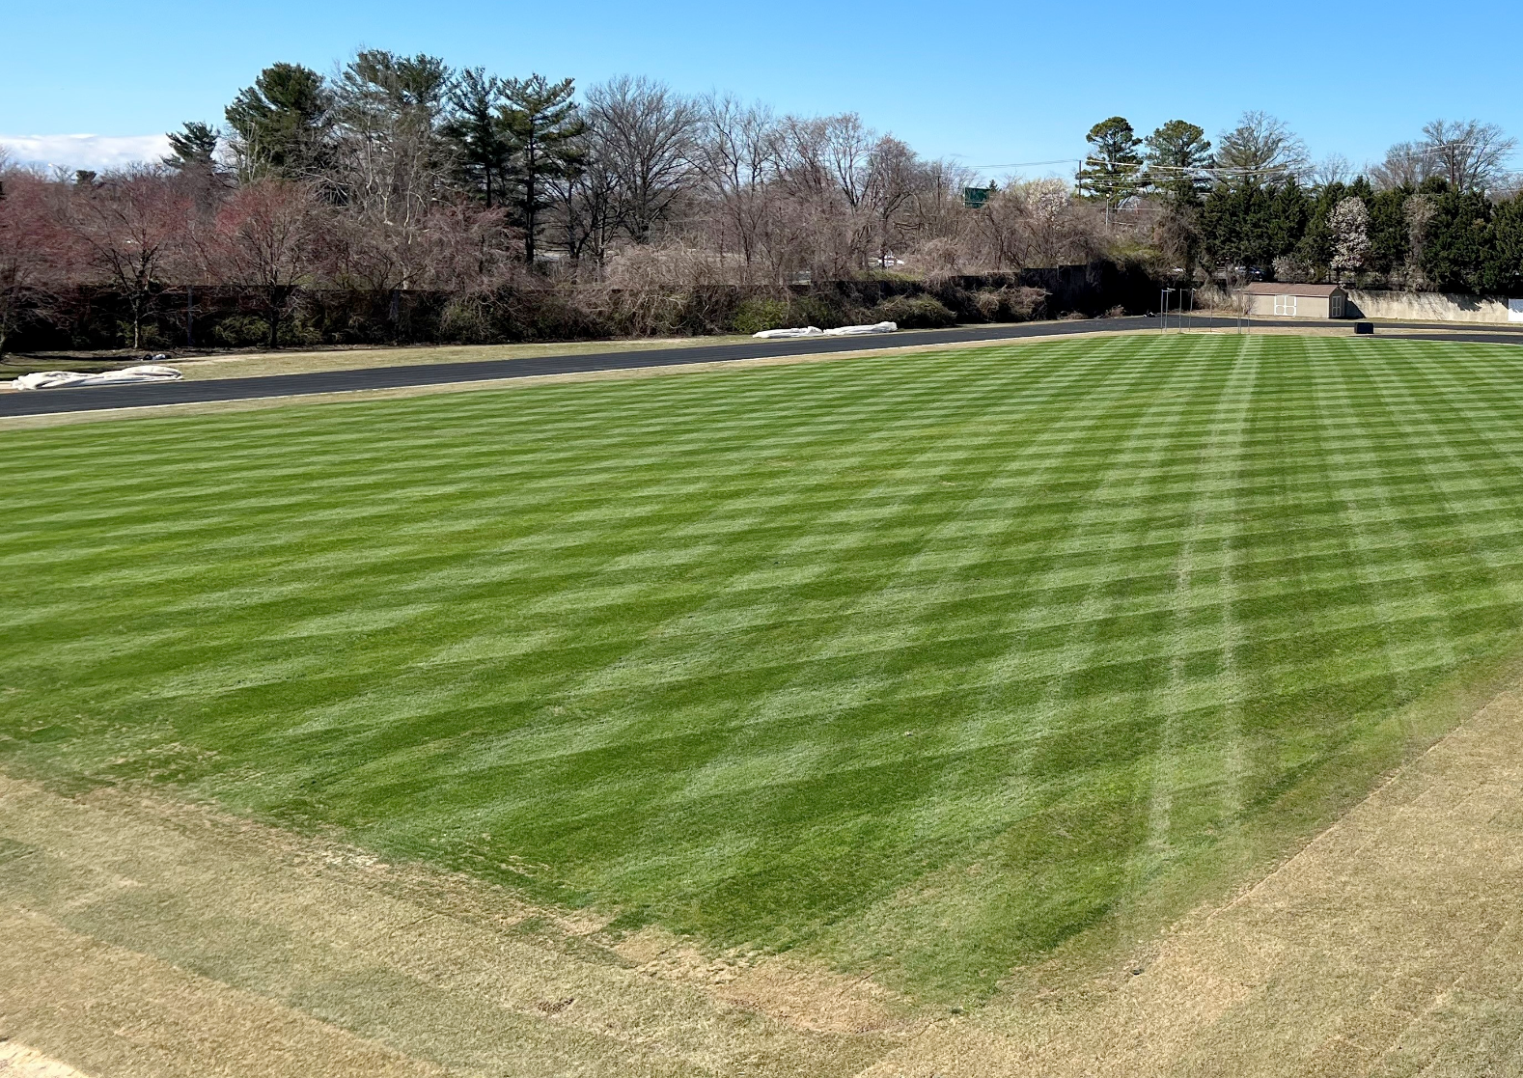
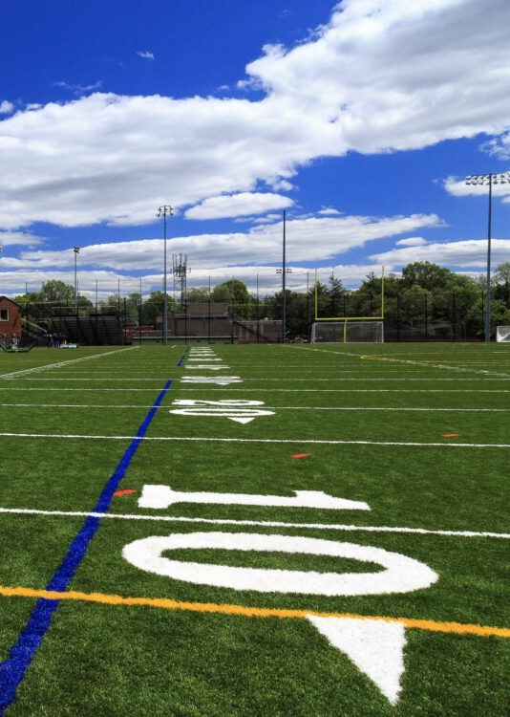
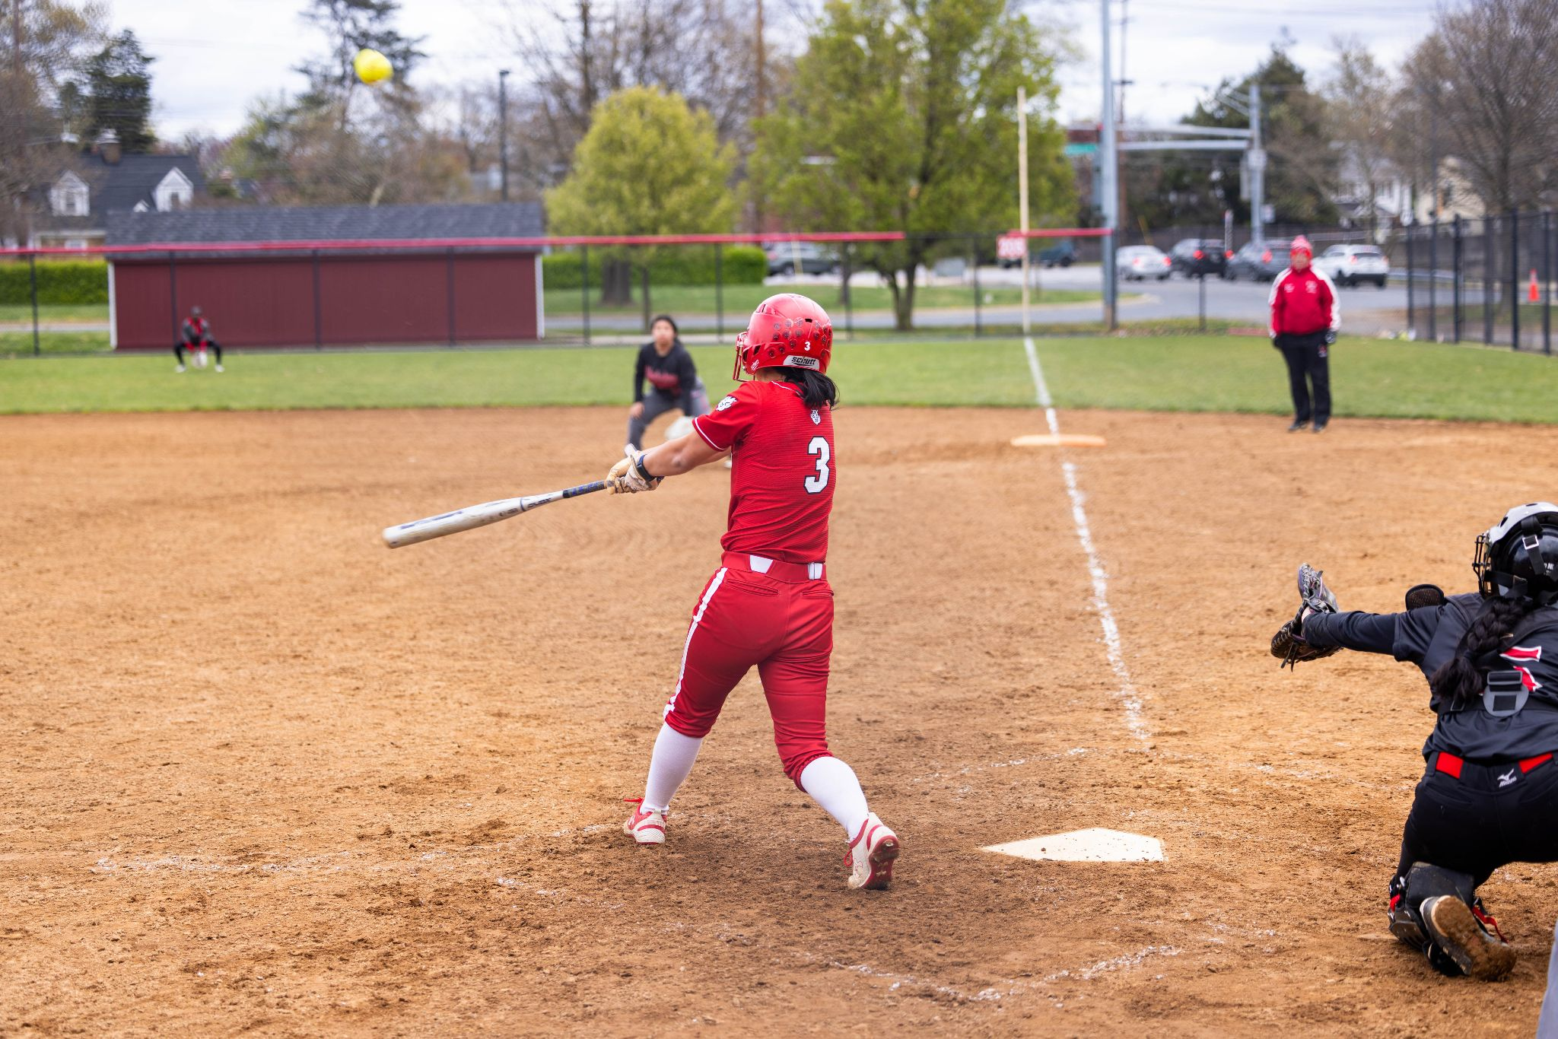
Problem #1: Limited data
Additionally, there is a need to understand how the unique relationship between MCPS and Parks at Montgomery Blair High School has impacted sport participation in the local community.
Photo by Tino Pham

Slide 7
Problem #1: Limited data
Blair High School MCPS-Parks shared use:
Has the model promoted or inhibited participation among residents in that district?
What impact has the relationship had on MCPS sport participation for Blair students?
As noted in the Bill that created the SAC, there is a need to produce an annual report detailing the “factors that affect sports participation in the County, including the availability and access to athletic fields, facilities, and sports” (see link, p. 3) (2022 L.M.C., ch. 23, §1.)

Slide 8
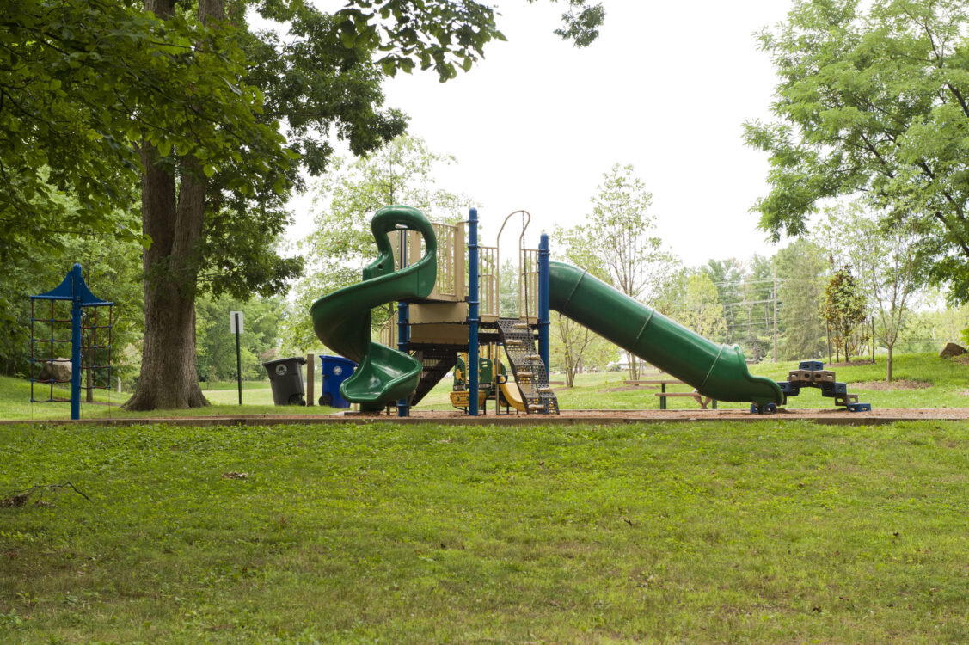
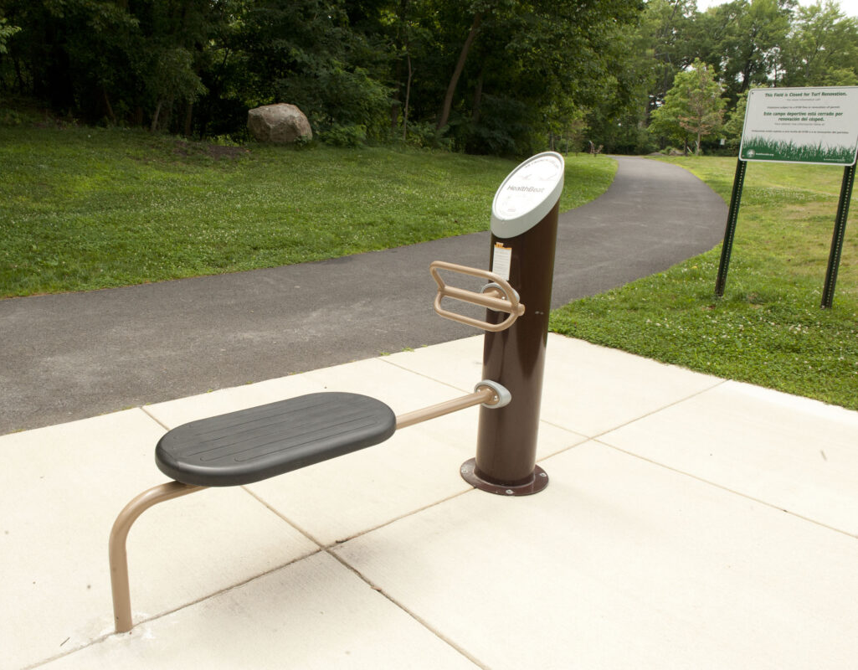
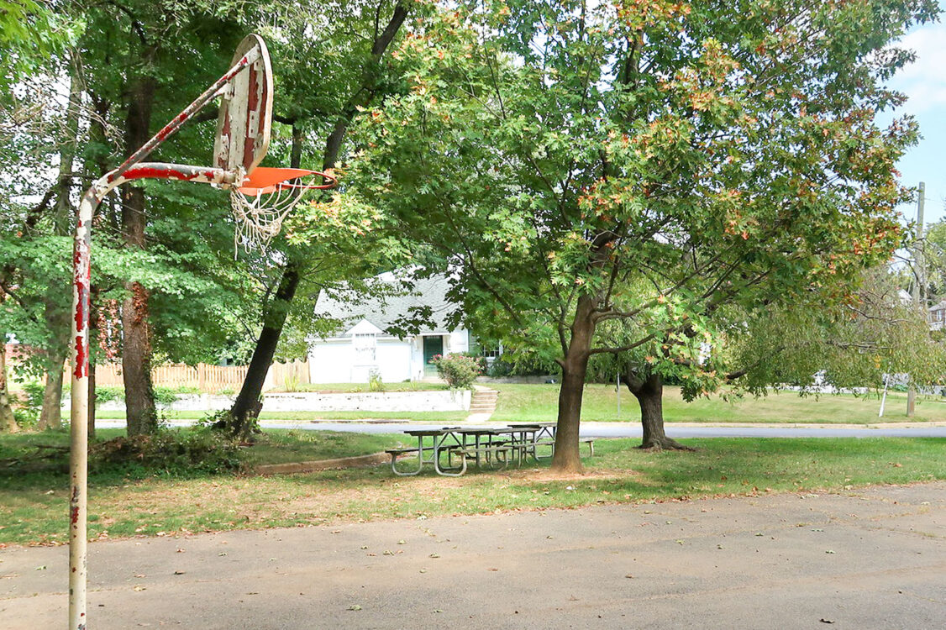
RECOMMENDATION #1: Conduct a case study
>
Conduct a Case Study (as previously proposed) of:
existing sport, facility, and field conditions
circumstances of participation (or lack thereof)
barriers and enablers of sport participation, particularly for youth and seniors

Slide 9
Problem #2: Recreation centers
Recreation centers are
outdated
lack modern amenities
not operating at “full capacity”, especially in communities of concern.
New rec center planning/construction—as well as updates to existing centers—must consider:
walkability
lighting (exterior)
access to public transportation

Slide 10
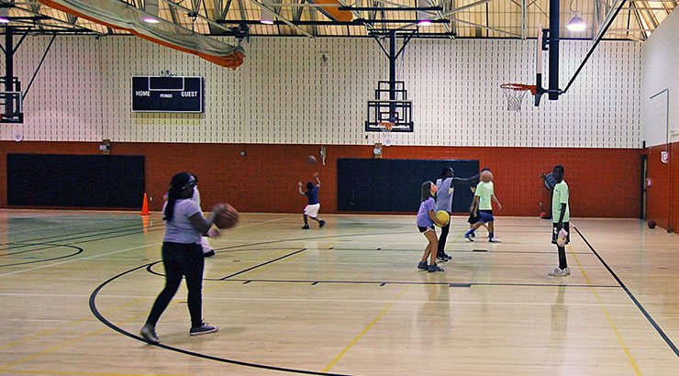
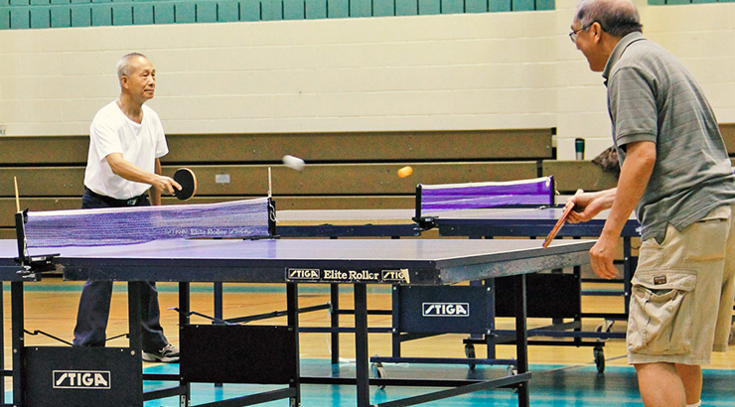
RECOMMENDATION #2A: Prioritize updating rec centers in communities of concern
>
Updating these centers should take priority over the construction of new recreation centers.

Slide 11
RECOMMENDATION #2B: Place all-season rec center on or adjacent to every middle school in communities of concern
>
Eastern Middle School University Boulevard
Silver Spring, MD 20901
8 out of 10 are students of color
6 out of 10 receive free/reduced-cost meals
1 in 4 have home/primary language other than English

Slide 12
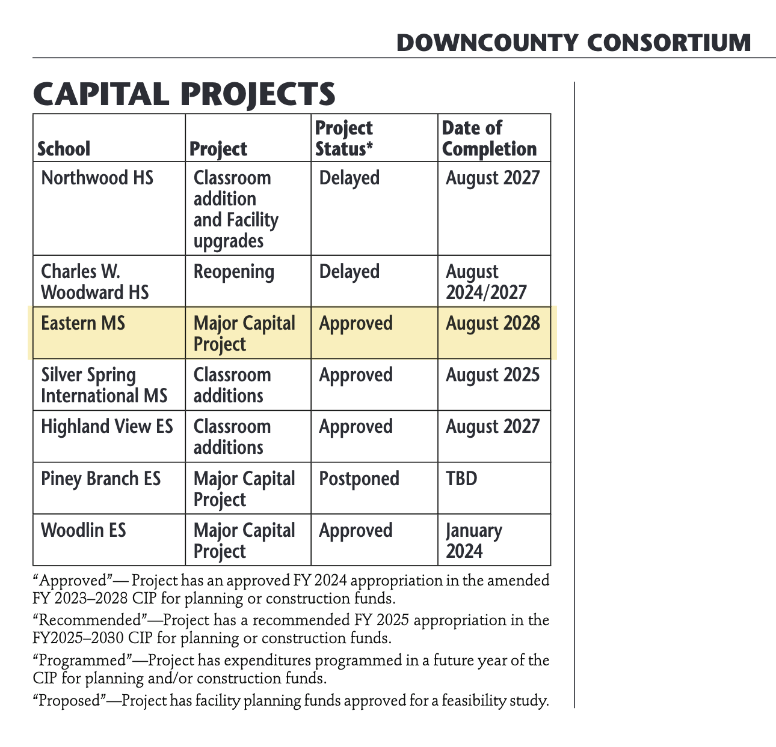
RECOMMENDATION #1 REPRISE! Conduct a case study
>
Eastern Middle School is awaiting a major capital project.
Open space for sports facilities is limited in this densely populated part of the county.
How can we balance this community’s needs for education and sports/rec as part of this construction project?

Slide 13
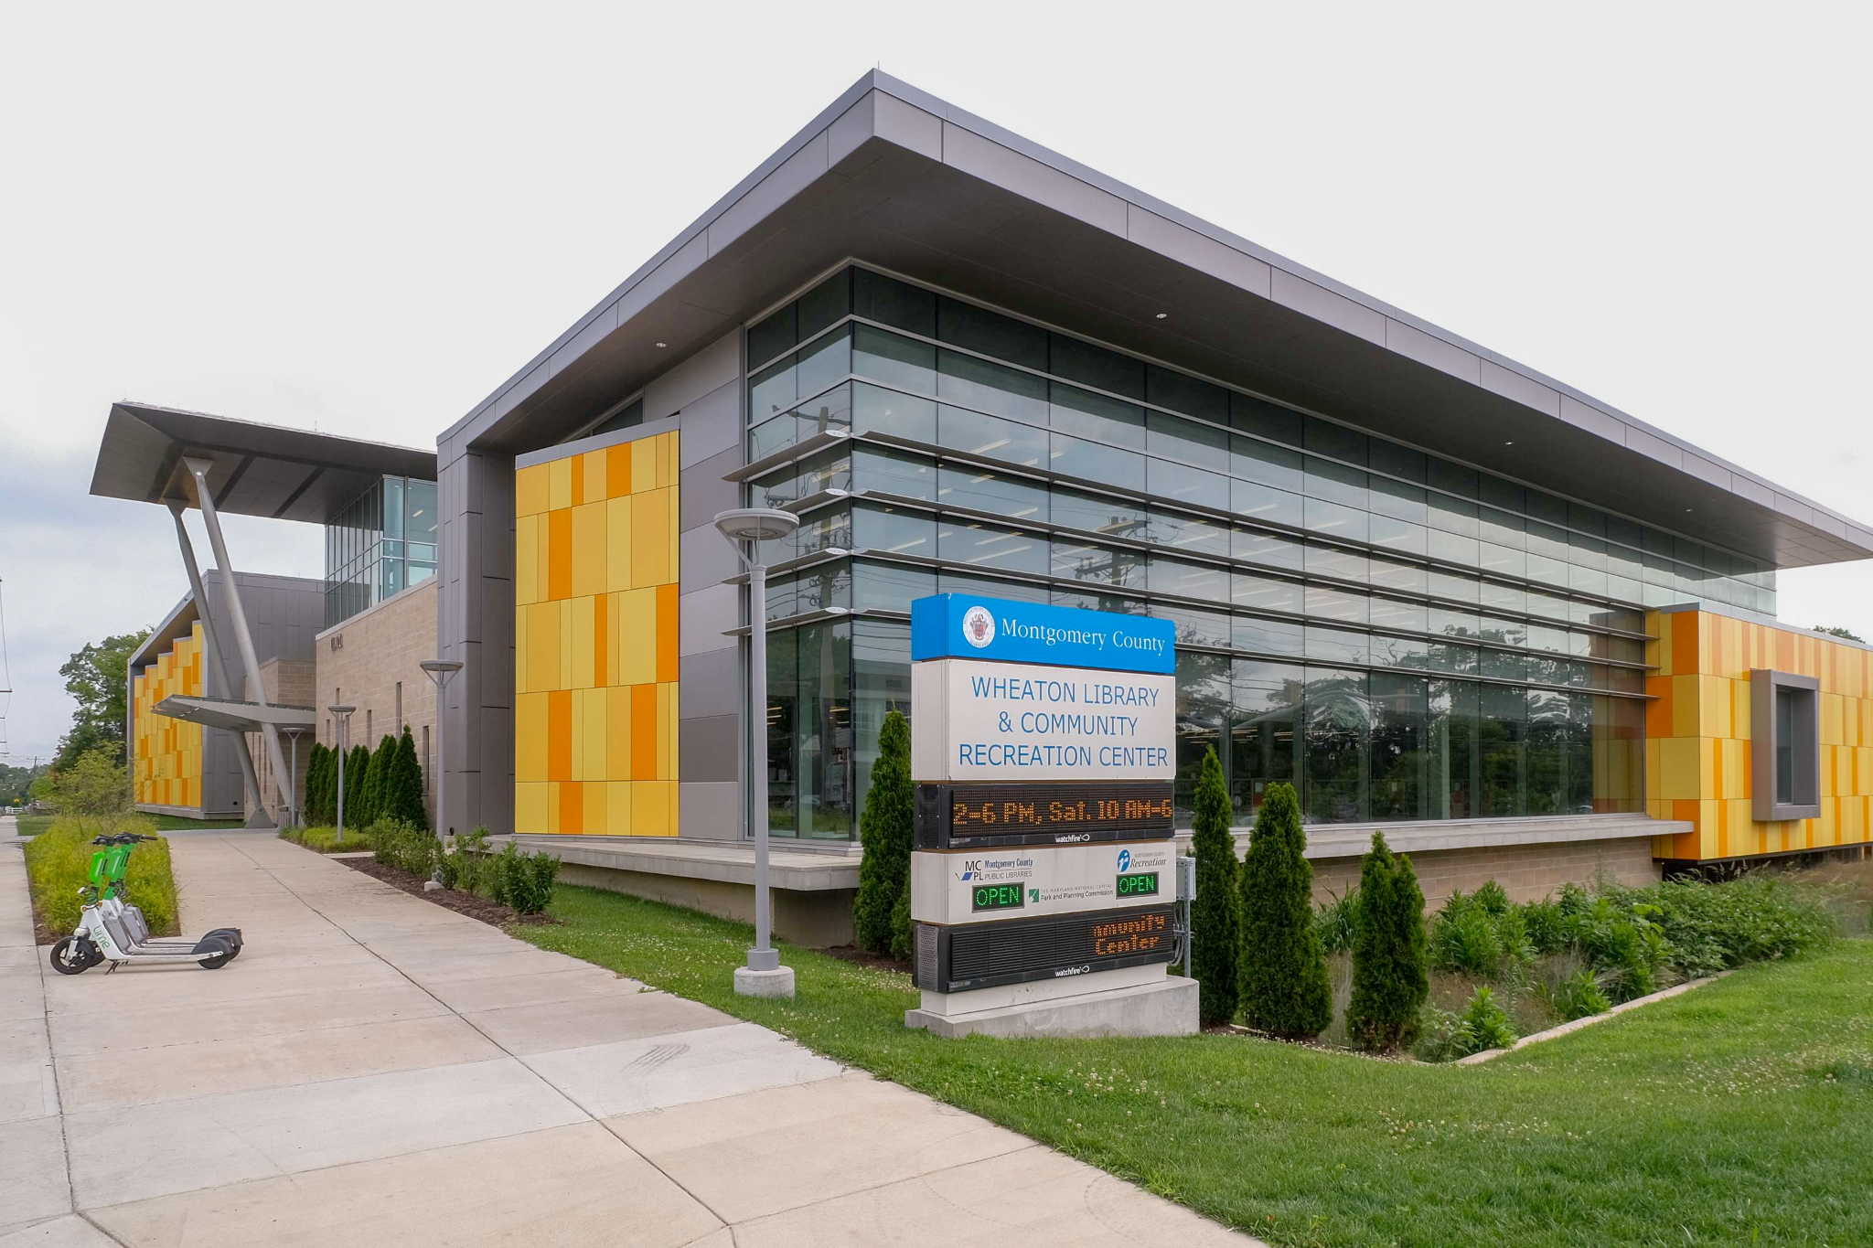
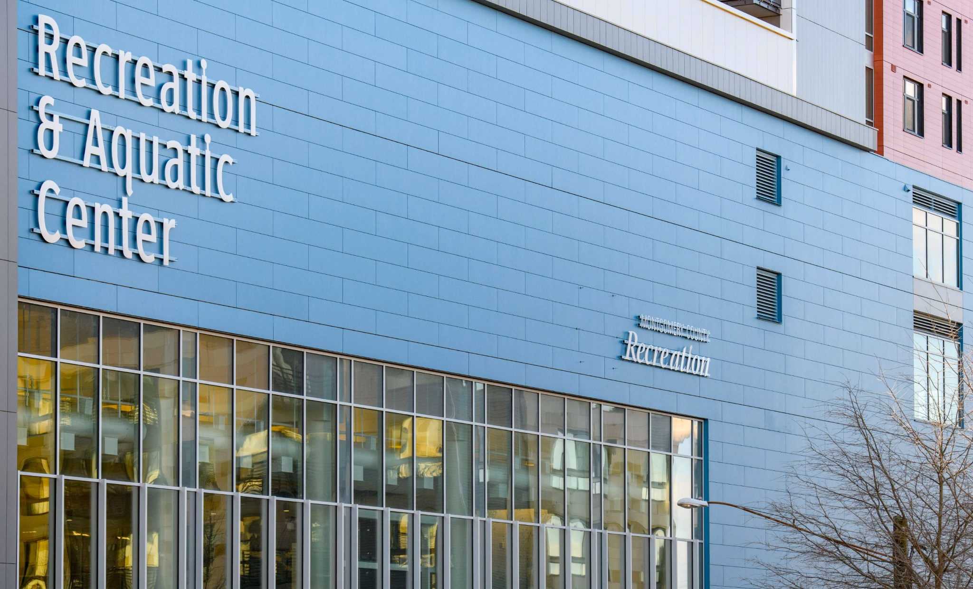
RECOMMENDATION #2C: Evaluate existing mixed-use facilities as possible models
>
Downtown Silver Spring
Wheaton

Slide 14
Problem #3: Facility permitting and access limitations
Prior Use (Parks) and Historical Use (CUPF) Permitting ensures sustainability in program offering from one year to the next.
Additionally, these permitting policies help agencies grant permits to reliable entities, reducing instances of unused spaces/facilities.
However, prior/historical use permitting could result in overbooking by those with these privileges, which could result in limited access for new and expanding programs in the county.

Slide 15
RECOMMENDATION #3: Establish a premium rate for Prior/ Historical Use and dedicate funds to support sport initiatives in communities of concern
>
For an increase to the permit holder, establish a premium (increased) rate for Prior Use and Historical Use permitting. Anticipated impact on participants would be minimal (estimated $2-$3 per sport season).
Additional revenue should be placed into an escrow account and used to directly support sport initiatives in communities of concern.
Recreation Department and MCPS programs would be exempt from the cost increase.
A premium fee model would also discourage potential overbooking, making facilities more available to programs without prior/historical use privileges.

Slide 16
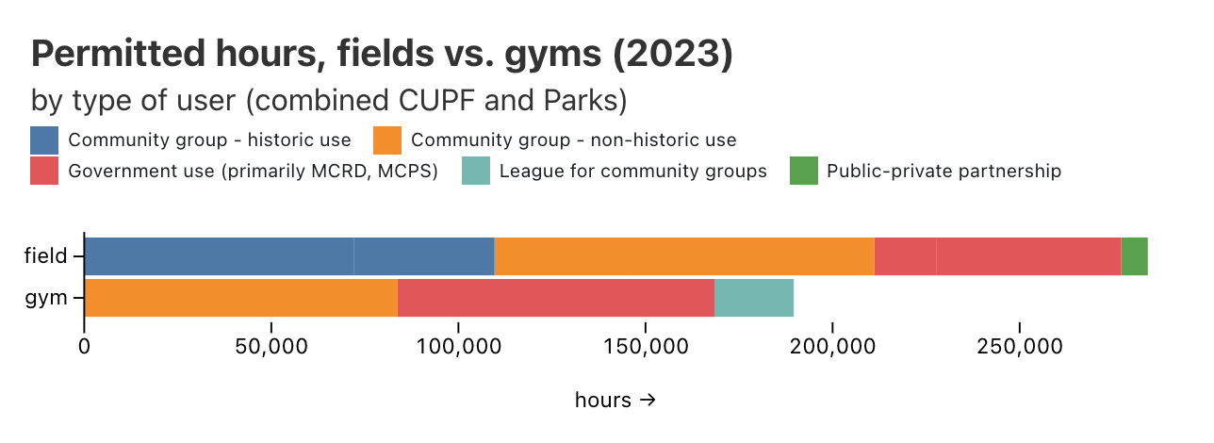
RECOMMENDATION #3: Establish a premium rate for Prior/ Historical Use and dedicate funds to support sport initiatives in communities of concern
>

Slide 17
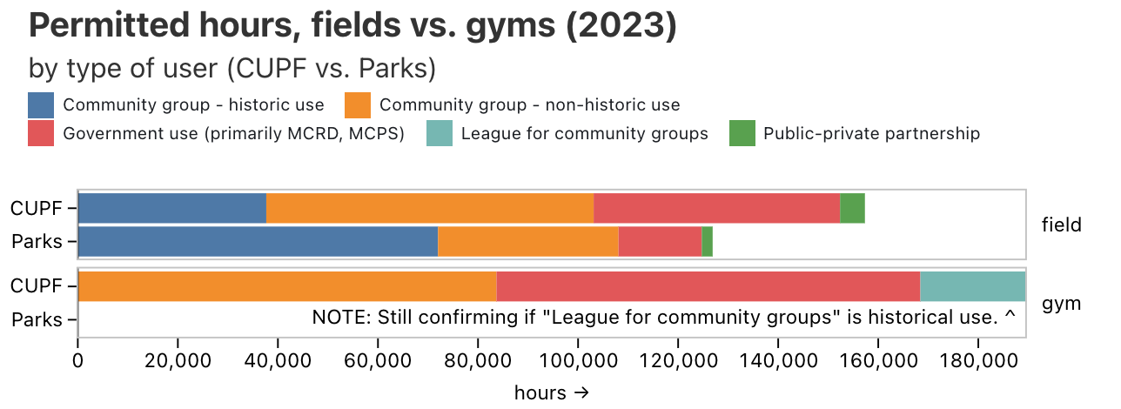
RECOMMENDATION #3: Establish a premium rate for Prior/ Historical Use and dedicate funds to support sport initiatives in communities of concern
>

Slide 18
RECOMMENDATION #3: Establish a premium rate for Prior/ Historical Use and dedicate funds to support sport initiatives in communities of concern
>

Slide 19
Problem #4: Attitudes toward sport
There is an opportunity to influence the way Montgomery County residents think about Recreation, sport, and Parks facilities as community assets that deserve to be appreciated.
Establishing a personal and community connection to these spaces will lead to community support for Parks which in turn can indirectly increase revenue in these spaces.

Slide 20
Problem #4: Attitudes toward sport
Further, OLO reports indicate many kids stop participating by age 11 and research shows that kids stop playing when sport is no longer fun.
Many studies show that verbal abuse of officials, critical feedback from parents and coaches, and an overly competitive atmosphere focused on winning contributes to a negative experience for kids.

Slide 21
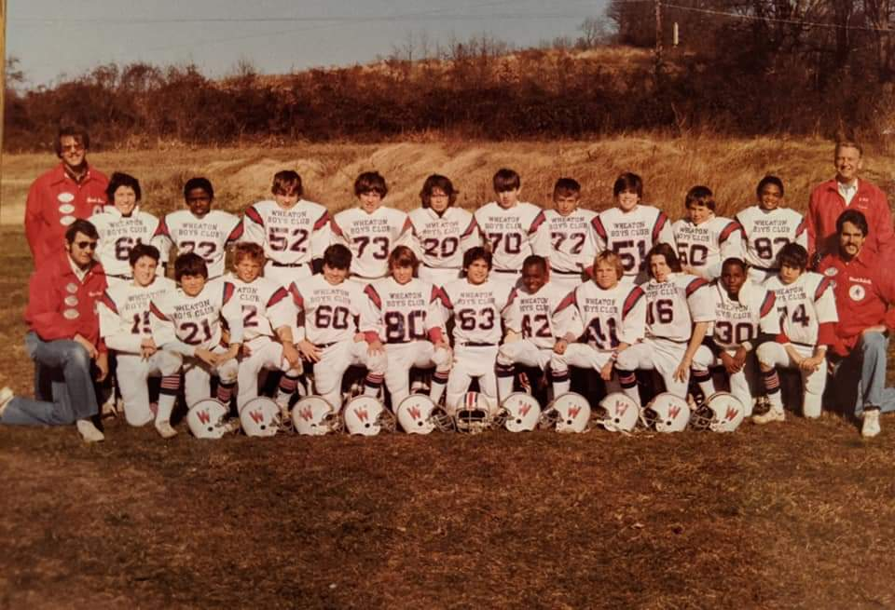

Slide 22
RECOMMENDATION #4: Develop a social marketing campaign to:
Increase appreciation of Parks facilities
Educate about the benefits of sport participation among all age groups, and
Show how to get involved in sport
>

Slide 23
RECOMMENDATION #4: Develop a social marketing campaign
>
The primary communication strategy shall include visual reminders within the Parks about the value of parks to a community and the value of sport participation, including a sense of community respect for our natural environment and our fellow residents.
The message should include aspirational ideals related to respect of the physical space, fellow participants, coaches, referees, and the game(s) themselves.
See also Move Your Way, Choose Civility, Vision Zero, Belonging Begins With Us

Slide 24
Problem #5: Harnessing the power of private/nonprofit providers
The Montgomery County Recreation Department serves many residents. However, the reach of the department would not be possible without the power of private/nonprofit sport and recreation providers.
The list of such partners is extensive and unwieldy. Partners often have competing priorities and visions regarding the best ways to serve citizens of the County.

Slide 25
RECOMMENDATION #5: Establish a Montgomery County Sports Authority
>
Use Montgomery County Revenue Authority as a model, or make this a subgroup of the existing revenue authority.
Would facilitate cohesion among nonprofit and private organizations with interests in sport and recreation participation in the county.
Consider using this new Authority to manage new facilities at middle schools in communities of concern (see recommendation #2B).

Slide 26
Participation Working Group

Slide 27
Programs Working Group

Slide 28
Recommendation
The County Council should direct the Montgomery County Recreation to develop and host a publicly accessible directory that includes information on sports program Montgomery County offered by approved public and private entities.

Slide 29
Recognition Working Group

Slide 30
Administrative Items
Nominations Update
Next Meeting: Thursday, May 16, 6:00 p.m.

