Slide 1

Welcome!
Nancy H. Dacek N. Potomac Community Recreation Center Thursday, March 20, 2025 6:00 p.m.

Slide 2
AGENDA
Wheaton Community Recreation Center • Thursday, March 20, 2025
6:00 p.m. Welcome and General Announcements 6:05 p.m. Review and Approve Agenda 6:08 p.m. Review and Approve February Minutes 6:10 p.m. Presentation from Collaboration Council and Q&A - Sydney Wilson-Hunter 6:40 p.m. Presentation from MCPS on Middle School Athletics and Q&A - Bryan Walker 7:10 p.m. Working Group Updates
Recognition: David, Trish, Princess, Steve (ex-officio)
Advocacy: Ben, Jay, Tom, Tony, Steve (ex-officio)
Community Engagement: Samantha, Princess, Rachel, Amy, Joe
Operations: Tina, Mary Kate, Christopher
Communications: Mary Kate, Rachel
7:35 p.m. Sports Programming Directory 7:50 p.m. New Business 8:00 p.m. Adjourn

Slide 3
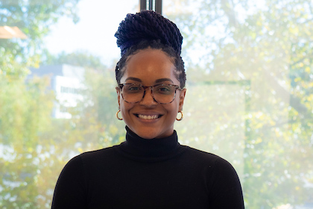

Sydney Wilson-Hunter Director, Out-of-School-Time Programs

Slide 4
Working Group Updates:
Recognition: David, Trish, Princess, Steve (ex-officio)
Advocacy: Ben, Jay, Tom, Tony, Steve (ex-officio)
Community Engagement: Samantha, Princess, Rachel, Amy, Joe
Operations: Tina, Mary Kate, Christopher
Communications: Mary Kate, Rachel

Slide 5







COMMUNITY ENGAGEMENT PROCESS
The Community Engagement Working Group proposes SAC engages in the following process to engage with and consider input from the community:
1
2
3
4
Identify and Invite Community Voices
Collect Input
Share Information
Develop Recommendations from Community
Build an email list
Create list of orgs/communities to invite (include parent, coach, athlete)
Develop an invitation template
Allocate time in meetings for invitees/public to speak and/or to share input collected
Set questions for invitees
SAC members complete a post-session survey SAC to gather insights and measure effectiveness
Increase online presence (i.e., social media, website) to publicize meetings and collect input
Have a centralized location / shared drive for document sharing (e.g., list of orgs)
Send out a newsletter/post/email blast
Draft recommendations based on community input
Continue engagement with impacted communities
Provide a summary/report of community feedback (can be shared with other committees)

Slide 6
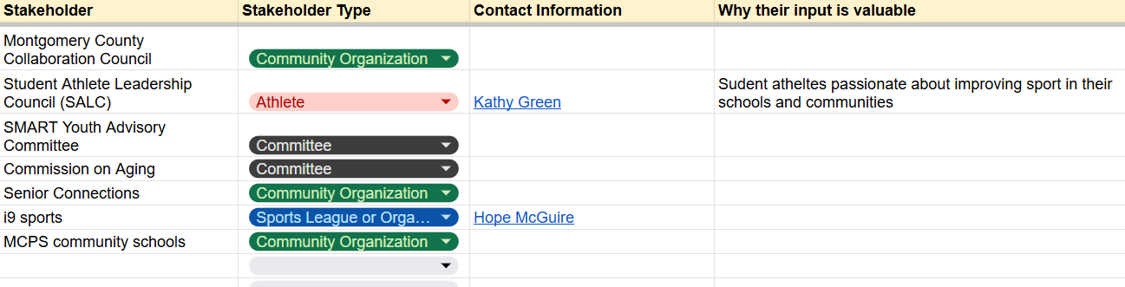
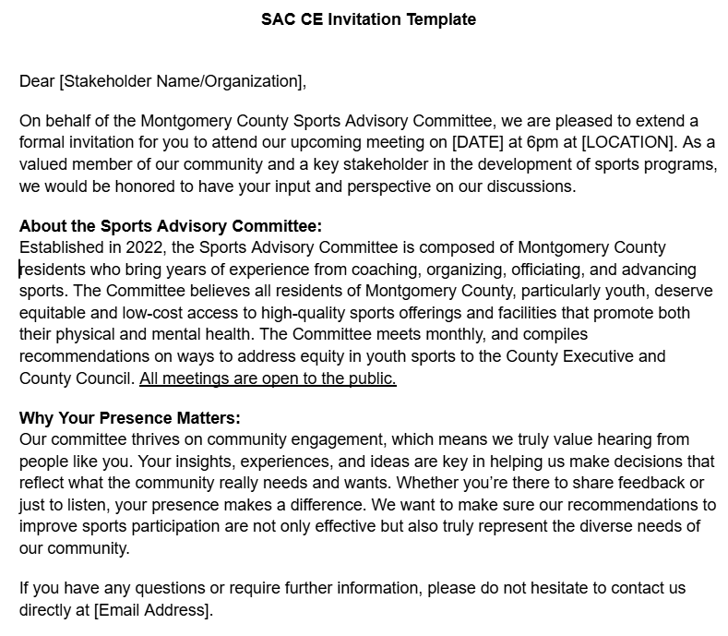
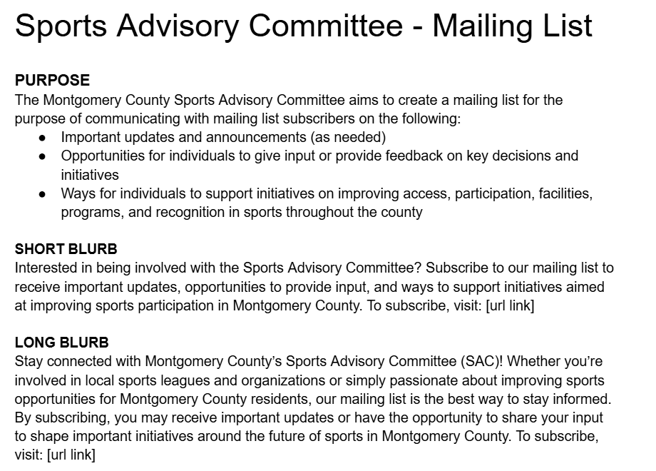
Identify & Invite Community Voices

Slide 7
Identify & Invite Community Voices
SALC Meeting
Date: April 8th
Time: 11:00am – 1:30pm
Location: Carver Education Services Center, 850 Hungerford Drive Rockville, Maryland 20850

Slide 8
Collect Input
Standard Questions for Every Presenter
What are the main barriers or challenges to participation or quality sports programming in your community/organization?
How can we better involve your community in improving sport participation that is accessible for all?
What does successful youth sports participation look like from your (or your organization’s) perspective?
Post-Presentation Survey Questions (Internal)
Was this presentation effective?
How can we use the information from this presentation to move forward as a committee?
What additional follow up questions do you have?
Based on this presentation, what other speakers/community members should we talk to?

Slide 9


Montgomery County Public Schools Middle School Interscholastic Athletic Programs

Slide 10
History of Middle School Athletics
Early Years (1975 – 76)
Three tiered approach: Intramural, Extramural & Interscholastic
Budget Constraints (1992)
Reinstatement of Program (1997)

Slide 11
Middle School Program Goals
Student participation that supported a middle school philosophy.
Competition be controlled and program structure be age and developmentally appropriate.
Offer sports that could be supported from an operational perspective – officials, coaches, facilities, etc.
Introduce R.A.I.S.E. core values which would be carried into the high school athletics.

Slide 12
Middle School Sport Offerings
Fall
Slow pitch Softball
Cross Country (2005)
Winter
Basketball
Spring
Soccer

Slide 13
Grade Level Participation
Sixth Graders – Intramural Program
- Introduction to team sports
- All games are played at local schools
- No officials
Seventh and Eighth Graders – Interscholastic Athletics
- Coaches & Officials operate under NFHS Guidelines
- Practices and contests are restricted to three days a week
- Private transportation is used for away games

Slide 14
Middle School Participation Numbers & Diversity (2003, 2013, 2023)

Slide 15
Middle School Participation Numbers & Diversity (2003, 2013, 2023)

Slide 16
Middle School Participation Numbers & Diversity (2003, 2013, 2023)

Slide 17

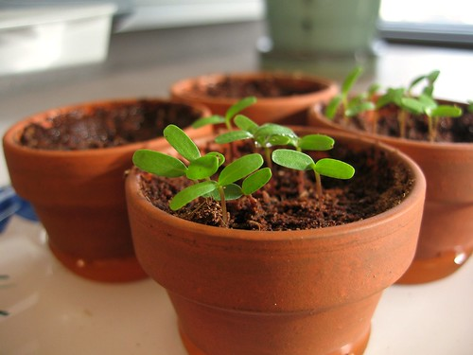
GLOWS & GROWS
GLOWS:
Increase in preparedness for registration, physicals and coach expectations
Time Management Skills and interpersonal relationships with teachers & officials - communication
Social, mental and physical well-being
GROWS:
Sports offerings that match the interest of student-athletes
Transportation
Facility Constraints/Budget

