Slide 1
Booming Trends in Volunteering: Engaging 50+ Volunteers
Deborah Missal and Gretchen Zekiel, Senior Fellows
Montgomery County Volunteer Center
Leah Bradley, Senior Director, and
Bonnie Leko-Shapiro, Volunteer Manager
JCA® Heyman Interages® Center
Notes:
Introduce ourselves, Briefly go around name and organization explain that we will cover topic and at the end we will answer questions, share ideas and experiences. As we are talking please feel free to note your questions/ comments on a note card. We will collect them and begin by addressing. Three years ago, those born in the last year of the baby boom turned 50. So the generation that has been described as the “pig in a python” is gradually moving towards retirement and many of them are looking at the next chapter in their lives.

Slide 2
Why the “booming” trend?
Rapid growth of senior population in Montgomery County forecasted to continue at rate of 113%
That’s 119,770 seniors to 254,530 from 2010-2040
Maryland Department of Planning

Slide 3
Why Focus on 50+ Volunteers?
"Boomers" seeking different type of retirement:
"Most of the people I work with don’t want anything to do with a retirement that has them sailing toward a sunset of irrelevance. The people I speak with want a retirement packed with meaning, new careers and new experiences.”
--Financial Planner quoted in Kiplinger article on retirement

Slide 4
Why Focus on 50+ Volunteers?
Lifetime of experience and skills
Highly educated and socially conscious
Available during the day
More flexibility
Tend to be reliable
Historically high retention rate
More and more seeking right opportunity to give back
Notes:
· Lifetime of experiences and skills: Particularly in MoCo, which has one of the highest levels of education in the country, as well as a culture of community services. (when we talk about “skilled” volunteers it may mean professional expertise or personal talents)
· Many of them have retired from careers in government agencies, NIH, start-up businesses, nonprofit sectors, national associations, media – all skills that can be used by nonprofit and government agencies to help
· Others who have taken a different path may have spent years volunteering in schools, faith-based organizations, sports clubs, and other activities generally related to their families
· Now they have more availability and WANT to be busy
· Reliable – treat it as a profession
· High retention rate – your investment in these volunteers will be well worth the time

Slide 5
50+ Volunteer Network
What is it?
Unique, new county program launched in January
Part of Montgomery County Volunteer Center
Assists local nonprofits and Montgomery County government agencies
Leverages professional/personal skills of 50+ population as resource for agencies
Effectively matches agencies needing assistance with skilled volunteers
Incorporates the best practices of and goes beyond Pro Bono and RSVP programs
Notes:
Where We Come In: 50+ Volunteer Network
Unique county program launched last week!
· Two senior fellows hired as part-time county employees
· Part of Volunteer Center, using the resources already available
· Explain how PBC and RSVP are expanded (give a little history)
· Leverages professional/personal skills of 50+ population as resource for agencies
· Effectively matches agencies needing assistance with skilled volunteers
So, Debby, can you please explain what makes this program different from other services?

Slide 6
50+ Volunteer Network
What makes it different?
Personal consultations with both agencies and volunteers
Targeted recruitment of skilled volunteers
Matching by knowledgeable Advisors
Follow-up with both agencies and volunteers
Helps you rethink role of volunteer and accomplish more
No cost to agency
Notes:
Switch to DM
· Personal consultations with both agencies and volunteers – we have met with many of you already. Trying to get agencies to rethink notion of volunteers and move beyond what they already do and to help them with challenges that may arise. Personal interviews with prospective volunteers, learn about their interests, skills, and find something that’s a good fit
· Targeted recruitment of skilled volunteers: outreach into the community, including retirement programs, professional organizations, community groups, Villages, county programs
· Matching by trained advisors: We are leading by example, and using volunteers to help us run the program
· Follow-up with both agencies and volunteers – want to make sure things don’t fall through the cracks and getting feedback from both to constantly improve
· No cost to agency!
Note to discuss what a “skilled” volunteer

Slide 7
Our Tips for Working with 50+
Treat volunteers as staff – their compensation is merely different
Communicate effectively
  Respond to inquiry promptly
  Share agency mission and how volunteer advances
  Check in regularly
Invest in training
Show your appreciation
Grow the relationship
Notes:
Contract, job descriptions
Training – even phone numbers
Segue to Leah

Slide 8
50+ Volunteer Network
What types of opportunities?
Ongoing, program management/support
  edit a newsletter, provide administrative and client intake services, manage an event or program, become a board of directors member...
Short-term consulting projects
  grant-writing, accounting, strategic planning, marketing, web design, IT help...
Direct services to clients in need
  in tutoring or mentoring programs, teaching adult literacy, providing career counseling…
Notes:
· Ongoing, program management and support: run a project, plan an event, edit a newsletter, provide administrative or client intake services, everything from answering phones to serving on the board
· Short-term consulting projects: Like the Pro Bono Consultant, we will still be getting volunteers who want to offer their professional expertise on projects. This could include writing grants, accounting services, IT help, marketing/public relations, etc.
· Direct services to clients: Many nonprofits need tutors/mentors, and Leah is going to talk more directly about how JCA Interages uses this population. But also includes mental health services, hospice volunteers, or ESOL classes

Slide 9
50+ Volunteer Network
How does it work?
Any agency registered with MCVC is eligible
First step is brief interview to learn more about agency and volunteer opportunities/needs
Agency completes brief registration form
Advisor e-introduces agency and potential volunteer
Agency contacts volunteer/contin. with own process
Agency and volunteer decide if match good fit
After placement, Advisor conducts brief, periodic check-ins with both agency and volunteer
Notes:
· Any agency registered with MCVC is eligible
· First step is brief interview to learn more about agency and volunteer opportunities/needs. Some of you have already had these conversations, and we will be available after this session to answer questions
· Agency completes brief registration form: For opportunities that are already posted on the Montgomery County Volunteer Center database, you need only reference it and we can tag it on our end. For other opportunities, you can give us a brief description of what you are looking for and what particular skills you need
· Advisor e-introduces agency and interested potential volunteer
· Organization contacts volunteer and continues with own process
· Agency and volunteer decide whether or not match is a good fit
· After placement, Advisor conducts brief, periodic check-ins with both agency and volunteer

Slide 10

JCA® Heyman Interages® Center

Slide 11


Slide 12


Slide 13


Slide 14
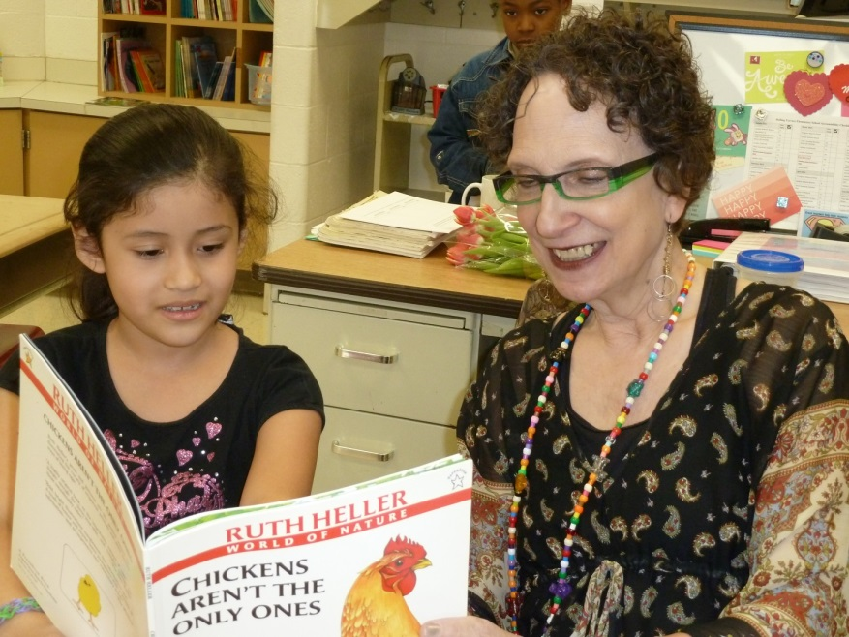
Did you know…..there are proven benefits of intergenerational volunteering for older adults?
Increased physical, mental and social activity
Better physical, brain and emotional health*
    Reduced risk of heart and brain disease
    Improved coping with chronic pain and disease as well as disability and stress events
    Greater sense of well-being and life satisfaction, reduced rate of depression
Sense of purpose and contribution
Expanded social networks
Positive image of seniors
No financial burden
*Corporation for National and Community Service, National Association of Area Agencies on
Aging (n4a), National Institute on Aging, Home Instead, Inc., Senior Citizens Bureau

Slide 15
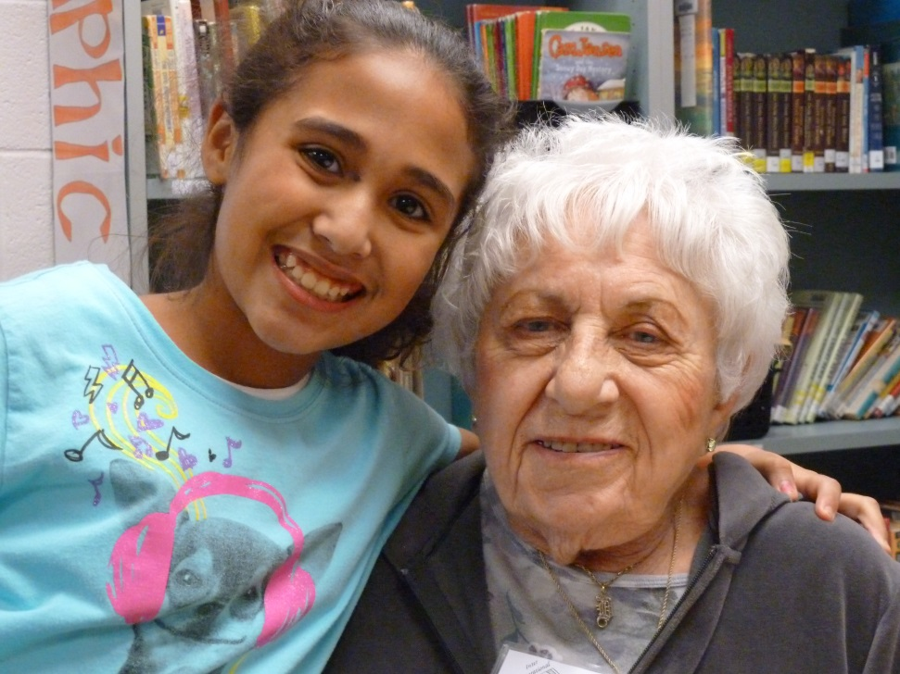
Benefits of Working with Older Adults
Wealth of skills, knowledge and experience
  Parents, grandparents, mentors, friends
  Professionals
Commitment to community, future generations and legacy
Extensive social networks
Growing resource
  number of volunteers age 65-plus is expected to double in just a few years (n4a)

Slide 16
