Slide 1

Grantsmanship 101 Brad Lewis, MSW
Montgomery County Volunteer Center Training
October 2020
Notes:
Comments: Keep it to an hour

Slide 2
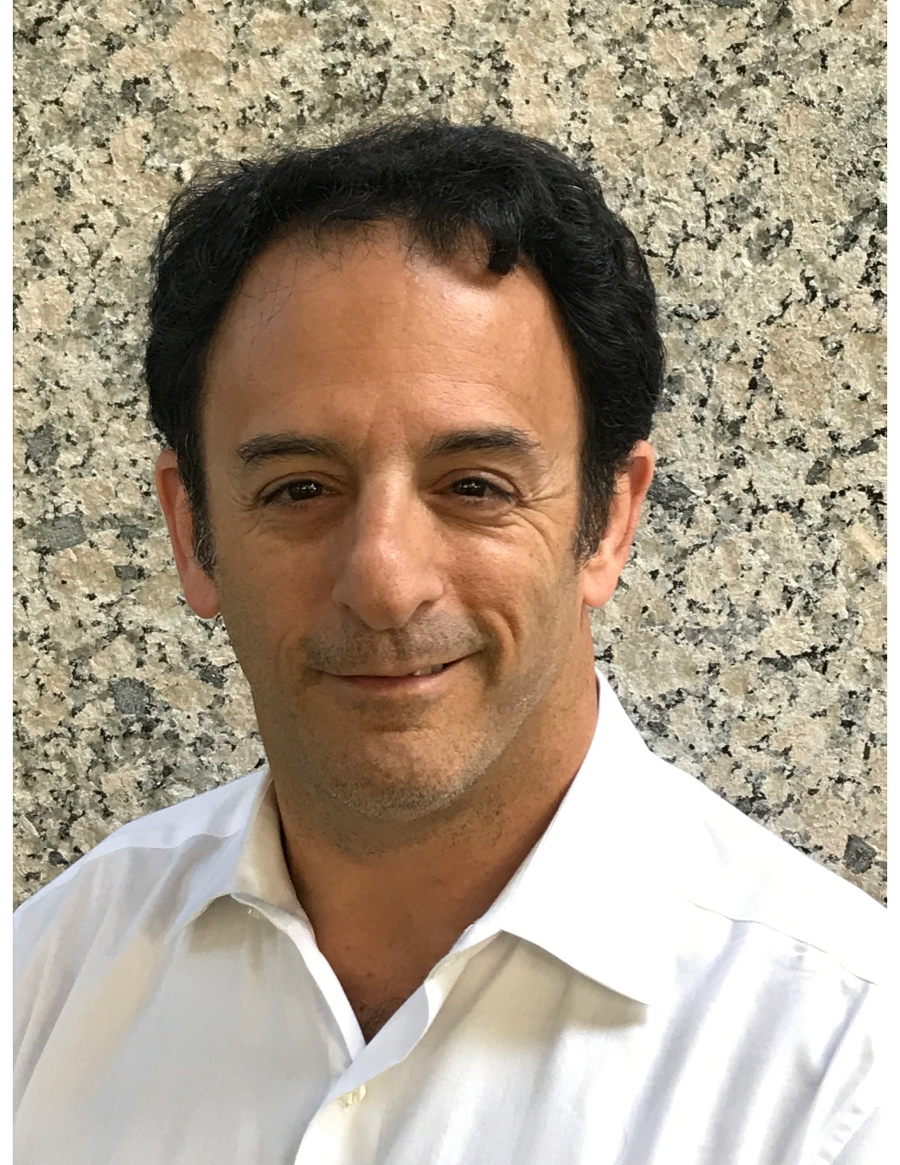
Brad Lewis, MSW (ret.)
BradfordLewis@gmail.com
Corporation for National and
Community Service
Grants and Program Officer 1994-2017

Slide 3
Grants 101
Welcome, Introductions & Expectations
Grant Continuity Chart
Tips and Pointers
What NOT to Include
Web Resources
Questions
Evaluation
Grant Proposal Cycle

Slide 4
Grants 101
Grant Proposal Cycle
1. Brainstorming/Determine Need
2. Identify Funding Opportunity
12. Submit Final Report
10a. Request Feedback
3. Review RFP
11. Evaluate Program
4. Draft Proposal
9a. Thank Funder
5. 1st Outside Reader Reviews Proposal
10. Run Program
6. 2nd Outside Reader Reviews Proposal
9. Thank Funder
No
Yes
8. Receive Funding Decision
7. Submit Proposal On Time

Slide 5
Grants 101
Grant Continuity Chart (Example)
Needs | Goal | Objectives | Activities | Timeline | Responsible Person | Evaluation
Fewer Hungry Clients
10% less hunger in MOCO
Fund one new Distribution Center
Hungry Clients
Center open by 1/31/21
Feeding Program Dir
Weekly Statistics

Slide 6

Grants 101 – Tips and Pointers (A)
Use charts and images – one picture really is ...
Relationships with funders are crucial
A coherent approach is important (think Continuity Chart).
Make sure the Job Titles match = Staffing Chart = Budget.
Grants 101 – Tips and Pointers (B)
Whether you have hired a grant writer or appointed a “single point of exit”, it is their job to verbalize apparent lack of consensus and check this out with the group.
Follow the funders’ guidelines in terms of letter of support, number of pages, attachments, etc. Count the number of copies you need for the interior audience and the external audiences.
Call the contact person at the funder at least once with well-defined questions. If they were were contacted with constructive questions, they’re likely to carry that positive impression into their review process.
Contact previously funded programs or agencies, if you can, and get a feel for the funder’s philosophy, or preferred approach. They may fund a clearinghouse or technical assistance providers. If so, contact them, as well, and ask for guidance.
Apply to various funders so that you “Don’t put all of your begs in one Ask-it”.
Grants 101 – Tips and Pointers (C)
Check and re-check your budget figures, and goals and objectives, and make sure they relate to the purpose of the funder’s announcement, mission and funding priorities as well as the deadline.
Set a deadline of at least 24 hours prior to the proposals’ due date. Decide whether it will be delivered, mailed, sent overnight or some other method. Most are due via electronic grants software, but not always, so check it out. Expect snags and glitches, especially with your computer and troubleshoot ahead of time. Always get a receipt, if available.
Have your signature pages signed or electronically approved as early as possible. Invariably the board member or staff person you need will be away on vacation or out sick on the day they’re due.
Notes:
Tips (A) Use charts – one picture really is worth a thousand words.
Relationships with funders are crucial (Who do you a/board member/a church pastor know?)
A coherent approach is important.
Tie the document together (be consistent throughout – e.g. terminology).
Make sure the Job Titles match the Staffing Chart and the budget.
Appoint a “single point of exit” for the application. That person must check for continuity, grammar, spelling, “tightness” of message, as well as checking the proposal for all attachments, signatures, appendices, etc.

Slide 7
Grants 101 – Tips and Pointers (B)
Your grant writer or appointed “single point of exit”, should verbalize any apparent lack of consensus
Follow the funders’ guidelines – e.g. - letters of support, etc.
Call the contact person at the funder at least once with well-defined questions.
Contact previously funded programs or agencies.
Apply to various funders so that you “Don’t put all of your begs in one Ask-it”.
Notes:
Grants 101 – Tips and Pointers (B)
Whether you have hired a grant writer or appointed a “single point of exit”, it is their job to verbalize apparent lack of consensus and check this out with the group.
Follow the funders’ guidelines in terms of letter of support, number of pages, attachments, etc. Count the number of copies you need for the interior audience and the external audiences.
Call the contact person at the funder at least once with well-defined questions. If they were were contacted with constructive questions, they’re likely to carry that positive impression into their review process.
Contact previously funded programs or agencies, if you can, and get a feel for the funder’s philosophy, or preferred approach. They may fund a clearinghouse or technical assistance providers. If so, contact them, as well, and ask for guidance.
Apply to various funders so that you “Don’t put all of your begs in one Ask-it”.

Slide 8
Grants 101 – Tips and Pointers (C)
Check and re-check your budget, goals and objectives.
Set an internal deadline of at least 24 hours prior to the proposals’ due date.
Decide whether it will be delivered, mailed, emailed, sent overnight or some other method.
Have your signature pages signed or electronically approved as early as possible.
Notes:
Grants 101 – Tips and Pointers (C)
Check and re-check your budget figures, and goals and objectives, and make sure they relate to the purpose of the funder’s announcement, mission and funding priorities as well as the deadline.
Set a deadline of at least 24 hours prior to the proposals’ due date. Decide whether it will be delivered, mailed, sent overnight or some other method. Most are due via electronic grants software, but not always, so check it out. Expect snags and glitches, especially with your computer and troubleshoot ahead of time. Always get a receipt, if available.
Have your signature pages signed or electronically approved as early as possible. Invariably the board member or staff person you need will be away on vacation or out sick on the day they’re due.

Slide 9
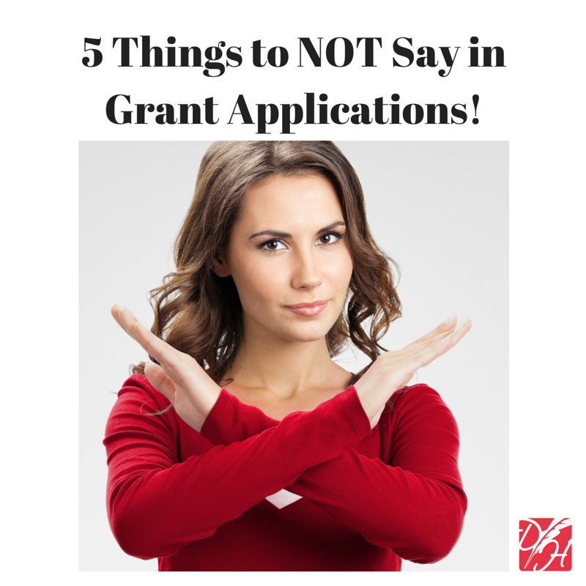
Grants 101 -
5 Things NOT to Say in Grant Applications
1. “We are not sure how we will continue the
program after your grant funding ends.”
2. “We hope to be able to…”
3. “We need your funding to continue to operate:.…”
4. Buzz words, phrases, or industry jargon.
5. Overly ambitious outcome statements.
Credit: GRANT READINESS GRANT WRITING TIPS AND BEST PRACTICES JANUARY 8, 2016 WRITTEN BY: DIANE LEONARD, GPC, ST

Slide 10

Grants 101
Resources on the Web
Foundation Center
The Grantsmanship Center

Slide 11
Grants 101
Fundraising with Social Media (A)
GlobalGiving http://www.globalgiving.org/
Change.org http://www.change.org/
ChangingThePresent http://www.changingthepresent.org/
Causes https://www.causes.com/
Givezooks http://www.givezooks.com/
FirstGiving http://www.firstgiving.com/
SixDegrees http://www.sixdegrees.org/
JustGive https://www.justgive.org/
Crowdrise http://www.crowdrise.com
BetterTheWorld http://bettertheworld.com/

Slide 12
Grants 101
Fundraising with Social Media (B)
Pifworld http://www.pifworld.com/en
PincGiving http://causepro.com/
UniversalGiving http://www.universalgiving.org/
SocialVibe http://www.socialvibe.com/
GoFundMe http://www.gofundme.com/
Care2 http://www.care2.com/
DonorPerfect http://www.donorperfect.com/
FundRazr https://fundrazr.com/

Slide 13

Grants 101
Questions?

Slide 14

Grants 101
Evaluation
Did the presentation cover the topics, as discussed at the start?
Grant Proposal Cycle
Grant Continuity Chart
Tips and Pointers
Web Resources
What NOT to include
Questions and Evaluation
Do you have suggestions for future topics?
Thank you!

Slide 15
Brad Lewis, MSW (ret.)
BradfordLewis@gmail.com
Corporation for National and
Community Service
Grants and Program Officer 1994-2017

