Slide 1
Student Service Learning (SSL) in MCPS

Slide 2
Activator – Type what comes to mind in the chat box.
Middle School Student
High School Student
Notes:
When it comes to education, we always want to keep the students in mind at all times.
Share with elbow partner – add ideas to your own
Share whole group
Collect at end
Anonymous – no names

Slide 3
Developmental Characteristics
Middle School
Physically active
Peer driven
High School
Active with additional abstract thinking skills
Longer attention span
Shorter attention span
Easily motivated with explicit directions
Personal philosophy
Independence and responsibility
*Adapted from The Training Toolbox: A Guide to Service-Learning Training -- Maryland State Department of Education

Slide 4
The ABCs of Student Service Learning

Slide 5
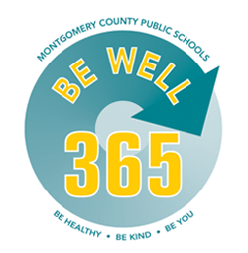
What is Student Service Learning (SSL)?
Student Service Learning
Practical experience addressing real community needs
Curriculum-based learning and academic study
Civic knowledge and engagement
Character and social development
BeWell365 Essential:
Character Education and Empathy
Notes:
Student Service Learning provides students with practical experiences that address real community needs, allows them to apply their curriculum-based learning and academic study, and increases their civic knowledge and engagement while developing their character and social skills.
An experiential teaching method that addresses real community needs through meaningful service and curriculum-based learning.
High quality service learning promotes civic knowledge, civic engagement, academic success, character and social development in students.

Slide 6
What Sets Student Service Learning Apart?
Community Service – Improving the Community
Volunteerism – Civic Engagement
Internships – Academic Learning
Student Service Learning is an instructional strategy that combines meaningful service to the community with curriculum-based learning, providing students with opportunities to apply what they learn in school to the real world as active, engaged citizens.
Notes:
Student Service Learning often gets equated with three other terms that can all overlap with Student Service Learning but are not one in the same with Student Service Learning.
While all three experiences (community service, volunteering, internships) are good for MCPS students, they do not all automatically qualify as Student Service Learning.
True student service learning is a unique combination of all three.

Slide 7
Student Requirements for SSL
SSL is a state graduation requirement
MCPS students must complete 75 SSL hours for graduation
MCPS students may begin to work on this graduation requirement the summer after completing grade 5
Students continue to accrue hours throughout middle and high school

Slide 8
How Can Students Earn SSL Hours?
Specific Academic Courses
Grade 6 Science (10 hours)
Non-Profit Agencies
Approved SSL opportunities with MCPS SSL Organizations through the Montgomery County Volunteer Center (MCVC) website
Complete MCPS Form 560-50 for approval to serve with a non-profit agency that is not an MCPS SSL Organization
Grade 7 English (10 hours)
Grade 8 Social Studies (10 hours)
High School Social Studies Course – National, State, and Local (NSL) (15 hours)
High School Electives (5+ hours)
High School Health (5 hours)
Notes:
MCPS is one of only a few school districts in Maryland that require students to obtain SSL hours outside of specific academic courses.
As a result of attending this training and following through with the remaining steps to becoming an MCPS SSL organization, you eliminate the step that students need to take to obtain pre-approval. Thank you!

Slide 9
The Role of Community Organizations

Slide 10
Participation with Community Organizations
All SSL must be completed under the supervision of a registered non-profit community organization
For-profit nursing homes and assisted living facilities are the only exceptions to the non-profit rule. All SSL activities must directly support the patients/residents of these facilities.

Slide 11
Facilitating High-Quality Student Service Learning
Preparation
Action
Reflection
Gain knowledge and skills needed for service
Meet a recognized need in the community
Reflect throughout the service learning experience
Plan ahead for service-learning, and frame the experience
Learn about the community and the importance of active citizenry
Develop student responsibility
Teach real-world, transferable skills
Engage in thoughtful contemplation and evaluation
Provide authentic feedback about impact
Notes:
We want to equip agencies with the knowledge and skills they need to support Student Service Learning in the same way our academic courses do.
There are three phases that drive Student Service Learning, and MSDE has identified 7 best practices that are covered during these three phases.
Preparation – During the preparation stage, students are expected to gain knowledge and skills needed for service and learn about the community they’re serving and the importance of active citizenry. To support this phase, it’s helpful to plan ahead and thoughtfully consider how you will frame the work and introduce it to students so they are leaving with larger takeaways about the importance of that work.
Action – During the action phase, students are expected to meet a recognized need in the community and develop a sense of ownership and responsibility. You can support this phase by using teachable moments to model interpersonal skills and providing students with opportunities to practice these skills. Allow the students as many opportunities as possible to drive the work.
Reflection – During the reflection phase, students are expected to reflect throughout the service learning experience and engage in thoughtful contemplation and evaluation. You can support this phase by engaging in authentic discussion with them, providing feedback as they perform. Many students’ metacognitive skills are not fully developed yet and need support with reflecting and attending to details relevant to what they’re actually doing and what they’re learning from it,
Preparation – educate and raise awareness, civic engagement
Action – help students develop interpersonal, real-world, professional skills
Reflection – evaluate student performance an give feedback to prepare them for workforce

Slide 12
Considerations for SSL Opportunities
School clubs
Special needs
Grades 6-12
Post service opportunities for MCPS school staff members to complete with their student groups and/or classes – all the benefit without the extra paperwork!
Notes:
Grades 6-12 – Consider what can younger students can do vs older students, and consider all types of service action that kids can perform. Think back to what you wrote down about middle schoolers and high schoolers.
Special needs - All students need to complete this requirement so if you have a project that can be completed by a student with disabilities, provide those opportunities as well.
School clubs – Contact local schools, consider what clubs might partner well with the work you are doing, contact me and I can serve as liaison between your agency and the schools

Slide 13
MCPS SSL Organizations

Slide 14
The Volunteer Center website links to all of the Organizations that meet MCPS guidelines
Organizations and opportunities that meet MCPS guidelines are identified with an MCPS SSL graduation cap icon.

Slide 15
Organizations identified as MCPS SSL have done the following:
Registered with MCVC/ Updated MCVC Account at least once per year
Attended an orientation at the Volunteer Center where the MCPS SSL guidelines were explained (every three years)
Signed MCPS Form 560-51A: Organization Responsibility and Assurance Certification Document
Provided a description of the work of student volunteers for review and approval by MCPS
Obtained official tax-exempt status from the IRS or registered nonprofit status

Slide 16
Business Relationships
SSL opportunities may not
be used to increase the revenue for a private, for-profit business
replace a paid staff worker of the participating organization
compensate students with money, goods, or services, such that the service learning opportunity is performed in expectation of both the SSL credit and compensation
Notes:
When we check for whether work qualifies for SSL hours, we consider the following restrictions.

Slide 17
Service with Religious Organizations
Approved for SSL | Not approved for SSL
Address a recognized need in the greater community | Prepare for or participate in a religious service
Serve the wider public beyond organization membership | Membership mailings, congregation websites, or any activity that does not include the general public
Provide secular curriculum and programming | Tutor or classroom assistance in a congregationally-based program
Provide childcare for meetings that meet the above requirements | Provide childcare for a religious service
Notes:
For religious organizations, there are additional conditions that must be met for work to count for SSL hours.
The following are key to faith organizations awarding SSL opportunities:
• Address and/or serve issues and populations beyond their religious community and general membership.
• Serve the wider public (generally an underserved population: poor, elderly, infirmed, disabled, at-risk youth,
etc)—not just members of a particular faith community or those who are adherents to their denomination.
• Be an activity that is open to the non-denominational public.
• If educational, be in a setting that has a secular curriculum and secular programming.
https://www.montgomerycountymd.gov/volunteercenter/Resources/Files/sslfaithbased.pdf

Slide 18
Organization Responsibility and Assurance Certification Document
Notes:
On your checklist, you have attended the orientation, so you can check #2 off of your list. Step #3 is to complete, sign, and submit this MCPS document.

Slide 19
MCPS Form 560-51A: Organization Responsibility and Assurance Certification Document

Slide 20
MCPS SSL Organizations agree to:
1. Provide activities that are secular in nature
2. Advise students of the need that will be addressed, overall expectations, and safety information
3. Cover the SSL phases of preparation, action, and reflection
4. Supervise all activities in public spaces, not at private residences, in vehicles, or with a parent or relative
5. Prohibit door-to-door neighborhood canvassing opportunities or telephone solicitation
Notes:
When you sign this document, you are agreeing to the following.

Slide 21
MCPS SSL Organizations agree to:
6. Evaluate student performance at regular intervals and share results with the student
7. Maintain log and verify service on MCPS Form 560-51: Student Service Learning Activity Verification
8. Award 1 SSL hour for every hour of service, no longer than 8 hours in a 24-hour period
9. Comply with all federal, state and local laws that forbid discrimination based on race, creed, sex, age, disability or natural origin
10. Prohibit verbal abuse, threats, physical violence, or sexual harassment directed at others

Slide 22
For Organizations that are MCPS SSL:
No site visits or background check by MCPS or MCVC personnel
Parents and guardians may contact individual organizations to verify safety and background check information
Parents and guardians are responsible for determining if an organization’s opportunity is appropriate and safe for their child(ren)
Notes:
Upon signing this agreement, you are agreeing to act professionally when working with MCPS students. We do tell parents that they should feel free to contact an organization directly if they have any questions about their children’s safety.

Slide 23
MCPS Form 560-51A: Organization Responsibility and Assurance Certification Document
Please note the conditions you and your organization are agreeing to upon signing.
Make special note of the liability line that states that you are responsible for maintaining general liability insurance that covers MCPS student volunteers.
Notes:
In the past, we required agencies to submit their Certificate of Insurance. With this new form, you are agreeing to maintain liability insurance that covers MCPS student volunteers.

Slide 24
MCPS Form 560-51: Student Service Learning Activity Verification
Please complete Section II in full.
Note: You may choose to pre-fill some of these boxes if you are hosting a large event with many volunteers.
Notes:
There is one additional form you will need to sign when a student volunteers with you. You are responsible for completing section 2. Please be sure to include your Federal Employer Identification Number.

Slide 25
MCPS Form 560-51: Student Service Learning Activity Verification
Please build in opportunities for students to reflect.
What did you do?
What need did your service address?
Who benefitted from your service?
What did you learn about yourself?
How was this experience connected to something you learned in a class at school?
Note: You do not need to review or evaluate a student’s written reflection on this form.
Notes:
There is one additional form you will need to sign when a student volunteers with you. You are responsible for completing section 2. Please be sure to include your Federal Employer Identification Number.

Slide 26
Next Steps
Sign the MCPS Form 560-51A: Organization Responsibility and Assurance Certification Document and email to Donna Kleffman as soon as possible
Ensure “What We Do” on organization page generally describes activities for student volunteers
Post Opportunities with specific details when recruiting volunteers
Communicate any questions or concerns to Donna Kleffman at 240-740-4691 OR SSL@mcpsmd.org
Notes:
Please refer to the checklist you picked up from the table on your way in. If you would like to stay for the remaining time and begin setting up your account on the MCVC website, we can assist and answer any questions you have.

Slide 27
MCPS SSL Status on MCVC Website

Slide 28
MCPS SSL Icon
Organizations on the MCVC Website
Opportunities on the MCVC Website
Must include a general description of possible activities for student volunteers in the “What We Do” section
Must include a specific description of tasks assigned to volunteers in the “Description” section
Notes:
The MCPS SSL icon can be applied to two different areas on the MCVC website – your organization page and your opportunities.

Slide 29
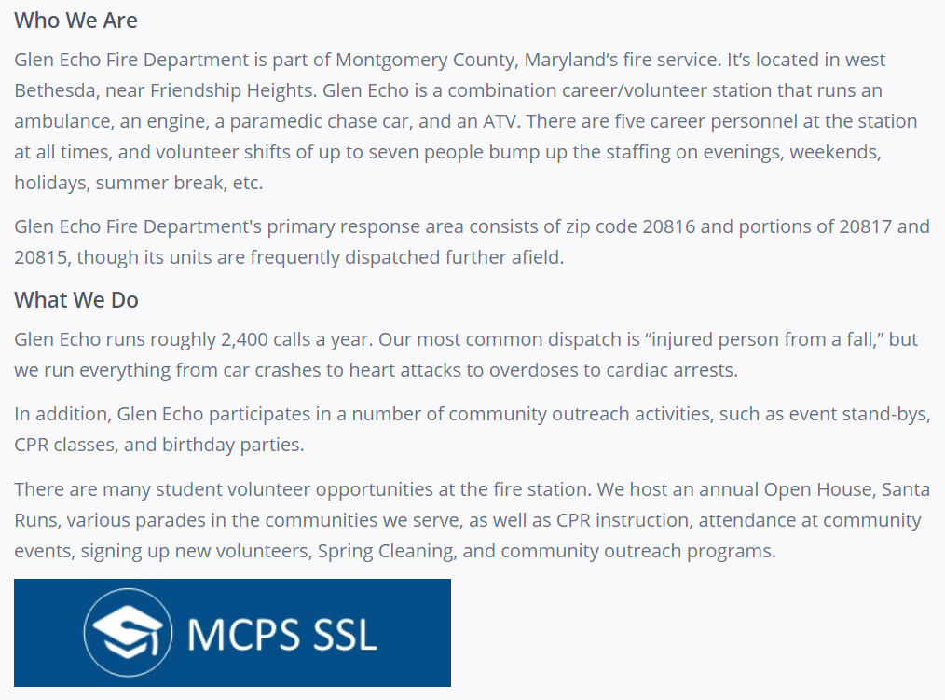
Sample “What We Do” on Organization page
“There are many student volunteer opportunities at the fire station. We host an annual Open House, Santa Runs, various parades…”
Notes:
Make sure your description speaks specifically to student volunteers and possible activities they might perform.

Slide 30
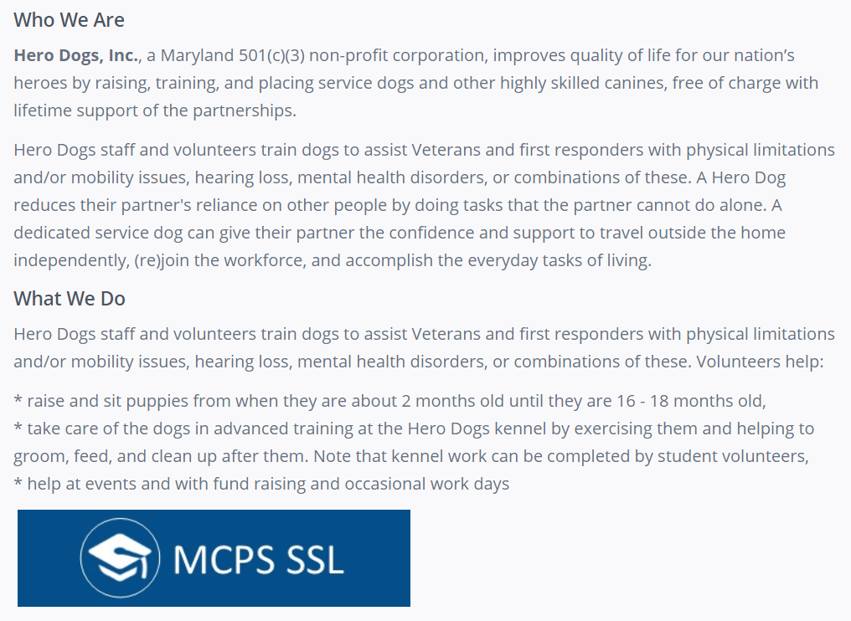
Sample “What We Do” on Organization page
“…helping to groom, feed, and clean up after them. Note that kennel work can be completed by student volunteers…”

Slide 31
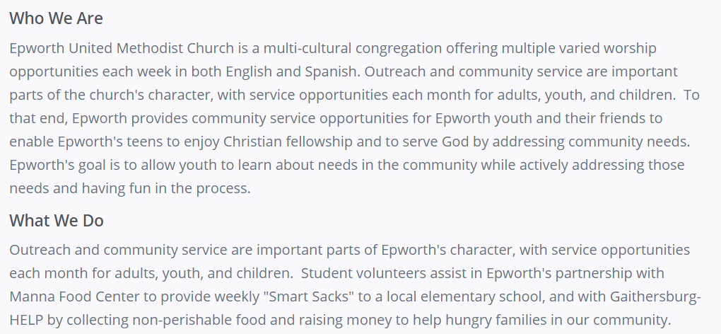
Sample “What We Do” on Religious Organization page
“Student volunteers assist in providing weekly ‘Smart Sacks’ to a local elementary school and…collecting non-perishable food and raising money to help hungry families in our community.”
Notes:
Notice that this religious organization’s “What We Do” describes the activities performed to address recognized needs in the greater community.

Slide 32
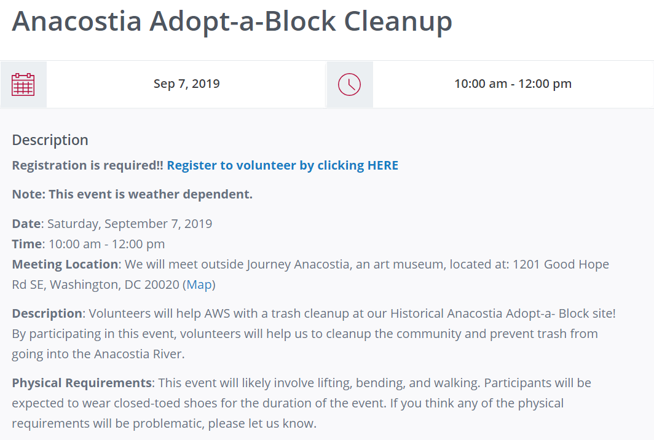
Sample “Description” on Opportunities page
Possible details to add:
Hours/shifts
Specific tasks
Lunch options
Proper attire
Notes:
These details can be added in the description or added as attributes in an opportunity.

Slide 33
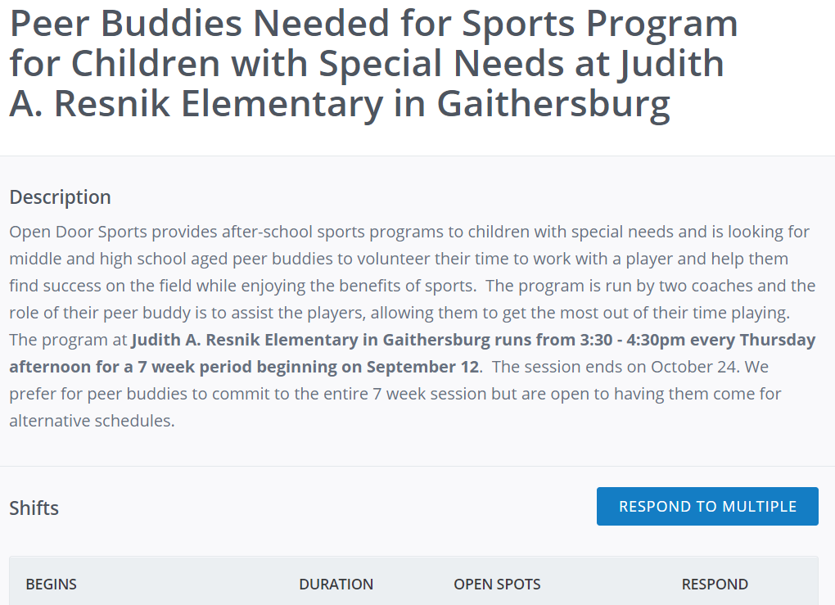
Sample “Description” on Opportunities page
Paint a clear picture of the activity for students.
Notes:
You know how they say you don’t get sold on a house until you can picture yourself living in it? Same with opportunities. Students need help picturing exactly what they will be doing.

Slide 34
Requesting SSL Approval for an Opportunity
Notes:
There are two ways you can communicate to us that you want us to review an opportunity’s eligibility for SSL hours.

Slide 35
MCPS SSL Guidelines for Virtual/Remote Service
Notes:
To meet the service-learning needs of our students during this time period, we are excited to announce that students can now earn Student Service Learning (SSL) hours for virtual/remote service completed from home under the sponsorship of an approved nonprofit organization or MCPS school staff member. Students may engage in the specific virtual/remote MCPS SSL opportunities outlined below until schools return to normal status.

Slide 36
Process for Offering Virtual/Remote SSL until the end of the 2021-2022 School Year:
Opportunity posted on the MCVC website and tagged as MCPS SSL – address service, expectations, and safety information
Determine and post reasonable equivalency approved by MCPS SSL office (X number of items = X number of SSL hours)
Review student evidence, determine hours, maintain log, and verify student service on student’s SSL form
Notes:
Nonprofit-hosted virtual/remote MCPS SSL opportunities will be posted on the Montgomery County Volunteer Center website (www.montgomeryserves.org) and tagged with the blue MCPS SSL banner and graduation cap icon.

Slide 37
Examples of Virtual/Remote Service
Direct (for community in need)
Letters, cards, artwork for senior citizens
Indirect (for your organization)
Creating materials for organization
Advocacy (for a cause/need)
Research-based
Social media posts
Raising awareness about a cause or issue
Administrative/ clerical work
Flyers
Sandwiches, bagged lunches
Masks, PPE, gratitude for healthcare workers
Providing student input
Agency’s website

Slide 38
MCPS Guidance for Virtual/Remote SSL
Guidelines for Student Safety | Not Approved for SSL
Students may only engage in virtual platforms with parent permission | Individual service not sponsored by nonprofit or MCPS staff member
Students may not directly communicate with anyone outside of the nonprofit organization | Service supervised solely by a student’s parent/guardian or individual younger than 18
Students may not share videos, pictures, or images of themselves | Service that involves neighborhood canvassing or telephone solicitation
Students’ personal information must be protected and not shared | Service that involves collection drives, donating items, fundraising, or fostering an animal from home
Notes:
Please review the temporarily amended MCPS SSL guidelines below that have been created to ensure that any virtual/remote service during this time maintains the safety and privacy of our students and adheres to the proper supervision and monitoring needed for SSL as a state graduation requirement.

Slide 39
MCPS Guidance for SSL on Virtual Platforms
Nonprofit organizations must submit written agreement to adhere to the following:
Parent/guardian provides written approval of the student’s participation
Nonprofit organizations accept full responsibility and any liability for a student’s participation in any virtual platforms
Students use personal/private accounts (not MCPS student accounts) to engage in virtual platforms
Students may ONLY engage with others under the direct supervision of a nonprofit supervisor (including breakout rooms)
Virtual sessions will not be recorded

Slide 40
Virtual/Remote and In-Person SSL
Nonprofit-hosted virtual/remote MCPS SSL opportunities must be posted on the MCVC website and tagged with the blue MCPS SSL banner
Until the end of the 2021-2022 School Year
Students may also continue to engage in traditional MCPS SSL opportunities offered in a public space under the direct supervision of a nonprofit representative, at the discretion of the student’s parent/guardian
Post virtual/remote group opportunities for MCPS school staff members to complete with student groups or classes (products, advocacy, awareness)
Mark as virtual, allow group registration, and request SSL approval

Slide 41
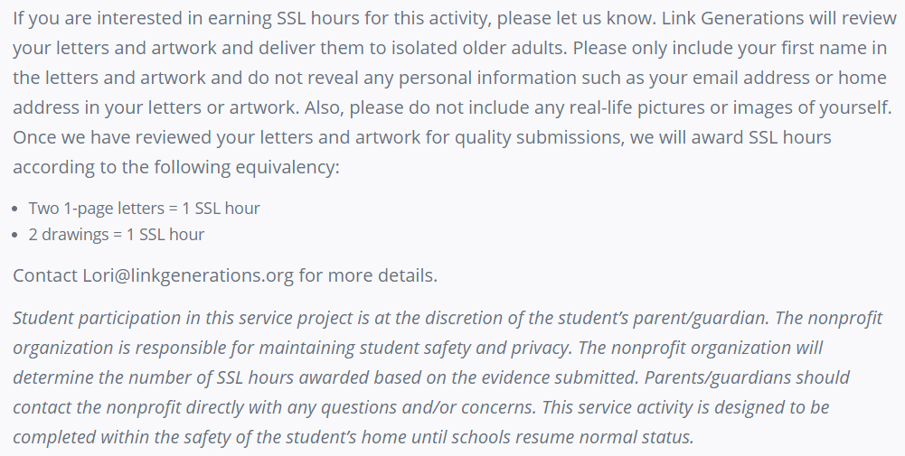
Sample Virtual/Remote SSL Opportunity
Select “Ongoing”
Put “0” in Hours field
Add Age Requirements
Mark “Yes” for virtual

Slide 42
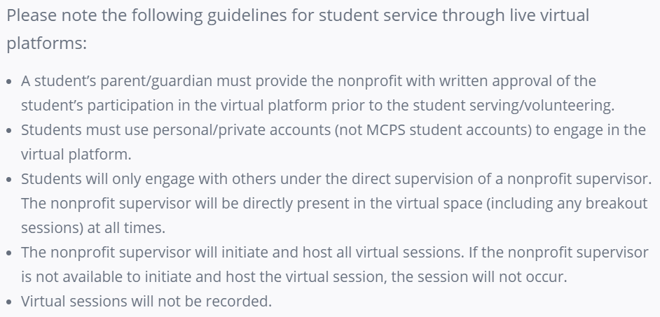
Sample Virtual Platform SSL Opportunity
Describe student expectations
Supervised live service in virtual or public space – hour-for-hour
Remote service from home requires reasonable equivalency
Select “Runs Until”
Enter Hours Description
Add Waiver

Slide 43
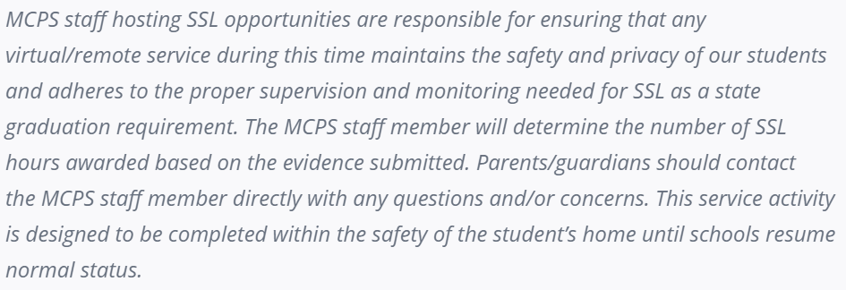
Sample Virtual/Remote Group SSL Opportunity
Describe nonprofit
Detail service project and need
Provide details for student/staff submission
Ongoing
Group Registration
Virtual
Request SSL Approval

Slide 44
Unity Through Community
Please feel free to email us at ssl@mcpsmd.org with any questions regarding the MCPS SSL program.
The virtual/remote service guidelines can be found at: https://bit.ly/VirtualSSLGuidelines

